Slide 1
MOVING TRUCK PERMITS
RIA NISAR, JOSE ORDAZ, SAMANTHA CASTELINO

Slide 2
01
INTRODUCTION

Slide 3
Data Source
Dataset
Data Point
Utility
Purpose
City of Boston's Open Data Portal.
Provides information on permits issued for moving trucks in Boston.
Furnishes data on the permit's date, time, location, and duration.
Valuable resource for city planners, transportation authorities, and researchers
Recognize recurrent behaviors and tendencies in the transportation of commodities and amenities, and devise approaches to enhance the transportation framework and alleviate traffic.

Slide 4
02
QUALITATIVE ANALYSIS

Slide 5
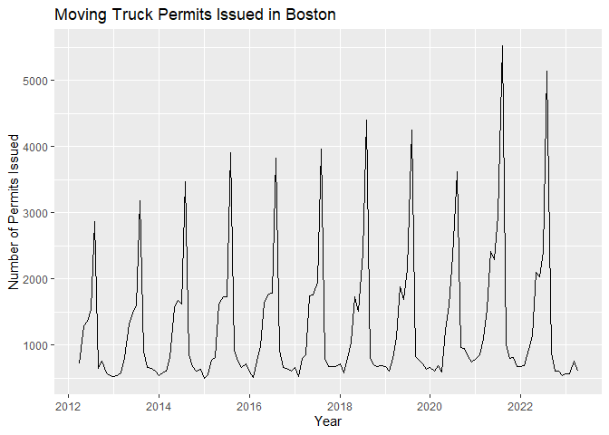

Slide 6
TIME SERIES - MONTHLY PLOT
TREND
SEASONALITY
VARIABILITY
The number of permits issued has been on a rise over time
Follows a distinct seasonal trend, with higher levels during summer and lower levels in winter.
There are occasional spikes in
permit issuance, late May and
early June of 2016 and 2017 and
a massive spike in 2018

Slide 7
DAY WISE DISTINCTION
36,317
2,730
Wednesdays and Thursdays have similar average permit issuances, while the weekends have lower average permit issuances.
Highest number of permits on Tuesdays
Lowest number of permits on Saturdays

Slide 8
913
Highest number of permits issued on 24th July, 2018

Slide 9
03
DECOMPOSITION

Slide 10
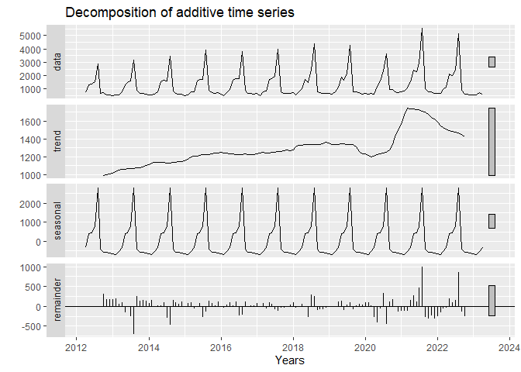
SS
0.9561
ST
0.4385

Slide 11
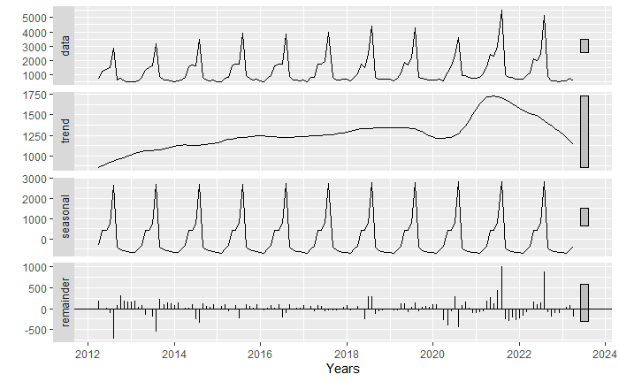
STL DECOMPOSITION
Seasonal and Trend decomposition using Loess
NON-CONSTANT SEASONAL EFFECT
ROBUST w.r.t OUTLIERS
WIDE RANGE

Slide 12
04
EXPONENTIAL SMOOTHING

Slide 13
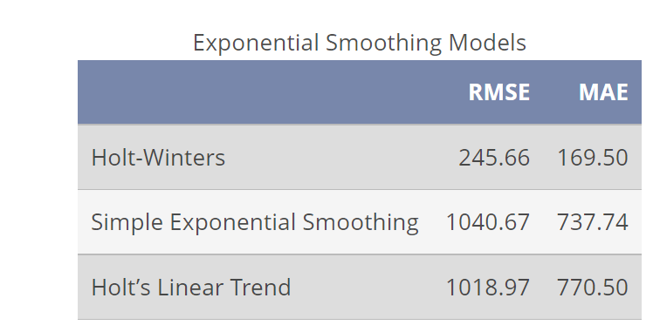
ACCURACY METRICS

Slide 14
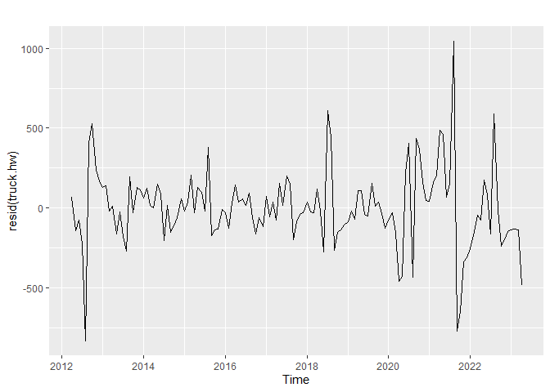
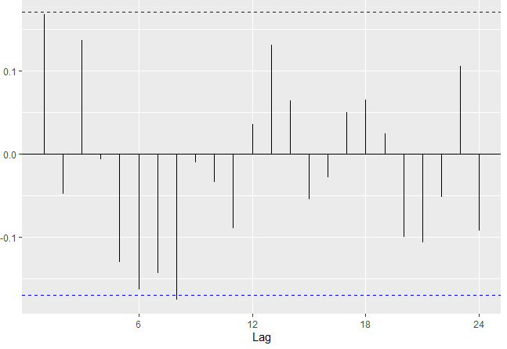
HOLT-WINTERS MODEL - RESIDUALS

Slide 15
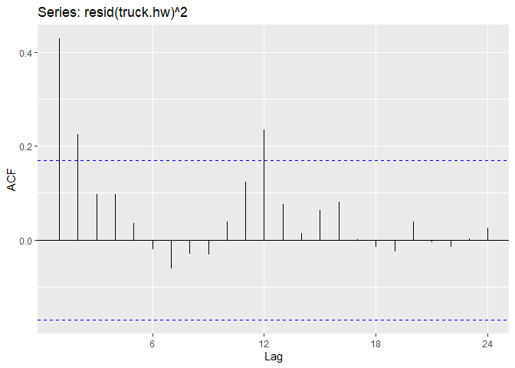
SQUARED RESIDUALS – HW MODEL
WAVY/SINUSOIDAL PATTERN
INDICATING SEASONALITY

Slide 16
05
ARCH/GARCH MODEL

Slide 17
GARCH MODEL
ARCH LM-TEST
GARCH MODEL
IMPROVED ACCURACY
P-VALUE 0.0002066
REJECT NULL HYPOTHESIS
SUPPORTING USE OF GARCH
GARCH MODEL CAPTURES CHANGING VOLATILITY AND AUTOCORRELATION PATTERNS IN THE RESIDUAL
RMSE – 120.4495
MAE – 29.6438
Holt-Winters fitted values with the GARCH residuals

Slide 18
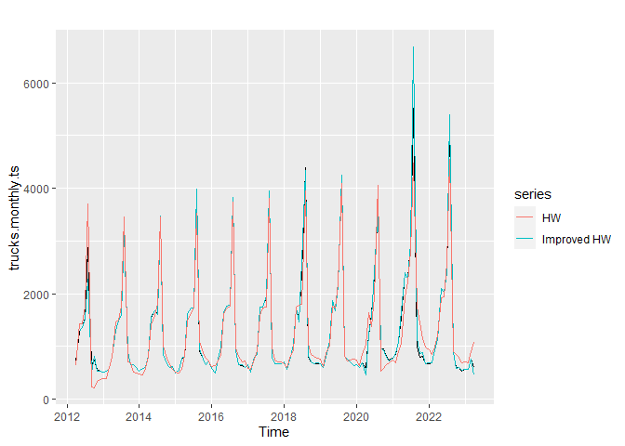
IMPROVED HOLT-WINTERS

Slide 19
06
SEASONAL ARIMA

Slide 20
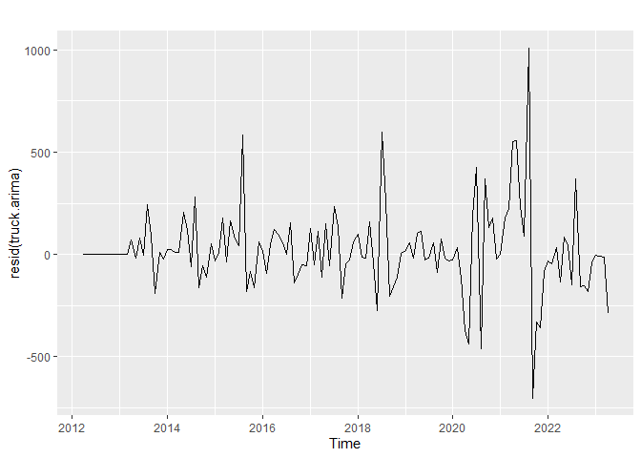
SARIMA MODEL
RECOMMENDED MODEL
ARIMA (1,0,3)(0,1,1,)[12]
AIC – 1663.89
BIC – 1680.87

Slide 21
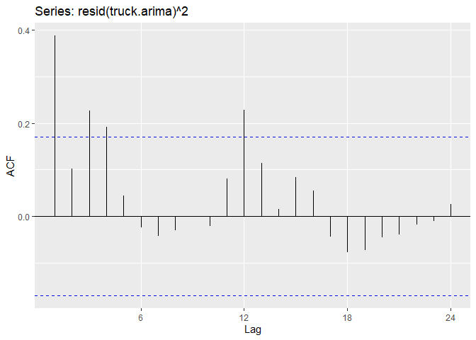
SQUARED RESIDUALS – ARIMA MODEL
WAVY/SINUSOIDAL PATTERN
INDICATING SEASONALITY

Slide 22
SARIMA-GARCH MODEL
ARCH LM-TEST
IMPROVED ACCURACY
P-VALUE < 0.05
REJECT NULL HYPOTHESIS
SUPPORTING USE OF GARCH
RMSE – 137.1293
MAE – 29.2057
SARIMA FITTED VALUES WITH THE GARCH RESIDUALS

Slide 23
07
LINEAR REGRESSION MODEL

Slide 24
08
NEURAL NETWORK MODEL

Slide 25
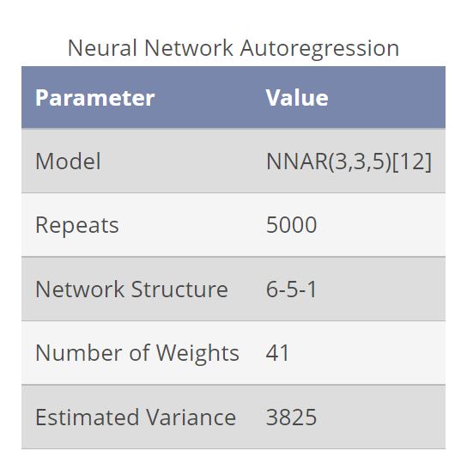
NNAR OUTPUT

Slide 26
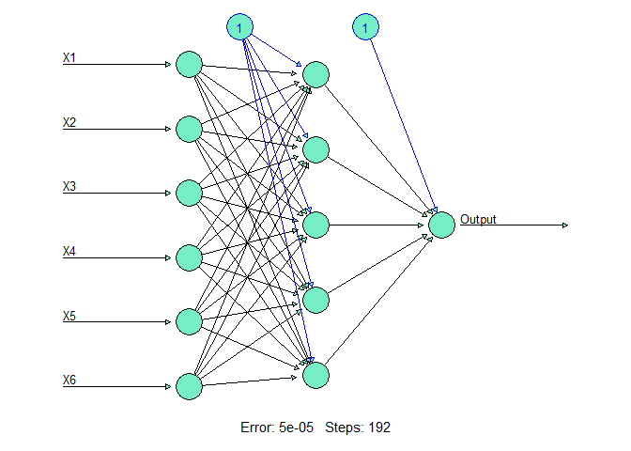
NNAR MODEL ARCHITECTURE

Slide 27
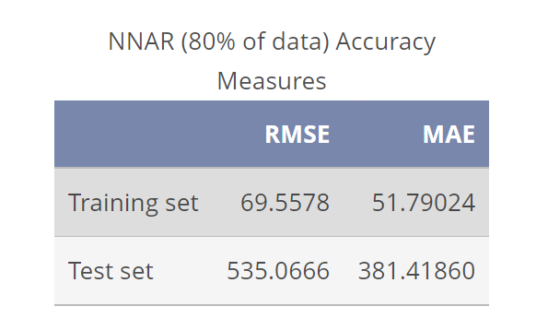
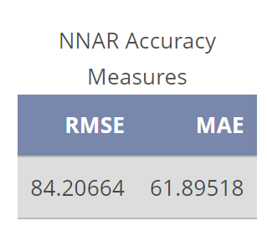
FULL DATASET
80% OF DATASET

Slide 28
09
FORECASTS

Slide 29
10
CONCLUSION

Slide 30
THANK
ANY
YOU
QUESTIONS?

