Slide 1
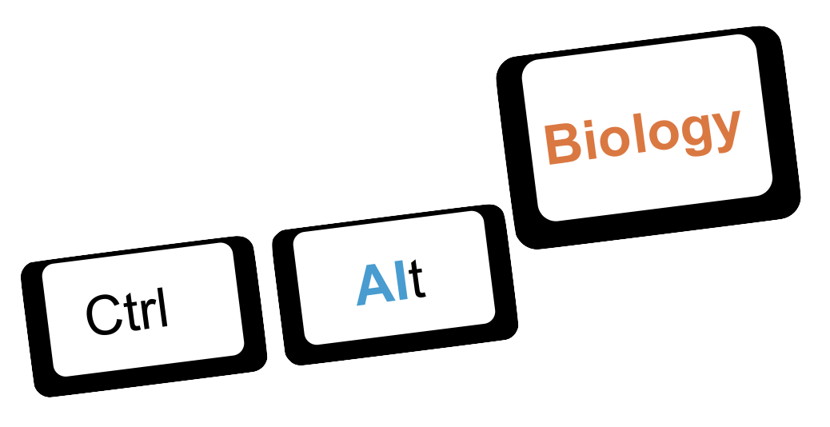
AI for Bioscientists, Hands-on Workshops
Using Biological Large Language Models
Andreas Tiffeau-Mayer, Antonio Matas Gil & Lucia Guillamet Garcia

Slide 2
Upcoming workshops
June 10th: AI for protein design (Registration closed)
June 24th : AI for transcriptomics (Registration not yet open)
July 1st : Large-scale structure comparison with FoldSeek (Registration not yet open)

Slide 3



What you need for this workshop
https://github.com/josef0731/AIxBio_Workshops/tree/main/workshop05-using-llm

