Slide 1
TCR Language Model Workshop
CD4/CD8 T Cell Classification
Hands-on comparison of representation-based approaches to a non-neural baseline
Hands-on session

Slide 2
What we're doing today
?
⬡
✓
The question
The data
The task
Can we predict whether a T cell is CD4⁺ or CD8⁺ from its TCR sequence alone?
1 000 CD4 + 1 000 CD8 paired α-β TCRs from a single PBMC donor (10x Genomics)
Train classifiers and compare three ways of featurising TCR sequences

Slide 3
Three representations, five classifiers
V-gene usage
Logistic regression on categorically encoded TRAV and TRBV
Simple baseline — no biological pre-training
SCEPTR
TCR-specific language model. Embeds paired α-β TCRs into a dense vector, trained on large TCR repertoire data.
Domain-specific representation
ESM-2
General protein language model (8 M params). CDR3α and CDR3β are embedded separately; the two vectors are concatenated.
General protein LM — no TCR-specific knowledge
Each representation is tested with both logistic regression and a single hidden-layer neural network (hidden layer dimensions = 64).

Slide 4
Step 1 — The data
Each row is one paired α-β TCR with its CD4/CD8 label:
TRAV | CDR3α | TRBV | CDR3β | Label
TRAV12-2*01 | CAVRYNQGGKLIF | TRBV20-1*01 | CSARDLGQGANVLTF | CD4
TRAV13-1*01 | CAENRDDKIIF | TRBV7-2*01 | CASSLGQGAYEQYF | CD8
TRAV6*01 | CALVGDSSKIIF | TRBV5-1*01 | CASSQAGLAGELF | CD8
… | … | … | … | …
2 000
1 000
1 000
75/25
total TCRs
CD4
CD8
train/test split

Slide 5
Steps 2 & 3 — Computing embeddings
SCEPTR
ESM-2
Input: paired TRAV + CDR3α + TRBV + CDR3β
Output: single dense vector per TCR
Shape: (2000, D) — one row per cell
Embeddings are cached to disk on first run.
Subsequent runs load instantly from the .csv cache.
Input: CDR3α and CDR3β as separate AA strings
Model: facebook/esm2_t6_8M_UR50D
Pooling: mean over residue embeddings
(excluding CLS/EOS special tokens)
Concatenate α and β vectors → one row per cell
Shape: (2000, 2×D)
Cached as .npy after first run.

Slide 6
Step 4 — Classification results
Typical results on a balanced CD4/CD8 test set (your numbers may vary slightly):
Representation + classifier | Accuracy | ROC AUC
V genes + logistic regression | 0.576 | 0.610
SCEPTR + logistic regression | 0.578 | 0.593
SCEPTR + neural network | 0.574 | 0.593
ESM-2 CDR3 + logistic regression | 0.564 | 0.591
ESM-2 CDR3 + neural network | 0.554 | 0.578
The baseline wins! V gene identity carries strong CD4/CD8 signal — a protein LM is not automatically better for every supervised task.

Slide 7
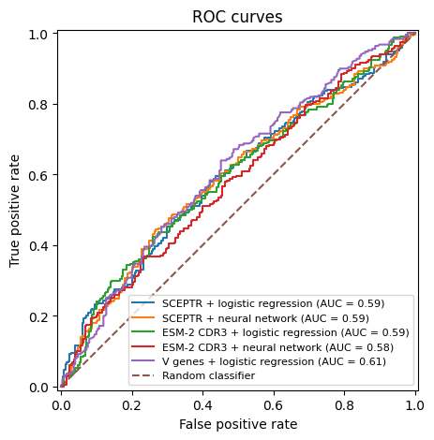
Step 5 — ROC & precision-recall curves
ROC curves show classifier performance across all decision thresholds. An AUC of 1 is perfect; 0.5 is random.
V-gene usage
Best AUC (~0.61) — V genes carry lineage signal
ESM-2
Lowest AUC – insufficient data for training in the high-dimensional representation space
SCEPTR
Marginally better, but still worse than baseline: TCR-specific pretraining doesn't automatically win at classification

Slide 8
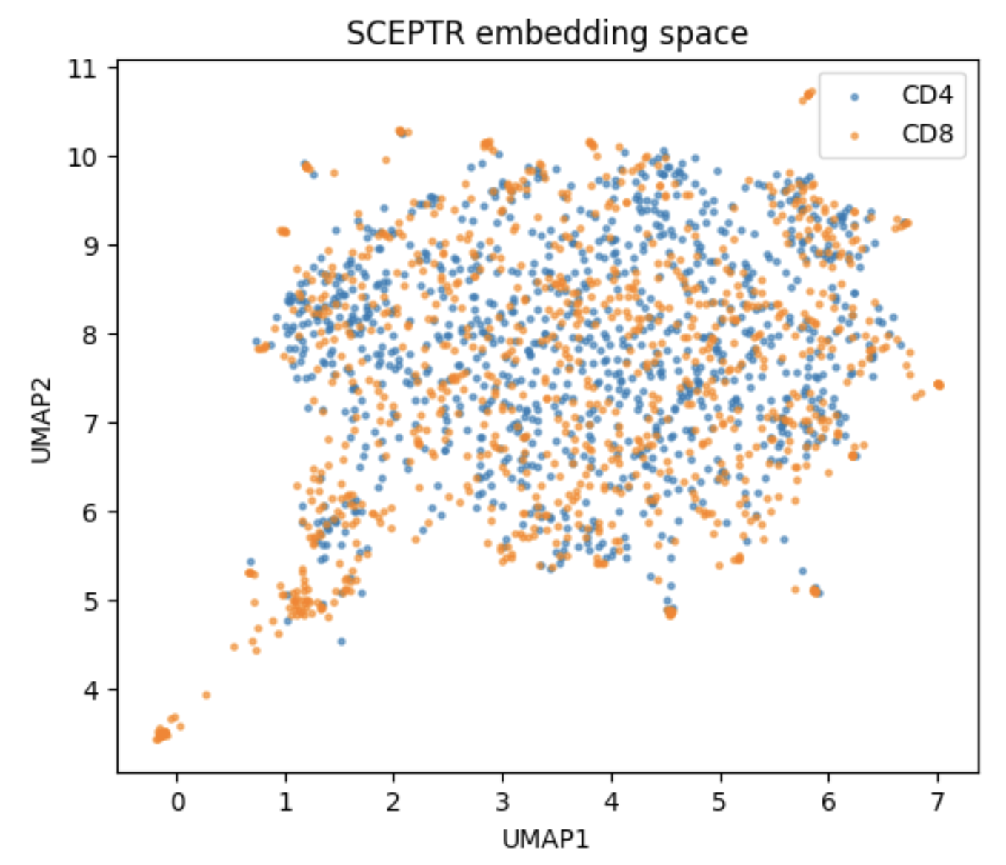
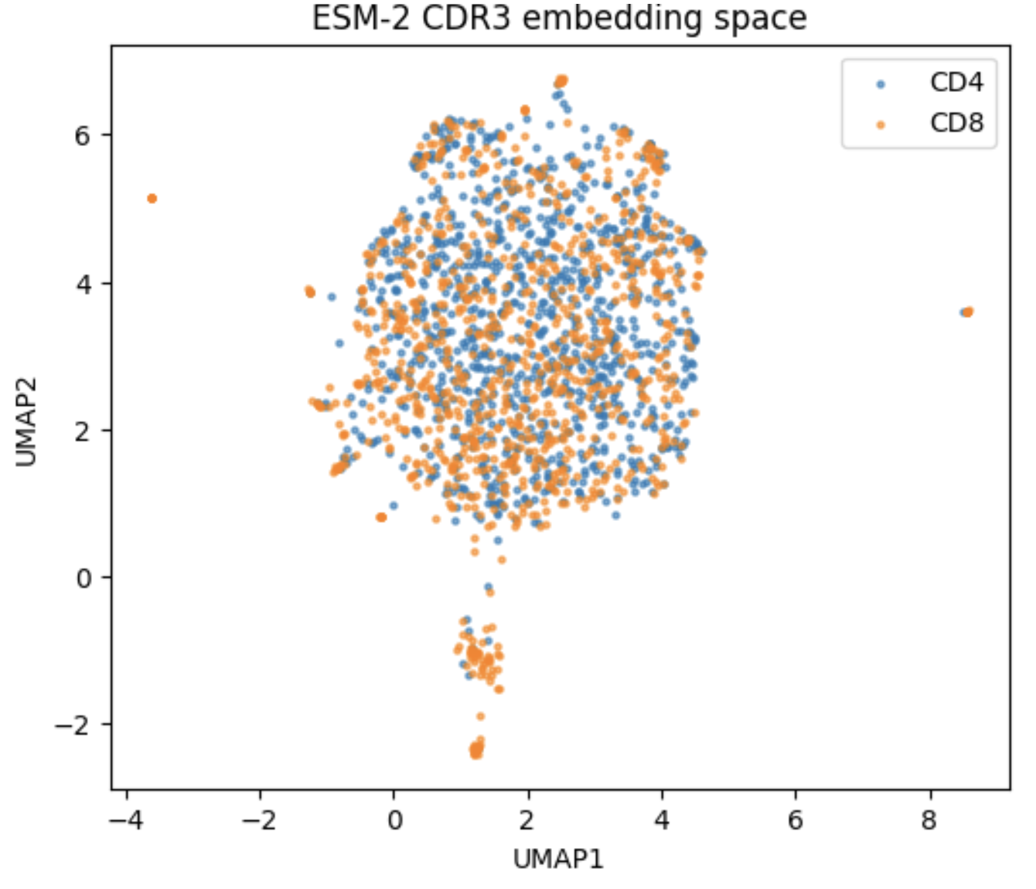
Step 8 — UMAP embedding spaces
UMAP compresses high-dimensional embeddings to 2D for visual inspection. Better separation → better classifier.
SCEPTR embedding
ESM-2 CDR3 embedding
CD4
CD8

Slide 9
Key takeaways
①
A language model embedding is not a free lunch
Logistic regression on V genes outperformed both SCEPTR and ESM-2 at the tested dataset scale. Pre-training on sequences doesn't automatically translate to better supervised classification.
②
Why does the baseline work so well?
Biology: V genes encode CDR1/CDR2 which make direct contact with MHC Computer Science: Data too small to learn more complex patterns
③
Small data is a real constraint
With only 1 500 training TCRs, simpler models may generalise better
④
UMAP reveals the structure
When embeddings form cleaner clusters for CD4 vs CD8, classification accuracy follows. Visualisation and performance go hand in hand.

Slide 10
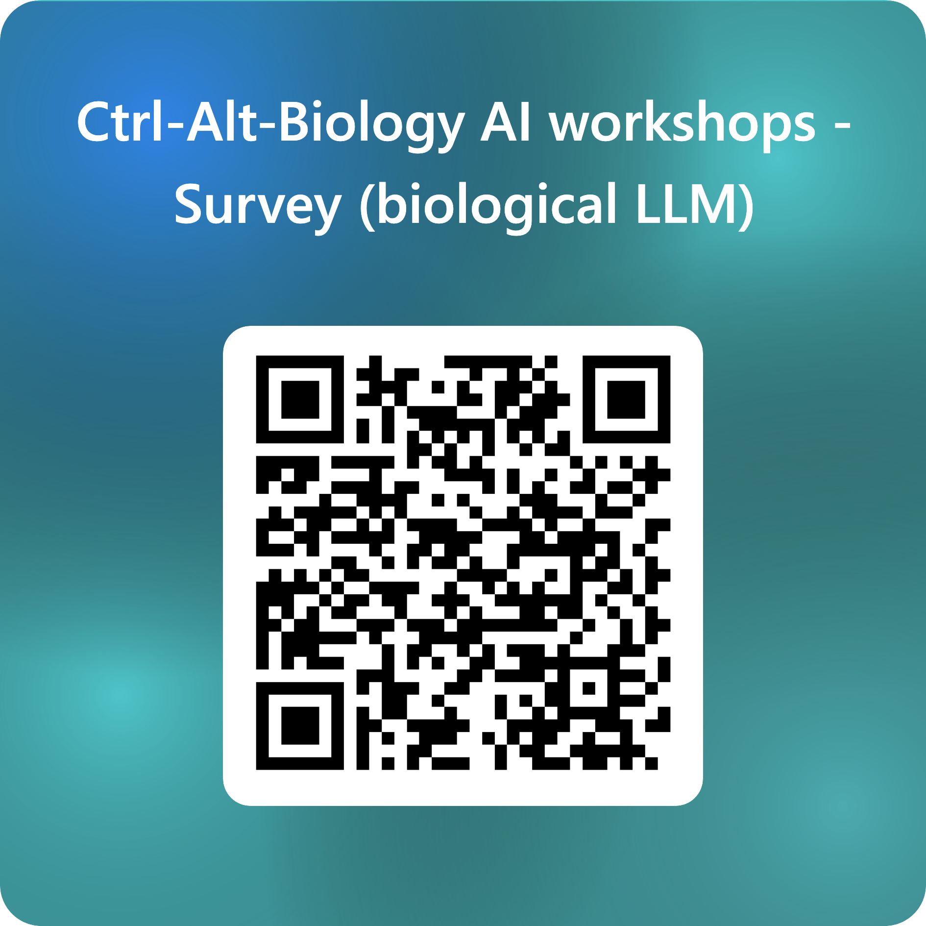

Slide 11
Discussion prompts
1
Why might the V gene alone (without CDR3) be predictive of CD4 vs CD8 lineage?
2
ESM-2 embeds CDR3α and CDR3β separately and concatenates. What information is lost compared to SCEPTR's paired embedding?
If you had 10× more training data, would the ranking between representations change? Try this by increasing “N_PER_CLASS” in cell 2.
3
What other labels beyond CD4/CD8 might be predictable from TCR sequence alone? What wouldn't be?
4
5

