Slide 1
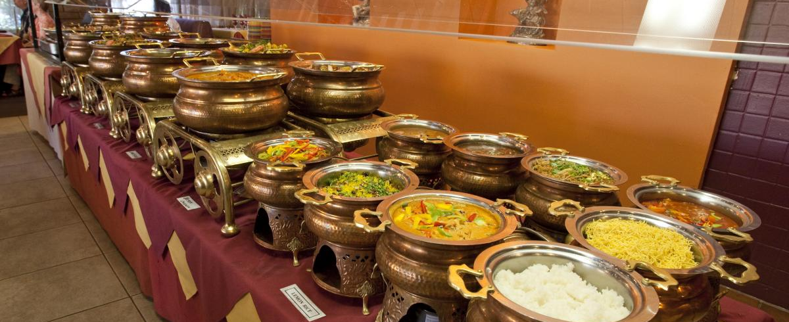
Indian Buffet Process
Xiaolong Wang and Daniel Khashabi
UIUC, 2013

Slide 2
Contents
Mixture Model
Finite mixture
Infinite mixture
Matrix Feature Model
Finite features
Infinite features(Indian Buffet Process)

Slide 3
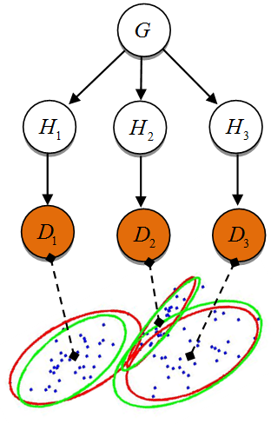
Bayesian Nonparametrics
Models with undefined number of elements,
Dirichlet Process for infinite mixture models
With various applications
Hierarchies
Topics and syntactic classes
Objects appearing in one image
Cons
The models are limited to the case that could be modeled using DP.
i.e. set of observations are generated by only one latent component

Slide 4
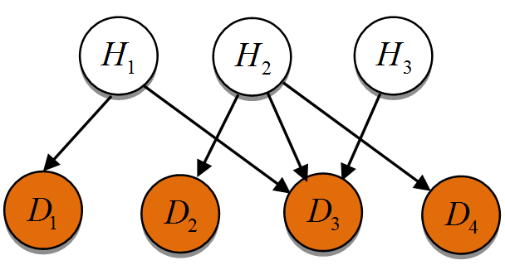
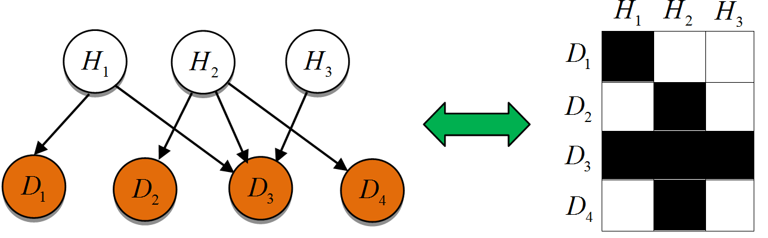
Bayesian Nonparametrics contd.
In practice there might be more complicated interaction between latent variables and observations
Solution
Looking for more flexible nonparametric models
Such interaction could be captured via a binary matrix
Infinite features means infinite number of columns

Slide 5
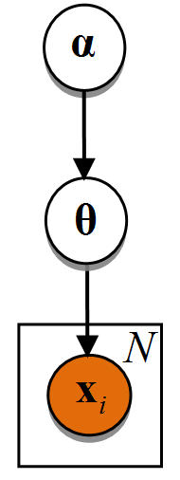
Finite Mixture Model
Set of observation:
Constant clusters,
Cluster assignment for is
Cluster assignments vector :
The probability of each sample under the model:
The likelihood of samples:
The prior on the component probabilities (symmetric Dirichlet dits.)

Slide 6
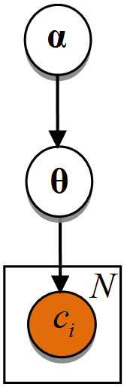
Finite Mixture Model
Since we want the mixture model to be valid for any general component we only assume the number of cluster assignments to be the goal of learning this mixture model !
Cluster assignments:
The model can be summarized as :
To have a valid model, all of the distributions
must be valid !
likelihood
prior
posterior
Marginal likelihood
(Evidence)

Slide 7
Finite Mixture Model contd.

Slide 8
Infinite mixture model
Infinite clusters likelihood
It is like saying that we have :
Since we always have limited samples in reality, we will have limited number of clusters used; so we define two set of clusters:
number of classes for which
number of classes for which
Assume a reordering, such that
Infinite clusters likelihood
It is like saying that we have :
Infinite dimensional multinomial cluster distribution.

Slide 9
Infinite mixture model
Now we return to the previous slides and set in formulas
If we set the marginal likelihood will be .
Instead we can model this problem, by defining probabilities on partitions of samples, instead of class labels for each sample.

Slide 10
Infinite mixture model contd.
Define a partition of objects;
Want to partition objects into classes
Equivalence class of object partitions:
Valid probability distribution for an infinite mixture model
Exchangeable with respect to clusters assignments !
Important for Gibbs sampling (and Chinese restaurant process)
Di Finetti’s theorem: explains why exchangeable observations are conditionally independent given some probability distribution

Slide 11
Chinese Restaurant Process (CRP)
Parameter

Slide 12
Chinese Restaurant Process (CRP)
Parameter

Slide 13
Chinese Restaurant Process (CRP)
Parameter

Slide 14
Chinese Restaurant Process (CRP)
Parameter

Slide 15
Chinese Restaurant Process (CRP)
Parameter

Slide 16
Chinese Restaurant Process (CRP)
Parameter

Slide 17
Chinese Restaurant Process (CRP)
Parameter

Slide 18
Chinese Restaurant Process (CRP)
Parameter

Slide 19
Chinese Restaurant Process (CRP)
Parameter

Slide 20
Chinese Restaurant Process (CRP)
Parameter

Slide 21
CRP: Gibbs sampling
Gibbs sampler requires full conditional
Finite Mixture Model:
Infinite Mixture Model:

Slide 22
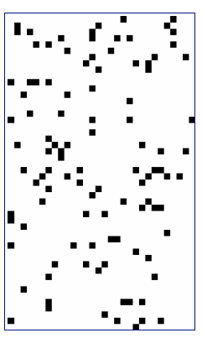

Beyond the limit of single label
In Latent Class Models:
Each object (word) has only one latent label (topic)
Finite number of latent labels: LDA
Infinite number of latent labels: DPM
In Latent Feature (latent structure) Models:
Each object (graph) has multiple latent features (entities)
Finite number of latent features: Finite Feature Model (FFM)
Infinite number of latent features: Indian Buffet Process (IBP)
Rows are data points
Columns are latent features
Movie Preference Example:
Rows are movies: Rise of the Planet of the Apes
Columns are latent features:
Made in U.S.
Is Science fiction
Has apes in it …

Slide 23
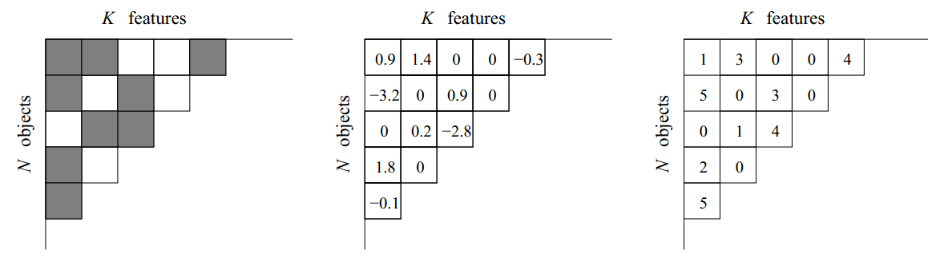
Latent Feature Model
F : latent feature matrix
Z : binary matrix
V : value matrix
With p(F)=p(Z). p(V)
Z
continuous
F
discrete
F

Slide 24
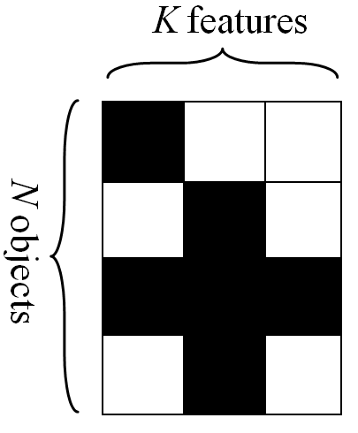
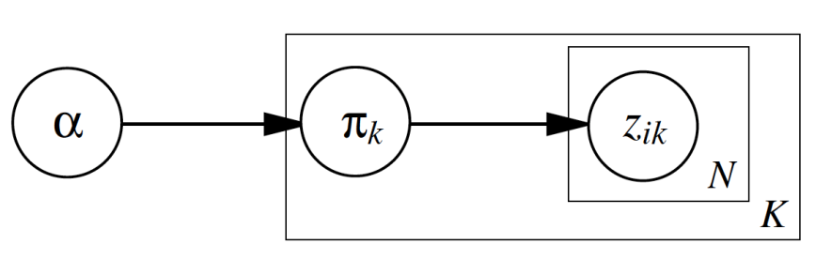
Finite Feature Model
Generating Z : (N*K) binary matrix
For each column k, draw from beta distribution
For each object, flip a coin by
Distribution of Z :

Slide 25
Finite Feature Model
Generating Z : (N*K) binary matrix
For each column k, draw from beta distribution
For each object, flip a coin by
Z is sparse:
Even

Slide 26
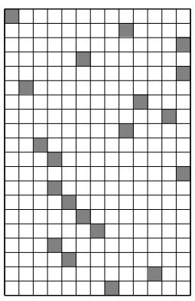
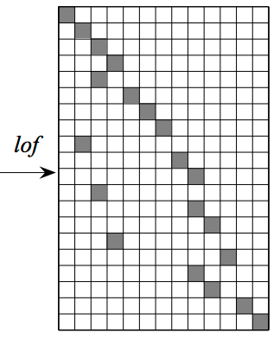
Indian Buffet Process 1st Representation:
Difficulty:
P(Z) -> 0
Solution: define equivalence classes on random binary feature matrices.
left-ordered form function of binary matrices, lof(Z):
Compute history h of feature (column) k
Order features by h decreasingly
Z1 Z2 are lof equivalent
iff lof(Z1)=lof(Z2) = [Z]
19
18
17
16
15
14
13
12
11
10
9
8
7
6
5
4
3
2
1
0
Describing [Z]:
Cardinality of [Z]:

Slide 27

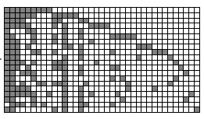
Indian Buffet Process 1st Representation:
Given:
Derive when :
( almost surely)

Slide 28
Indian Buffet Process 1st Representation:
Given:
Derive when :
( almost surely)

Slide 29
Indian Buffet Process 1st Representation:
Given:
Derive when :
( almost surely)

Slide 30
Indian Buffet Process 1st Representation:
Given:
Derive when :
( almost surely)
Harmonic sequence sum

Slide 31
Indian Buffet Process 1st Representation:
Given:
Derive when :
( almost surely)
Note:
is well defined because a.s.
depends on K_{h} :
The number of features (columns) with history h
Permute the rows (data points) does not change K_{h} (exchangeability)

Slide 32
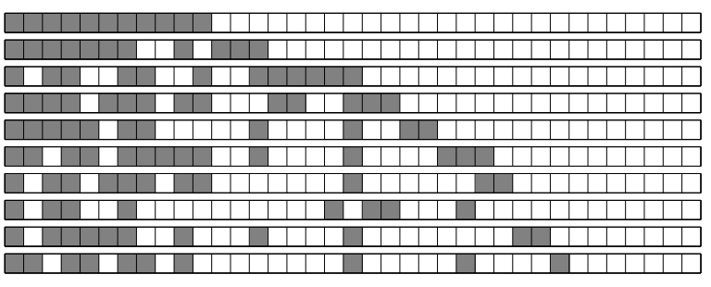


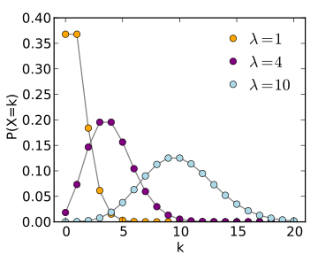
Indian Buffet Process 2st Representation: Customers & Dishes
Indian restaurant with inﬁnitely many inﬁnite dishes (columns)
The first customer tastes first K₁⁽¹⁾ dishes, sample
The i-th customer:
Taste a previously sampled dish with probability
m_{k} : number of previously customers taking dish k
Taste following K₁^{(i)} new dishes, sample
Poission Distribution:

Slide 33
Indian Buffet Process 2st Representation: Customers & Dishes
1/1
1/2
1/3
2/4
2/5
3/6
4/7
3/8
5/9
6/10
1/1
2/2
3/3
1/4
4/5
5/6
6/7
1/8
7/9
8/10

Slide 34
Indian Buffet Process 2st Representation: Customers & Dishes
From:
We have:
Note:
Permute K₁⁽¹⁾, next K₁⁽²⁾, next K₁⁽³⁾,… next K₁^{(N)} dishes (columns) does not change P(Z)
The permuted matrices are all of same lof equivalent class [Z]
Number of permutation:
2nd representation
is equivalent to
1st representation

Slide 35
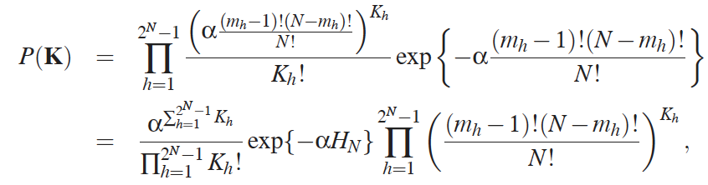
Indian Buffet Process 3rd Representation:
Distribution over Collections of Histories
Directly generating the left ordered form (lof) matrix Z
For each history h:
m_{h}: number of non-zero elements in h
Generate K_{h} columns of history h
The distribution over collections of histories
Note:
Permute digits in h does not change m_{h} (nor P(K) )
Permute rows means customers are exchangeable

Slide 36
Indian Buffet Process
Effective dimension of the model K₊:
Follow Poission distribution:
Derives from 2nd representation by summing Poission components
Number of features possessed by each object:
Follow Possion distribution:
Derives from 2nd representation:
The first customer chooses dishes
The customers are exchangeable and thus can be purmuted
Z is sparse:
Non-zero element
Derives from the 2nd (or 1st) representation:
Expected number of non-zeros for each row is
Expected entries in Z is

Slide 37
IBP: Gibbs sampling
Need to have the full conditional
denotes the entries of Z other than .
p(X|Z) depends on the model chosen for the observed data.
By exchangeability, consider generating row as the last customer:
By IBP, in which
If sample z_{ik}=0, and m_{k}=0: delete the row
At the end, draw new dishes from with considering
Approximated by truncation, computing probabilities for a range of values of new dishes up to a upper bound

Slide 38
More talk on applications
Applications
As prior distribution in models with infinite number of features.
Modeling Protein Interactions
Models of bipartite graph consisting of one side with undefined number of elements.
Binary Matrix Factorization for Modeling Dyadic Data
Extracting Features from Similarity Judgments
Latent Features in Link Prediction
Independent Components Analysis and Sparse Factor Analysis
More on inference
Stick-breaking representation (Yee Whye Teh et al., 2007)
Variational inference (Finale Doshi-Velez et al., 2009)
Accelerated Inference (Finale Doshi-Velez et al., 2009)

Slide 39
References
Griffiths, T. L., & Ghahramani, Z. (2011). The indian buffet process: An introduction and review. Journal of Machine Learning Research, 12, 1185-1224.
Slides: Tom Griffiths, “The Indian buffet process”.

