Slide 1
Transcriptograms and Differentially Expressed Modules of Leukemia Patients

Slide 2
Instalation
Tools for transcriptogram: https://github.com/joseflaviojr/transcriptograma/wiki

Slide 3
Use Case: Leukemia Patients
Reference: Macrae T, Sargeant T, Lemieux S, Hébert J et al. RNA-Seq reveals spliceosome and proteasome genes as most consistent transcripts in human cancer cells. PLoS One 2013;8(9):e72884.
Data: http://www.ncbi.nlm.nih.gov/geo/query/acc.cgi?acc=GSE4817
Patients: 72 = 17 (Healthy) + 12 (ALL) + 43 (AML)

Slide 4
Main Input Files
Expressions.txt : RNA-Seq data / leukemia and healthy patients
Network.txt : Human protein/gene network
EnsemblDB.txt : Gene name map
Source: https://github.com/joseflaviojr/transcriptograma/tree/master/UseCase-Leukemia

Slide 5
Protein/Gene Network
Reference: Rolland T, Taşan M, Charloteaux B, et al. A proteome-scale map of the human interactome network. Cell. 2014;159(5):1212-1226. doi:10.1016/j.cell.2014.10.050.
Data: http://interactome.dfci.harvard.edu/H_sapiens/
Name: HI-II-14
Genes: 4303
Edges: 13685

Slide 6
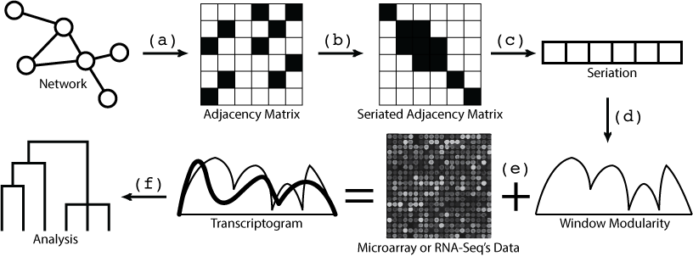
Pipeline
Make the adjacency matrix
Seriate
Extract the seriation
Calculate the window modularity
Put the expression data and calculate the transcriptogram
Analysis the result

Slide 7
Step 1: Adjacency Matrix
Generate the adjacency matrix of the network.
Determine the initial sequence of the genes.
MatrizAdjacencias.sh "Network.txt" nao tab
mv "Network.txt.matriz.csv" "Network.csv"
mv "Network.txt.nomes.txt" "Seriation_Initial_Genes.txt"

Slide 8
Step 2[INPUT]: Seriation
Seriate the adjacency matrix with the Claritate algorithm – by 10 hours = 3600 seconds.
Generate evoluation snapshots.
Determine the final sequence of the genes.
Get general informations about the seriated network.
Experimento.sh "*.csv" 3600 96 1 Cla
GerarImagensDeExperimento.sh .
cp "Network.csv.CLA[1].ordem.txt" "Seriation_Final_Sequence.txt"
ConverterNumerosParaNomes.sh "Seriation_Final_Sequence.txt" "Seriation_Initial_Genes.txt" > "Seriation_Final_Genes.txt"
Informacao.sh "Network.csv" "Seriation_Final_Sequence.txt" > "Information.txt"
GerarImagem.sh "Network.csv" "Seriation_Final_Sequence.txt" "Network.png"

Slide 9

Step 2[OUTPUT]: Seriation
Seriated adjacency matrix of the network.
Final sequence of the genes.
MAPK7, UBE2C, ASTE1, LIG4, XRCC4, ATP5A1, …

Slide 10
Step 3: Translation
Translate, if necessary, the gene names to other identity patterns: Ensembl, Entrez, etc.
ConverterGenes.sh Hs ALIAS2EG "Seriation_Final_Genes.txt" "Seriation_Final_Genes_Entrez.txt"
TraduzirColuna.sh "Seriation_Final_Genes.txt" 1 "EnsemblDB.txt" 1 3 "#" > "Seriation_Final_Genes_Entrez2.txt"

Slide 11
Step 4[INPUT]: Window Modularity
Calculate modularities of the seriated network, identify borders and paint the modules.
ModularidadeJanela.sh "Network.csv" "Seriation_Final_Sequence.txt" 251 > "WindowModularity.txt"
ModularidadeDensidade.sh "Network.csv" "Seriation_Final_Sequence.txt" 60 > "DensityModularity.txt"
GerarGrafico.sh "WindowModularity.txt" area 600 000000 "WindowModularity.png"
GerarGrafico.sh "DensityModularity.txt" area 600 000000 "DensityModularity.png"
Fronteiras.sh "WindowModularity.txt" 50 4 > "WindowModularity_Borders.txt"
ColorirModulos.sh "WindowModularity.png" "WindowModularity_Colored.png" < "WindowModularity_Borders.txt"

Slide 12
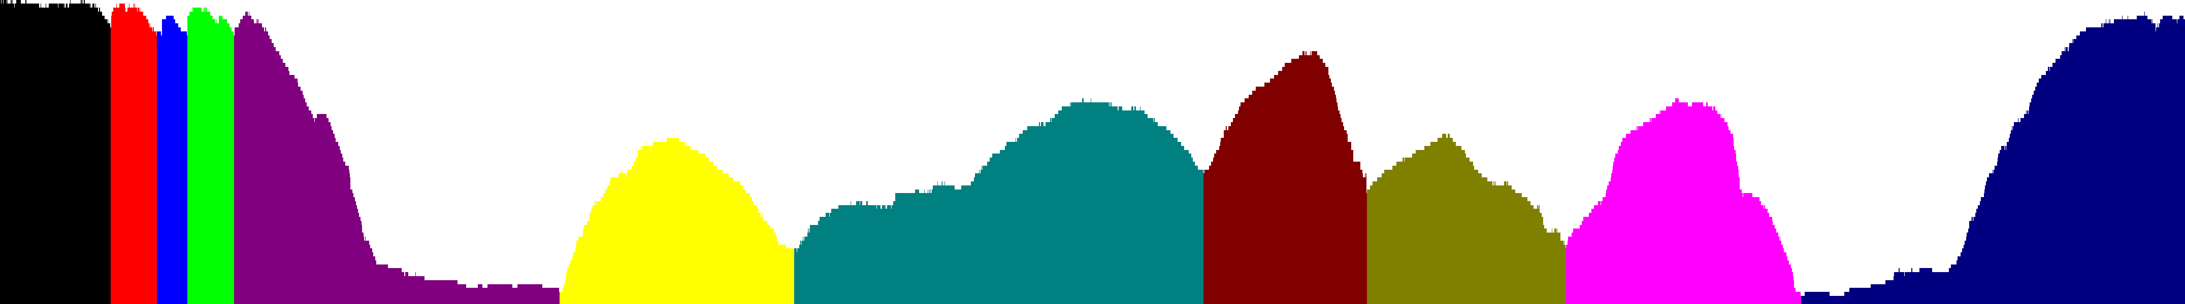
Step 4[OUTPUT]: Window Modularity
Modules of the related genes, based only on the seriated network.

Slide 13
Step 5: Quality Metrics
Check the quality of the clusters/modules.
Qualidade.sh "Network.txt" "Seriation_Final_Genes.txt" "WindowModularity_Borders.txt" "Silhouette,Dunn,Connectivity" "WindowModularity_Quality.txt"
Silhouette.sh "Network.txt" "Seriation_Final_Genes.txt" "WindowModularity_Borders.txt" "WindowModularity_Silhouette.txt"

Slide 14
Step 6[INPUT]: Functional Enrichment
Detect the biological functions of the modules, based on enrichment analysis of the Gene Ontology Consortium.
mkdir WindowModularity_Enrichment
cd WindowModularity_Enrichment
SepararModulos.sh "../Seriation_Final_Genes_Entrez.txt" "../WindowModularity_Borders.txt" "#" "M"
files=""
for f in M*txt; do
files="$files$f "
done
Enriquecer.sh Hs BP GeneOntology_BP.txt $files
Enriquecer.sh Hs MF GeneOntology_MF.txt $files
Enriquecer.sh Hs CC GeneOntology_CC.txt $files
Heatmap.sh GeneOntology_BP.txt M 50
Heatmap.sh GeneOntology_MF.txt M 50
Heatmap.sh GeneOntology_CC.txt M 50
cd ..

Slide 15
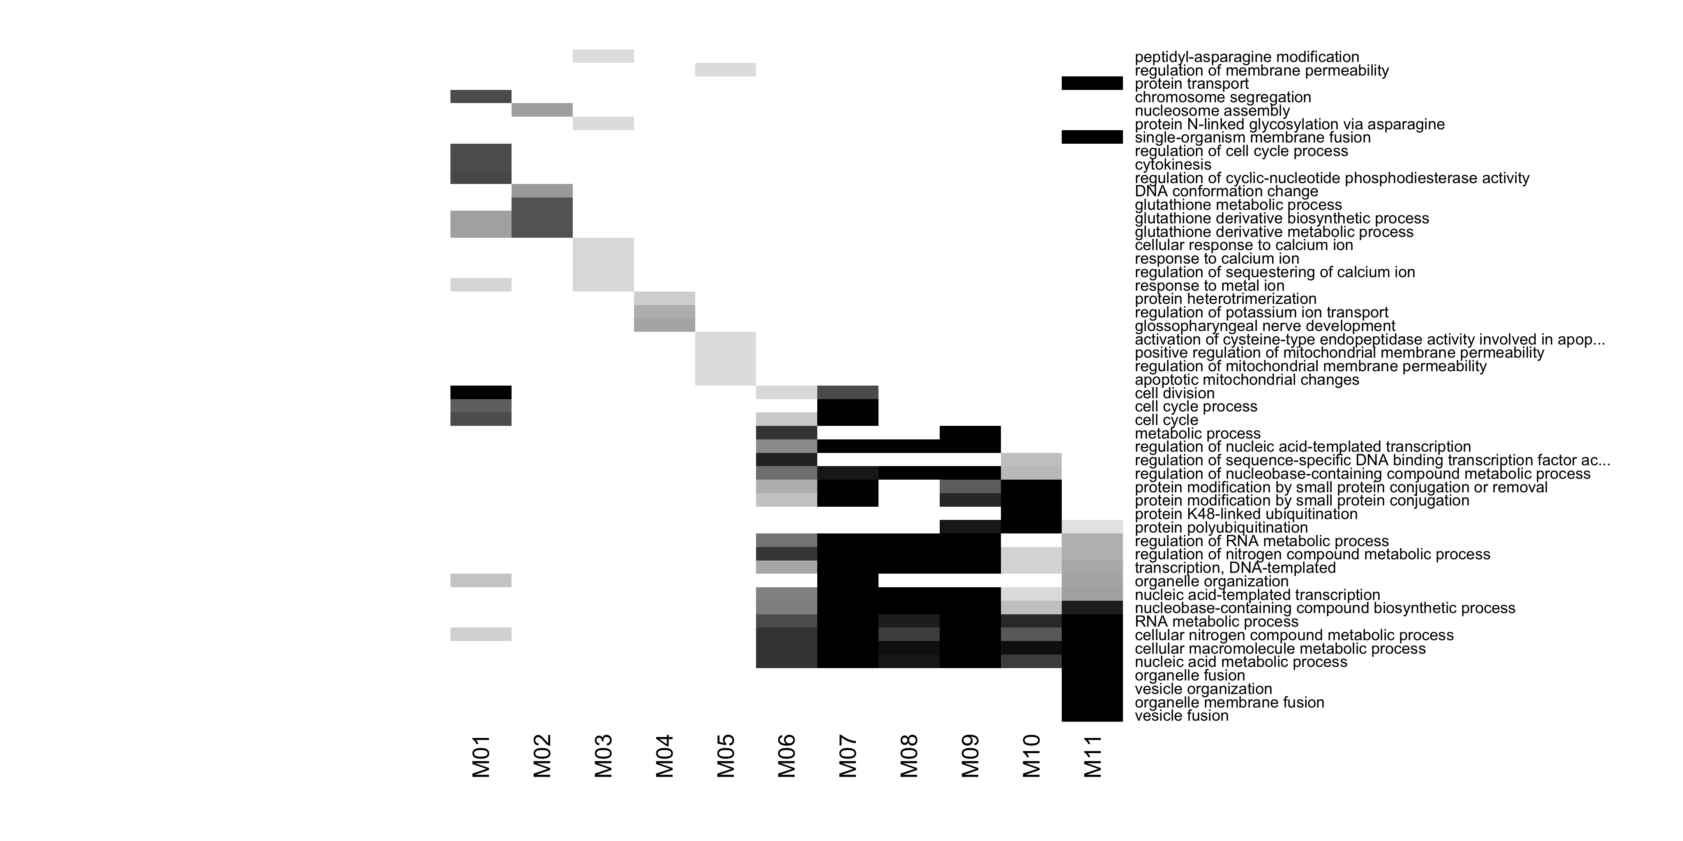
Step 6[OUTPUT]: Functional Enrichment
BP enrichment’s top result for window modules.

Slide 16
Step 6[OUTPUT]: Functional Enrichment

Slide 17
Step 7[INPUT]: Transcriptogram
Calculate and plot the transcriptograms of the patients.
OrganizarTabela.sh "Seriation_Final_Genes.txt" "Expressions.txt" tab > "Expressions_Seriated.txt"
Transcriptograma.sh "Expressions_Seriated.txt" 251 > "Transcriptograms.txt"
GraficoTranscriptograma.sh "WindowModularity.txt" "DensityModularity.txt" "Transcriptograms.txt" "1-17" "Expressions_Labels.txt" "Chart_Healthy_Labels.txt" "Chart_Healthy.svg"
GraficoTranscriptograma.sh "WindowModularity.txt" "DensityModularity.txt" "Transcriptograms.txt" "18-29" "Expressions_Labels.txt" "Chart_ALL_Labels.txt" "Chart_ALL.svg"
GraficoTranscriptograma.sh "WindowModularity.txt" "DensityModularity.txt" "Transcriptograms.txt" "30-72" "Expressions_Labels.txt" "Chart_AML_Labels.txt" "Chart_AML.svg"

Slide 18
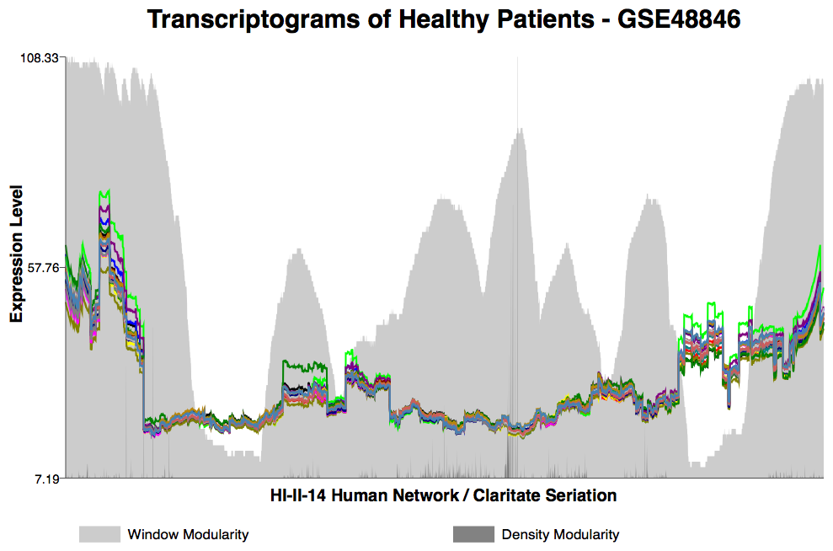
Step 7[OUTPUT]: Transcriptogram

Slide 19
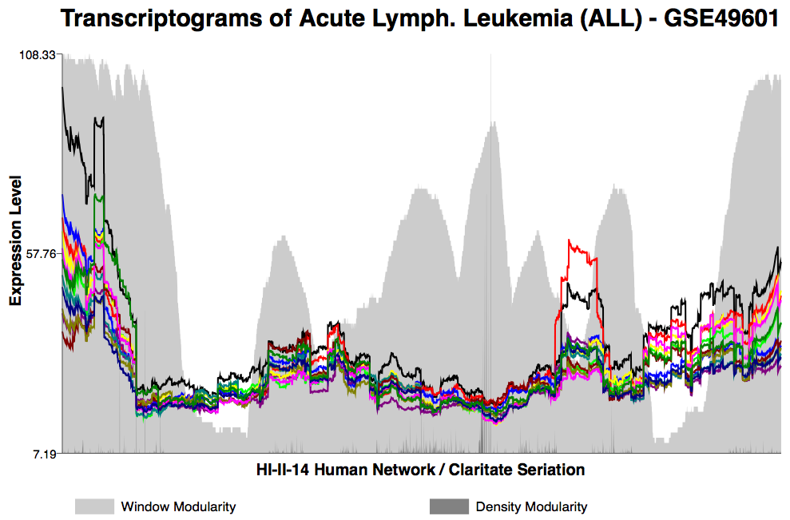
Step 7[OUTPUT]: Transcriptogram

Slide 20
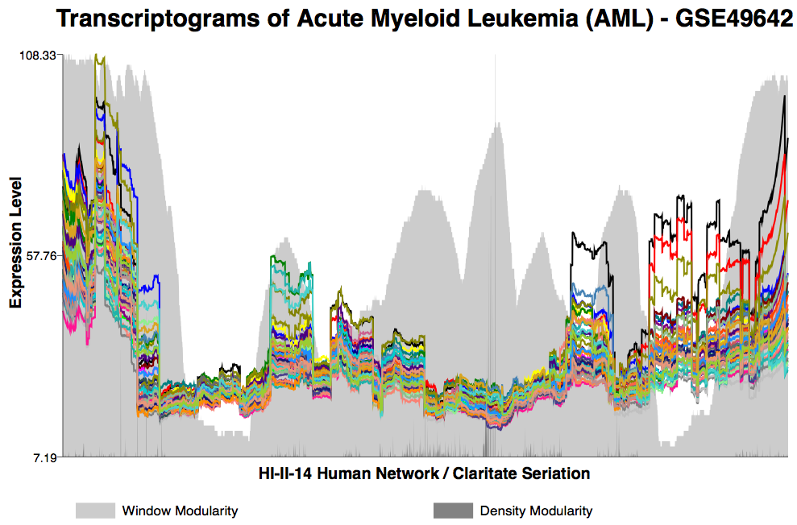
Step 7[OUTPUT]: Transcriptogram

Slide 21
Step 8[INPUT]: Dendrogram
Execute script to plot dendrograms of the patients.
R -q --no-save -e "source('Dendrograms.R');"

Slide 22
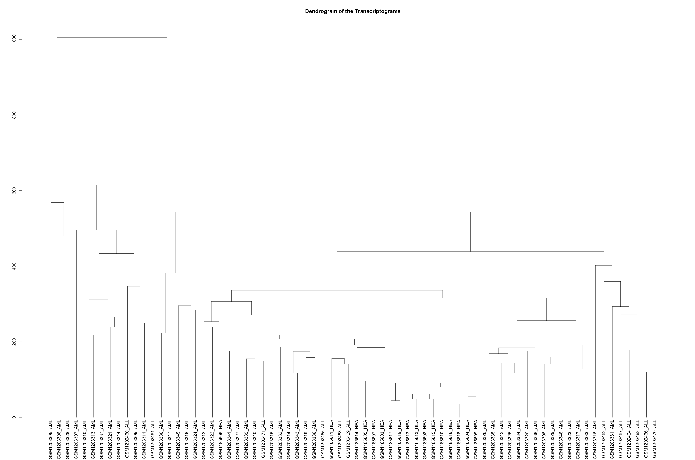
Step 8[OUTPUT]: Dendrogram
Dendrogram of the patients based on its transcriptograms.

Slide 23
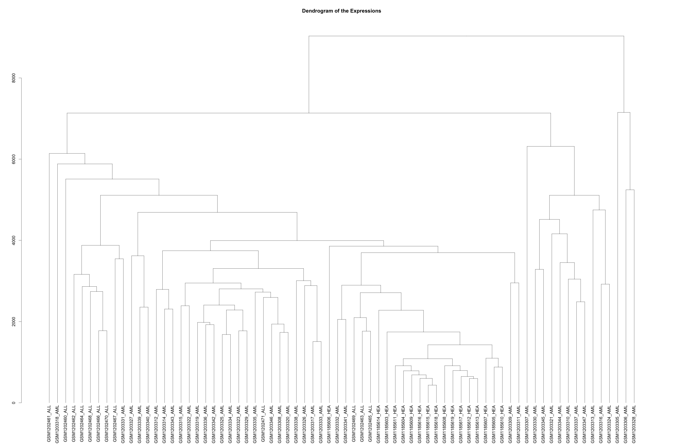
Step 8[OUTPUT]: Dendrogram
Dendrogram of the patients based on its expressions.

Slide 24
Step 9[INPUT]: DEG
Differentially Expressed Genes (DEG)
ALL versus Healthy
AML versus Healthy
DEG.sh "Transcriptograms.txt" "DEG_ALL.txt" "1-17" "18-29”
DEG.sh "Transcriptograms.txt" "DEG_AML.txt" "1-17" "30-72"

Slide 25
Step 9[OUTPUT]: DEG
DEG ALL x Healthy – Top 10
index statistic pvalue gene
3554 5.65301188833966 4.59046631073878e-05 RFESD
3555 5.64786121828344 4.63451047695296e-05 ZNF224
3541 5.64143519355814 4.69007683987499e-05 PRR22
3540 5.64116599274164 4.69241969430767e-05 PDGFRA
3537 5.6373459045242 4.72579729804412e-05 NUDT22
3538 5.6364247921491 4.73388226822635e-05 TDRD7
3536 5.63559620286918 4.74116740529773e-05 PCTP
3535 5.63470685562561 4.7489997023531e-05 SREK1
3539 5.63315502537733 4.76269856117817e-05 NID2
3556 5.63066181312944 6.2001738832751e-05 RAD18
... And more

Slide 26
Step 9[OUTPUT]: DEG
DEG AML x Healthy – Top 10
index statistic pvalue gene
931 -13.6610252098166 0 CASP7
932 -13.6147187598722 0 APOL1
884 -13.3959850475511 0 CDKN1B
882 -13.3938753304491 0 IL11
896 -13.3825079405206 0 CCDC130
929 -13.3638040101552 0 CARD10
930 -13.3518726386199 0 JMJD7
928 -13.3502276393306 0 FOXJ2
972 -13.3435712717987 0 BUD13
883 -13.3413873221972 0 FAM129A
... And more

Slide 27
Step 10[INPUT]: DEG’s Heatmap
Top DEG’s heatmap relative to the transcriptograms of the patients.
HeatmapDEG.sh "Transcriptograms.txt" "Expressions_Labels.txt" "DEG_ALL.txt" "DEG_ALL.png”
HeatmapDEG.sh "Transcriptograms.txt" "Expressions_Labels.txt" "DEG_AML.txt" "DEG_AML.png"

Slide 28
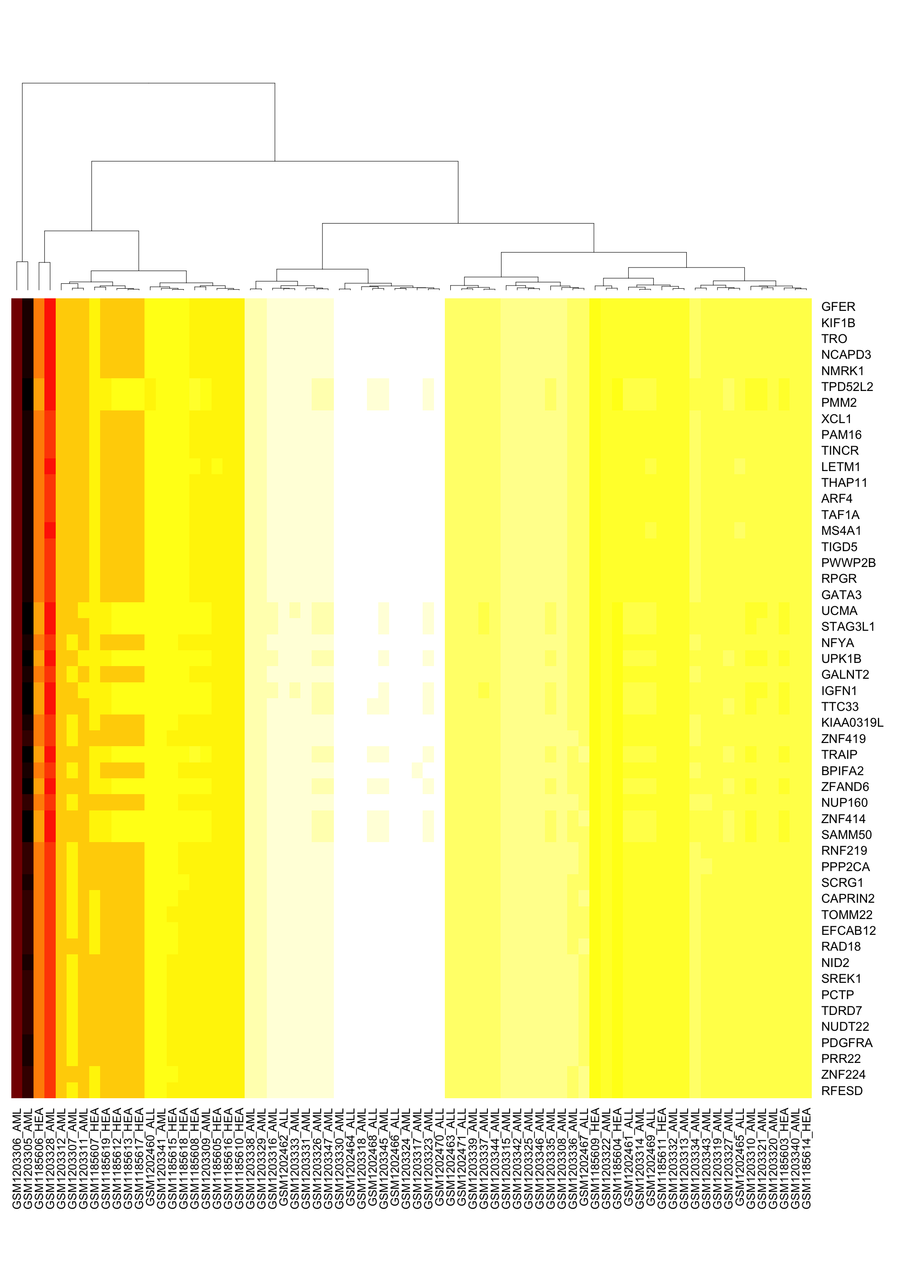
Step 10[OUTPUT]: DEG’s Heatmap
Top DEG of the ALL/Healthy in all transcriptograms.

Slide 29
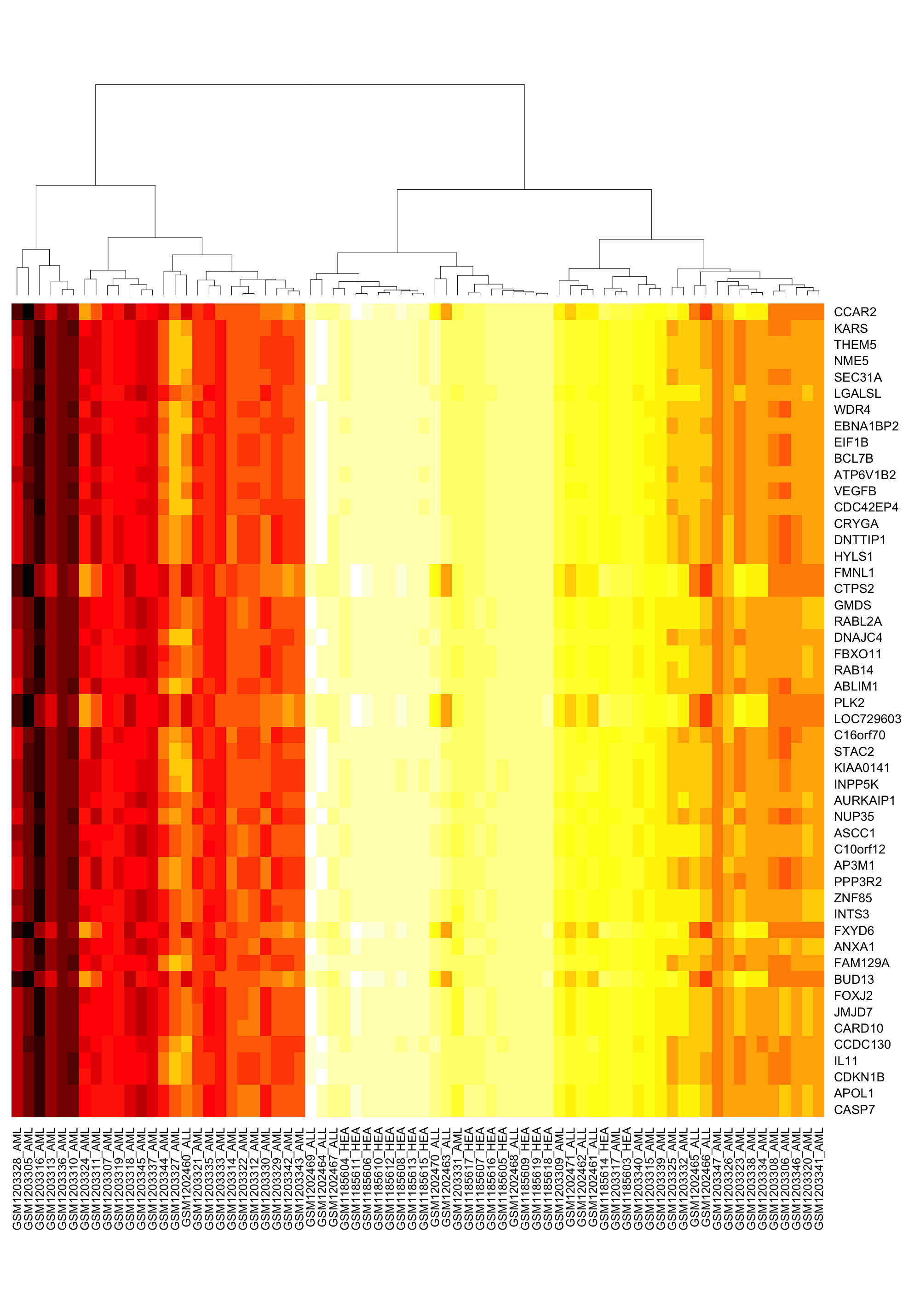
Step 10[OUTPUT]: DEG’s Heatmap
Top DEG of the AML/Healthy in all transcriptograms.

Slide 30
Step 11: Seriation of the DEG
Place the DEG’s results in the order of the network seriation.
R -q --no-save -e "source('DEG_Seriated.R');"
Normalizar.sh "DEG_Seriated_ALL_Values.txt" virg 1000 > "DEG_Seriated_ALL_Values_Norm.txt”
Normalizar.sh "DEG_Seriated_AML_Values.txt" virg 1000 > "DEG_Seriated_AML_Values_Norm.txt"

Slide 31
Step 12: Differentially Expressed Modules
Identify differentially expressed modules (DEM) based on DEG’s seriated results: ALL/Healthy and AML/Healthy.
GerarGrafico.sh "DEG_Seriated_ALL_Values_Norm.txt" area 600 000000 "DEG_Seriated_ALL.png"
FronteirasDEG.sh "Seriation_Final_Genes.txt" "DEG_ALL.txt" S 4 2 S DESC 50 1000 "DEG_ALL_Borders.txt" "DEG_ALL_Modules.txt"
ColorirModulos.sh "DEG_Seriated_ALL.png" "DEG_Seriated_ALL_Colored.png" < "DEG_ALL_Borders.txt"
GerarGrafico.sh "DEG_Seriated_AML_Values_Norm.txt" area 600 000000 "DEG_Seriated_AML.png"
FronteirasDEG.sh "Seriation_Final_Genes.txt" "DEG_AML.txt" S 4 2 S DESC 50 1000 "DEG_AML_Borders.txt" "DEG_AML_Modules.txt"
ColorirModulos.sh "DEG_Seriated_AML.png" "DEG_Seriated_AML_Colored.png" < "DEG_AML_Borders.txt"

Slide 32
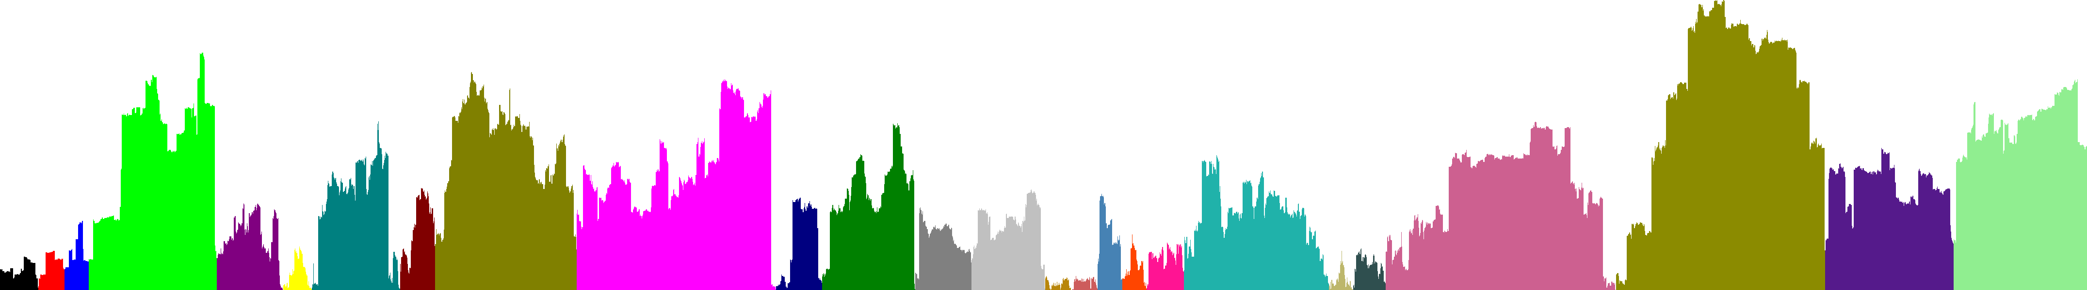
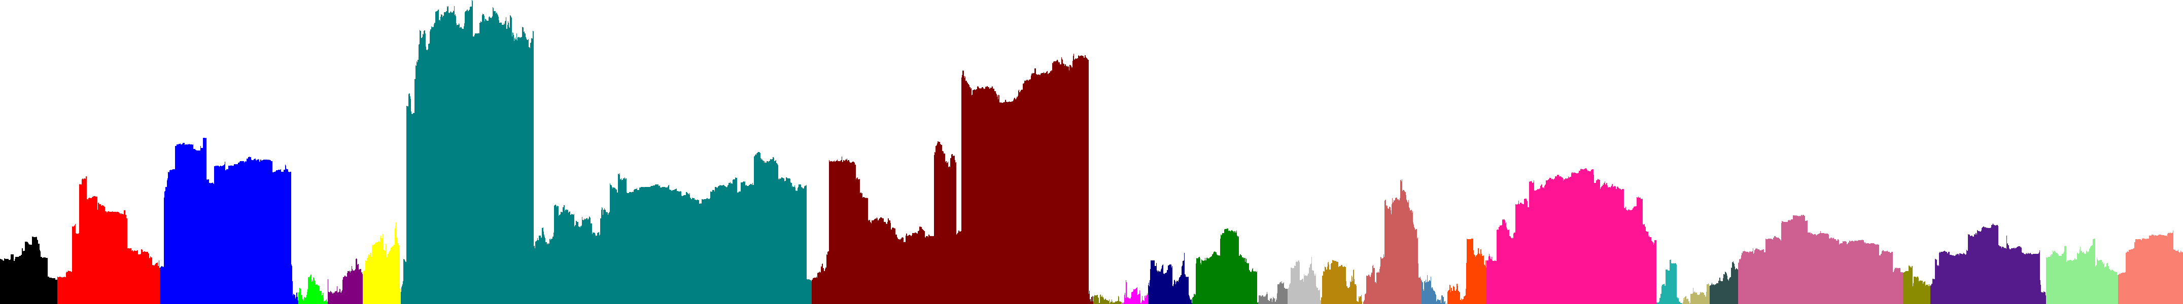
Step 12: Differentially Expressed Modules
The borders were calculated based on tail of the DEG’s list.
Seriated DEG and expressed modules of the ALL/Healthy.
Seriated DEG and expressed modules of the AML/Healthy.

Slide 33
Step 12: Differentially Expressed Modules
Enrichment of the expressed modules of the DEG ALL/Healthy.
mkdir DEG_ALL_Enrichment
cd DEG_ALL_Enrichment
SepararModulos.sh "../Seriation_Final_Genes_Entrez.txt" "../DEG_ALL_Borders.txt" "#" "M"
files=""
for f in M*txt; do
files="$files$f "
done
Enriquecer.sh Hs BP GeneOntology_BP.txt $files
Enriquecer.sh Hs MF GeneOntology_MF.txt $files
Enriquecer.sh Hs CC GeneOntology_CC.txt $files
Heatmap.sh GeneOntology_BP.txt M 50
Heatmap.sh GeneOntology_MF.txt M 50
Heatmap.sh GeneOntology_CC.txt M 50
cd ..

Slide 34
Step 12: Differentially Expressed Modules
Samples of the Biological Process (Gene Ontology) terms detected in the functional enrichment of the differentially expressed modules of the DEG ALL/Healthy.
GO:0006749 glutathione metabolic process
GO:0072540 T-helper 17 cell lineage commitment
GO:0035690 cellular response to drug
GO:0010467 gene expression
GO:0044260 cellular macromolecule metabolic process
GO:0008380 RNA splicing

Slide 35
Step 12: Differentially Expressed Modules
Enrichment of the expressed modules of the DEG AML/Healthy.
mkdir DEG_AML_Enrichment
cd DEG_AML_Enrichment
SepararModulos.sh "../Seriation_Final_Genes_Entrez.txt" "../DEG_AML_Borders.txt" "#" "M"
files=""
for f in M*txt; do
files="$files$f "
done
Enriquecer.sh Hs BP GeneOntology_BP.txt $files
Enriquecer.sh Hs MF GeneOntology_MF.txt $files
Enriquecer.sh Hs CC GeneOntology_CC.txt $files
Heatmap.sh GeneOntology_BP.txt M 50
Heatmap.sh GeneOntology_MF.txt M 50
Heatmap.sh GeneOntology_CC.txt M 50
cd ..

Slide 36
Step 12: Differentially Expressed Modules
Samples of the Biological Process (Gene Ontology) terms detected in the functional enrichment of the differentially expressed modules of the DEG AML/Healthy.
GO:0002376 immune system process
GO:0006952 defense response
GO:0070208 protein heterotrimerization
GO:0007049 cell cycle
GO:0006996 organelle organization
GO:0043933 macromolecular complex subunit organization

Slide 37
Step 13: Transcriptogram of the DEG
Transcriptograms of the DEG’s results.
Transcriptograma.sh "DEG_Seriated.txt" 251 > "Transcriptograms_DEG.txt”
GraficoTranscriptograma.sh "WindowModularity.txt" "DensityModularity.txt" "Transcriptograms_DEG.txt" "0" "DEG_Labels.txt" "Chart_DEG_Labels.txt" "Chart_DEG.svg"

Slide 38
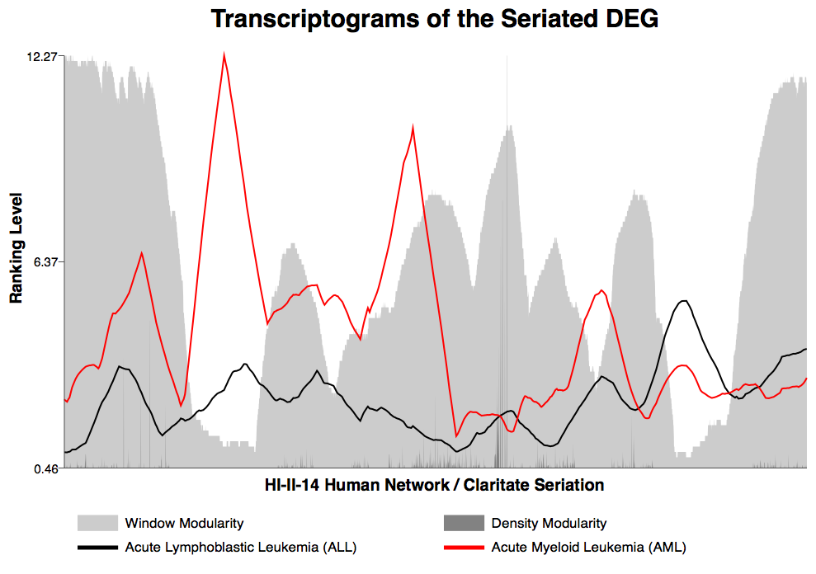

Slide 39
Step 14[INPUT]: Average Expression per Group
Calculate, for each gene, the average expression per group: Healthy, ALL and AML.
MediaPerfis.sh "Expressions_Seriated.txt" "1-17" "18-29" "30-72" > "Expressions_Average_Patients.txt”
Transcriptograma.sh "Expressions_Average_Patients.txt" 251 > "Transcriptograms_Average_Patients.txt"
GraficoTranscriptograma.sh "WindowModularity.txt" "DensityModularity.txt" "Transcriptograms_Average_Patients.txt" "0" "Expressions_Average_Patients_Labels.txt" "Chart_Average_Patients_Labels.txt" "Chart_Average_Patients.svg"

Slide 40
Step 14[OUTPUT]: Average Expression per Group
GENE HEALTHY ALL AML
MAPK7 8.257422352941177 4.4434458333333335 4.733830232558139
UBE2C 4.7770247058823525 15.6066675 8.882123255813951
ASTE1 1.6349376470588235 3.3167900000000006 3.283910232558139
LIG4 3.201185882352941 8.675902500000001 3.4670174418604636
XRCC4 1.7636164705882351 2.7732858333333326 5.0195030232558135
ATP5A1 228.45422647058822 194.88605833333335 209.48216651162795
ASPH 3.9695064705882346 1.317643333333333 6.527040232558141
DRG2 18.303418235294117 19.32307 16.82014674418605
...

Slide 41
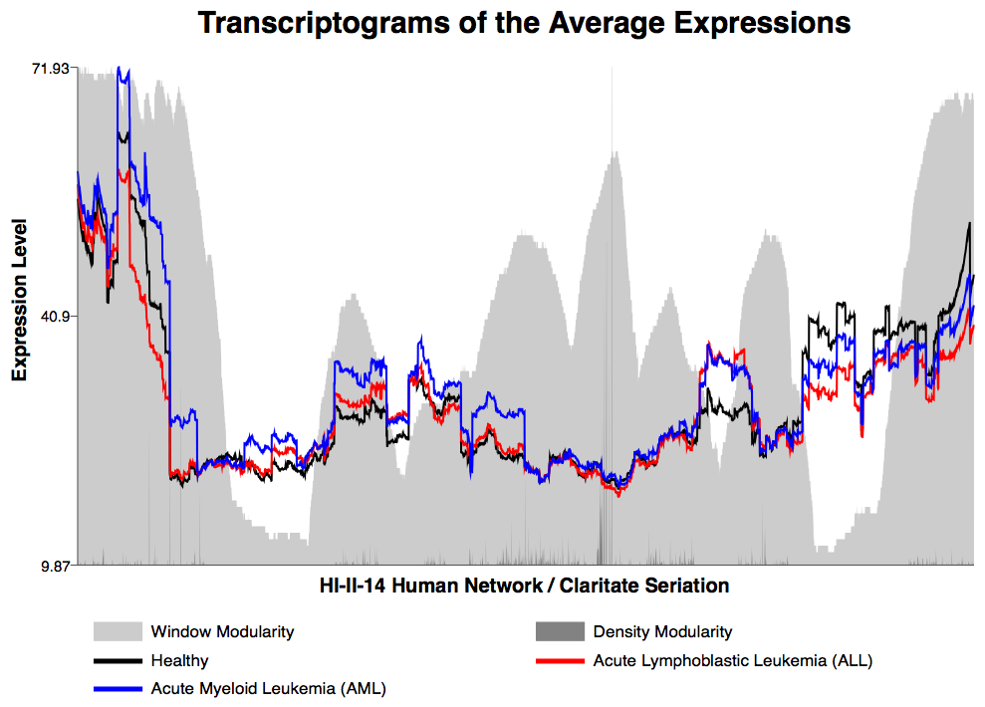

Slide 42
Step 15[INPUT]: Average Expression per Module
Calculate the average expression per module of the “Window Modularity”, “DEG ALL” and “DEG AML”.
MediaModulos.sh "Expressions_Average_Patients.txt" "WindowModularity_Borders.txt" > "Expressions_Average_Patients_WindowModules.txt"
MediaModulos.sh "Expressions_Average_Patients.txt" "DEG_ALL_Borders.txt" > "Expressions_Average_Patients_ALLModules.txt"
MediaModulos.sh "Expressions_Average_Patients.txt" "DEG_AML_Borders.txt" > "Expressions_Average_Patients_AMLModules.txt"

Slide 43
Step 15[OUTPUT]: Average Expression per Module
Average expression of the detected modules in the Window Modularity.
MOD HEALTHY ALL AML
M1 49.198809995978685 47.99625778945623 52.872376891489324
M2 40.66683248181029 38.831559164403515 44.004647697876806
M3 89.75433565582885 60.02517477660731 99.06158404247908
M4 16.53933628272068 16.53747410623043 37.10427718146631
M5 13.609250737456074 14.315416817116182 15.259160548386612
M6 19.83442048891097 21.808060232280287 24.111098659150215
M7 17.956391222271026 18.28605997955249 20.89736886164982
M8 13.818872900111504 12.818230305482638 14.051765608581094
M9 17.13925064570132 18.837447466342365 19.17593607016014
M10 21.226944115629006 23.093612777179622 23.197743093858982
M11 35.76070972723684 29.38175253159843 32.085415419105146

