Slide 1
Color Detect
Josef Rodriguez Mallma

Slide 2
Tools
Which tools did you use of the following:
Cam Logitech
Open CV library
Laptop Mac Book
Python Programming language
IDE – Spyder
Rubik Cube

Slide 3
Motivation
I want to detect 3 different colors using Open cv library and HSV color Space for learning Artificial Intelligence and computer Vision.
For continue learn I need to solve this challenge detect 3 colors using Open CV python library and HSV.

Slide 4
Research Question(s)
Is possible to detect 3 different colors using Opencv and HSV space color?

Slide 5
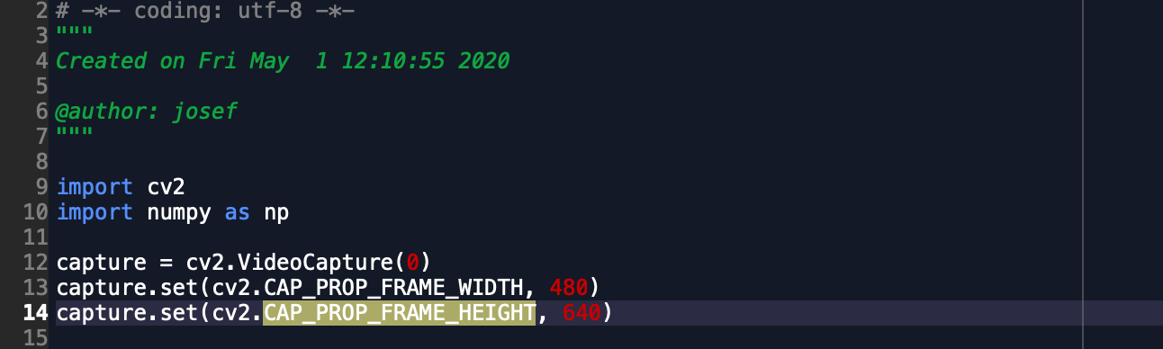
Process
Firts of all I need to import Opencv and Numpy, then use my webcam for get frames and set dimensions of my Windows.

Slide 6
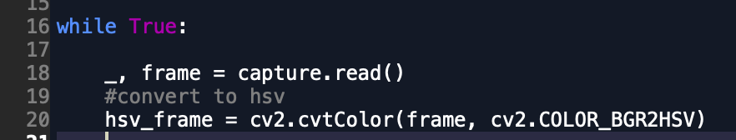
Process
Now I start a Loop where we get the frames and we do the detection.
In this part I use HSV ranges, transform RGB color to HSV.

Slide 7
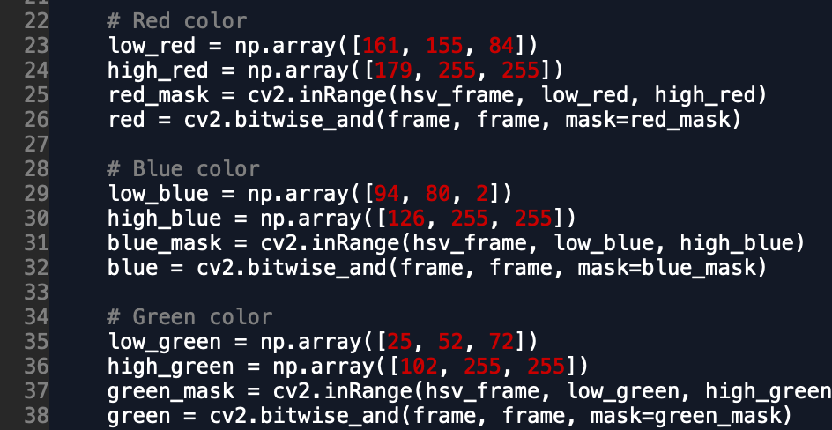
Process
For detect color I need to define HSV ranges for colors and create the mask for show only object for colors reed green and blue.

Slide 8
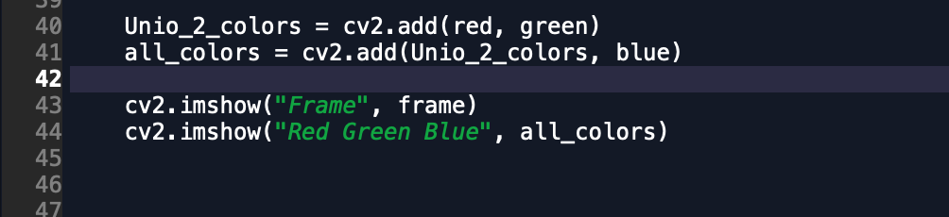
Process
Then I add the colors for detect and show results.

Slide 9

Process
For stop loop while I use ‘ESC’.

Slide 10
Process
For stop loop while I use ‘ESC’.

Slide 11
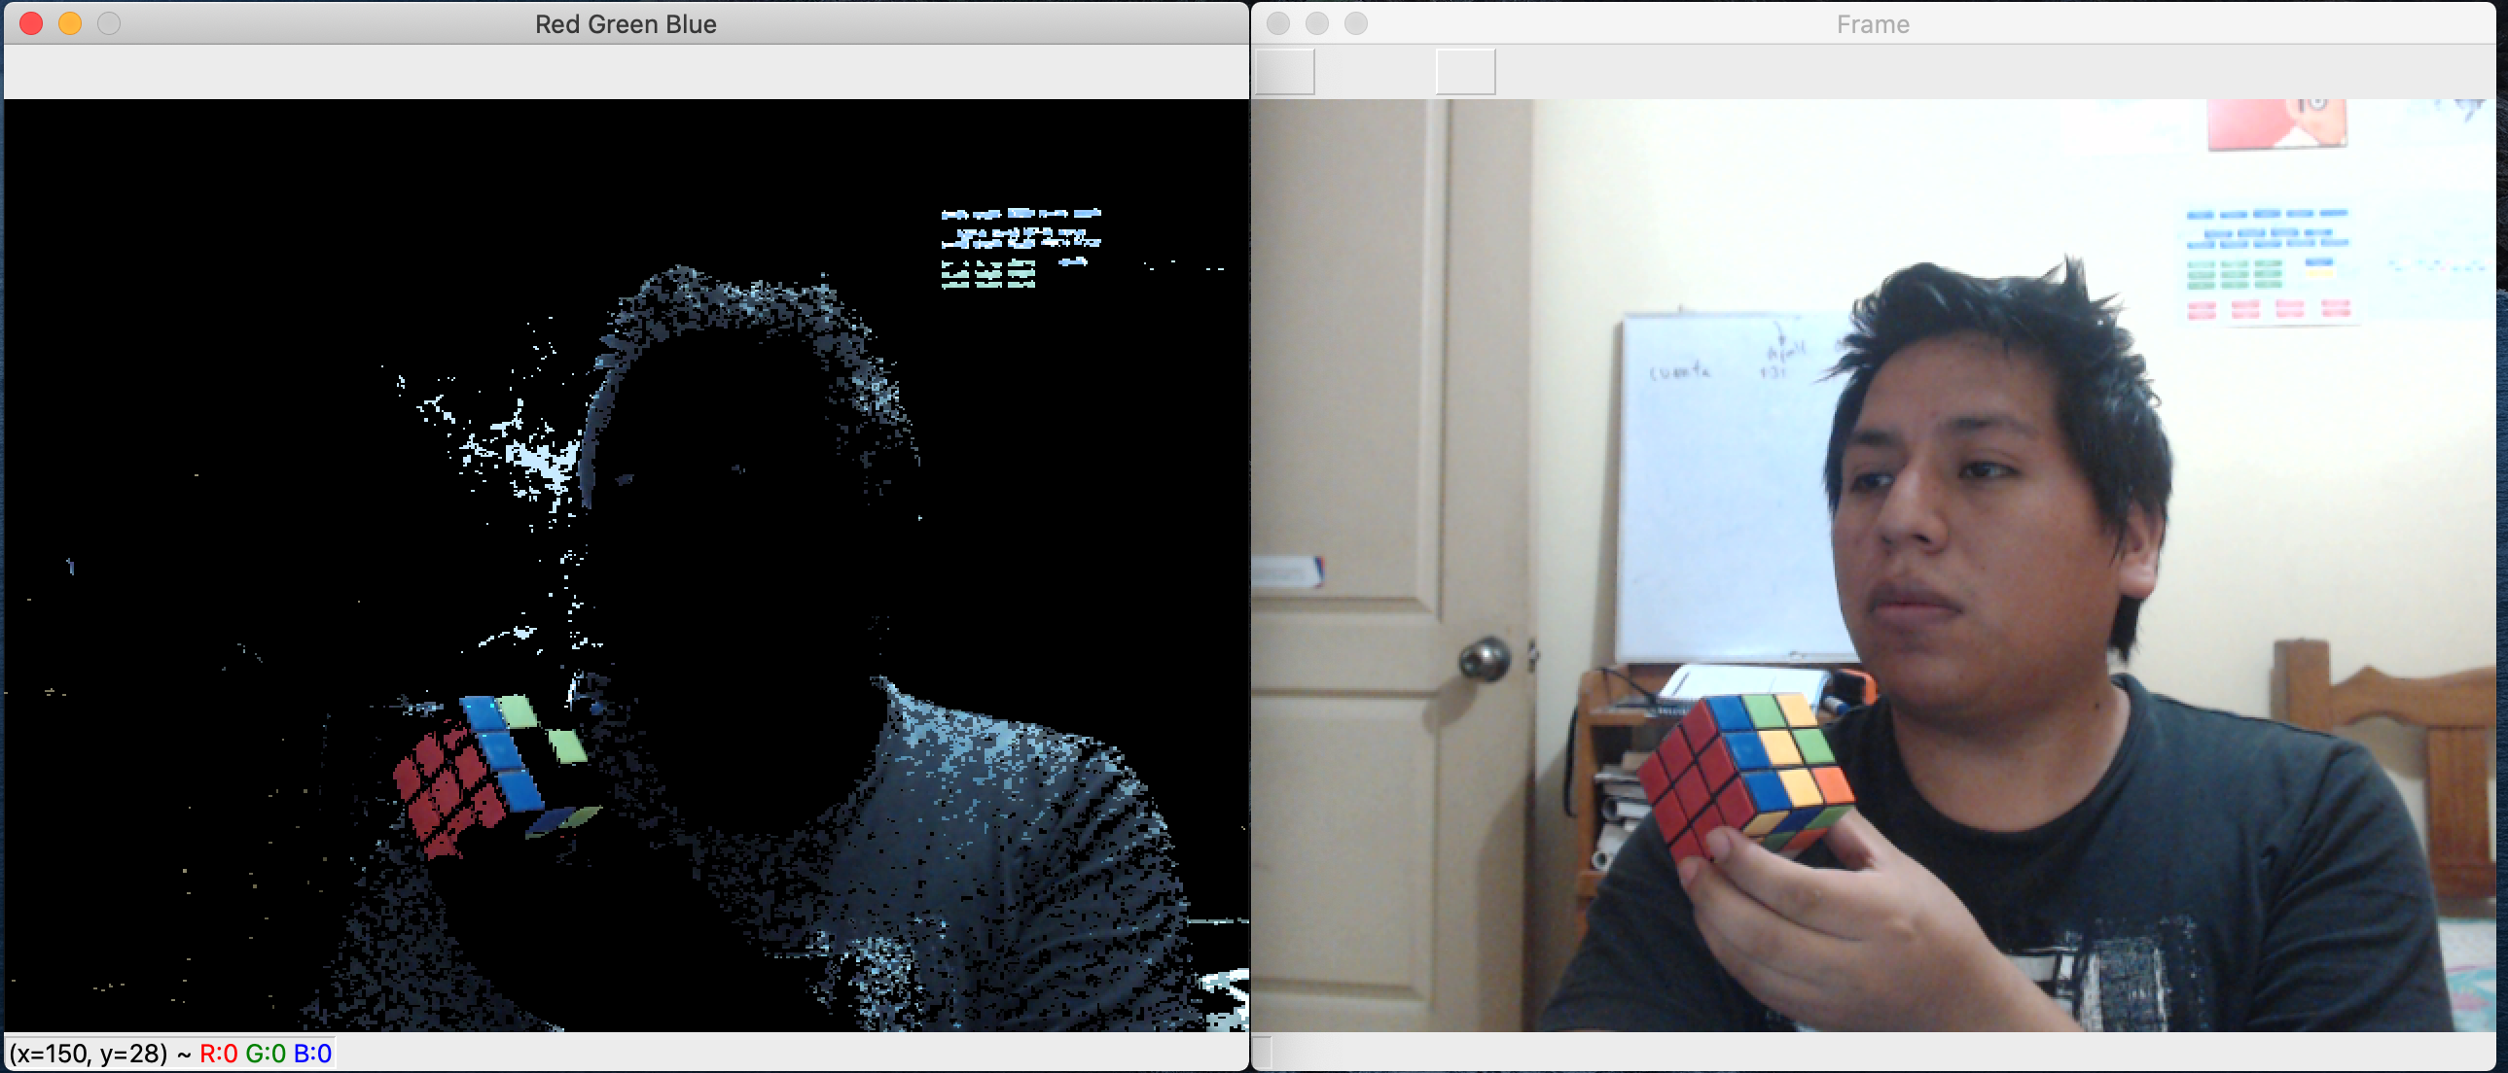
Process
Finally Ican detect 3 colors: red , Green and blue in the same time.

Slide 12
Findings
Open CV is a great library for computer vision but in this case when i use my computer camera the red color was difficult to recognize, for solve this problem I change for better camera ‘Logitech HD 1080p’, so in my opinion for create good Artificial Intelligence we need good software and good hardware.

Slide 13
References
https://docs.opencv.org/2.4/index.html

