Slide 1
🍊 Orange Juice Fair Pricing
Classical Monte Carlo vs Quantum Amplitude Estimation
A Simulation-Based Comparison for Fair Pricing Decisions
Jose Giori Herran Escobar — Solutions Architect
May 2026
1

Slide 2
📋 Executive Summary
Metric | Classical MC | Quantum AE | Improvement
Error at N = 100 | ± $2.20 | ± $0.22 | 10×
Error at N = 10,000 | ± $0.18 | ± $0.006 | 31.6×
Price stability (N=50) | σ = $0.15 | σ = $0.07 | 2×
Price stability (N=1000) | σ = $0.07 | σ ≈ $0.00 | ∞
Decision clarity | Ambiguous | Clear ✅ | Qualitative leap
💡 Bottom Line:
Quantum AE enables more precise, stable, and fair pricing decisions
with the same computational budget — turning ambiguous choices into confident ones.
2

Slide 3
🎯 Problem Statement
The Business Question
A juice vendor must choose a selling price that
maximizes expected profit under uncertain demand.
Why "Fair" Pricing Matters
⚠️ Overpricing → lose customers, reduced demand
⚠️ Underpricing → leave profit on the table
✅ Fair pricing → reflects true demand dynamics
The Core Challenge
Estimating expected profit accurately under
demand uncertainty. The precision of this estimate
directly determines the quality of the pricing decision.
Pricing = Expectation Estimation
Goal: estimate E[Profit(p)]
Profit = (price − cost) × Demand
Demand is uncertain:
D(p) = D₀ · (1 − α·(p − p_ref)) · (1+ε)
ε ~ Uniform(−15%, +15%)
Two approaches to estimate E[Profit]:
🎲 Classical Monte Carlo
⚛️ Quantum Amplitude Estimation
3

Slide 4
🔧 Model Parameters
Parameter | Symbol | Value | Description
Cost per cup | c | $2.50 | Production cost
Reference demand | D_ref | 100 cups | Demand at reference price
Reference price | p_ref | $5.00 | Baseline price
Price sensitivity | α | 0.30 | Demand drop per $1 increase
Demand noise | ε | ±15% | Random demand fluctuation
Mathematical Formulation
Demand: D(p) = 100 · (1 − 0.3·(p − 5.0)) · (1 + ε)
Profit: Π(p) = (p − 2.5) · D(p)
Optimal: p* = (1/α + p_ref + c) / 2 = $5.42 → Simulated: $5.40
Expected profit at optimal: $255.20
4

Slide 5
🎲 Classical Monte Carlo
Algorithm
For each candidate price p:
1. Draw N random demand scenarios
ε_i ~ Uniform(−0.15, +0.15)
2. Compute profit for each scenario
Π_i = (p − c) · D(p, ε_i)
3. Average all samples
Π̂(p) = (1/N) · Σ Π_i
Error Scaling
Error ~ σ / √N = O(1/√N)
The Problem: Quadratically Expensive
2× more precise → 4× more samples
10× more precise → 100× more samples
100× more precise → 10,000× more samples
⚠️ At N = 100:
Profit estimate: $255 ± $2.20
That's almost 1% uncertainty
5

Slide 6
⚛️ Quantum Amplitude Estimation (QAE)
Core Idea
Instead of sampling independently, QAE:
1. Encodes all demand scenarios into a
quantum superposition
2. Computes profit and encodes it into the
amplitude of a flag qubit
3. Uses quantum interference (Grover-like
iterations) to extract the expected value
A|0⟩ = √(1−a)|ψ₀⟩|0⟩ + √a|ψ₁⟩|1⟩
where a = E[normalized profit]
Error Scaling
Error ~ O(1/N)
The Advantage: Linear Scaling
2× more precise → 2× more queries
10× more precise → 10× more queries
100× more precise → 100× more queries
✅ At N = 100:
Profit estimate: $255 ± $0.22
10× more precise than MC!
6

Slide 7
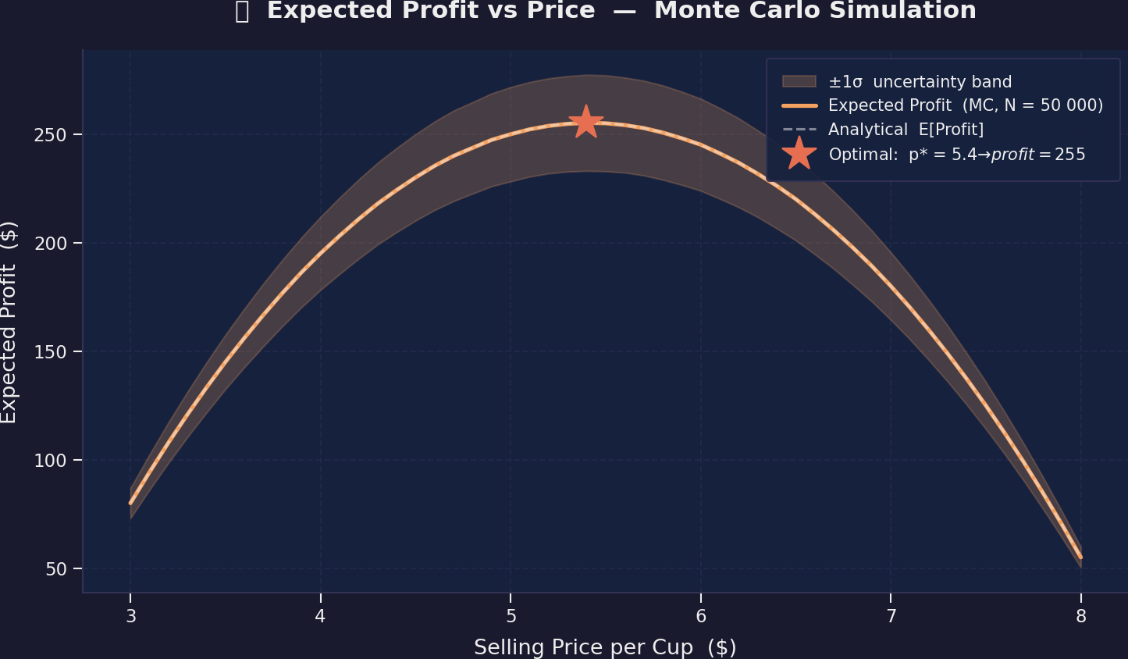
🍊 Expected Profit vs Price
Key Insights
Optimal price: $5.40 → Expected profit: $255.20
The flat-top curve means small estimation errors can shift the perceived optimal price significantly
This is exactly where QAE's precision advantage matters most
7

Slide 8
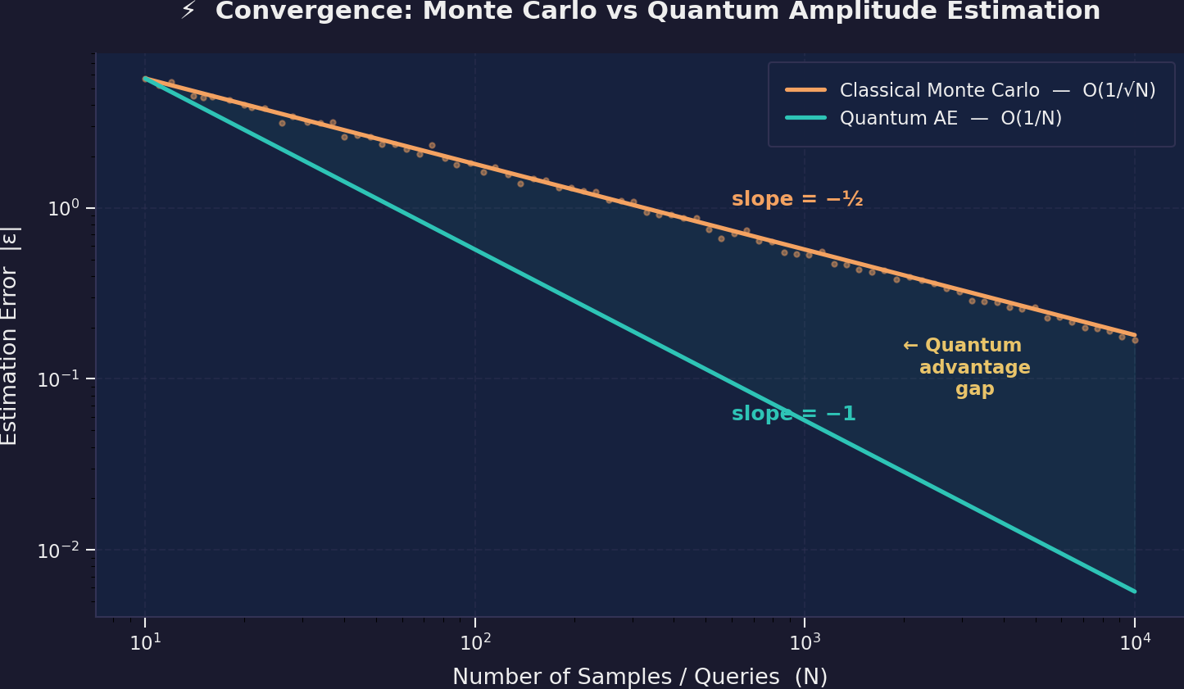
⚡ Convergence: MC vs QAE
Key Insights
Orange (MC): slope −½ → O(1/√N) | Teal (QAE): slope −1 → O(1/N)
The shaded gap = quantum advantage — it grows with N
At N=10,000: QAE achieves 31.6× lower error than classical MC
8

Slide 9
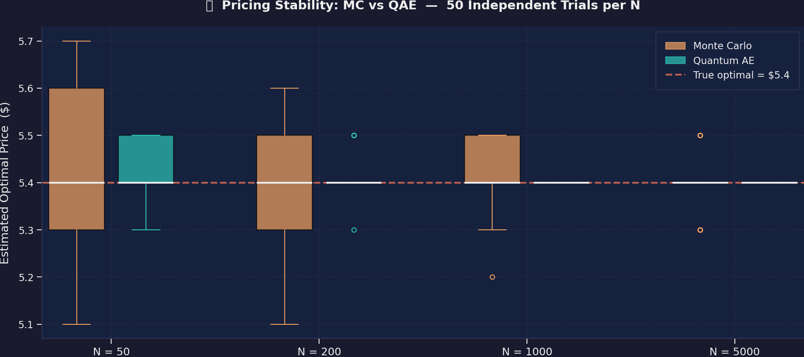
📊 Pricing Stability: 50 Independent Trials
Key Insights
At N=50: MC shows σ=$0.15 spread — the "optimal" price jumps around
QAE stabilizes much faster — near-deterministic even at low N
Stable pricing = consistent decisions = fairer outcomes
9

Slide 10
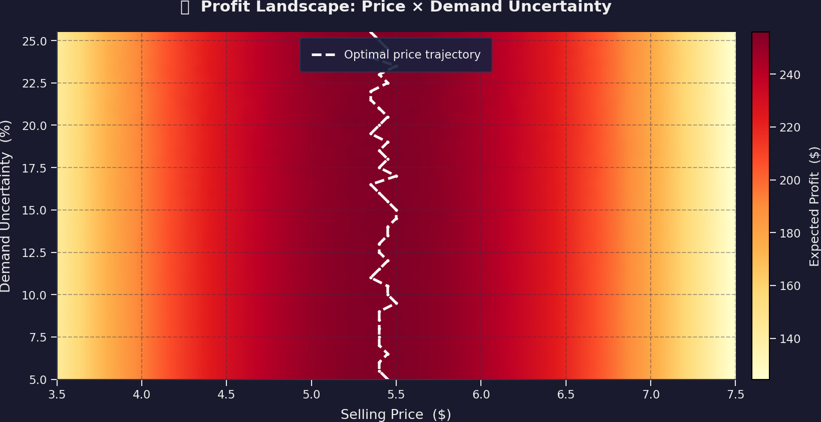
🔥 Profit Landscape: Price × Uncertainty
Key Insights
Heatmap shows profit across all price + uncertainty combinations
Higher uncertainty → higher profit variance → MC estimates become noisier
QAE's advantage is greatest where uncertainty is highest
10

Slide 11
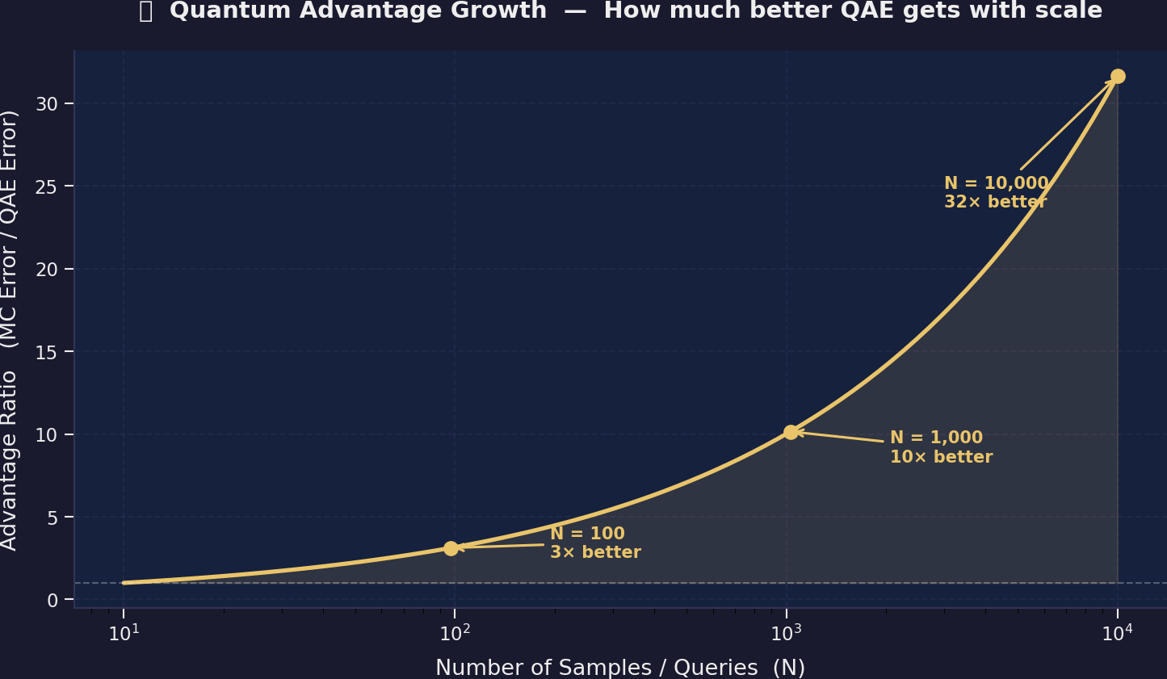
🚀 Quantum Advantage Growth
Key Insights
The ratio (MC error / QAE error) grows as √N
N=100: 3× better | N=1,000: 10× better | N=10,000: 31.6× better
The more you invest in computation, the more quantum pays off
11

Slide 12
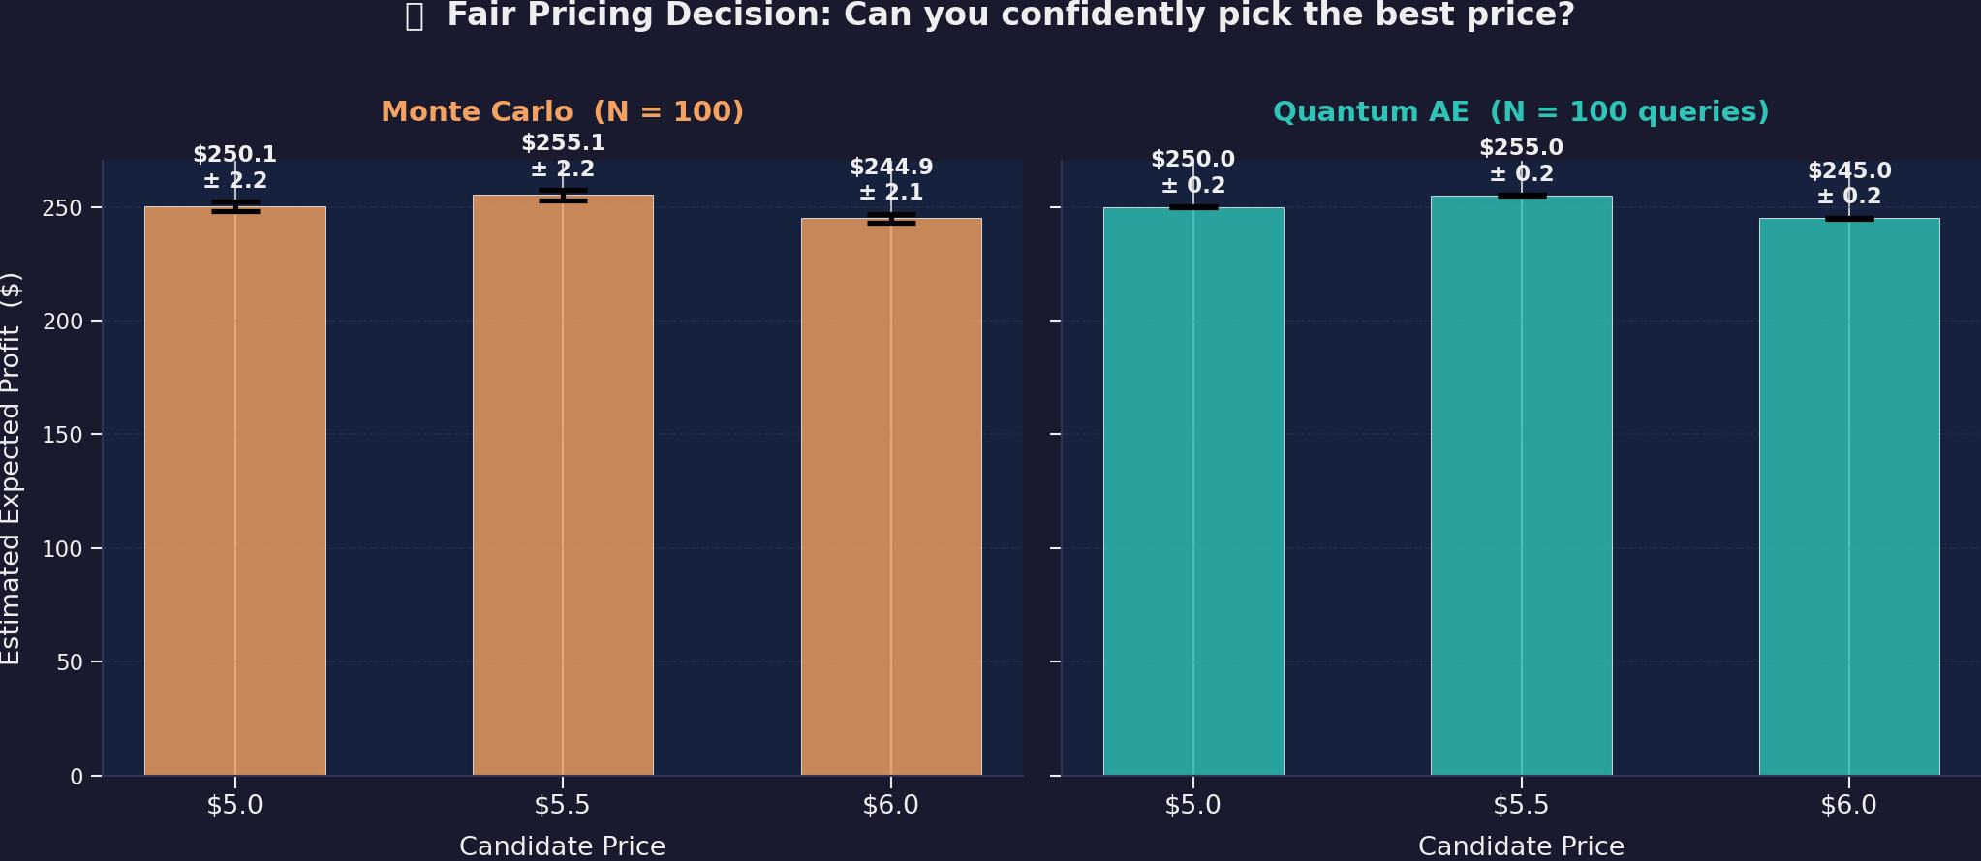
🎯 Fair Pricing Decision: The Killer Chart
Key Insights
MC (left): error bars OVERLAP — ambiguous decision, cannot distinguish $5.0 from $5.5
QAE (right): clear separation — $5.50 is unambiguously the best choice
Same budget (N=100), dramatically different decision quality
12

Slide 13
⚖️ Full Comparison: Classical vs Quantum
Dimension | Monte Carlo | Quantum AE
What it computes | Sample average | Amplitude of quantum state
Core mechanism | Random sampling | Quantum interference
Error scaling | O(1/√N) | O(1/N)
Cost for error ε | O(1/ε²) | O(1/ε)
Error at N = 100 | ± $2.20 | ± $0.22
Error at N = 10,000 | ± $0.18 | ± $0.006
Advantage at N=10K | 1× (baseline) | 31.6×
Price stability | Noisy at low N | Stable even at low N
Decision quality | Ambiguous | Clear ✅
13

Slide 14
💡 The Fair Pricing Argument
Why Classical MC Falls Short
🔴 High estimation noise
Price appears optimal when it's not
🔴 Inconsistent decisions
Same analysis twice → different prices
🔴 Requires massive samples
Impractical for real-time pricing
🔴 Noise-driven decisions ≠ fair pricing
Why Quantum AE Enables Fairer Pricing
✅ 10–30× lower noise
Price reflects true demand, not artifacts
✅ Deterministic convergence
Same analysis → same decision
✅ Linear scaling
Feasible for complex pricing models
✅ Accurate estimation = fair pricing
14

Slide 15
🧠 Executive Conclusion
"Quantum advantage in pricing is not about speed alone — it's about better decision quality under uncertainty."
Strategic Implications
🔹 Near-term: Use classical MC with awareness of its limitations; build confidence intervals into pricing
🔹 Medium-term: Explore hybrid classical-quantum approaches (variational QAE, noise-aware protocols)
🔹 Long-term: Full QAE on fault-tolerant quantum hardware for high-precision, fair, real-time pricing
Value Proposition
For every pricing decision where $5 of profit difference matters, QAE can resolve the
difference with 100× fewer evaluations. In high-frequency pricing, thin margins, and complex
demand models — quantum advantage translates directly into better margins and fairer prices.
15

Slide 16
Thank You!
Questions & Discussion
Jose Giori Herran Escobar
Solutions Architect
🍊 Fair pricing through quantum-enhanced estimation
May 2026
16

