Slide 1

QA & INSPECTION CIRCLE, KERALA
ACCEPTANCE TEST SCHEDULE 4G Phase IX.2 – eNode-B: RP-01287-CHORUKKALA
Document No QAIN-11/31(14)/1/2024-CM No of Pages 29 Issue No. 1 Issued By: QA & Inspection, Kerala Approved By: CGM, QA & Inspection Circle Date of Issue: Amendment No (If Any) No of Pages: Issued by: Date of Issue: Restricted use by BSNL Employees only
“FIX IT RIGHT AT THE FIRST INSTANCE”

Slide 2
QA & INSPECTION CIRCLE KL
4G PHASE IX.2 eNode-B A/T SCHEDULE
ACCEPATNCE TEST SCHEDULE FOR eNode-B
1. Details of eNode-B: Cross check with planning document from Local Craft Terminal
/EMS/DTT kit/Engg. Handset/Physical verification.
Type of site: (BSNL/NBSNL/IP): ----NBSNL------------
Lat/Long | 12.04003191/ 75.41092776 | Equipment type: (Macro/Micro/Pico) | Micro | Config: (TDD/FDD)
Project name | BSNL | Site name | RP-00553- MAYYIL | Site ID | RP-01287
BA | KNR | SDCA / OA | KANNUR | Cell Ids | 674971- 0/1/2
Circle name | KERALA | Vendor name | ZENTIX | MIMO Config | 2*2
On Air Date | 27-12-2024 | A/T Date | -
Site type :(ID/OD) | Outdoor | Site Category: (RTT/RTP/GBT) | GBT | Transmission type: (MW/Fiber/VSAT) | OFC (Fiber)
Antenna type /Port (Single Band / Dual Band) (4 / 6 / 8 / 10 Port) | Dual Band | CPRI length | 60m
eNode –B: CAT (A/B/C/D/E/ any other) | CAT-D | Bandwidth (5MHz/ 10MHz /20MHz etc.) | 10Mhz
Sector (Antenna detailsfor the Installed 4G site) | Mechanical Tilt in degree | E-Tilt | Height | Azimuth
Sec 1 | 2 | 2 | 50M | 330
Sec 2 | 2 | 2 | 50M | 80
Sec 3 | 2 | 2 | 50M | 255
QAIN-11/31(14)/1/2024-CM

Slide 3
QA & INSPECTION CIRCLE KL
4G PHASE IX.2 eNode-B A/T SCHEDULE
Site ID(IP): | Site Name |  | MME |  | SGW
RP-01287 | RP-01287-CHORUKKALA |  | 10.62.43.100 |  | 117.231.204.210
SACFA ID (New site)
Equipment configuration | No. of racks (ODC): Mention (Indoor/Outdoor) and Rack/ODC No. of sectors: 3
 | No. of carrier/ sector: Single
 | No. of carrier/ sector: 2
 | No. of Antenna per sector: Single
 | MME Location: Kerala
 | SGW Location: Kerala
Sector No. | Cell ID/PCI | EARFCN |  | TAC
1 | 37 | 515 |  | 31743
2 | 36 | 515 |  | 31743
3 | 38 | 515 |  | 31743
2. Infrastructure provided by: BSNL Capacity/Rating (Please tick appropriate box)
VENDOR
I. Power plant | DELTA
II. Battery | VRLA
III. Engine Alternator | NA
IV. Air-conditioning | NA
V. Fire detection system. | BSNL
VI. Tower | GBT
VII. Earthing
VIII. Media | MW
IX. Shelter (for Indoor eNode-B) | Outdoor
X. Microwave | NEC
XI. Outdoor UPS with Li-ion | 4 Hrs

Slide 4
QA & INSPECTION CIRCLE KL
4G PHASE IX.2 eNode-B A/T SCHEDULE
Wideband-AMR (HD-voice) enabled: - Pass (AMR-WB 12.65Kbps)
Sector | Codec
1 | AMR-WB 12.65Kbps
2 | AMR-WB 12.65Kbps
3 | AMR-WB 12.65Kbps

Slide 5

QA & INSPECTION CIRCLE KL
4G PHASE IX.2 eNode-B A/T SCHEDULE
Test results as per QA & Inspection Circle latest test schedule (In case infra provided by vender).
For BSNL deliverables, BSNL has to submit a sufficiency certificate for existing infra and in case of new infra, it has to be tested as per approved test schedule.
PART – A: INFRASTRUCTURE TEST
S.No | TEST DESCRIPTION | REFERENCE / PROCEDURE | REMARK
1 | Check of documentation. | Hard/Soft copy as per PO. | NA
2 | Check QA certificate. | QA certificate to be submitted. BBU, RRH and ODC serial no. as per release report. | 10M 64M 10M 15M
3 | Location, Alignment & Rigidity (LAR). | As per approved plan. | Location- 12.04003191/75.41092776 Alignment- OK Rigidity- OK
4 | Check for protection from lightning /accidental high voltage/ induced high power for power plant and outdoor eNode-B. | Lightning protector earth continuity should be checked. | Protection- OK Lightening Arrester to earth and equipment’s earth continuity checked
5 | Check the electrical tilt of the antenna. | Yes | OK
6 | Check for site Earthing and connectivity with BBU and RRH etc. | Use Megger for measuring the earth’s resistance value. The value of earth to be measured and the same shall be indicated irrespective of whether the earth was provided by the supplier or not. Earth resistance value should be .5 Ohm. | Tested Earth value = 0.3 Ohms and Equipment’s, tower earth Continuity checked Ok.

Slide 6
QA & INSPECTION CIRCLE KL
4G PHASE IX.2 eNode-B A/T SCHEDULE
PART-B: SYSTEM TEST
1. System Related Test: (As per planning document)
S.No | TEST DESCRIPTION | REFERENCE / PROCEDURE | REMARK
1.1 | Hardware conformity check. | Verify the HW details as deployed on the site. As per vetted BoM. | BBU-1, RRH-3 CPRI LENTH(M)-60*3 POWER CABLE(M)55M DCDB POWER CABLE(M)-20M EARTHING CABLE(M)-15M GSM ANTENNA-10 PORT*3
1.2 | eNode-B software version. | SW version to be filled from EMS and should be as per document approved by the planning wing. | RAC: rac_sw_package_R14Rel_447_I_025_003 CEF: REL_10_0_13_a79_51_6_ 5
1.3 | Check EMS integration. | OK/NOK | OK
1.4 | Check integration with SON. | OK/NOK | OK
 | Transport - related information. Connection type, quantity and its capacity: |  | NA
1.5 | a. Microwave | Provide the MW make and Model details. | MW
 | b. Integrated Transport Module (CEF12/CEF12T) | BBU OD with TX Card (CEF12T) | 10 Ge Optical / 1-4-2
 | Port type-1G/10G/E1/FE No. of Ports-1G/10G/E1/FE | Optical port used-1G (P1) 2/2/4/1
1.6 | MME and SGW IP address. | MME:10.62.43.100 SGW:117.231.204.210 | Ping test to MME and SGW OK
1.7 | eNode-B details (TX). | Electrical / Optical | Optical
1.7.1 | IP details (Table to be plugged in w.r.t. IP, VLAN including GW). | CEF: RAC: S1C: S1U: | 10.61.182.162 10.61.186.67 10.61.187.67 10.61.188.67
eNode-B status check from Access Point:
A/T procedure:
Check the visual alarm (LED) indication on all cards. All LEDs should show a healthy condition.

Slide 7
QA & INSPECTION CIRCLE KL
4G PHASE IX.2 eNode-B A/T SCHEDULE
Connect a Laptop with Control Card through RJ45/Console port. (CEF will be accessible through RJ 45 and RAC through Console Port (Diag cable).
Login through eNode-B Maintenance Tool (Like LMT)/CLI.
Check the working status of all cards by LMT/CLI. All cards should be healthy.
Expected Results: | Status | OK/NOK
i | OK | OK
ii | OK | OK
iii | OK | OK
iv | OK | OK
2. Installation, cabling and marking: All cabling should be done by straight wire without having any joint in between. Marking should be at both ends to identify the cable as per documentation and correlate both ends.
CHECK | STATUS (OK/NOK) | REMARK
Check the installation and cabling, crimping of cable and iron work of the eNode-B. | OK
Check of proper laying of CPRI & its termination / RF connectors & sealing of CPRI cable. | OK
Labelling of CPRI. | OK
CPRI Details. | Make: | Size: 60m
Data Rate/CPRI. | 1.2GBPS per CPRI/Huber + Suhnu
3. Power Measurement:
CHECK | STATUS (OK/NOK) | REMARK
Polarity and labelling of power cables. | OK | Good
Measure the voltage at battery point. | OK | 52.24 V
Measure input voltage to ODC. | OK | 52.7 V
Calculate voltage drop (Between Battery terminal & eNode-B). | OK | Should be less than 1V 0.2
Functional & Service Related Test:
eNode-B restart test.
Test procedure (Hardware reset and Power reset):
Check for eNode-B recovery after switching off the power supply to eNode-B.
Check for eNode-B recovery after hardware reset.

Slide 8
QA & INSPECTION CIRCLE KL
4G PHASE IX.2 eNode-B A/T SCHEDULE
The eNode-B should come up and the status of the site should be same as what was before the reset.
Expected Results: | Status | OK/NOK
i | 5 TO 10 Minute | 10 Min
ii | 5 TO 10 Minute | 10 Min
Check for the related alarm on OMC-R /LMT Log-in.
Check for Wideband-AMR (HD-voice) enabled. Yes
Check of Clock synchronization ( as per planning document)
: OK
Synchronization type : GPS Clock
5.
6.
Outdoor eNode-B: Fan Cooling Unit operational status. (OK / NOK)-OK
System alarm test: Generation of alarms for power failure/ media failure/
fan failure alarm by manually switching off or unplugging module. -OK
7. Transmit Power Outputs: Configured power to be checked through EMS.
Integrated module (for RRH type): Check TX power of eNode-B using LMT.
Sector –0 |  | Sector –1 |  | Sector –2
46 |  | 46 |  | 46
8.
VSWR Measurements:
Check feeder grounding is done properly, if applicable. Status (OK/Not:- OK)
i. Measure the VSWR values of each sector (<=1.3). Measurement can be done through LMT/EMS/NMS/CLI.
Antennas & Cables | VSWR | Antennas & Cables | VSWR
Sector 0 Main | 1.10 | Sector 0 Div | 1.10
Sector 1 Main | 1.11 | Sector 1 Div | 1.12
Sector 2 Main | 1.12 | Sector 2 Div | 1.11

Slide 9
QA & INSPECTION CIRCLE KL
4G PHASE IX.2 eNode-B A/T SCHEDULE
9. 4G services to be tested in all sectors.
I. | VoLTE/ CSFB/ SRVCC/eSRVCC /Fast return to LTE– O/G and I/C call :
II. | ViLTE : Under Discussion
III. | DATA, Video and Audio Streaming/Web Browsing : Pass
IV. | SMS, USSD : Pass, NA
V. | Emergency call (112) : Pass
VI. | LBS services : Under Discussion
VII. | Cell Broadcast on handset.: Under Discussion
VIII. | Check NB-IoT / M2M service : Under Discussion
Sec 1 | OK
Sec 2 | OK
Sec 3 | OK
10. Calls for Handover (4G to 4G)
Intra Enb Handover Call
 | Sector -1 | Sector -2 | Sector-3
Intra eNB Handover - Sector 1 | -pass | Pass | pass
Intra eNB Handover - Sector 2 | Pass | pass | Pass
Intra eNB Handover - Sector 3 | Pass | Pass | Pass
Inter eNB Handover | Pass | Pass | Pass

Slide 10
QA & INSPECTION CIRCLE KL
4G PHASE IX.2 eNode-B A/T SCHEDULE
11.
External alarm tests:
Vendor is responsible in all types of sites (NBSNL, IP and BSNL) for extending external alarm termination from eNode-B to the nearest KRONE- box. For eNode-B A/T external alarm generation may be verified from the KRONE box.
In the case of sites where infra items are supplied by the vendor, the vendor should extend external alarms from elements like PP/Bty etc all the way to eNode-B.
Alarm cables are punched firmly and correctly. Status (OK/NOK)
List of External alarms to be extended–
1. AC Main Fail | OK | Actual
2. DG on Load | OK | Actual
3. Diesel Low (below a threshold level) | OK | Actual
4. High Temperature | OK | Actual
5. eNode-B Battery Low (Voltage of the battery bank below a threshold level) | OK | Actual
6. Cabin Door Open | OK | Actual
7. DG Battery Low (Voltage of the battery of the DG set below a threshold level | OK | Actual
8. Fire | OK | Actual

Slide 11
QA & INSPECTION CIRCLE KL
4G PHASE IX.2 eNode-B A/T SCHEDULE
PART C: COVERAGE TEST
The vendor shall carry out the simulation of coverage and generate prediction maps of the cities with the existing and identified sites to be specified by the purchaser. The supplier shall indicate additional locations, if any, required to meet the coverage requirements of the purchaser. The prediction map so generated and agreed upon shall form the basis for acceptance testing of the coverage.
Prior requisite to start coverage test:
Basic calls / messages / data may be checked. Geographical clusters and size of cluster may be finalized by the Circle RF Planning teams in consultation with the vendor.
Link budget should be submitted for all bands as mentioned in the PO & DTR.
Coverage A/T should cover all sectors of the sites included in the cluster and plots may be prepared cluster wise. Event based KPIs may be performed as static tests for each of the sectors and cell wise statistics may also be submitted as part of the A/T reports along with cluster wise plots and KPI statistics.
80% [minimum] of technology-specified throughput shall be demonstrated in field drive tests as applicable.
The coverage A/T reports submitted by the vendor should be evaluated & approved by the BA
/ Circle RF teams after ensuring that suitable measures to improve the QoS are incorporated, in case issues are identified during A/T.
Drive Test Results: The following drive test results plots are prepared.
RSRP Plot (As per Prediction Plot)
RSRQ Plot
SINR Plot
DL Throughput plot
The plot indicates the coverage parameters marked by different colours for different levels e.g. Excellent, Good, Poor etc.
Results
Pass
Remark
Pass
Fail
Passing criteria as per approved prediction plot by BSNL RF planning teams for RSRP, RSRQ, SINR, DL & UL Throughput. Colour legends (Green, Yellow, and Red etc.) for different levels of respective coverage parameters to be decided by planning in consultation with the vendor.

Slide 12
QA & INSPECTION CIRCLE KL
4G PHASE IX.2 eNode-B A/T SCHEDULE
2. Physical site information.
Circle | SSA | City | eNodeB Name | Site ID | Cell ID | Site Name | Lat | Long | Orientation | M-
 |  | /Town |  |  |  |  |  |  |  | Tilt
KERAL A | KNR | KANNUR | T4KL01KNTH AP09R01287_ A | RP-01287 | 674971-0 | RP-01287- CHORUKKA LA | 12.0739318 5 | 75.41092776 | 330 | 2
KERAL A | KNR | KANNUR | T4KL01KNTH AP09R01287_ B | RP-01287 | 674971-1 | RP-01287- CHORUKKA LA | 12.0400319 1 | 75.41092776 | 80 | 2
KERAL A | KNR | KANNUR | T4KL01KNTH AP09R01287_ C | RP-01287 | 674971-2 | RP-01287- CHORUKKA LA | 12.0400319 1 | 75.41092776 | 255 | 2
3. Technical site information
.
eNodeB Name | eNode B Cell name | eNode B ID | eNode B Cell ID | Sector Id | TAC | PCI | RSI | RS Power | EUARFCN UL | EUARFCN DL | Neighbour Verified and Corrected from EMS including X2
 |  |  |  |  |  |  |  |  |  |  | 4G-4G | 4G-3G/4G-2G
T4KL01 KNTHA P09R01 287 | T4KL01 KNTHAP 09R01287_A | 674971 | 674971-0 | 0 | 31743 | 37 | 124 | 15 | 18515 | 515
T4KL01 KNTHA P09R01 287 | T4KL01 KNTHAP 09R01287_B | 674971 | 674971-1 | 1 | 31743 | 36 | 183 | 15 | 18515 | 515
T4KL01 KNTHA P09R01 287 | T4KL01 KNTHAP 09R01287_C | 674971 | 674971-2 | 2 | 31743 | 38 | 22 | 15 | 18515 | 515

Slide 13
QA & INSPECTION CIRCLE KL
4G PHASE IX.2 eNode-B A/T SCHEDULE
4. Drive test procedure
The Drive Test will be done with NEMO/TEMS/X-CAL with Calibrated Mobiles. The phones will be in the following modes
Device | Type of Call | Operator Name | Mode | Comment
MS1 | Volte Call Short | BSNL | LTE | YES ( 30 s interval /5s hold )
MS2 | Volte Call Long | BSNL | LTE | YES
MS3 | Data Download | BSNL | LTE | YES

Slide 14
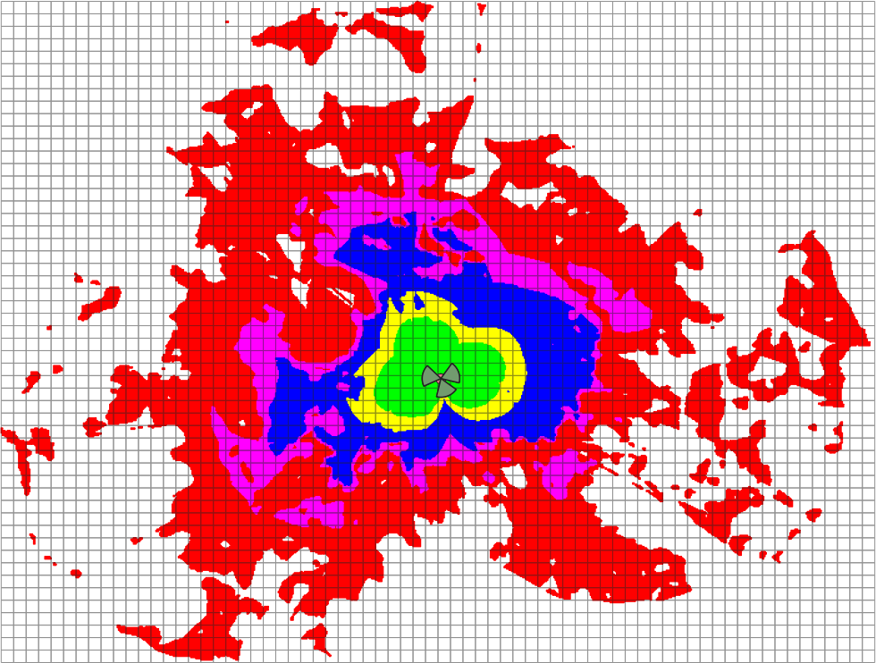


QA & INSPECTION CIRCLE KL
4G PHASE IX.2 eNode-B A/T SCHEDULE
5. Drive test plots Prediction Plot-RSRP

Slide 15
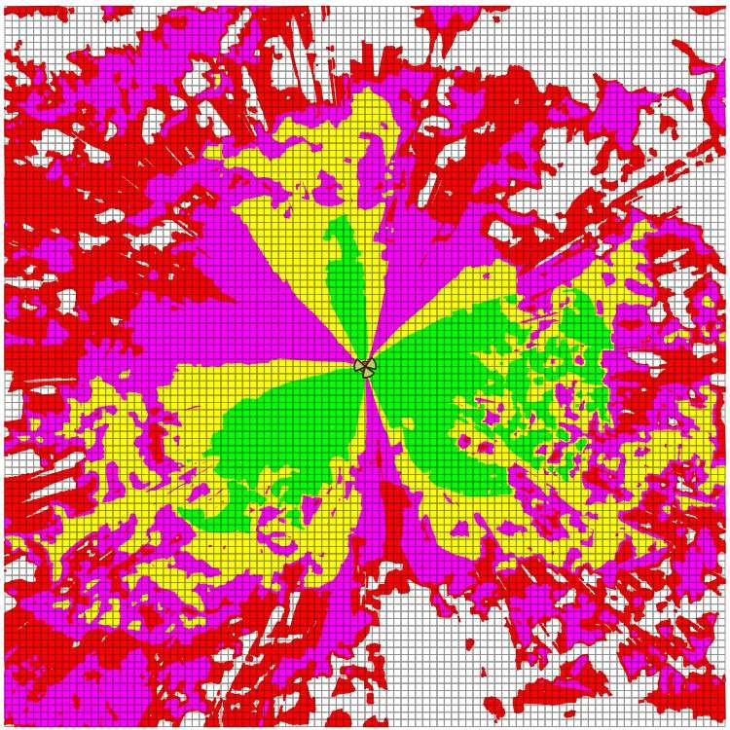

QA & INSPECTION CIRCLE KL
4G PHASE IX.2
eNode-B A/T SCHEDULE
Prediction Plot-RSRQ

Slide 16
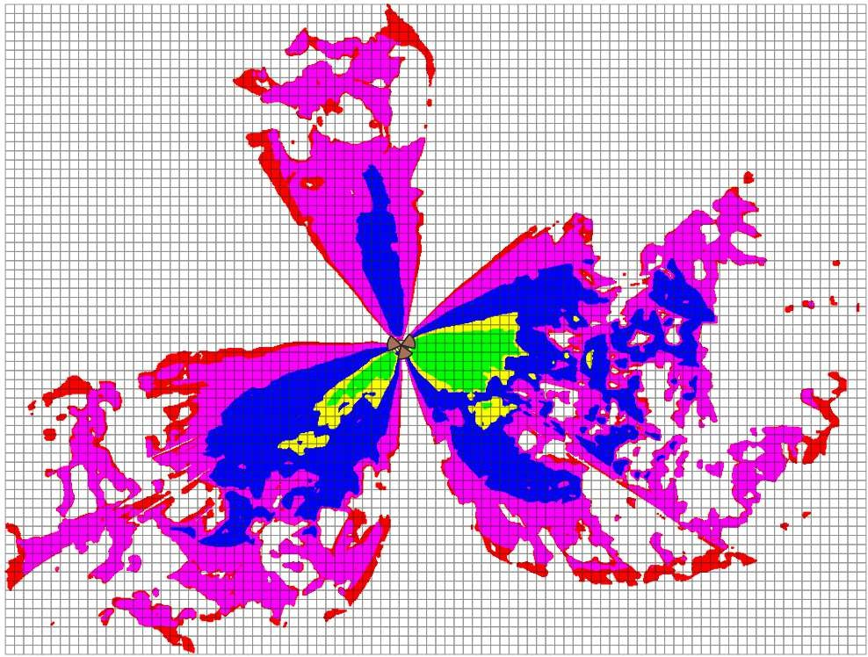

QA & INSPECTION CIRCLE KL
4G PHASE IX.2
eNode-B A/T SCHEDULE
Prediction Plot-SINR

Slide 17
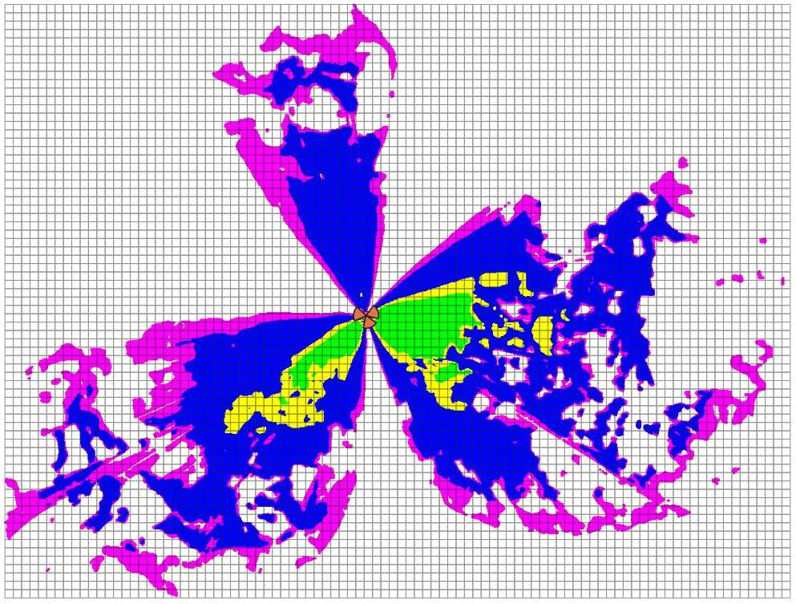

QA & INSPECTION CIRCLE KL
4G PHASE IX.2 eNode-B A/T SCHEDULE
Prediction Plot-DL Throughput

Slide 18
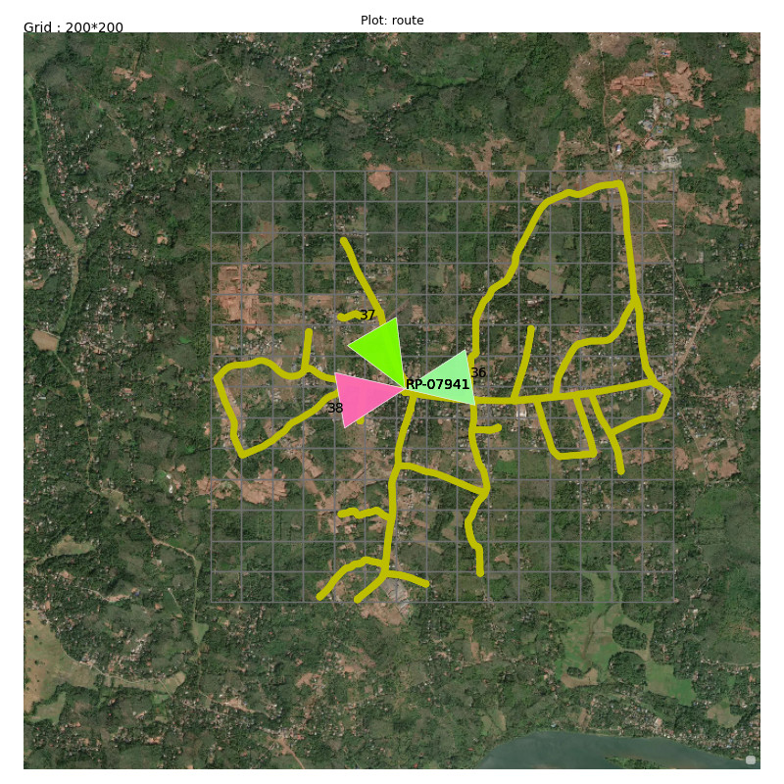
QA & INSPECTION CIRCLE KL
4G PHASE IX.2 eNode-B A/T SCHEDULE
Drive route:
QAIN-11/31(14)/1/2023-CM

Slide 19
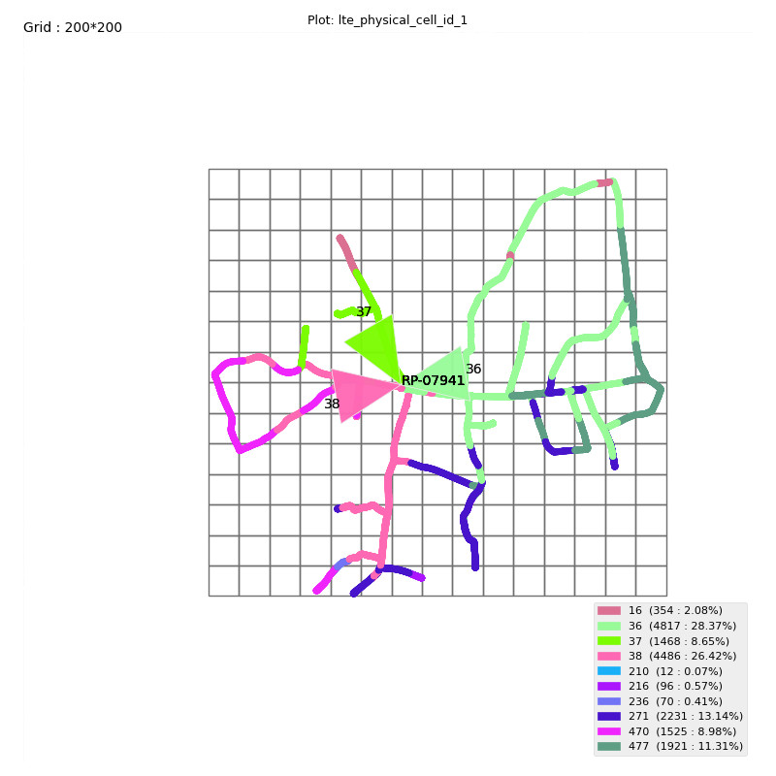
QA & INSPECTION CIRCLE KL
4G PHASE IX.2 eNode-B A/T SCHEDULE
E. Serving PCI Plot
QAIN-11/31(14)/1/2023-CM

Slide 20
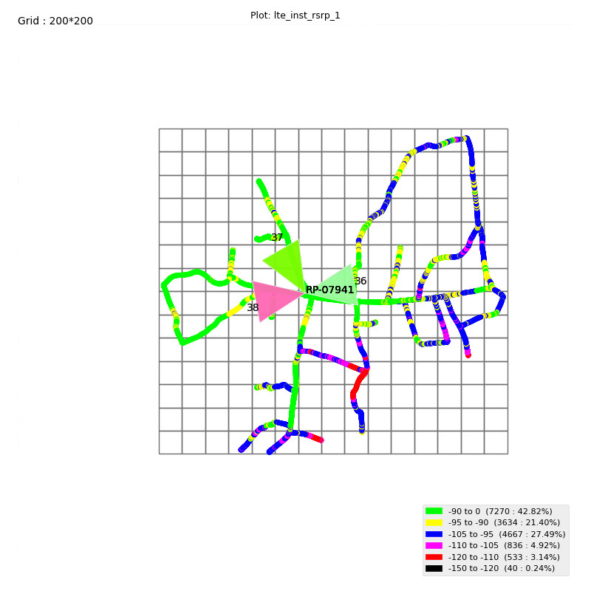
QA & INSPECTION CIRCLE KL
4G PHASE IX.2 eNode-B A/T SCHEDULE
A. RSRP Plot

Slide 21
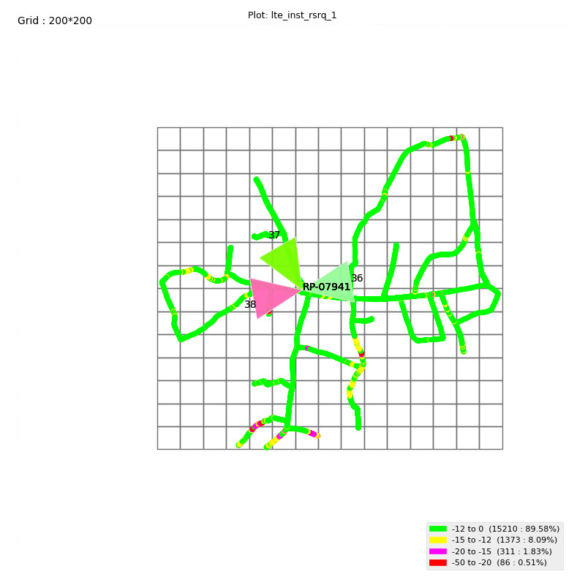
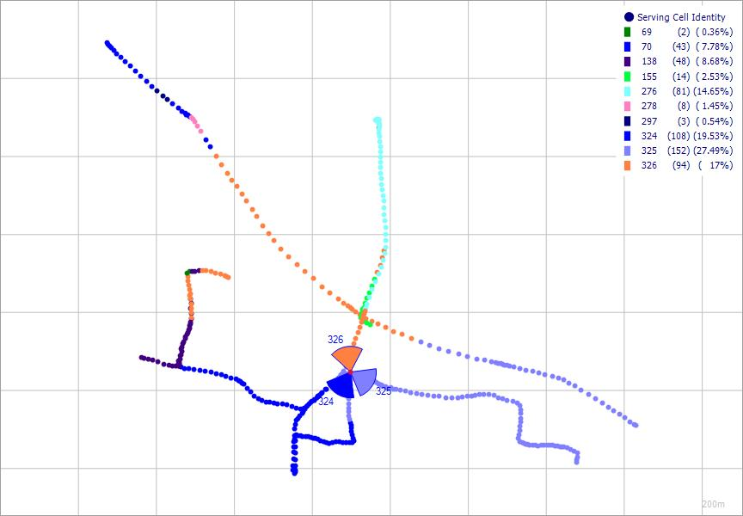
QA & INSPECTION CIRCLE KL
4G PHASE IX.2 eNode-B A/T SCHEDULE
B. RSRQ Plot

Slide 22
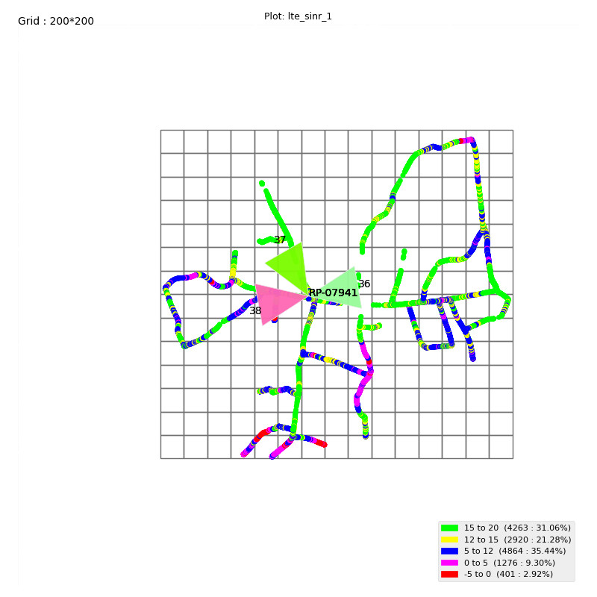
QA & INSPECTION CIRCLE KL
4G PHASE IX.2 eNode-B A/T SCHEDULE
C. SINR Plot
QAIN-11/31(14)/1/2023-CM

Slide 23
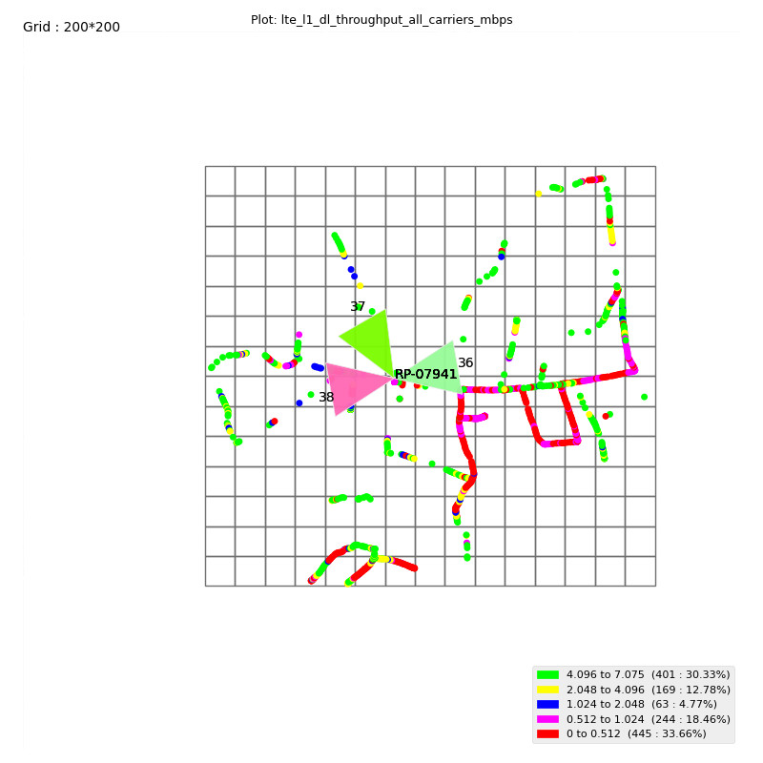
QA & INSPECTION CIRCLE KL
4G PHASE IX.2 eNode-B A/T SCHEDULE
D. DL Throughput plot
QAIN-11/31(14)/1/2023-CM

Slide 24
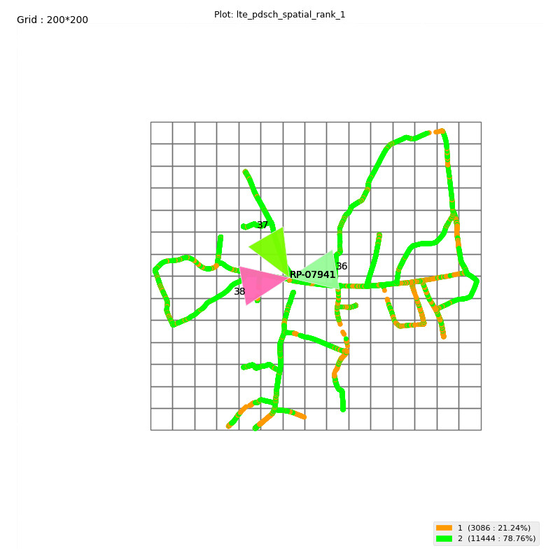
QA & INSPECTION CIRCLE KL
4G PHASE IX.2 eNode-B A/T SCHEDULE
E. Rank Indicator Plot
QAIN-11/31(14)/1/2023-CM

Slide 25
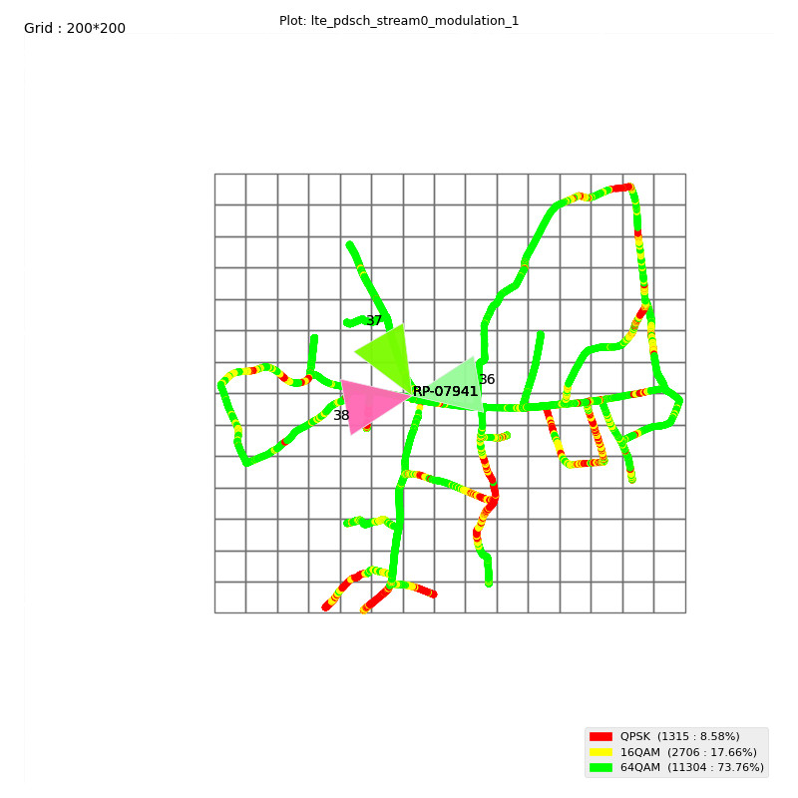
QA & INSPECTION CIRCLE KL
4G PHASE IX.2 eNode-B A/T SCHEDULE
F. Modulation Plot
QAIN-11/31(14)/1/2023-CM

Slide 26
QA & INSPECTION CIRCLE KL
4G PHASE IX.2 eNode-B A/T SCHEDULE
Uplink Performance Data from Drive Results
 | Band 1
Up link | Sector1 | Sector 2 | Sector3
Avg Uplink throughput | 9.37 | 3.25 | 7.05
Maximum Uplink throughput | 12.82 | 6.73 | 11.73
Modulation percentage | Count/Percentage | Count/Percentage | Count/Percentage
64 QAM | 98.96907216 | 0 | 98.31144465
 | 99% | 0% | 98%
16 QAM | 0.171821306 | 90.78694818 | 1.688555347
 | 0% | 91% | 2%
QPSK | 0.859106529 | 9.213051823 | 0
 | 1% | 9% | 0%
TA advance Value of location where test conducted | -77.526 | -81.534 | -74.283
Avg PUSCH Trans Power | 22.09909513 | 31.9265643 | 33.09552819
Ping/Latency Test (ms) | 78.34 | 78.495 | 67.635
QAIN-11/31(14)/1/2023-CM

Slide 27
QA & INSPECTION CIRCLE KL
4G PHASE IX.2 eNode-B A/T SCHEDULE
6. Events Based KPIs
 | Sector 1 | Sector 2 | Sector 3 | Comments
MOC/MTC Voice LTE | Pass | Pass | Pass | 5-MO/MT Successful Calls-All Passed
Call Setup Time – VoLTE | 1607 | 2164.666667 | 2998.666667 | All OK
CSFB to WCDMA/GSM Success | PASS | PASS | PASS | 5-CSFB Call Initiated and All are Successfully at GSM Network-All OK
SMS MO Success LTE | PASS | PASS | PASS | 5 SMS MO-All OK
SMS MT Success LTE | PASS | PASS | PASS | 5 SMS MT-All OK
SMS MO Success Volte | PASS | PASS | PASS | 5 SMS MO-All OK
SMS MT Success Volte | PASS | PASS | PASS | 5 SMS MT-All OK
OTP TESTING LTE | PASS | PASS | PASS | 1 OTP MO-All OK
OTP TESTING Volte | PASS | PASS | PASS | 1 OTP MT-All OK
Attach Success | 100 | 100 | 100 | All OK
 | Sector 1 | Sector 2 | Sector 3
Intra eNB Handover - Sector1 | pass | PASS | PASS | All OK
Intra eNB Handover - Sector2 | PASS | pass | PASS | All OK
Intra eNB Handover - Sector3 | PASS | PASS | pass | All OK
Inter eNB Handover (Intra Freq) | PASS | PASS | PASS | All OK
Inter eNB Handover (Inter Freq) | PASS | PASS | PASS | All OK
Intra eNB Handover (Inter Freq) | NA | NA | NA | All OK
Intra eNB Handover (Inter Freq) | Pass | Pass | Pass | All OK
SRVCC to 2G Handover | NA | NA | NA | All OK
SRVCC to 3G Handover | NA | NA | NA | Still Under Development
IRAT Handover for Data 2G | PASS | PASS | PASS | All OK
IRAT Handover for Data 3G | NA | NA | NA | Wherever applicable
QAIN-11/31(14)/1/2023-CM

Slide 28
QA & INSPECTION CIRCLE KL
4G PHASE IX.2 eNode-B A/T SCHEDULE
2G to 4G Cell Reselection | PASS | PASS | PASS | All OK
3G to 4G Cell Reselection | NA | NA | NA | All OK
4G to 3G Cell Reselection | NA | NA | NA | All OK
4G to 2G Cell Reselection | PASS | PASS | PASS | All OK
4G to 4G Cell Reselection | PASS | PASS | PASS | All OK
FTP Download | PASS | PASS | PASS | All OK
DL Average & Peak Throughput (Mbps) | 19.96 /26.16 | 19.14 /26.28 | 16.05 /27.53 | All OK
FTP Upload | PASS | PASS | PASS | All OK
UL Average & Peak Throughput (Mbps) | 9.37/ 12.82 | 3.25 /6.73 | 7.05/ 11.73 | All OK
The report confirms that Successful bidder/Installer has passed these new site Acceptance Test criteria.
Authorized Signatory
QAIN-11/31(14)/1/2023-CM

