Slide 1

QA & INSPECTION CIRCLE, KERALA
ACCEPTANCE TEST SCHEDULE 4G Phase IX.2 – eNode-B {SCFT MODEL REPORT : C2}
Document No QAIN-11/31(14)/1/2024-CM No of Pages 29 Issue No. 1 Issued By: QA & Inspection, Kerala Approved By: CGM, QA & Inspection Circle Date of Issue: Amendment No (If Any) No of Pages: Issued by: Date of Issue: Restricted use by BSNL Employees only
“FIX IT RIGHT AT THE FIRST INSTANCE”

Slide 2
QA & INSPECTION CIRCLE KL
4G PHASE IX.2 eNode-B A/T SCHEDULE
ACCEPATNCE TEST SCHEDULE FOR eNode-B
1. Details of eNode-B: Cross check with planning document from Local Craft Terminal
/EMS/DTT kit/Engg. Handset/Physical verification.
Type of site: (BSNL/NBSNL/IP): ----NBSNL------------
Lat/Long | 11.99473199/75.4560 2767 | Equipment type: (Macro/Micro/Pico) | Micro | Config: (TDD/FDD)
Project name | BSNL | Site name | {SCFT MODEL REPORT :C2} | Site ID | {SCFT MODEL REPORT :D2}
BA | {SCFT MODEL REPORT :A2} | SDCA / OA | {SCFT MODEL REPORT :B2} | Cell Ids | {SCFT MODEL REPORT:AI1} {SCFT MODEL REPORT :AI2} {SCFT MODEL REPORT :AI3}
Circle name | KERALA | Vendor name | zentix | MIMO Config | 2*2
On Air Date | {SCFT MODEL REPORT:AK2} | A/T Date | -
Site type :(ID/OD) | {SCFT MODEL REPORT :G2} | Site Category: (RTT/RTP/GBT) | {SCFT MODEL REPORT :Q2} | Transmission type: (MW/Fiber/VSAT) | {SCFT MODEL REPORT :T2}
Antenna type /Port (Single Band / Dual Band) (4 / 6 / 8 / 10 Port) | Dual Band | CPRI length | {SCFT MODEL REPORT :AB2}
eNode –B: CAT (A/B/C/D/E/ any other) | {SCFT MODEL REPORT:H2} | Bandwidth (5MHz/ 10MHz /20MHz etc.) | 10Mhz
Sector (Antenna detailsfor the Installed 4G site) | {SCFT MODEL REPORT:N2} {SCFT MODEL REPORT:N3} {SCFT MODEL REPORT:N4} | {SCFT MODEL REPORT:O2} {SCFT MODEL REPORT:O3} {SCFT MODEL REPORT:O4} | {SCFT MODEL REPORT:M2} {SCFT MODEL REPORT:M3} {SCFT MODEL REPORT:M4} | {SCFT MODEL REPORT:J2} {SCFT MODEL REPORT:J3} {SCFT MODEL REPORT:J4}
Sec 1 | 1 | 3 | 50M | 110
Sec 2 | 1 | 3 | 50M | 240
Sec 3 | 1 | 3 | 50M | 350
QAIN-11/31(14)/1/2024-CM

Slide 3
QA & INSPECTION CIRCLE KL
4G PHASE IX.2 eNode-B A/T SCHEDULE
Site ID(IP): | Site Name |  | MME |  | SGW
RP-00553 | {SCFT MODEL REPORT:C2} |  | {SCFT MODEL REPORT:AG2} |  | {SCFT MODEL REPORT:AH2}
SACFA ID (New site)
Equipment configuration | No. of racks (ODC): Mention (Indoor/Outdoor) and Rack/ODC No. of sectors: 3
 | No. of carrier/ sector: Single
 | No. of carrier/ sector: 2
 | No. of Antenna per sector: Single
 | MME Location: Kerala
 | SGW Location: Kerala
Sector No. | Cell ID/PCI | EARFCN |  | TAC
1 | {SCFT MODEL REPORT:K2} | 515 |  | {SCFT MODEL REPORT:L2}
2 | {SCFT MODEL REPORT:K3} | 515 |  | {SCFT MODEL REPORT:L3}
3 | {SCFT MODEL REPORT:K4} | 515 |  | {SCFT MODEL REPORT:L4}
VENDOR
2. Infrastructure provided by: BSNL Capacity/Rating (Please tick appropriate box)
I. Power plant | {SCFT MODEL REPORT:R2}
II. Battery | {SCFT MODEL REPORT:S2}
III. Engine Alternator | NA
IV. Air-conditioning | NA
V. Fire detection system. | BSNL
VI. Tower | {SCFT MODEL REPORT:Q2}
VII. Earthing | {SCFT MODEL REPORT:AC2}
VIII. Media | MW
IX. Shelter (for Indoor eNode-B) | {SCFT MODEL REPORT:AD2}
X. Microwave | OFC
XI. Outdoor UPS with Li-ion | 4 Hrs

Slide 4
QA & INSPECTION CIRCLE KL
4G PHASE IX.2 eNode-B A/T SCHEDULE
Wideband-AMR (HD-voice) enabled: - Pass (AMR-WB 12.65Kbps)
Sector | Codec
1 | AMR-WB 12.65Kbps
2 | AMR-WB 12.65Kbps
3 | AMR-WB 12.65Kbps

Slide 5

QA & INSPECTION CIRCLE KL
4G PHASE IX.2 eNode-B A/T SCHEDULE
Test results as per QA & Inspection Circle latest test schedule (In case infra provided by vender).
For BSNL deliverables, BSNL has to submit a sufficiency certificate for existing infra and in case of new infra, it has to be tested as per approved test schedule.
PART – A: INFRASTRUCTURE TEST
S.No | TEST DESCRIPTION | REFERENCE / PROCEDURE | REMARK
1 | Check of documentation. | Hard/Soft copy as per PO. | NA
2 | Check QA certificate. | QA certificate to be submitted. BBU, RRH and ODC serial no. as per release report. | {SCFT MODEL REPORT:AB2} {SCFT MODEL REPORT:AA2} {SCFT MODEL REPORT:AA3}
3 | Location, Alignment & Rigidity (LAR). | As per approved plan. | {SCFT MODEL REPORT:E2} {SCFT MODEL REPORT:F2}
4 | Check for protection from lightning /accidental high voltage/ induced high power for power plant and outdoor eNode-B. | Lightning protector earth continuity should be checked. | Protection- OK Lightening Arrester to earth and equipment’s earth continuity checked
5 | Check the electrical tilt of the antenna. | Yes | OK
6 | Check for site Earthing and connectivity with BBU and RRH etc. | Use Megger for measuring the earth’s resistance value. The value of earth to be measured and the same shall be indicated irrespective of whether the earth was provided by the supplier or not. Earth resistance value should be .5 Ohm. | Tested Earth value = 0.3 Ohms and Equipment’s, tower earth Continuity checked Ok.

Slide 6
QA & INSPECTION CIRCLE KL
4G PHASE IX.2 eNode-B A/T SCHEDULE
PART-B: SYSTEM TEST
1. System Related Test: (As per planning document)
S.No | TEST DESCRIPTION | REFERENCE / PROCEDURE | REMARK
1.1 | Hardware conformity check. | Verify the HW details as deployed on the site. As per vetted BoM. | {SCFT MODEL REPORT:AF2} {SCFT MODEL REPORT:AE2} {SCFT MODEL REPORT:AF2} {SCFT MODEL REPORT:AC2}
1.2 | eNode-B software version. | SW version to be filled from EMS and should be as per document approved by the planning wing. | {SCFT MODEL REPORT:AI2}
1.3 | Check EMS integration. | OK/NOK | OK
1.4 | Check integration with SON. | OK/NOK | OK
 | Transport - related information. Connection type, quantity and its capacity: |  | NA
1.5 | a. Microwave | Provide the MW make and Model details. | MW
 | b. Integrated Transport Module (CEF12/CEF12T) | BBU OD with TX Card (CEF12T) | 10 Ge Optical / 1-4-2
 | Port type-1G/10G/E1/FE No. of Ports-1G/10G/E1/FE | Optical port used-1G (P1) 2/2/4/1
1.6 | MME and SGW IP address. | {SCFT MODEL REPORT:AL2} | Ping test to MME and SGW OK
1.7 | eNode-B details (TX). | Electrical / Optical | Optical
1.7.1 | IP details (Table to be plugged in w.r.t. IP, VLAN including GW). | CEF: RAC: S1C: S1U: | {SCFT MODEL REPORT:AH2} {SCFT MODEL REPORT:AJ2} {SCFT MODEL REPORT:AL2} {SCFT MODEL REPORT:AM2}
eNode-B status check from Access Point:
A/T procedure:
Check the visual alarm (LED) indication on all cards. All LEDs should show a healthy condition.

Slide 7
QA & INSPECTION CIRCLE KL
4G PHASE IX.2 eNode-B A/T SCHEDULE
Connect a Laptop with Control Card through RJ45/Console port. (CEF will be accessible through RJ 45 and RAC through Console Port (Diag cable).
Login through eNode-B Maintenance Tool (Like LMT)/CLI.
Check the working status of all cards by LMT/CLI. All cards should be healthy.
Expected Results: | Status | OK/NOK
i | OK | OK
ii | OK | OK
iii | OK | OK
iv | OK | OK
2. Installation, cabling and marking: All cabling should be done by straight wire without having any joint in between. Marking should be at both ends to identify the cable as per documentation and correlate both ends.
CHECK | STATUS (OK/NOK) | REMARK
Check the installation and cabling, crimping of cable and iron work of the eNode-B. | OK
Check of proper laying of CPRI & its termination / RF connectors & sealing of CPRI cable. | OK
Labelling of CPRI. | OK
CPRI Details. | Make: | Size: 80M
Data Rate/CPRI. | 1.2GBPS per CPRI/Huber + Suhnu
3. Power Measurement:
CHECK | STATUS (OK/NOK) | REMARK
Polarity and labelling of power cables. | OK | Good
Measure the voltage at battery point. | OK | 52.24 V
Measure input voltage to ODC. | OK | 52.7 V
Calculate voltage drop (Between Battery terminal & eNode-B). | OK | Should be less than 1V 0.2
Functional & Service Related Test:
eNode-B restart test.
Test procedure (Hardware reset and Power reset):
Check for eNode-B recovery after switching off the power supply to eNode-B.
Check for eNode-B recovery after hardware reset.

Slide 8
QA & INSPECTION CIRCLE KL
4G PHASE IX.2 eNode-B A/T SCHEDULE
The eNode-B should come up and the status of the site should be same as what was before the reset.
Expected Results: | Status | OK/NOK
i | 5 TO 10 Minute | 10 Min
ii | 5 TO 10 Minute | 10 Min
Check for the related alarm on OMC-R /LMT Log-in.
Check for Wideband-AMR (HD-voice) enabled. Yes
Check of Clock synchronization ( as per planning document)
: OK
Synchronization type : GPS Clock
5.
6.
Outdoor eNode-B: Fan Cooling Unit operational status. (OK / NOK)-OK
System alarm test: Generation of alarms for power failure/ media failure/
fan failure alarm by manually switching off or unplugging module. -OK
7. Transmit Power Outputs: Configured power to be checked through EMS.
Integrated module (for RRH type): Check TX power of eNode-B using LMT.
Sector –0 |  | Sector –1 |  | Sector –2
46 |  | 46 |  | 46
8.
VSWR Measurements:
Check feeder grounding is done properly, if applicable. Status (OK/Not:- OK)
i. Measure the VSWR values of each sector (<=1.3). Measurement can be done through LMT/EMS/NMS/CLI.
Antennas & Cables | VSWR | Antennas & Cables | VSWR
Sector 0 Main | 1.10 | Sector 0 Div | 1.10
Sector 1 Main | 1.11 | Sector 1 Div | 1.12
Sector 2 Main | 1.12 | Sector 2 Div | 1.11

Slide 9
QA & INSPECTION CIRCLE KL
4G PHASE IX.2 eNode-B A/T SCHEDULE
9. 4G services to be tested in all sectors.
I. | VoLTE/ CSFB/ SRVCC/eSRVCC /Fast return to LTE– O/G and I/C call :
II. | ViLTE : Under Discussion
III. | DATA, Video and Audio Streaming/Web Browsing : Pass
IV. | SMS, USSD : Pass, NA
V. | Emergency call (112) : Pass
VI. | LBS services : Under Discussion
VII. | Cell Broadcast on handset.: Under Discussion
VIII. | Check NB-IoT / M2M service : Under Discussion
Sec 1 | OK
Sec 2 | OK
Sec 3 | OK
10. Calls for Handover (4G to 4G)
Intra Enb Handover Call
 | Sector -1 | Sector -2 | Sector-3
Intra eNB Handover - Sector 1 | -pass | Pass | pass
Intra eNB Handover - Sector 2 | Pass | pass | Pass
Intra eNB Handover - Sector 3 | Pass | Pass | Pass
Inter eNB Handover | Pass | Pass | Pass

Slide 10
QA & INSPECTION CIRCLE KL
4G PHASE IX.2 eNode-B A/T SCHEDULE
11.
External alarm tests:
Vendor is responsible in all types of sites (NBSNL, IP and BSNL) for extending external alarm termination from eNode-B to the nearest KRONE- box. For eNode-B A/T external alarm generation may be verified from the KRONE box.
In the case of sites where infra items are supplied by the vendor, the vendor should extend external alarms from elements like PP/Bty etc all the way to eNode-B.
Alarm cables are punched firmly and correctly. Status (OK/NOK)
List of External alarms to be extended–
1. AC Main Fail | OK | Actual
2. DG on Load | OK | Actual
3. Diesel Low (below a threshold level) | OK | Actual
4. High Temperature | OK | Actual
5. eNode-B Battery Low (Voltage of the battery bank below a threshold level) | OK | Actual
6. Cabin Door Open | OK | Actual
7. DG Battery Low (Voltage of the battery of the DG set below a threshold level | OK | Actual
8. Fire | OK | Actual

Slide 11
QA & INSPECTION CIRCLE KL
4G PHASE IX.2 eNode-B A/T SCHEDULE
PART C: COVERAGE TEST
The vendor shall carry out the simulation of coverage and generate prediction maps of the cities with the existing and identified sites to be specified by the purchaser. The supplier shall indicate additional locations, if any, required to meet the coverage requirements of the purchaser. The prediction map so generated and agreed upon shall form the basis for acceptance testing of the coverage.
Prior requisite to start coverage test:
Basic calls / messages / data may be checked. Geographical clusters and size of cluster may be finalized by the Circle RF Planning teams in consultation with the vendor.
Link budget should be submitted for all bands as mentioned in the PO & DTR.
Coverage A/T should cover all sectors of the sites included in the cluster and plots may be prepared cluster wise. Event based KPIs may be performed as static tests for each of the sectors and cell wise statistics may also be submitted as part of the A/T reports along with cluster wise plots and KPI statistics.
80% [minimum] of technology-specified throughput shall be demonstrated in field drive tests as applicable.
The coverage A/T reports submitted by the vendor should be evaluated & approved by the BA
/ Circle RF teams after ensuring that suitable measures to improve the QoS are incorporated, in case issues are identified during A/T.
Drive Test Results: The following drive test results plots are prepared.
RSRP Plot (As per Prediction Plot)
RSRQ Plot
SINR Plot
DL Throughput plot
The plot indicates the coverage parameters marked by different colours for different levels e.g. Excellent, Good, Poor etc.
Results
Pass
Remark
Pass
Fail
Passing criteria as per approved prediction plot by BSNL RF planning teams for RSRP, RSRQ, SINR, DL & UL Throughput. Colour legends (Green, Yellow, and Red etc.) for different levels of respective coverage parameters to be decided by planning in consultation with the vendor.

Slide 12
QA & INSPECTION CIRCLE KL
4G PHASE IX.2 eNode-B A/T SCHEDULE
2. Physical site information.
Circle | SSA | City | eNodeB Name | Site ID | Cell ID | Site Name | Lat | Long | Orientation | M-
 |  | /Town |  |  |  |  |  |  |  | Tilt
KERALA | {SCFT MODEL REPORT:A2} | KANNUR | {SCFT MODEL REPORT:AP2} | {SCFT MODEL REPORT:C2} | {SCFT MODEL REPORT:AQ2} | {SCFT MODEL REPORT : C2} | {SCFT MODEL REPORT:E2} | {SCFT MODEL REPORT:F2} | {SCFT MODEL REPORT:J2} | {SCFT MODEL REPORT:N2}
KERALA | KNR | KANNUR | {SCFT MODEL REPORT:AP3} | {SCFT MODEL REPORT:C3} | {SCFT MODEL REPORT:AQ3} | {SCFT MODEL REPORT : C3} | {SCFT MODEL REPORT:E2} | {SCFT MODEL REPORT:F2} | {SCFT MODEL REPORT:J3} | {SCFT MODEL REPORT:N2}
KERALA | KNR | KANNUR | {SCFT MODEL REPORT:AP4} | {SCFT MODEL REPORT:C4} | {SCFT MODEL REPORT:AQ4} | {SCFT MODEL REPORT : C4} | {SCFT MODEL REPORT:E2} | {SCFT MODEL REPORT:F2} | {SCFT MODEL REPORT:J4} | {SCFT MODEL REPORT:N2}
3. Technical site information
.

Slide 13
eNodeB Name | eNode B Cell name | eNode B ID | eNode B Cell ID | Sector Id | TAC | PCI | RSI | RS Power | EUARFCN UL | EUARFCN DL | Neighbour Verified and Corrected from EMS including X2
 |  |  |  |  |  |  |  |  |  |  | 4G-4G | 4G-3G/4G-2G
{SCFT MODEL REPORT:AP2} | {SCFT MODEL REPORT:AP2} | {SCFT MODEL REPORT:AR2} | 674886-0 | 0 | {SCFT MODEL REPORT:L2} | {SCFT MODEL REPORT:K2} | {SCFT MODEL REPORT:AT2} | {SCFT MODEL REPORT:AU2} | 18515 | 515
{SCFT MODEL REPORT:AP2} | {SCFT MODEL REPORT:AP2} | 674886 SCFT MODEL REPORT:AR2} | 674886-1 | 1 | {SCFT MODEL REPORT:L2} | {SCFT MODEL REPORT:K3} | {SCFT MODEL REPORT:AT3} | {SCFT MODEL REPORT:AU3} | 18515 | 515
{SCFT MODEL REPORT:AP2} | {SCFT MODEL REPORT:AP2} | 674886 SCFT MODEL REPORT:AR2} | 674886-2 | 2 | {SCFT MODEL REPORT:L2} | {SCFT MODEL REPORT:K4} | {SCFT MODEL REPORT:AT4} | {SCFT MODEL REPORT:AU4} | 18515 | 515

Slide 14
QA & INSPECTION CIRCLE KL
4G PHASE IX.2 eNode-B A/T SCHEDULE
4. Drive test procedure
The Drive Test will be done with NEMO/TEMS/X-CAL with Calibrated Mobiles. The phones will be in the following modes
Device | Type of Call | Operator Name | Mode | Comment
MS1 | Volte Call Short | BSNL | LTE | YES ( 30 s interval /5s hold )
MS2 | Volte Call Long | BSNL | LTE | YES
MS3 | Data Download | BSNL | LTE | YES

Slide 15
QA & INSPECTION CIRCLE KL
4G PHASE IX.2 eNode-B A/T SCHEDULE
5. Drive test plots Prediction Plot-RSRP
{Drive route:IMG}

Slide 16
QA & INSPECTION CIRCLE KL
4G PHASE IX.2 eNode-B A/T SCHEDULE
Prediction Plot-RSRQ
{Prediction Plot-RSRP:IMG}

Slide 17
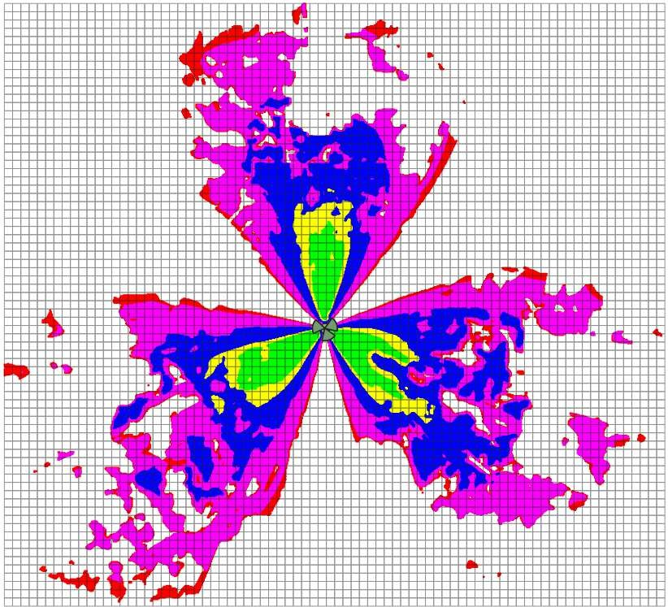


QA & INSPECTION CIRCLE KL
4G PHASE IX.2 eNode-B A/T SCHEDULE
Prediction Plot-SINR

Slide 18
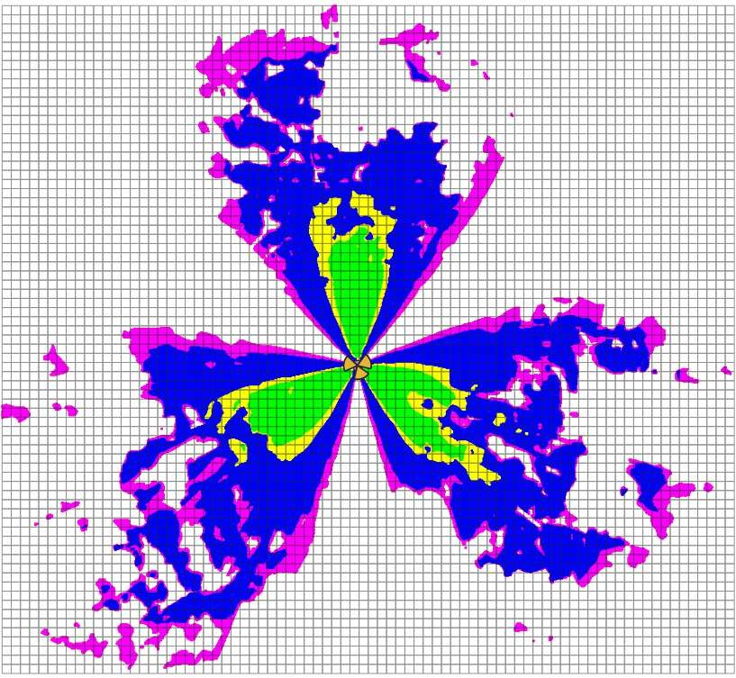

QA & INSPECTION CIRCLE KL
4G PHASE IX.2 eNode-B A/T SCHEDULE
Prediction Plot-DL Throughput

Slide 19
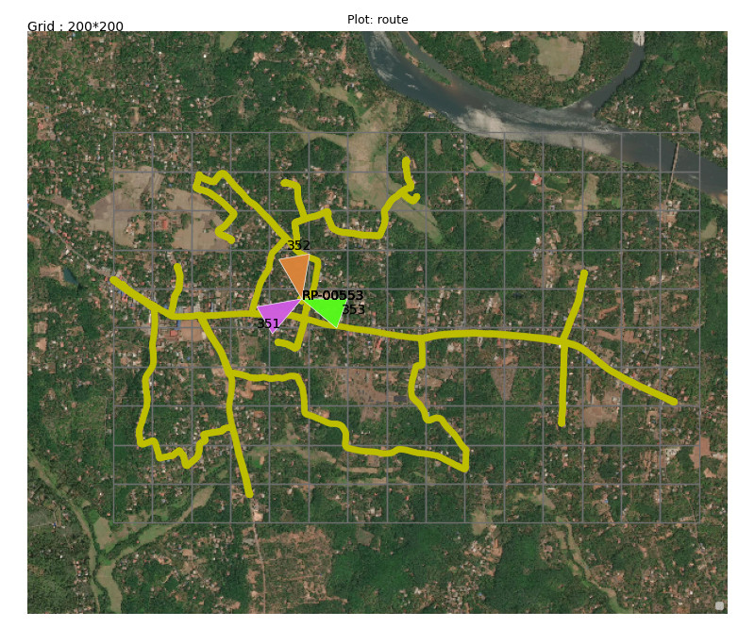
QA & INSPECTION CIRCLE KL
4G PHASE IX.2 eNode-B A/T SCHEDULE
Drive route:
QAIN-11/31(14)/1/2023-CM

Slide 20
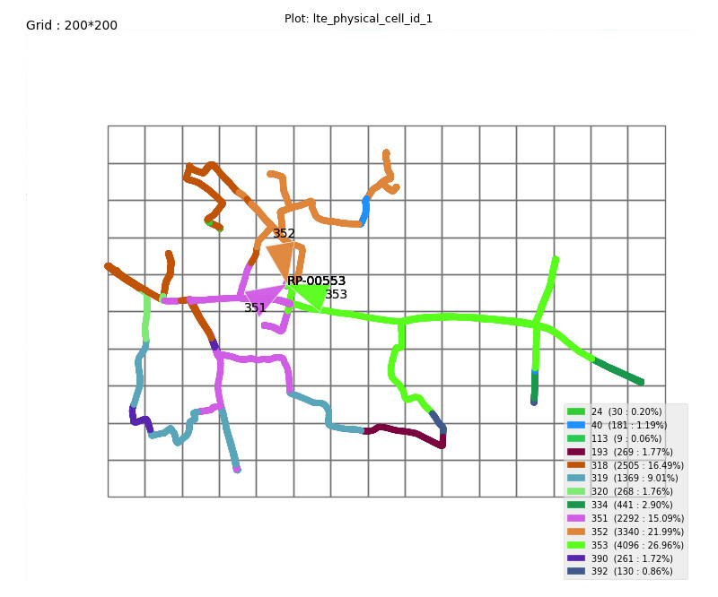
QA & INSPECTION CIRCLE KL
4G PHASE IX.2 eNode-B A/T SCHEDULE
E. Serving PCI Plot
200*200
QAIN-11/31(14)/1/2023-CM

Slide 21
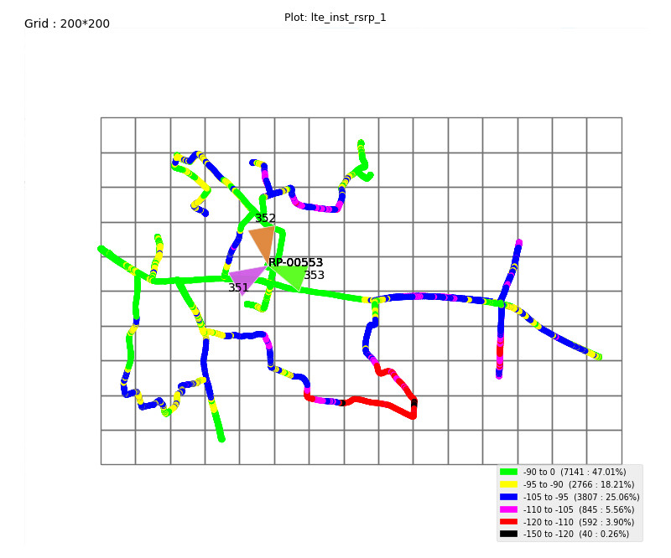
QA & INSPECTION CIRCLE KL
4G PHASE IX.2 eNode-B A/T SCHEDULE
A. RSRP Plot
200*200

Slide 22
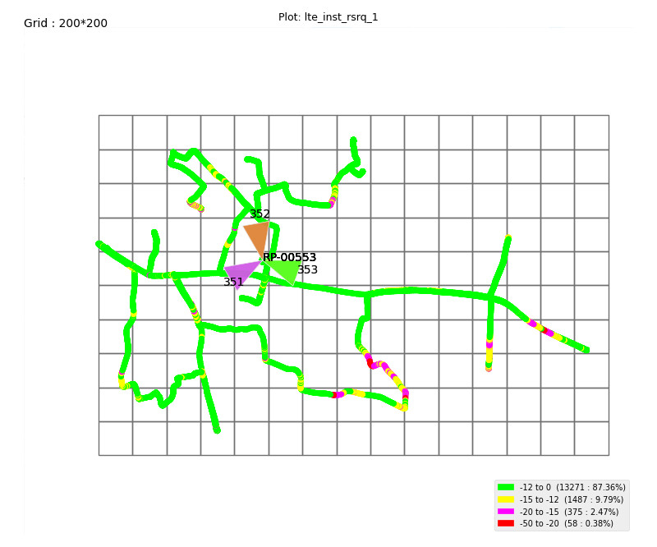
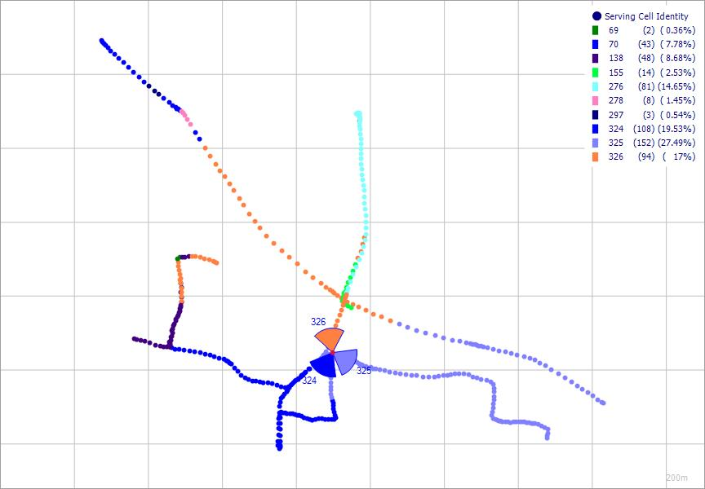
QA & INSPECTION CIRCLE KL
4G PHASE IX.2 eNode-B A/T SCHEDULE
B. RSRQ Plot
200*200

Slide 23
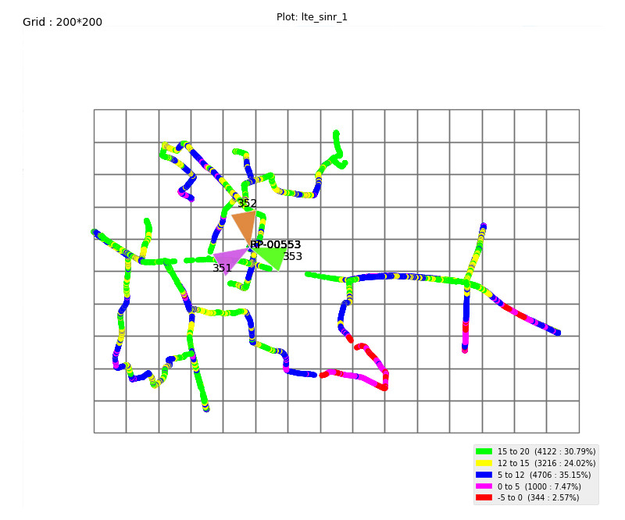
QA & INSPECTION CIRCLE KL
4G PHASE IX.2 eNode-B A/T SCHEDULE
C. SINR Plot
200*200
QAIN-11/31(14)/1/2023-CM

Slide 24
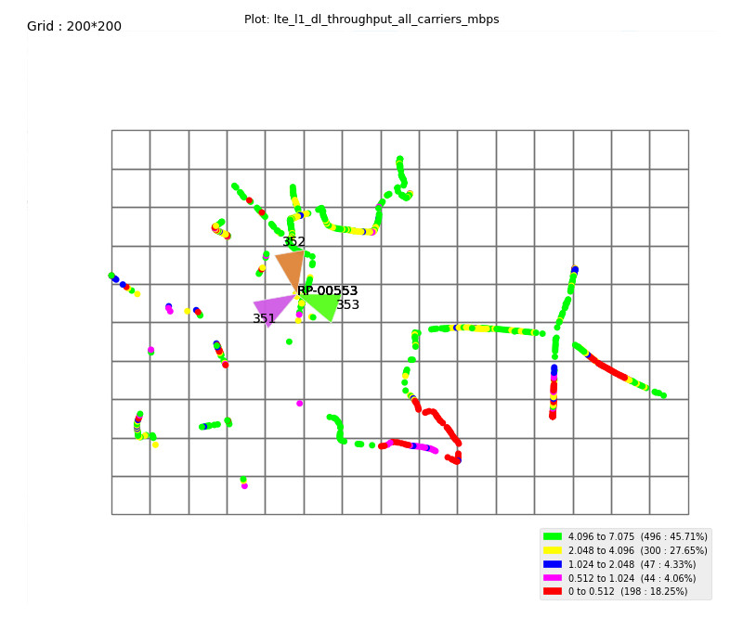
QA & INSPECTION CIRCLE KL
4G PHASE IX.2 eNode-B A/T SCHEDULE
D. DL Throughput plot
200*200
QAIN-11/31(14)/1/2023-CM

Slide 25
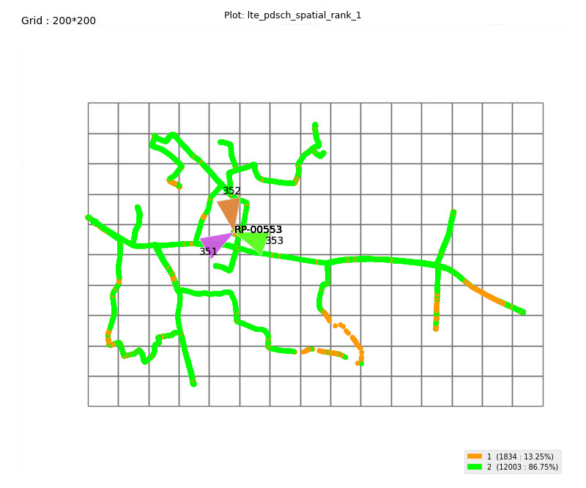
QA & INSPECTION CIRCLE KL
4G PHASE IX.2 eNode-B A/T SCHEDULE
E. Rank Indicator Plot
200*200
QAIN-11/31(14)/1/2023-CM

Slide 26
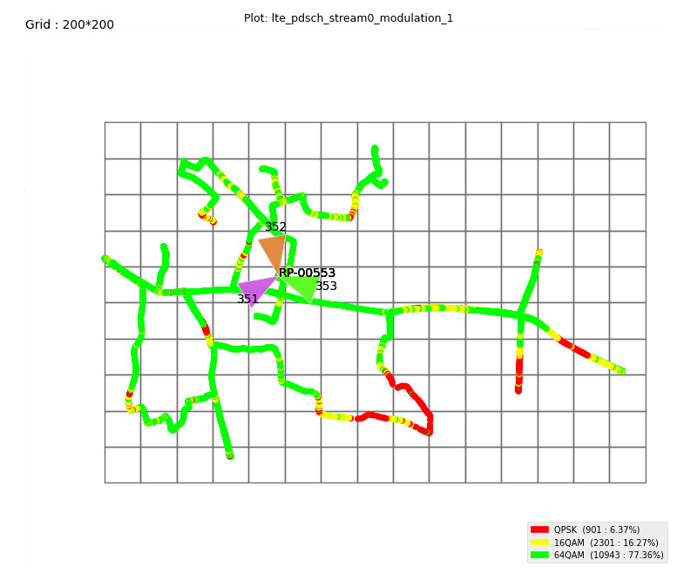
QA & INSPECTION CIRCLE KL
4G PHASE IX.2 eNode-B A/T SCHEDULE
F. Modulation Plot
200*200
QAIN-11/31(14)/1/2023-CM

Slide 27
Uplink Performance Data from Drive Results
QA & INSPECTION CIRCLE KL
4G PHASE IX.2 eNode-B A/T SCHEDULE
 | Band 21
Up link | Sector1 | Sector 2 | Sector3
Avg Uplink throughput | {SCFT MODEL REPORT:AZ2} | {SCFT MODEL REPORT:AZ3} | {SCFT MODEL REPORT:AZ4}
Maximum Uplink throughput | {SCFT MODEL REPORT:BA2} | {SCFT MODEL REPORT:BA3} | {SCFT MODEL REPORT:BA4}
Modulation percentage | Count/Percentage | Count/Percentage | Count/Percentage
64 QAM | 100 | 91.53713299 | 95.87628866
 | {SCFT MODEL REPORT:BB2} | {SCFT MODEL REPORT:BB3} | {SCFT MODEL REPORT:BB4}
16 QAMCOLUM AT | 0 | 7.772020725 | 3.951890034
 | {SCFT MODEL REPORT:BC2} | {SCFT MODEL REPORT:BC3} | {SCFT MODEL REPORT:BC4}
QPSK | 0 | 0.690846287 | 0.171821306
 | {SCFT MODEL REPORT:BE2} | {SCFT MODEL REPORT:BE3} | {SCFT MODEL REPORT:BE4}
TA advance Value of location where test conducted COLUM AW | {SCFT MODEL REPORT:BF2} | {SCFT MODEL REPORT:BF3} | {SCFT MODEL REPORT:BF4}
Avg PUSCH Trans Power | 32.73838154 | 25.00432628 | 28.51565597
Ping/Latency Test (ms) COLUM AY | 77.61 | 74.995 | 65.38
QAIN-11/31(14)/1/2023-CM

Slide 28
 | Band 21
Up link | Sector1 | Sector 2 | Sector3
Avg Uplink throughput | {SCFT MODEL REPORT:AZ2} | {SCFT MODEL REPORT:AZ3} | {SCFT MODEL REPORT:AZ4}
Maximum Uplink throughput | {SCFT MODEL REPORT:BA2} | {SCFT MODEL REPORT:BA3} | {SCFT MODEL REPORT:BA4}
Modulation percentage | Count/Percentage | Count/Percentage | Count/Percentage
64 QAM | 100 | 91.53713299 | 95.87628866
 | {SCFT MODEL REPORT:BB2} | {SCFT MODEL REPORT:BB3} | {SCFT MODEL REPORT:BB4}
16 QAMCOLUM AT | 0 | 7.772020725 | 3.951890034
 | {SCFT MODEL REPORT:BC2} | {SCFT MODEL REPORT:BC3} | {SCFT MODEL REPORT:BC4}
QPSK | 0 | 0.690846287 | 0.171821306
 | {SCFT MODEL REPORT:BE2} | {SCFT MODEL REPORT:BE3} | {SCFT MODEL REPORT:BE4}
TA advance Value of location where test conducted COLUM AW | {SCFT MODEL REPORT:BF2} | {SCFT MODEL REPORT:BF3} | {SCFT MODEL REPORT:BF4}
Avg PUSCH Trans Power | {SCFT MODEL REPORT:BG2} | {SCFT MODEL REPORT:BG3} | {SCFT MODEL REPORT:BG4}
Ping/Latency Test (ms) COLUM AY | {SCFT MODEL REPORT:BI2} | {SCFT MODEL REPORT:BI3} | {SCFT MODEL REPORT:BI4}

Slide 29
QA & INSPECTION CIRCLE KL
4G PHASE IX.2 eNode-B A/T SCHEDULE
6. Events Based KPIs
 | Sector 1 | Sector 2 | Sector 3 | Comments
MOC/MTC Voice LTE | Pass | Pass | Pass | 5-MO/MT Successful Calls-All Passed
Call Setup Time – VoLTE | {SCFT MODEL REPORT:BJ2} | {SCFT MODEL REPORT:BJ3} | {SCFT MODEL REPORT:BJ4} | All OK
CSFB to WCDMA/GSM Success | PASS | PASS | PASS | 5-CSFB Call Initiated and All are Successfully at GSM Network-All OK
SMS MO Success LTE | PASS | PASS | PASS | 5 SMS MO-All OK
SMS MT Success LTE | PASS | PASS | PASS | 5 SMS MT-All OK
SMS MO Success Volte | PASS | PASS | PASS | 5 SMS MO-All OK
SMS MT Success Volte | PASS | PASS | PASS | 5 SMS MT-All OK
OTP TESTING LTE | PASS | PASS | PASS | 1 OTP MO-All OK
OTP TESTING Volte | PASS | PASS | PASS | 1 OTP MT-All OK
Attach Success | 100 | 100 | 100 | All OK
 | Sector 1 | Sector 2 | Sector 3
Intra eNB Handover - Sector1 | pass | PASS | PASS | All OK
Intra eNB Handover - Sector2 | PASS | pass | PASS | All OK
Intra eNB Handover - Sector3 | PASS | PASS | pass | All OK
Inter eNB Handover (Intra Freq) | PASS | PASS | PASS | All OK
Inter eNB Handover (Inter Freq) | PASS | PASS | PASS | All OK
Intra eNB Handover (Inter Freq) | NA | NA | NA | All OK
Intra eNB Handover (Inter Freq) | Pass | Pass | Pass | All OK
SRVCC to 2G Handover | NA | NA | NA | All OK
SRVCC to 3G Handover | NA | NA | NA | Still Under Development
IRAT Handover for Data 2G | PASS | PASS | PASS | All OK
IRAT Handover for Data 3G | NA | NA | NA | Wherever applicable
QAIN-11/31(14)/1/2023-CM

Slide 30
QA & INSPECTION CIRCLE KL
4G PHASE IX.2 eNode-B A/T SCHEDULE
2G to 4G Cell Reselection | PASS | PASS | PASS | All OK
3G to 4G Cell Reselection | NA | NA | NA | All OK
4G to 3G Cell Reselection | NA | NA | NA | All OK
4G to 2G Cell Reselection | PASS | PASS | PASS | All OK
4G to 4G Cell Reselection | PASS | PASS | PASS | All OK
FTP Download | PASS | PASS | PASS | All OK
DL Average & Peak Throughput (Mbps) | {SCFT MODEL REPORT:BK2} | {SCFT MODEL REPORT:BK3} | {SCFT MODEL REPORT:BK4} | All OK
FTP Upload | PASS | PASS | PASS | All OK
UL Average & Peak Throughput (Mbps) | {SCFT MODEL REPORT:BL2} | {SCFT MODEL REPORT:BL3} | {SCFT MODEL REPORT:BL4} | All OK
The report confirms that Successful bidder/Installer has passed these new site Acceptance Test criteria.
Authorized Signatory
QAIN-11/31(14)/1/2023-CM

