Slide 1



Alejandro Espinosa
Jose Ángel Pardo
@Alex__ESP
@josegury

Slide 2
¿Qué es?
Framework de desarrollo.
Sencillo y potente sistema de Data Binding.
Basado en JavaScript.
Mantenido por Google.

Slide 3
¿Para qué sirve?
Gestionar aplicaciones web de una sola página.
Extender HTML.
Servir contenido dinámico.
Aumentar las aplicaciones basadas en navegador.

Slide 4
Características de AngularJS
Modelo Vista – Controlador.
Modularización de las aplicaciones.
Inyección de dependencias.
Construcción de componentes y/o modificación de comportamiento mediante directivas.
Compatible con otras librerías.

Slide 5
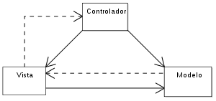
Patrón MVC
//Model
$scope.files = [‘foo’, ‘bar’, ‘baz’];
<!-- View: HTML -->
<div ng-repeat=”f in files”></div>
//Controller
function addFile(fileName){
$scope.files.push(fileName);
}

Slide 6
Directivas
<html ng-app=“myApp”>
</html>

Slide 7
Directivas
<html ng-app=“myApp”>
<body ng-controller=“myController”>
</body>
</html>

Slide 8
Controladores
<html ng-app=“myApp”>
<body ng-controller=“myController”>
<div ng-controller=“subController">
<button ng-click=“btn1()">Boton 1</button>
<button ng-click=“btn2()">Boton 2</button>
<p>Boton pulsado: {{que_boton}}</p>
</div>
</body>
</html>

Slide 9
Controladores
angular.module('myApp.controllers', [])
.controller(‘subController', [ '$scope' , function($scope){
$scope.click1 = function(){
$scope.que_boton = “Boton 1”
}
$scope.click2 = function(){
$scope.que_boton = “Boton 2”
}
}]);

Slide 10
Filtros
<label> buscar </label>
<input type="search" ng-model="busqueda" >
<p ng-repeat = " persona in agenda | filter: busqueda ">
{{persona .name }} : {{persona .phone }}
</p>

Slide 11
Filtros
<label> buscar </label>
<input type="search" ng-model="busqueda" >
<p ng-repeat = " persona in agenda | filter: busqueda ">
{{persona .name }} : {{persona .phone }}
</p>

Slide 12
Filtros
<label> buscar </label>
<input type="search" ng-model="busqueda" >
<p ng-repeat = " persona in agenda | filter: busqueda ">
{{persona .name }} : {{persona .phone }}
</p>
<p>{{message | toUpperCase}}</p>

Slide 13
Data Binding
<label> buscar </label>
<input type="search" ng-model="busqueda" >
<p ng-repeat = " persona in agenda | filter: busqueda ">
{{persona .name }} : {{persona .phone }}
</p>

Slide 14
Data Binding
<label> buscar </label>
<input type="search" ng-model="busqueda" >
<p ng-repeat = " persona in agenda | filter: busqueda ">
{{persona .name }} : {{persona .phone }}
</p>

Slide 15
Data Binding
<label> buscar </label>
<input type="search" ng-model="busqueda" >
<p ng-repeat = " persona in agenda | filter: busqueda ">
{{persona .name }} : {{persona .phone }}
</p>
angular.module('myApp.controllers',[]).controller('indexCtrl',['$scope',function($scope){
var listPhone=[
{name:'Jose', phone:'123465789'},
{name:'Angel', phone:'987654321'},
{name:'Alejandro', phone:'159357825'},
{name:'Pepe', phone:'414789963'},
{name:'Juan', phone:'142365478'},
{name:'Juliette', phone:'987654321'}
];
$scope.agenda=listPhone;
}]);

Slide 16
Data Binding
<label> buscar </label>
<input type="search" ng-model="busqueda" >
<p ng-repeat = " persona in agenda | filter: busqueda ">
{{persona .name }} : {{persona .phone }}
</p>
angular.module('myApp.controllers',[]).controller('indexCtrl',['$scope',function($scope){
$scope.agenda =[
{name:'Jose', phone:'123465789'},
{name:'Angel', phone:'987654321'},
{name:'Alejandro', phone:'159357825'},
{name:'Pepe', phone:'414789963'},
{name:'Juan', phone:'142365478'},
{name:'Juliette', phone:'987654321'}
];
}]);

Slide 17
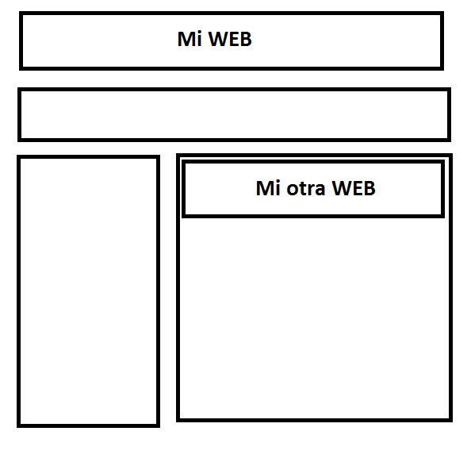
Routing

Slide 18
Routing Include
Debemos importar el script de routing
<script src="https://code.angularjs.org/1.2.21/angular-route.min.js"></script>

Slide 19
Routing Include
Debemos importar el script de routing
<script src="https://code.angularjs.org/1.2.21/angular-route.min.js"></script>
Incluir la directiva ng-include
<div ng-include src=" ‘pagInclude.html’ " > </div>

Slide 20
Routing Include
Debemos importar el script de routing
<script src="https://code.angularjs.org/1.2.21/angular-route.min.js"></script>
Incluir la directiva ng-include
<div ng-include src=" ‘pagInclude.html’ " > </div>
Declarar al menos el modulo de la aplicación
<script>
var miAplicacion = angular.module( 'includes' , [] )
</script>

Slide 21
Routing View
Debemos importar el script de routing
<script src="https://code.angularjs.org/1.2.21/angular-route.min.js"></script>
Incluir la directiva ng-view
<div ng-view ></div>

Slide 22
Routing View
Incluimos la configuración de las URLs
<script>
var users= angular.module( myApp' , ['ngRoute'] )
users.config(['$routeProvider',
function($routeProvider) {
$routeProvider.
when'('/user/jose, {
templateUrl: ‘blog/users/jose.html',
}).
when('/user/angel', {
templateUrl: 'blog/users/angel.html',
}).
when('/user/alex', {
templateUrl: 'blog/users/alejandro.html',
}).
otherwise({
redirectTo: '/',
templateUrl: ‘index.html',
});
}]);
</script>

Slide 23
Routing View
Incluimos la configuración de las URLs
<script>
var users= angular.module( myApp' , ['ngRoute'] )
users.config(['$routeProvider',
function($routeProvider) {
$routeProvider.
when'('/user/jose, {
templateUrl: ‘blog/users/jose.html',
}).
when('/user/angel', {
templateUrl: 'blog/users/angel.html',
}).
when('/user/alex', {
templateUrl: 'blog/users/alejandro.html',
}).
otherwise({
redirectTo: '/',
templateUrl: ‘index.html',
});
}]);
</script>

Slide 24
Routing View
Incluimos la configuración de las URLs
<script>
var users= angular.module( myApp' , ['ngRoute'] )
users.config(['$routeProvider',
function($routeProvider) {
$routeProvider.
when'('/user/jose, {
templateUrl: ‘blog/users/jose.html',
}).
when('/user/angel', {
templateUrl: 'blog/users/angel.html',
}).
when('/user/alex', {
templateUrl: 'blog/users/alejandro.html',
}).
otherwise({
redirectTo: '/',
templateUrl: ‘index.html',
});
}]);
</script>

Slide 25

¿Preguntas?

Slide 26
Repositorio del taller
https://github.com/josegury/AngularJS

