Slide 1
California Zoning Board Councilpersons
Links between Fast Food Restaurants and Crime
Charles Pryor & Joseph Hart

Slide 2
Goal
To make a better California by making our residents healthier and safer
Population and Fast Food Overview
Amount of Property Crime in linked to ratio of Fast food
Amount of Property crime by gender linked to Fast Food

Slide 3
Hypothesis 1
We hypothesize that the counties which have over 1 million residents, minus Los Angeles County will have more fast food restaurants per person than counties that have between 250k and 1 million inhabitants. A separate study should be done on counties with less than 250k inhabitants.
Group 2
Group 1
San Diego
Orange
Riverside
San Bernardino
Santa Clara
Alameda
Sacramento
Contra Costa
Marin Santa Cruz 'Merced San Luis Obispo Placer Monterey Santa Barbara Solano | Tulare Sonoma Stanislaus San Joaquin San Mateo Ventura San Francisco Kern Fresno

Slide 4
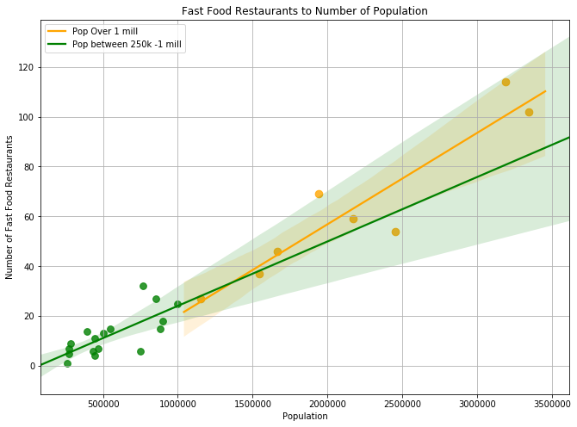
P < .99
Notes:
Significance of the Difference between Two Slopes Calculator

Slide 5
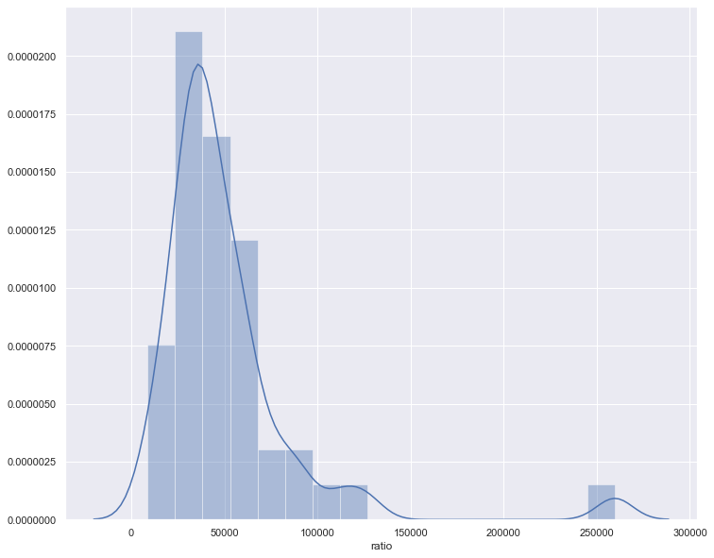

Slide 6
Hypothesis 2
Ho: There is no significant difference in property arrests between males and females in the state of CA.
Ha: There is a significant difference in property arrests between male and females.

Slide 7
How are we defining property arrests?
A property arrests constitutes one or more of the following:
Burglary
Theft
Motor vehicle theft
Forgery
Access cards
Arson

Slide 8
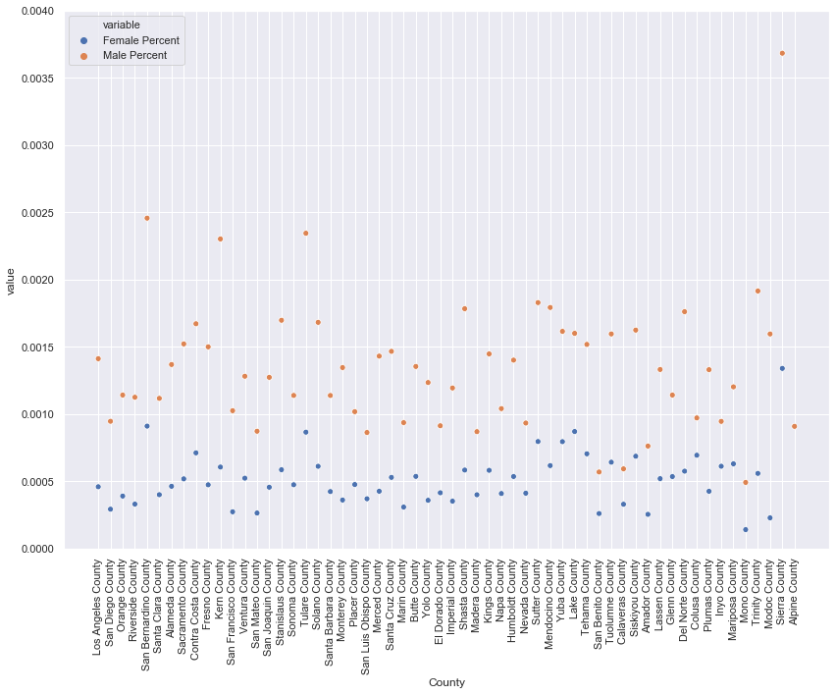

Slide 9
Hypothesis 2 results:
We can conclude that there is a significant difference in property arrests between males and females and reject the hypothesis.

Slide 10
Hypthesis 3:
Ho: There is no link between the percent of property arrests and the ratio of fast food restaurants per person in CA
Ha: There is a link between restaurants and property arrests

Slide 11
Results
After performing a wlech’s t test, we found that there was a link between the percent of property arrests and the ratio of fast food restaurants per person in CA.

Slide 12
Conclusion
Hypothesis 1,2,3 - rejected
Counties with populations over 1m do not have more fast food restaurants per person than counties with 250k - 1m inhabitants.
There is a link between restaurants and property arrests
There is a significant difference in property arrests between male and females.
Recommendations
Further research is needed to curb crime and create a healthier California
We would like to access the full data set to analyze the numbers further.

