Slide 1
QUARTERLY DATABASE PROJECT
MYSQL 8.0
FINAL DEMO
Educational Resource
Management System
Final database demonstration
6
normalized
tables
Anudari Undrakh • Jose Antonio Horta Herrera
Notes:
Presenter: Anudari Undrakh
Target time: 0:20–0:25
SCRIPT
Hello. We are Anudari Undrakh and Jose Antonio Horta Herrera. Our project is the Educational Resource Management System. It gives a college one searchable place for course materials. In this presentation, we will explain the database design, demonstrate four meaningful SQL queries and a view, and finish with the main challenges and lessons we learned.
[Sources]
- Database-Project/README.md
- Database-Project/Database/Quarterly_Database_Project_Part_3.sql

Slide 2
EDUCATIONAL RESOURCE MANAGEMENT SYSTEM
One database replaces scattered resource records
THE PROBLEM
WHO USES IT
Textbooks, e-books, videos, lab materials, software, and assessments can be spread across spreadsheets, email, websites, folders, and paper records.
Students
Find required and available materials
Instructors
Assign resources to courses and weeks
Resource administrators
Maintain formats, locations, and status
DATABASE OUTCOME
A centralized, searchable source that connects every learning resource to its course, category, creator, availability, and usage history.
Academic coordinators
Review coverage, access, and feedback
ANUDARI UNDRAKH
02
Notes:
Presenter: Anudari Undrakh
Target time: 0:40–0:50
SCRIPT
The real-world problem is that a college may track textbooks, e-books, videos, lab materials, software, and assessments in many separate places. That makes it harder to find the correct item, know whether it is available, or understand how it is being used. Our database centralizes that information. Students can find course materials, instructors can assign resources, resource administrators can maintain availability and locations, and academic coordinators can review access and feedback. The goal is not only storage. The goal is reliable discovery, assignment, and reporting.
[Sources]
- Database-Project/README.md
- Database-Project/Documentation/Database_Design_Explanation.md

Slide 3
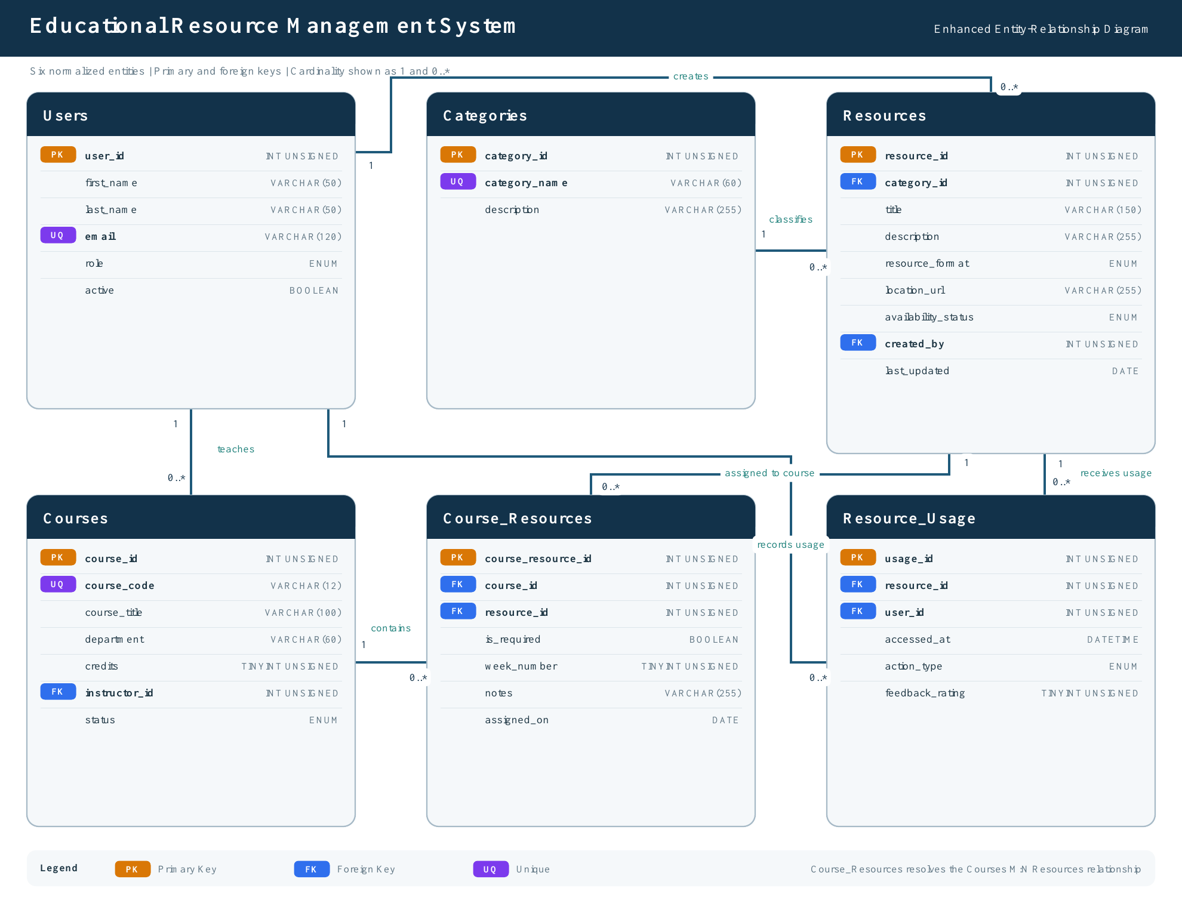
ANUDARI UNDRAKH
03
Notes:
Presenter: Anudari Undrakh
Target time: 1:00–1:10
SCRIPT
This EER diagram shows the six normalized tables. Users stores students, instructors, administrators, and coordinators. Courses points to its instructor, Categories classifies each Resource, and Resource_Usage records who accessed a resource and what action occurred. The key design decision is Course_Resources. Courses and Resources have a many-to-many relationship, because one course can use many resources and one resource can support many courses. The junction table converts that into two one-to-many relationships and stores assignment details such as whether the item is required and which week it is used. Primary keys identify rows, foreign keys connect them, and unique constraints prevent duplicate emails, course codes, categories, and assignments.
[Sources]
- Database-Project/ERD/EER_Diagram.png
- Database-Project/Documentation/Database_Design_Explanation.md

Slide 4
KEY SQL QUERY • JOIN
Query 1 connects courses to the resources students need
Business question: Which resources are assigned to each active course, and who teaches it?
FIVE-TABLE RELATIONSHIP PATH
Code | Instructor | Resource | Req.
CSC110 | Priya Davis | Programming Fundamentals | Yes
CSC120 | Rafael Evans | Academic Writing Slides | Yes
CSC210 | Sofia Foster | Biology Lab Manual | Yes
CSC240 | Samuel Green | MySQL Workbench | No
SELECT c.course_code,
CONCAT(i.first_name, ' ', i.last_name) AS instructor,
r.title AS resource, cr.is_required
FROM courses AS c
JOIN users AS i ON i.user_id = c.instructor_id
JOIN course_resources AS cr ON cr.course_id = c.course_id
JOIN resources AS r ON r.resource_id = cr.resource_id
WHERE c.status = 'Active'
ORDER BY c.course_code, cr.week_number;
WHAT THE RESULT TELLS US
Every row represents one valid course–resource assignment, with instructor and requirement status included.
ANUDARI UNDRAKH
04
Notes:
Presenter: Anudari Undrakh
Target time: 0:50–1:00
SCRIPT
Our first query answers which resources are assigned to each active course and who teaches the course. This is useful for students, instructors, and coordinators because it brings related information into one result instead of requiring them to inspect separate tables. The query follows the relationships from Courses to Users, Course_Resources, and Resources. In MySQL Workbench, I will run the query and point out that each result row represents one course-resource assignment. The is_required field also distinguishes required materials from recommendations. This query demonstrates why the junction table and foreign keys are essential.
[Sources]
- Database-Project/Database/Quarterly_Database_Project_Part_3.sql — Query 1

Slide 5
KEY SQL QUERY • GROUP BY + SUBQUERY
Query 2 turns availability into an inventory decision
Business question: How many available resources exist in each format, and what share does each format represent?
AGGREGATE + SCALAR SUBQUERY
Format | Available | Share
Software | 4 | 17.4%
Physical | 3 | 13.0%
PDF | 3 | 13.0%
Dataset | 3 | 13.0%
Web | 2 | 8.7%
SELECT resource_format,
COUNT(*) AS available_count,
ROUND(100.0 * COUNT(*) /
(SELECT COUNT(*) FROM resources
WHERE availability_status = 'Available'), 1) AS share_pct
FROM resources
WHERE availability_status = 'Available'
GROUP BY resource_format
ORDER BY available_count DESC;
23
resources are currently available across eight formats
JOSE ANTONIO HORTA HERRERA
05
Notes:
Presenter: Jose Antonio Horta Herrera
Target time: 1:00–1:10
SCRIPT
The second query answers how many available resources exist in each format and what percentage of the available inventory each format represents. A resource administrator would use this information to identify gaps or decide which formats need more investment. The WHERE clause keeps only available items, GROUP BY creates one group per format, and COUNT calculates the totals. The subquery calculates the overall number of available resources so the outer query can compute each format's percentage. In our sample data, 23 resources are available, and Software has the largest count with four.
[Sources]
- Database-Project/Database/Quarterly_Database_Project_Part_3.sql — Query 2

Slide 6
KEY SQL QUERY • CASE + HAVING
Query 3 reveals patterns in student resource activity
Business question: Which students interacted with resources, how often, and what feedback did they provide?
CONDITIONAL AGGREGATION
Student | Uses | Downloads | Rating
Aaliyah Anderson | 2 | 0 | 4.0
Chloe Garcia | 2 | 0 | 4.0
Ethan Johnson | 2 | 2 | 3.5
Jose Ramirez | 2 | 2 | 4.0
Jasmine Quinn | 2 | 0 | 3.0
SELECT CONCAT(u.first_name, ' ', u.last_name) AS student,
COUNT(ru.usage_id) AS interactions,
SUM(CASE WHEN ru.action_type = 'Downloaded'
THEN 1 ELSE 0 END) AS downloads,
ROUND(AVG(ru.feedback_rating), 2) AS avg_rating
FROM users AS u
JOIN resource_usage AS ru ON ru.user_id = u.user_id
JOIN resources AS r ON r.resource_id = ru.resource_id
WHERE u.role = 'Student'
GROUP BY u.user_id, u.first_name, u.last_name
HAVING COUNT(ru.usage_id) >= 1;
CASE counts specific actions; HAVING removes users with no matching activity.
JOSE ANTONIO HORTA HERRERA
06
Notes:
Presenter: Jose Antonio Horta Herrera
Target time: 1:05–1:15
SCRIPT
The third query summarizes student interaction and feedback. It joins Users, Resource_Usage, and Resources, then limits the results to students. COUNT shows total interactions. CASE inside SUM counts only downloads, and AVG calculates the average rating while ignoring null ratings. GROUP BY creates one result row per student, and HAVING keeps only students with at least one interaction. This information could help instructors identify whether students are using the assigned materials, while coordinators could compare engagement and feedback. The result shows both activity volume and quality signals without deleting the underlying detailed usage records.
[Sources]
- Database-Project/Database/Quarterly_Database_Project_Part_3.sql — Query 3

Slide 7
VIEW DEMONSTRATION • DATE FUNCTION
The usage view turns three tables into a reusable report
vw_resource_usage_summary
QUERY 4 • RETRIEVE FROM THE VIEW
Resources + Categories + Resource_Usage
SELECT resource_title, category_name,
average_rating,
DATE_FORMAT(last_accessed_at,
'%b %d, %Y') AS last_accessed
FROM vw_resource_usage_summary
WHERE average_rating >= 4
ORDER BY average_rating DESC,
last_accessed_at DESC
LIMIT 5;
Pre-joins descriptive fields and aggregates views, downloads, loans, returns, ratings, and the most recent access time.
USED BY
Resource administrators and academic coordinators
Resource | Category | Rating | Last accessed
Chemistry Midterm | Sample Exam | 5.0 | Jul 25, 2026
Git & GitHub | Tutorial | 5.0 | Jul 20, 2026
APA Citation | Citation Guide | 5.0 | Jul 15, 2026
Civil Rights | Primary Source | 5.0 | Jul 12, 2026
Why a view: one tested definition can support many reports without repeating a long JOIN and GROUP BY.
JOSE ANTONIO HORTA HERRERA
07
Notes:
Presenter: Jose Antonio Horta Herrera
Target time: 1:15–1:25
SCRIPT
To simplify repeated reporting, we created the vw_resource_usage_summary view. It combines Resources, Categories, and Resource_Usage, then calculates interaction counts, average ratings, and the latest access time for every resource. Resource administrators and academic coordinators can use it without rewriting the same long JOIN and GROUP BY. This fourth query retrieves highly rated resources from the view and uses DATE_FORMAT to present the last access date clearly. In Workbench, I will first show the view definition, then run this SELECT statement. The result answers which well-rated resources were accessed most recently and demonstrates how a view makes complex logic easier and more consistent.
[Sources]
- Database-Project/Database/Quarterly_Database_Project_Part_3.sql — vw_resource_usage_summary and Query 4

Slide 8
LESSONS LEARNED + CHALLENGE
A many-to-many challenge became a design strength
CHALLENGE
Normalization
Keys + JOINs
Courses ↔ Resources is many-to-many
3NF keeps instructor and category details in one authoritative place.
Primary and foreign keys protect integrity and create reliable relationship paths.
Storing lists of resource IDs inside Courses would violate 1NF and create duplicate or inconsistent data.
Views
Indexes
SOLUTION
A view packages complicated reporting logic into a simpler, reusable interface.
Six targeted indexes support common filters, joins, and chronological reports.
Course_Resources creates one row per assignment and safely stores is_required, week_number, notes, and assigned_on.
JOSE ANTONIO HORTA HERRERA
08
Notes:
Presenter: Jose Antonio Horta Herrera
Target time: 1:10–1:20
SCRIPT
The most important challenge was modeling the many-to-many relationship between Courses and Resources. A list of resource IDs inside Courses would violate First Normal Form and become difficult to update. We addressed this with the Course_Resources junction table. It gives every assignment its own row and provides a correct place for is_required, week_number, notes, and assigned_on. This challenge helped us understand how normalization and business requirements work together. We also learned that primary and foreign keys create reliable JOIN paths, views simplify repeated reporting, and indexes support common filters and chronological lookups. These decisions make the database easier to maintain as it grows.
[Sources]
- Database-Project/Documentation/Database_Design_Explanation.md
- Assignment_5_Individual_Database_Design_Reflection.docx
- Database-Project/Database/Quarterly_Database_Project_Part_3.sql

Slide 9
PROJECT OUTCOME
One normalized model now supports discovery, assignment, and reporting
6
240
2
6
normalized tables
sample records
reusable views
supporting indexes
Next improvement: add Resource_Copies to track individual textbooks and equipment.
GITHUB REPOSITORY
github.com/josehorta21/educational-resource-database-project
JOSE ANTONIO HORTA HERRERA
Notes:
Presenter: Jose Antonio Horta Herrera
Target time: 0:35–0:45
SCRIPT
In conclusion, the project meets the main success criteria: students can discover course resources, instructors can assign them, administrators can manage availability, and coordinators can analyze usage and feedback. The completed implementation contains six normalized tables, 240 sample records, two reusable views, and six supporting indexes. The GitHub repository contains the EER diagram, documentation, sample data, and SQL files. A future improvement would be a Resource_Copies table for tracking individual physical books and equipment. Thank you for reviewing our Educational Resource Management System.
[Sources]
- Database-Project/README.md
- Database-Project/Database/Quarterly_Database_Project_Part_3.sql
- https://github.com/josehorta21/educational-resource-database-project

