Slide 1
BARD1

Slide 2
Breast and Ovarian

Slide 3
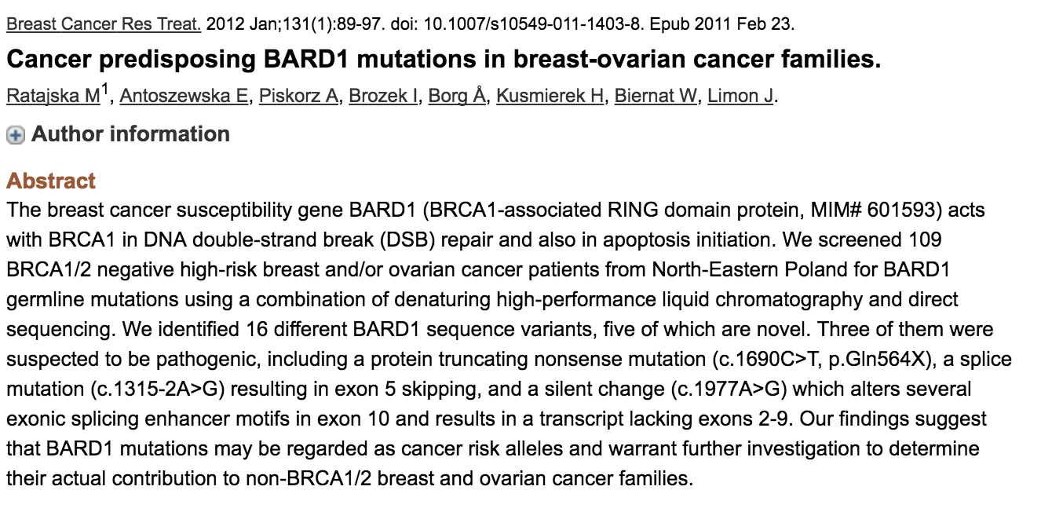

Slide 4
