Slide 1
BRIP1

Slide 2
Breast

Slide 3
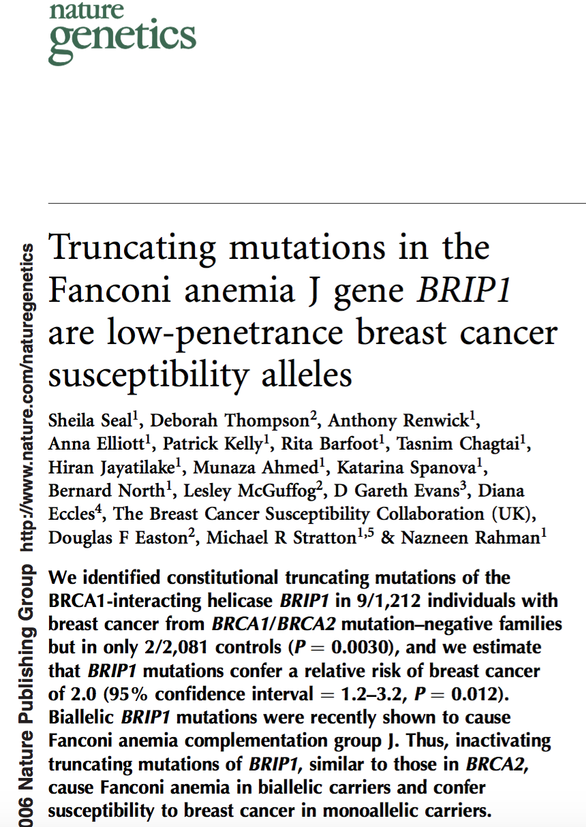

Slide 4
Ovarian

Slide 5
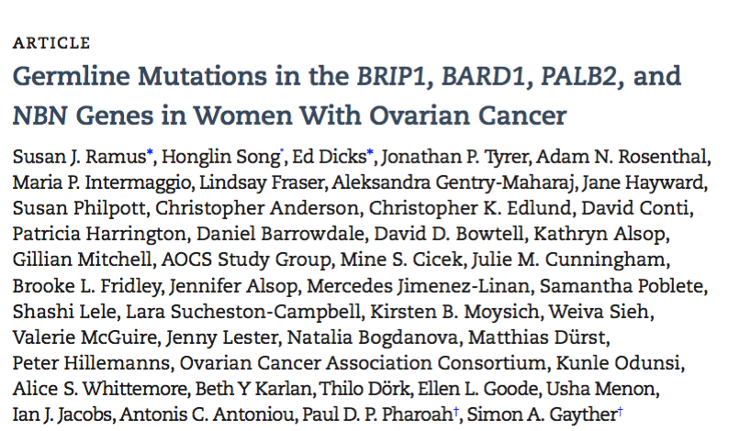

Slide 6
