Slide 1
MUTYH
Biallelic and Monoallelic

Slide 2
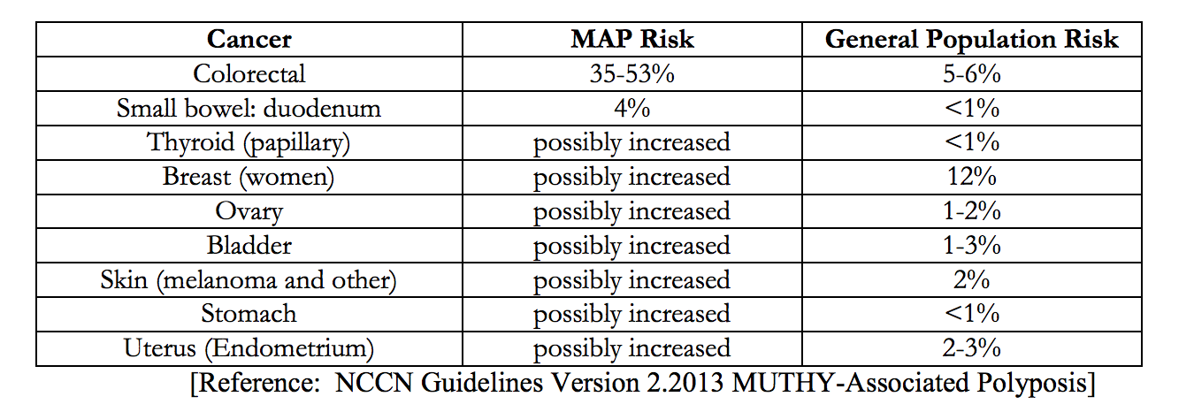
What is MAP?
MUTYH-Associated Polyposis

Slide 3
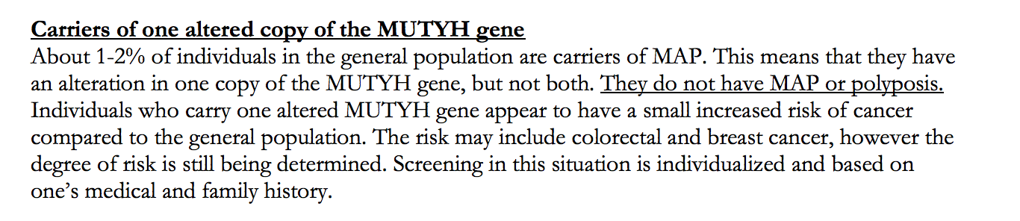
Carriers

Slide 4
Biallelic
Colorectal
Urinary tract
Ovarian
Small Bowel

Slide 5
Monoallelic
Breast
Gastric
Hepatobiliary
Endometrial
Colorectal

Slide 6
Biallelic

Slide 7
Colorectal
Stick with Theodoratou 2010

Slide 8
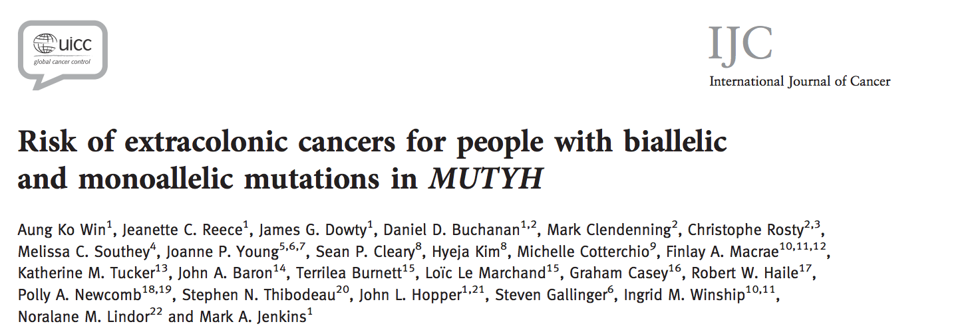
Urinary Tract and Ovarian

Slide 9
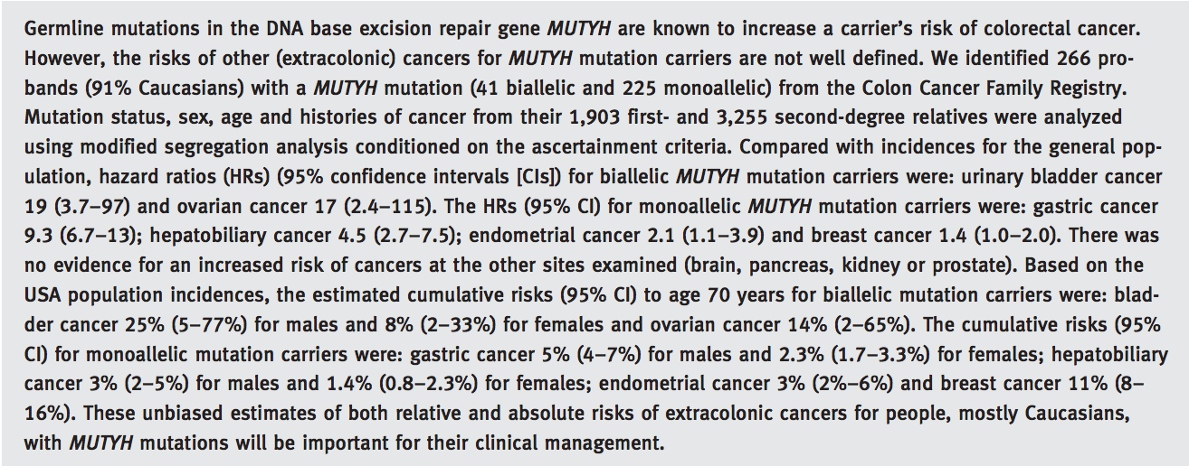

Slide 10
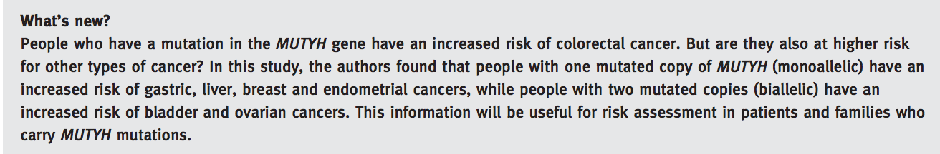

Slide 11
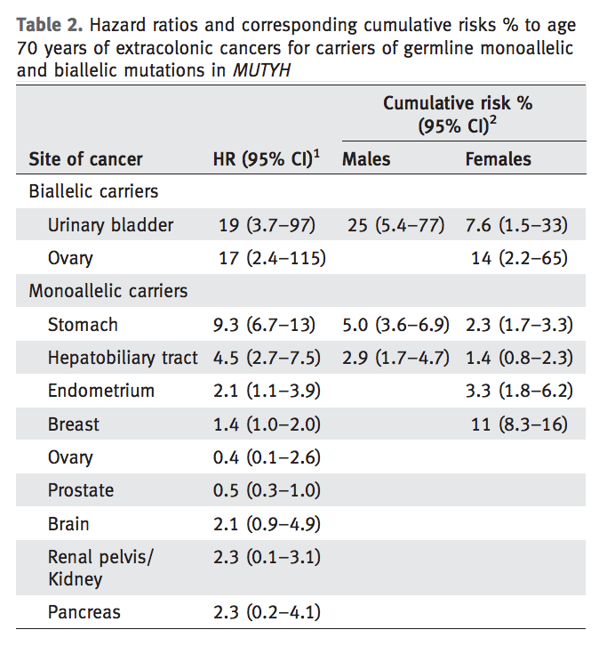

Slide 12
Monoallelic

Slide 13
Breast, Endometrial, Gastric, and Hepatobiliary

Slide 15
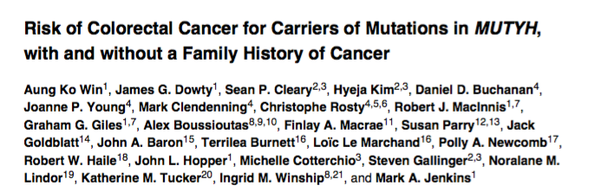
Colorectal

Slide 16
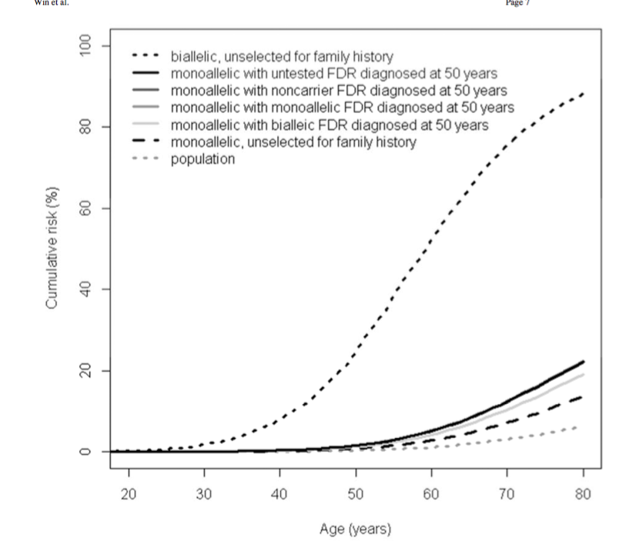

Slide 17
