Slide 1
NBN

Slide 2
Breast Prostate

Slide 3
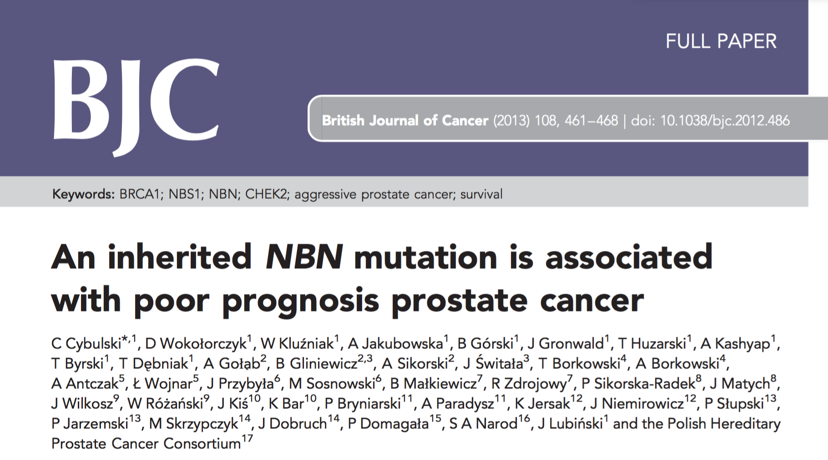

Slide 4
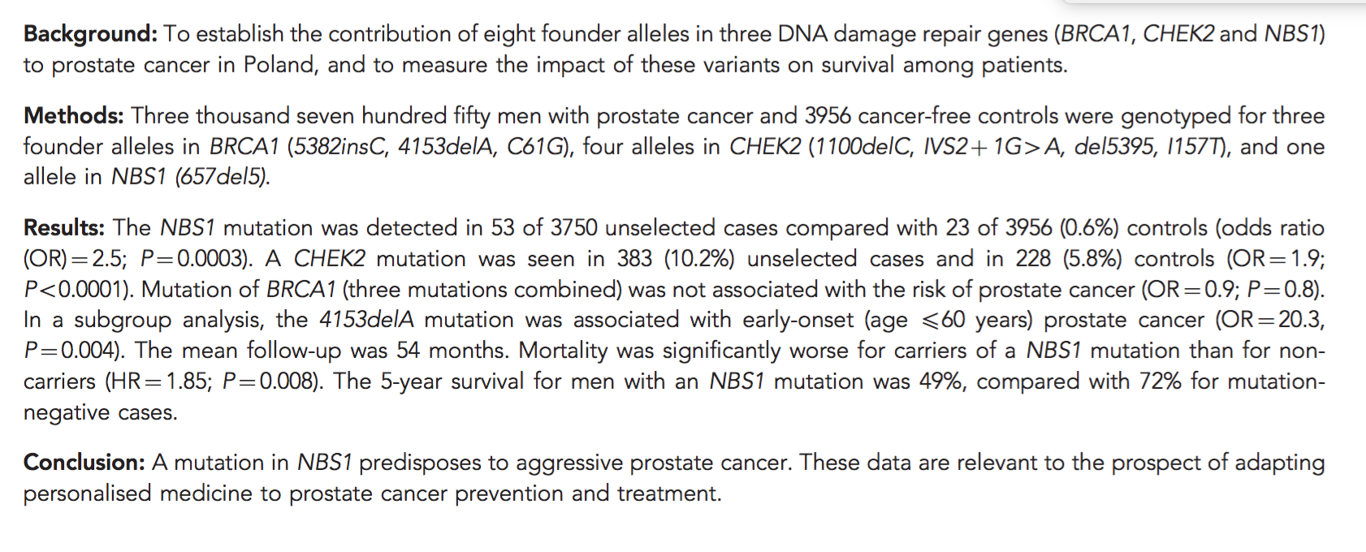

Slide 5


Slide 6
