Slide 1
PTEN
Breast
Endometrial
Thyroid
Colorectal
Notes:
2014

Slide 2
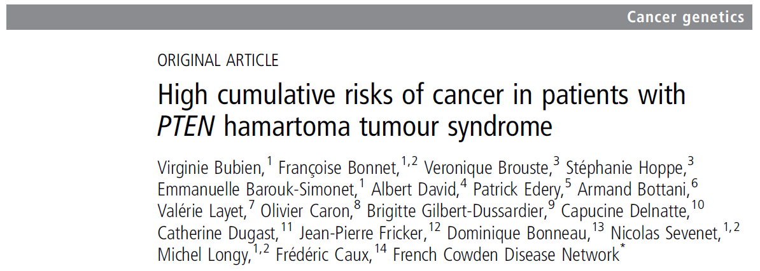

Slide 3
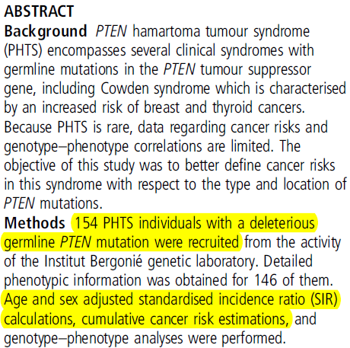
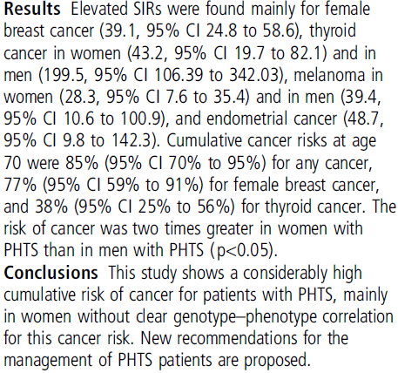

Slide 4
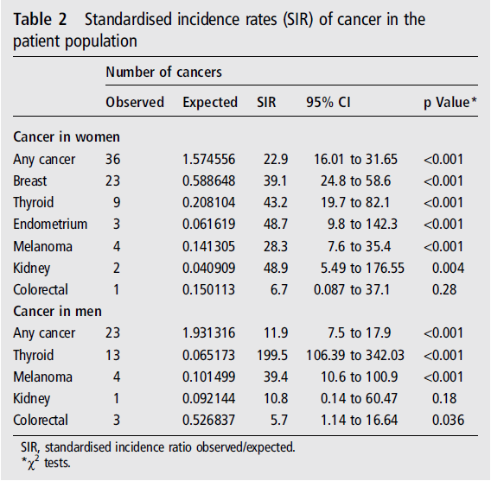

Slide 5
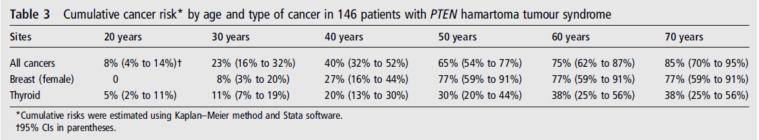

Slide 6
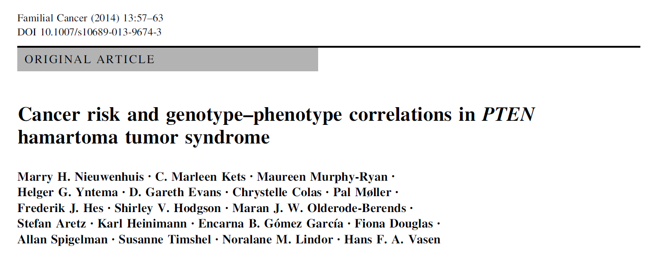
Notes:
2014

Slide 7
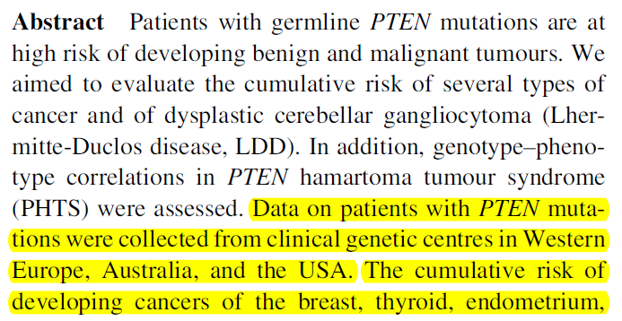
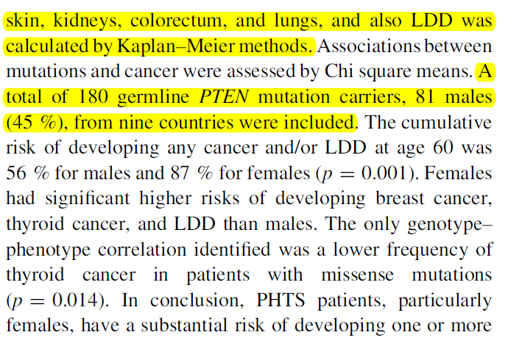

Slide 8
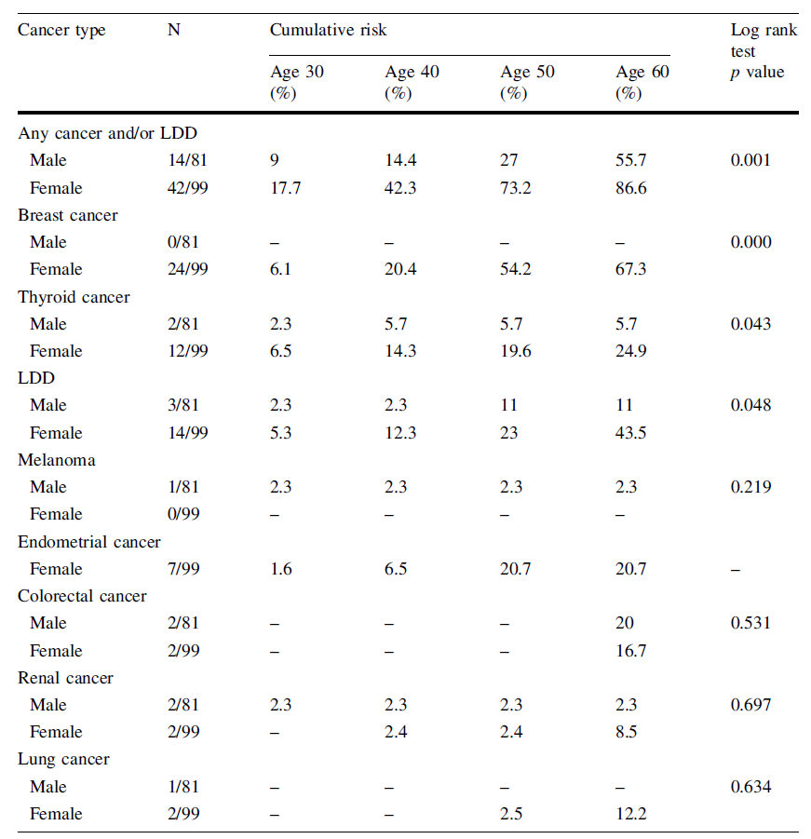

Slide 9
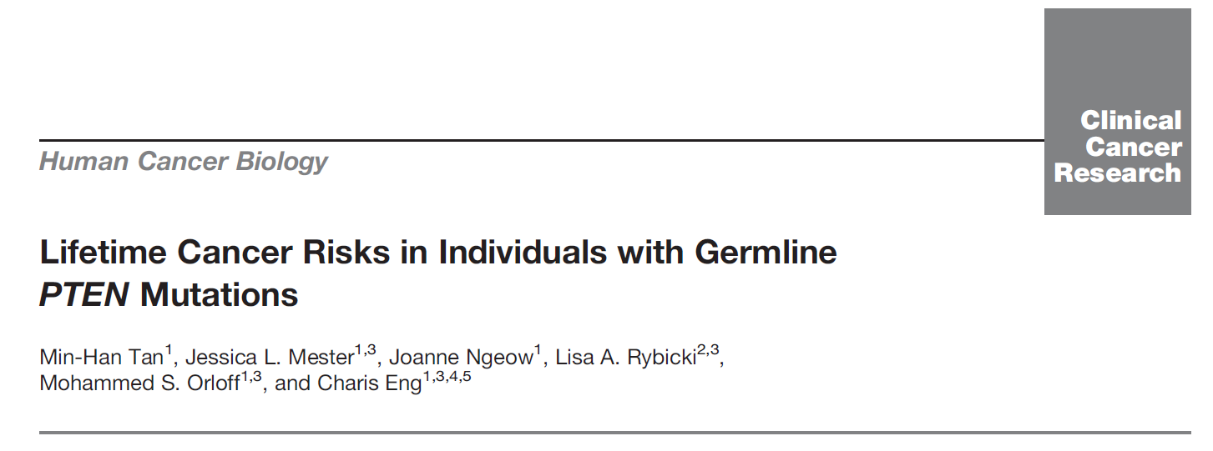
Notes:
2012

Slide 10
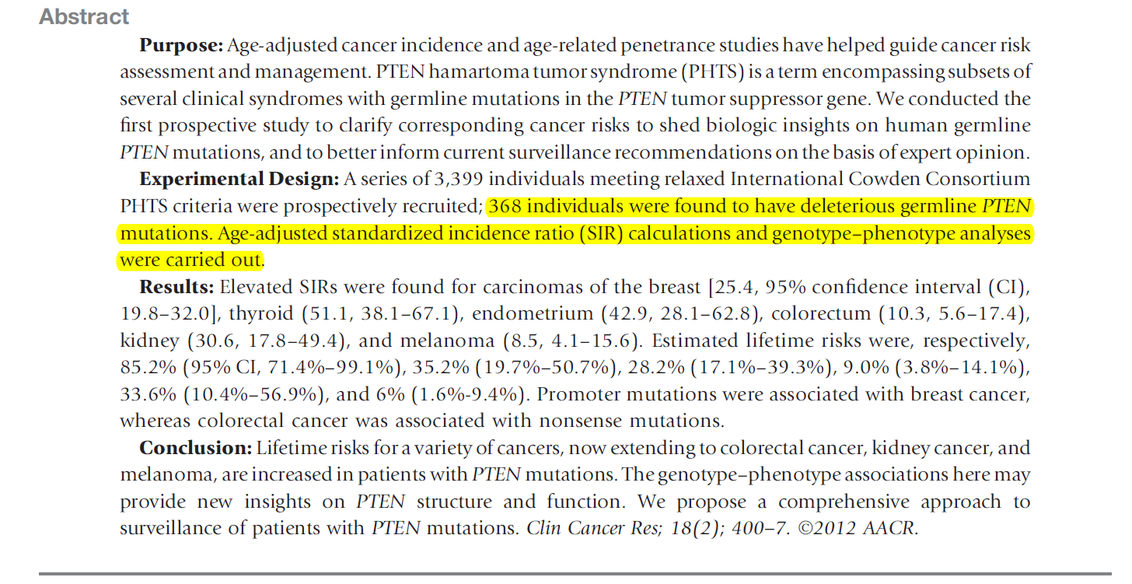

Slide 11
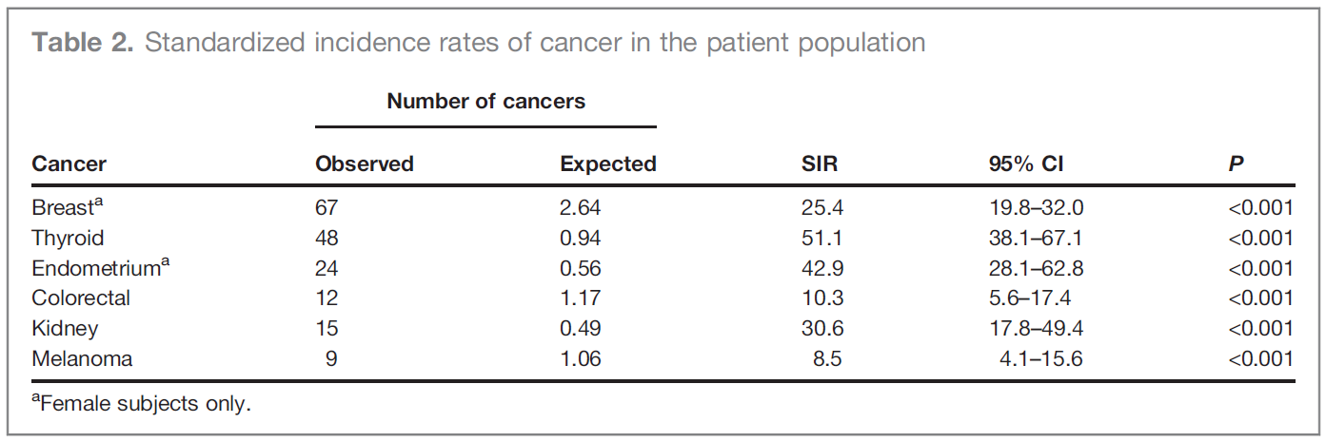

Slide 12
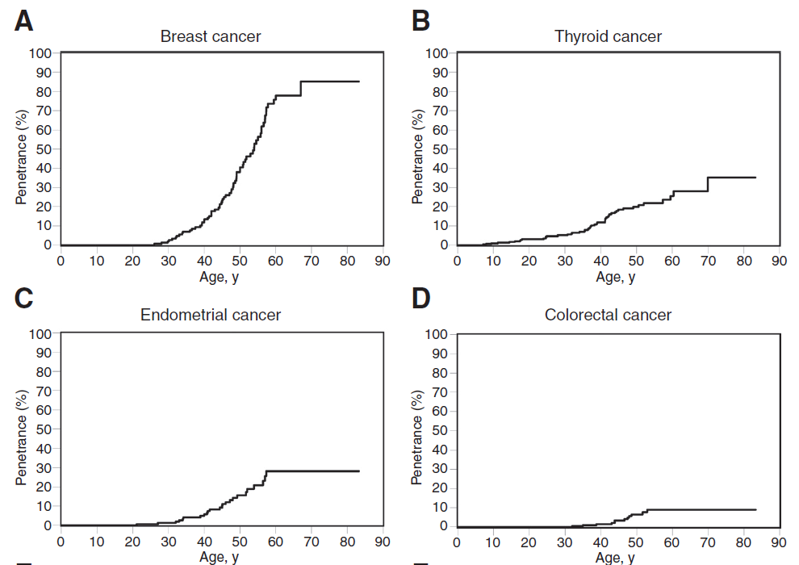
Age-related penetrance curves

Slide 13
 | Year | Sample Size | Breast Female | Breast Male | Colorectal Female | Colorectal Male | Endometrial | Thyroid Female | Thyroid Male
High cumulative risks of cancer in patients with PTEN hamartoma tumour syndrome | 2013 | 154 | + | - | + | + | + | + | +
Cancer risk and genotype–phenotype correlations in PTEN hamartoma tumor syndrome | 2013 | 180 | + | - | + | + | + | + | +
Lifetime Cancer Risks in Individuals with Germline PTEN Mutations | 2012 | 368 | No seperate risk |  | No seperate risk |  | + | No seperate risk

Slide 14
For Breast and Endometrial cancer: Lifetime Cancer Risks in Individuals with Germline PTEN Mutations
For Colorectal and Thyroid: Cancer risk and genotype–phenotype correlations in PTEN hamartoma tumor syndrome (Because of Gender choice)

