Slide 1
RAD51C
Ovarian Cancer
Breast Cancer
Notes:
There is no meta-analysis.

Slide 2
Ovarian Cancer

Slide 3
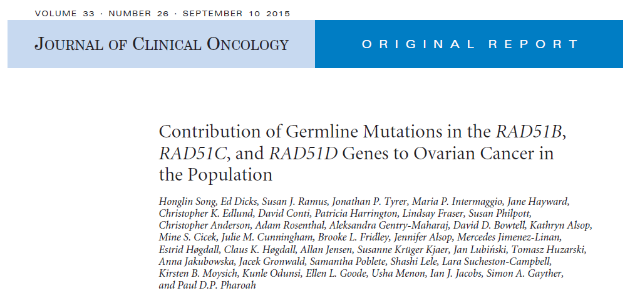
Notes:
2012

Slide 4
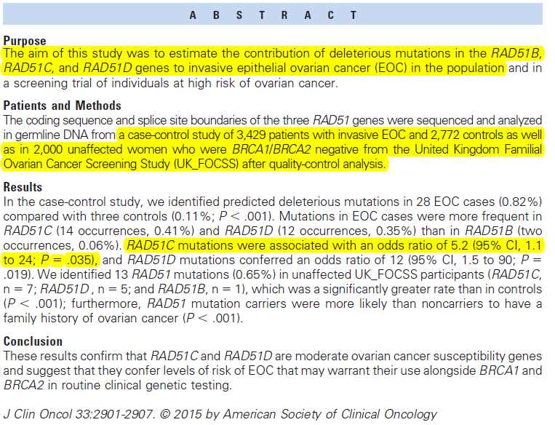

Slide 5
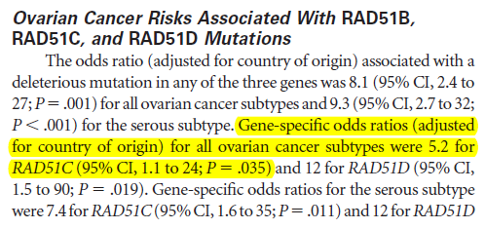


Slide 6


Slide 7
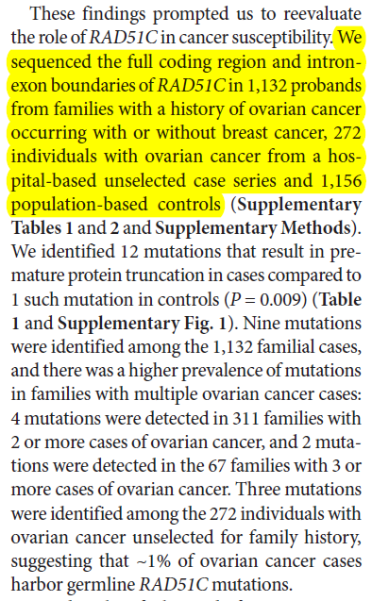
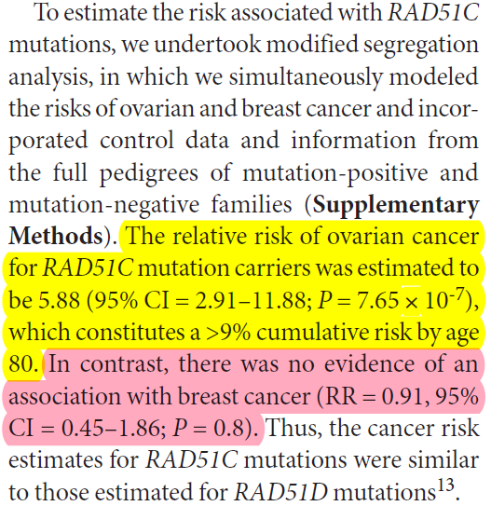

Slide 8
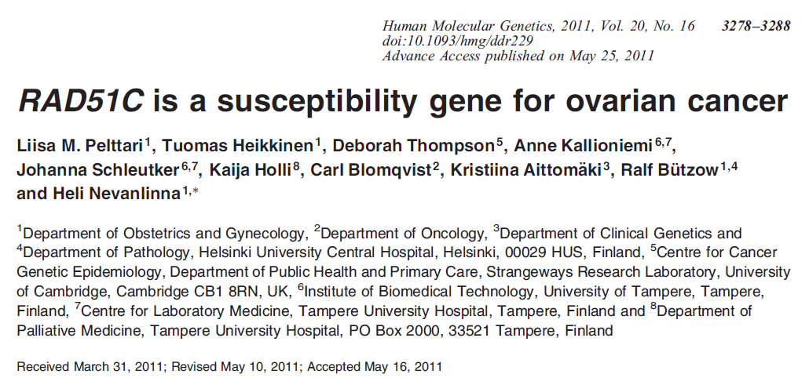

Slide 9
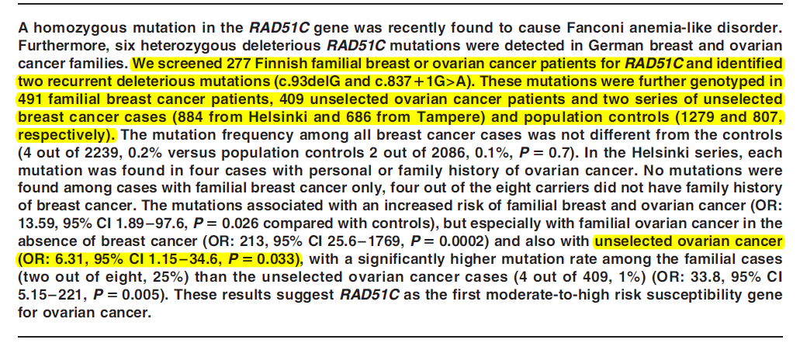

Slide 10
