Slide 1
RAD51D

Slide 2
Ovarian

Slide 3
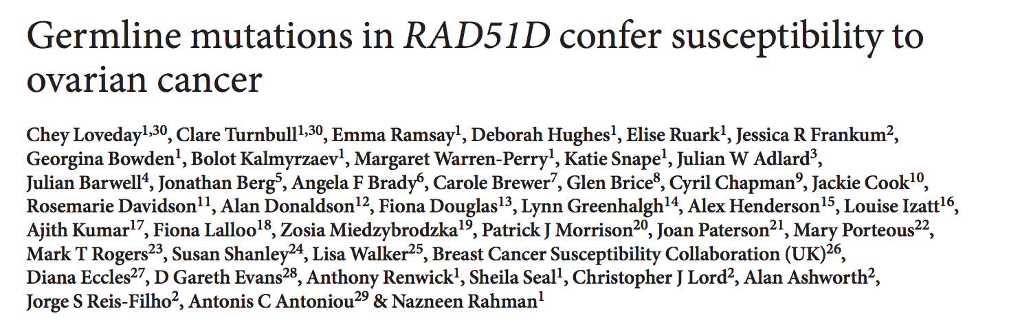

Slide 4
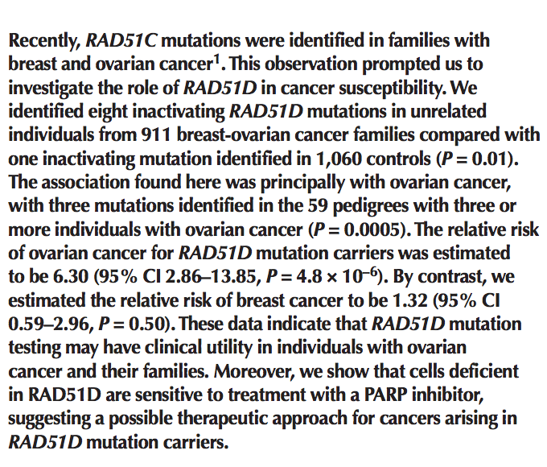

Slide 5
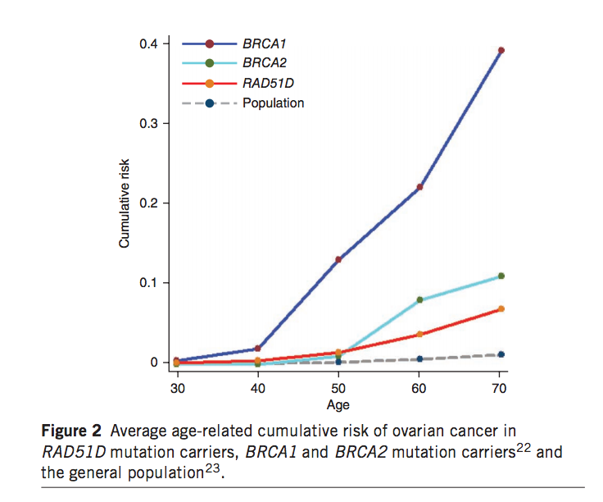

Slide 6
Breast
No good papers

