Slide 1
STK11

Slide 2
Breast
Ovarian
Colorectal
Uterine
Pancreatic
Gastric

Slide 3
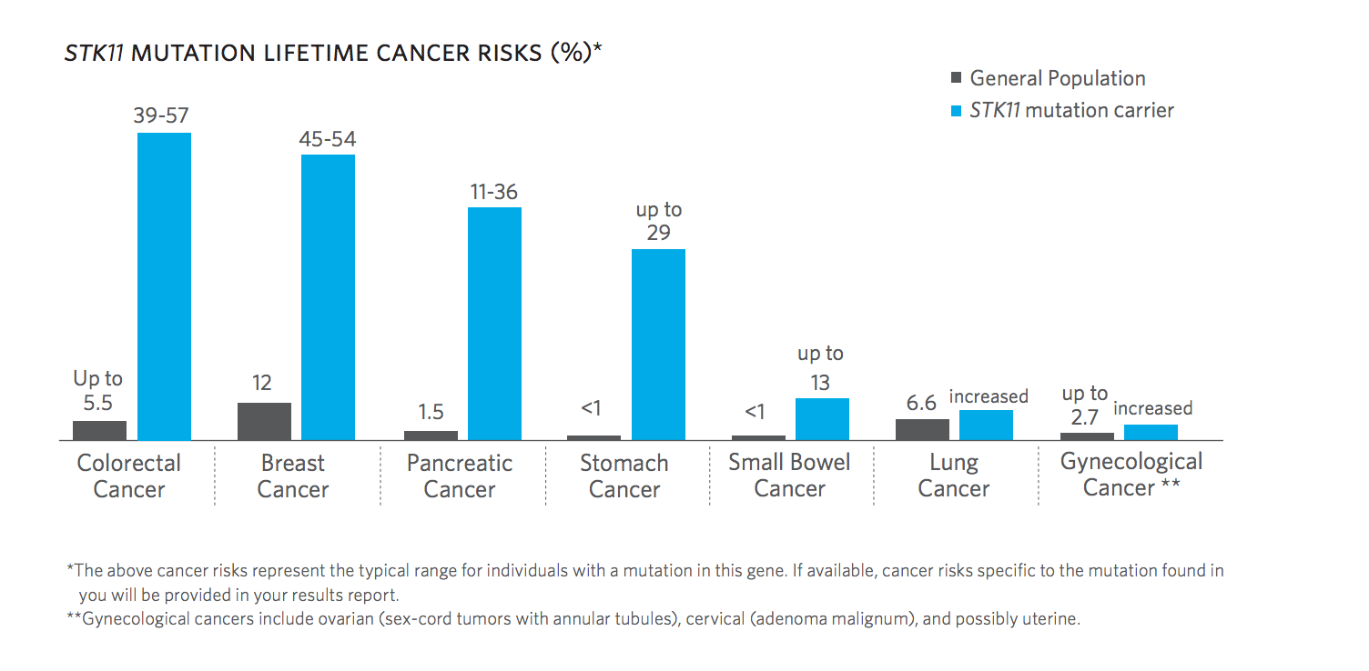

Slide 4


Slide 5
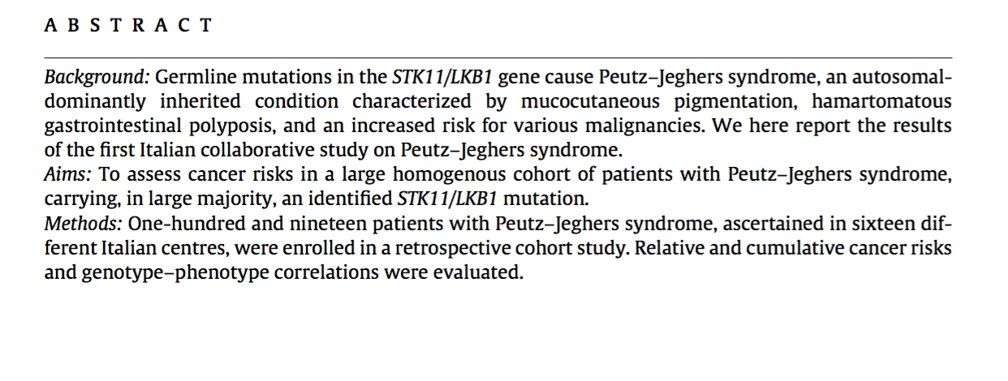

Slide 6


Slide 7
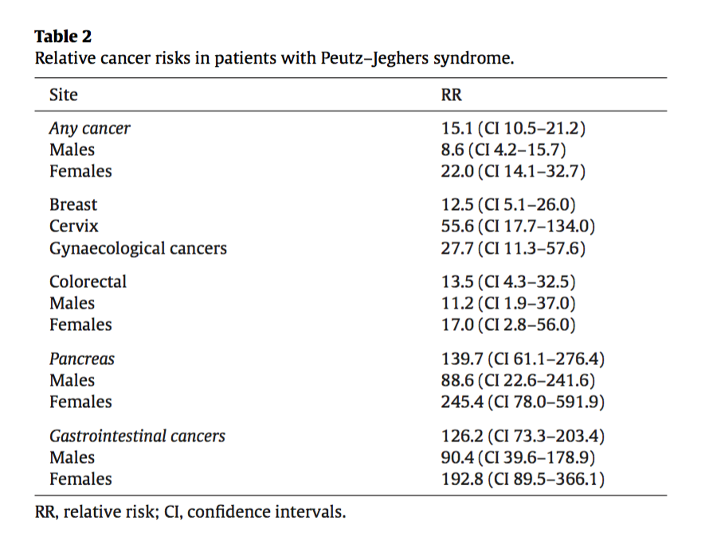

Slide 8
