Slide 1
MUTYH

Slide 2
Colorectal

Slide 3
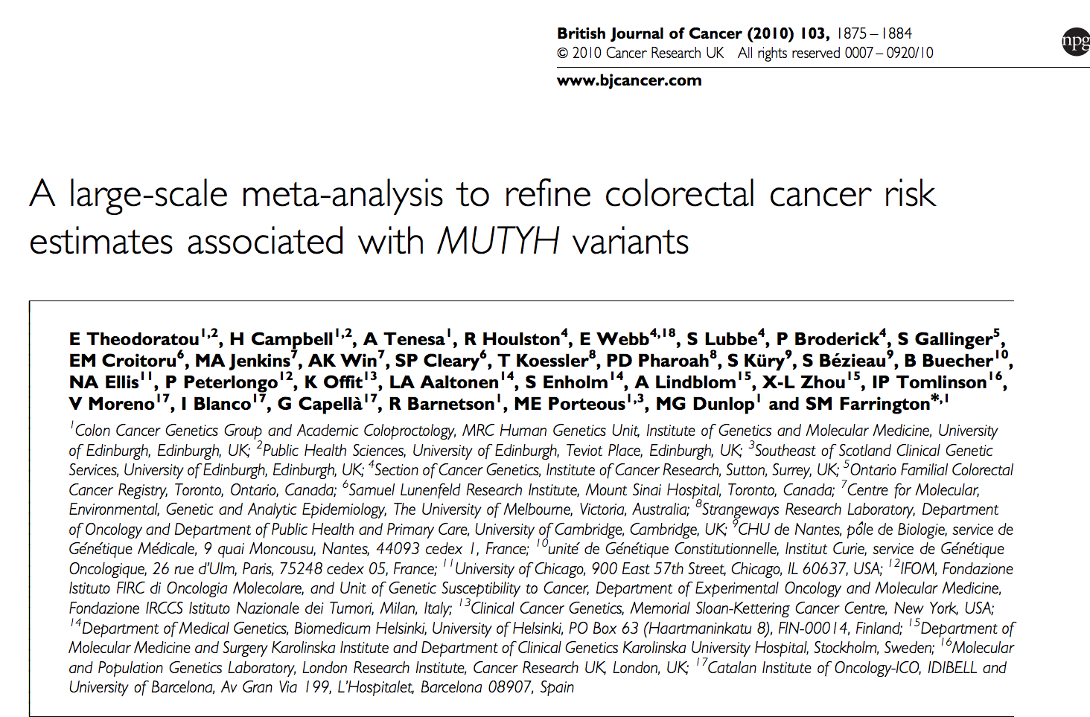

Slide 4
