Slide 1
U.S. Airline Flight Performance Dashboard (2015)
Prepared By: Joselin Mercy J
Tools Used: • SQL • Power BI • Excel

Slide 2
Project Overview
Problem: Flight delays and cancellations impact operational efficiency and customer satisfaction.
Objectives: • Analyze delays and cancellations • Evaluate airline performance • Analyze airport operations • Generate actionable insights

Slide 3
Dataset Overview
Dataset: 2015 U.S. Domestic Flights
Data Volume: • 1.05M+ Flight Records
Key Attributes: • Airline • Airports • Delays • Cancellations • Month • State

Slide 4
Data Preparation
Steps Performed: • Data Cleaning • Null Handling • Data Type Conversion • Data Modeling
Tools: • SQL • Power BI

Slide 5
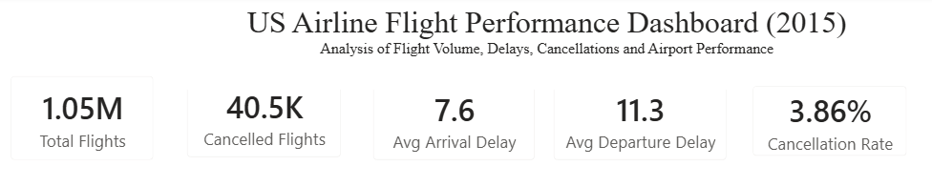
KPI Dashboard
Key Metrics:
• Total Flights – 1.05M • Cancelled Flights – 40.5K • Avg Arrival Delay – 7.6 Minutes • Avg Departure Delay – 11.3 Minutes • Cancellation Rate – 3.86%

Slide 6
Airline Performance Analysis
Visuals: • Top Airlines by Flight Volume • Airlines with Most Cancellations • Avg Arrival Delay by Airline • Avg Departure Delay by Airline
Key Finding: Southwest Airlines operated the highest flight volume.

Slide 7
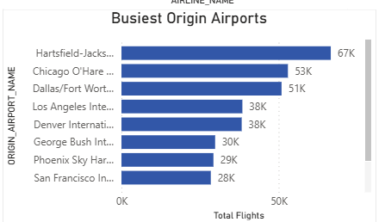
Airport Performance Analysis
Visual: Busiest Origin Airports
Key Finding: Hartsfield-Jackson Atlanta International Airport recorded the highest traffic.

Slide 8
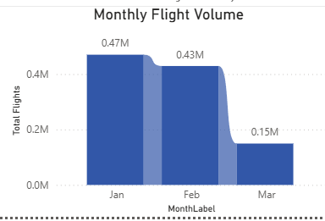
Monthly Trend Analysis
Visual: Monthly Flight Volume
Key Finding: Flight activity varied across months with noticeable volume differences.

Slide 9
Business Impact
Reduced identification time for delay patterns
Improved airline performance monitoring
Enabled data-driven decision making
Highlighted operational bottlenecks
Improved understanding of cancellation trends

Slide 10
Recommendations
Improve turnaround processes for delayed airlines.
Increase operational resources at busy airports.
Implement proactive cancellation mitigation strategies.

Slide 11
Conclusion
Analyzed 1.05M+ flight records
Built an interactive Power BI dashboard
Identified key delay and cancellation trends
Evaluated airline and airport performance
Generated actionable business recommendations

