Slide 1

Lumosity
By Jose Ramirez

Slide 2
About the app
Lumosity is an online program and app consisting of games claiming to improve brain performance.
Product of Lumos Labs, based in San Francisco, California.
The company was founded in 2005 by Kunal Sarkar, Michael Scanlon, and David Drescher.
Launched in 2007 and has 70 million members in 182 countries and 150 employees.

Slide 3
More about the app
Lumosity membership is free.
You have the option to unlock full access to more games and special features for a range of fees.
Their site is available in 7 languages.
The cognitive assessment and training market will grow from $2.4 billion in 2015 to $7.5 billion by 2020.
Over 3 billion games played and 35+ million app downloads.

Slide 4
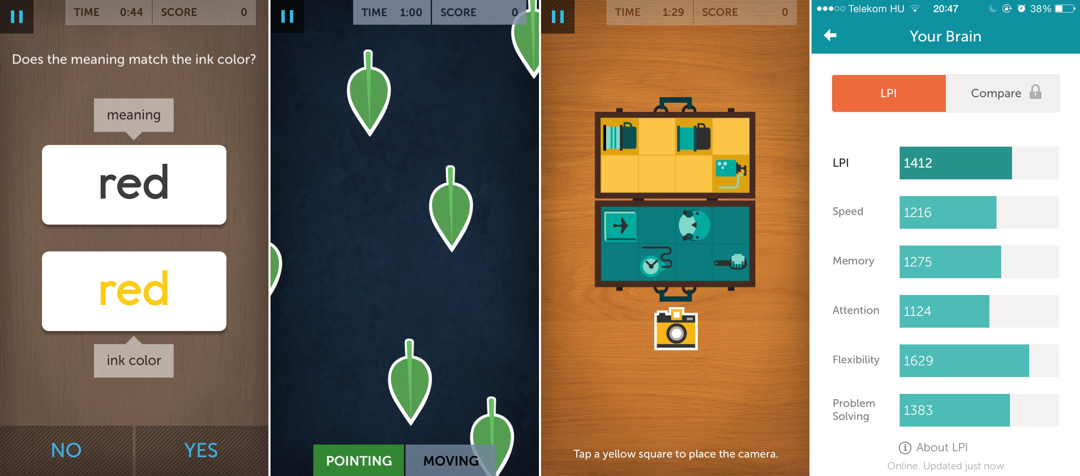
How the app works.

Slide 5
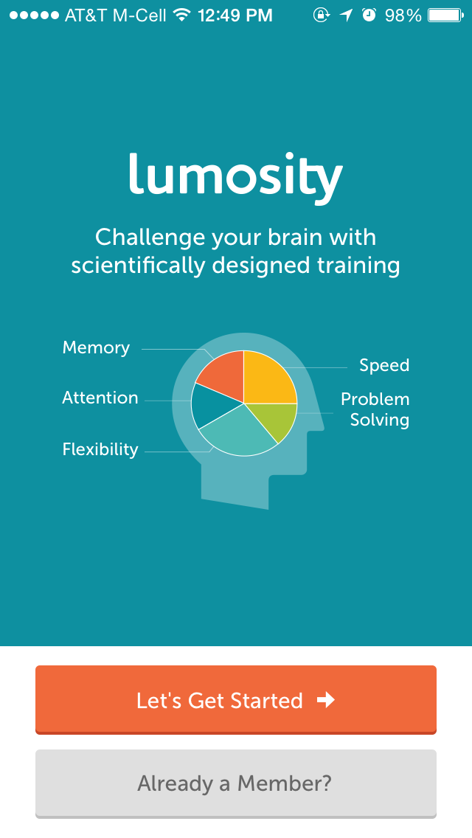
Does it really work?
Lumosity is based on neuroplasticity.
Depends on two basic elements. First, users need to use the program regularly.
The second part depends on using many different types of games.
There are 40+ different games available.

Slide 6


Where is available?
Lumosity is available online at their web site, www.lumosity.com
It can be downloaded as an app from the Apple App Store and Google Play.

