Slide 1
Query
image or text
Abstract Syntax Tree
Abstract Syntax Tree with annotations
Annotated Query
System Overview

Slide 2
union all
aggregation
SUM(T.hours) AS hours
GROUP BY EA.name
project
ET.name
ET.training_program
ET.hours
project
EA.name AS Employee
T.name AS Action
T.hours
Employees_training
join
ON T.actionId = EA.actionId
Training_actions
Employees_training_actions

Slide 3
union all
aggregation
SUM(T.hours) AS hours
GROUP BY EA.name
project
ET.name
ET.training_program
ET.hours
'(' || STRING_AGG(EA.prov || ' · ' || T.prov || ' ⊗ ' || hours, ' + ' ORDER BY EA.prov, T.prov)
ET.prov
project
EA.name AS Employee
T.name AS Action
T.hours
Employees_training
EA.prov ⊗ T.prov AS prov
join
ON T.actionId = EA.actionId
Training_actions
Employees_training_actions

Slide 4


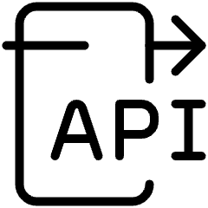


Provenance Annotator
Distributed Query Engine

