Slide 1

Data Science Project 1 proposal
Javier de la Rúa Martínez,
Jose Manuel Perez Ricote,
Daniel Mínguez Camacho

Slide 2
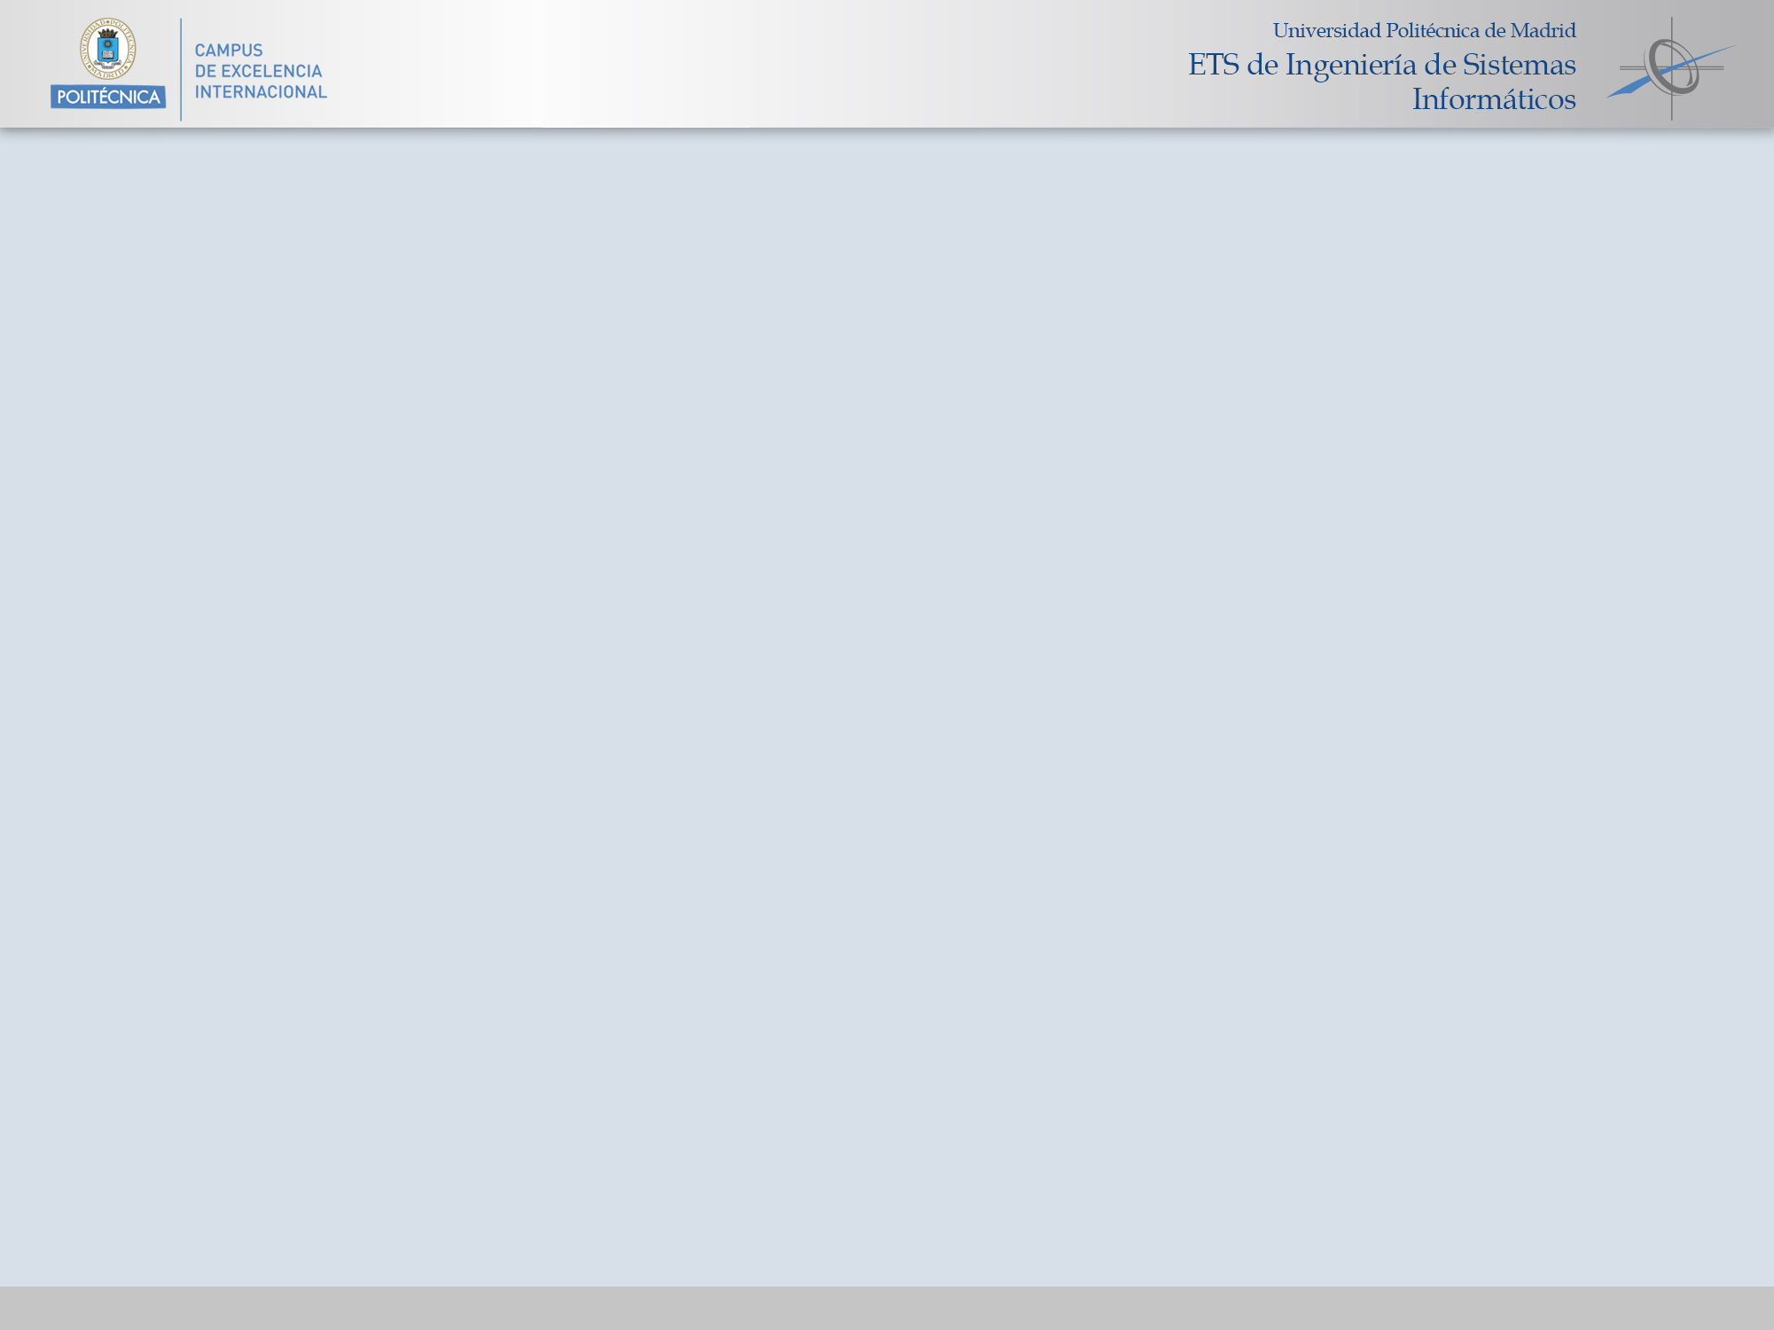
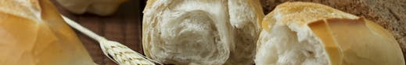
Starting point & Business Goal
The file BreadBasket_DMS.csv contains the tickets of products sales during the period 2016/10/30 – 2017/04/09 in the bakery XXX.
The objective is to increase the revenue by creating offers during weekdays at lunch time for products that are sold together.
In order to increase the revenue it is proposed to apply an algorithm to analyse the products sales and being able to identify the most important products to which apply the discounts

Slide 3
Tasks & Calendar
Problem analysis (4h):
  Kick off meeting
  Understanding of the data
  Data cleaning & Data pre-processing
Algorithm selection and tuning, preparation of the results (4h):
  Algorithm matching and tuning
  Selection of the more optimal algorithm
Presentation meeting (1h):
  Feedback and possible upgrades
Final adjustments and implementation (2h):
  Implementation of the feedback upgrades
  Final deliverables (Report with algorithm used, results and conclusions).
Monday | Tuesday | Friday | Thursday | Friday
Kick off meeting (1) | Problem analysis and Algorithm selection (1-2) |  | Presentation of results meeting (3) | Final adjustments and deliverable delivery (4)

Slide 4
Technical goals and details
Technical goals
  Find which products are sold together during weekdays at lunch times using an a priori algorithm.
Data preparation tasks:
  Formatting for processing in R.
  Data exploration and basic information extraction:
    More frequent items sold
    Trends by week day and month
    Average of items per transaction
    …
Modelling tasks:
  Execution of the algorithm using different parameters for support and confidence.
  Analysis of the results and selection of the best model.
Analysis of the results and benefits:
  The results will be delivered with a recommendation for which group of items are more suitable for being targets of offers. It will be supported by the graphs and results obtained in R.

Slide 5
Requirements & next steps
Requirements:
  The meetings should be agreed in the kick-off meeting and depending of this the final calendar could be subject to changes.
  In the case of finding some inconsistencies in the data that could drive into extra pre-processing, a notification will be sent with the problem and the correspondent new proposed calendar.
Next steps (not in scope):
  In order to analyse the results of the algorithm and the offers that will be made, we proposed the following KPI:
  Nº of products sell before offers / Nº of products sell after offers
  Use of alternatives algorithms for analyse the problem like FP-Growth algorithm.

Slide 6
Fees
The following are the fees agreed for the project. This fees does not include expenses neither taxes:
Type | Hours | Fees
Analyst | 10 | 1.000€
Manager | 1 | 200€
 | 11 | 1.200€

