Slide 1
Who will keep receiving overtime?
C2 · Classification · Fixed-term staff of the six Santiago Metropolitan Health Services
Group 01 · Alessandro Lavezzi · José Saavedra · 10 November 2026
Feature window
Sep 2024 – Jul 2025
Gap
Aug 2025
Target year
Sep 2025 – Aug 2026
Persistent = overtime in ≥ 75% of a person's months
Decision: 1 Sep 2025
Notes:
About 1.5 minutes. Since W1 we measure persistent overtime. C2 moves to prediction: on 1 September 2025, with only what was known that day, who will be persistent in the next 12 months? One row is one person (service plus name). Positive class: persistent, 18% of people. Features come only from September 2024 to July 2025, the last payroll published by the decision date; August is a gap month. The decision it supports: where to review staffing first.

Slide 2
W2 feedback shaped the dataset
8,732
135
372
Cohort by decision date
Names in two services
Paid after contract end
≥ 6 months in the window and on the July 2025 payroll. 598 without a year-2 label are reported, not hidden
39 at the same time, 96 one after another (transfers). 24 C2 people excluded from all sets
Payroll month = payment month. The gap month limits this lag; it stays a limitation
W2 split by person, reused (same person never in two sets)
5,691
Training · 1,043 persistent · fits the model
1,227
Validation · 238 persistent · picks the threshold
1,192
Test · 204 persistent · used once at the end
Notes:
About 2 minutes. The instructor asked us to build the cohort by decision date and to investigate name matches and the paid-versus-worked lag. Cohort: only people known on the decision date. Names in two services: excluded so one person cannot sit in two sets. Lag: the gap month. Then we reuse the W2 split by person: training fits the model, validation picks the threshold, test is used only once.

Slide 3
A simple rule against a logistic regression
Reference rule
Persistent in the window → persistent next year. Nothing to fit.
Logistic regression
Simple, readable coefficients
Scaling and encoding fitted on training only
Default L2 penalty (C = 1), no tuning
Threshold 0.35 chosen on validation (highest F1; rule fixed beforehand)
Validation F1: 0.779 vs 0.728 for the rule
Notes:
About 2 minutes. The reference rule is what a manager would do without a model. The logistic regression gives one coefficient per input; past persistence dominates (odds about 6 times higher per standard deviation). Values below 1 lower the odds. These are associations, not causes. The threshold was chosen on validation with a rule fixed before looking; 0.35 because only 18% are persistent.

Slide 4
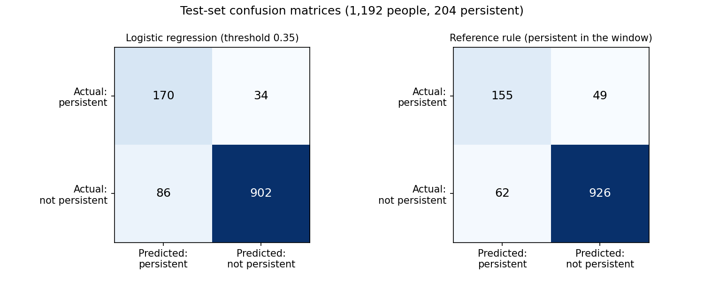
Test set: same F1, a different trade-off
+15
persistent people found (170 vs 155)
+24
false alarms (86 vs 62)
FP: a review that was not needed. FN: another year of overtime (25‑50% surcharge)
Accuracy hides this: "nobody is persistent" scores 0.829
Test (1,192 people) | Precision | Recall | F1 | Accuracy
Reference rule | 0.714 | 0.760 | 0.736 | 0.907
Logistic (0.35) | 0.664 | 0.833 | 0.739 | 0.899
Always "not persistent" | 0.000 | 0.000 | 0.000 | 0.829
Notes:
About 2 minutes. Positive class: persistent. The test set was used once, after fixing model and threshold. The model finds 15 more persistent people but raises 24 more false alarms; F1 is practically the same, 0.739 vs 0.736. The validation gain did not hold on test. Accuracy alone is misleading: predicting nobody is persistent already gives 0.829.

Slide 5
Past persistence predicts future persistence
What the model adds
More recall (83% vs 76%) and a probability per person to rank cases by review capacity. It does not clearly beat the rule in F1
Important limit
One decision date and one predicted year only: we cannot show it works in another year. Also names without ID, payment month ≠ work month
Possible improvement
Threshold with explicit costs (overtime CLP of a missed case vs a review); a 2026–27 cohort to validate across years
Prediction is not intervention
A flag does not prove that a review or hire reduces overtime: that needs a comparison group, such as a pilot in some flagged units
Contributions: José Saavedra (dataset, split reuse, metrics, baseline, model) · Alessandro Lavezzi (W2 feedback, threshold, test, interpretation, brief, slides). AI: Claude for code and text drafts, checked against saved outputs.
Notes:
About 1.5 minutes. Conclusion: past persistence is the dominant signal and a simple rule is already strong; the model trades precision for recall and adds a ranking score. Main limit: one decision date only. Improvement: cost-based threshold and a second cohort. A prediction is not proof that an action works. Then questions.

