Slide 1
PHISHSHIELD
Local and Explainable
Phishing Email Triage
.eml
evidence
risk
with Deterministic Analysis and Experimental AI Assistance
safe · local · explainable
A practical security workflow with a responsible path toward AI assistance.
José Nieto Alaber
Máster en Desarrollo con IA · Big School
August 2026

Slide 2
THE PROBLEM
A Reported Email Needs A Safe First Look
Reported .eml
Unsafe first inspection
Evidence before escalation
Users forward suspicious messages for review. The original message may contain URLs, attachments, and sensitive context.
Opening the message in a normal mail client can expose the analyst to the very content they need to investigate.
A help-desk or SOC analyst needs a repeatable first assessment, not an opaque verdict.
The first triage step should be safe, local, and explainable.
PhishShield | José Nieto Alaber | 2

Slide 3
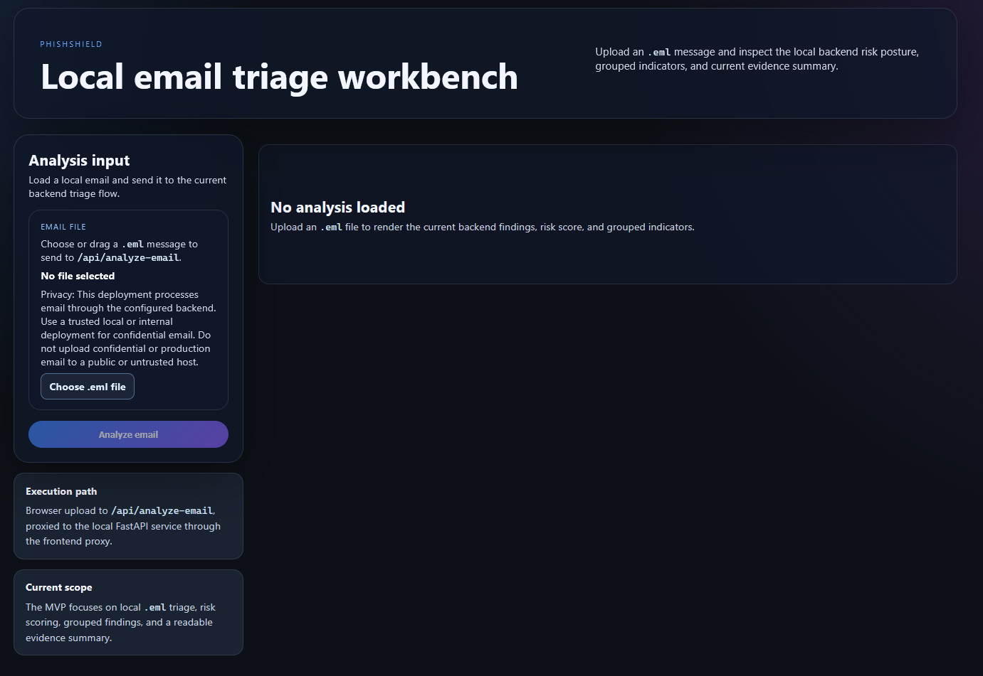
PROJECT GOAL
Local-First Triage For Analysts And Help-Desk Teams
LOCAL-FIRST
EXPLAINABLE
DETERMINISTIC
EXPORTABLE
A safe and repeatable first look before escalation.
PhishShield processes the message locally, explains the evidence behind each finding, and produces a deterministic risk assessment.
PhishShield | José Nieto Alaber | 3

Slide 4
CORE WORKFLOW
From Reported Message To Evidence
1
2
3
4
5
Upload .eml
Extract indicators
Analyze rules
Review risk
Export report
Technical evidence · grouped findings · deterministic risk · reusable reports
PhishShield | José Nieto Alaber | 4

Slide 5
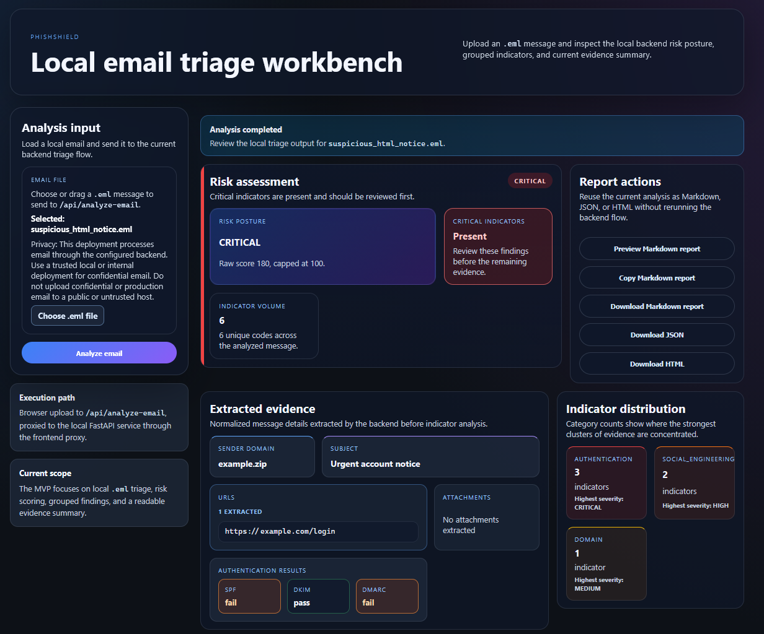
PRODUCT OUTPUT
How To Read An Analysis Result
1. Deterministic Risk
CRITICAL is calculated from the combined deterministic findings.
1
3
2. Header Authentication
SPF, DKIM, and DMARC are extracted from email headers. They are technical evidence, not AI predictions.
3. Report Actions
Export the current evidence as Markdown, JSON, or HTML.
2
PhishShield | José Nieto Alaber | 5

Slide 6
ARCHITECTURE AND STACK
A Modular Monolith With Clear Boundaries
React / TypeScript / Vite
Backend
Python · FastAPI · Pydantic
Nginx frontend
Frontend
FastAPI backend
React · TypeScript · Vite
Application use cases and ports
Distribution
Domain rules, evidence, and risk
Docker · Compose · GHCR
Quality
pytest · Vitest · GitHub Actions · pre-commit
PhishShield | José Nieto Alaber | 6

Slide 7
EXPERIMENTAL AI-ASSISTED ASSESSMENT
A Local Advisory Capability, Not An Automated Verdict
.eml
Deterministic
representation
Scope
gate
TF-IDF +
Logistic Regression
Benign / Suspicious /
Inconclusive
OPTIONAL
LOCAL
DISABLED BY DEFAULT
ADVISORY ONLY
The deterministic path remains authoritative for findings, evidence, risk, and CI decisions.
PhishShield | José Nieto Alaber | 7

Slide 8
WHY THE AI REMAINS EXPERIMENTAL
Evidence Quality Sets The Promotion Boundary
What is not sufficient yet
Safety decision
Authorized data
Representative families
Independent validation
Temporal evaluation
Reliable false-positive and false-negative analysis
Local processing
Explicit abstention
Deterministic-first results
No automated production verdict
Clear promotion criteria for future work
Limiting the model is a safety decision, not an absence of work.
PhishShield | José Nieto Alaber | 8

Slide 9
DELIVERY, IMPACT AND FUTURE WORK
A Public, Reproducible Foundation For Further Validation
1
2
3
4
Public
repository
Docker
distribution
Community
feedback
Safer AI
promotion
Current result
Current boundary
Next step
A functional local security tool with reproducible execution.
No representative authorized corpus for AI promotion.
Independent validation with privacy-preserving data.
PhishShield demonstrates a practical security tool and a responsible path toward AI-assisted triage.
PhishShield | José Nieto Alaber | 9

