Slide 1
Web Scraping with Python
Carpentry @ UCSB
November 5, 2024

Slide 2


Before we start
Workshop website
https://ucsbcarpentry.github.io/workshop/2024/11/05/ucsb-webscraping.html
Pre-workshop survey

Slide 3
A simple website
<!DOCTYPE html>
<html>
<head>
<title>Sample web page</title>
</head>
<body>
<h1>h1 Header #1</h1>
<p>This is a paragraph tag</p>
<h2>h2 Sub-header</h2>
<p>A new paragraph, now in the <b>sub-header</b></p>
<h1>h1 Header #2</h1>
<p>
This other paragraph has two hyperlinks,
one to <a href="https://carpentries.org/">The Carpentries homepage</a>,
and another to the
<a href="https://carpentries.org/past_workshops/">past workshops</a> page.
</p>
</body>
</html>

Slide 4
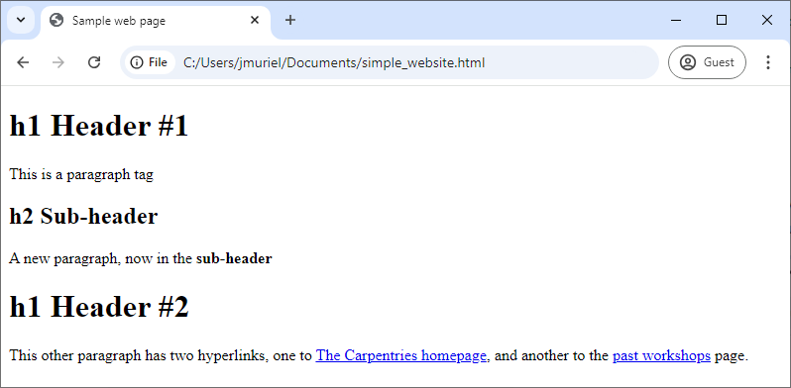
A simple website
<!DOCTYPE html>
<html>
<head>
<title>Sample web page</title>
</head>
<body>
<h1>h1 Header #1</h1>
<p>This is a paragraph tag</p>
<h2>h2 Sub-header</h2>
<p>A new paragraph, now in the <b>sub-header</b></p>
<h1>h1 Header #2</h1>
<p>
This other paragraph has two hyperlinks,
one to <a href="https://carpentries.org/">The Carpentries homepage</a>,
and another to the
<a href="https://carpentries.org/past_workshops/">past workshops</a> page.
</p>
</body>
</html>
All websites have a Hypertext Markup Language (HTML) document behind them

Slide 5
HTML structure - Elements
An HTML document is composed of elements
Most elements can be identified as they have an opening <tag> and a closing </tag>
<!DOCTYPE html>
<html>
<head>
<title>Sample web page</title>
</head>
<body>
<h1>h1 Header #1</h1>
<p>This is a paragraph tag</p>
<h2>h2 Sub-header</h2>
<p>A new paragraph, now in the <b>sub-header</b></p>
<h1>h1 Header #2</h1>
<p>
This other paragraph has two hyperlinks,
one to <a href="https://carpentries.org/">The Carpentries homepage</a>,
and another to the
<a href="https://carpentries.org/past_workshops/">past workshops</a> page.
</p>
</body>
</html>
title element

Slide 6
HTML structure - Elements
An HTML document is composed of elements
Most elements can be identified as they have an opening <tag> and a closing </tag>
<!DOCTYPE html>
<html>
<head>
<title>Sample web page</title>
</head>
<body>
<h1>h1 Header #1</h1>
<p>This is a paragraph tag</p>
<h2>h2 Sub-header</h2>
<p>A new paragraph, now in the <b>sub-header</b></p>
<h1>h1 Header #2</h1>
<p>
This other paragraph has two hyperlinks,
one to <a href="https://carpentries.org/">The Carpentries homepage</a>,
and another to the
<a href="https://carpentries.org/past_workshops/">past workshops</a> page.
</p>
</body>
</html>
title element
paragraph element
level 1 header element
hyperlink element

Slide 7
HTML structure – Nested tree structure
Given than an element can be inside another element, an HTML document has a nested tree structure
<!DOCTYPE html>
<html>
<head>
<title>Sample web page</title>
</head>
<body>
<h1>h1 Header #1</h1>
<p>This is a paragraph tag</p>
<h2>h2 Sub-header</h2>
<p>A new paragraph, now in the <b>sub-header</b></p>
<h1>h1 Header #2</h1>
<p>
This other paragraph has two hyperlinks,
one to <a href="https://carpentries.org/">The Carpentries homepage</a>,
and another to the
<a href="https://carpentries.org/past_workshops/">past workshops</a> page.
</p>
</body>
</html>
title element
head element
html root element

Slide 8
HTML structure - Content
Everything between the opening and closing tag is called the element’s content. It can be text, or other elements.
<!DOCTYPE html>
<html>
<head>
<title>Sample web page</title>
</head>
<body>
<h1>h1 Header #1</h1>
<p>This is a paragraph tag</p>
<h2>h2 Sub-header</h2>
<p>A new paragraph, now in the <b>sub-header</b></p>
<h1>h1 Header #2</h1>
<p>
This other paragraph has two hyperlinks,
one to <a href="https://carpentries.org/">The Carpentries homepage</a>,
and another to the
<a href="https://carpentries.org/past_workshops/">past workshops</a> page.
</p>
</body>
</html>
Content of this <p> element

Slide 9
HTML structure - Attributes
The behavior or appearance of an element can be modified using attributes. Attributes are defined inside opening tags in the form of
<tag attribute_name=“attribute_vale>”
<!DOCTYPE html>
<html>
<head>
<title>Sample web page</title>
</head>
<body>
<h1>h1 Header #1</h1>
<p>This is a paragraph tag</p>
<h2>h2 Sub-header</h2>
<p>A new paragraph, now in the <b>sub-header</b></p>
<h1>h1 Header #2</h1>
<p>
This other paragraph has two hyperlinks,
one to <a href="https://carpentries.org/">The Carpentries homepage</a>,
and another to the
<a href="https://carpentries.org/past_workshops/">past workshops</a> page.
</p>
</body>
</html>
href attribute inside <a> tag

Slide 10
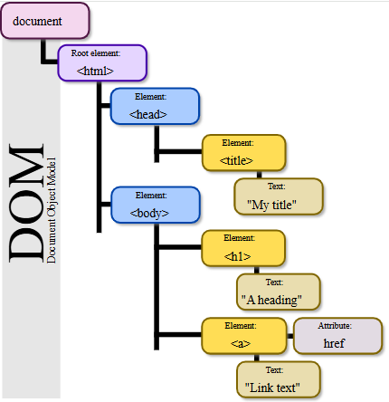
HTML structure – Nested tree structure
Source: Wikipedia. Author: Birger Eriksson

Slide 11
HTML structure – Tags and attributes
A non-comprehensive list of elements:
<hmtl>...</html> The root element
<head>...</head> Contains metadata
<body>...</body> The content that is going to be displayed
<h1>...</h1>, <h2>...</h2> Headers of level 1, 2, …
<p>...</p> A paragraph
<a href="">...</a> Creates a hyperlink
<img src="" alt=""> Embedds an image
<table>...</table>, <th>...</th>, <tr>...</tr>, <td>...</td> Defines a table, with its header, rows and data
<div>...</div> Is used to group sections of HTML content.
<script>...</script> Embeds or references JavaScript code.
<!DOCTYPE html>
<html>
<head>
<title>Sample web page</title>
</head>
<body>
<h1>h1 Header #1</h1>
<p>This is a paragraph tag</p>
<h2>h2 Sub-header</h2>
<p>A new paragraph, now in the <b>sub-header</b></p>
<h1>h1 Header #2</h1>
<p>
This other paragraph has two hyperlinks,
one to <a href="https://carpentries.org/">The Carpentries homepage</a>,
and another to the
<a href="https://carpentries.org/past_workshops/">past workshops</a> page.
</p>
</body>
</html>

Slide 12
HTML structure – Tags and attributes
Other useful global (that any element can have) attributes:
id="" Assigns a unique identifier to an element, which cannot be repeated in the entire HTML document
title="" Provides extra information, displayed as a tooltip when the user hovers over the element.
class="" Is used to apply a similar styling to multiple elements at once.
<!DOCTYPE html>
<html>
<head>
<title>Sample web page</title>
</head>
<body>
<h1>h1 Header #1</h1>
<p>This is a paragraph tag</p>
<h2>h2 Sub-header</h2>
<p>A new paragraph, now in the <b>sub-header</b></p>
<h1>h1 Header #2</h1>
<p>
This other paragraph has two hyperlinks,
one to <a href="https://carpentries.org/">The Carpentries homepage</a>,
and another to the
<a href="https://carpentries.org/past_workshops/">past workshops</a> page.
</p>
</body>
</html>

