Slide 1

Ini
Jose Pablo Ocio Mazo

Slide 2

Gramatica
//gramatica
program -> ini_block
ini_block -> "ini" "{" statements "}"
statements -> statement statements | statement
statement -> variable_declarationInt | variable_declarationString | assignment | if_statement | for_statement | while_statement | printing
variable_declarationInt -> type identifier "=" expression ";" | type identifier ";"
variable_declarationString -> type identifier "=" string ";" | type identifier ";"
assignment -> identifier "=" expression ";"
if_statement -> "if" "(" condition ")" "{" statements "}"
| "if" "(" condition ")" "{" statements "}" "else" "{" statements "}"
for_statement -> "for" "(" variable_declaration ";" condition ";" assignment ")" "{" statements "}"
while_statement -> "while" "(" condition ")" "{" statements "}"
printing -> mostrar "(" identifier ")" ";"
type -> "int"
| "string"
identifier -> [char][char | number | _]*
expression -> factor operator expression | factor
string -> """ [char+ | " "]+ """
char -> [a-zA-Z]
number -> [0-9]+
arguments -> expression arguments | expression
factor -> identifier | number | "(" expression ")"
condition -> expression comparison_operator expression
operator -> "+"
| "-"
| "*"
| "/"
| "^"
comparison_operator -> ">"
| "<"
| "=>"
| "<="
| "=="
| "!="

Slide 3
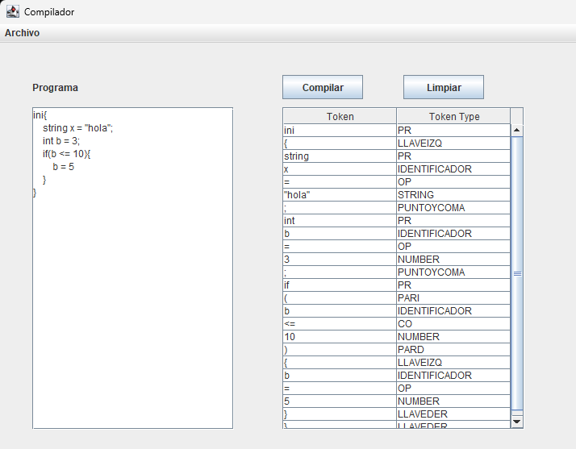
Ejemplo
ini{
string x = "hola";
int b = 3;
if(b <= 10){
b = 5
}
}

Slide 4
program
ini_block
Ini
{
statements
}
statement
statement
statement
variable_declarationString
if_statement
id
=
string
;
pr
pr
(
condition
)
{
statements
}
variable_declarationInt
statement
Expression
<=
Expression
factor
assignment
factor
id
=
number
;
id
number
pr
Expression
id
=
factor
;
number

Slide 5
ini{
string x = "hola";
int b = 3;
if(b <= 10){
b = 5;
}
}
.data
x db “hola$” b dw 3

