Slide 1

Ini
Jose Pablo Ocio Mazo

Slide 2

Gramatica
program -> ini_block
ini_block -> "ini" "{" statements "}"
statements -> statement statements | statement
statement -> variable_declaration | assignment | if_statement | printing
variable_declaration -> type identifier "=" expression ";" | type identifier ";"
assignment -> identifier "=" expression ";"
if_statement -> "if" "(" condition ")" "{" statements "}"
| "if" "(" condition ")" "{" statements "}" "else" "{" statements "}"
for_statement -> "for" "(" variable_declaration ";" condition ";" assignment ")" "{" statements "}"
while_statement -> "while" "(" condition ")" "{" statements "}"
printing -> mostrar "(" identifier ")" ";"
arguments -> expression arguments | expression
expression -> factor operator expression | factor
factor -> identifier | number | "(" expression ")"
condition -> expression comparison_operator expression
operator -> "+"
| "-"
| "*"
| "/"
| "^"
comparison_operator -> ">"
| "<"
| "=>"
| "<="
| "=="
| "!="
type -> "int"
| "string"
identifier -> [a-zA-Z_][a-zA-Z0-9_]*
number -> [0-9]+

Slide 3
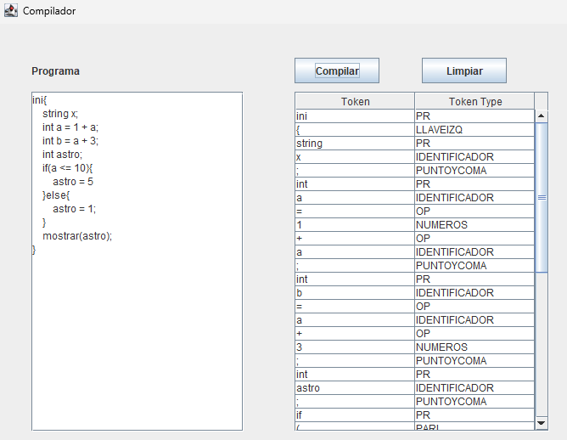
Ejemplo
ini{
string x;
int a = 1 + a;
int b = a + 3;
int astro;
if(a <= 10){
astro = 5
}else{
astro = 1;
}
mostrar(astro);
}

Slide 4
Program

