Slide 1
Professor Kedem’s changes, if any, are marked in green, they are not copyrighted by the authors, and the authors are not responsible for them
Dennis's changes in blue.

Slide 2
Database Design
Logical DB Design:
  Create a model of the enterprise (using ER diagrams perhaps)
  Create a logical “implementation” (using a relational model perhaps)
  Creates the top two layers: “User” and “Community”
  Independent of any physical implementation
Physical DB Design
  requires knowledge of hardware and operating systems characteristics
  depends upon the implementation
  possibly addresses questions of distribution, if necessary
  creates the third layer
Query Optimization ties the two together
©Zvi M. Kedem
Notes:
313

Slide 3
Issues Addressed in Physical Design
Main issues addressed generally in physical design
  Storage Media
  File structures
  Indices
  Query Optimization
  Distribution
We concentrate on
  Centralized (not distributed) databases
  Database stored on a disk using a “standard” file system, not one “tailored” to the database
  Indices
The only issue for us: performance
©Zvi M. Kedem
Notes:
314

Slide 4
What is a Disk?
Disk consists of a sequence of cylinders
A cylinder consists of a sequence of tracks
A track consist of a sequence of blocks (actually each block is a sequence of sectors)
For us: A disk consists of a sequence of blocks
All blocks are of same size, say 16K bytes
We assume: physical block is essentially the same as a virtual memory page
A physical unit of access is always a block.
If an application wants to read a single bit, the system reads a whole block and puts it as a whole page in a cache block
  Unless an up-to-date copy of the page is in RAM already
©Zvi M. Kedem
Notes:
315

Slide 5
What is a File
File can be thought of as “logical” of “physical” entity
File as a logical entity: a sequence of records.
Records are either fixed size or variable
A file as a physical entity: a sequence of blocks (on the disk)
In fact, the blocks are organized into consecutive subsequences called “extents”.
©Zvi M. Kedem
Notes:
316

Slide 6
What is a File (cont.)
Records are stored in blocks
  This gives the relation between a “logical” file and a “physical” file
Very preliminary over-simplified assumptions:
  Fixed size records
  No record spans more than one block
  There are several records in a block
  There is some “left over” space in a block as needed later
©Zvi M. Kedem
Notes:
317

Slide 7
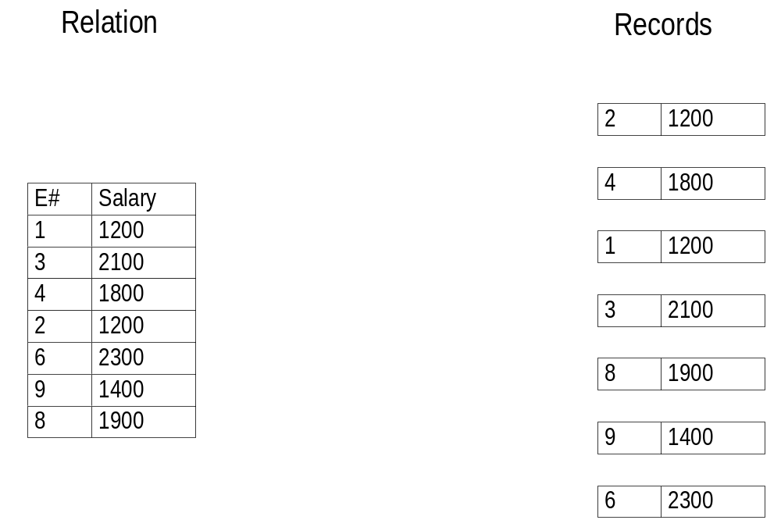
Example: Storing a Relation
Notes:
318

Slide 8
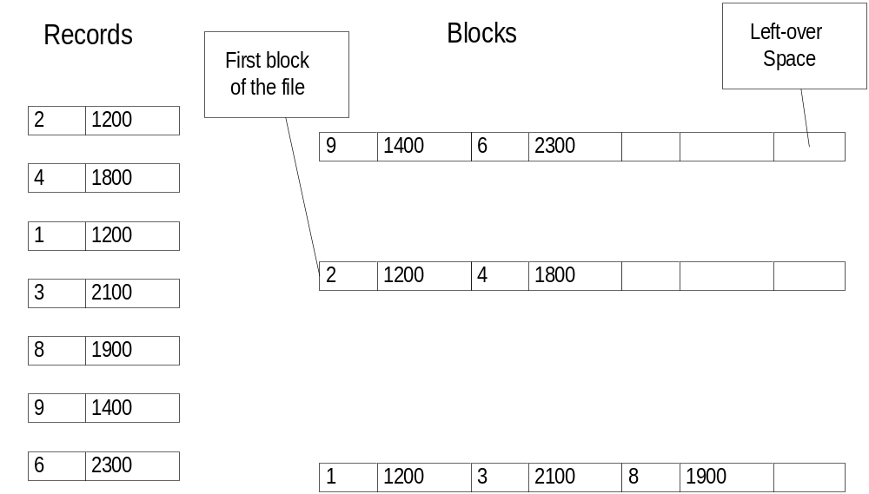
Example: Storing a Relation (cont.)
Notes:
319

Slide 9
Vertical Partitioning Approach
Instead of storing data one record at a time, one can store one column at a time.
In our example that would mean storing the E# values contiguously and then the salaries contiguously with one another but separately from the E# values.
This is a great idea for very wide tables (100s of columns) but where most queries want just a few columns. Particularly good for data warehouses. Example users of this idea: Sybase IQ, kdb, …

Slide 10
Processing a Query
Simple query
SELECT E#
FROM R
WHERE SALARY > 1500;
What needs to be done “under the hood” by the file system:
  Read into RAM at least all the blocks containing all records satisfying the condition (unless already there, which is often the case)
  It may be necessary/useful to read other blocks too, as we see later
  Get the relevant information from the blocks
  Additional processing to produce the answer to the query
What is the cost of this?
We need a “cost model”
©Zvi M. Kedem
Notes:
320

Slide 11
Cost Model
Reading or Writing a block costs 1 time unit
Processing in RAM is free
Ignore caching of blocks (unless done previously by the query itself, as the byproduct of reading)
Justifying the assumptions
  Accessing the disk is much more expensive than any reasonable RAM processing. In practice hit ratios are 90% or more so most data is in RAM. So I/O based model is reasonable only for extremely large tables and scanning aggregate style queries.
  Further, files are laid out sequentially (in extents) and the database system has explicit control over storage. So seek cost matters more.
©Zvi M. Kedem
Notes:
321

Slide 12
Implications of the Cost Model
Goal: Minimize the number of block accesses
A good heuristic: Organize the physical database so that you make as much use as possible from any block you read/write
©Zvi M. Kedem
Notes:
322

Slide 13
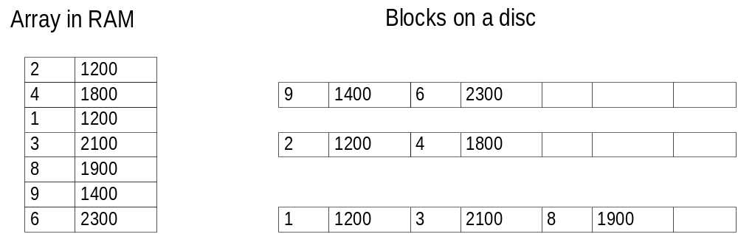
Example
If you know exactly where E# = 2 and E# = 9 are:
The data structure cost model gives a cost of 2 (2 RAM accesses)
The database cost model gives a cost of 2 (2 block accesses)
©Zvi M. Kedem
Notes:
323

Slide 14
Example
If you know exactly where E# = 2 and E# = 4 are:
The data structure cost model gives a cost of 2 (2 RAM accesses)
The database cost model gives a cost of 1 (1 block access)
©Zvi M. Kedem
Notes:
324

Slide 15
File Organization and Indices
If we know what we will generally be asking, we can try to minimize the number of block accesses for “frequent” queries
Tools:
  File organization
  Indices
Intuitively: File organization tries to provide:
  When you read a block you get “many” useful records
Intuitively: Indices try to provide:
  You know where blocks containing useful records are
©Zvi M. Kedem
Notes:
325

Slide 16
Tradeoff
Maintaining file organization and indices is not “free”
Changing (deleting, inserting, updating) the database requires
  maintaining the file organization
  updating the indices
Extreme case: database is used only for SELECT queries
  The “better” file organization and the more indices we have will result in more efficient query processing
Extreme case: database is used only for INSERT queries
  The simpler file organization and no indices (except to avoid duplicates) will result in more efficient query processing
In general, somewhere in between
©Zvi M. Kedem
Notes:
326

Slide 17
Review of Data Structures to Store N Numbers
Heap: unsorted sequence (note difference from the use of the term “heap” (as partially ordered tree) in data structures)
Hashing (great for point queries – queries on a single key)
2-3 trees (sometimes used in main memory based database systems)
B+ trees (the main workhorse of database systems)
©Zvi M. Kedem
Notes:
327

Slide 18
Heap (assume contiguous storage)
Finding (including detecting of non-membership)
Takes between 1 and N operations
Deleting
Takes between 1 and N operations
Inserting
Takes 1 (put in front), or N (put in back if you cannot access the back easily, otherwise also 1), or maybe in between by reusing null values
©Zvi M. Kedem
Notes:
328

Slide 19
Hashing
Pick a number B “somewhat” bigger than N (the number of records in the database; B = 2N is a good rule of thumb).
Pick a “good” pseudo-random function h
h: integers → {0,1, ..., B – 1}
Create a “bucket directory,” D, a vector of length B, indexed 0,1, ..., B – 1
For each integer k, it will be stored in a location pointed at from location D[h(k)], or if there are more than one such integer to a location D[h(k)], create a linked list of locations “hanging” off this D[h(k)]
Probabilistically, almost always, most of the the locations D[h(k)], will be pointing at a linked list of length 1 only
©Zvi M. Kedem
Notes:
331

Slide 20
Hashing: Example of Insertion
N = 7
B = 10
h(k) = k mod B (this is an extremely bad h, but good for a simple example Normally one would at least mod by a prime number)
Integers arriving in order:
37, 55, 21, 47, 35, 27, 14
©Zvi M. Kedem
Notes:
332

Slide 21
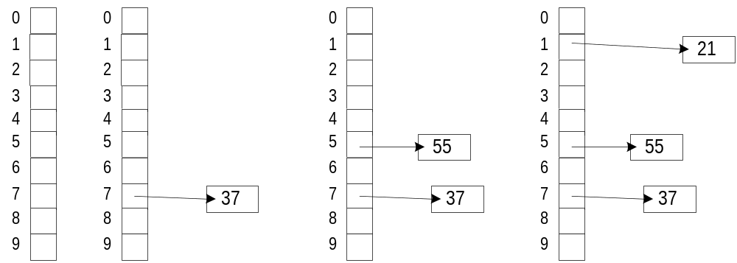
Hashing: Example of Insertion (cont.)
©Zvi M. Kedem
Notes:
333

Slide 22
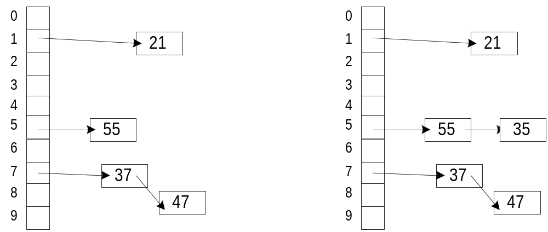
Hashing: Example of Insertion (cont.)
©Zvi M. Kedem
Notes:
334

Slide 23
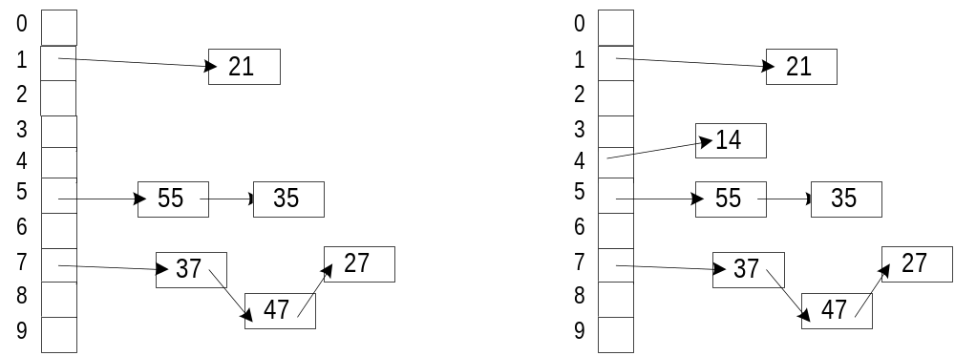
Hashing: Example of Insertion (cont.)
©Zvi M. Kedem
Notes:
335

Slide 24
Hashing (cont.)
Assume, computing h is “free”
Finding (including detecting of non-membership)
Takes between 1 and N + 1 operations.
Worst case, there is a single linked list of all the integers from a single bucket.
Average, between 1 (look at bucket, find nothing). and a little more than 2 (look at bucket, go to the first element on the list, with very low probability, continue beyond the first element)
Deleting
Obvious modification of Finding
Sometimes bucket table too small, act “opposite” to Insert, see next
©Zvi M. Kedem
Notes:
336

Slide 25
Hashing (cont.)
Inserting
Obvious modifications of finding
But sometimes N is “too close” to B. Then, increase the size of the bucket table and rehash. Number of operations linear in N. Can amortize across all accesses.
©Zvi M. Kedem
Notes:
337

Slide 26
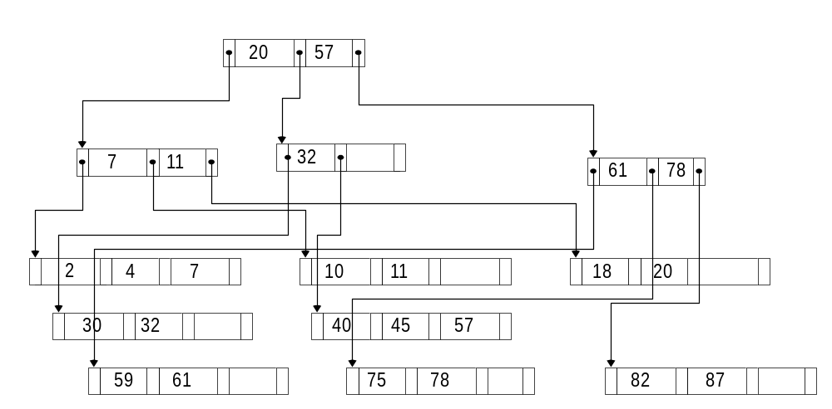
2-3 Tree (an Example)
©Zvi M. Kedem
Notes:
338

Slide 27
2-3 Trees
A 2-3 tree is a rooted (it has a root) directed (order of children matters) tree such that:
  All paths from root to leaves are of same length
  Each node (other than leaves) has between 2 and 3 children. For each child, other than the last there is an index value
  For each non-leaf node, the index value indicates the largest value of the leaf in the subtree rooted at the left of the index value.
  A leaf has between 2 and 3 values from among the integers to be stored
Important properties
  It is possible to maintain the “structural characteristics above,” while inserting and deleting leaf nodes
  Each such operation takes time linear in the number of levels of the tree (which is between log₃N and log₂N; so we write: O(log N).
  We show by example of an insertion
©Zvi M. Kedem
Notes:
339

Slide 28
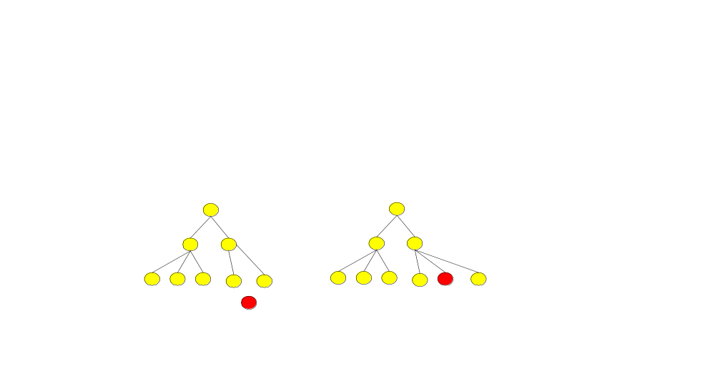
Insertion of a Node in the Right Place
First example: Insertion resolved at the lowest level
©Zvi M. Kedem
Notes:
340

Slide 29
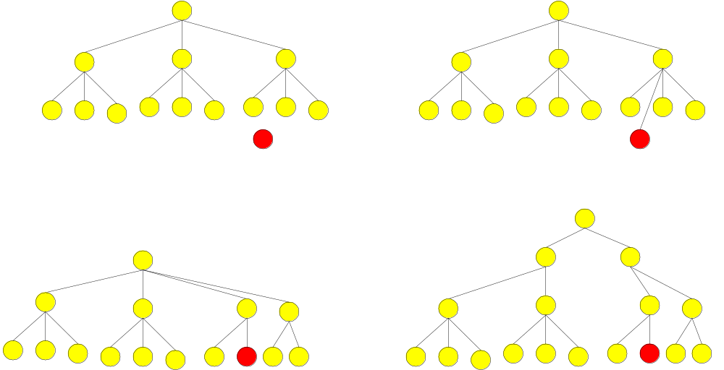
Insertion of a Node in the Right Place (cont.)
Second example: Insertion propagates up to the creation of a new root
©Zvi M. Kedem
Notes:
341

Slide 30
2-3 Trees
Finding (including detecting of non-membership)
Takes O(log N) operations
Deleting
Takes O(log N) operations
Inserting
Takes O(log N) operations
©Zvi M. Kedem
Notes:
342

Slide 31
What to Use?
If the set of integers is large, use either hashing or 2-3 trees (in memory) or B-trees (on disk)
Use 2-3 trees if “many” of your queries are range, sort, >= or <= queries, e.g.,
Find all elements in the range 070520000 to 070529999
Use hashing if “many” of your queries are point queries (based on a single value)
If you have a total of 10,000 integers randomly chosen from the set 0 ,..., 999999999, how many will fall in the range above, you think?
How will you find the answer using hash structures, and how will you find the answer using 2-3 trees?
©Zvi M. Kedem
Notes:
343

Slide 32
B⁺-trees
B⁺-trees are a generalization of 2-3 trees. From now, we will call them B-trees (technically something different, but now “obsolete”)
A B tree is a rooted (it has a root) directed (order of children matters) tree such that:
  All paths from root to leaves are of same length
  For some parameter m:
    All internal (not root and not leaves) nodes have between ceiling of m/2 and m children
    The root has 0 children or between 2 and m children
    If the root is also a leaf, it may have as few as 1 key
Each node consists of a sequence (P is pointer or address, I is index or key):
P₁,I₁,P₂,I₂,...,P_{m-1},I_{m-1},P_{m}
I_{j}’s form an increasing sequence.
I_{j} is the largest key value in the leaves in the subtree pointed by P_{j}
  Note, some authors have slightly different conventions
©Zvi M. Kedem
Notes:
344

Slide 33
B⁺-trees (cont.)
Note that a 2-3 tree is a B-tree with m = 3
Important properties
  For any value of N, and m ≥ 3, there is always a B-tree storing N items in the leaves
  It is possible to maintain this properties for the given m, while inserting and deleting items in the leaves
  Each such operation only O(depth of the tree) nodes need to be manipulated.
Depth of the tree is “logarithmic” in the number of items in the leaves
In fact, this is logarithm to the base at least ceiling of m/2 (ignore the children of the root)
What value of m is best in RAM (assuming RAM cost model)?
m = 3
Why? Think of the extreme case where N is large and m = N
You get a sorted sequence, which is not good
©Zvi M. Kedem
Notes:
345

Slide 34
B⁺-trees (cont.)
But on disk the situation is very different.
The cost to worry about is the number of block accesses. This translates to the number of levels.
For example if a B-tree has a fanout of 1000 on the average, then a four level B-tree can store 1 billion records.
Even a completely balanced binary tree would require about 30 levels. A 2-3 case would require at least log₃ 1,000,000,000
There is one more trick we can use to reduce the number of levels even further: sparseness.
But before we get there, let me tell you an interesting story about why it's good to be lazy when you build B-trees….
©Zvi M. Kedem
Notes:
346

Slide 35
Dense vs. sparse indices
Let there be a file of records
An index (file) pointing to this file is dense if for every record in the file there there is a pointer from the index (file) to the block containing the record (sometimes to record itself) otherwise it is sparse
An index (file) pointing to this file is clustered if in the file logically close records are mostly physically close (for a B-tree, sorted), otherwise it is unclustered
Logically close blocks do not have to be physically close, in general. But normally they are because one lays out tables in those multiblock contiguous sequences called extents.
©Zvi M. Kedem

Slide 36
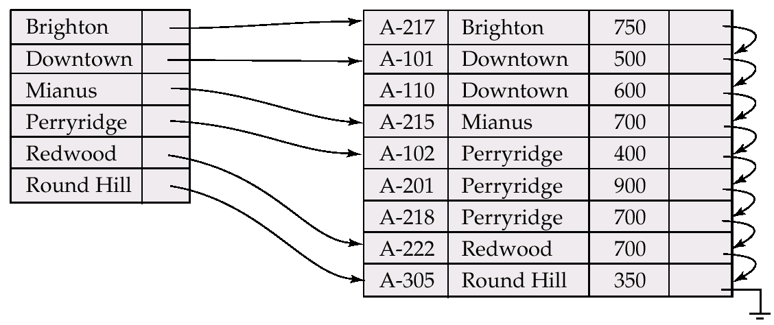
Dense Index Files
Dense index — Index record appears for every search-key value in the file.

Slide 37
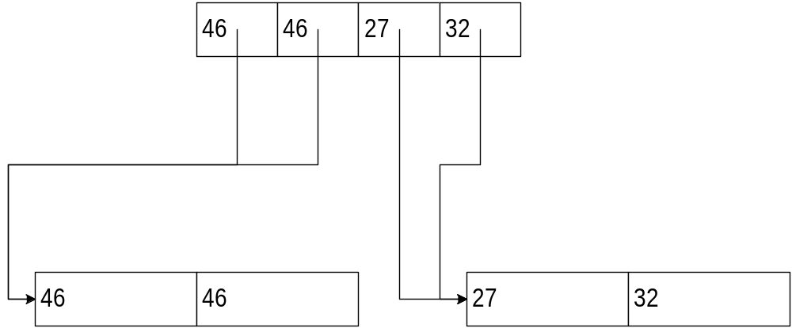
Dense clustered index
(for B trees these would be sorted)
©Zvi M. Kedem

Slide 38
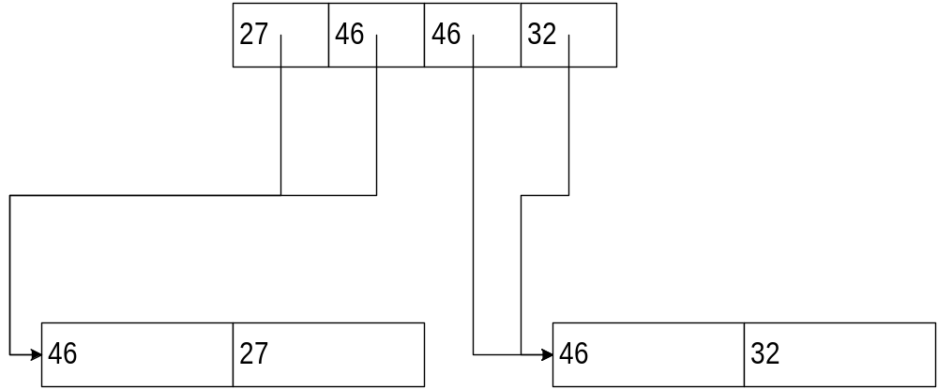
Dense unclustered index
©Zvi M. Kedem

Slide 39
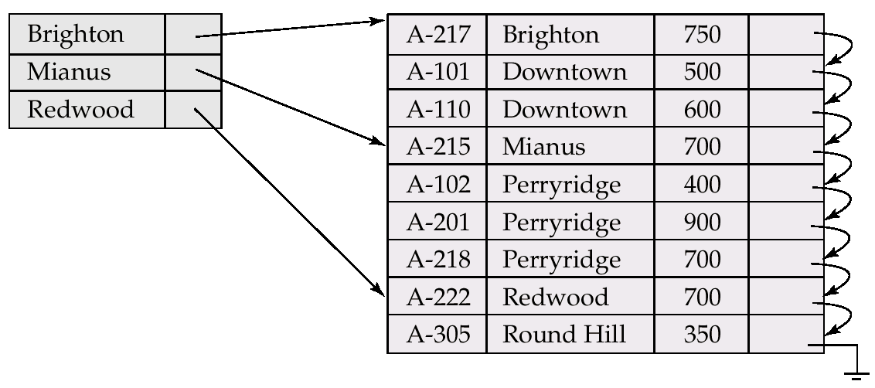
Example of Sparse Index Files

Slide 40
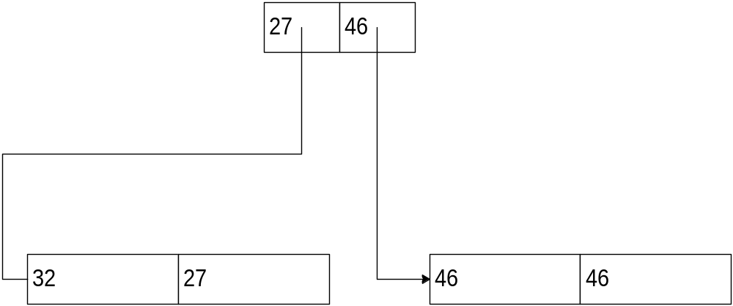
Sparse clustered index (fewer levels)
©Zvi M. Kedem

Slide 41
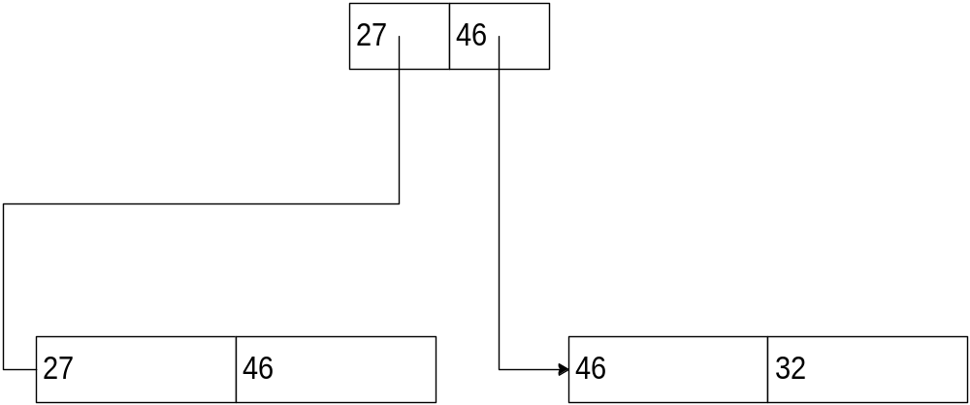
Sparse unclustered index
(never used – would not be able to find records)
©Zvi M. Kedem

Slide 42
Index on Several Columns
In general, a single index can be created for a set of columns
So if there is a relation R(A,B,C,D), and index can be created for, say (B,C)
This means that given a specific value or range of values for (B,C), appropriate records can be easily found
This is applicable for both primary and secondary indices
This can give rise to a “covering index” e.g. Given the index on (B,C) the query
select C from R where B = 5
can be answered without going to the data records at all!
This is vastly faster.
©Zvi M. Kedem

Slide 43
Symbolic vs. Physical Pointers
Our secondary (non-clustered) indices were symbolic
Given value of SALARY or NAME, the “pointer” was primary key value
Instead we could have physical pointers
(SALARY)(block address)* and/or (NAME)(block address)*
Here the block addresses point to the blocks containing the relevant records It's often a trade secret how this is done in a particular DBMS.
©Zvi M. Kedem
Notes:
362

Slide 44
When to Use Indices to Find Records
When you expect that it is cheaper than simply going through the file
How do you know that? Make profiles, estimates, guesses, etc.
Back of the envelope calculation: compare the scan cost in terms of disk accesses with the cost of using a secondary index in terms of disk accesses.
If there are |r| records altogether and there are c records per block and each access in a scan in fact fetches f blocks, then a scan will cost |r|/fc accesses. If we are doing a point query on a key field, then the index is surely worth it, but if not, let us say we're getting p |r| records. For a non-clustering index each such record will entail an access. So we are comparing p |r| with |r|/fc. Whichever is less, we take.
©Zvi M. Kedem
Notes:
363

Slide 45
SQL Specification of indexes
Most commercial database systems implement indices
But indices are not a part of any existing SQL standard
Assume relation R(A,B,C,D) with primary key A
Some typical statements in commercial SQL-based database systems
  CREATE UNIQUE INDEX index1 on R(A)
  CREATE INDEX index2 ON R(B ASC,C)
  CREATE CLUSTERED INDEX index3 on R(A)
  DROP INDEX index4
Generally some variant of B tree is used (not hashing)
  In fact generally you cannot specify whether to use B-trees or hashing

Slide 46
Deficiencies of Static Hashing
In static hashing, function h maps search-key values to a fixed set of B of bucket addresses.
  Databases grow with time. If initial number of buckets is too small, performance will degrade due to too much overflows.
  If file size at some point in the future is anticipated and number of buckets allocated accordingly, significant amount of space will be wasted initially.
  If database shrinks, again space will be wasted.
  One option is periodic re-organization of the file with a new hash function, but it is very expensive.
These problems can be avoided by using techniques that allow the number of buckets to be modified dynamically.

Slide 47
Dynamic Hashing
Good for database that grows and shrinks in size
Allows the hash function to be modified dynamically
Extendable hashing – one form of dynamic hashing
  Hash function generates values over a large range — typically b-bit integers, with b = 32.
  At any time use only a prefix of the hash function to index into a table of bucket addresses.
  Let the length of the prefix be i bits, 0 ≤ i ≤ 32.
  Bucket address table size = 2^{i.} Initially i = 0
  Value of i grows and shrinks as the size of the database grows and shrinks.
  Multiple entries in the bucket address table may point to a bucket.
  Thus, actual number of buckets is < 2^{i}
    The number of buckets also changes dynamically due to coalescing and splitting of buckets.

Slide 48
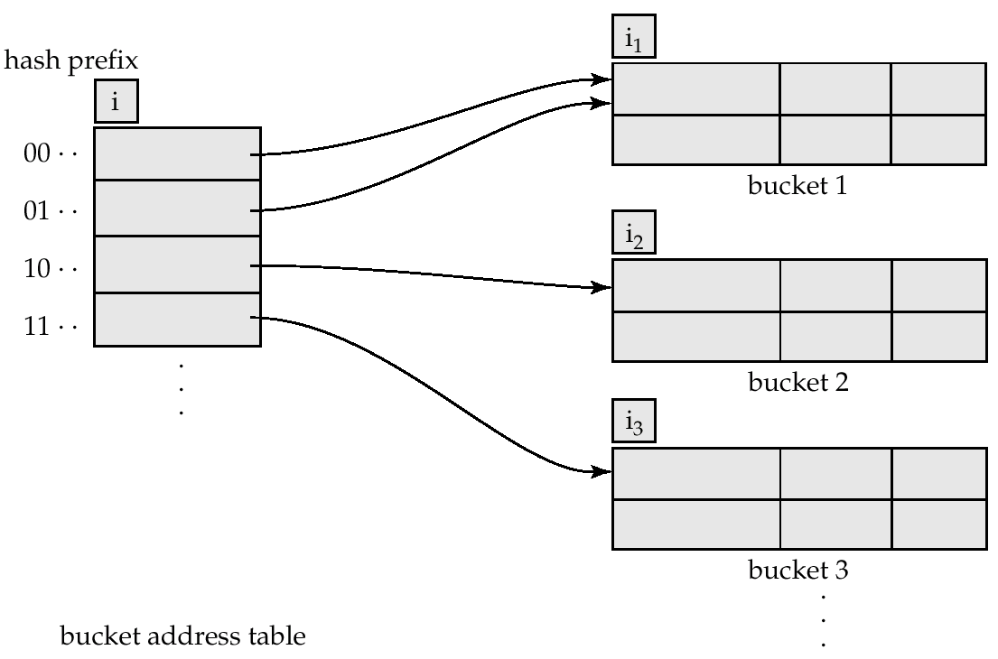
General Extendable Hash Structure
In this structure, i₂ = i₃ = i, whereas i₁ = i – 1 (see next slide for details)

Slide 49
Use of Extendable Hash Structure
Each bucket j stores a value i_{j}; all the entries that point to the same bucket have the same values on the first i_{j} bits.
To locate the bucket containing search-key K_{j}:
  1. Compute h(K_{j}) = X
  2. Use the first i high order bits of X as a displacement into bucket address table, and follow the pointer to appropriate bucket
To insert a record with search-key value K_{j}
  follow same procedure as look-up and locate the bucket, say j.
  If there is room in the bucket j insert record in the bucket.
  Else the bucket must be split and insertion re-attempted (next slide.)
    Overflow buckets used instead in some cases (will see shortly)

Slide 50
Updates in Extendable Hash Structure
To split a bucket j when inserting record with search-key value K_{j}:
If i > i_{j} (more than one pointer to bucket j)
  allocate a new bucket z, and set i_{j} and i_{z} to the old i_{j} -+ 1.
  make the second half of the bucket address table entries pointing to j to point to z
  remove and reinsert each record in bucket j.
  recompute new bucket for K_{j} and insert record in the bucket (further splitting is required if the bucket is still full)
If i = i_{j} (only one pointer to bucket j)
  increment i and double the size of the bucket address table.
  replace each entry in the table by two entries that point to the same bucket.
  recompute new bucket address table entry for K_{j}
  Now i > i_{j} so use the first case above.

Slide 51
Updates in Extendable Hash Structure (Cont.)
When inserting a value, if the bucket is full after several splits (that is, i reaches some limit b) create an overflow bucket instead of splitting bucket entry table further.
To delete a key value,
  locate it in its bucket and remove it.
  The bucket itself can be removed if it becomes empty (with appropriate updates to the bucket address table).
  Coalescing of buckets can be done (can coalesce only with a “buddy” bucket having same value of i_{j} and same i_{j} –1 prefix, if it is present)
  Decreasing bucket address table size is also possible
    Note: decreasing bucket address table size is an expensive operation and should be done only if number of buckets becomes much smaller than the size of the table

Slide 52
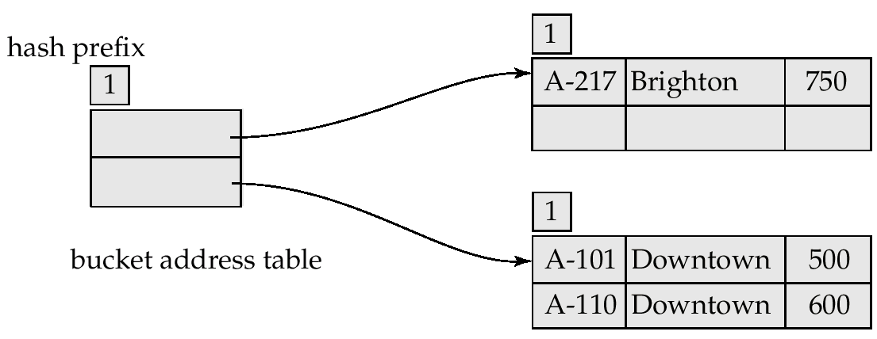
Example (Cont.)
Hash structure after insertion of one Brighton and two Downtown records

Slide 53
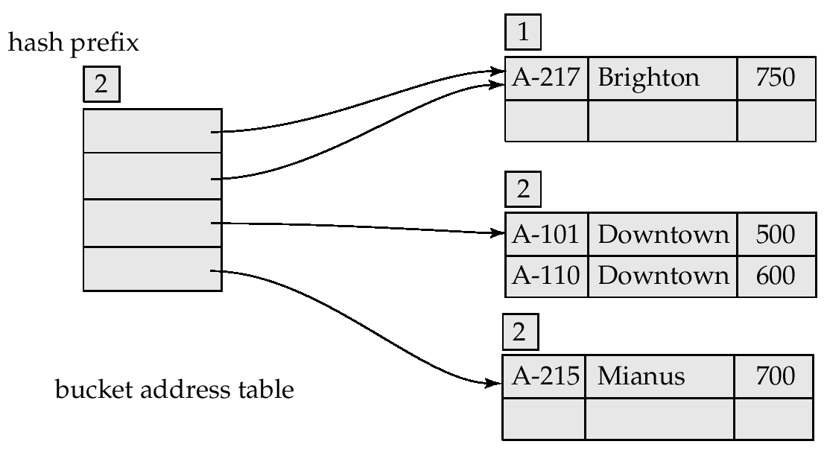
Example (Cont.)
Hash structure after insertion of Mianus record

Slide 54
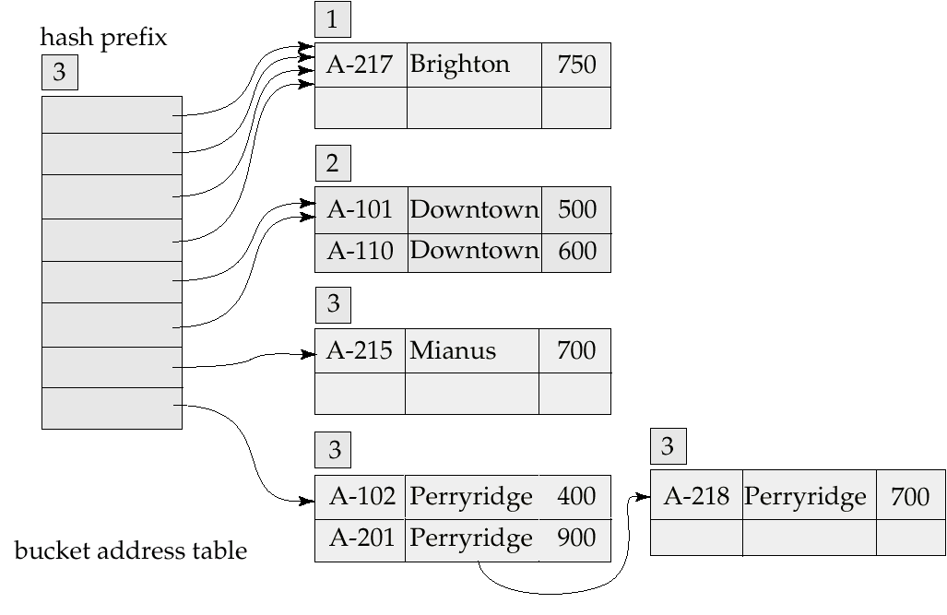
Example (Cont.)
Hash structure after insertion of three Perryridge records

Slide 55
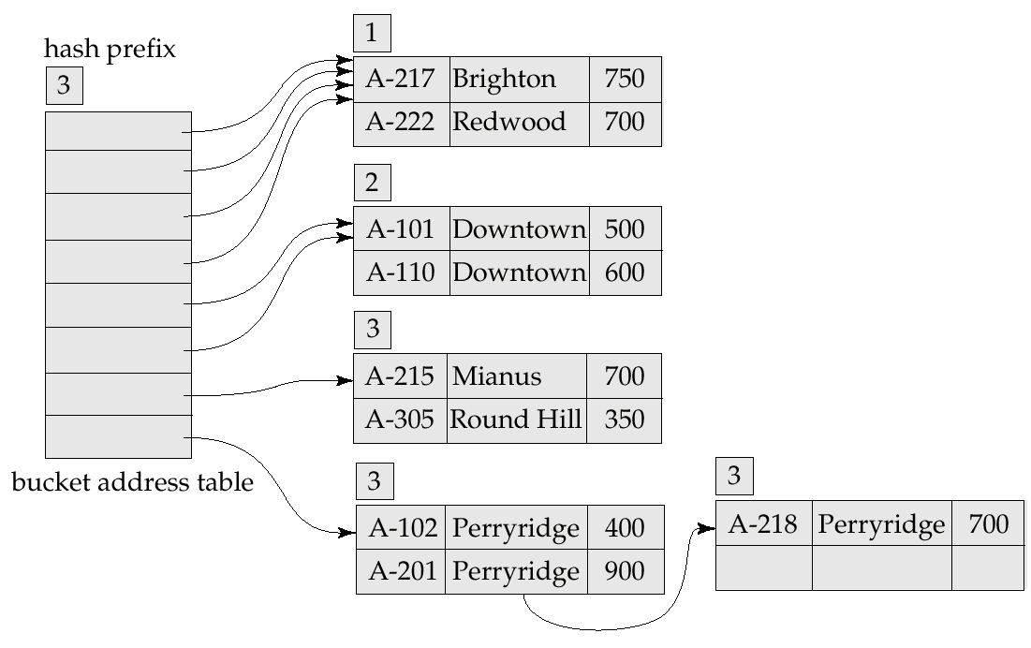
Example (Cont.)
Hash structure after insertion of Redwood and Round Hill records

Slide 56
Extendable Hashing vs. Other Schemes
Benefits of extendable hashing:
  Hash performance does not degrade with growth of file
  Minimal space overhead
Disadvantages of extendable hashing
  Bucket address table may itself become very big (larger than memory)
    Need a tree structure to locate desired record in the structure!
  Changing size of bucket address table is an expensive operation
Linear hashing is an alternative mechanism which avoids these disadvantages at the possible cost of more bucket overflows

Slide 57
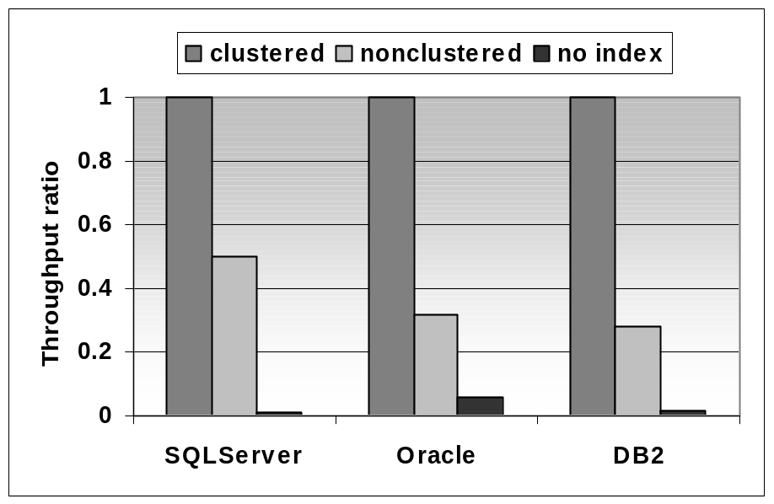
Clustered Index
(Remaining slides in this unit from Shasha and Bonnet Database Tuning book)
Multipoint query that returns 100 records out of 1000000.
Cold buffer
Clustered index is twice as fast as non-clustered index and orders of magnitude faster than a scan.

Slide 58
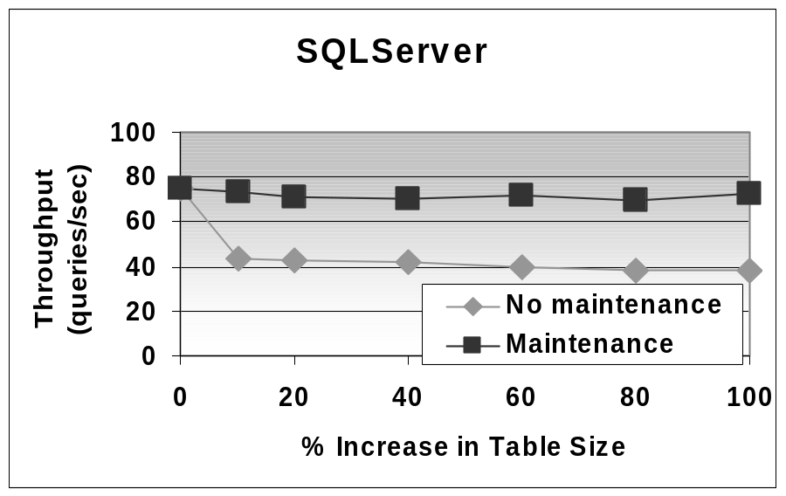
Index “Face Lifts”
Index is created with fillfactor = 100.
Insertions cause page splits and extra I/O for each query
Maintenance consists in dropping and recreating the index
With maintenance performance is constant while performance degrades significantly if no maintenance is performed.

Slide 59
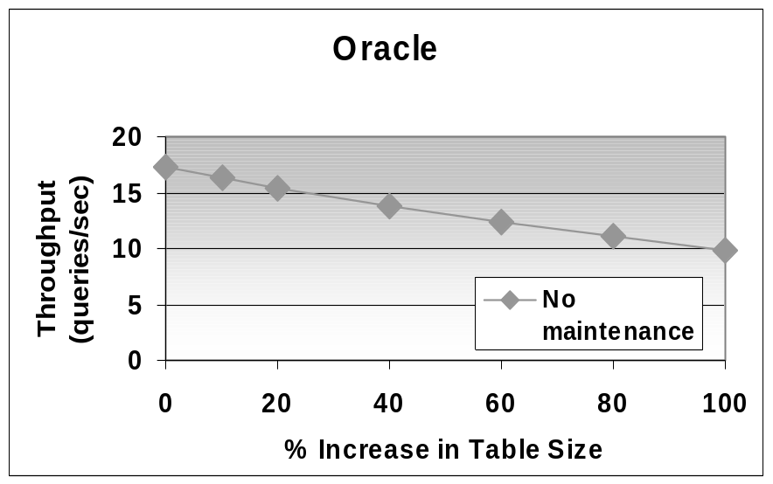
Index Maintenance
In Oracle, clustered index are approximated by an index defined on a clustered table
No automatic physical reorganization
Index defined with pctfree = 0
Overflow pages cause performance degradation

Slide 60
Covering Index - defined
Select name from employee where department = “marketing”
Good covering index would be on (department, name)
Index on (name, department) less useful.
Index on department alone moderately useful.

Slide 61
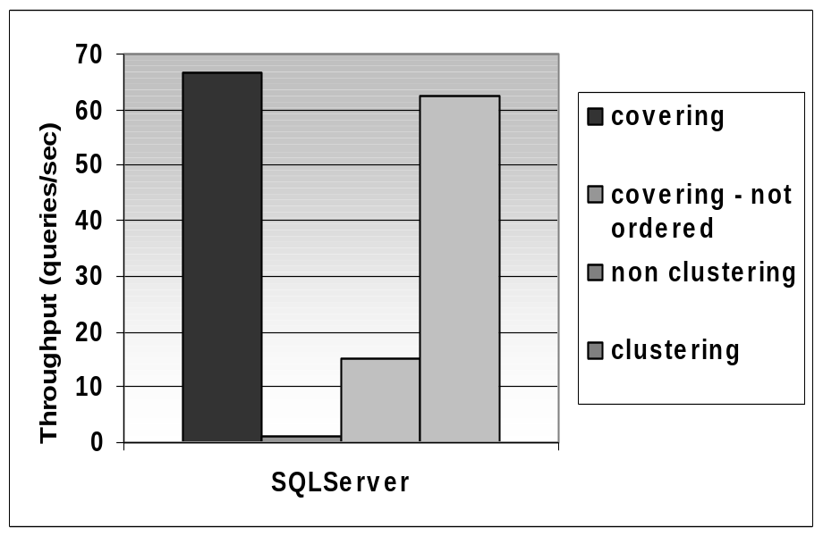
Covering Index - impact
Covering index performs better than clustering index when first attributes of index are in the where clause and last attributes in the select.
When attributes are not in order then performance is much worse.

Slide 62
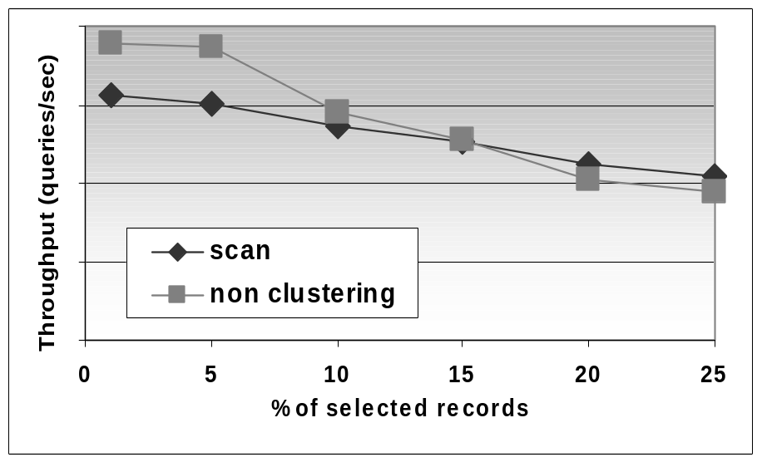
Scan Can Sometimes Win
IBM DB2 v7.1 on Windows 2000
Range Query
If a query retrieves 10% of the records or more, scanning is often better than using a non-clustering non-covering index. Crossover > 10% when records are large or table is fragmented on disk – scan cost increases.

Slide 63
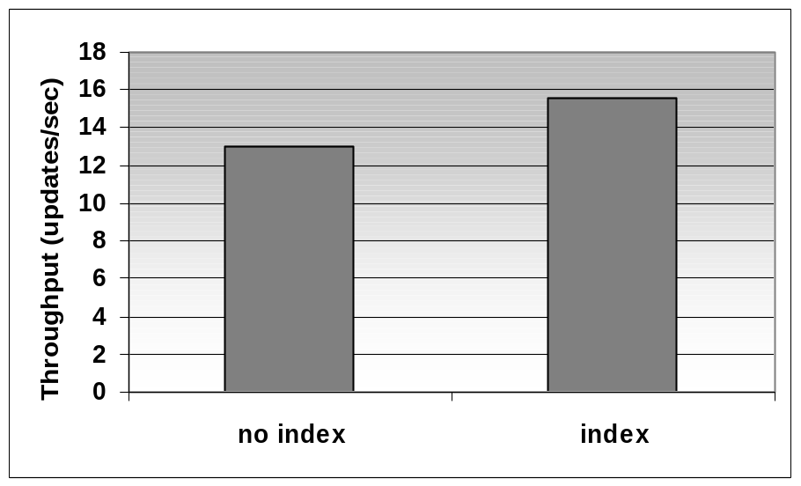
Index on Small Tables
Small table: 100 records, i.e., a few pages.
Two concurrent processes perform updates (each process works for 10ms before it commits)
No index: the table is scanned for each update. No concurrent updates.
A clustered index allows to take advantage of row locking.

