Slide 1
AQuery
A Database System for Order
Dennis Shasha
Joint work with Alberto Lerner
lerner@cs.nyu.edu
shasha@cs.nyu.edu

Slide 2
Motivation
The need for ordered data
Queries in Finance, Biology, and Network Management depend on order.
SQL 99 has extensions – the OLAP amendment – that incorporate order to the language but they are clumsy to use.

Slide 3
3-month moving average: the wrong way
month
1
2
3
4
5
sales
100
120
140
140
130
3-avg
100
110
120
133
136
SELECT t1.month,t1.sales,
(t1.sales+t2.sales+t3.sales)/3
FROM Sales t1, Sales t2, Sales t3
WHERE t1.month – 1 = t2.month AND
t1.month – 2 = t3.month
Problems?
Join eliminates first two months!
Do we really need a three-way join?
Can the optimizer make it linear-time?

Slide 4
3-month moving average: the hard way
month
1
2
3
4
5
sales
100
120
140
140
130
3-avg
100
110
120
133
136
SELECT t1.month,t1.sales,
(t1.sales+
CASE WHEN t2.sales is null AND
t3.sales is null
THEN 2*t1.sales
WHEN t2.sales is not null AND
t3.sales is null
THEN t2.sales
+(t1.sales+t2.sales)/2
ELSE t2.sales + t3.sales
END) / 3
FROM Sales t1
LEFT OUTER JOIN Sales t2
ON t1.month – 1 = t2.month
LEFT OUTER JOIN Sales t3
ON t1.month – 2 = t3.month
Problems?
“Write-once” query
Three way join

Slide 5
3-month moving average: the OLAP way
month
1
2
3
4
5
sales
100
120
140
140
130
3-avg
100
110
120
133
136
SELECT month,sales,
avg(sales) OVER (ORDER BY month
ROWS BETWEEN
2 PRECEDING AND
CURRENT ROW)
FROM Sales
Problems?
OVER construct is confined to the
SELECT clause
Awkward syntax

Slide 6
Network Management Query
Find duration and average length of packets of src-dst flows. A flow from src to dest ends after a 2-minute silence
WITH
Prec AS (src,dst,len,time,ptime)
(SELECT src,dst,len,time,min(time) OVER w
FROM Packets
WINDOW w AS
(PARTITION BY src,dst
ORDER BY time
ROWS BETWEEN 1 PRECEDING
AND 1 PRECEEDING)),
Flow AS (src,dst,len,time,flag)
(SELECT src,dst,len,time,
CASE
WHEN time-ptime > 120 THEN 1
ELSE 0
FROM Prec),
FlowID AS (src,dst,len,time,fID)
(SELECT src,dst,len,time,sum(flag) OVER w
FROM Flow
WINDOW w AS
(ORDER BY src,dst, time
ROWS UNBOUNDED PRECEDING))
SELECT src,dst,count(*),avg(len)
FROM FlowID
GROUP BY src,dst,fID
Packets
src
s1
s1
s2
s1
s2
s2
dst
s2
s2
s1
s2
s1
s1
len
250
270
330
235
280
305
time
1
20
47
141
150
155

Slide 7
Order in SQL:1999
Inter-tuple operations require joins or additional query constructs - or both!
Ordering can only be obtained in specific clauses (e.g., SELECT)
Bottom line:
Queries become difficult to read
Cost of execution is larger than necessary (optimization of nested queries is still an open problem)

Slide 8
Idea
Replace ordered tables (arrables) for tables in the data model (inspiration from KSQL by KX systems)
  Whatever can be done on a table can be done on an arrable. Not vice-versa.
Define order on a per-query basis
  All query clauses can count on data ordering
Maintain SQL flavor (upward compatibility to SQL 92) while allowing expressions based on order with no additional language constructs
Exploit optimization techniques involving order
That’s AQuery!

Slide 9
Moving average over Arrables
month
1
2
3
4
5
sales
100
120
140
140
130
3-avg
100
110
120
133
136
SELECT month,avgs(3,sales)
FROM Sales
ASSUMING ORDER month
Arrable: a collection of named
arrays, ordered by a column list

Slide 10
Moving average over Arrables
month
1
2
3
4
5
sales
100
120
140
140
130
3-avg
100
110
120
133
136
SELECT month,avgs(3,sales)
FROM Sales
ASSUMING ORDER month
Arrable: a collection of named
arrays, ordered by a column list
Each query defines data ordering

Slide 11
Moving average over Arrables
month
1
2
3
4
5
sales
100
120
140
140
130
3-avg
100
110
120
133
136
SELECT month,avgs(3,sales)
FROM Sales
ASSUMING ORDER month
Arrable: a collection of named
arrays, ordered by a column list
Each query defines data ordering
Variables (e.g., month) are bound
to an array, as opposed to a value

Slide 12
Moving average over Arrables
month
1
2
3
4
5
sales
100
120
140
140
130
3-avg
100
110
120
133
136
SELECT month,avgs(3,sales)
FROM Sales
ASSUMING ORDER month
Arrable: a collection of named
arrays, ordered by a column list
Each query defines data ordering
Variables (e.g., month) are bound
to an array, as opposed to a value
Expression are mappings from arrays
to array

Slide 13
Built-in Functions
size-
preserving
non size-
preserving
prev, next
avgs, prds, sums, mins,
deltas, ratios, reverse,
…
drop, first, last
order-
dependent
rank, n-tile
min, max, avg, count
non order-
dependent

Slide 14
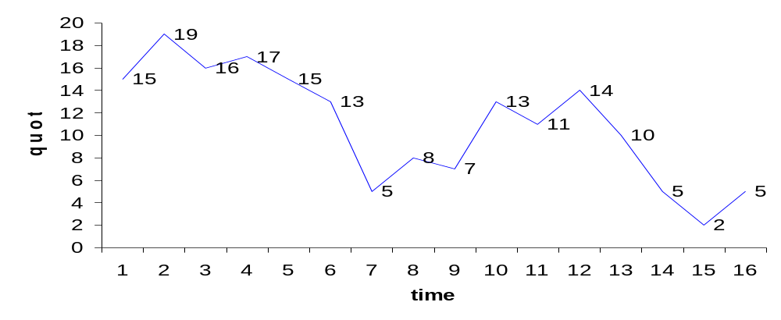
Emotive Query
Find the best profit one could make by buying a stock and
selling it later in the same day
price 15 19 16 17 15 13 5 8 7 13 11 14 10 5 2 5

Slide 15
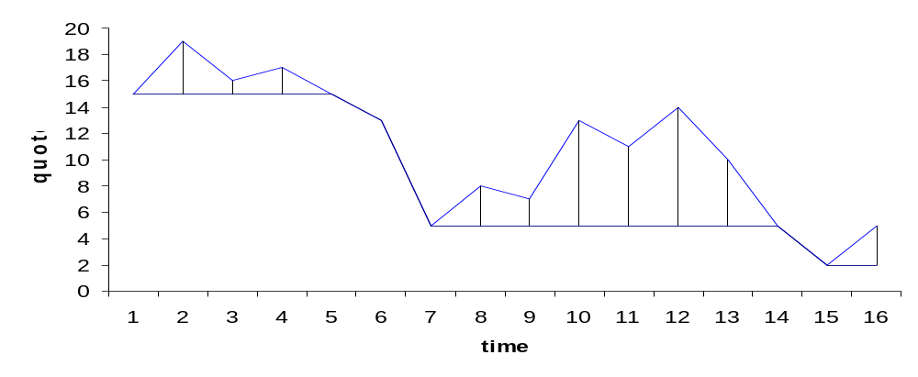
Emotive Query
Find the best profit one could make by buying a stock and
selling it later in the same day
price 15 19 16 17 15 13 5 8 7 13 11 14 10 5 2 5
mins(price)15 15 15 15 15 13 5 5 5 5 5 5 5 5 2 2
0 4 1 2 0 0 0 3 2 8 6 9 0 0 0 3

Slide 16
Best-profit Query Comparison
[AQuery]
SELECT max(price–mins(price))
FROM ticks
ASSUMING timestamp
WHERE ID=“S”
AND tradeDate=‘1/10/03'
[SQL:1999]
SELECT max(rdif)
FROM (SELECT ID,tradeDate,
price - min(price)
OVER
(PARTITION BY ID,
tradeDate
ORDER BY timestamp
ROWS UNBOUNDED
PRECEDING) AS rdif
FROM Ticks ) AS t1
WHERE ID=“S”
AND tradeDate=‘1/10/03'
Optimizer doesn’t
push this selection. To get good performance, the query author has to rewrite it.

Slide 17
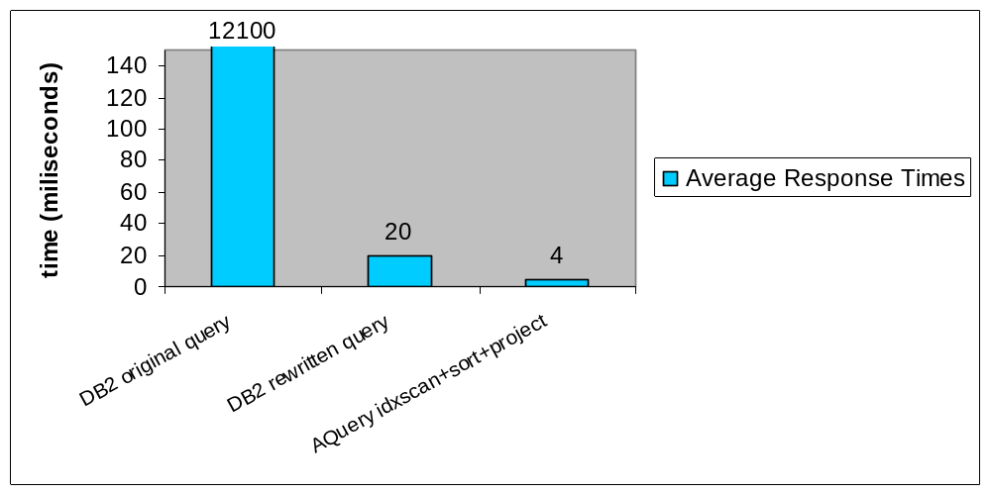
Best-profit Query Performance

Slide 18
Complex queries: Network
Management Query Revisited
Create a log of flow information. A flow from src to dest ends after a 2-minutes silence
Packets
pID
...
src
...
dest
...
len
...
time
...
SELECT src, dst, count(*), avg(len)
FROM Packets
ASSUMING ORDER src, dst, time
GROUP BY src, dst, sums (deltas(time) > 120)

Slide 19
Network Management Query in Pictures
Packets
src
s1
s1
s2
s1
s2
s2
dst
s2
s2
s1
s2
s1
s1
len
250
270
330
235
280
305
time
1
20
47
141
150
155
SELECT src, dst, count(*), avg(len)
FROM Packets
ASSUMING ORDER src, dst, time
GROUP BY src, dst, sums (deltas(time) > 120)

Slide 20
Network Management Query in Pictures
Packets
src
s1
s1
s2
s1
s2
s2
dst
s2
s2
s1
s2
s1
s1
len
250
270
330
235
280
305
time
1
20
47
141
150
155
Packets
src
s1
s1
s1
s2
s2
s2
dst
s2
s2
s2
s1
s1
s1
len
250
270
235
330
280
305
time
1
20
141
47
150
155
SELECT src, dst, count(*), avg(len)
FROM Packets
ASSUMING ORDER src, dst, time
GROUP BY src, dst, sums (deltas(time) > 120)

Slide 21
Network Management Query in Pictures
Packets
src
s1
s1
s1
s2
s2
s2
dst
s2
s2
s2
s1
s1
s1
len
250
270
235
330
280
305
time
1
20
141
47
150
155
c1
F
F
T
F
F
F
SELECT src, dst, count(*), avg(len)
FROM Packets
ASSUMING ORDER src, dst, time
GROUP BY src, dst, sums (deltas(time) > 120)

Slide 22
Network Management Query in Pictures
Packets
src
s1
s1
s1
s2
s2
s2
dst
s2
s2
s2
s1
s1
s1
len
250
270
235
330
280
305
time
1
20
141
47
150
155
c1
F
F
T
F
F
F
c2
0
0
1
1
1
1
SELECT src, dst, count(*), avg(len)
FROM Packets
ASSUMING ORDER src, dst, time
GROUP BY src, dst, sums (deltas(time) > 120)

Slide 23
Network Management Query in Pictures
Packets
src
s1
s1
s1
s2
s2
s2
dst
s2
s2
s2
s1
s1
s1
len
250
270
235
330
280
305
time
1
20
141
47
150
155
c1
F
F
T
F
F
F
c2
0
0
1
1
1
1
SELECT src, dst, count(*), avg(len)
FROM Packets
ASSUMING ORDER src, dst, time
GROUP BY src, dst, sums (deltas(time) > 120)

Slide 24
Network Management Query in Pictures
Packets
src
s1
s1
s1
s2
s2
s2
dst
s2
s2
s2
s1
s1
s1
len
250
270
235
330
280
305
time
1
20
141
47
150
155
src
s1
s1
s2
dst
s2
s2
s1
len
250,270
235
330,280,305
time
1,20
141
47,150,155
SELECT src, dst, count(*), avg(len)
FROM Packets
ASSUMING ORDER src, dst, time
GROUP BY src, dst, sums (deltas(time) > 120)

Slide 25
Network Management Query in Pictures
Packets
src
s1
s1
s1
s2
s2
s2
dst
s2
s2
s2
s1
s1
s1
len
250
270
235
330
280
305
time
1
20
141
47
150
155
src
s1
s1
s2
dst
s2
s2
s1
len
250,270
235
330,280,305
time
1,20
141
47,150,155
src
s1
s1
s2
dst
s2
s2
s1
avg(len)
260
235
305
count(*)
2
1
3
SELECT src, dst, count(*), avg(len)
FROM Packets
ASSUMING ORDER src, dst, time
GROUP BY src, dst, sums (deltas(time) > 120)

Slide 26
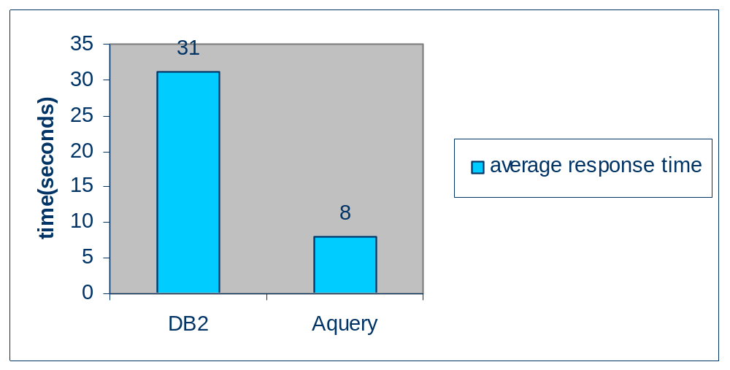

Network Management Query Performance

Slide 27
Order-aware Query Languages
Relations, Sequences, and ordered-relations
  SQL:1999
  Sequin (Seshadri et al., 96)
  SRQL (Ramakrishnan et al., 98)
  Grouping in SQL (Chatziantoniou and Ross, 96)
Array query languages
  AQL (Libkin et al., 96)
  AML (Marathe and Salem, 97)
  RaSQL (Widmann and Baumann, 98)
  KSQL (KX Systems) – our direct ancestor

Slide 28
Order-related
Optimization Techniques
Starburst’s “glue” (Lohman 88) and Exodus/Volcano “Enforcers” (Graefe and McKeena, 93)
DB2 Order optimization (Simmens et al., 96)
Top-k query optimization (Carey and Kossman, 97; Bruno,Chaudhuri, and Gravano 02)
Hash-based order-preserving join (Claussen et al., 01)
Temporal query optimization addressing order and duplicates (Slivinskas et al., 01)

Slide 29
AQuery Optimization
Optimization is cost based
The main strategies are:
  Define the extent of the order-preserving region of the plan, considering (correctness, obviously, and) the performance of variation of operators
  Exploit algebraic equivalences
  Apply efficient implementations of patterns of operators (e.g. “edge-by”)

Slide 30
Interchange sorting + order preserving operators
SELECT ts.ID, avgs(10, hq.ClosePrice)
FROM TradedStocks AS ts NATURAL JOIN
HistoricQuotes AS hq
ASSUMING ORDER hq.TradeDate
GROUP BY Id
π
π
_{avgs()}
π
_{avgs()}
_{avgs()}
gby
π
gby
sort
_{avgs()}
gby
sort
gby
sort
(1) Sort then join
preserving order
(2) Preserve existing
order
(3) Join then sort
before grouping
(4) Join then sort
after grouping

Slide 31
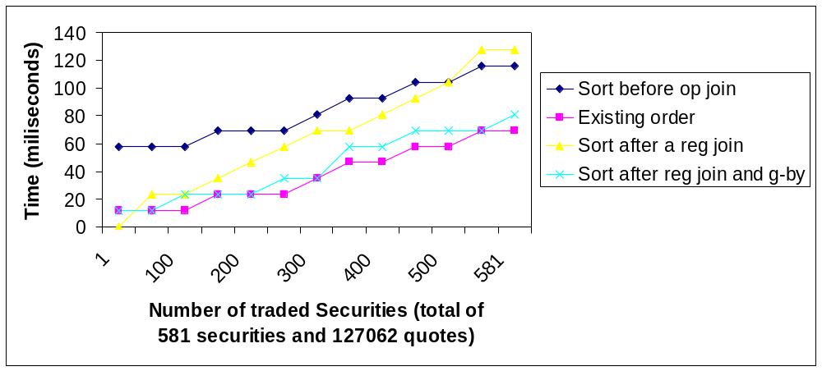
Performance depends on size

Slide 32
Last price for a name query
SELECT last(price)
FROM ticks t,base b
ASSUMING ORDER name,timestamp
WHERE t.ID=b.ID
AND name=“x”
π
_{last(price)}
σ
_{Name=“x”}
sort
_{name,timesamp}
Ticks
ID
...
date
...
price
...
time
...
_{ID}
base
ID
...
name
...
ticks
base

Slide 33
Last price for a name query
The sort on name can be eliminated because there will be only one name
Then, push sort
  sort_{A}(r₁ r₂) ≡_{A} sort_{A}(r₁) ^{lop} r₂
  sort_{A}(r) ≡_{A} r
π
_{last(price)}
sort
_{name,timesamp}
_{ID}
ticks
σ
_{Name=“x”}
base

Slide 34
Last price for a name query
π
_{price}
The projection is carrying an implicit selection: last(price) = price[n], where n is the last index of the price array
  π_{f(r.col[i])}(r) ≡_{order(r)}
  π_{f(r.col)}(σ_{pos()=i}(r))
π
_{last(price)}
σ
_{pos()=last}
_{lop}
_{ID}
ticks
σ
_{Name=“x”}
base

Slide 35
Last price for a name query
But why join the entire relation if we are only using the last tuple?
Can we somehow push the last selection down the join?
π
_{price}
σ
_{pos()=last}
_{lop}
_{ID}
ticks
σ
_{Name=“x”}
base

Slide 36
Last price for a name query
We can take the last position of each ID on ticks to reduce cardinality, but we need to group by ticks.ID first
But trading a join for a group by is usually a good deal?!
One more step: make this an “edge by”
π
_{price}
σ
_{safety}
_{lop}
_{ID}
σ
_{each}
σ
_{pos()=last}
_{Name=“x”}
Gby
_{ID}
base
ticks

Slide 37
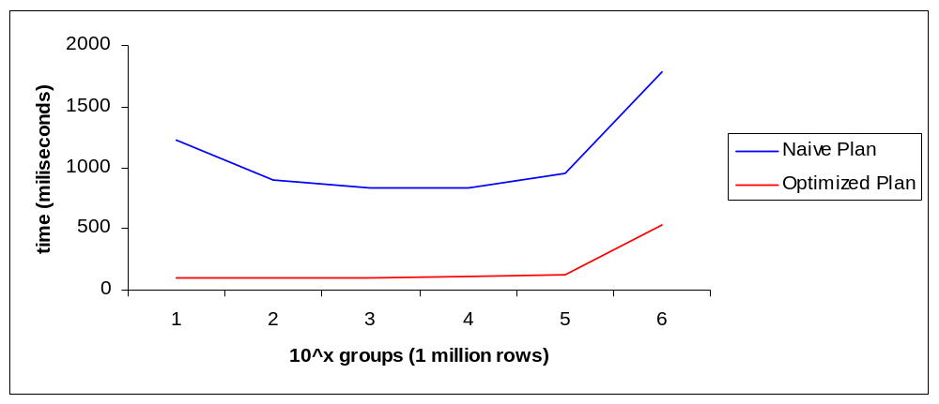
Performance

Slide 38
Conclusion
AQuery declaratively incorporates order in a per-query basis
Any clause can rely on order; expressions can be order-dependent
Optimization possibilities are vast; performance improvements of an order of magnitude
Applications to Finance, Biology, Linguistics, ...
http://www.cs.nyu.edu/~lerner
(for additional references)

