Slide 1
Clustering the Neighbourhoods with Chinese Restaurants of London
Final Project
Applied Capstone
José Antonio Peño Beldad
21-01-2020

Slide 2
Index
1. Introduction
2. Business problem
3. Data
Wikipedia
Foursquare API
ArcGIS geolocations
4. Methodology
Tables and data obtained from Wikipedia and Foursquare
5. Results
6. Discussion
7. Conclusion

Slide 3
Introduction
This is the final project of the IBM Data Science Course on Coursera. In this project, I have analyzed the scenario of Chinese Restaurants in London. The results and data obtained might be used such as information for tourisms guides, neighbourhoods where it is possible to create a new Chinese restaurant or areas to avoid in the city for this news Chinese restaurants. Whit these ideas in mind, I have developed this project to get the correct information for tourists or the best locations for new restaurant. The project will be developed with python, Foursquare API and all tools and mechanism that I have learned in this IBM Course.

Slide 4
Business problem
The aim of this project is to help to find the best location for any person that wants establish his Chinese Restaurant in London. In addition, this project can help to elaborate a tourist guide with the better information about Chinese Restaurants in the capital of United Kingdom.

Slide 5
Data
It is necessary data about the boroughs (or Neighbourhoods), geolocation data of each borough and all the venues in each borough visited by the people in London. When we have obtained this information will be relevant the correct union of valid information in order to cluster the Neighbourhoods and obtain valuables results. We are going to use the following apps or websites pages in order to obtain the primary information:
Wikipedia
Foursquare API
ArcGIS geolocations

Slide 6
Wikipedia
To obtain the data of London's Borough, we have to scrape data from: https://en.wikipedia.org/wiki/List_of_areas_of_London
On this website we will obtain: Borough, Town and Postal code after clean the dataframes.
Borough: Name of Neighbourhood
Town: Name of Borough
Post-code: Postal codes in London

Slide 7
Foursquare API
We need credentials in order to obtain the information, so first of all we have to register in Foursquare Developer API https://foursquare.com/. All the information about venues location in London will be provided by Foursquare API. This information will be the cornerstone to elaborate this project.
On this website we will obtain: Neighbourhoods, latitude, longitude, venues and venues category.
Neighbourhood: Name of Neighbourhood in London
Latitude Neighbourhood: Latitude coordinate of each Neighbourhood in London
Longitude Neighbourhood: Longitude coordinate of each Neihgbourhood in London
Venue: Name of venue in London
Venue Category: Category assigned of each venue in London

Slide 8
ArcGIS geolocations
Arcgis is a System of Geographic Information (GIS) that provide to the project the coordinates of each neighbourhood and the city of London in order to obtain the maps and make the cluster with Folium.
Latitude Neighbourhood: Data of latitude coordinates
Longitude Neighbourhood: Data of longitude coordinates

Slide 9
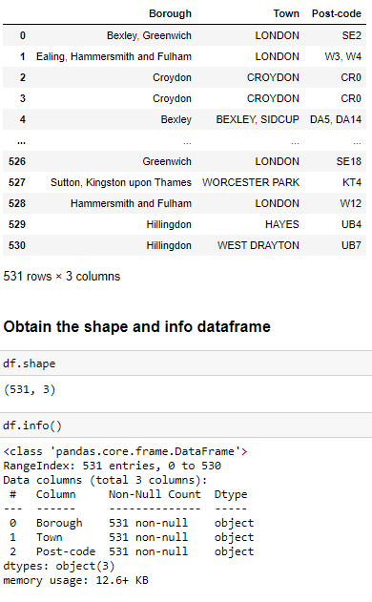
Methodology
First, we need to get the list of Boroughs in London. So, we are extracting the list of borough from Wikipedia: https://en.wikipedia.org/wiki/List_of_areas_of_London. We have to do web scraping by utilizing pandas with read_html to pull tabular directly from Wikipedia page into a data frame.

Slide 10
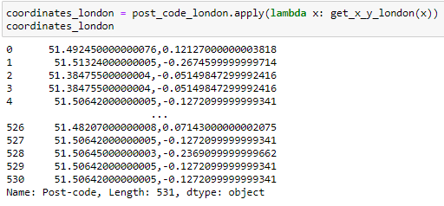
We must concatenate this list of borough names and postal codes of London with its coordinates. For this reason, it is necessary to use ArcGIS in order to get the coordinates of each neighbour in London. First, we have to get the coordinates in function of postal code and then we have to concatenate this results with the table obtained from Wikipedia.

Slide 11
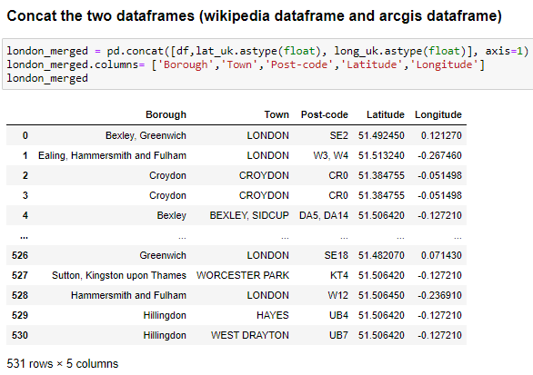

Finally, to finish this geolocation part we have to import the coordinates of the city of London in order to make a map and locate the neighbour on this map.

Slide 12
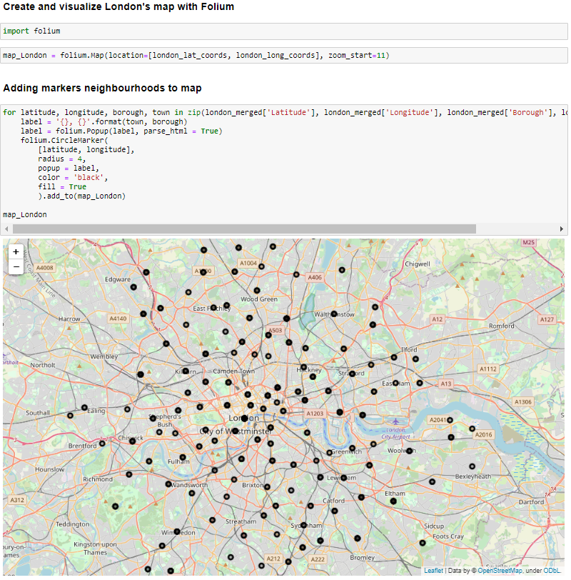

Slide 13
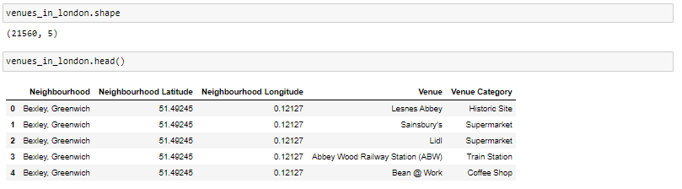
Next, it will be used Foursquare API to obtain the list of venues in a 500 meters radius from each Neighbourhood. First of all, I had created an account on Foursquare API developers to obtain the credentials that allow me to obtain these calls to Foursquare API. The result of these calls is the following data frame

Slide 14

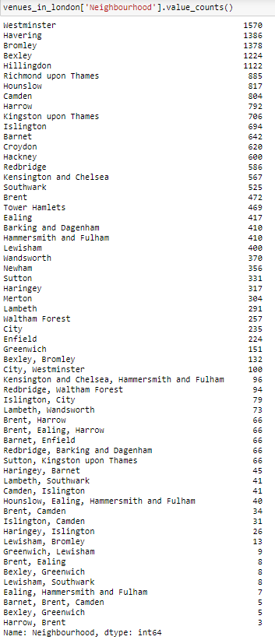
Tables and data obtained from Wikipedia and Foursquare
Number of venues on each Neighbourhood
Number of Chinese Restaurants in London
Number of Neighbourhood with at least one Chinese Restaurant

Slide 15
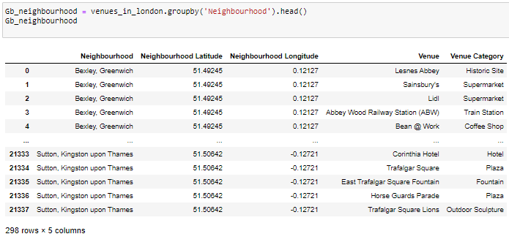
Tables and data obtained from Wikipedia and Foursquare
Venues in London group by Neighbourhood

Slide 16
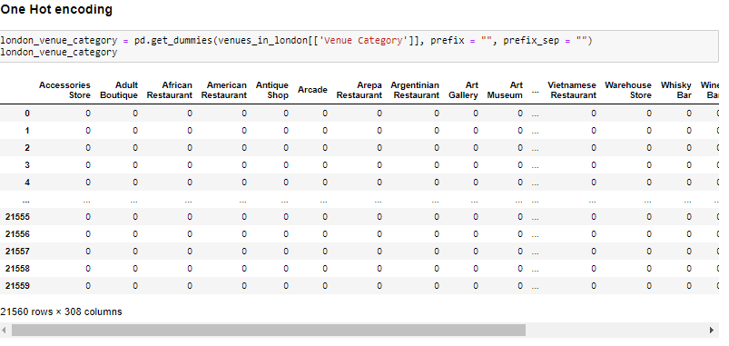
The following step on the methodology is the One Hot Encoding, we need to encode our venue categories to get a better result for our clustering.

Slide 17
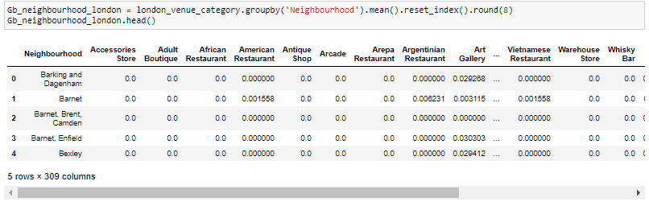
To the last data frame we have to add the column Neighbourhood and group this data by each Neighbourhood.

Slide 18
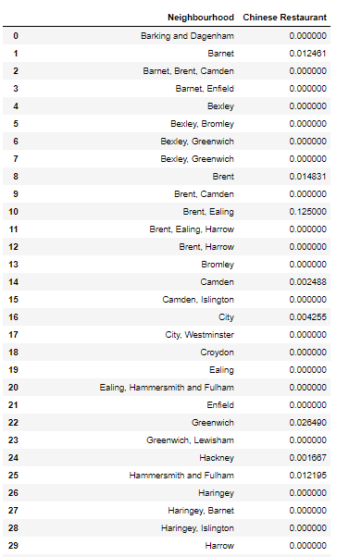
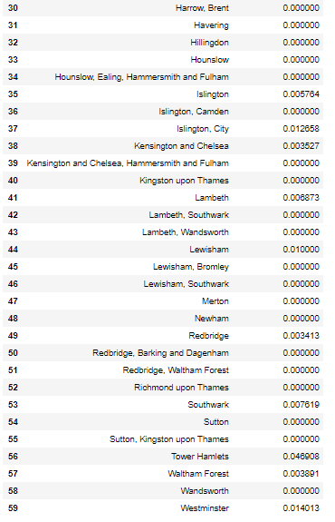
The next step is obtaining a data frame with the neighbourhood and its hot encoding of ‘Chinese Restaurant’ that is the aim of this project. With this data frame, we can perform the clustering method by using k-means.

Slide 19
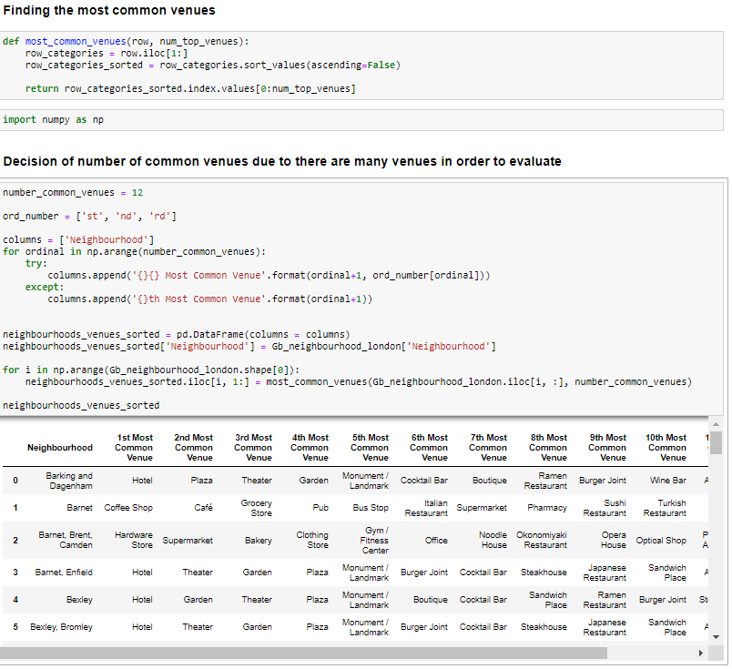
We can analysed more the data in order to obtain the best clustering so I find the most common venues of each neighbourhood and I look at if any Chinese Restaurant is among these common venues.

Slide 20
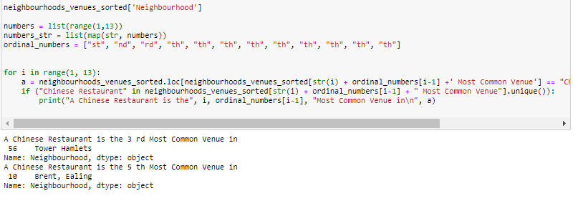

Slide 21
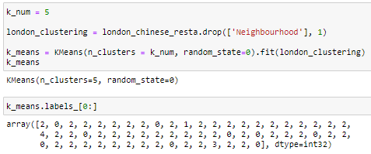
The following step of the methodology is a important step, k-means clustering algorithm identifies k number of centroids an then allocates every data point to the nearest cluster while keeping the centroids as small as possible. It is an unsupervised machine learning. I have decided clustering the neighbourhoods in London into 5 clusters based on their frequency of occurrence for ‘Chinese Restaurant’.

Slide 22
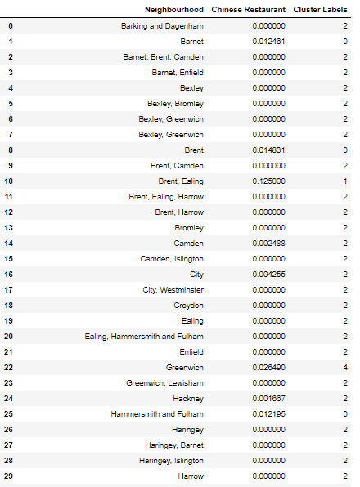
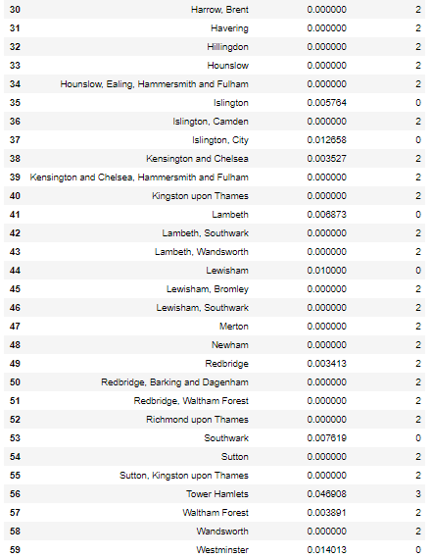

Slide 23
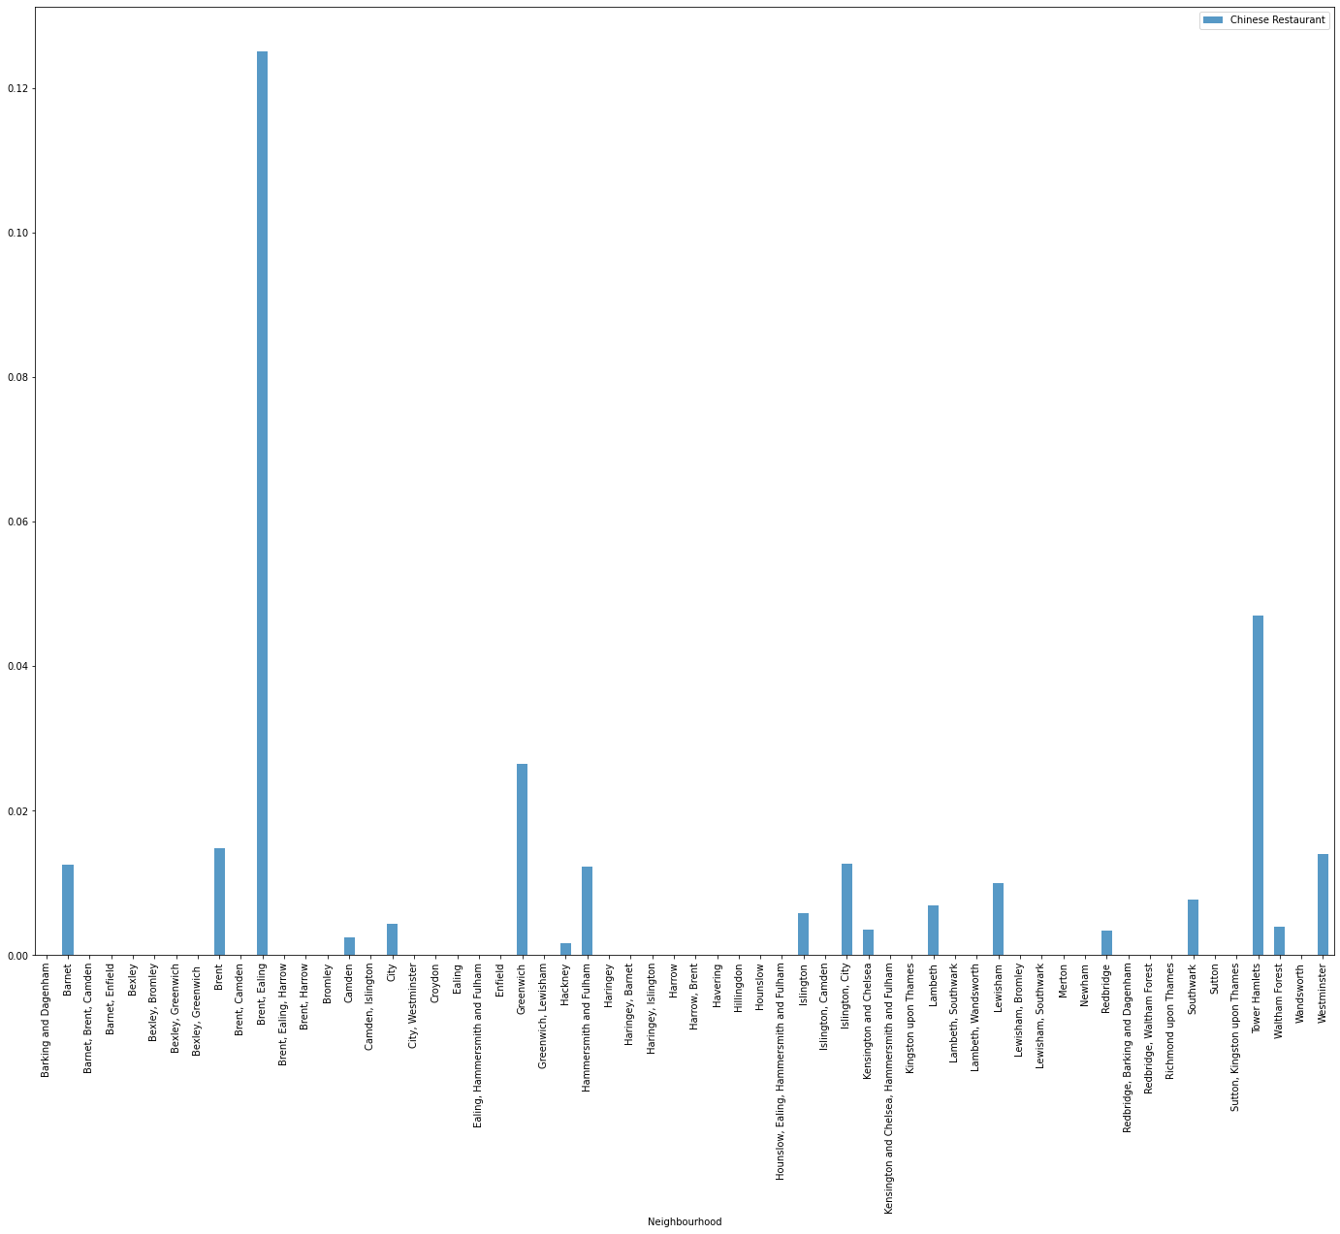
Results
Hot encoding graphic

Slide 24
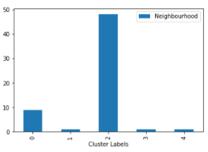
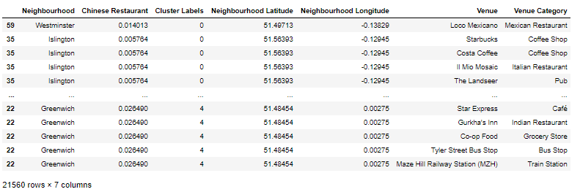
Data frame merged with all data frames obtained.
Number of neighbourhoods in each cluster.

Slide 25
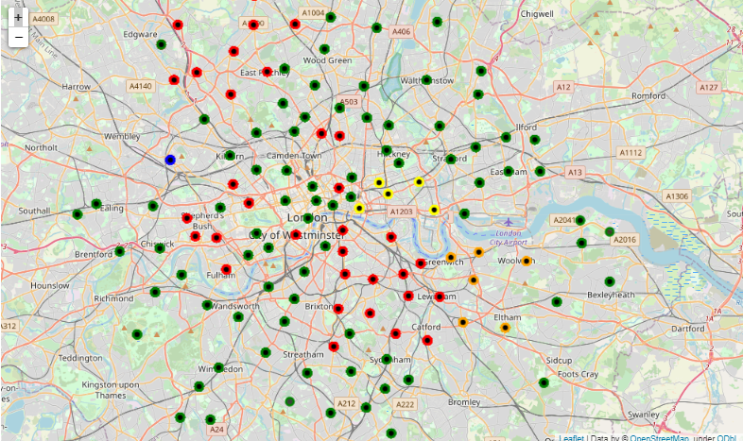
*Cluster 1 Neighbourhoods with few Chinese restaurants in London
*Cluster 2 Neighbourhoods whit the greatest number of Chinese restaurants in London
*Cluster 3 Neighbourhoods with 0 or low number of Chinese restaurants in London
*Cluster 4 Neighbourhoods with high number of Chinese restaurants in London
*Cluster 5 Neighbourhoods with considerable number of Chinese restaurants in London

Slide 26
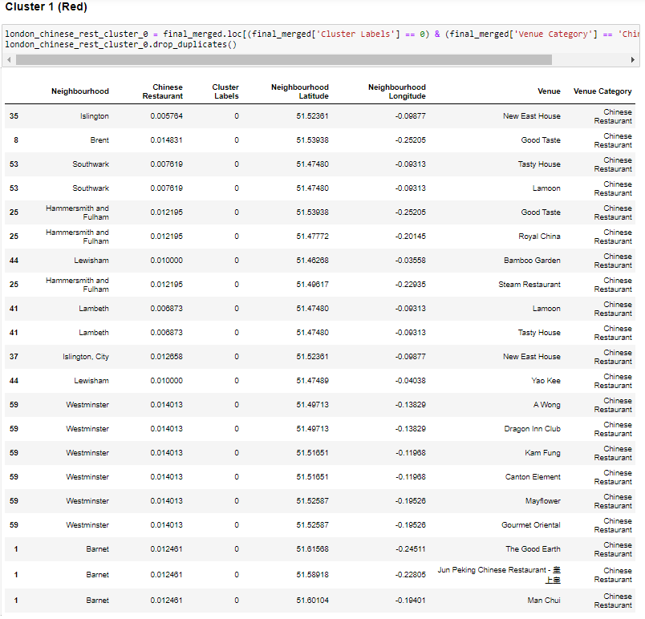
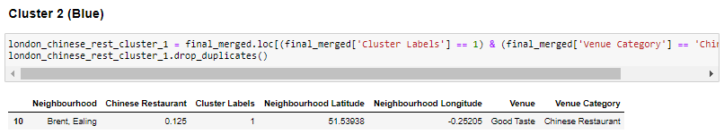
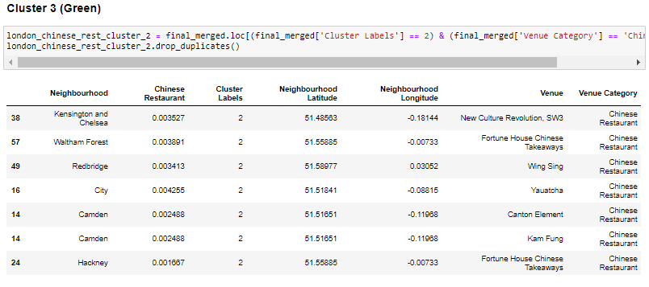
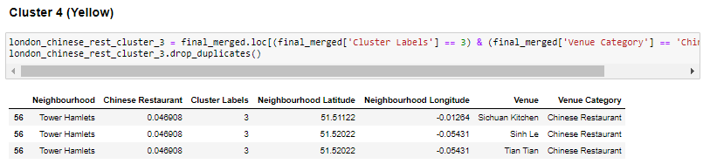
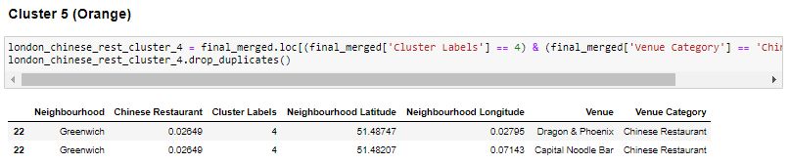

Slide 27
Discussion
In the cluster 2 that is the neighbourhood with the highest number of Chinese restaurants in London we can observe that a Chinese restaurant is the 5th most common venue to be visited in the neighbourhood.
In the cluster 4 that is the neighbourhood with the highest number of Chinese restaurant in London we can observe that a Chinese restaurant is the 3rd most common venue to be visited in the neighbourhood.
This information confirms the success of Chinese restaurant in these areas so this information can be very useful for tourists that are looking for a Chinese restaurants for his trip.

Slide 28
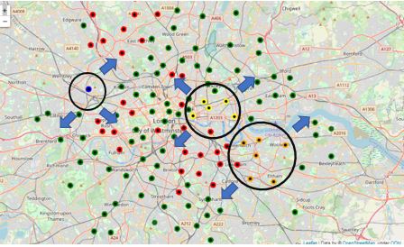
Evaluating the results of the clustering neighbourhoods in London depending on the number of Chinese restaurants in each neighbourhood we can observed that it exists a zone at southeast of London with two clusters that they having a high quantity of Chinese Restaurants (Cluster 4 and 5) and in the west of city there is the neighbourhood with the greatest number of Chinese restaurants.
The neighbourhoods near this neighbourhood (Brent (Ealing), Tower Hamlets and Greenwich) could be good opportunities to open a new Chinese restaurant.

Slide 29
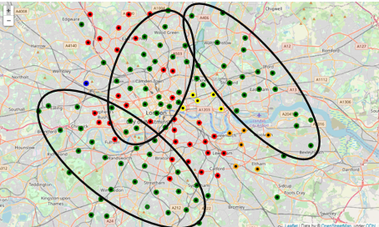
If we carefully observe the London map with the colour clusters, we can explain another insight for someone that wants to open a new restaurant in London. There are three big zones which belong to the cluster number 3 where the number of Chinese restaurants is low or none.

Slide 30
Conclusion
After evaluating the results, we can conclude:
The most number of Chinese restaurants are shared in the center of London.
The result map of London is useful to use by a tourist that want eat in a Chinese restaurant. There are three zones in London with a high number of Chinese restaurants Brent (Ealing), Tower Hamlets and Greenwich.

Slide 31
For a person who want to open a new Chinese restaurant he have to consider two branches:
Open a new restaurant near to Brent (Ealing), Tower Hamlets and Greenwich. Due to the success of Chinese restaurants in these neighbourhoods a new restaurant can attract a lot of people.
If a fast-food chain want to open some Chinese restaurants it could be interested in the other model that is the following: Open restaurants where the number of restaurants are low or zero (cluster 3). People who lived here or tourist who have been accommodated on these zones will be the people interested in new Chinese restaurants in these zones.

Slide 32
Thanks for view my assignment

