Slide 1
Redemption of a Failed Knight
Project One
Jose Perla

Slide 2
Storyboard: Description
You awaken from a failed battle in the clearing of a forest. The dark wizard has taken over the castle and you must retake it. You have to regain your equipment which scattered across the land. Your old staff to cast magic which remains in the great bridge before you get to the castle. Your trusty sword taken by the blacksmith for repairs, and armor that is stowed away in your home. To succeed in this fight however you must also collect three runes to add to your magic staff to match the wizard's power. Collect the rune of fire that is hidden in an old shack, the rune of earth imbedded in a stone in the woods, and the rune of water which is near the riverbank. Return to the castle for a rematch. This could be your last chance to save your home.

Slide 3
Storyboard: Map
The Great Bridge:
Item: Magic Staff
East
Castle:
DARK WIZARD
BOSS FIGHT!
West
North
South
Forest Clearing:
Starting point of the game
Home:
Item: Armor
Old Shack:
Item: Rune of Fire
East
North
South
West
East
BlackSmith:
Item: Sword
West
North
South
Forest:
Item: Rune of Earth
East
Riverbank:
Item: Rune of Water
West

Slide 4
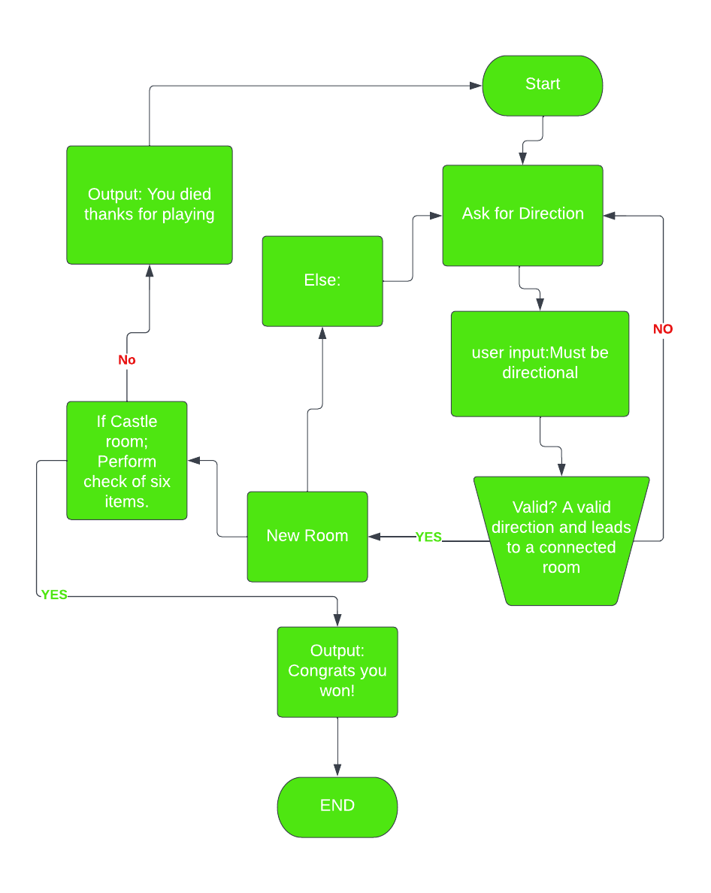
Flowchart: Move Between Rooms

Slide 5
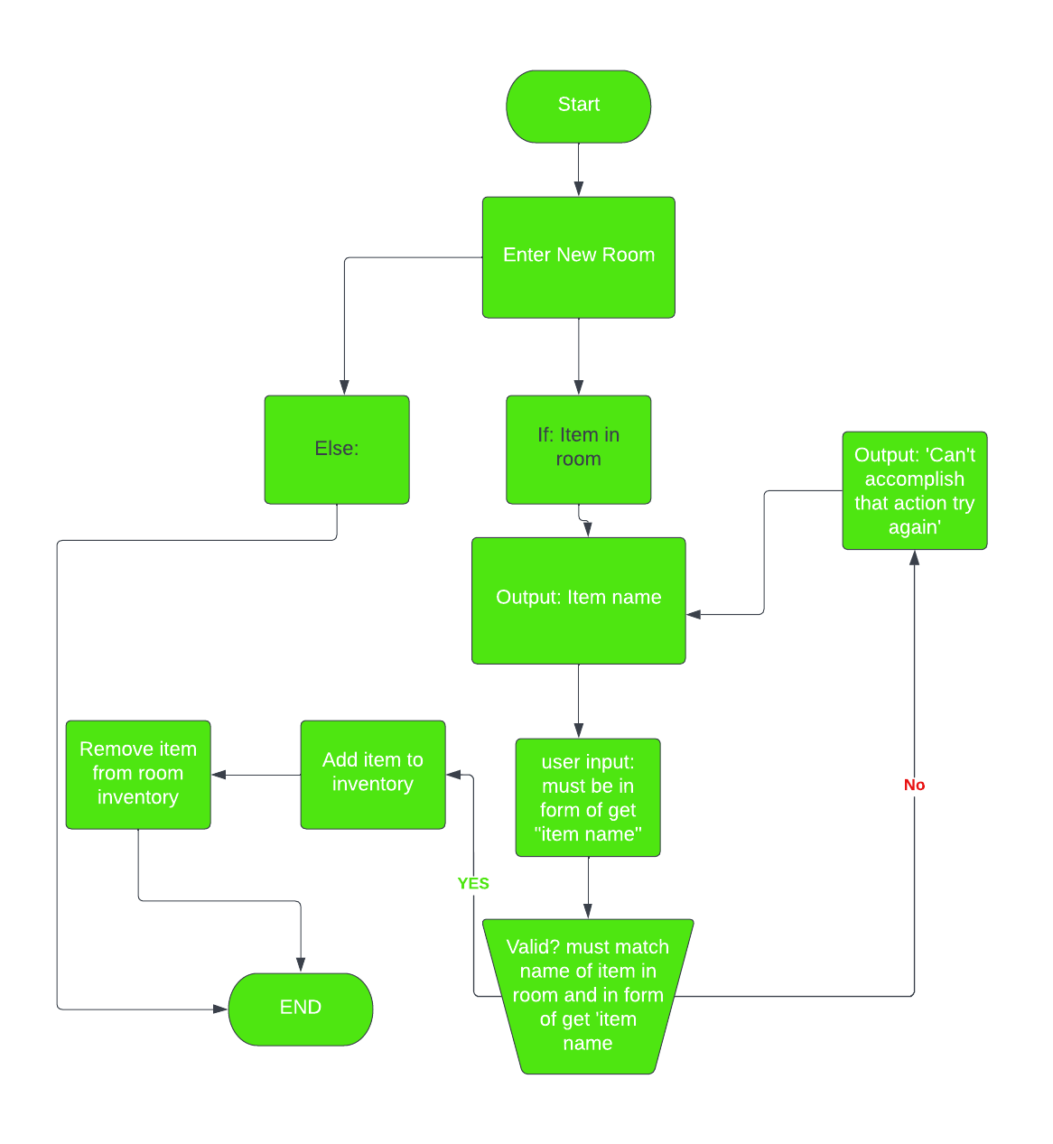
Flowchart: Get an Item

