Slide 1
Change Detection in Video
By Joe Allen

Slide 2
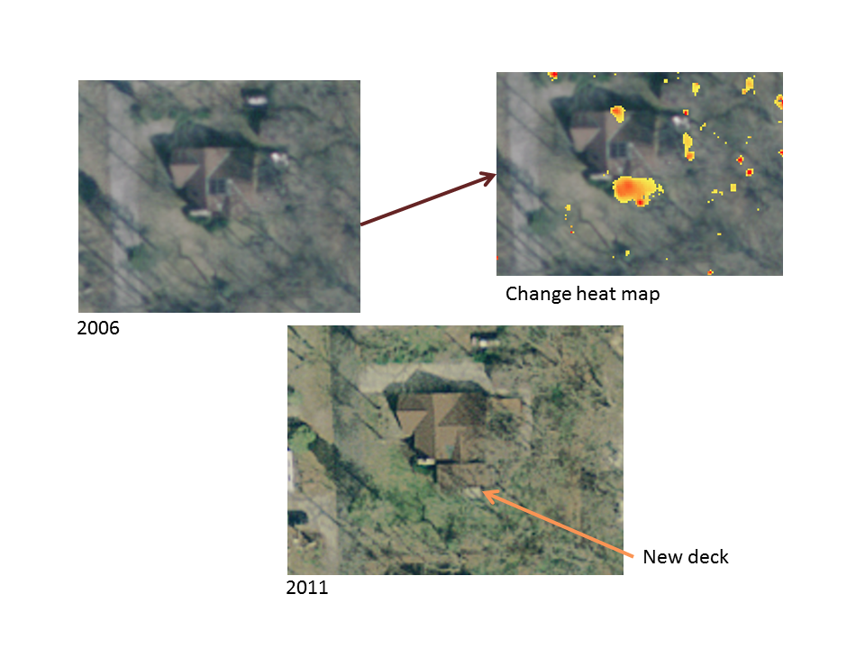
What is the project?
What am I making?
What will it be used for
Notes:
Change detection in a live video
Creating a tool for artists to use to give them easy access to change detection for art projects
And as an example I am going to be working closely with Sarah, a 3rd year Art student at MMU to create a projected artwork that will be a dancer in a white room and hopefully we can project the mask directly onto the dancer.

Slide 3
Processing
What is Processing?
Why was it made?
What Languages can you write in?
Why I picked Java?
My project will be a free tool for artists, like Processing.
Notes:
I will be using Processing
A “flexible software sketchbook”.
Designed to help artists get into Digital art, supposed to be quick and easy to use.
Can be written in Java,JS or Python.
Decided to use Java as there is an abundance of examples available and most Processing users seem to use it.
This software also inspired me to make my project an open project for other artists to use.

Slide 4
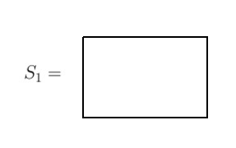
Basics of Change Detection
Notes:
This is a grossly simplified example.
Each image is made of pixels where each pixel holds a 1 for black, a 2 for white.
An Image can be represented as a 2D array of these pixels.
So an image of a plain white room in this Black and White world is an array full of white pixels

Slide 5
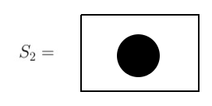
Basics of Change Detection
A ball rolls into view
Notes:
Now imagine a black ball is rolled into view.
A new Image is taken (S2) where we now have some black pixels in our image, our perfect mask will look identical to this image by the way.

Slide 6

Basics of Change Detection
For each pixel
Notes:
We then make a new 2D array of the same size as our images and for each pixel we do mod(pixel from our “empty” scene - pixel from our current scene), this is called Euclidean distance.

Slide 7

Basics of Change Detection
Thresholding
Notes:
Then for each pixel in our mask we simply say that if the value mod | “old pixel” minus “new pixel” is greater than some threshold, in this case it is simply zero, then we add it to our mask by coloring this pixel black, else color it white.

Slide 8
Basics of Change Detection
recall White = 2, Black = 1.We have 4 cases for each pixel:
  It was white, now it is black.
  It was black, now it is white.
  It was black, it is still black.
  It was white, it is still white.
Notes:
|White(2) – Black(1)| = 1
(there wasn’t a ball and now there is)
|Black(1) – White(2)| = -1
(there was a ball, and now there isn’t not in our example)
Black(1) – Black(1) = 0
White(2) – White(2) = 0
No changes
MAKE THIS LOOK NICER

Slide 9
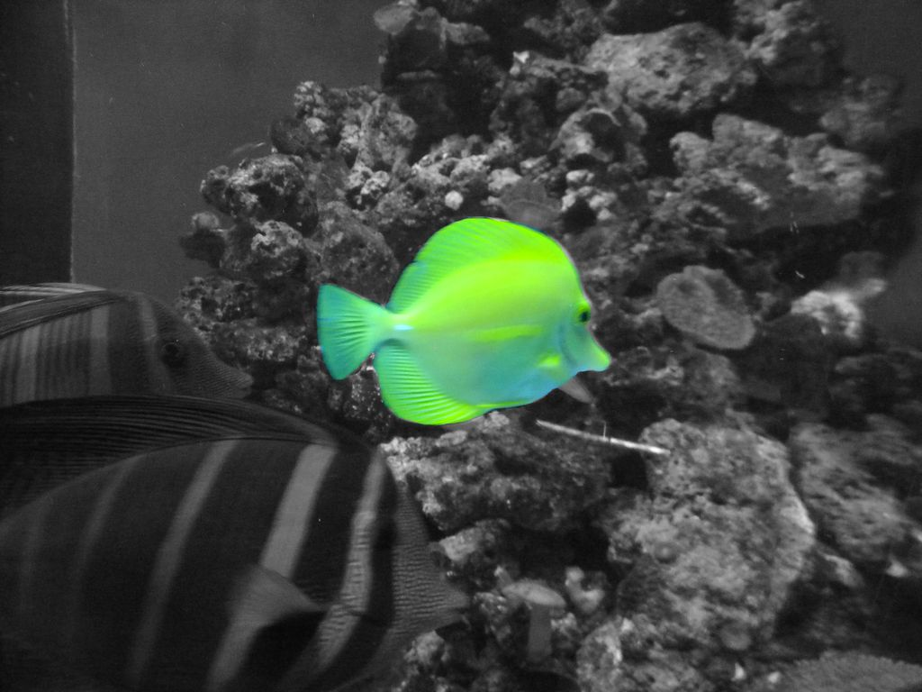
The Real World
Not just two images.
Not just two colors
Notes:
In our example we will not just be looking at two separate images, we will be looking at hopefully 30 frames per second compared to an initial calibration image.
Also the real world isn’t just two colors black and white.
We can start with Greyscale, [0,255]
Then move to RGB[255,255,255] as color contains useful properties.

Slide 10
Issues with implementation
More complicated issues:
  Brightness changes
  Noise
  Backgrounds
  Shadows
Notes:
So that simple implementation was very easy, however change detection comes with some more complicated issues.

Slide 11
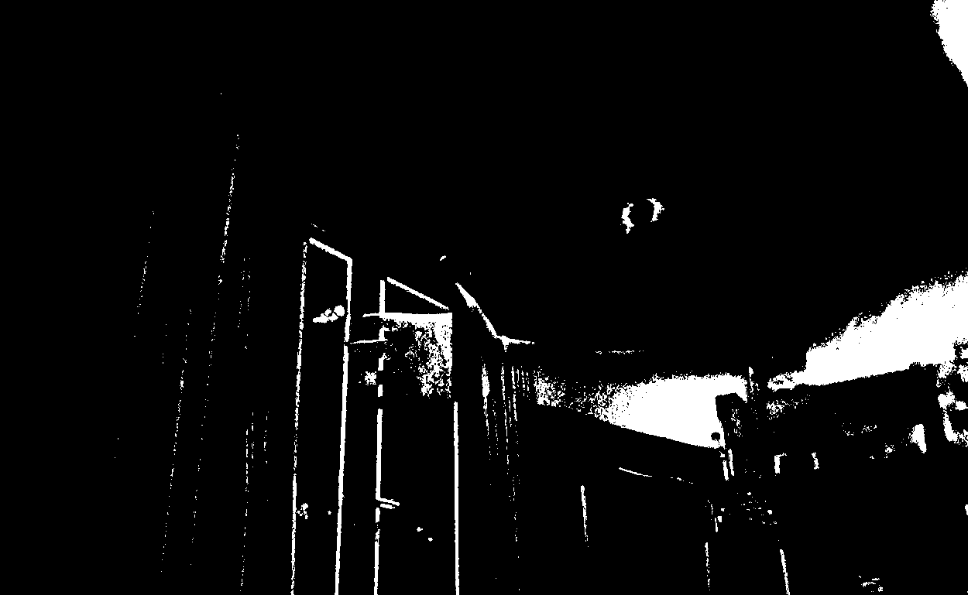
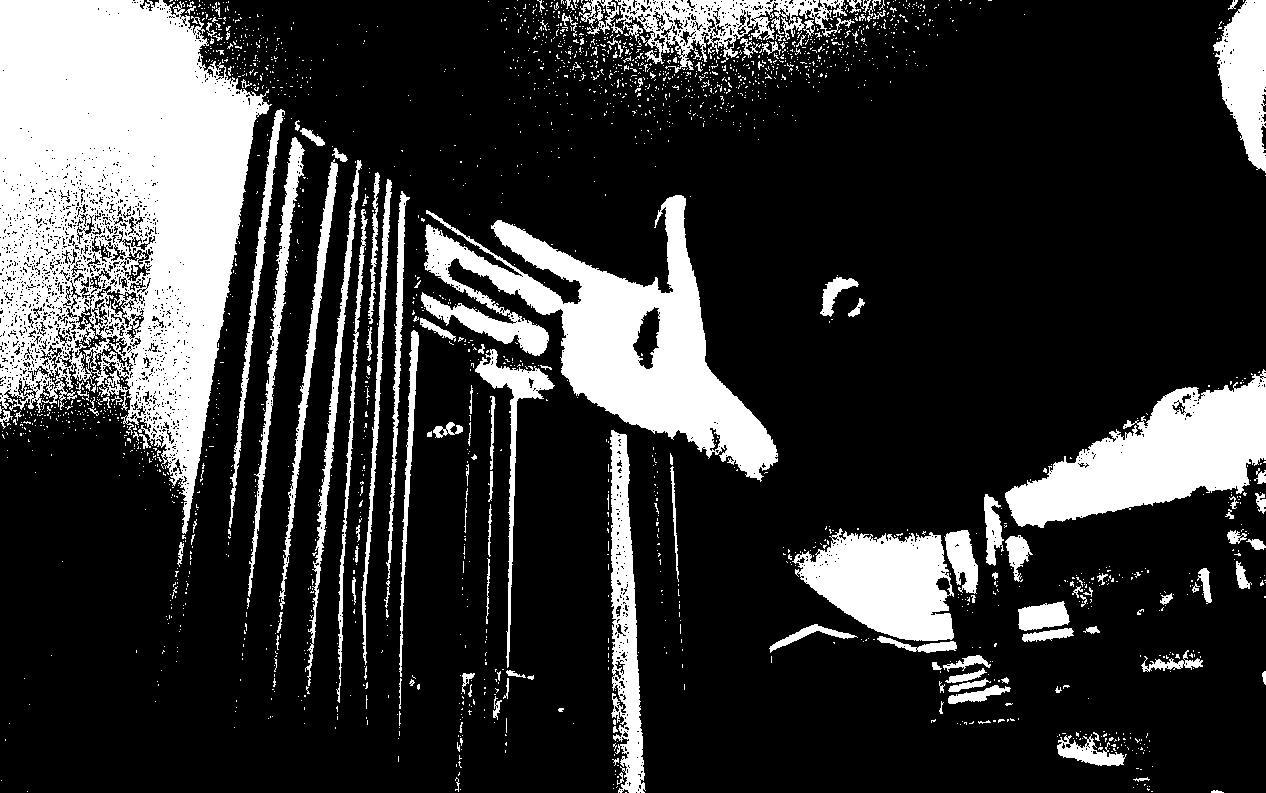
Brightness change
Sudden change in illumination will affect a large part of the mask.
Notes:
Changes in illumination can come in one of two forms.
Sudden Change , a cloud blocking the sun, or a second light source being switched on.(as shown in pictures)
Gradual Change, the sun gradually rising over the course of 30 minutes.
Both will have the same impact and can be dealt with simultaneously.

Slide 12




Brightness change
From RGB Black [1,1,1] to RGB White [255,255,255]
How can we fix this?
Notes:
Instead of looking at a total change in the 3 color channels (from black[1,1,1] to pure white[255,255,255]) which is a change of 762 (a big change) in Euclidean distance.
We can look at a normalization of two of the channels which in white illumination should increase linearly together.
2/3 = 2/3 no change in color ratio

Slide 13
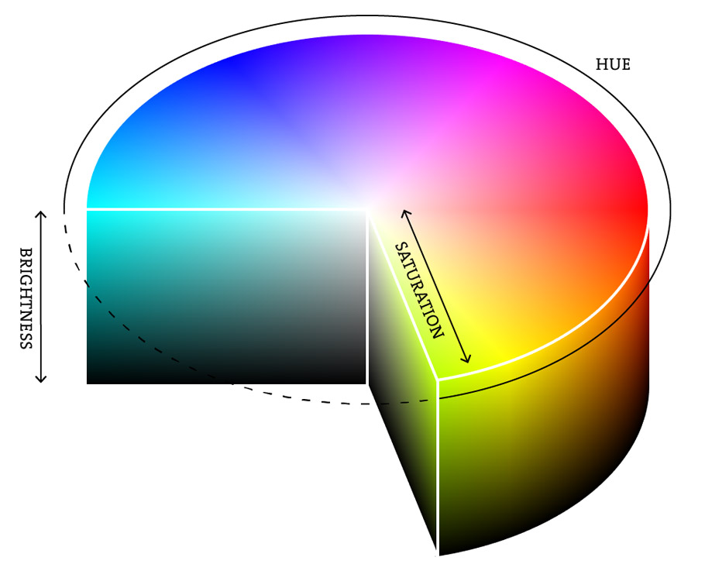
Brightness change
HSB Color space:
  H – Hue
  S – Saturation
  B – Brightness
Notes:
For even greater simplicity I then moved to using HSB color space instead of RGB. This does not improve the quality of the mask but it makes the code read better than normalizing lots of vectors.
This color space can be visualized as a cylinder where Hue is the angle of rotation around the cylinder, S is the saturation and distance from the center and B is the Brightness or depth of the cylinder.

Slide 14
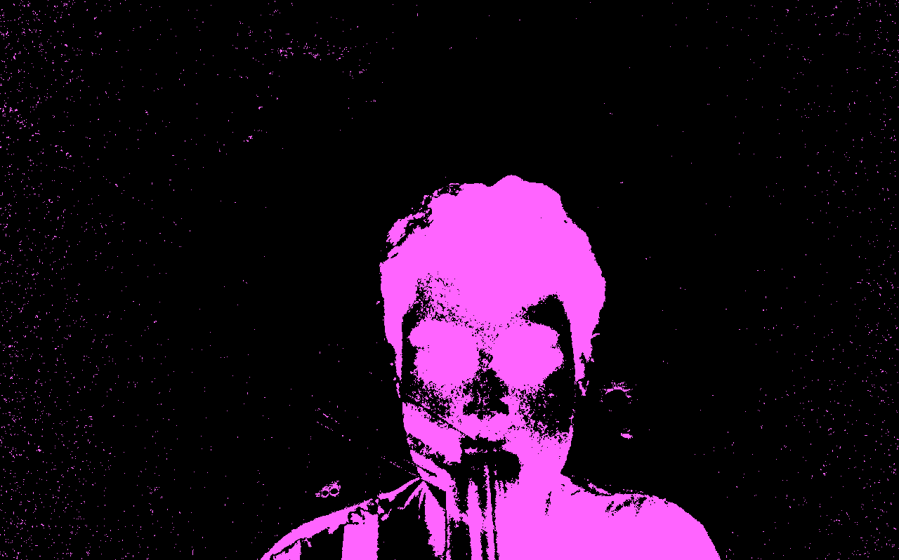
Noise
What is noise?
Notes:
Noise is random variations in brightness or color information in images. This is usually produced by interference in the circuitry of a digital camera.
As you can see in this image of me there are little dots everywhere this is not what I want to be considered part of the mask and needs to be dealt with.

Slide 15
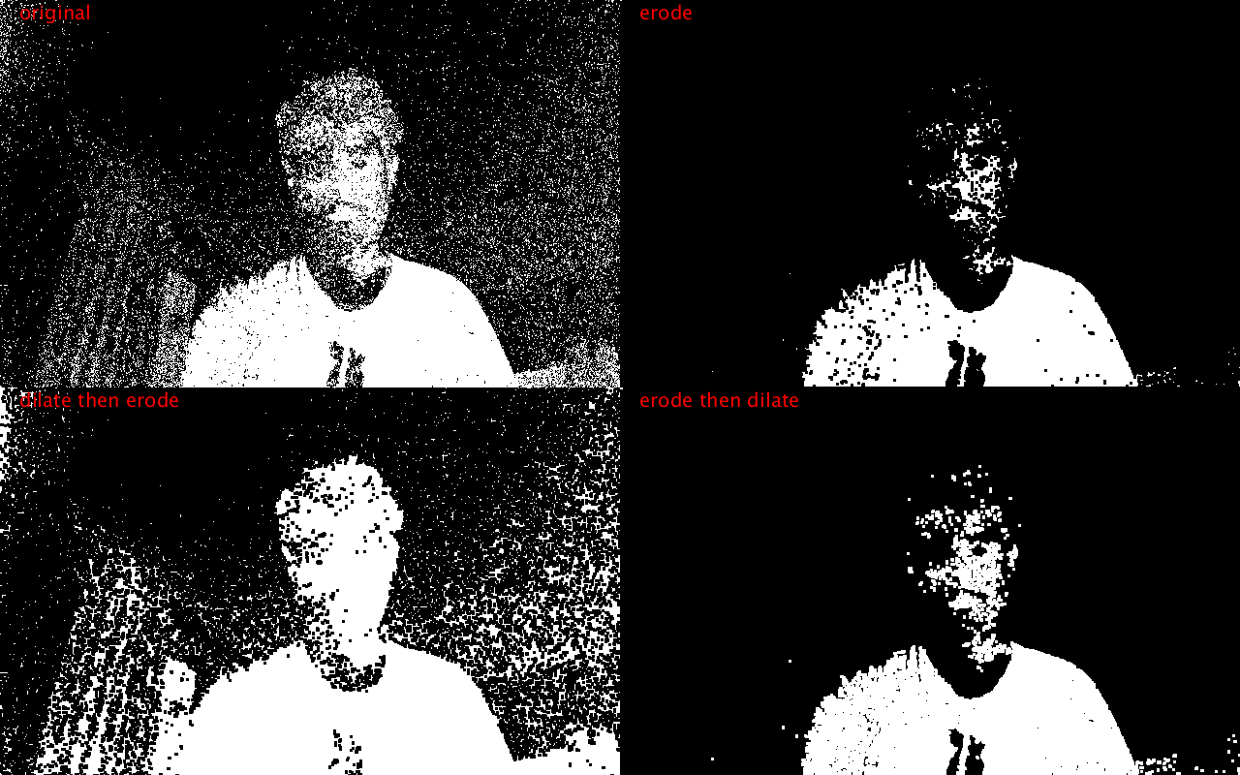
Noise
How I fix noise? See Demo
Notes:
There are two functions built into Processing called Erode and Dilate.
Erode will “erode” the boundries of a region of pixels, removing small regions completely.
Dilate will do the opposite, adding a boundary to each region of pixels.
The OpenCV library also has these functions and many more useful ones so I used this.

Slide 16
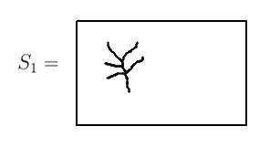
Background Subtraction
Back to our simple example
Notes:
Recall our simple Black and White world example from before.
We have left the room alone for a long time and a tree has grown, it is also very windy now. Forgive the rendition.
This shouldn’t matter due to our calibration taking the tree as part of the initial screenshot, however the branches sway constantly in the wind.

Slide 17
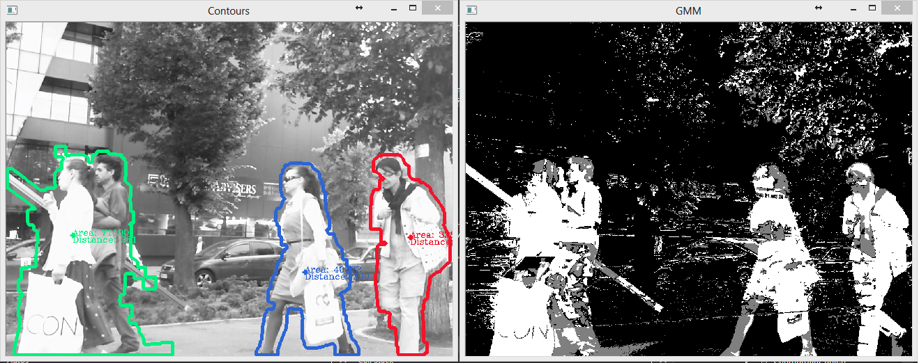
Background subtraction
Notes:
As shown a bit better in this image you can see the effect a swaying tree will have on our change detection as it is significant enough to not be caught and treated as noise.
The solution to this is to update what we consider the background over time.

Slide 18
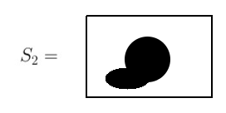
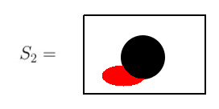
Shadows
Somebody set the lights wrong!
Notes:
So before we had great lighting for our simple scene, but in the real world we don’t always have that shadowless lighting.
What we need is a way to distinguish between the object and it’s shadows.

Slide 19
Shadows
There are 2 interesting parts of the changes.
Object
Shadow
MVO
Ghost
MVO Shadow
Ghost Shadow
Notes:
There are 4 parts of the image that would be considered a “change”.
MVO (Moving Visual Object) – A visual object
MVO Shadow – a shadow connected to a MVO, like the example
Ghost – a change that does not reflect a Visual object (for example a reflection)
Ghost Shadow – a shadow not connected to an MVO, say a spotlight shined on the top of the ball

Slide 20
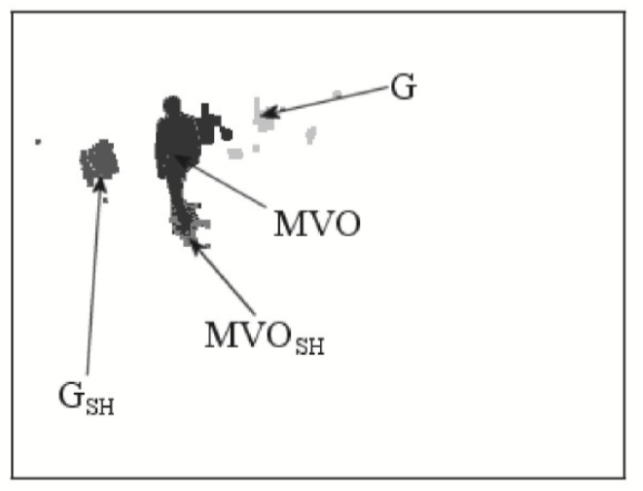
Shadows
How do we detect shadows?
Notes:
An interesting property of shadows is that shadows are only a change in brightness compared the the rest of the changes so by using the methods discussed before for Brightness change at a certain threshold we should be able to change the way these are picked up to distinguish between MVO and shadow.

Slide 21
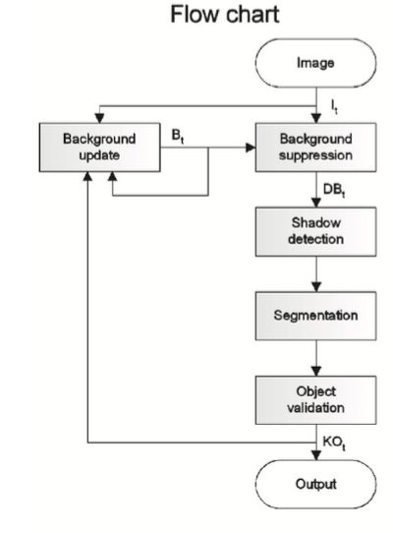
Sakbot
What is Sakbot?
Notes:
Sakbot is an Architecture used to detect changes in an image.
The plan for the future is to implement Sakbot, this should fix the shadow and background problems I have been having.
It will be useful to the artists as well to be able to use the shadows as another dynamic to experiment with.

Slide 22
Plan for artists
Tool Availability
Features
Notes:
The planned functionality is that it should be easy for artists to gain the source code.
The artists should also be able to set images/videos/code as the foreground/background mask.

Slide 23
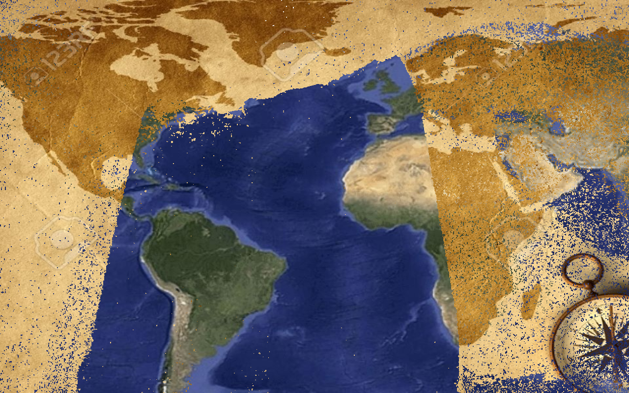
Images as masks
Notes:
Here is an example where the map appears old (used as a background) but walking in front of it or in this case holding up a towel reveals a new hidden google maps image.
We have also played around with the back image being a skeleton which is revealed when you walk in front of the camera and projected onto you.

Slide 24
Videos as Masks
See demo

Slide 25
Key Dates
Sakbot by January
February 1st

Slide 26
Any Questions?

