Slide 1
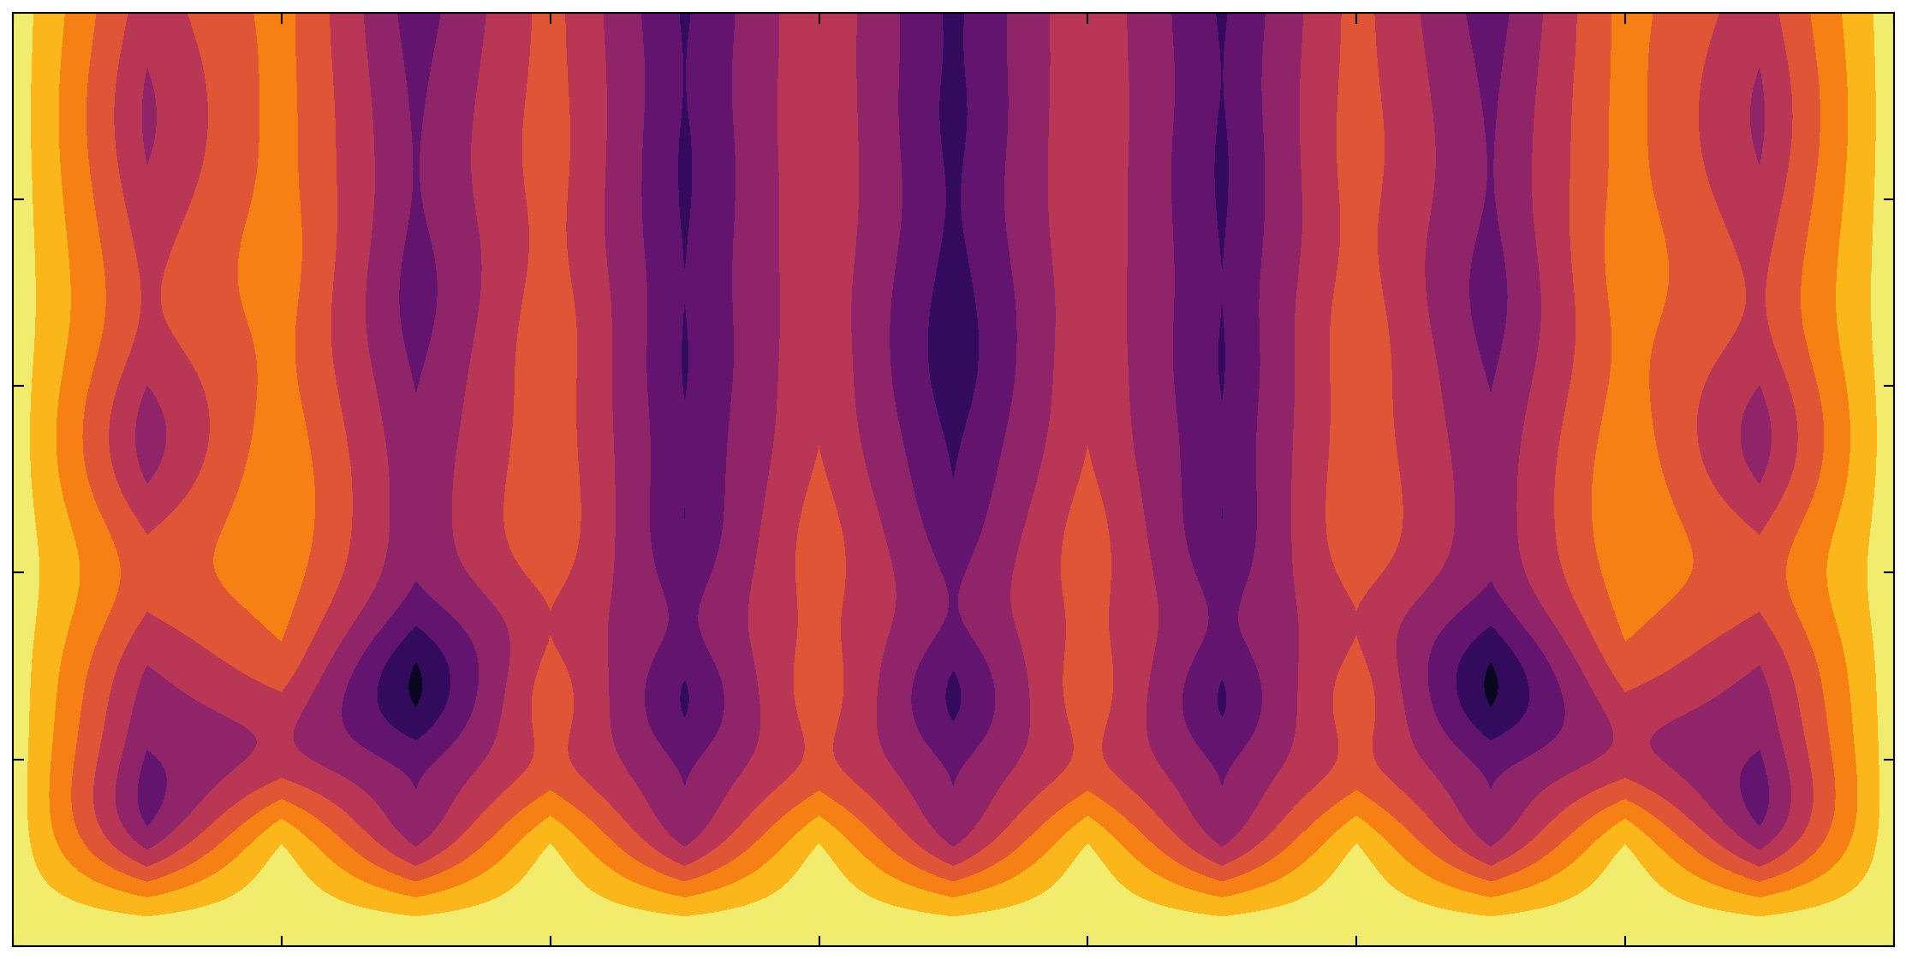
QLM simulation for Schwinger‘s model.
Joseph El-Forzli
Presentation of
Quantum Simulations for Gauge Theories
15. December 2023

Slide 2
Schwinger model
All this work is based on the article :
Atomic Quantum Simulation of Dynamical Gauge Fields coupled to Fermionic Matter: From String Breaking to Evolution after a Quench [1].
- Electrodynamics in one spatial dimension.
- It is a U(1) gauge theory.
- To simulate the theory, we can discretise it.
- Then we have two procedures :
Exact diagonalization : Limited by the size of the system.
Quantum Simulations : We need to impose Gauss’ law.

Slide 3
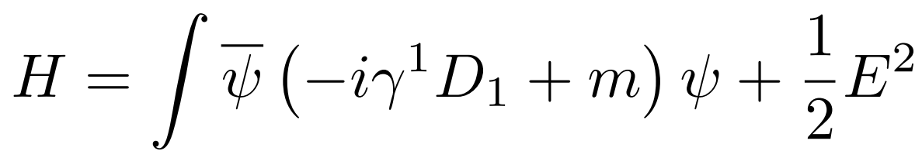
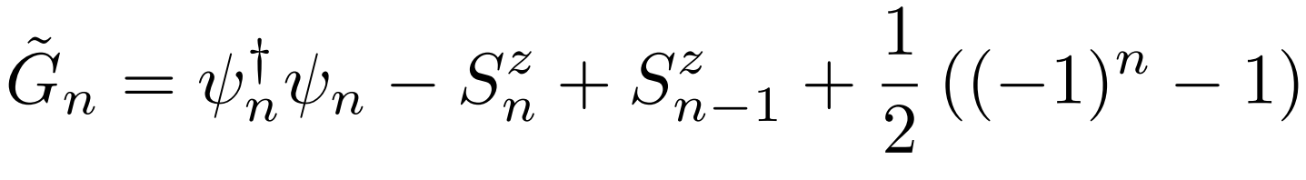
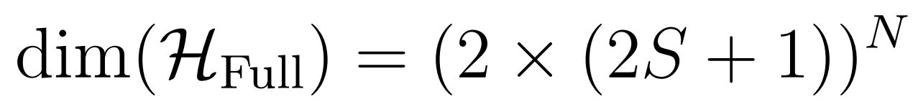
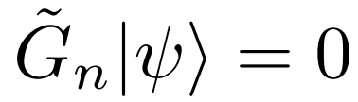
From Schwinger model to Quantum Link Model :
Schwinger model Hamiltonian :
Discretise the theory [1] :
Impose Gauss’ law :
Exponential cost !!!

Slide 4

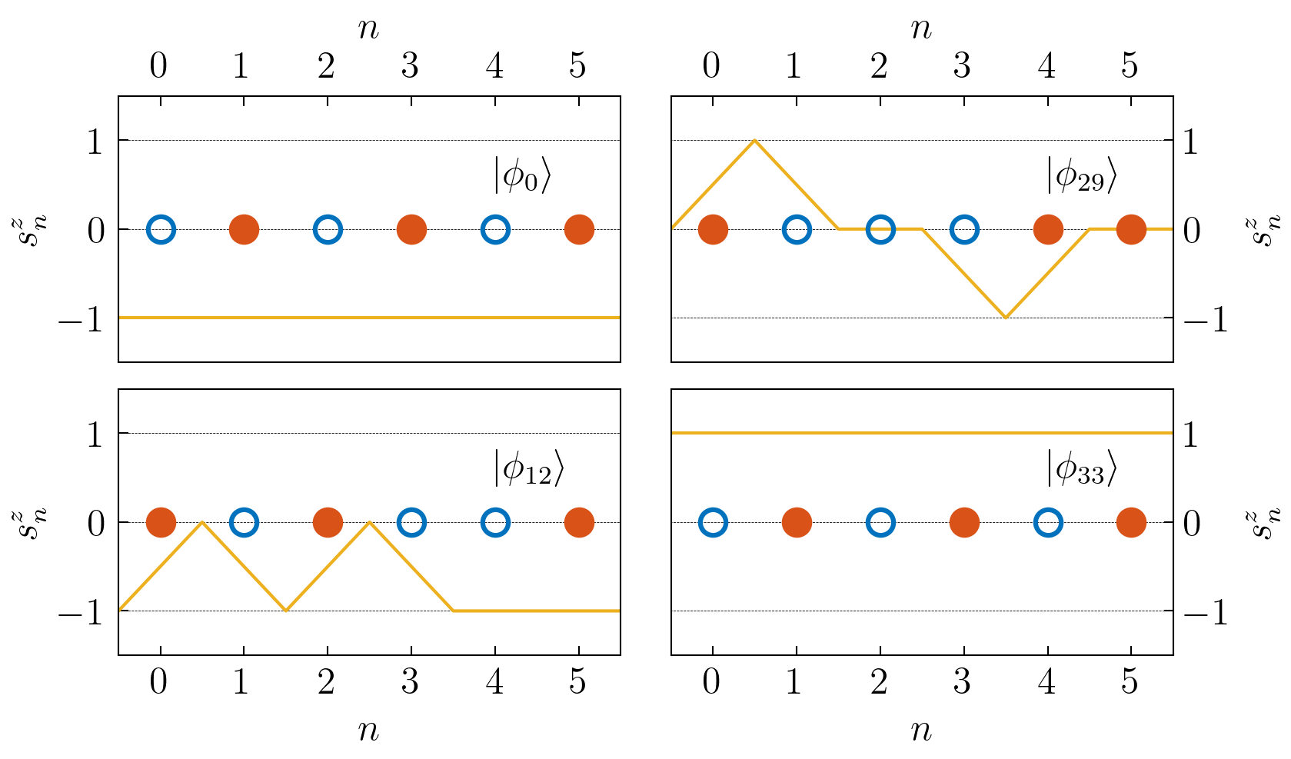
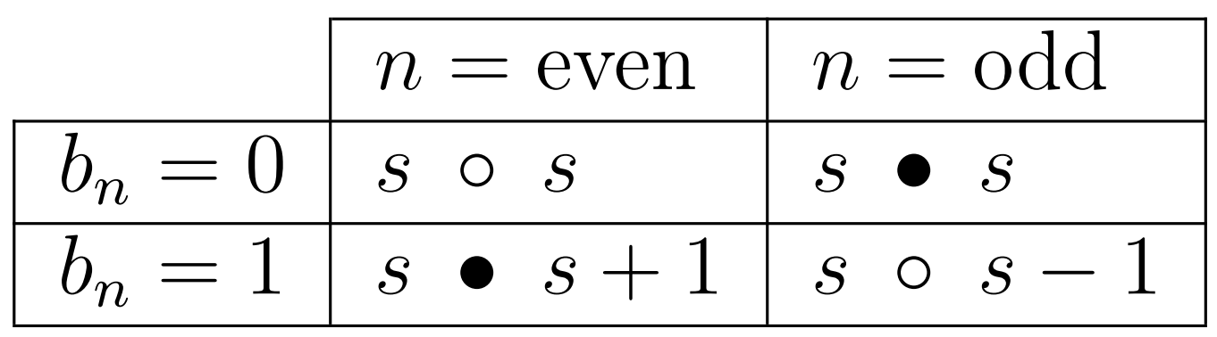
Focus on physical space :
We construct an algorithm to find a basis for
and compute its Hamiltonian.
Figure 1 : Few basis vectors of the physical space.

Slide 5
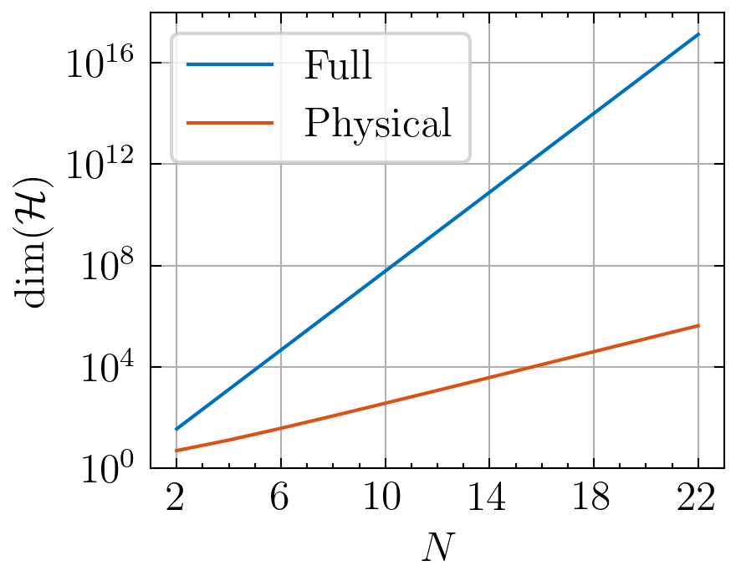
Focus onphysical space :
Focus on physical space :
We obtain a considerable reduction in the dimensionnality of the space. But the scaling remains exponential.
Figure 2 : Dimensionnality of the Hilbert space in function of N the number of sites.

Slide 6
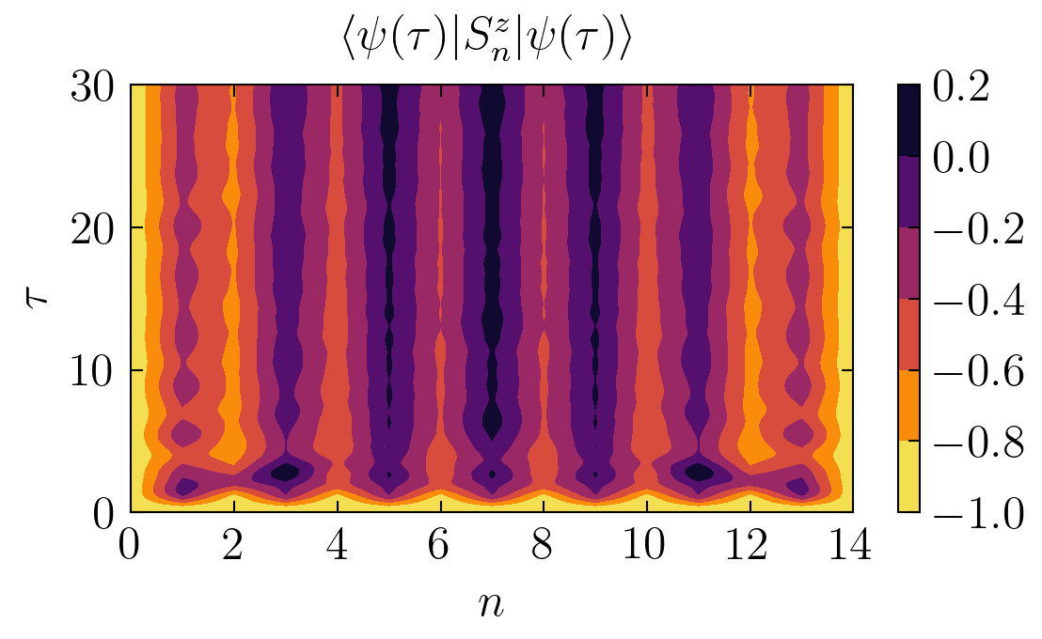
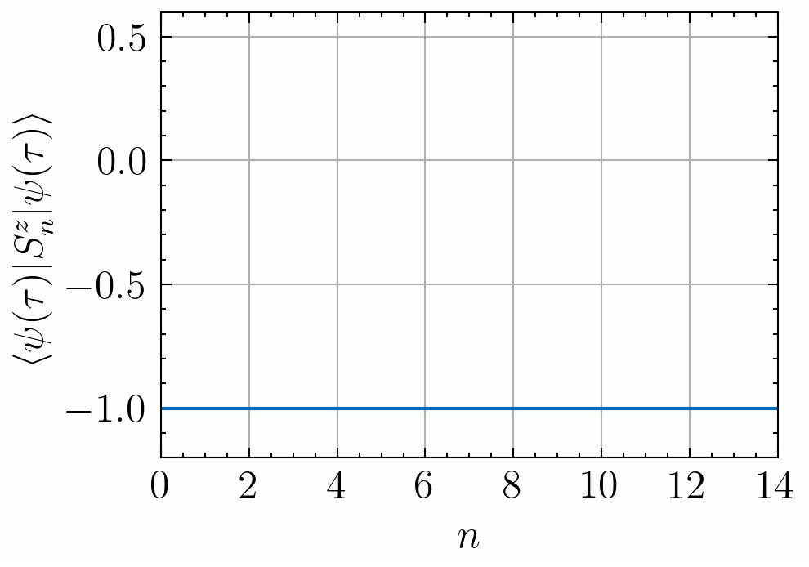
Classical Simulation :
String Breaking phenomena
We use Exact Diagonalization to simulate the time evolution of a String Breaking configuration [1].
Figure 3 : Time evolution of the expected electric field for String Breaking configuration.

Slide 7
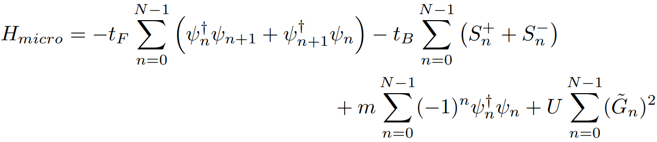
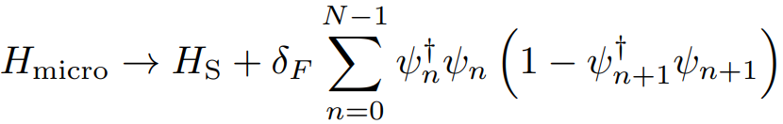
Quantum Simulation: Optical Lattice
The system can be physically implementated using cold atoms in an optical lattice [1] (Microscopic system).
At low energy and for big U :
+

Slide 8
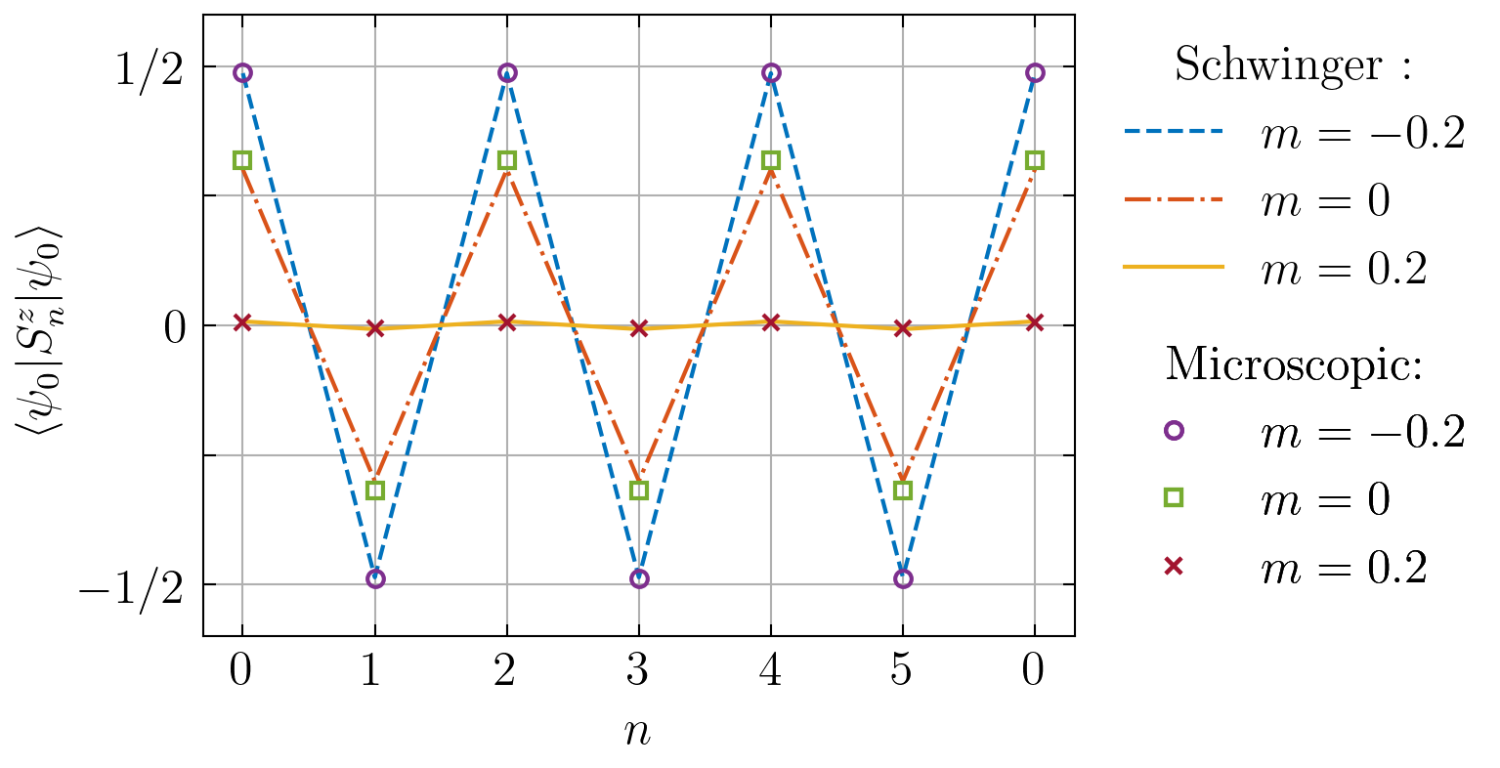
Quantum Simulation :
Ground state
We compare the ground state of Schwinger and Microscopic system.
Figure 4 : Expected electric field of the ground state
for Schwinger and Microscopic system with U=20.

Slide 9
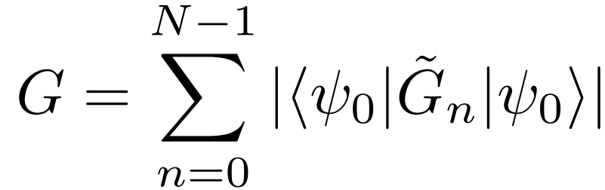
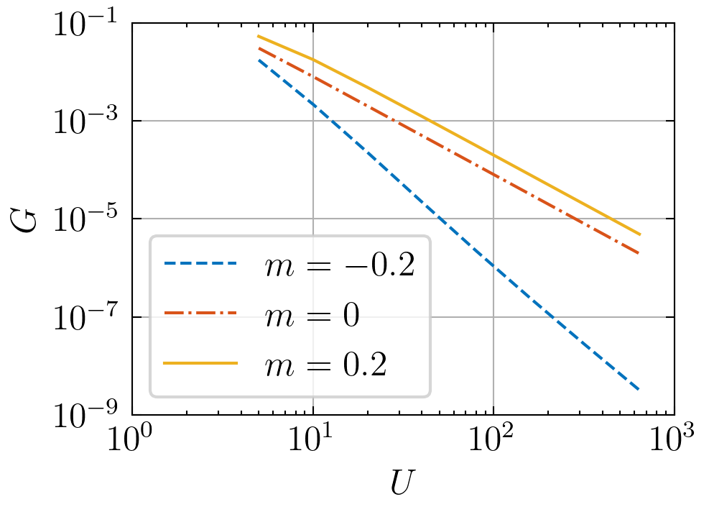
Quantum Simulation :
Gauss’ law
We verify Gauss’ law for the Microscopic system.
Figure 5 : Expected value of G in function of U.

Slide 10
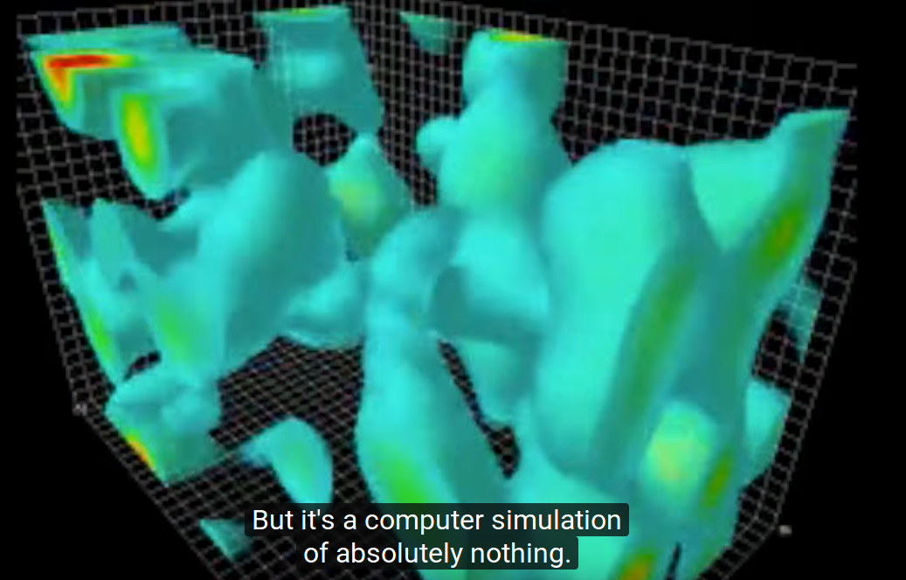
Conclusion
- Schwinger model is discretised.
- The resulting Quantum Link Model is studied through a classical simulation of the String Breaking mechanism.
- We have verified that the proposed physical implementation [1] is a correct quantum simulator of the theory.
Exact diagonalization is very limited (exponential scaling).
→ We have to use approximate methods such as Tensor Network representation [2].
But ED is still useful for checking the behaviour of Quantum Simulation systems.

Slide 11
Joseph El-Forzli
MSc Physics
jelforzli@student.ethz.ch
References:
[1] D. Banerjee, M. Dalmonte, M. Müller, E. Rico, P. Stebler, U.-J. Wiese, and P. Zoller. Atomic quantum simulation of dynamical gauge fields coupled to fermionic matter: From string break- ing to evolution after a quench. Physical Review Letters, 109(17), October 2012
[2] T. Pichler, M. Dalmonte, E. Rico, P. Zoller, and S. Montangero. Real-time dynamics in u(1) lattice gauge theories with tensor networks. Phys. Rev. X, 6:011023, Mar 2016.

Slide 12
