Slide 1
BIOE 498 / BIOE 599 Advanced Biological Control Systems Linear Time Invariant Systems
Joseph L. Hellerstein
eScience Institute, Computer Science & Engineering
Allen School of Computer Science
BioEngineering
Notes:
Diverse students. Some with bio-backgrounds; some without. Some with CS background; some with very limited. Two separate courses combined because of a substantial shared curriculum.

Slide 2
Agenda
Why models?
Discrete time analysis
Laplace transforms
Definition, calculation, poles
Solving high order approximations
Poles determine stability and oscillations.
Definition of transfer function.
Calculating DC gain.

Slide 3
The Problem
Most control properties are dynamic: stability, oscillations, settling times.
We need a way to easily assess these properties and to manipulate signals and systems (which are dynamical objects).

Slide 4
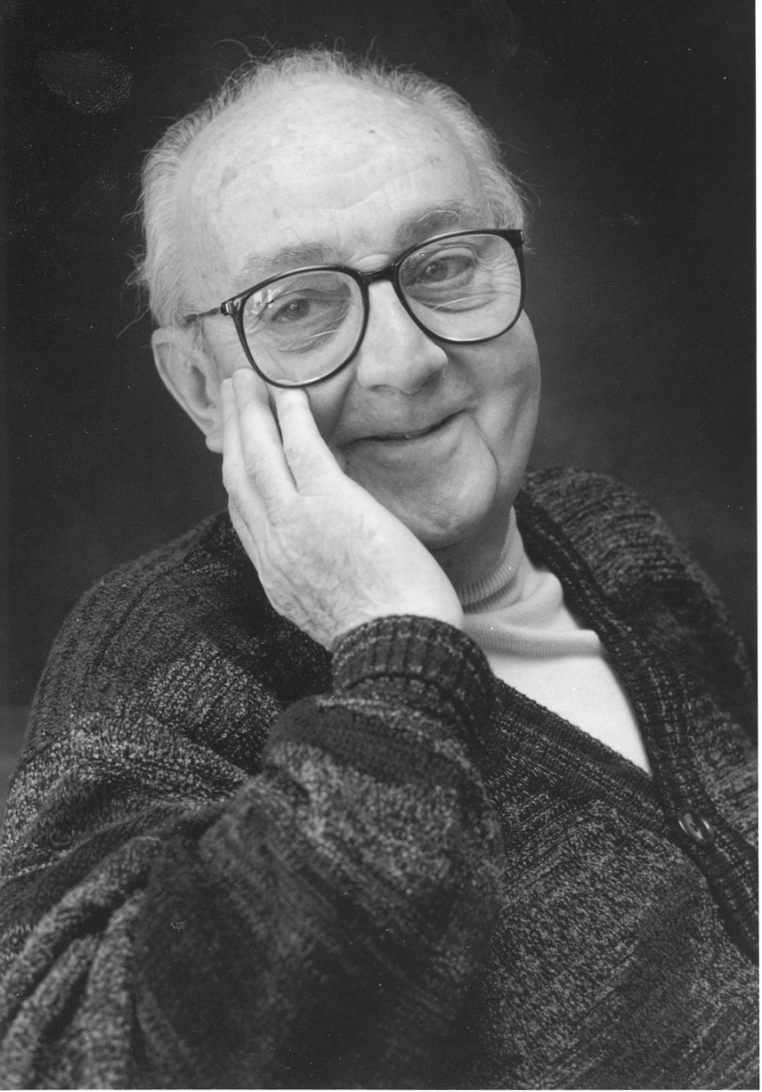
G.P.E. Box (Famous Statistician)
All models are wrong.
But some models are useful.

Slide 5


Modeling Signals & Systems
$$u$$
$$y$$
System
We want a mathematical representation of the relationship between the input signal (u) and the output signal (y).
Properties of interest
Stability
Setting times
DC Gain (”final” value of y for a unit step of u)
Oscillations

Slide 6
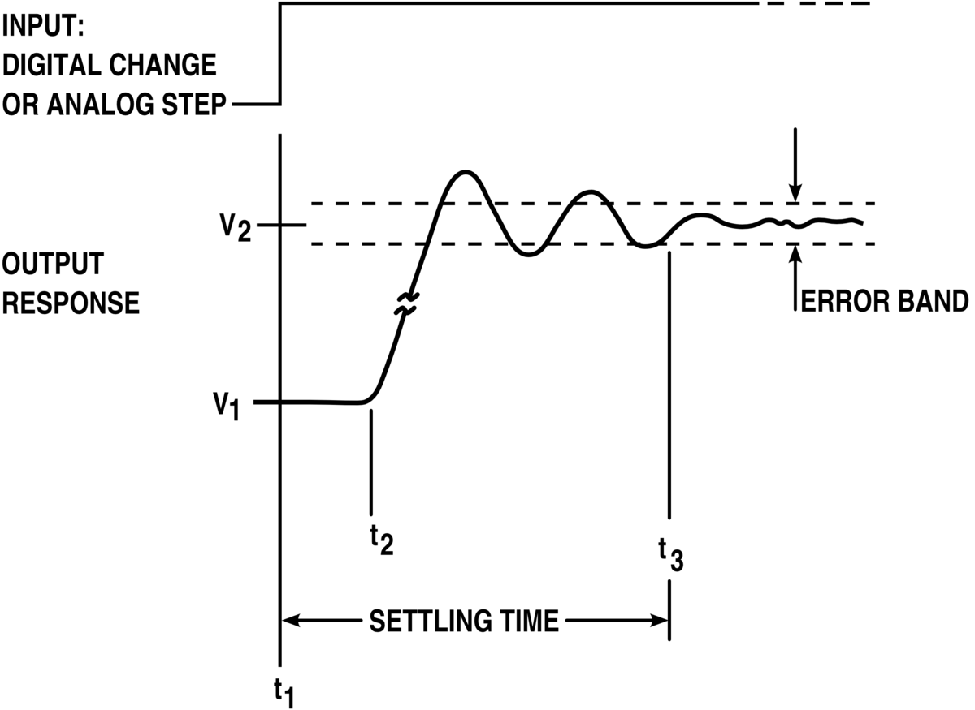
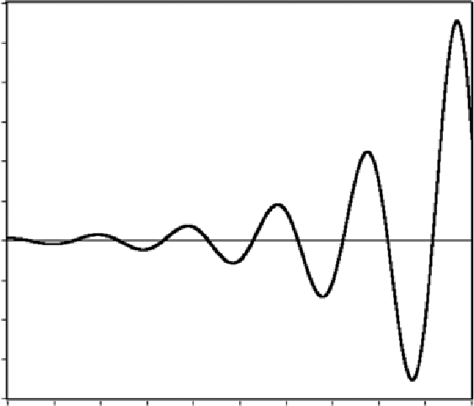
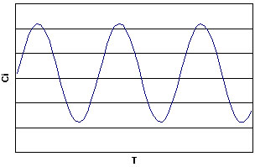

Some System Response
$$u$$
$$y$$
System

Slide 7
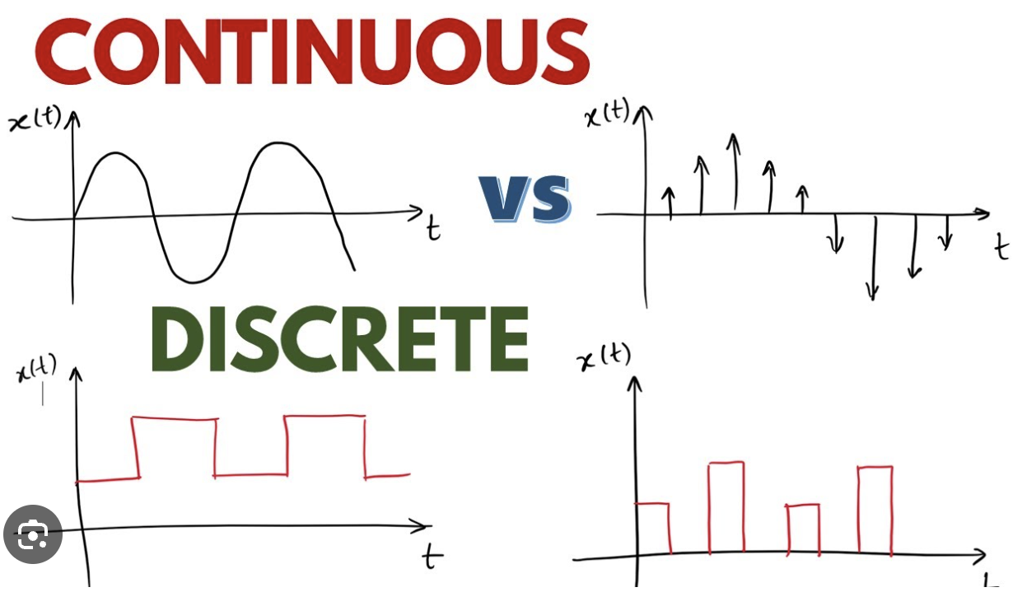




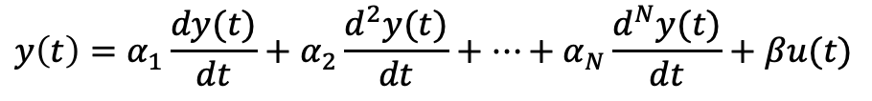

What Models?
$$y(t)$$
$$t$$
We will work with continuous time.
$$y(k)$$
$$k$$
Linear discrete time model (autoregressive time series)
$$y\left(k\right)=a_{1}y\left(k−1\right)+a_{2}y\left(k−2\right)+…+a_{N}y\left(k−N\right)+bu(k)$$
$a_{n}, b$ are constants that do not change over time.
Linear continuous time model (differential equation)
$$y\left(t\right)=α_{1}\frac{dy(t)}{dt}+α_{2}\frac{d^{2}y(t)}{dt}+…+α_{N}\frac{d^{N}y(t)}{dt}+βu(t)$$
$α_{n} ,β$ are constants.

Slide 8
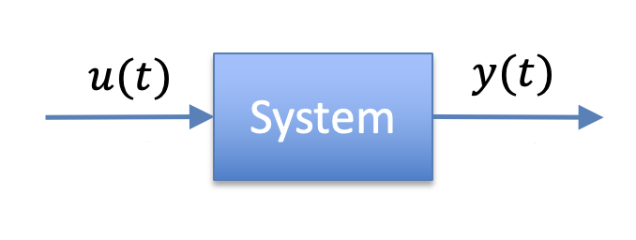
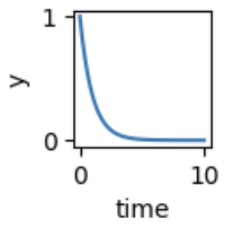
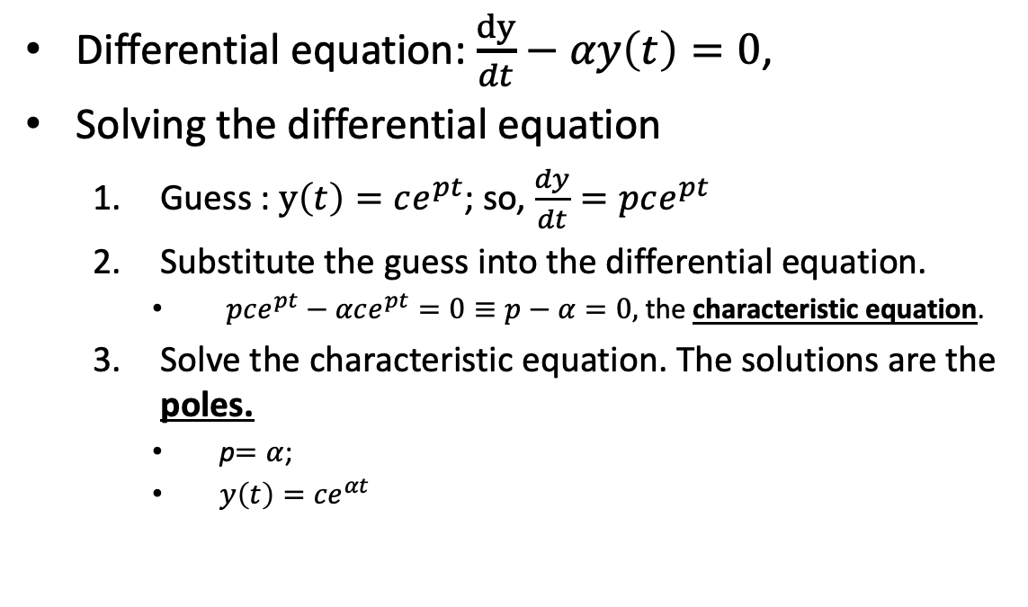
First Order Linear Time Invariant (LTI) System
X
Differential equation: $\frac{dy}{dt}−αy\left(t\right)=0$,
Solving the differential equation
Guess : $y\left(t\right)=ce^{pt}$; so, $\frac{dy}{dt}=pce^{pt}$
Substitute the guess into the differential equation.
$pce^{pt}−αce^{pt}=0≡p−α=0,$ the characteristic equation.
Solve the characteristic equation. The solutions are the poles.
p$=α$;
$y\left(t\right)={ce}^{αt}$
c is found using the initial conditions.

Slide 9
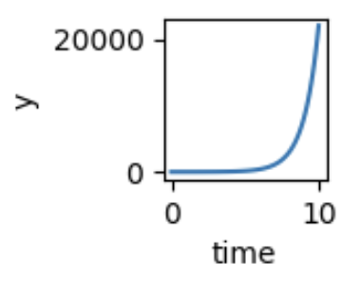
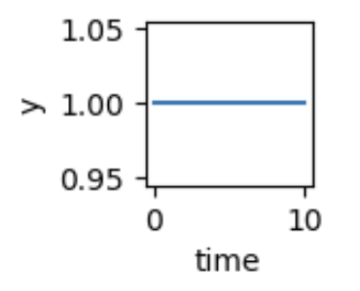


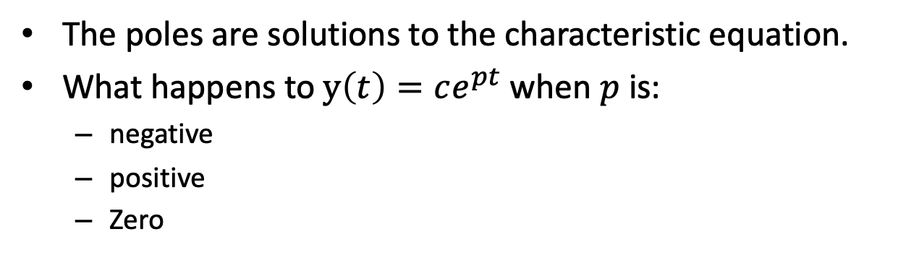

Poles
X
$\frac{dy}{dt}=pce^{pt}$, $p−α=0,$ the characteristic equation
The poles are solutions to the characteristic equation.
What happens to $y\left(t\right)=ce^{pt}$ when $p$ is:
negative
positive
Zero
$$α>0$$
$$α<0$$
$$α=0$$

Slide 10
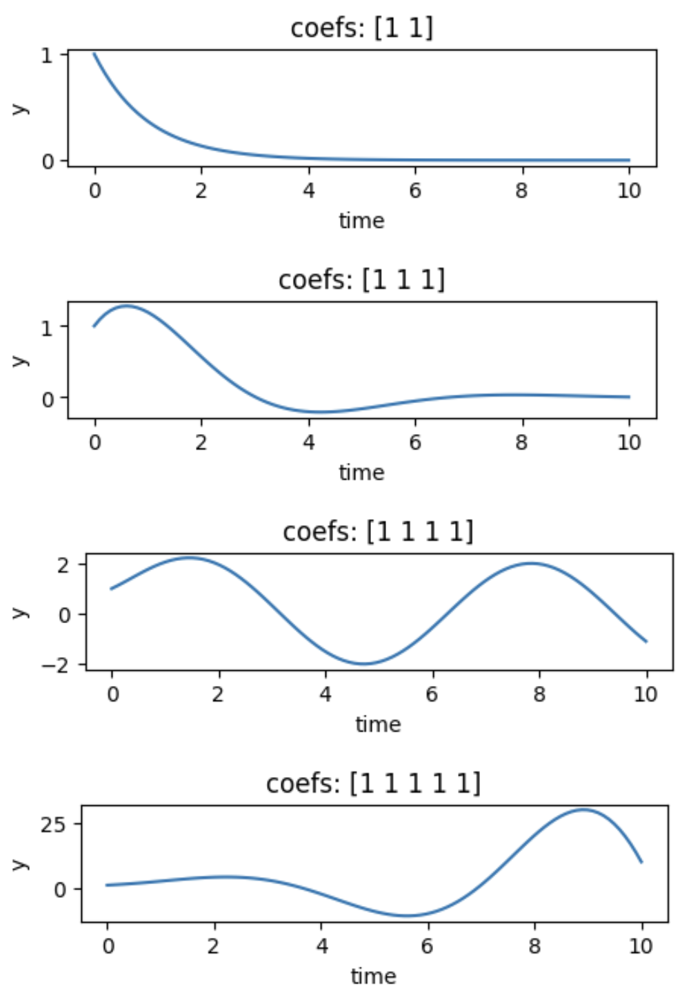
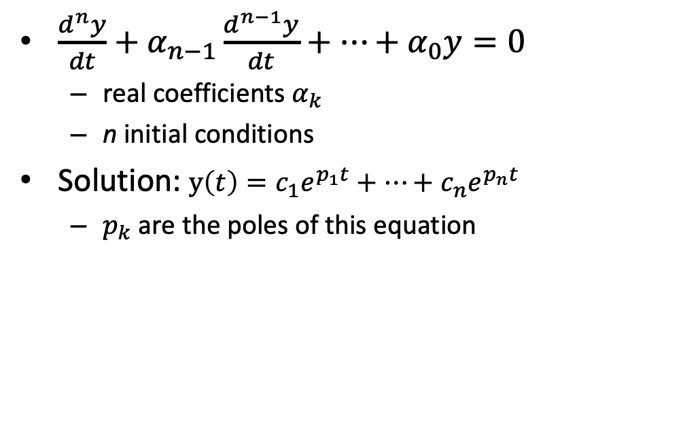

High Order Differential Equations
X
$\frac{d^{n}y}{dt}+α_{n−1}\frac{d^{n−1}y}{dt}+⋯+α_{0}y=0$
real coefficients $α_{k}$
n initial conditions
Solution: $y\left(t\right)=c_{1}e^{p_{1}t}+⋯+c_{n}e^{p_{n}t}$
$p_{k}$ are the poles of this equation
1st order
2nd order
3rd order
4th order
$$α_{k}=1$$

Slide 11
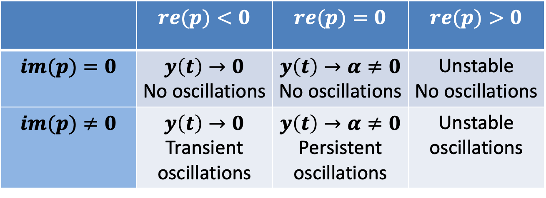
Poles Tell Us About Stability and Oscillations
Consider the (possibly complex) pole $p=(re\left(p\right), im\left(p\right))$
 | $$re(p)<0$$ | $$re(p)=0$$ | $$re(p)>0$$
$$im(p)=0$$ | $$y\left(t\right)→0$$ No oscillations | $$y\left(t\right)→α≠0$$ No oscillations | Unstable No oscillations
$$im(p)≠0$$ | $$y\left(t\right)→0$$ Transient oscillations | $$y\left(t\right)→α≠0$$ Persistent oscillations | Unstable oscillations

Slide 12
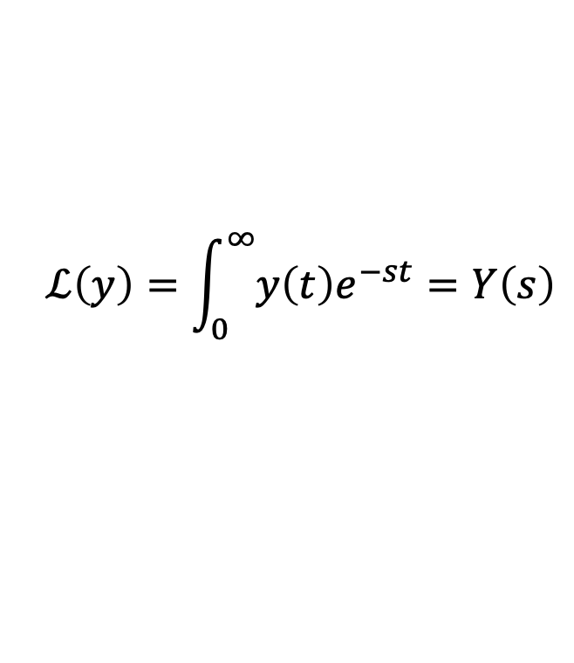

Laplace Transform
$$ℒ\left(y\right)=\int_{0}^{∞}{y\left(t\right)e^{−st}}=Y\left(s\right)$$
$s$ is an imaginary number
$y(t)$ is a continuous function of time
Provides an easy way to key properties of systems

Slide 13
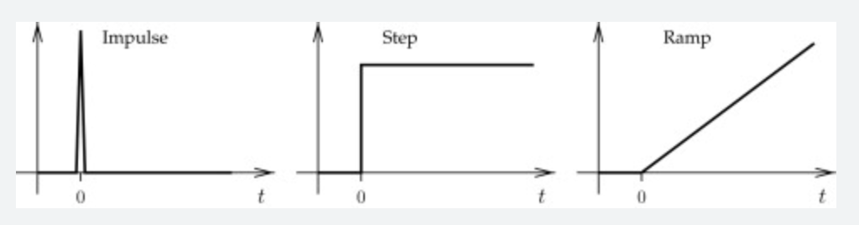



Basic Signals
$${u\left(t\right)=δ}_{0}(t)$$
$${y\left(t\right)= 1}_{0}(t)$$
$$y\left(t\right)=t$$

Slide 14
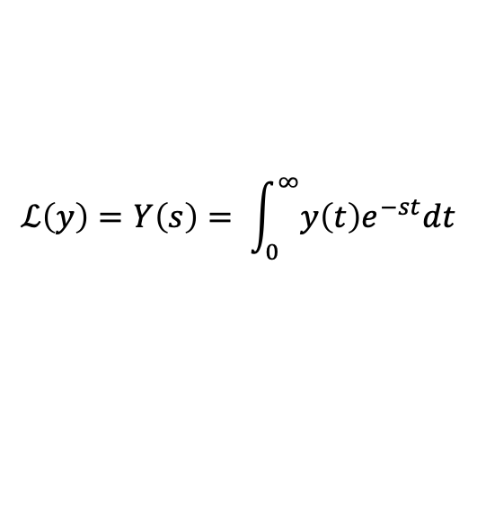
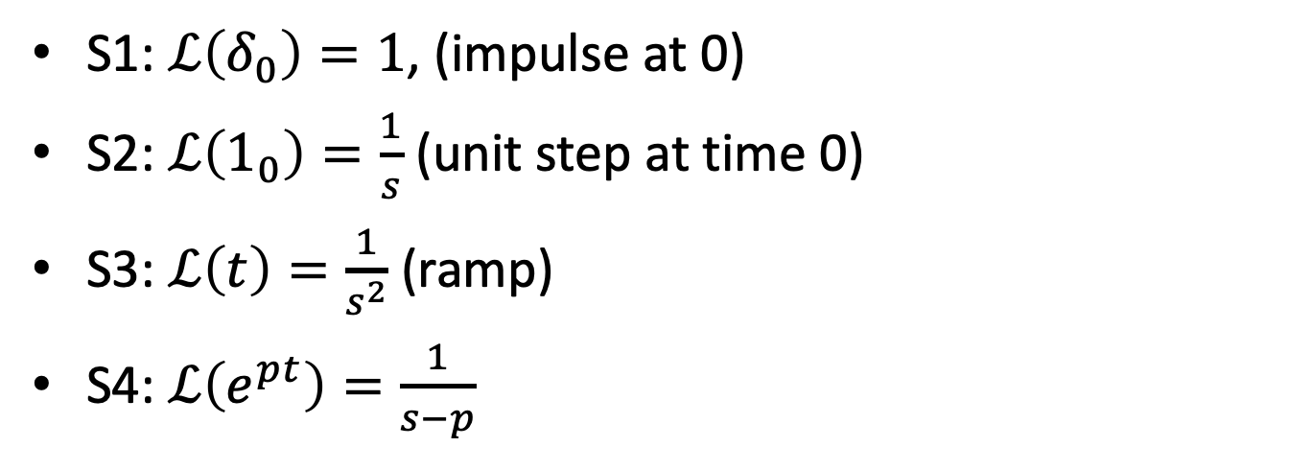
Laplace Transforms of Basic Signals
$$ℒ\left(y\right)=Y\left(s\right)= \int_{0}^{∞}{y\left(t\right)e^{−st}dt}$$
S1: $ℒ\left(δ_{0}\right)=1$, (impulse at 0)
S2: $ℒ\left(1_{0}\right)=\frac{1}{s}$ (unit step at time 0)
S3: $ℒ\left(t\right)=\frac{1}{s^{2}}$ (ramp)
S4: $ℒ\left(e^{pt}\right)=\frac{1}{s−p}$

Slide 15
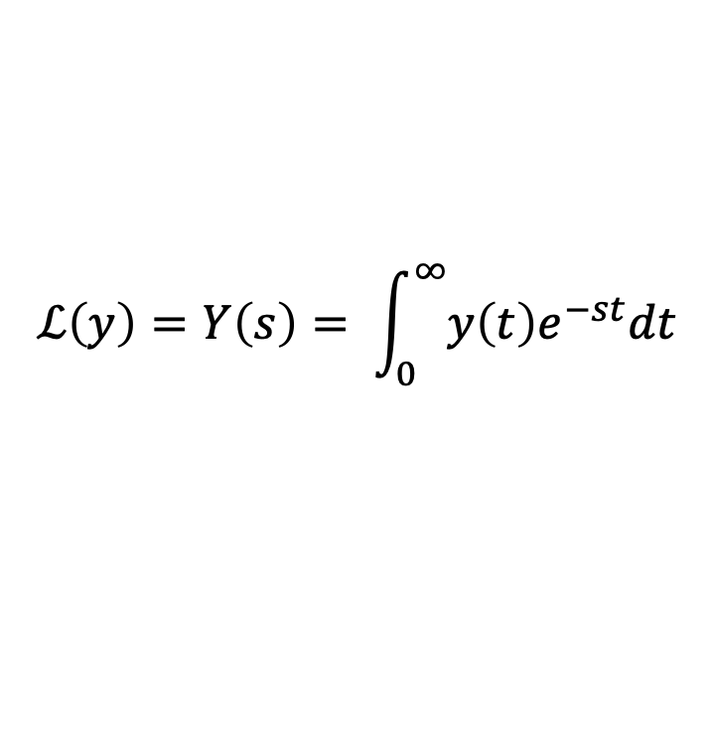
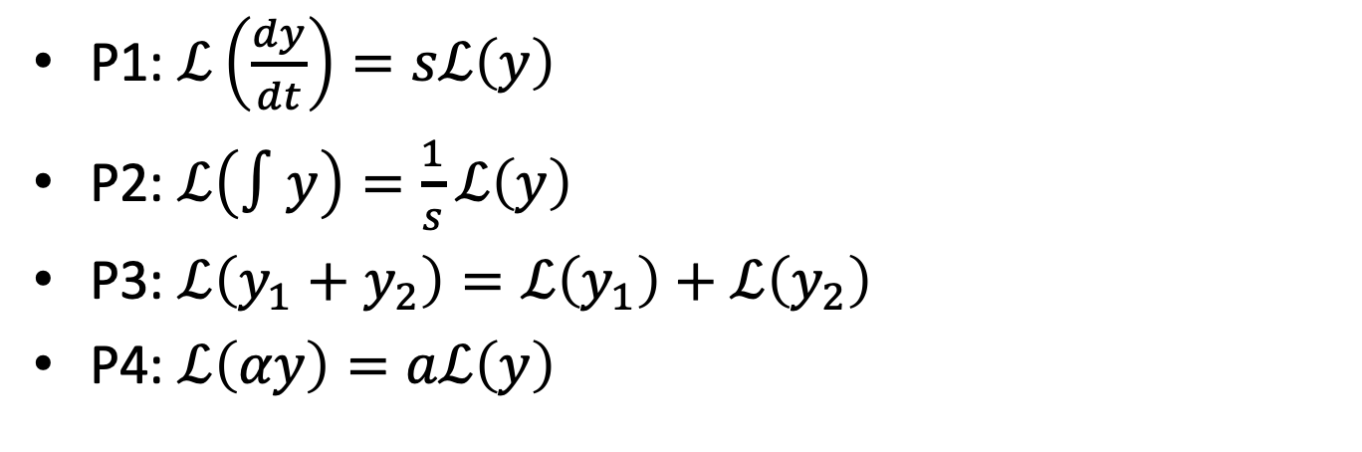
Laplace Transforms Properties
$$ℒ\left(y\right)=Y\left(s\right)= \int_{0}^{∞}{y\left(t\right)e^{−st}dt}$$
P1: $ℒ\left(\frac{dy}{dt}\right)=sℒ\left(y\right)$
P2: $ℒ\left(∫y\right)=\frac{1}{s}ℒ\left(y\right)$
P3: $ℒ\left(y_{1}+y_{2}\right)=ℒ\left(y_{1}\right)+ℒ\left(y_{2}\right)$
P4: $ℒ\left(αy\right)=aℒ\left(y\right)$

Slide 16


Find These Laplace Transforms
$y\left(t\right)=5+3t^{2}+ 100δ$
$\frac{5}{s}+\frac{3}{s^{3}}+100$
$y\left(t\right)={6e}^{−4t }+∫8e^{0.2 t}$
$\frac{6}{s+4}+\frac{8}{s(s−0.2)}$
S1: $ℒ\left(δ_{0}\right)=1$
S2: $ℒ\left(1_{0}\right)=\frac{1}{s}$
S3: $ℒ\left(t\right)=\frac{1}{s^{2}}$
S4: $ℒ\left(e^{−αt}\right)=\frac{1}{s+α}$
P1: $ℒ\left(\frac{dy}{dt}\right)=sℒ\left(y\right)$
P2: $ℒ\left(∫y\right)=\frac{1}{s}ℒ\left(y\right)$
P3: $ℒ\left(y_{1}+y_{2}\right)=ℒ\left(y_{1}\right)+ℒ\left(y_{2}\right)$
P4: $ℒ\left(αy\right)=aℒ\left(y\right)$

Slide 17

Poles & Laplace Transforms
“$p$ is a pole of $y\left(t\right)$” is equivalent to “$p$ is a root for $s$ in the denominator of $ℒ(y)$”.
Examples
$$y\left(t\right)=e^{pt}≡Y\left(s\right)=\frac{1}{s−p}$$

Slide 18


What are the poles? Are the systems stable?
$\frac{5}{s}+100$
poles at 0. Step + impulse.
$\frac{6}{s+4}+\frac{8}{s(s−0.2)}$
poles at -4, 0, 0.2. unstable.
S1: $ℒ\left(δ_{0}\right)=1$
S2: $ℒ\left(1_{0}\right)=\frac{1}{s}$
S3: $ℒ\left(t\right)=\frac{1}{s^{2}}$
S4: $ℒ\left(e^{at}\right)=\frac{1}{s+a}$
P1: $ℒ\left(\frac{dy}{dt}\right)=sℒ\left(y\right)$
P2: $ℒ\left(∫y\right)=\frac{1}{s}ℒ\left(y\right)$
P3: $ℒ\left(y_{1}+y_{2}\right)=ℒ\left(y_{1}\right)+ℒ\left(y_{2}\right)$
P4: $ℒ\left(αy\right)=aℒ\left(y\right)$

Slide 19






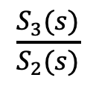
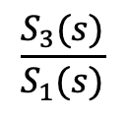
Transfer Function
S1
S2
S3
$$G_{1}(s)$$
$$G_{2}(s)$$
$$G\left(s\right)$$
A transfer function is the ratio of the Laplace transform of the output to the Laplace transform of the input.
$$G_{1}\left(s\right)=\frac{S_{2}(s)}{S_{1}(s)}$$
$$\frac{S_{3}(s)}{S_{2}(s)}$$
$$\frac{S_{3}(s)}{S_{1}(s)}$$
$$G_{2}\left(s\right)=$$
$$G\left(s\right)=$$
A transfer function is a Laplace transform and so has all of its properties.

Slide 20
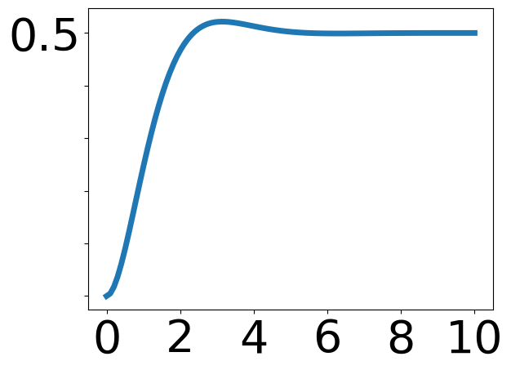
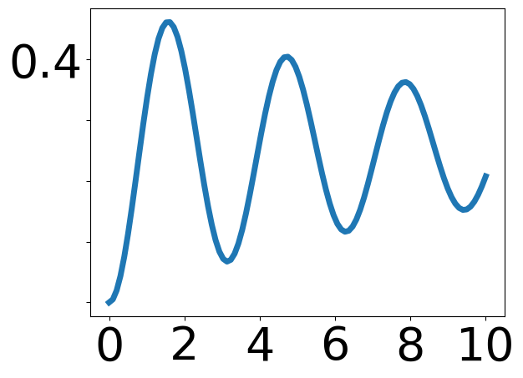
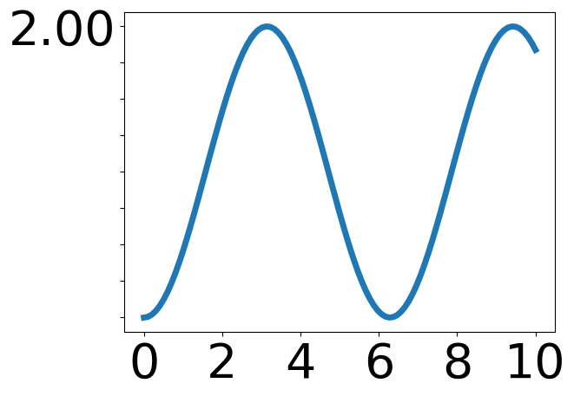
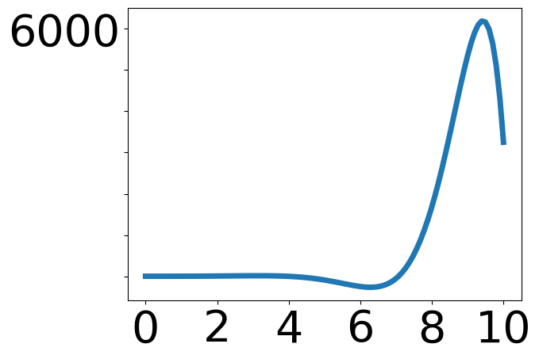
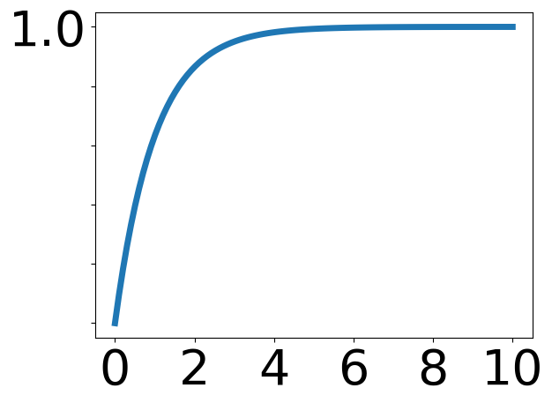
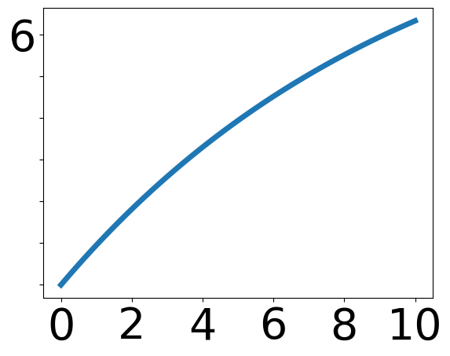
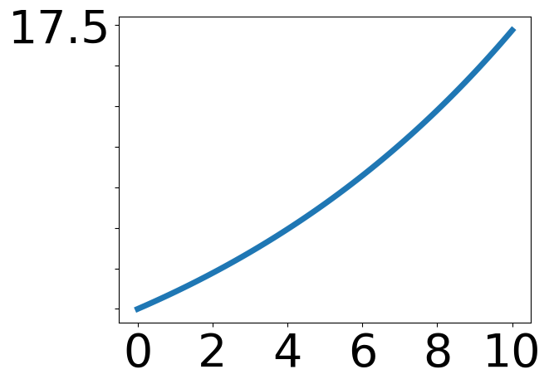
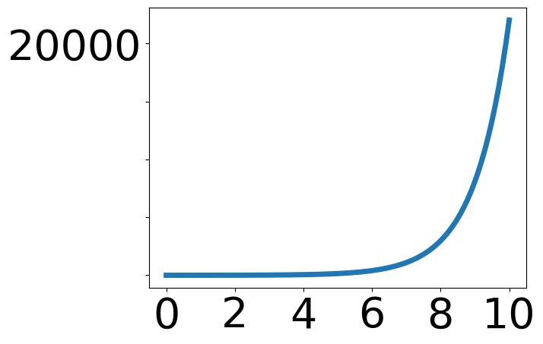


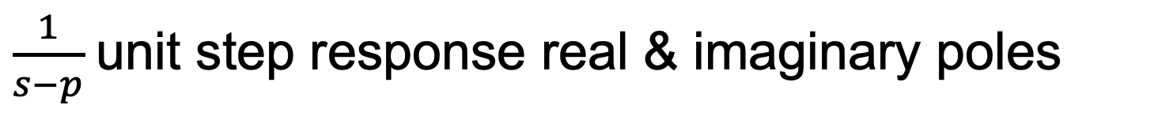
$\frac{1}{s−p}$unit step response real & imaginary poles
$$re$$
Plots are centered on p.
$$img$$

Slide 21

Steady State Step Response (DC Gain)
If $Y\left(s\right)=ℒ\left(y\right)$ and $y\left(t\right)$ converges, then $y\left(∞\right)=Y(0).$
Example
$Y\left(s\right)=\frac{1}{s+1}$. $y\left(∞\right)=\frac{1}{0+1}=1$

Slide 22
What You Need to Know
How stability, oscillation are determined by poles
Calculating DC gain from transfer functions.

Slide 23
Exercise 1: Find the Transfer Function for a Sequential Chemical Network

Slide 24
BACKUP

Slide 25



Representing Signals in Discrete Time
k | 0 | 1 | 2 | 3 | 4 | 5
y | 5 | 10.1 | 20.03 | 15 | 30 | 11.11
$$y\left(k\right)=5, 10.1, 20.03, 15, 30, 11.11$$
30
X
$$y(k)$$
20
X
X
10
X
X
X
0
0
1
2
3
4
5
$$k$$
Let $z$ be a complex number. We can encode discrete times as a polynomial, where the exponent indicates the time index. This is called a z-transform.
$$Y\left(z\right)=5z^{0}+10.1z^{−1}+20{.03z}^{−2}+15 z^{−3}+30 z^{−4}+11.11z^{−5}$$

Slide 26



Shifting in time
k | 0 | 1 | 2 | 3 | 4 | 5
y | 5 | 10.1 | 20.03 | 15 | 30 | 11.11
original $Y\left(z\right)$
k | 0 | 1 | 2 | 3 | 4 | 5
y | 0 | 5 | 10.1 | 20.03 | 15 | 30
delay $Y′\left(z\right)$
k | 0 | 1 | 2 | 3 | 4 | 5
y | 10.1 | 20.03 | 15 | 30 | 11.11 | 0
shift $Y′′\left(z\right)$
$$Y\left(z\right)=5z^{0}+10.1z^{−1}+20{.03z}^{−2}+15 z^{−3}+30 z^{−4}+11.11z^{−5}$$
Let $Y^{′}(z)$ the z-transform of $Y\left(z\right)$, delayed by one time unit
$$Y^{′}\left(z\right)=5z^{−1}+10.1z^{−2}+20{.03z}^{−3}+15 z^{−4}+30 z^{−5}+11.11z^{−6}=z^{−1}Y(z)$$
Let $Y^{′}(z)$ the z-transform of $Y\left(z\right)$ shifted by one time unit
$$Y^{′}\left(z\right)=10.1z^{0}+20{.03z}^{−1}+15 z^{−2}+30 z^{−3}+11.11z^{−4}=z^{}Y(z)$$

Slide 27





Adding Signals
$$y_{1}\left(k\right)=5, 10, 0,15$$
$$Y_{1}\left(z\right)=5z^{0}+10z^{−1}+15z^{−3}$$
$$y_{2}\left(k\right)=1, 2, 3, 0$$
$$Y_{2}\left(z\right)=z^{0}+2z^{−1}+{3z}^{−2}$$
$$y_{3}\left(k\right)=6, 12, 3, 15$$
$${Y_{3}\left(z\right)=Y}_{1}\left(z\right)+Y_{2}\left(z\right)={6z}^{0}+12z^{−1}+{3z}^{−2}+15z^{−3}$$
The z-transform of the sum of two time series is the sum of the z-transforms.

Slide 28





Multiplication by a Constant
$$y_{1}\left(k\right)=5, 10, 0, 15$$
$$Y_{1}\left(z\right)=5z^{0}+10z^{−1}+15z^{−3}$$
$$y_{2}\left(k\right)=15, 30, 0, 45$$
$$Y_{2}\left(z\right)=15z^{0}+30z^{−1}+45z^{−3}$$
$Y_{2}\left(z\right)=3Y_{1}(z)$
The z-transform of the product of a constant times a time series is the constant times the z-transform of the time series.

Slide 29




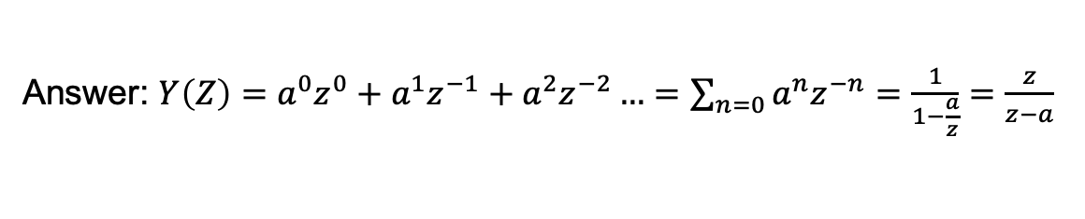
Exercise: Find the z-Transform
A. Find the z-transform of
$$y\left(k\right)=1, a, a^{2}, …$$
$$∞$$
Answer: $Y\left(Z\right)=a^{0}z^{0}+a^{1}z^{−1}+a^{2}z^{−2}…=\sum_{n=0}{a^{n}z^{−n}}=\frac{1}{1−\frac{a}{z}}=\frac{z}{z−a}$
B. For which values of a is this signal bounded (stable)?
Answer: $a<1$
C. Does the signal converge faster when $a→0$ or when $a→1$?
Answer: $a→0$

Slide 30

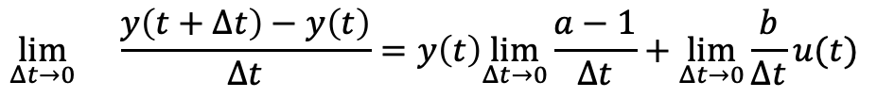

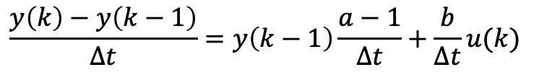

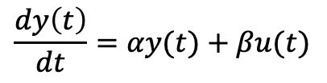

From Discrete to Continuous Time
$$\frac{dy\left(t\right)}{dt}=αy(t)+βu(t)$$
$$y\left(k\right)=ay\left(k−1\right)+bu(k)$$
$$y\left(k\right)−y\left(k−1\right)=ay\left(k−1\right)−y(k−1)+bu(k)$$
$$y\left(k\right)−y\left(k−1\right)=y\left(k−1\right)[a−1]+bu(k)$$
$$\frac{y\left(k\right)−y\left(k−1\right)}{Δt}=y\left(k−1\right)\frac{a−1}{Δt}+\frac{b}{Δt}u(k)$$
$$\lim_{Δt→0}{}\frac{y\left(t+Δt\right)−y\left(t\right)}{Δt}=y\left(t\right)\lim_{Δt→0}\frac{a−1}{Δt}+\lim_{Δt→0}\frac{b}{Δt}u(t)$$
$$\frac{dy\left(t\right)}{dt}=αy(t)+βu(t)$$
$$α=\lim_{Δt→0}\frac{a−1}{Δt}, β=\lim_{Δt→0}\frac{b}{Δt}$$
When is $y(t)$ bounded? How does this relate to when $y\left(k\right)$ is bounded?
$$α<0$$

Slide 31
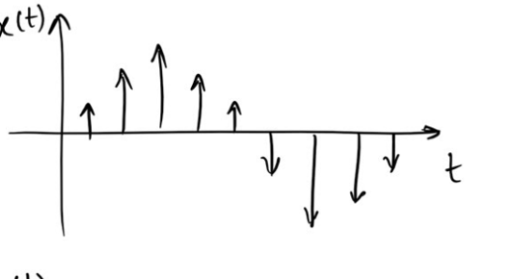







Discrete vs. Continuous Time
$$u$$
$$y$$
System
$$y(t)$$
$$t$$
$$y(k)$$
$$y(k)$$
$$k$$

Slide 32
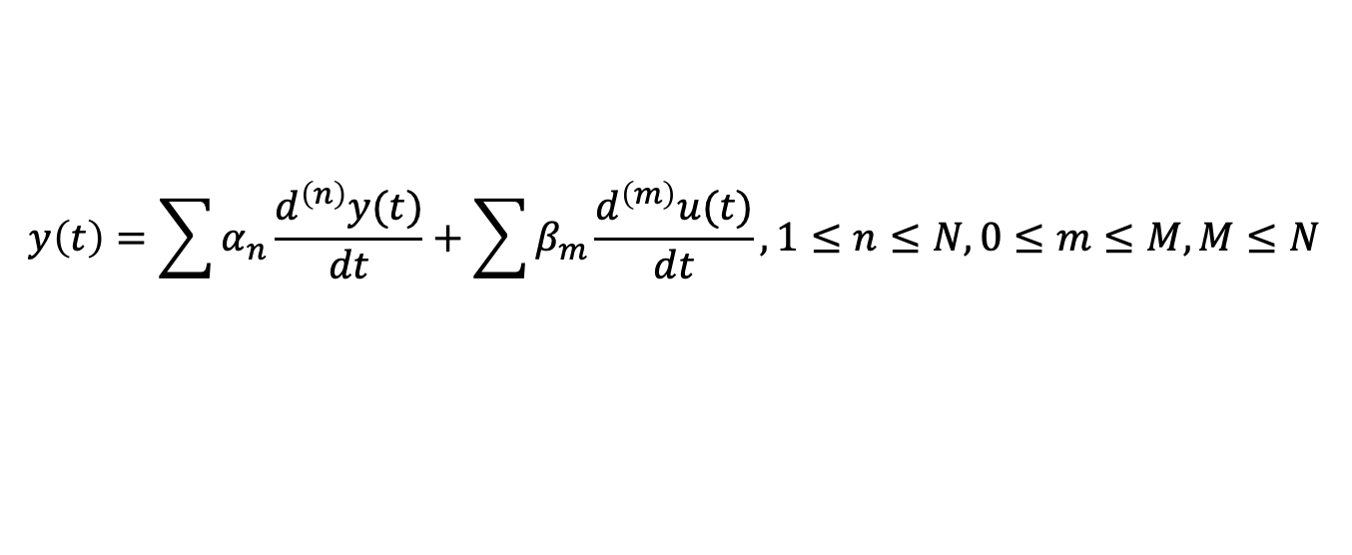
High Order Systems With Inputs
$$y\left(t\right)=\sum{α_{n}\frac{d^{\left(n\right)}y(t)}{dt}}+\sum{β_{m}\frac{d^{\left(m\right)}u(t)}{dt}}, 1≤n≤N, 0≤m≤M, M≤N$$
This is getting complicated!
We need a simpler approach than solving in the time domain.

Slide 33
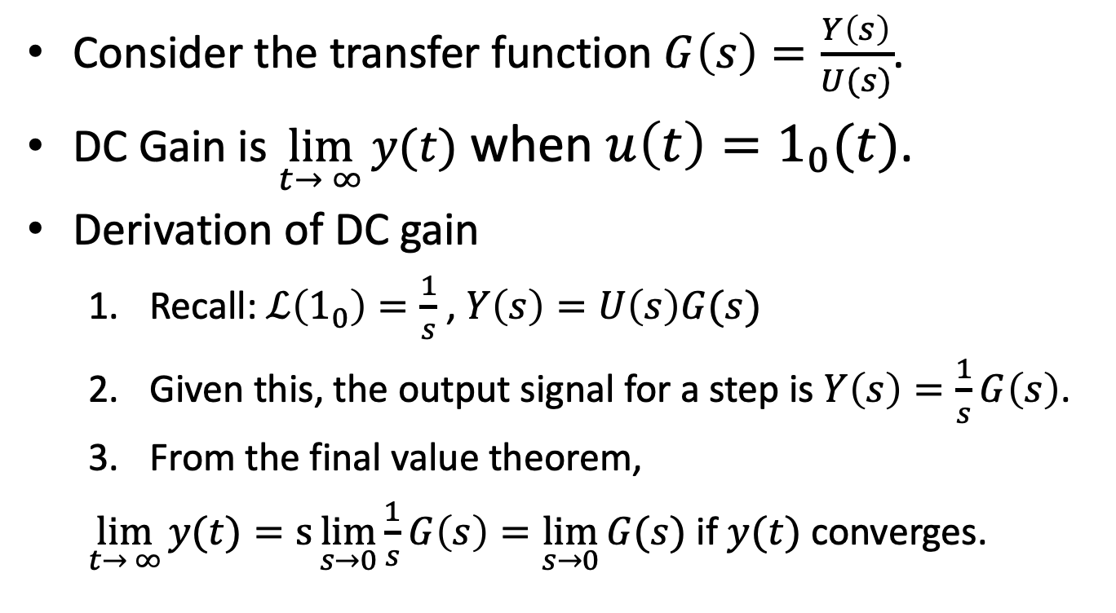
DC Gain For Transfer Functions
Consider the transfer function $G\left(s\right)=\frac{Y\left(s\right)}{U(s)}$.
DC Gain is $\lim_{t→ ∞}{y(t)}$ when $u\left(t\right)=1_{0}(t)$.
Derivation of DC gain
Recall: $ℒ\left(1_{0}\right)=\frac{1}{s}$ , $Y\left(s\right)=U\left(s\right)G(s)$
Given this, the output signal for a step is $Y\left(s\right)=\frac{1}{s}G\left(s\right)$.
From the final value theorem,
$\lim_{t→ ∞}{y(t)}=s\lim_{s→0}{\frac{1}{s}G\left(s\right)=\lim_{s→0}{G(s)}}$ if $y(t)$ converges.

Slide 34
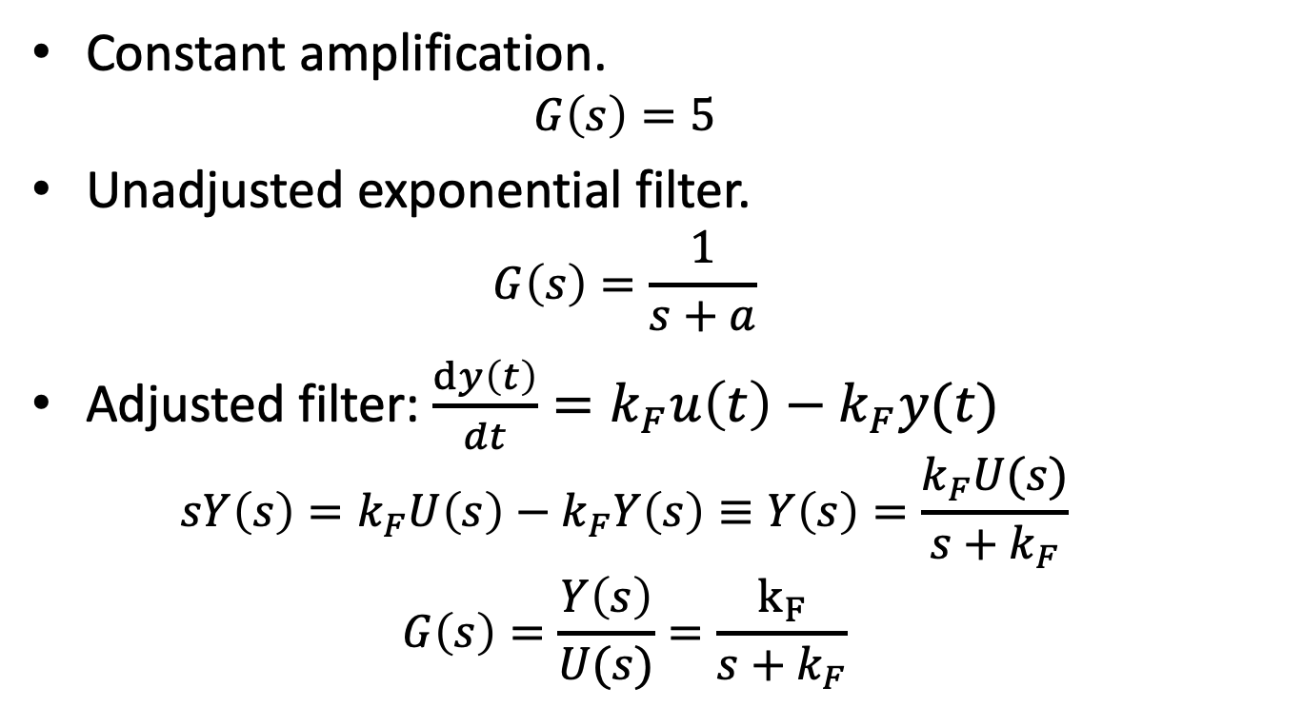

Examples of Calculating DC Gain
DC Gain: ${\lim_{s→0}{G(s)}}$
Constant amplification.
$$G\left(s\right)=5$$
Unadjusted exponential filter.
$$G\left(s\right)=\frac{1}{s+a}$$
Adjusted filter: $\frac{dy\left(t\right)}{dt}=k_{F}u\left(t\right)−k_{F}y(t)$
$$sY\left(s\right)=k_{F}U\left(s\right)−k_{F}Y\left(s\right)≡Y\left(s\right)=\frac{k_{F}U(s)}{s+k_{F}}$$
$$G\left(s\right)=\frac{Y\left(s\right)}{U(s)}=\frac{k_{F}}{s+k_{F}}$$
Notes:
DC gain for constant amplification: 5
DC gain for exponential: 1/a
DC gain for filter: 1

