Slide 1
BIOE 498 / BIOE 599 Advanced Biological Control Systems Lecture 1: Course Introduction
Joseph L. Hellerstein
March 28, 2022
eScience Institute, Computer Science & Engineering
Allen School of Computer Science
BioEngineering
Notes:
Diverse students. Some with bio-backgrounds; some without. Some with CS background; some with very limited. Two separate courses combined because of a substantial shared curriculum.

Slide 2
Agenda
What is control engineering and why it’s important
Course overview
Biochemistry basics
Lecture Notes: canvas/syllabus

Slide 3
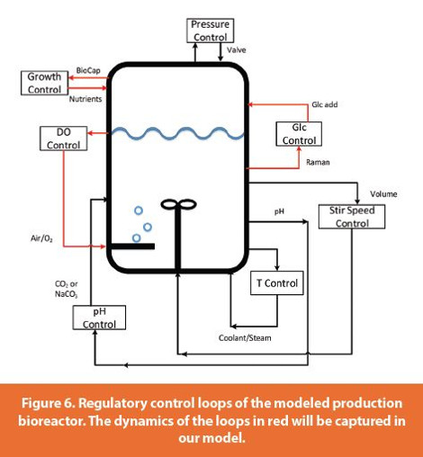
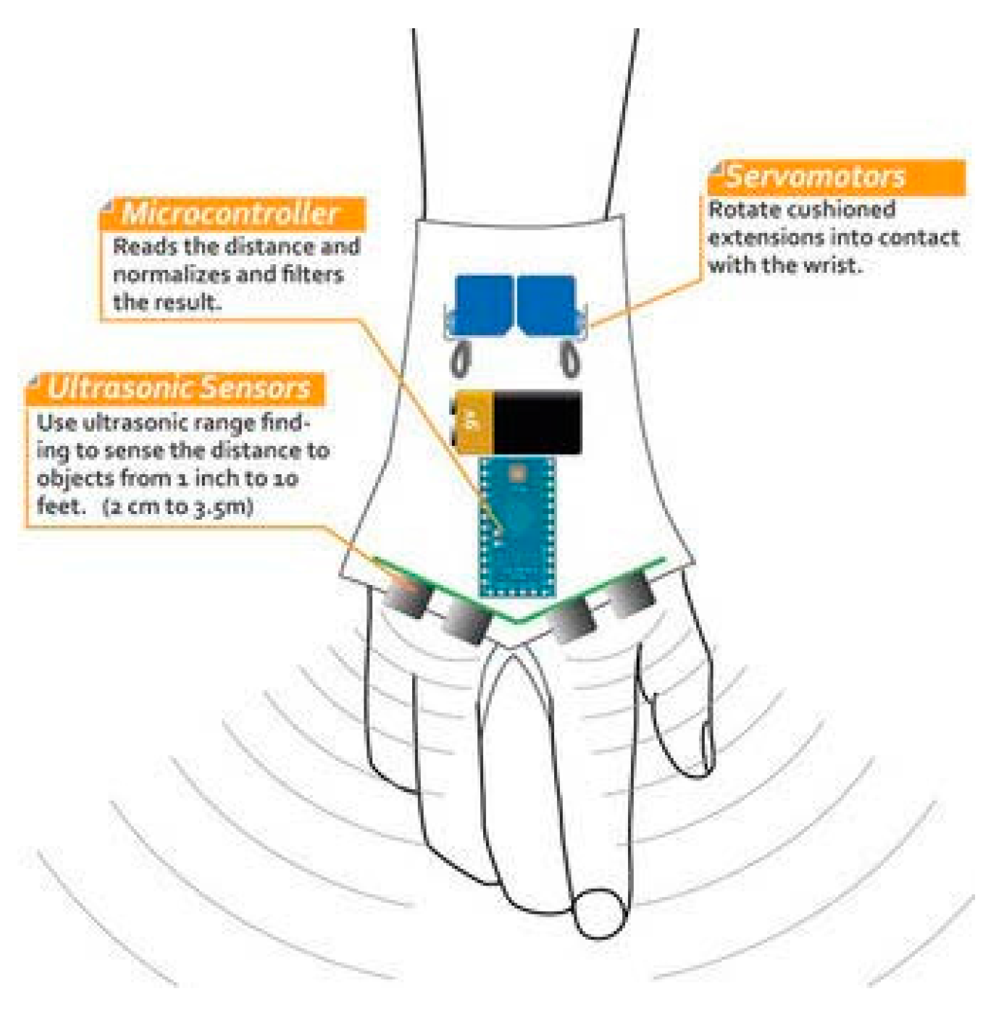
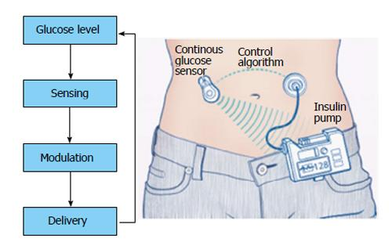
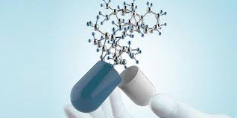
Why Control Engineering?
Bioreactor Control
Medical Device Control
Insulin Control
Create a system that:
ensures that bounded inputs produce bounded outputs;
regulates its output;
tracks a desired objective;
minimizes cost, energy, potential dangers.

Slide 4

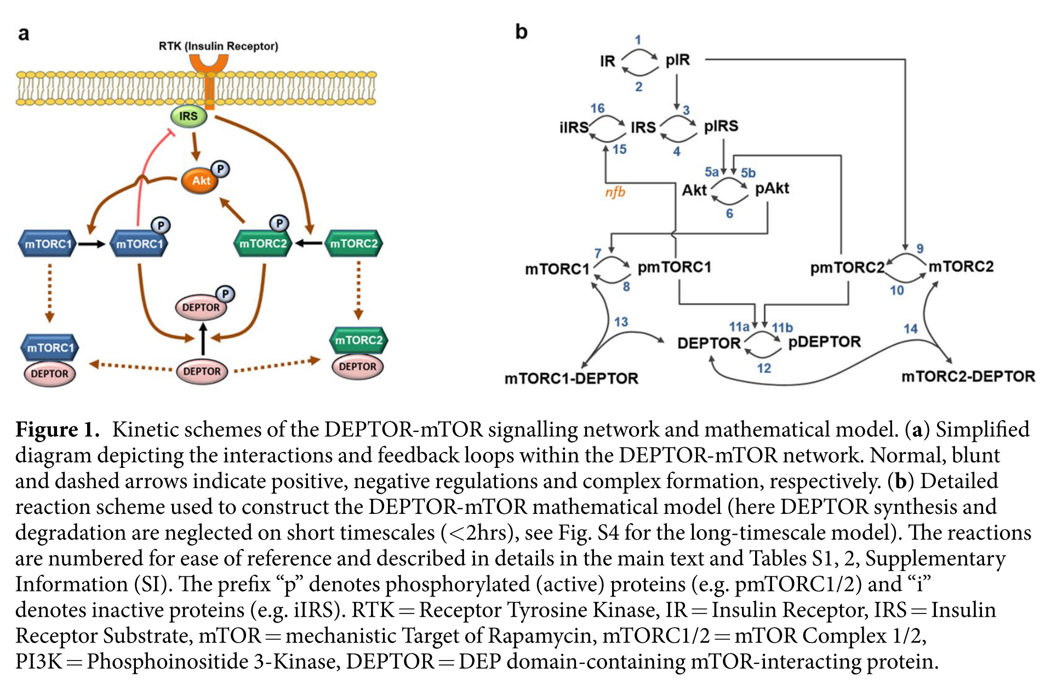
An Example: mTOR Signaling

Slide 5
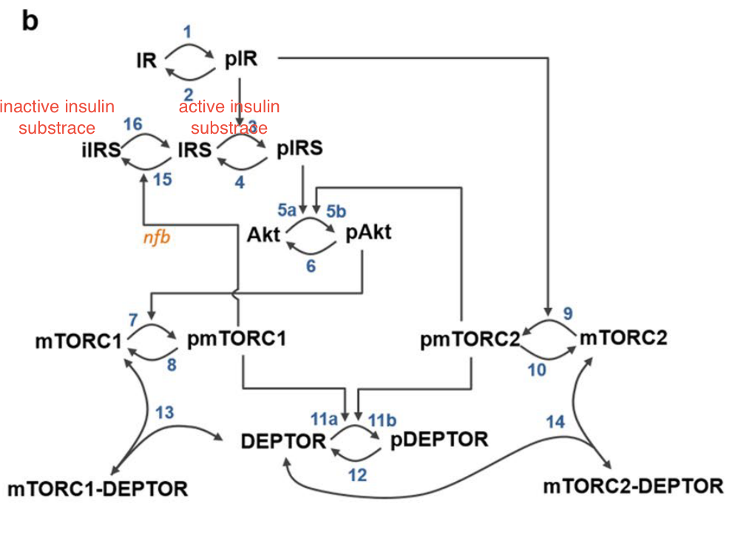
BioChemical State Space Model
$$J_{1}$$
Inputs (u)
States (x)
Outputs (y)
IR, IRS, Akt,
DEPTOR, mTORC1
$$J_{1}, J_{12}$$
pmTORC1, pmTORC2
$$J_{12}$$
States: Concentrations of floating chemical species
Because the Jacobian relates concentrations to their rates of change
Outputs: Concentrations of floating chemical species
Must either be a state or computable from the states (e.g., conserved species, assignment statements)
Inputs: Reaction names
Abstraction for possible effectors, such as an enzyme moderated reactions
Changing input J1 by $δ$ changes the flux of reaction J1 by $δ$
Product n changes by $δs_{n}$, where $s_{n}$ is the stoichiometry of the product
Reactant m changes by $−δs_{m}$, where $s_{m}$ is the stoichiometry of the reactant

Slide 6








Elements of a Control System
operator
$$d$$
$$n$$
user
Controller
“Plant”
x₁, …, x_{N}
+
+
actuators
sensors
+
$$r$$
$$−$$
$$e$$
$$u$$
$$y$$
Control Objectives
Regulation. The plant stays at an operating point r.
Tracking. Force plant to produce a desired sequence of outputs.
Optimization. The plant produces the ”best” outputs.
x₁, …, x_{N} are plant state variables that completely determine its outputs
r is the reference input specified by the operator
u is the control input to the plant
y is the plant output that is being controlled
e is the control error, r-y
d is a disturbance that impacts how u relates to the x’s
n is noise that impacts the observed output y

Slide 7
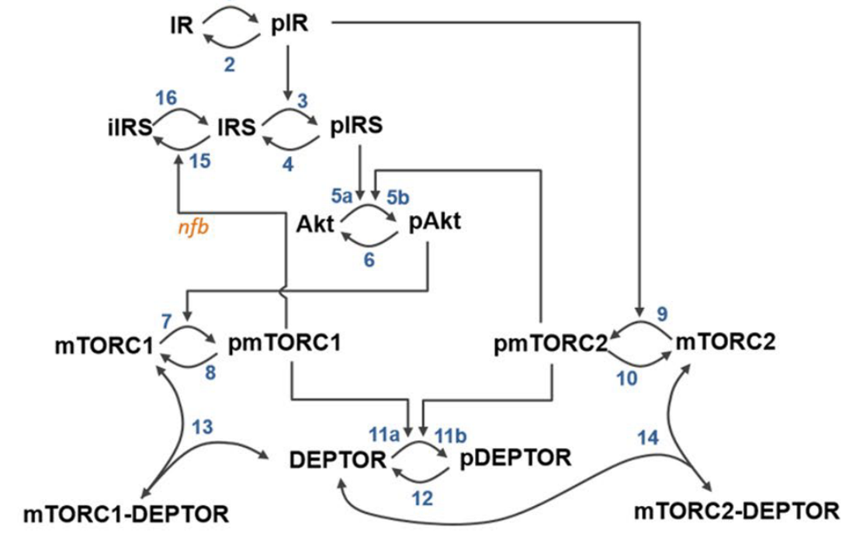
Challenges With Control Engineering in Systems Biology
What are the actuators? What are the sensors?
Effect of actuators given complex internal feedbacks.
Handling noise and disturbances.

Slide 8

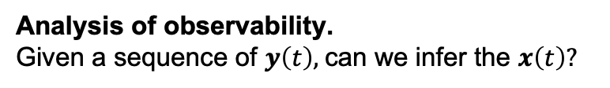







Modeling, Analysis, Design
$$d$$
$$n$$
Controller
“Plant”
x₁, …, x_{n}
$$y$$
$$r$$
+
$$e$$
$$u$$
+
actuators
sensors
+
$$−$$
Modeling.
How construct model state space for a biochemical network? How accurate is the model?
$$\dot{x}(t)=Ax(t)+Bu(t)$$
$x(t)$ is $N×1$
u$(t)$ is $P×1$
y$(t)$ is $Q×1$
$$y(t)=Cx(t)$$
$A$is $N×N$
$B$is $N×P$
$C$is $Q×N$
Analysis of controllability.
For any $x(t)$ and any initial state, is there a sequence of u$(t)$ that result in $x\left(t\right)?$
Analysis of observability.
Given a sequence of $y\left(t\right),$can we infer the $x\left(t\right)?$
Design full state feedback.
Design the controller u$(t)$, a function of $x(t)$, so that the closed loop outputs r.
Design observers.
Design a second closed loop system that estimates all $x(t)$ if some are unknown.
Design robust control.
Design feedback control that is robust to disturbances and noise.

Slide 9
Computational Approach
Create CalTech control objects for SBML model
NonlinearIOSystem – original model
StateSpace – Linearization
Evaluate accuracy of linearization
Design controller and create NonlinearIOSystem for it
Construct a closed system by creating InterconnectedSystem with the NonlinearIOSystem for the SBML model and controller
Simulate the closed system.

Slide 10
Course Goals
Construct and analyze models of chemical networks in both continuous and discrete time, taking into account nonlinearities.
Analyze the controllability of a chemical network.
Analyze the observability of chemical networks.
Control a chemical network using full state feedback.
Construct observers for a chemical network.
Develop a robust contruct solution that addresses modeling inaccuracies and “noise” (perturbations introduced by uncontrolled factors).

Slide 11
Instructor
Joseph Hellerstein, Senior Fellow eScience Institute, Affiliate Professor CSE
PhD in Computer Science
Industry (30+ years): IBM Research, Microsoft, Google
Mathematical models of distributed computing systems
Research
Modeling evolution of microbial communities
Model Engineering (tools for building biomedical models)

Slide 12
Grading
Homework (3 assignments): 30%
Final project: 70%
End-to-end analysis and design of a feedback control of an SBML model

Slide 13
Submitting Homework
You have a folder here. Only you and the instructors have permissions for the folder.
Upload your assignment to the folder before the due date.

Slide 14
Resources
Python
Python programming
Python Data Science Handbook
Python for control engineering (Part VIII)
Control Engineering
Modern Control Engineering, Ogata
Linear Systems - Theory and Design, Chi-Tsong Chen
State Space Design (YouTube), Jake Abbott (University of Utah)
YouTube playlist for control engineering
Steve Brunton Control Boot Camp
Control Systems Design Online

Slide 15
Software
The class will feature in-class exercises, so please bring a laptop to class
Software: Tellurium (http://tellurium.analogmachine.org/)
For detailed installation instructions see https://github.com/sys-bio/tellurium#installation-instructions
For a huge database of curated models see:
https://www.ebi.ac.uk/biomodels/
Other packages
control – CalTech package for control design
controlSBML – Control design with SBML models

Slide 16
Syllabus

Slide 17
Exploring Feedback Control

Slide 18
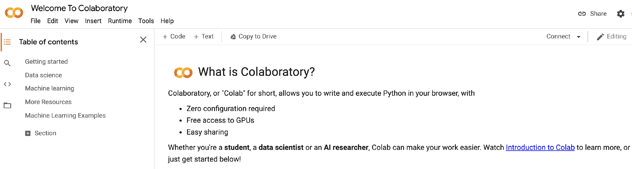
Getting Google Colaboratory (Colab)
We will use Google Colab for in-class presentation and student homeworks.
Actions: Set up Colab now on your Google Account.

