Slide 1
BIOE 498 / BIOE 599 Advanced Biological Control Systems Lecture 11: System Identification
Joseph L. Hellerstein
eScience Institute, Computer Science & Engineering
Allen School of Computer Science
BioEngineering
Notes:
Diverse students. Some with bio-backgrounds; some without. Some with CS background; some with very limited. Two separate courses combined because of a substantial shared curriculum.

Slide 2

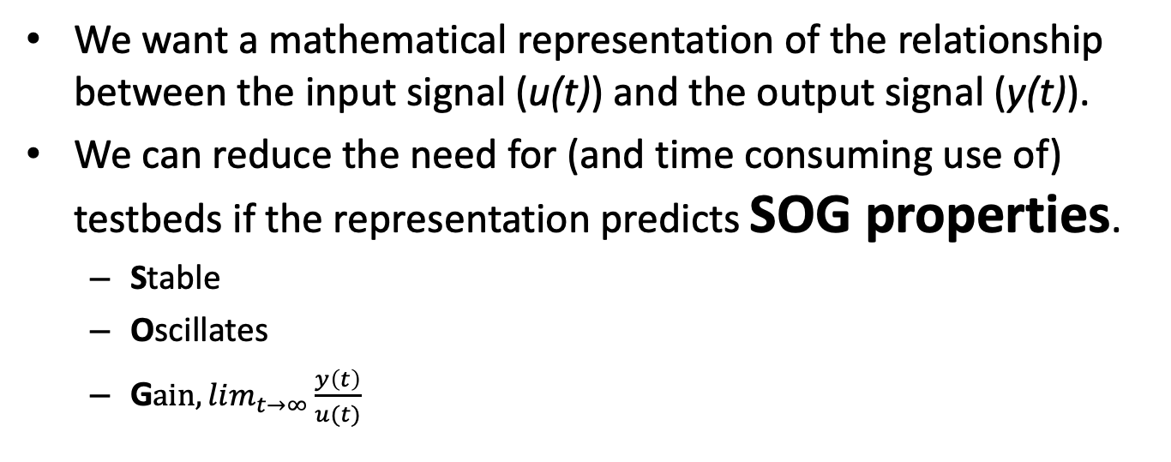

Modeling Dynamical Systems
$$u(t)$$
System
$$y(t)$$
We want a mathematical representation of the relationship between the input signal (u(t)) and the output signal (y(t)).
We can reduce the need for (and time consuming use of) testbeds if the representation predicts SOG properties.
Stable
Oscillates
G$ain, lim_{t→∞}{\frac{y\left(t\right)}{u(t)}}_{}$

Slide 3
System Identification
$$u(t)$$
System
$$y(t)$$
Constructing a transfer function for the system.
This is data driven.
We are given experimental data and the inputs that produced these data.
From this, we estimate a transfer function that predicts values close to the experimental data.

Slide 4
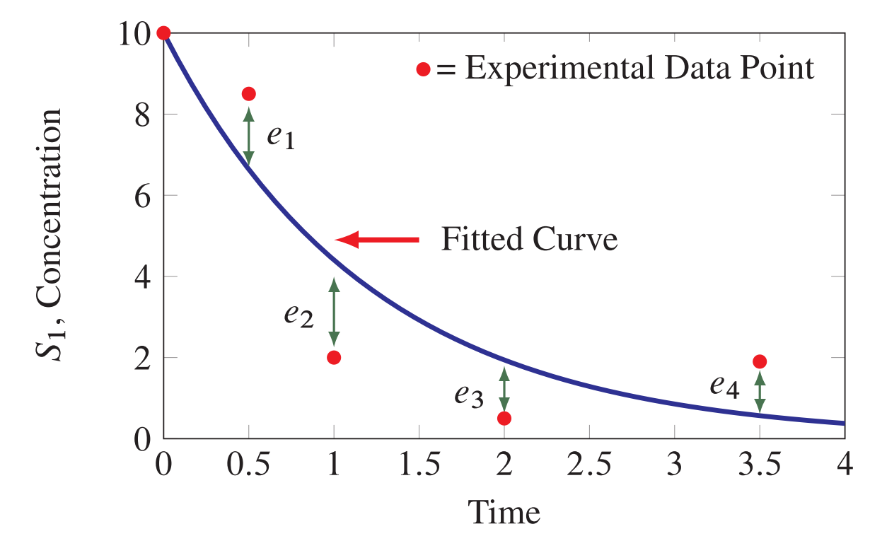
Key Concepts
Residual
Key concepts
Experimental (observational) data – what we want to predict
Fitted curve (predicted values) – predicted from out model
Residuals = Experimental data – fitted curve

Slide 5
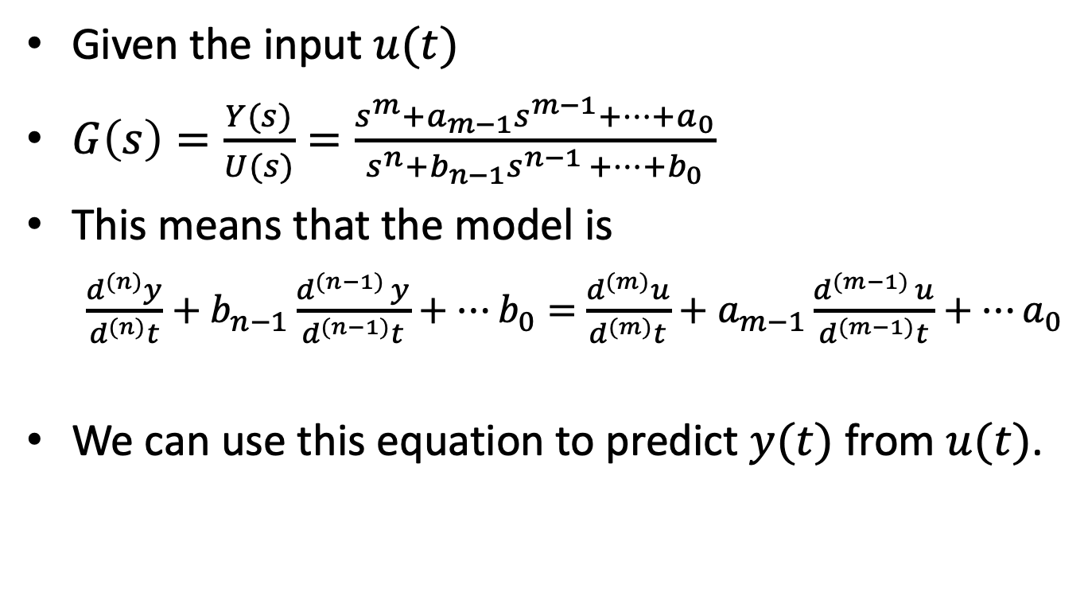
Transfer Functions as Models
Given the input $u(t)$
$G\left(s\right)=\frac{Y(s)}{U(s)}=\frac{s^{m}+a_{m−1}s^{m−1}+⋯+a_{0}}{s^{n}+b_{n−1}s^{n−1 }+⋯{+b}_{0}}$
This means that the model is
$\frac{d^{(n)}y}{d^{(n)}t}+b_{n−1}\frac{d^{(n−1) }y}{d^{(n−1)}t}+⋯b_{0}=$ $\frac{d^{(m)}u}{d^{(m)}t}+a_{m−1}\frac{d^{(m−1) }u}{d^{(m−1)}t}+⋯a_{0}$
We can use this equation to predict $y(t)$ from $u(t)$.

Slide 6
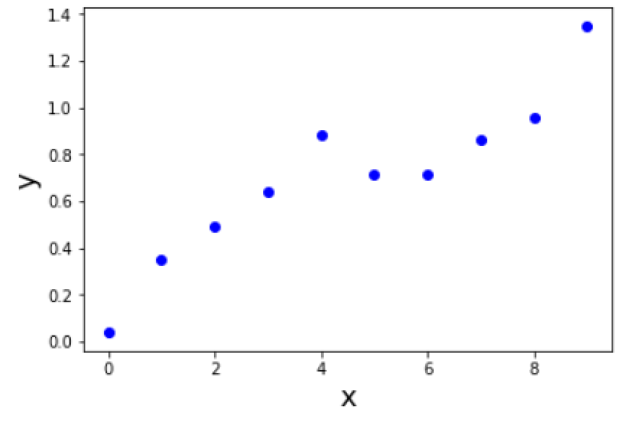
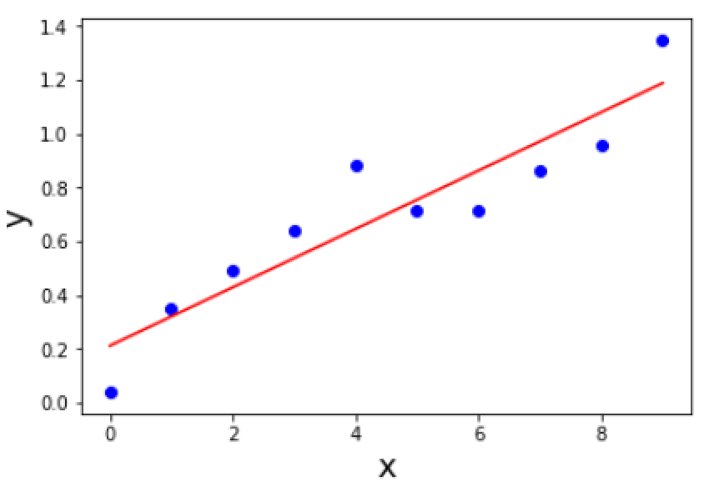
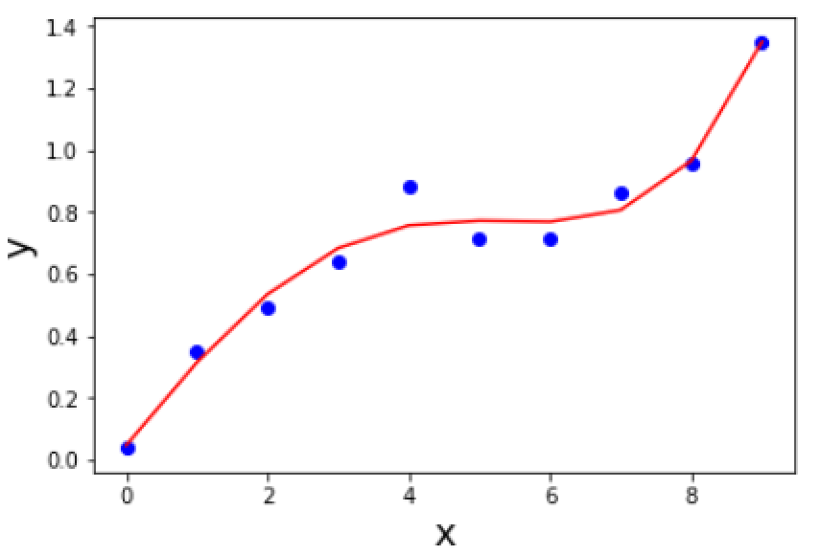


What is A Good Model?
Experimental Data
$$y=ax+b$$
$$y=a_{1}x+a_{2}x^{2}+a_{3}x^{3}+a_{4}x^{4}+b$$
Predictions from a good model have small deviations from the experimental data.

Slide 7
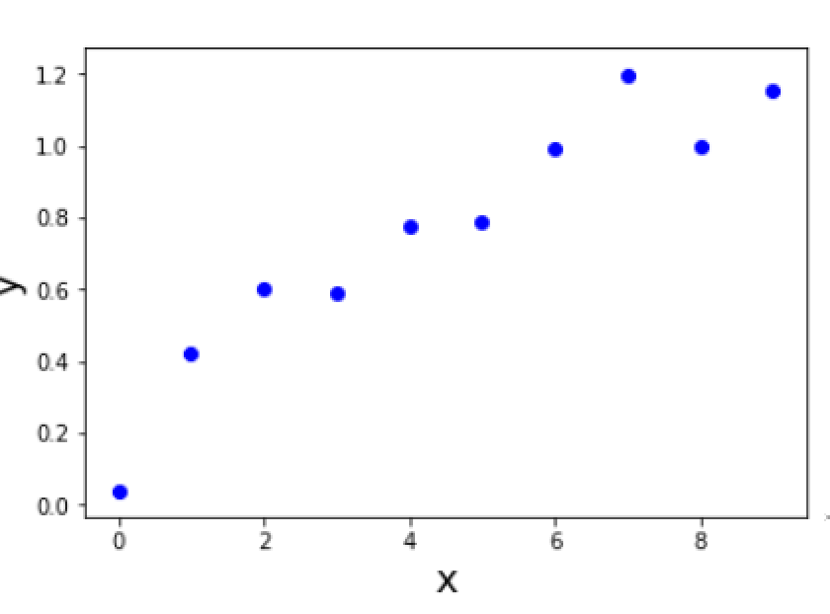
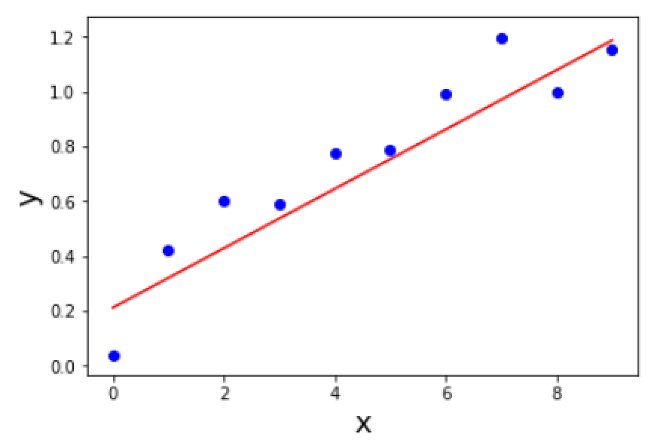
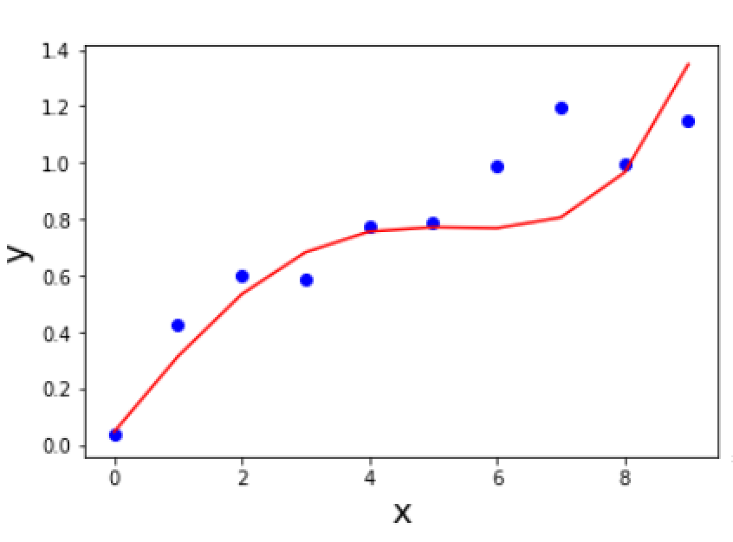
Generalizing Model to New Data
Data 2
Which is the better model now?
A good model provides good fits to many data sets.

Slide 8
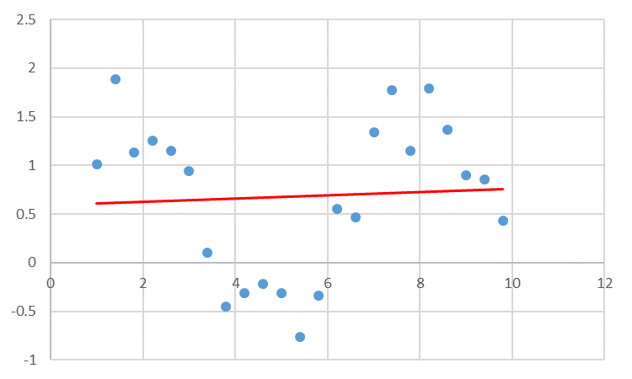
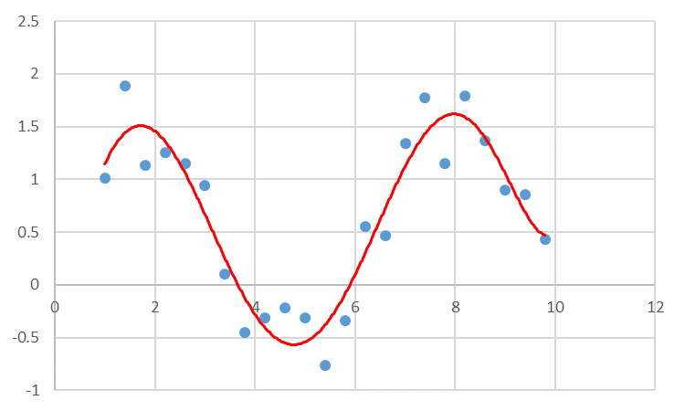
Under fitting
Under fitting
More Realistic

Slide 9
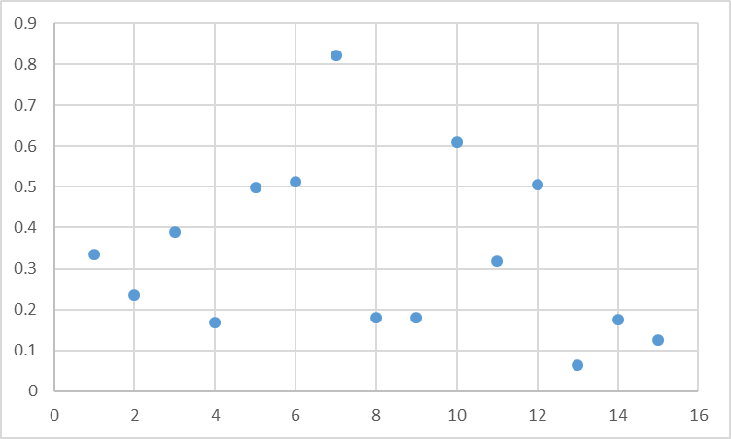
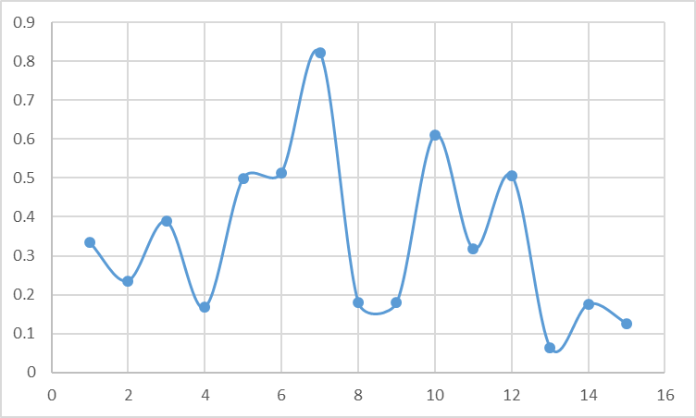
You’ve probably seen this: Someone is a bit too enthusiastic with Excel
Overfitting

Slide 10
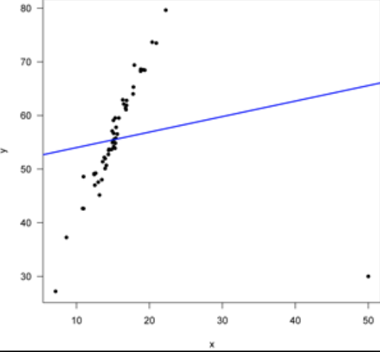
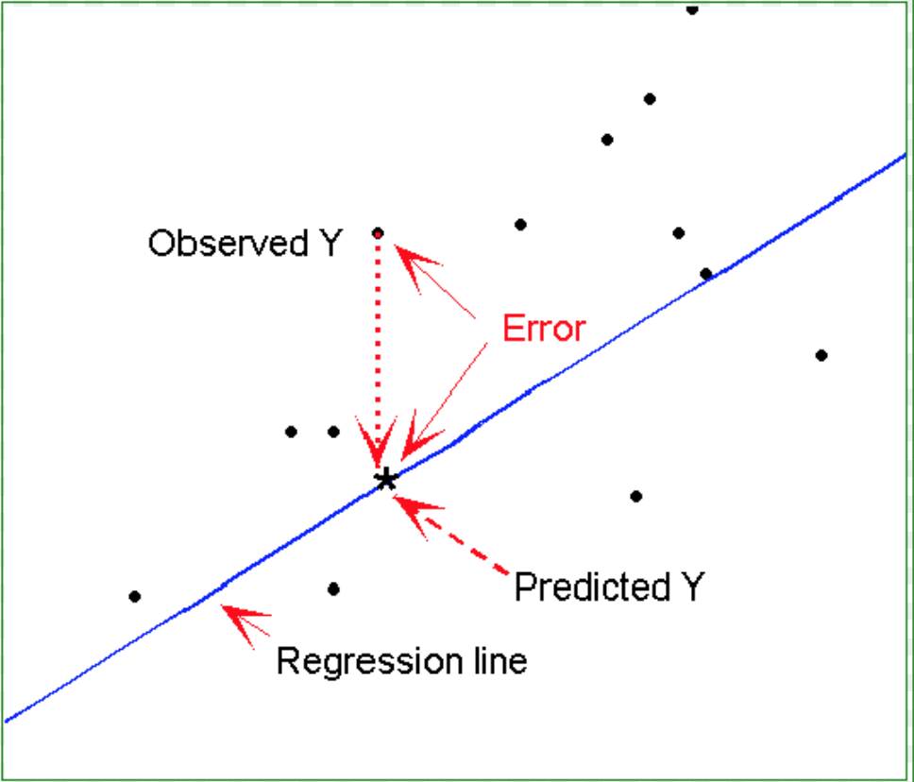
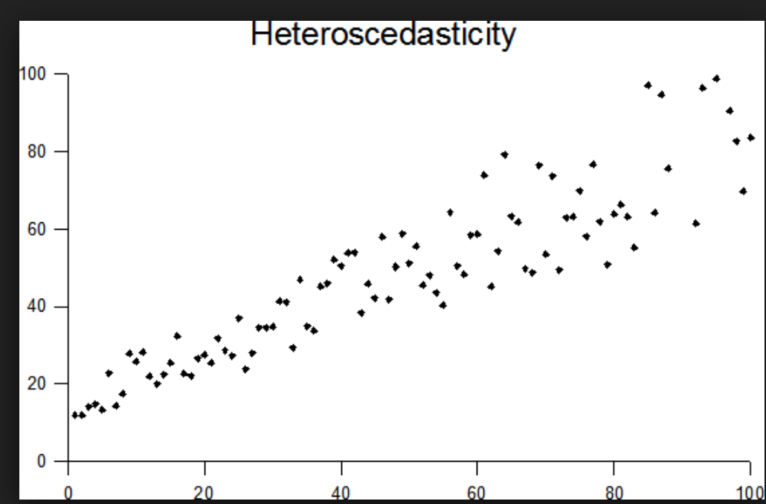
What Residuals Tell Us About Models
Likely Outlier
Functional Bias
Heteroschodasticity

Slide 11

Calculating Residuals
The fitting procedure will attempt to minimize the difference between the model $f$and the data points $y_{i}$, that is minimize:
$$y_{i}−f(x_{i};p_{1}…p_{m})$$

Slide 12
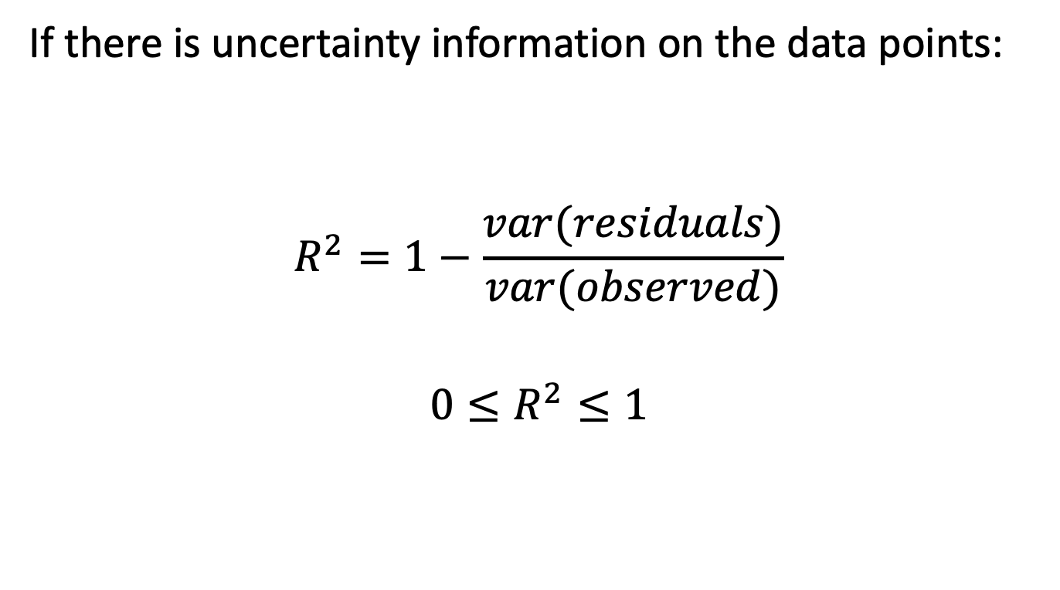
Assessing Model Quality: R²
If there is uncertainty information on the data points:
$$R^{2}=1−\frac{var(residuals)}{var(observed)}$$
$$0≤R^{2}≤1$$
A larger R² indicates a better model.

Slide 13
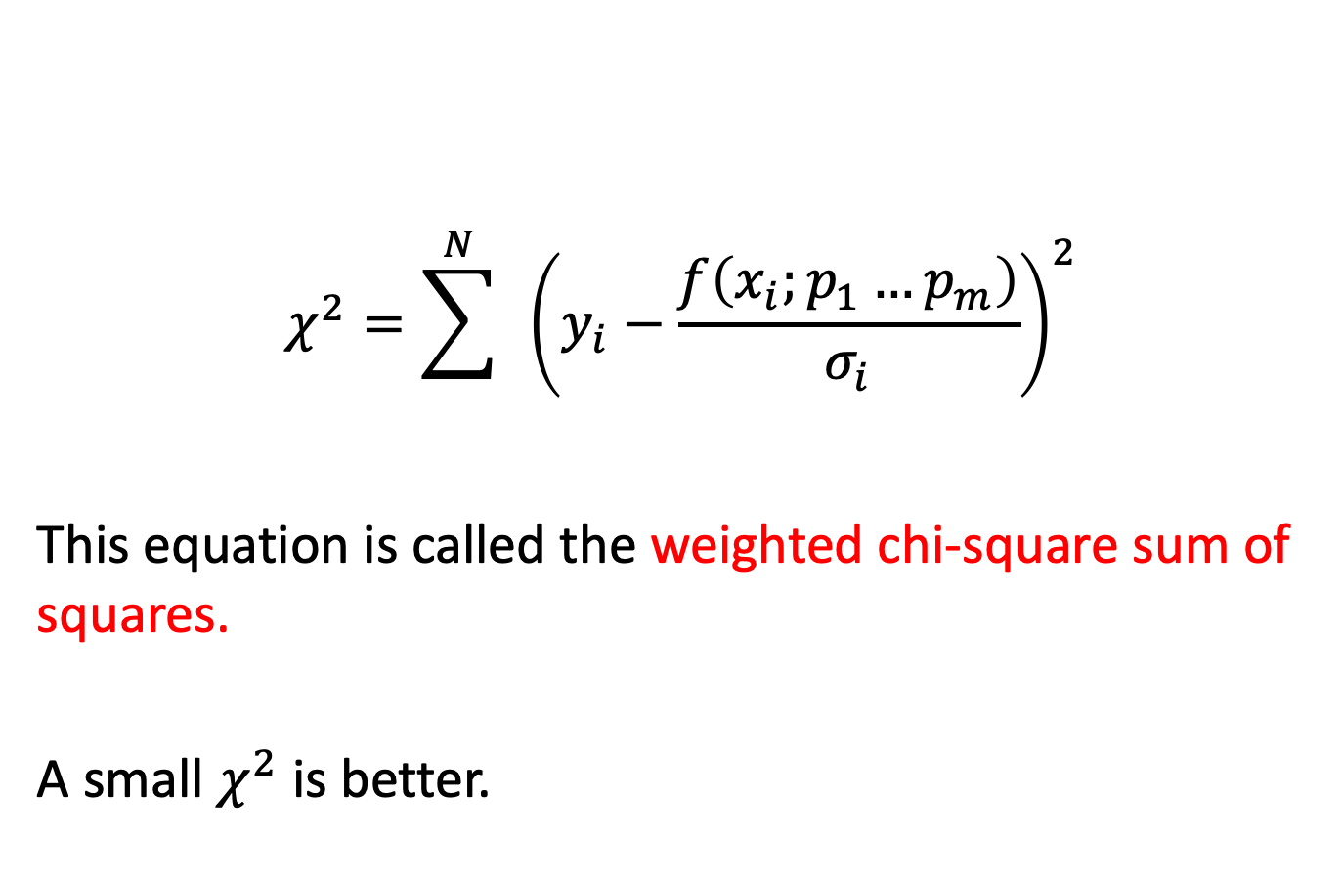
Assessing Model Quality: Chi-Square
$$χ^{2}=\sum^{N}{ }{\left(y_{i}−\frac{f\left(x_{i};p_{1}…p_{m}\right)}{σ_{i}}\right)}^{2}$$
This equation is called the weighted chi-square sum of squares.
A small $χ^{2}$ is better.

Slide 14
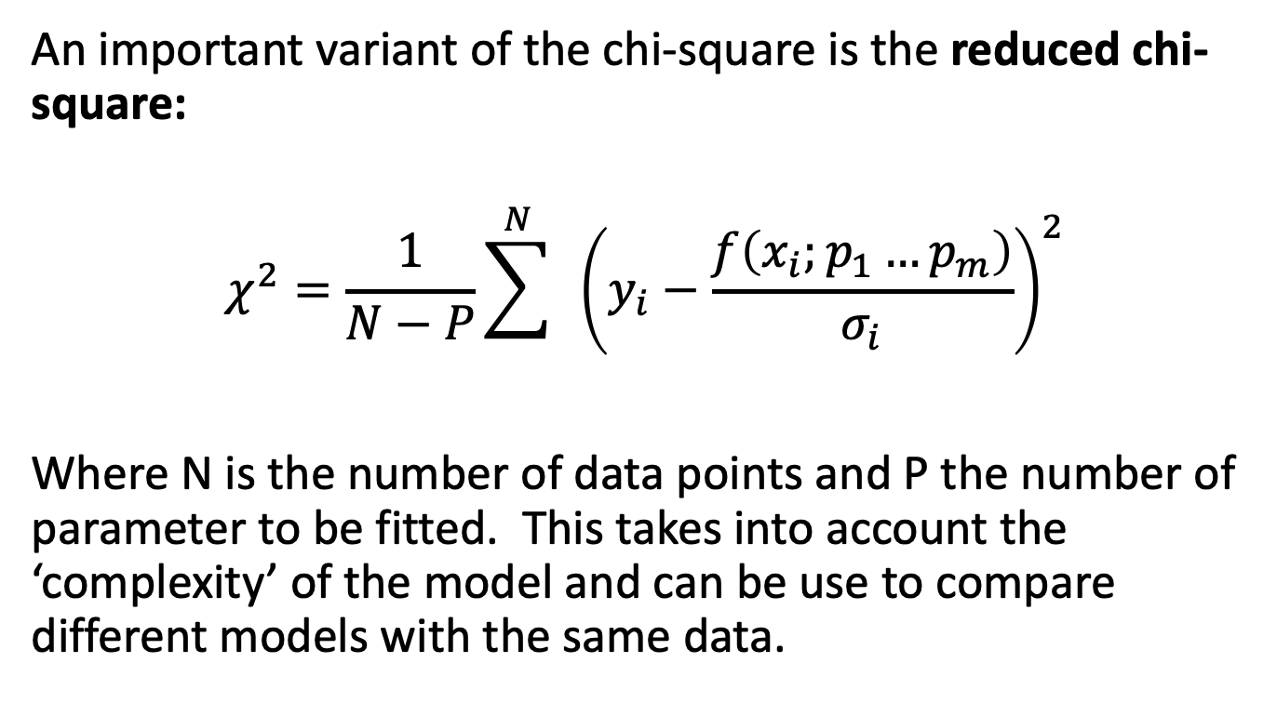
Assessing Model Quality: Reduced Chi-Square
An important variant of the chi-square is the reduced chi-square:
$$χ^{2}=\frac{1}{N−P}\sum^{N}{ }{\left(y_{i}−\frac{f\left(x_{i};p_{1}…p_{m}\right)}{σ_{i}}\right)}^{2}$$
Where N is the number of data points and P the number of parameter to be fitted. This takes into account the ‘complexity’ of the model and can be use to compare different models with the same data.

Slide 15


What is A Good Model?
Data 1
Data 2
$$y=ax+b$$
$$y=a_{1}x+a_{2}x^{2}+a_{3}x^{3}+a_{4}x^{4}+b$$
Fits measurement data
Simple (e.g., few parameters)
Generalizes to new measurement data

Slide 16
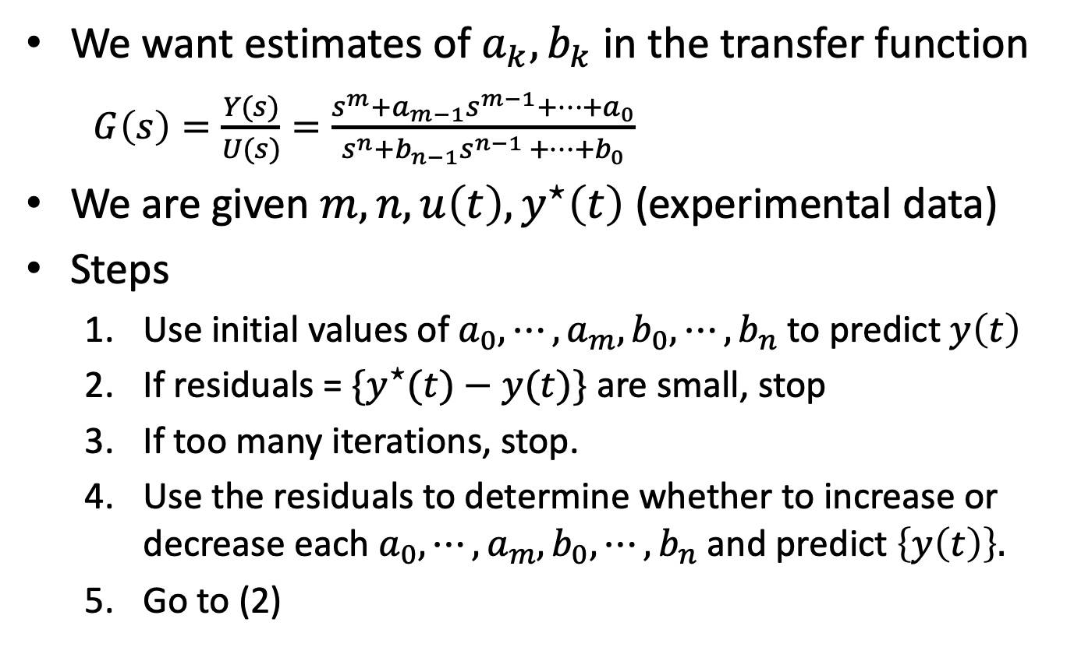
System Identification: Estimating Model Parameters
We want estimates of $a_{k},b_{k}$ in the transfer function
$G\left(s\right)=\frac{Y(s)}{U(s)}=\frac{s^{m}+a_{m−1}s^{m−1}+⋯+a_{0}}{s^{n}+b_{n−1}s^{n−1 }+⋯{+b}_{0}}$
We are given $m, n, u\left(t\right), y^{⋆}\left(t\right)$ (experimental data)
Steps
Use initial values of $a_{0},⋯,a_{m},b_{0},⋯,b_{n}$to predict $y\left(t\right)$
If residuals = ${\{y}^{⋆}(t)−y(t)\}$ are small, stop
If too many iterations, stop.
Use the residuals to determine whether to increase or decrease each $a_{0},⋯,a_{m},b_{0},⋯,b_{n}$and predict $\left\{y\left(t\right)\right\}.$
Go to (2)

