Slide 1
BIOE 498 / BIOE 599 Advanced Biological Control Systems Designing Proportional Controllers
Joseph L. Hellerstein
eScience Institute, Computer Science & Engineering
Allen School of Computer Science
BioEngineering
Notes:
Diverse students. Some with bio-backgrounds; some without. Some with CS background; some with very limited. Two separate courses combined because of a substantial shared curriculum.

Slide 2


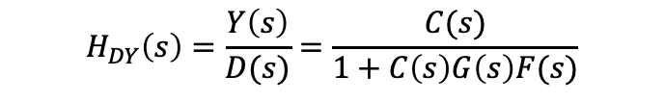


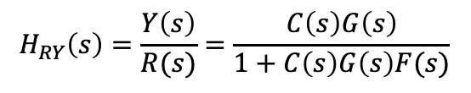


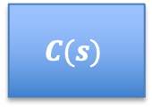
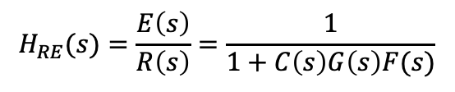



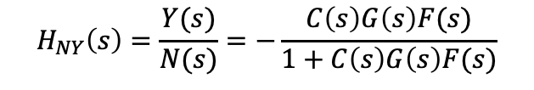
Closed Loop System
Actuator
Disturbance
Measurement
Noise
$$D(s)$$
$$N(s)$$
$$R(s)$$
$$E(s)$$
$$U(s)$$
$$Y(s)$$
$$C(s)$$
$$G(s)$$
+
+
+
$$−$$
$$F(s)$$
$$H_{RY}\left(s\right)=\frac{Y\left(s\right)}{R(s)}=\frac{C\left(s\right)G\left(s\right)}{1+C\left(s\right)G\left(s\right)F(s)}$$
$$H_{RE}(s)=\frac{E\left(s\right)}{R\left(s\right)}=\frac{1}{1+C\left(s\right)G\left(s\right)F(s)}$$
$$H_{NY}\left(s\right)=\frac{Y(s)}{N(s)}=−\frac{C\left(s\right)G\left(s\right)F(s)}{1+C\left(s\right)G\left(s\right)F(s)}$$
$$H_{DY}\left(s\right)=\frac{Y\left(s\right)}{D(s)}=\frac{C(s)}{1+C\left(s\right)G\left(s\right)F(s)}$$
Notes:
Why doesn’t a filter help with measurement noise? Verify transfer functions.

Slide 3



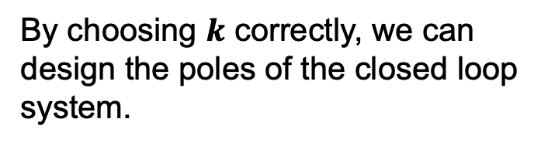


Closed Loop System
$$R(s)$$
$$E(s)$$
$$U(s)$$
$$Y(s)$$
$$C(s)$$
$$G(s)$$
+
$$−$$
By choosing $k$ correctly, we can design the poles of the closed loop system.
$$\dot{x}\left(t\right)=Ax\left(t\right)+bu(t)$$
$$u\left(t\right)=r\left(t\right)−kx(t)$$
$$\dot{x}\left(t\right)=Ax\left(t\right)+b(r\left(t\right)−kx\left(t\right))$$
$$\dot{x}\left(t\right)=(A−bk)x\left(t\right)+br\left(t\right)$$
Notes:
Why doesn’t a filter help with measurement noise? Verify transfer functions.

