Slide 1
BIOE 498 / BIOE 599 Advanced Biological Control Systems Closed Loop Systems
Joseph L. Hellerstein
eScience Institute, Computer Science & Engineering
Allen School of Computer Science
BioEngineering
Notes:
Diverse students. Some with bio-backgrounds; some without. Some with CS background; some with very limited. Two separate courses combined because of a substantial shared curriculum.

Slide 2
Agenda
Block diagrams
Properties of Laplace transforms
Building more complex systems

Slide 3
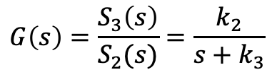



Running Example
Reaction Network
Systems Representation
$S1 -> S2; k1*$S1 J1: S2 -> S3; k2*S2 J2: S3 -> S2; k3*S3 J3: S2 -> ; k4*S2 k1=1; k2=2; k3=3; k4=4 $S1=10; S2=0; S3=0; S4=0
$$G\left(s\right)=\frac{S_{3}\left(s\right)}{S_{2}(s)}=\frac{k_{2}}{s+k_{3}}$$
$$G(s)$$
$$S_{3}\left(s\right)$$
$$S_{2}\left(s\right)$$
S1
S2
S3
input
output

Slide 4




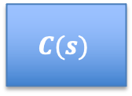

Block Diagram of a Closed Loop System
Controller
Reference: $R(s)$
$$C(s)$$
$$S_{2}(s)$$
$$G(s)$$
$$S_{3}(s)$$
+
$$−$$
Changing System Behavior With Control
Rules for drawing block diagrams
Arrows are directional signals
May be labelled with the name of the signal
Boxes are SISO (single input single output) systems
Internal label is the transfer function
External label (if any) is the name of the system
Filled circles are connectors that add signals
Can derive the transfer function of the composed system from the block diagram.

Slide 5

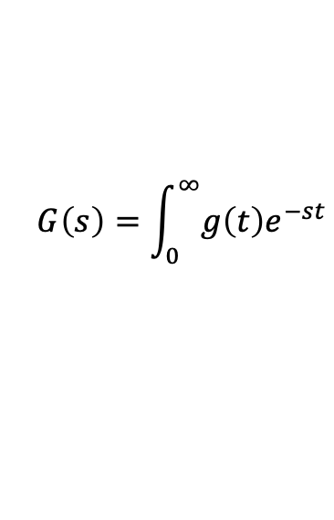

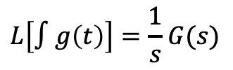


Properties of Laplace Transforms
$$G\left(s\right)=\int_{0}^{∞}{g\left(t\right)e^{−st}}$$
These properties are used to construct the Laplace transform of a complex system.
Constant multiplication
Derivative
Integral
$$L[\dot{g}\left(t\right)]=sG(s)$$
$$L\left[∫g\left(t\right)\right]=\frac{1}{s}G(s)$$
$$L[ag\left(t\right)]=aG(s)$$
Summation (Systems in parallel)
$$L\left[g\left(t\right)+h\left(t\right)\right]=G\left(s\right)+H(s)$$
$L\left[⋅\right]$ is a linear operator.
Notes:
How do the last 3 LT relate to each other?

Slide 6





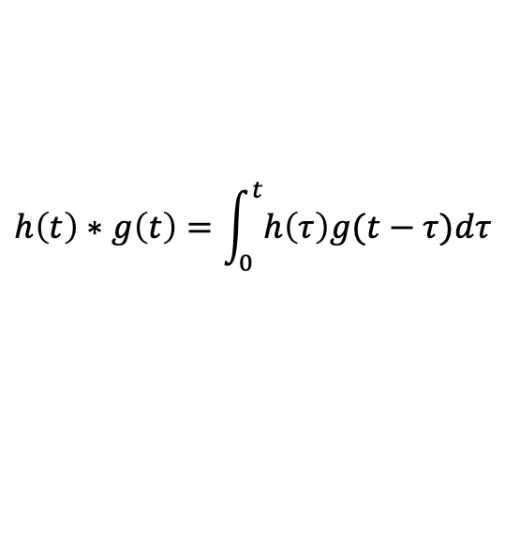

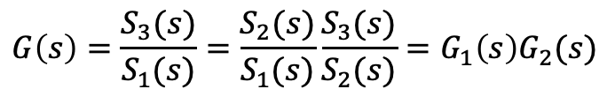
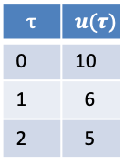

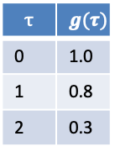

Systems in Series
Convolution definition
Input History
Function
$$h\left(t\right)∗g\left(t\right)=\int_{0}^{t}{h\left(τ\right)g(t−τ})dτ$$
$$y$$
$$u$$
$$τ$$ | $$u(τ)$$
0 | 10
1 | 6
2 | 5
$$τ$$ | $$g(τ)$$
0 | 1.0
1 | 0.8
2 | 0.3
Convolution Laplace Transform
$$L[h\left(t\right)∗g\left(t\right)]=H\left(s\right)G(s)$$
Systems/signals in series are a convolution.
S1
S2
$$G_{2}(s)$$
S3
$$S_{3}\left(s\right)=S_{1}\left(s\right)G(s)$$
$$G_{1}(s)$$
$$G(s)$$
$$G\left(s\right)=\frac{S_{3}(s)}{S_{1}(s)}=\frac{S_{2}(s)}{S_{1}(s)}\frac{S_{3}(s)}{S_{2}(s)}=G_{1}\left(s\right)G_{2}(s)$$
$$G\left(s\right)=\frac{S_{3}(s)}{S_{1}(s)}$$

Slide 7

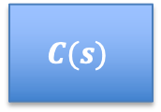




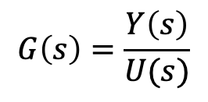

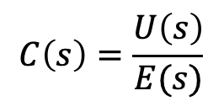

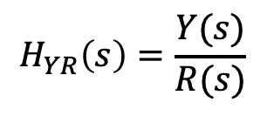
Closed Loop System
S1
S2
S3
$$G(s)$$
Reference
Input
Control
Error
Control
Input
Measured
Output
$$R(s)$$
$$E(s)$$
$$U(s)$$
$$Y(s)$$
$$C(s)$$
$$G(s)$$
+
$$−$$
Controller
$$C\left(s\right)=\frac{U\left(s\right)}{E(s)}$$
System
Under
Control
$$G\left(s\right)=\frac{Y\left(s\right)}{U(s)}$$
$$H_{YR}\left(s\right)=\frac{Y(s)}{R(s)}$$
We will use this terminology and notation.

Slide 8


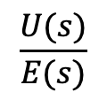

Controller Transfer Function
S1
S2
S3
$$G(s)$$
Reference
Input
Control
Error
Control
Input
Measured
Output
$$R(s)$$
$$E(s)$$
$$U(s)$$
$$Y(s)$$
$$C(s)$$
$$G(s)$$
+
$$−$$
Controller
System
Under
Control
$$\frac{U(s)}{E(s)}$$
$$C\left(s\right)=$$
If $u(t)=k(e\left(t\right))$, then
$$C\left(s\right)=k.$$

Slide 9
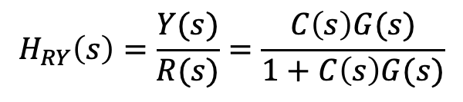
Closed Loop Transfer Function
S1
S2
S3
$$G(s)$$
Reference
Input
Control
Error
Control
Input
Measured
Output
$$R(s)$$
$$E(s)$$
$$U(s)$$
$$Y(s)$$
$$C(s)$$
$$G(s)$$
+
$$−$$
Controller
System
Under
Control
$$H_{RY}\left(s\right)=\frac{Y(s)}{R(s)}=\frac{C\left(s\right)G(s)}{1+C\left(s\right)G(s)}$$

Slide 10






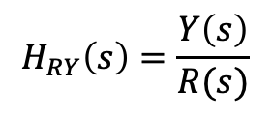




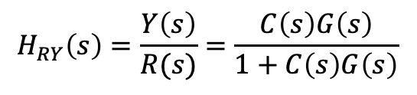
Calculating Transfer Functions In Diagrams
Reference
Input
Control
Error
Control
Input
Measured
Output
$$R(s)$$
$$E(s)$$
$$C(s)$$
$$U(s)$$
$$Y(s)$$
+
$$G(s)$$
$$H_{RY}\left(s\right)=\frac{Y\left(s\right)}{R(s)}$$
$$−$$
Controller
System
Under
Control
From the diagram
Solve for Y(s) in terms of R(s)
$$E\left(s\right)=R\left(s\right)−Y(s)$$
$$Y\left(s\right)=[R\left(s\right)−Y\left(s\right)]C\left(s\right)G(s)$$
$$Y\left(s\right)=E\left(s\right)C\left(s\right)G(s)$$
$$Y\left(s\right)[1+C\left(s\right)G\left(s\right)]=R\left(s\right)C\left(s\right)G(s)$$
$$H_{RY}\left(s\right)=\frac{Y\left(s\right)}{R(s)}=\frac{C\left(s\right)G\left(s\right)}{1+C\left(s\right)G\left(s\right)}$$

Slide 11
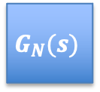


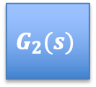


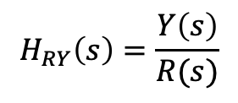




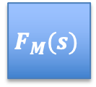
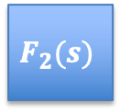
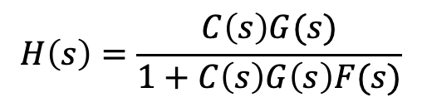
Analysis of a More Complicated System
$$R(s)$$
$$E(s)$$
$$Y(s)$$
$$G_{1}(s)$$
$$G_{2}(s)$$
$$G_{N}(s)$$
+
$$−$$
$$F_{1}(s)$$
$$F_{2}(s)$$
$$F_{M}(s)$$
$$H_{RY}\left(s\right)=\frac{Y\left(s\right)}{R(s)}$$
$$G\left(s\right)=G_{1}\left(s\right)⋯G_{N}(s)$$
$$F\left(s\right)=F_{1}\left(s\right)⋯F_{M}(s)$$
$$H\left(s\right)=\frac{C\left(s\right)G(s)}{1+C\left(s\right)G\left(s\right)F(s)}$$

Slide 12
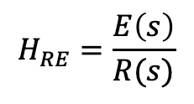

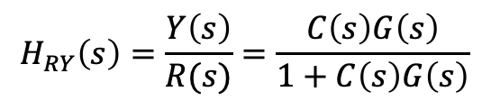
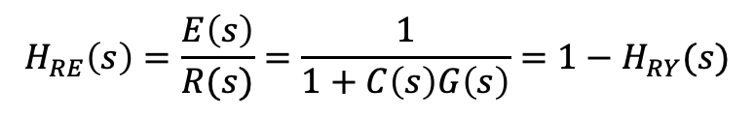



Error Transfer Function
Reference
Input
Control
Error
Control
Input
Measured
Output
$$R(s)$$
$$E(s)$$
$$C(s)$$
$$U(s)$$
$$Y(s)$$
+
$$G(s)$$
$$−$$
Controller
$$H_{RY}\left(s\right)=\frac{Y\left(s\right)}{R(s)}=\frac{C\left(s\right)G\left(s\right)}{1+C\left(s\right)G\left(s\right)}$$
System
Under
Control
$$H_{RE}=\frac{E\left(s\right)}{R(s)}$$
From the diagram
Solve for Y(s) in terms of R(s)
$$E\left(s\right)=R\left(s\right)−Y(s)$$
$$E\left(s\right)=R\left(s\right)−E\left(s\right)C\left(s\right)G(s)$$
$$Y\left(s\right)=E\left(s\right)C\left(s\right)G(s)$$
$$E\left(s\right)[1+C\left(s\right)G\left(s\right)]=R\left(s\right)$$
$$H_{RE}\left(s\right)=\frac{E\left(s\right)}{R(s)}=\frac{1}{1+C\left(s\right)G\left(s\right)}=1−H_{RY}(s)$$
Notes:
E(s)/R(s) + Y(s)/R(s) = 1
So, H(s) = 1 iff E(s)/R(s) = 0

Slide 13
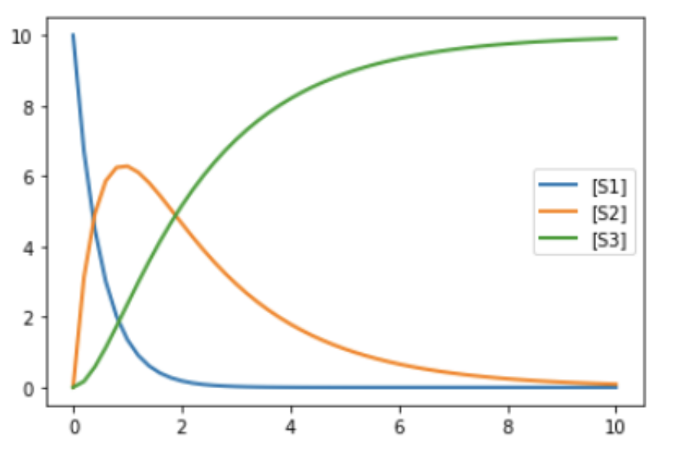
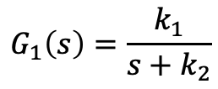
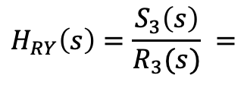
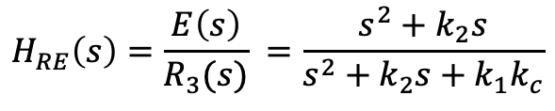

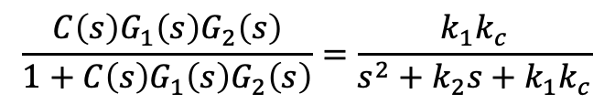
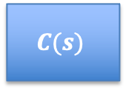






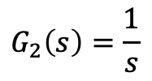

Application of Analysis
Controller
R3
E
$$C(s)$$
S1
S2
S3
$$H_{RY}\left(s\right)=\frac{Y\left(s\right)}{R(s)}=\frac{C\left(s\right)G\left(s\right)}{1+C\left(s\right)G\left(s\right)}$$
+
$$G_{1}(s)$$
$$G_{2}(s)$$
$$−$$
$$G_{1}\left(s\right)=\frac{k_{1}}{s+k_{2}}$$
$$G_{2}\left(s\right)=\frac{1}{s}$$
$$C\left(s\right)=k_{c}$$
$$H_{RY}\left(s\right)=\frac{S_{3}\left(s\right)}{R_{3}(s)} =$$
$$\frac{C\left(s\right)G_{1}\left(s\right)G_{2}\left(s\right)}{1+C\left(s\right)G_{1}\left(s\right)G_{2}\left(s\right)}=\frac{k_{1}k_{c}}{s^{2}+k_{2}s+k_{1}k_{c}}$$
$$H_{RE}\left(s\right)=\frac{E\left(s\right)}{R_{3}(s)} =\frac{s^{2}+k_{2}s}{s^{2}+k_{2}s+k_{1}k_{c}}$$
What are the poles of ${C\left(s\right)G_{1}(s)G}_{2}\left(s\right)?$
What are the poles of $H_{RE}\left(s\right), H_{RY}(s)?$
Why is DC gain $H_{RE}\left(s\right)=0$?
What is the DC gain of $H_{RY}\left(s\right)?$ $H_{RE}\left(s\right)?$

Slide 14


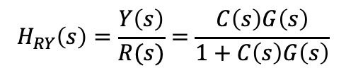



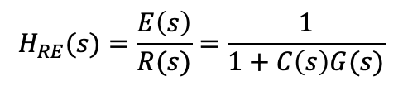
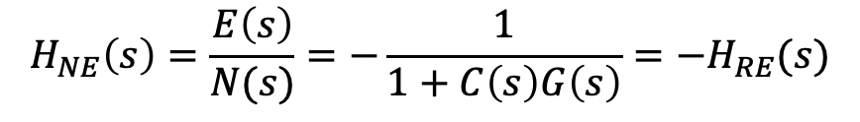

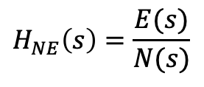

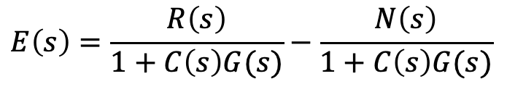

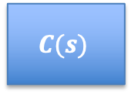

Measurement Noise
Measurement
Noise
$$N(s)$$
$$H_{RY}\left(s\right)=\frac{Y\left(s\right)}{R(s)}=\frac{C\left(s\right)G\left(s\right)}{1+C\left(s\right)G\left(s\right)}$$
$$R(s)$$
$$E(s)$$
$$U(s)$$
$$Y(s)$$
$$H_{RE}(s)=\frac{E\left(s\right)}{R(s)}=\frac{1}{1+C\left(s\right)G(s)}$$
$$C(s)$$
$$G(s)$$
+
+
$$−$$
$$H_{NE}\left(s\right)=\frac{E(s)}{N(s)}$$
From the diagram
Solve for Y(s) in terms of R(s)
$$E\left(s\right)=R\left(s\right)−Y\left(s\right)−N(s)$$
$$E\left(s\right)=R\left(s\right)−E\left(s\right)C\left(s\right)G(s)−N(s)$$
$$Y\left(s\right)=E\left(s\right)C\left(s\right)G(s)$$
$$E\left(s\right)=\frac{R\left(s\right)}{1+C\left(s\right)G(s)}−\frac{N\left(s\right)}{1+C\left(s\right)G(s)}$$
$$H_{NE}\left(s\right)=\frac{E\left(s\right)}{N(s)}=−\frac{1}{1+C\left(s\right)G\left(s\right)}={−H}_{RE}(s)$$
When a system has multiple inputs, only one is non-zero in the transfer function.
Notes:
I don’t believe this result for H_NE since noise should be amplified by C(s).

Slide 15
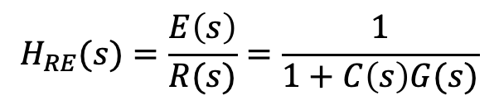



Interpreting $H_{NE}(s)$
Measurement
Noise
$$N(s)$$
$$R(s)$$
$$E(s)$$
$$U(s)$$
$$Y(s)$$
$$C(s)$$
$$G(s)$$
+
+
$$−$$
Does a larger $C(s)$ simultaneously reduce bias and the effect of noise?
$$H_{RE}(s)=\frac{E\left(s\right)}{R(s)}=\frac{1}{1+C\left(s\right)G(s)}$$
$$H_{RE}\left(s\right)=\frac{E\left(s\right)}{N(s)}=−\frac{1}{1+C\left(s\right)G\left(s\right)}$$
No. $H_{NE}(s)$ tells us the error in tracking noise. A small value is bad!
$$H_{NY}\left(s\right)=\frac{Y\left(s\right)}{N(s)}=−\frac{C\left(s\right)G(s)}{1+C\left(s\right)G\left(s\right)}$$
Indicates effect of noise on the output. So more ”aggressive” control (e.g., k) makes matters worse.
Notes:
I don’t believe this result for H_NE since noise should be amplified by C(s).

Slide 16


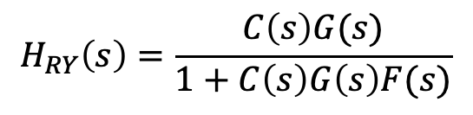

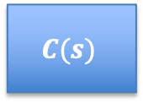





Adding a Filter
Measurement
Noise
$$N(s)$$
$$R(s)$$
$$E(s)$$
$$U(s)$$
$$Y(s)$$
$$C(s)$$
$$G(s)$$
+
+
$$−$$
$$F(s)$$
$$H_{NY}=−\frac{C\left(s\right)G\left(s\right)F(s)}{1+C\left(s\right)G\left(s\right)F\left(s\right)}$$
A filter with large dc gain can reduce the effect of noise.
$$H_{RY}\left(s\right)=\frac{C\left(s\right)G(s)}{1+C\left(s\right)G\left(s\right)F(s)}$$
A filter can reduce can increase bias.
How can we eliminate the bias caused by a filter?
Make $F(s)$ have a DC gain of 1.
But this affects the benefit to noise reduction.
Notes:
What happens to H_RY when F(s) becomes large?

Slide 17


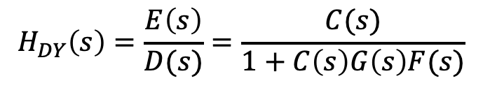


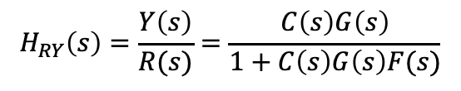


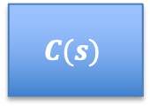
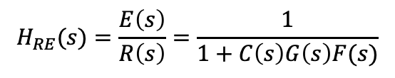


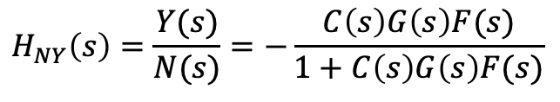
Disturbances
Actuator
Disturbance
Measurement
Noise
$$D(s)$$
$$N(s)$$
$$R(s)$$
$$E(s)$$
$$U(s)$$
$$Y(s)$$
$$C(s)$$
$$G(s)$$
+
+
+
$$−$$
$$F(s)$$
$$H_{RY}\left(s\right)=\frac{Y\left(s\right)}{R(s)}=\frac{C\left(s\right)G\left(s\right)}{1+C\left(s\right)G\left(s\right)F(s)}$$
A disturbance perturbs how the controller actuates the system and so diminishes the effectiveness of control.
$$H_{RE}(s)=\frac{E\left(s\right)}{R\left(s\right)}=\frac{1}{1+C\left(s\right)G\left(s\right)F(s)}$$
$$H_{NY}\left(s\right)=\frac{Y(s)}{N(s)}=−\frac{C\left(s\right)G\left(s\right)F(s)}{1+C\left(s\right)G\left(s\right)F(s)}$$
$$H_{DY}\left(s\right)=\frac{E\left(s\right)}{D(s)}=\frac{C(s)}{1+C\left(s\right)G\left(s\right)F(s)}$$
Notes:
Why doesn’t a filter help with measurement noise? Verify transfer functions.

Slide 18
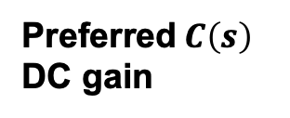
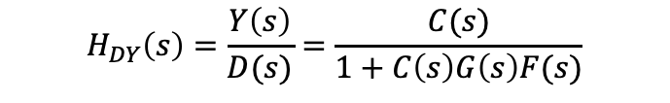




Tradeoffs for Eliminating Bias
Actuator
Disturbance
Measurement
Noise
$$D(s)$$
$$N(s)$$
$$R(s)$$
$$E(s)$$
$$U(s)$$
$$Y(s)$$
$$C(s)$$
$$G(s)$$
+
+
+
$$−$$
$$F(s)$$
Desired DC Gain
Preferred$C\left(s\right)$
DC gain
Preferred$F\left(s\right)$
DC gain
Transfer Functions
$$H_{RY}\left(s\right)=\frac{Y\left(s\right)}{R(s)}=\frac{C\left(s\right)G\left(s\right)}{1+C\left(s\right)G\left(s\right)F(s)}$$
1
High
1
$$H_{RE}(s)=\frac{E\left(s\right)}{R\left(s\right)}=\frac{1}{1+C\left(s\right)G\left(s\right)F(s)}$$
0
High
$$H_{NY}\left(s\right)=\frac{Y(s)}{N(s)}=−\frac{C\left(s\right)G\left(s\right)F(s)}{1+C\left(s\right)G\left(s\right)F(s)}$$
0
Low
Low
$$H_{DY}\left(s\right)=\frac{Y\left(s\right)}{D(s)}=\frac{C(s)}{1+C\left(s\right)G\left(s\right)F(s)}$$
0
Low
High
Notes:
Verify transfer functions
Desire: H_RY -> 1, all others go to 0.
Strategies:
Change G, larger DC gain.
Add a filter, but tradeoff between H_RY and others
More aggressive control – k is large and so larger C(s) DC gian. But large activation costs.
Design a different controller

Slide 19
BACKUP

Slide 20



System Abstraction for Reaction Networks
System abstraction of reaction network
Reaction Network
J1: S1→ S2; k1*S1
J2: S2 -> S3; k2*S2
S1
S2
S3
$$G_{1}(s)$$
$$G_{2}(s)$$
S1
J1
S2
$$J2$$
S3
Signal (S1, S2)
What: continuous valued function of time
Example: floating species
Single Input Single Output (SISO) System ($G_{1}(s)$, $G_{2}(s$))
What: transforms input signal into output signal
Example: reactions

Slide 21















Finding $e(∞)$
$$R(s)$$
$$E(s)$$
$$Y(s)$$
$$G_{1}(s)$$
$$G_{2}(s)$$
$$G_{N}(s)$$
+
$$−$$
$$F_{1}(s)$$
$$F_{2}(s)$$
$$F_{M}(s)$$
$$E\left(s\right)=R\left(s\right)H\left(s\right)−R\left(s\right)=R(s)(H\left(s\right)−1)$$
If $H\left(s\right)=\frac{k_{1}k_{c}}{s^{2}+k_{2}s+k_{1}k_{c}}$, what is $e(∞)$ for a step input?
Hint: $e\left(∞\right)=\lim_{s→0}{sE(s)}$
1. What is $U\left(s\right)$?
$$R(s)=\frac{1}{s}$$
2. What is$R(s)(H\left(s\right)−1)$?
R$(s)(H\left(s\right)−1)\text{=}\frac{1}{s}$ $\frac{−s^{2}−k_{2}s}{s^{2}+k_{2}s+k_{1}k_{c}}$
3. What is$e\left(∞\right)=lim_{s→0}sR(s)(H\left(s\right)−1)$?
$$e\left(∞\right)=0$$
4. What does this tell us about the need for control action once we’re at steady state?

Slide 22













Calcuating Transfer Functions In Diagrams
Controller
R3
E
$$C(s)$$
S1
S2
S3
+
$$G_{1}(s)$$
$$G_{2}(s)$$
$$−$$
What is the transfer function $H\left(s\right)=\frac{S_{3}(s)}{R_{3}(s)}$?
$C\left(s\right), G_{1}\left(s\right), G_{2}(s)$ are in series, a convolution.
$$\frac{S_{3}(s)}{E(s)}=$$
$C\left(s\right)G_{1}\left(s\right)G_{2}\left(s\right)$
Or, $S_{3}\left(s\right)=C\left(s\right)G_{1}\left(s\right)G_{2}\left(s\right)E(s)$
$E\left(s\right)$ is the difference between R3 and S3.
$$E\left(s\right)=$$
$$R_{3}\left(s\right)−S_{3}(s)$$
$$\frac{S_{3}\left(s\right)}{C\left(s\right)G_{1}\left(s\right)G_{2}\left(s\right)}=R_{3}\left(s\right)−S_{3}(s)$$
$$S_{3}(s)\frac{1+C\left(s\right)G_{1}\left(s\right)G_{2}\left(s\right)}{C\left(s\right)G_{1}\left(s\right)G_{2}\left(s\right)}=R_{3}\left(s\right)$$
$$H\left(s\right)=\frac{S_{3}\left(s\right)}{R_{3}(s)} =\frac{C\left(s\right)G_{1}\left(s\right)G_{2}\left(s\right)}{1+C\left(s\right)G_{1}\left(s\right)G_{2}\left(s\right)}$$

Slide 23















General Solution
+
$$C(s)$$
$$G(s)$$
$$−$$
$$F(s)$$
$$H\left(s\right)=\frac{C\left(s\right)G(s)}{1+C\left(s\right)G\left(s\right)F(s)}$$
$$R(s)$$
$$G_{1}(s)$$
$$G_{2}(s)$$
$$G_{N}(s)$$
$$Y(s)$$
+
$$−$$
$$F_{1}(s)$$
$$F_{2}(s)$$
$$F_{M}(s)$$
$$H\left(s\right)=\frac{Y (s)}{R(s)}$$
$$H\left(s\right)=\frac{G_{1}\left(s\right)G_{2}\left(s\right)⋯G_{N}(s)}{1+G_{1}\left(s\right)G_{2}\left(s\right)⋯G_{N}\left(s\right)F_{1}\left(s\right)F_{2}\left(s\right)⋯F_{M}(s)}$$
Why?

