Slide 1
BIOE 498 / BIOE 599 Advanced Biological Control Systems Lecture 4: Modeling Dynamical Systems
Joseph L. Hellerstein
eScience Institute, Computer Science & Engineering
Allen School of Computer Science
BioEngineering
Notes:
Diverse students. Some with bio-backgrounds; some without. Some with CS background; some with very limited. Two separate courses combined because of a substantial shared curriculum.

Slide 2
Notes
Include environment where explore dynamical behavior as we change eigenvectors, eigenvalues

Slide 3
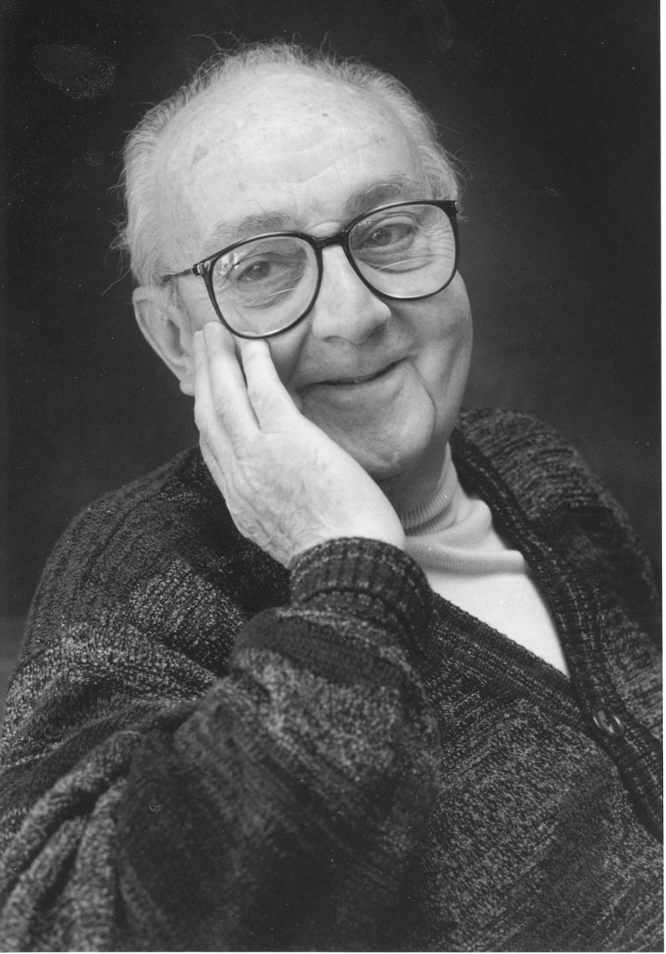
G.P.E. Box (Famous Statistician)
All models are wrong.
But some models are useful.

Slide 4
Agenda
Solving linear ordinary differential equations
Univariate without/with forced input
Multivariate without/with forced input
Matrix exponential solutions, eigenvalue solutions
LaPlace transform refresher
Poles, DC gain, convolution
Non-linear differential equations
Fixed points
Jacobian
Solution strategy

Slide 5
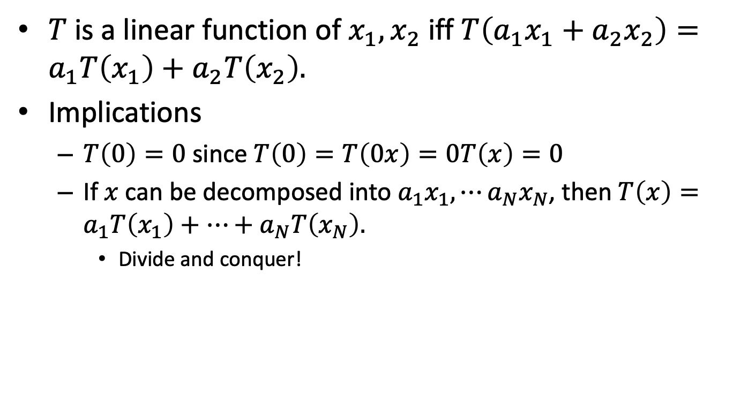
What is Linearity and Why it’s Important
$T$ is a linear function of $x_{1},x_{2}$ iff $T\left(a_{1}x_{1}+a_{2}x_{2}\right)=a_{1}T\left(x_{1}\right)+a_{2}T\left(x_{2}\right).$
Implications
$T\left(0\right)=0$ since $T\left(0\right)=T\left(0x\right)=0T\left(x\right)=0$
If $x$ can be decomposed into $a_{1}x_{1},⋯a_{N}x_{N}$, then $T\left(x\right)=a_{1}T\left(x_{1}\right)+⋯+a_{N}T\left(x_{N}\right).$
Divide and conquer!

Slide 6
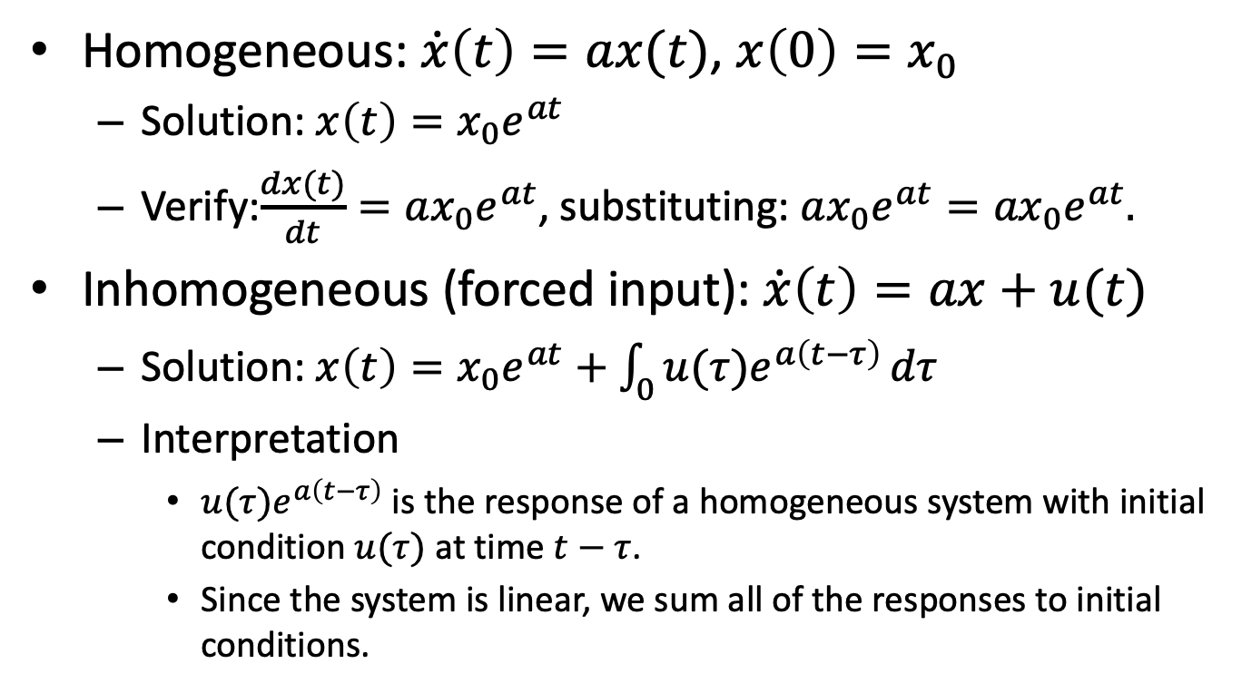
Univariate, First Order, Linear Differential Equations
Homogeneous: $\dot{x}\left(t\right)=ax(t)$, $x\left(0\right)=x_{0}$
Solution: $x\left(t\right)=x_{0}e^{at}$
Verify:$\frac{dx(t)}{dt}=ax_{0}e^{at}$, substituting: $ax_{0}e^{at}={ax}_{0}e^{at}.$
Inhomogeneous (forced input): $\dot{x}\left(t\right)=ax+u(t)$
Solution: $x\left(t\right)=x_{0}e^{at}+\int_{0}{{u(τ)e}^{a\left(t−τ\right)}}dτ$
Interpretation
${u(τ)e}^{a\left(t−τ\right)}$ is the response of a homogeneous system with initial condition $u(τ)$ at time $t−τ$.
Since the system is linear, we sum all of the responses to initial conditions.

Slide 7
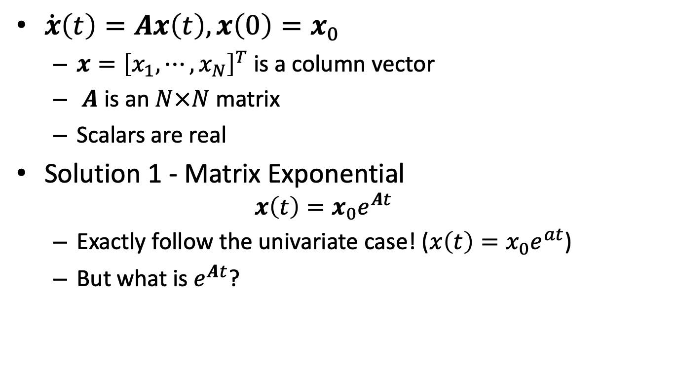
Multivariate, Linear Differential Equations Homogeneous
$\dot{x}\left(t\right)=Ax\left(t\right), x\left(0\right)=x_{0}$
$x={\left[x_{1}, ⋯, x_{N}\right]}^{T}$ is a column vector
$A$ is an $N×N$ matrix
Scalars are real
Solution 1 - Matrix Exponential
$$x\left(t\right)=x_{0}e^{At}$$
Exactly follow the univariate case! ($x\left(t\right)=x_{0}e^{at}$)
But what is $e^{At}$?
Notes:
Why did I leave out “first order”? Can solve high order systems with more variables.

Slide 8
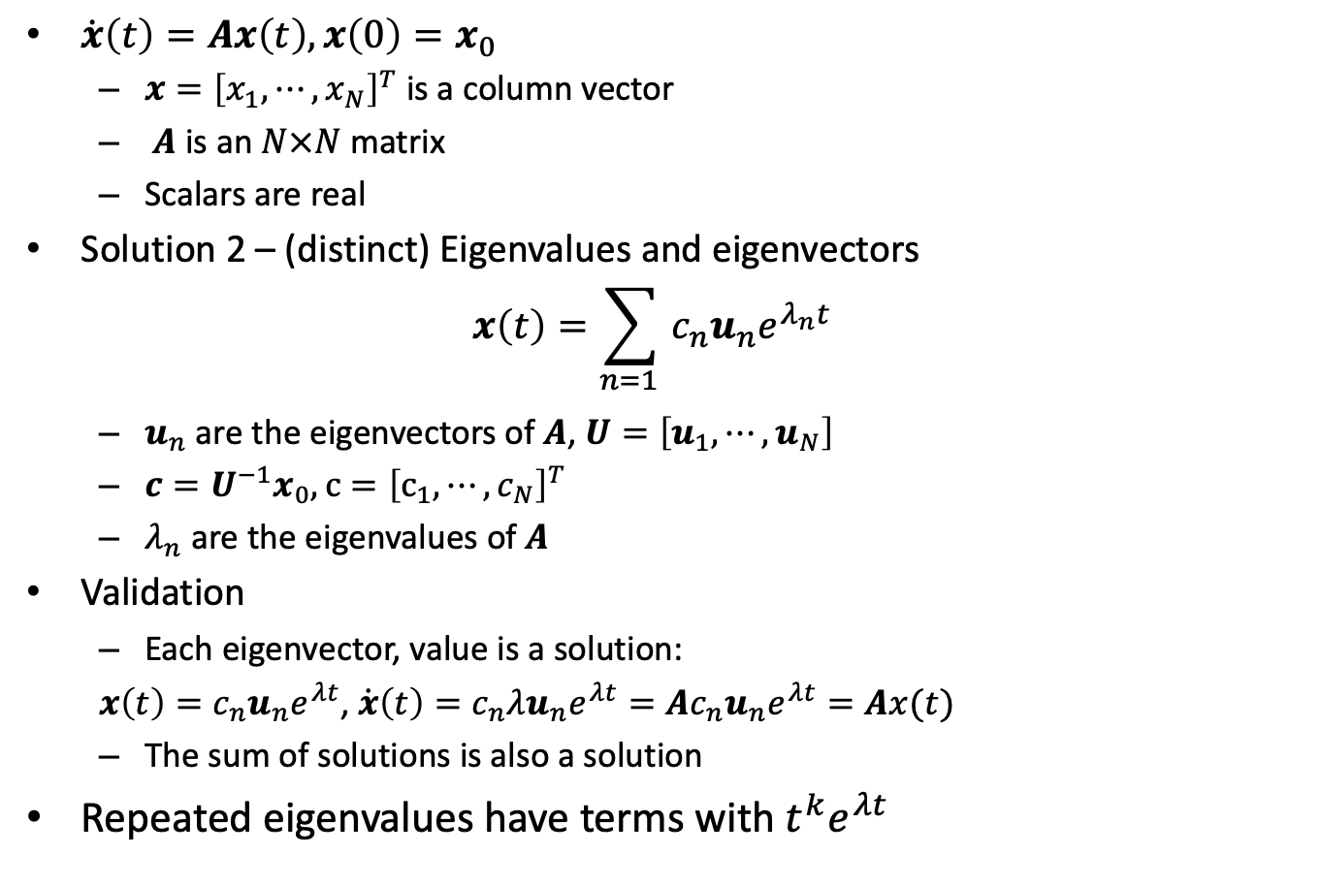
Multivariate, Linear Differential Equations Homogeneous
$\dot{x}\left(t\right)=Ax\left(t\right), x\left(0\right)=x_{0}$
$x={\left[x_{1}, ⋯, x_{N}\right]}^{T}$ is a column vector
$A$ is an $N×N$ matrix
Scalars are real
Solution 2 – (distinct) Eigenvalues and eigenvectors
$$x\left(t\right)={\sum_{n=1 }{c_{n}u_{n}e^{λ_{n}t}}}_{}$$
$u_{n}$ are the eigenvectors of $A$, $U={\left[u_{1},⋯,u_{N}\right]}^{}$
$c=U^{−1}x_{0}, c={\left[c_{1},⋯,c_{N}\right]}^{T}$
$λ_{n}$ are the eigenvalues of $A$
Validation
Each eigenvector, value is a solution:
${x\left(t\right)=c_{n}u}_{n}e^{λt}$, ${\dot{x}\left(t\right)=c_{n}λu}_{n}e^{λt}={{Ac}_{n}u}_{n}e^{λt}=Ax(t)$
The sum of solutions is also a solution
Repeated eigenvalues have terms with $t^{k}e^{λt}$
Notes:
Why did I leave out “first order”? Can solve high order systems with more variables.

Slide 9
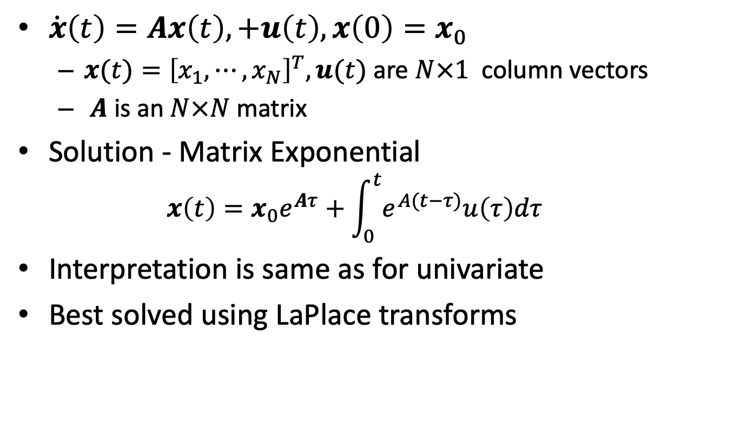
Multivariate, Linear, Forced Input
$\dot{x}\left(t\right)=Ax\left(t\right),+u\left(t\right), x\left(0\right)=x_{0}$
$x(t)={\left[x_{1}, ⋯, x_{N}\right]}^{T}, u(t)$ are $N×1$ column vectors
$A$ is an $N×N$ matrix
Solution - Matrix Exponential
$$x\left(t\right)=x_{0}e^{Aτ}+\int_{0}^{t}{e^{A(t−τ)}u\left(τ\right)dτ}$$
Interpretation is same as for univariate
Best solved using LaPlace transforms
Notes:
Why did I leave out “first order”? Can solve high order systems with more variables.

Slide 10


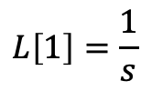
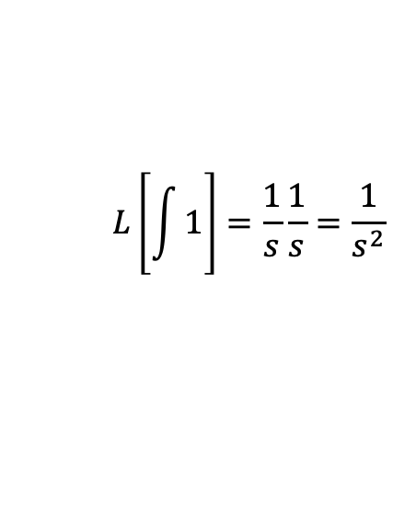
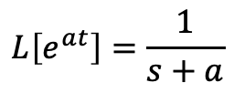
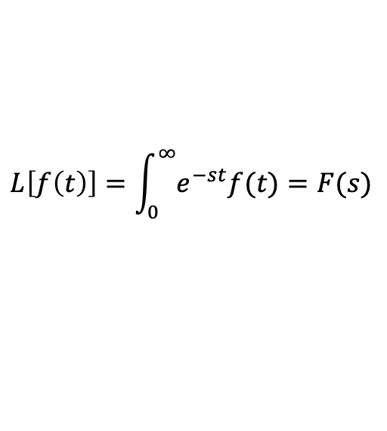


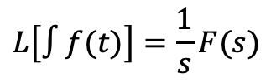

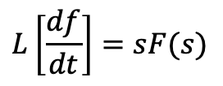
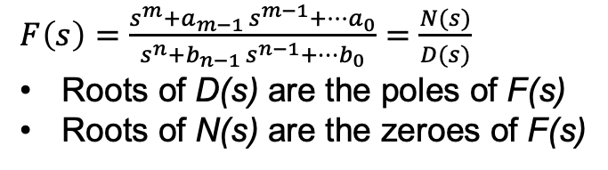
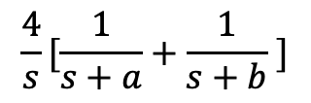
LaPlace Transform Essentials
Definition
$$L\left[f\left(t\right)\right]=\int_{0}^{∞}{e^{−st}f(t)}=F(s)$$
(0 initial conditions)
Properties`
Calculating LaPlace Transforms
$$L\left[∫f(t)\right]=\frac{1}{s}F(s)$$
$$L\left[1\right]=\frac{1}{s}$$
$$L\left[e^{at}\right]=\frac{1}{s+a}$$
$$L\left[\frac{df}{dt}\right]=sF(s)$$
$$L\left[\int{1}\right]=\frac{1}{s}\frac{1}{s}=\frac{1}{s^{2}}$$
$$L\left[∫af\left(t\right)\right]=aF\left(s\right)$$
$$L\left[t\right]=$$
$$L\left[∫f\left(t\right)g(t)\right]=F\left(s\right)G(s)$$
$$L\left[∫f\left(t\right)+g(t)\right]=F\left(s\right)+G(s)$$
$$\frac{4}{s}[\frac{1}{s+a}+\frac{1}{s+b} ]$$
$$L\left[{4∫(e}^{at}+e^{bt} )\right]=$$
$F\left(s\right)=\frac{s^{m}+a_{m−1 }s^{m−1}+⋯a_{0}}{s^{n}+b_{n−1 }s^{n−1}+⋯b_{0}}=\frac{N(s)}{D(s)}$
Roots of D(s) are the poles of F(s)
Roots of N(s) are the zeroes of F(s)

Slide 11


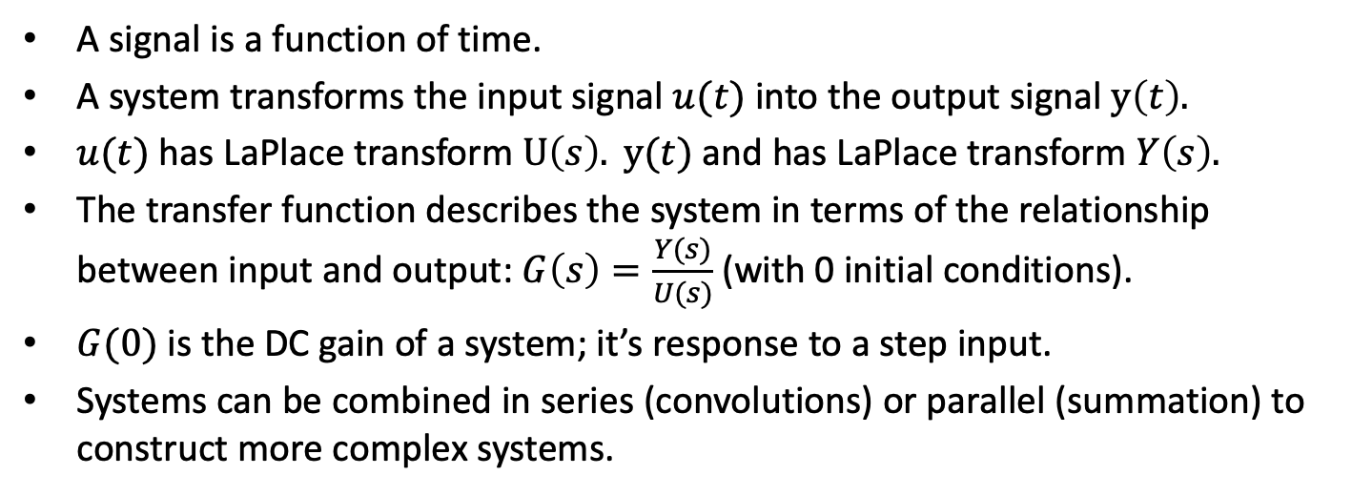



Signals and Transfer Functions
$$G(s)$$
$$u(t)$$
System
$$y(t)$$
$$U(s)$$
$$Y(s)$$
A signal is a function of time.
A system transforms the input signal $u(t)$ into the output signal $y\left(t\right).$
$u(t)$ has LaPlace transform $U\left(s\right). y(t)$ and has LaPlace transform $Y\left(s\right).$
The transfer function describes the system in terms of the relationship between input and output: $G\left(s\right)=\frac{Y(s)}{U(s)}$ (with 0 initial conditions).
$G(0)$ is the DC gain of a system; it’s response to a step input.
Systems can be combined in series (convolutions) or parallel (summation) to construct more complex systems.
A LaPlace Transform can represent a signal or a system.

Slide 12
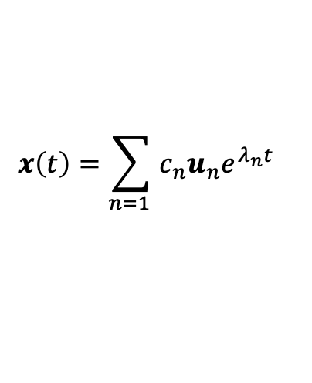
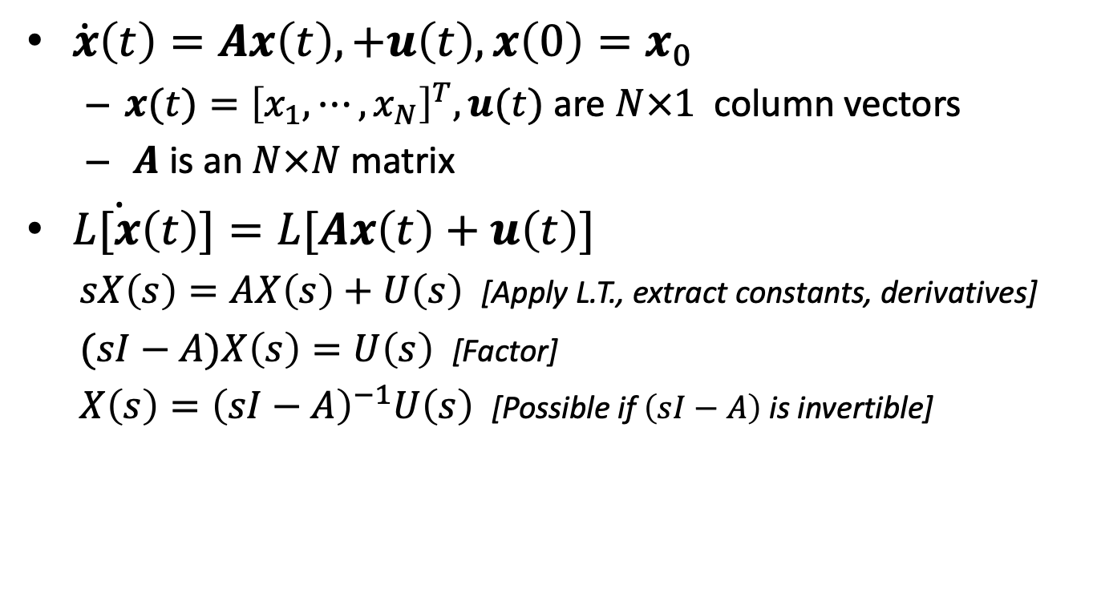
Solution for Multivariate With Forced Input
$\dot{x}\left(t\right)=Ax\left(t\right),+u\left(t\right), x\left(0\right)=x_{0}$
$x(t)={\left[x_{1}, ⋯, x_{N}\right]}^{T}, u(t)$ are $N×1$ column vectors
$A$ is an $N×N$ matrix
$L\dot{[x}\left(t\right)]=L[Ax\left(t\right)+u\left(t\right)]$
$sX\left(s\right)=AX\left(s\right)+U\left(s\right)$ [Apply L.T., extract constants, derivatives]
$(sI−A)X\left(s\right)=U\left(s\right)$ [Factor]
$X\left(s\right)={\left(sI−A\right)}^{−1}U\left(s\right)$ [Possible if $\left(sI−A\right)$ is invertible]
A system is stable if its poles (eigenvalues) are not positive.
$$x\left(t\right)={\sum_{n=1 }{c_{n}u_{n}e^{λ_{n}t}}}_{}$$

Slide 13
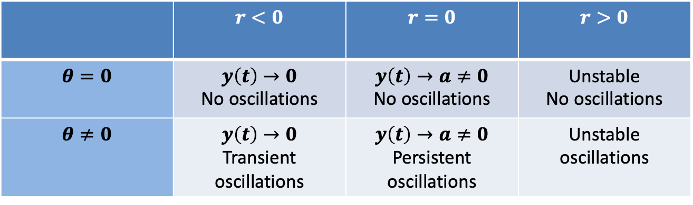
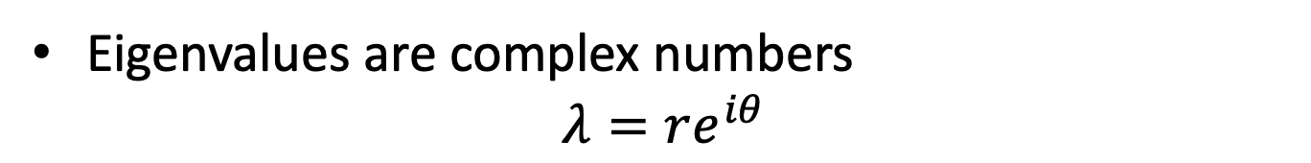
Classification of Systems
Eigenvalues are complex numbers
$$λ=re^{iθ}$$
 | $$r<0$$ | $$r=0$$ | $$r>0$$
$$θ=0$$ | $$y\left(t\right)→0$$ No oscillations | $$y\left(t\right)→a≠0$$ No oscillations | Unstable No oscillations
$$θ≠0$$ | $$y\left(t\right)→0$$ Transient oscillations | $$y\left(t\right)→a≠0$$ Persistent oscillations | Unstable oscillations

Slide 14

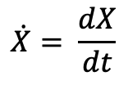
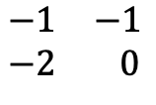


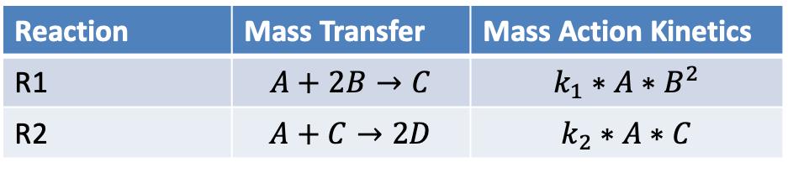




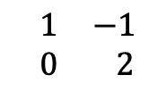

Reaction Network -> Differential Equations
Reaction Network
Reaction | Mass Transfer | Mass Action Kinetics
R1 | $$A+2B→C$$ | $$k_{1}∗A∗B^{2}$$
R2 | $$A+C→2D$$ | $$k_{2}∗A∗C$$
[
]
[
R1
R2
]
$$\dot{A}$$
A
[
]
$$\begin{matrix}−1 & −1 \\ −2 & 0\end{matrix}$$
R1
$$\dot{B}$$
$$=$$
B
$$×$$
$$k_{1}∗A∗B^{2}$$
$$\dot{C}$$
C
$$k_{2}∗A∗C$$
R2
$$\begin{matrix} 1 & −1 \\ 0 & 2\end{matrix}$$
$$\dot{D}$$
D
State Change Vector
Stoichiometry Matrix
Reaction Flux Vector
$$\dot{X}= \frac{dX}{dt}$$
But this is a nonlinear system!

Slide 15
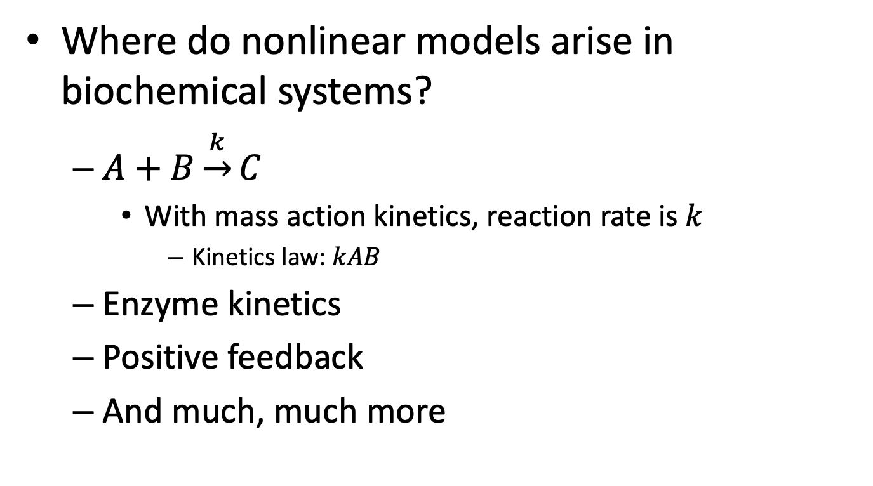
Nonlinear Models
Where do nonlinear models arise in biochemical systems?
$A+B\underset{→}{k}C$
With mass action kinetics, reaction rate is $k$
Kinetics law: $kAB$
Enzyme kinetics
Positive feedback
And much, much more

Slide 16


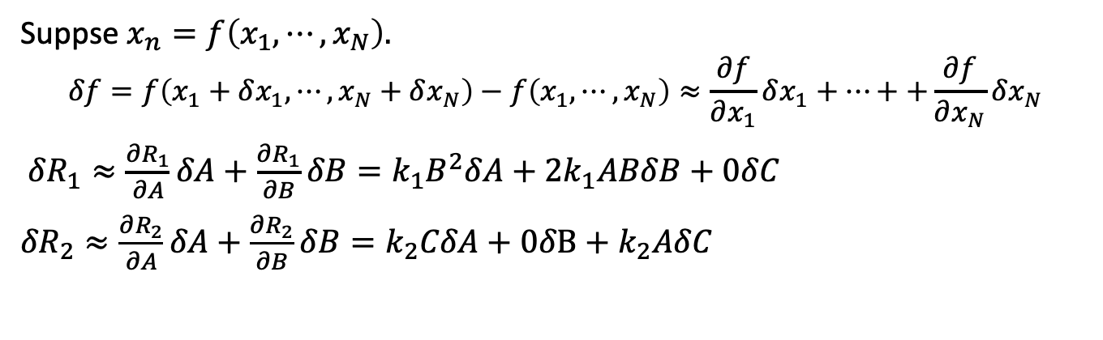

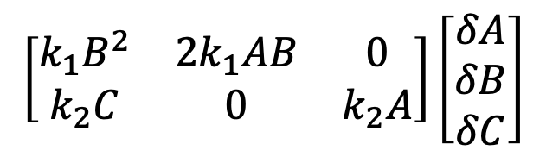
Linearizing a Nonlinear System
[
]
[
R1
R2
]
$$\dot{A}$$
A
[
]
$$\begin{matrix}−1 & −1 \\ −2 & 0\end{matrix}$$
R1
$$\dot{B}$$
$$=$$
B
$$×$$
$$k_{1}∗A∗B^{2}$$
$$\dot{C}$$
C
$$k_{2}∗A∗C$$
R2
$$\begin{matrix} 1 & −1 \\ 0 & 2\end{matrix}$$
$$\dot{D}$$
D
State Change Vector
Stoichiometry Matrix
Reaction Flux Vector
Suppse $x_{n}=f\left(x_{1},⋯,x_{N}\right).$
$$δf=f\left(x_{1}+δx_{1},⋯,x_{N}+δx_{N}\right)−f\left(x_{1},⋯,x_{N}\right)≈\frac{∂f}{∂x_{1}}δx_{1}+⋯++\frac{∂f}{∂x_{N}}δx_{N}$$
${δR}_{1}≈\frac{∂R_{1}}{∂A}δA+\frac{∂R_{1}}{∂B}δB=k_{1}B^{2}δA+{2k}_{1}ABδB+0δC$
${δR}_{2}≈\frac{∂R_{2}}{∂A}δA+\frac{∂R_{2}}{∂B}δB=k_{2}CδA+0δB+k_{2}AδC$
[
]
[
]
$$\left[\begin{matrix}k_{1}B^{2} & 2k_{1}AB & 0 \\ k_{2}C & 0 & k_{2}A\end{matrix}\right]\left[\begin{matrix}δA \\ δB \\ δC\end{matrix}\right]$$
$$k_{1}∗A∗B^{2}$$
$$≈$$
$$k_{1}∗A∗B^{2}$$
$$k_{2}∗A∗C$$
$$k_{2}∗A∗C$$

Slide 17
Characterizing Fixed Point(s)
Characterizing means classifying the type
Stable? Unstable? Saddle? Oscillatory?
Approach: Linearization
Construct linear approximations of the differential equations at the fixed point
Calculate the trace and determinant of the A matrix
Use results from linear models to classify the fixed point
Works for Stable node, unstable node, saddle
Doesn’t help with center (oscillation)

Slide 18
BACKUP

Slide 19

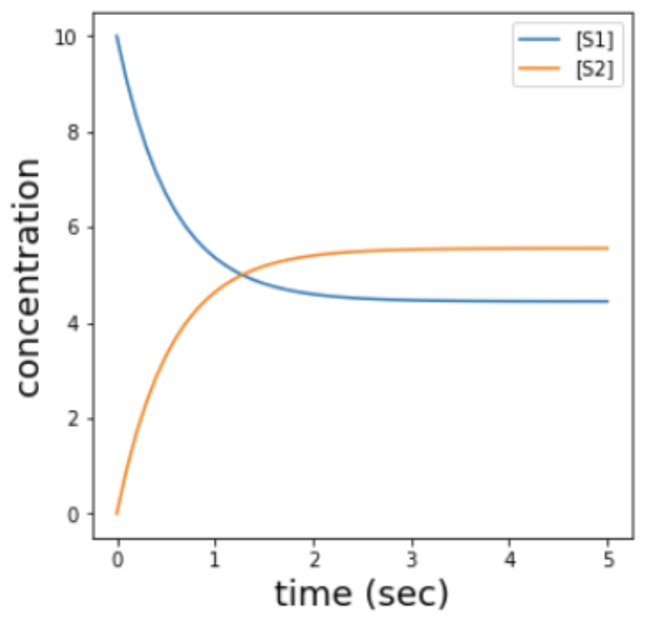






Analysis of a Simple System
Reaction Network
Mass action kinetics
$\frac{dS_{1}}{dt}=k_{r}S_{2}−k_{f}S_{1}$
$\frac{dS_{2}}{dt}={−k}_{r}S_{2}+k_{f}S_{1}$
Conservation Law
$S_{1}+S_{2}=S_{T}$
$\frac{dS_{1}}{dt}=k_{r}{(S_{T}−S}_{1})−k_{f}S_{1}=−\left(k_{r}+k_{f}\right)S_{1}+k_{r}S_{T}$
$$k_{f}$$
$$k_{f}=1,k_{r}=0.8,S_{T}=10,S_{1}\left(0\right)=S_{T}$$
$$S_{1}$$
$$S_{2}$$
$$k_{r}$$
Notes:
Even though there are 2 species, this is really a one dimensional system.

Slide 20
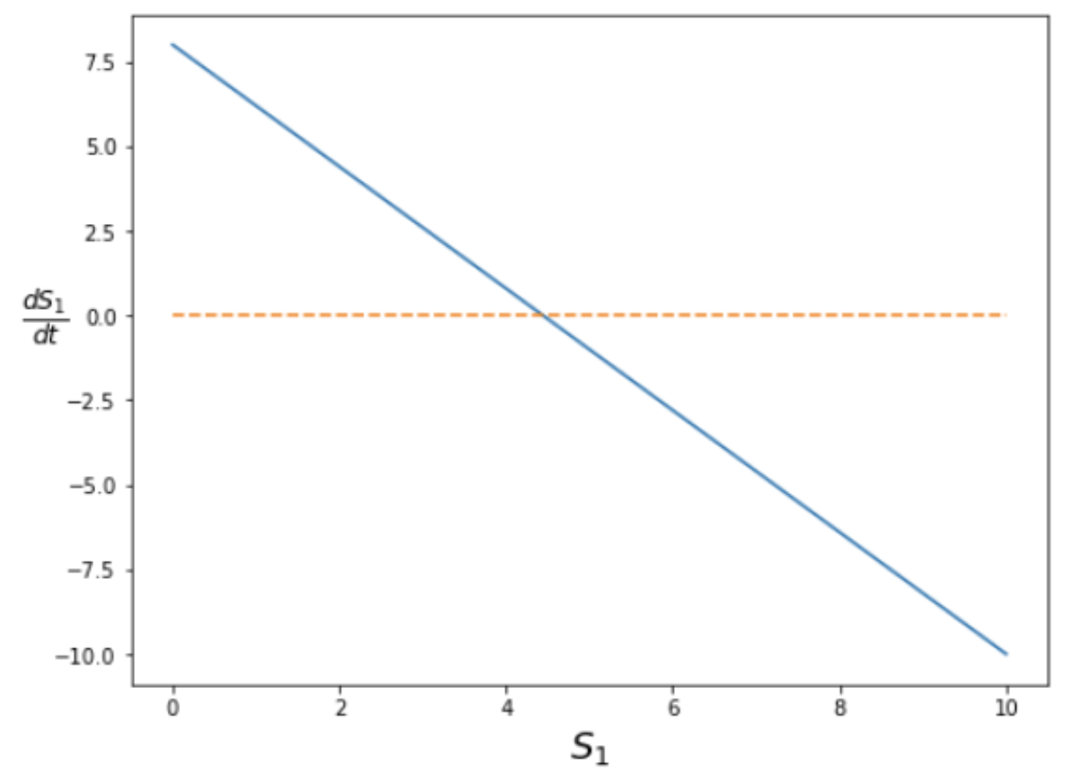
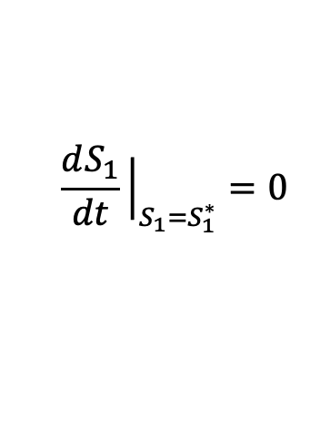

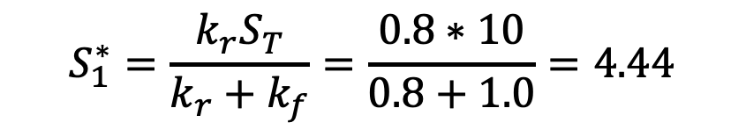
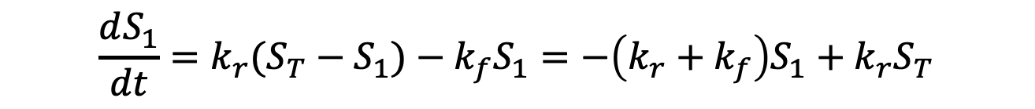
Calculating Fixed Points
$$\frac{dS_{1}}{dt}=k_{r}{(S_{T}−S}_{1})−k_{f}S_{1}=−\left(k_{r}+k_{f}\right)S_{1}+k_{r}S_{T}$$
$$\frac{dS_{1}}{dt}{\left.​\right|}_{S_{1}=S_{1}^{∗}}=0$$
Fixed point when
$$S_{1}^{∗}=\frac{{k_{r}S}_{T}}{k_{r}+k_{f}}=\frac{0.8∗10}{0.8+1.0}=4.44$$

Slide 21




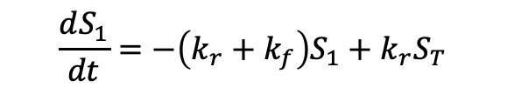
Observations About This System
$$k_{f}$$
$$\frac{dS_{1}}{dt}=−\left(k_{r}+k_{f}\right)S_{1}+k_{r}S_{T}$$
$$S_{1}$$
$$S_{2}$$
$$k_{r}$$
Although there are two chemical species, this is a 1-dimensional system.
”Autonomous system” – dynamics are not a explicit function of time.
There exists a stable steady state.
The system is linear in the state variable.
Notes:
Why is it sufficient to consider just S1?
Why is this system linear?

Slide 22
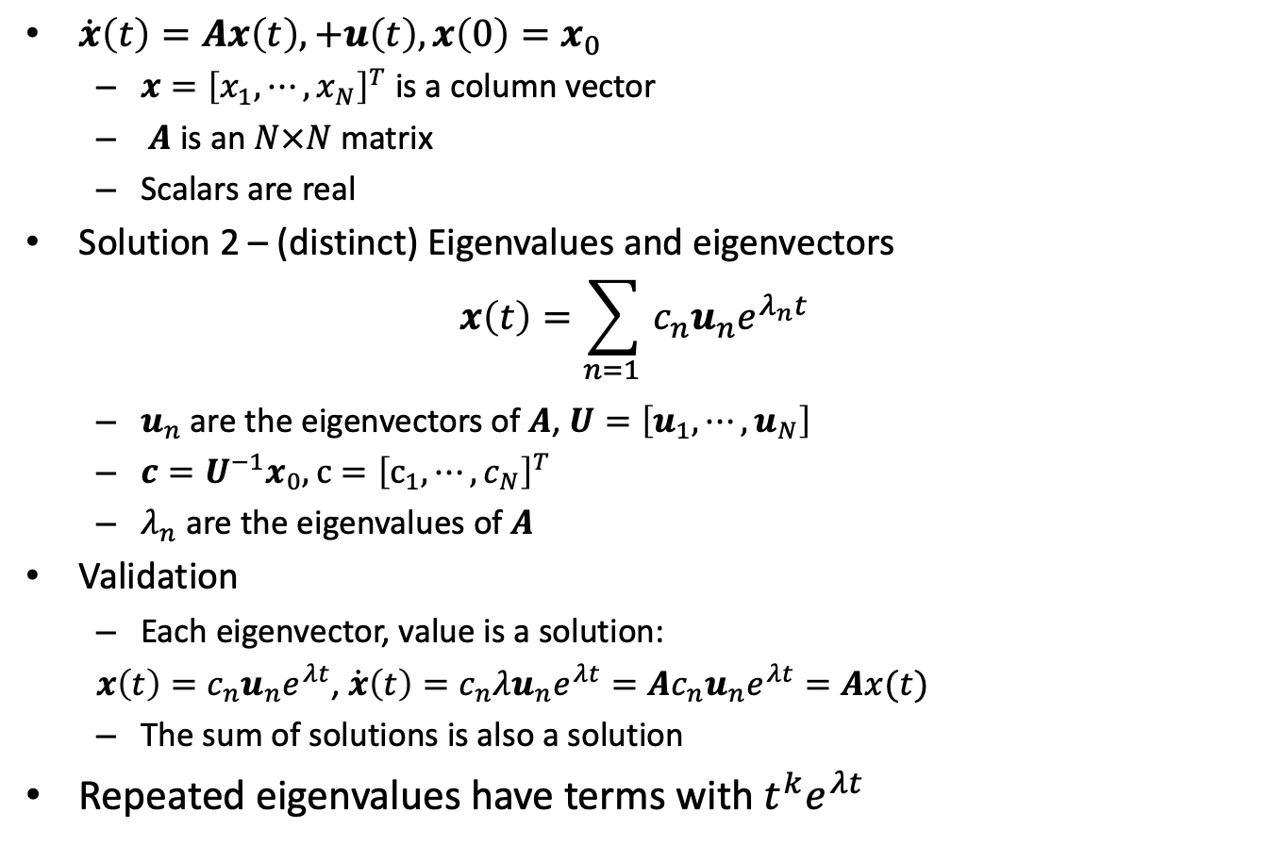
Multivariate, Linear, Forced Input
$\dot{x}\left(t\right)=Ax\left(t\right), +u\left(t\right), x\left(0\right)=x_{0}$
$x={\left[x_{1}, ⋯, x_{N}\right]}^{T}$ is a column vector
$A$ is an $N×N$ matrix
Scalars are real
Solution 2 – (distinct) Eigenvalues and eigenvectors
$$x\left(t\right)={\sum_{n=1 }{c_{n}u_{n}e^{λ_{n}t}}}_{}$$
$u_{n}$ are the eigenvectors of $A$, $U={\left[u_{1},⋯,u_{N}\right]}^{}$
$c=U^{−1}x_{0}, c={\left[c_{1},⋯,c_{N}\right]}^{T}$
$λ_{n}$ are the eigenvalues of $A$
Validation
Each eigenvector, value is a solution:
${x\left(t\right)=c_{n}u}_{n}e^{λt}$, ${\dot{x}\left(t\right)=c_{n}λu}_{n}e^{λt}={{Ac}_{n}u}_{n}e^{λt}=Ax(t)$
The sum of solutions is also a solution
Repeated eigenvalues have terms with $t^{k}e^{λt}$
Notes:
Why did I leave out “first order”? Can solve high order systems with more variables.

Slide 23



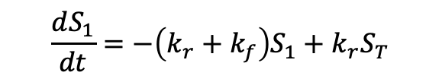

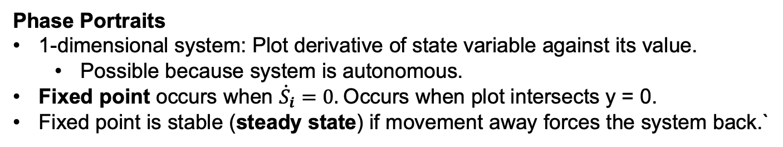

Visualizations and Fixed Points
$$k_{f}$$
$$\frac{dS_{1}}{dt}=−\left(k_{r}+k_{f}\right)S_{1}+k_{r}S_{T}$$
$$S_{1}$$
$$S_{2}$$
$$k_{r}$$
Steady state value of $S_{1}$
Phase Portraits
1-dimensional system: Plot derivative of state variable against its value.
Possible because system is autonomous.
Fixed point occurs when ${\dot{S}}_{i}=0.$Occurs when plot intersects y = 0.
Fixed point is stable (steady state) if movement away forces the system back.`
Notes:
Can we be anywhere in the 1-d phase plane? No, only those points specified by the differential equation.
What happens as we move from the fixed point in this example?

Slide 24
Why differential equations
From reactions to differential equations
Single variable, linear, homogeneous
Stability? Speed of dynamics?
Multiple variables, linear
Stability? Speed of dynamics? Oscillations
Non-linear
Fixed points

Slide 25
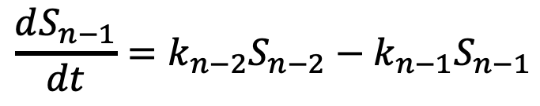
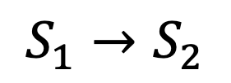
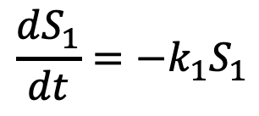

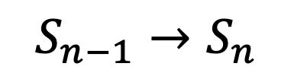

Single Reactant, Linear Pathway is a Linear (With Mass Action Kinetics)
Reaction Network
Differential Equations
$$k_{1}$$
$$\frac{dS_{1}}{dt}=−k_{1}S_{1}$$
$$S_{1}→S_{2}$$
$$k_{n−1}$$
$$\frac{dS_{n−1}}{dt}=k_{n−2}S_{n−2}−k_{n−1}S_{n−1}$$
$$S_{n−1}→S_{n}$$
Notes:
What’s the dimension of this system?
Why is there an n-2 term in the equation for S_{n-1}?
Is the network still linear if the reactions are reversible?
Under what conditions can we, in general, expect that a network will be a linear system using mass action kinetics?

Slide 26
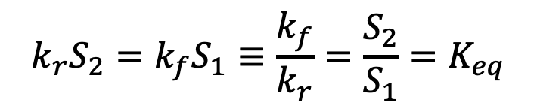
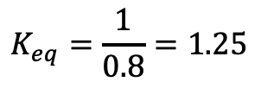
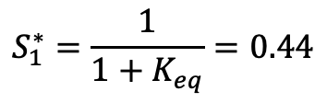
Calculating Fixed Points
$$\frac{dS_{1}}{dt}=k_{r}{(S_{T}−S}_{1})−k_{f}S_{1}=−\left(k_{r}+k_{f}\right)S_{1}+k_{r}S_{T}$$
$$\frac{dS_{1}}{dt}{\left.​\right|}_{S_{1}=S_{1}^{∗}}=0$$
Fixed point when
$$k_{r}S_{2}=k_{f}S_{1}≡\frac{k_{f}}{k_{r}}=\frac{S_{2}}{S_{1}}=K_{eq}$$
$$K_{eq}=\frac{1}{0.8}=1.25$$
$$S_{1}^{∗}=\frac{1}{1+K_{eq}}=0.44$$

