Slide 1
BIOE 498 / BIOE 599 Advanced Biological Control Systems Lecture 2: Elements of Closed Loop Systems
Joseph L. Hellerstein
January 8, 2024
eScience Institute, Computer Science & Engineering
Allen School of Computer Science
BioEngineering
Notes:
Diverse students. Some with bio-backgrounds; some without. Some with CS background; some with very limited. Two separate courses combined because of a substantial shared curriculum.

Slide 2
Agenda
Controllers
Filters
Testbed-based control design

Slide 3



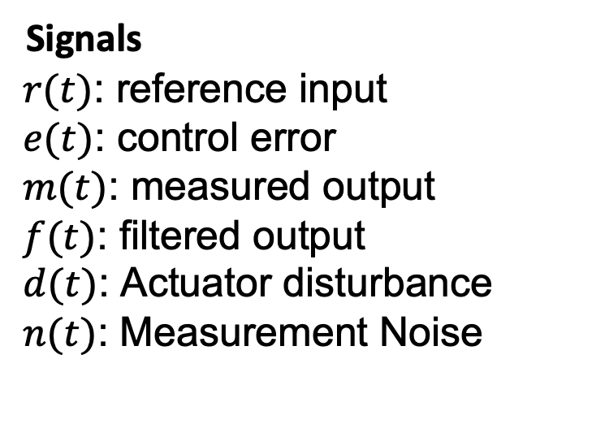









Control Architecture
Actuator
Disturbance
Measurement
Noise
$$d(t)$$
$$n(t)$$
$$e(t)$$
$$y(t)$$
$$r(t)$$
Controller
$$u(t)$$
C
m$(t)$
+
+
$$OLS$$
+
$$−$$
m$(t)$
f$(t)$
$$Filter$$
Signals
$r(t)$: reference input
$e(t)$: control error
$m(t)$: measured output
$f(t)$: filtered output
$d(t)$: Actuator disturbance
$n(t)$: Measurement Noise
Systems
Open loop system (OLS)
Controller
Filter
C (compensation)
Notes:
Why doesn’t a filter help with measurement noise? Verify transfer functions.

Slide 4



Control Architecture Without d(t), n(t)
Actuator
Disturbance
Measurement
Noise
$$0(t)$$
$$0(t)$$
$$e(t)$$
$$y(t)$$
$$r(t)$$
Controller
$$u(t)$$
C
m$(t)$
+
+
$$OLS$$
+
$$−$$
m$(t)$
f$(t)$
$$Filter$$
Notes:
Why doesn’t a filter help with measurement noise? Verify transfer functions.

Slide 5


Control Architecture Without r(t), d(t)
Actuator
Disturbance
Measurement
Noise
0$(t)$
$$n(t)$$
$$e(t)$$
$$y(t)$$
0$(t)$
Controller
$$u(t)$$
C
m$(t)$
+
+
$$OLS$$
+
$$−$$
m$(t)$
f$(t)$
$$Filter$$
Notes:
Why doesn’t a filter help with measurement noise? Verify transfer functions.

Slide 6


Control Architecture Without r(t), d(t)
setpoint
Controller
C
output
+
$$OLS$$
$$−$$
$$Filter$$
Notes:
Why doesn’t a filter help with measurement noise? Verify transfer functions.

Slide 7






Proportional, Integral, Differential (PID) Controllers
$$r(t)$$
$$e(t)$$
$$u(t)$$
$$y(t)$$
Controller
+
$$OLS$$
+
$$−$$
PID controllers are widely used.
3 different control mechanisms that can be used in combination
All have a single input and a single output.
All make use of the control error.

Slide 8
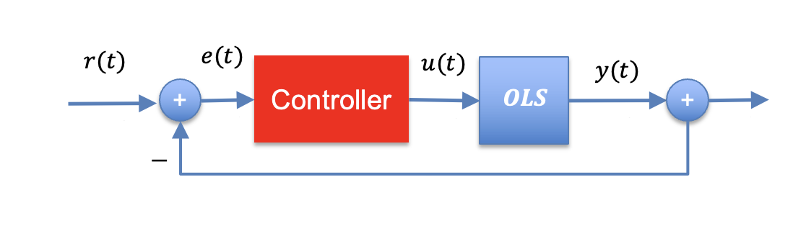




Proportional Control
$$u\left(t\right)=k_{P}e(t)$$
$$e(t)$$
$$u(t)$$
$$k_{p}$$
Only takes into account the current error.
Appeal
Simplicity, responds to change in current control error.
Issues
Biased since once at reference value, u(t) goes to 0.

Slide 9


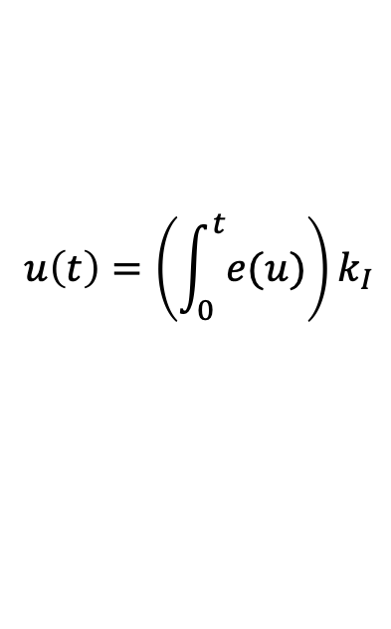
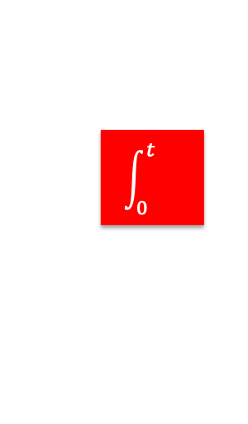


Integral Control
$$u\left(t\right)=\left(\int_{0}^{t}{e(u)}\right)k_{I}$$
$$e(t)$$
$$u(t)$$
$$\int_{0}^{t}{}$$
$$k_{I}$$
$$K_{p}$$
Considers entire history of control errors.
Appeal
Unbiased
Issues
Slow response

Slide 10


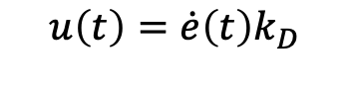



Differential Control
$$u\left(t\right)=\dot{e}\left(t\right)k_{D}$$
$$e(t)$$
$$u(t)$$
$$\frac{d}{dt}$$
$$k_{D}$$
$$K_{p}$$
Senses change in control errors.
Appeal
Fast response to changes.
Issues
Works poorly with noise.

Slide 11

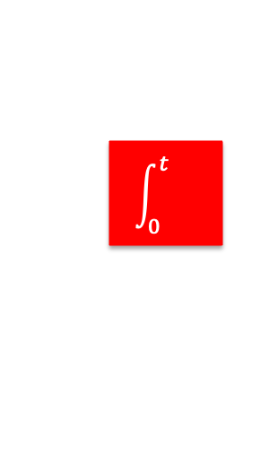















Common Controllers
PI Control
$$k_{P}$$
$$e(t)$$
$$u(t)$$
$$u(t)$$
$$k_{P}$$
$$e(t)$$
+
$$\int_{0}^{t}{}$$
$$k_{I}$$
P Control
$$K_{p}$$
PID Control
PI Control
$$k_{P}$$
$$e(t)$$
$$\int_{0}^{t}{}$$
$$k_{I}$$
$$u(t)$$
$$K_{p}$$
+
$$\frac{d}{dt}$$
$$k_{D}$$

Slide 12








Common Controllers
$$k_{P}$$
$$e(t)$$
$$\int_{0}^{t}{}$$
$$k_{I}$$
$$u(t)$$
$$K_{p}$$
+
$$\frac{d}{dt}$$
$$k_{D}$$

Slide 13
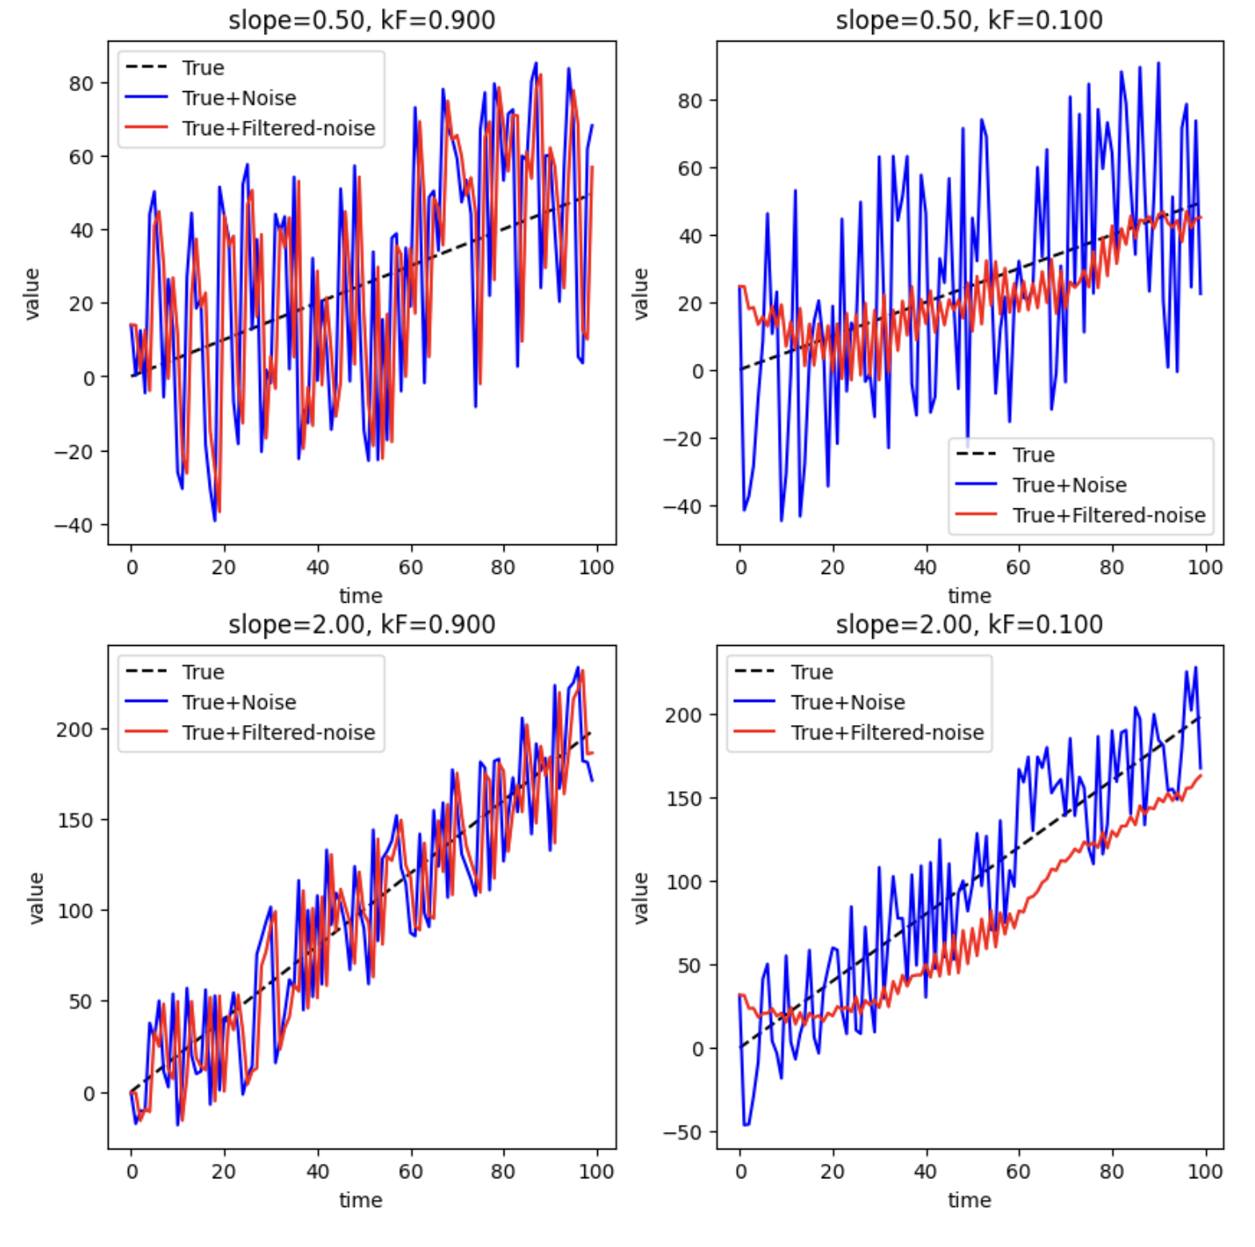







Filters
+
Controller
+
$$OLS$$
+
-
$$Filter$$
Discrete time
$$y(k)={k_{F}x\left(k\right)+\left(1−k_{F}\right)y(k−1)}_{}^{}$$
$$k_{F}∈[0,1]$$
Continuous time state equations
$$\dot{x}=k_{F}^{′}u−k_{F}^{′}x,$$
$$k_{F}^{′}>0$$
$$y=x$$
Rule of thumb:
Use small k_{F} for weak signal
Use large k_{F} for strong signal

