Slide 1
A Glimpse at BIOE 498 / BIOE 599 Advanced Biological Control Systems
Joseph L. Hellerstein
December 4, 2023
eScience Institute, Computer Science & Engineering
Allen School of Computer Science
Notes:
Diverse students. Some with bio-backgrounds; some without. Some with CS background; some with very limited. Two separate courses combined because of a substantial shared curriculum.

Slide 2
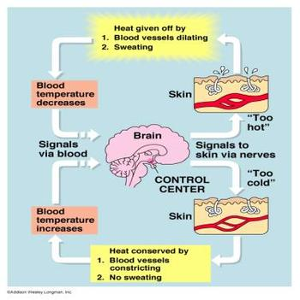
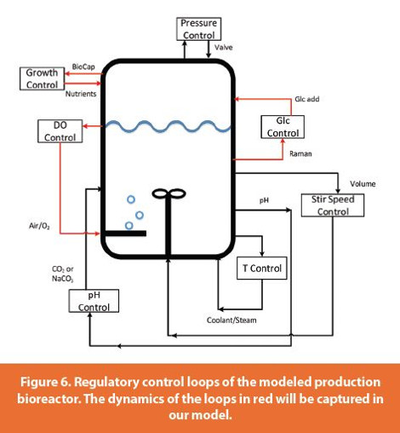
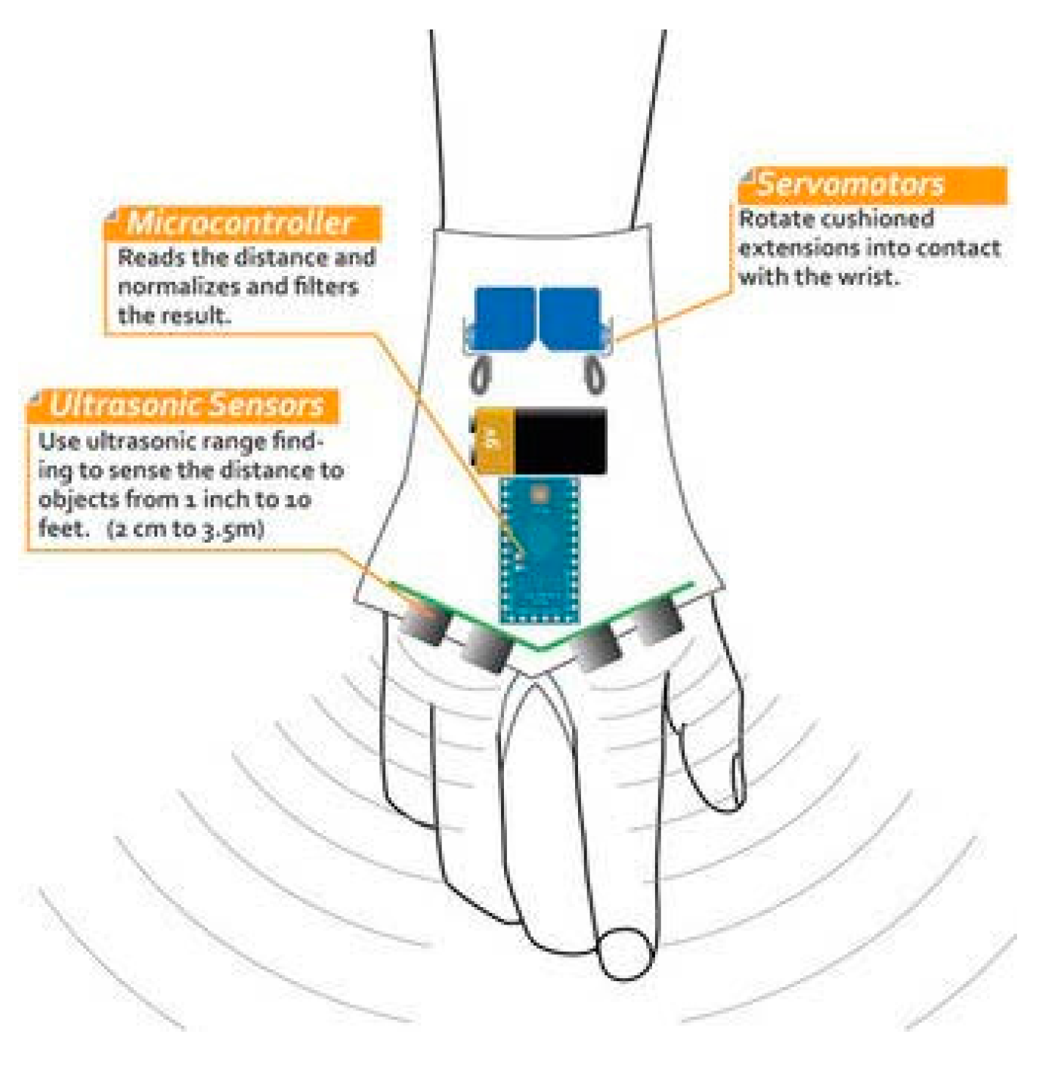
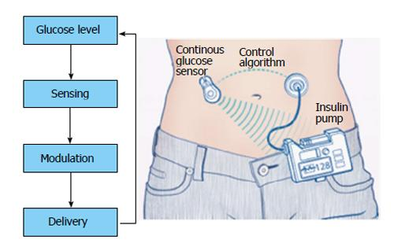
Biology has many closed loop systems.
Regulation objective: Maintain temperature at a constant value in the presence of external and internal disturbances.
Other examples of closed loop systems in biology

Slide 3






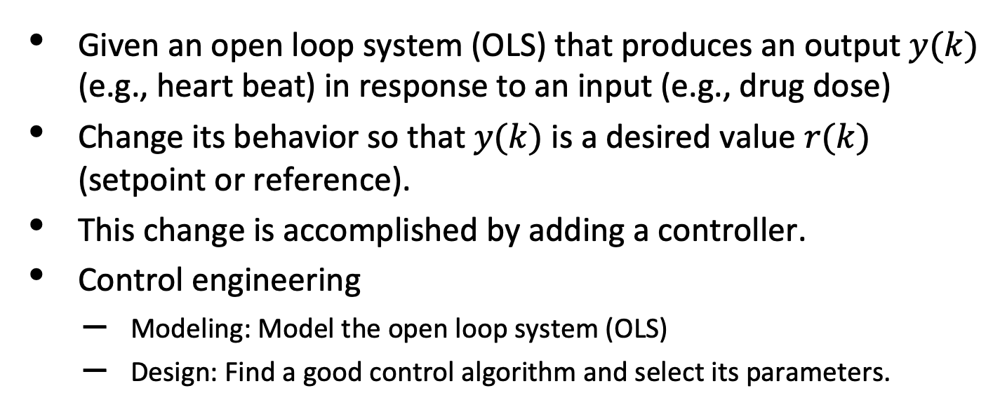

Control Engineering
$$r\left(k\right)$$
$$r\left(k\right)−y(k)$$
$$u\left(k\right)$$
$$y\left(k\right)$$
$$Controller$$
+
$$OLS$$
$$−$$
Given an open loop system (OLS) that produces an output $y(k)$ (e.g., heart beat) in response to an input (e.g., drug dose)
Change its behavior so that $y(k)$ is a desired value $r(k)$ (setpoint or reference).
This change is accomplished by adding a controller.
Control engineering
Modeling: Model the open loop system (OLS)
Design: Find a good control algorithm and select its parameters.

Slide 4
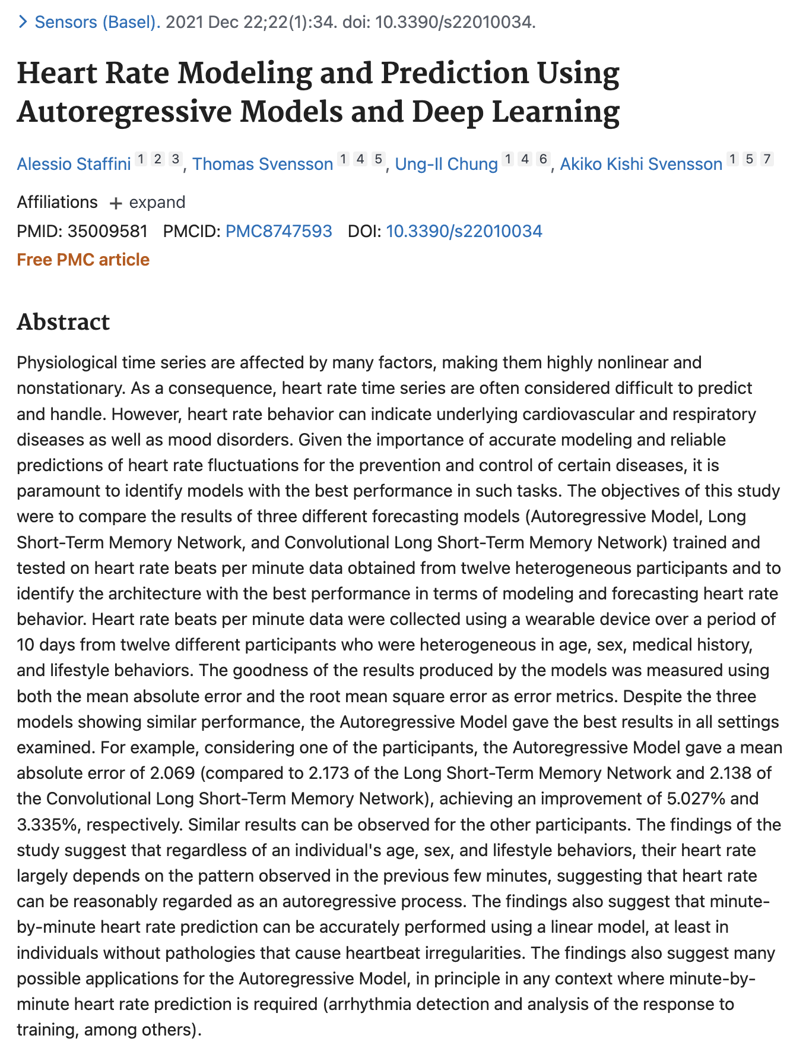
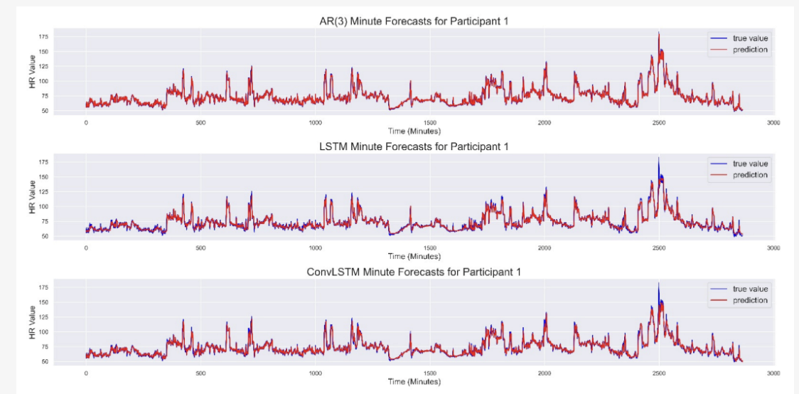
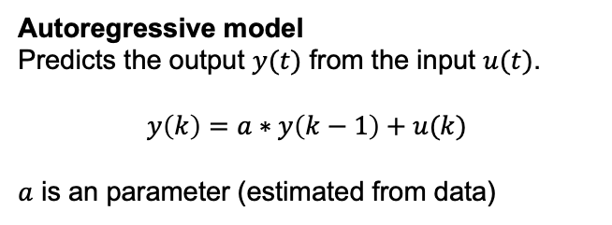
A Simple Model of an Open Loop System
Autoregressive model
Predicts the output $y(t)$ from the input $u(t)$.
$$y\left(k\right)=a∗y\left(k−1\right)+u(k)$$
$a$ is an parameter (estimated from data)
Autoregressive predicts heart beat as well as more complex approaches.

Slide 5
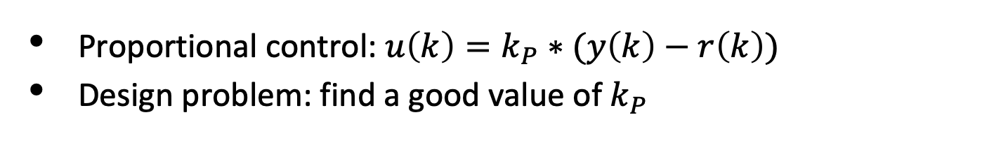
Design
$$r\left(k\right)$$
$$r\left(k\right)−y(k)$$
$$u\left(k\right)$$
$$y\left(k\right)$$
$$Controller$$
+
$$OLS$$
$$−$$
Proportional control: $u\left(k\right)=k_{P}∗(y\left(k\right)−r\left(k\right))$
Design problem: find a good value of $k_{P}$

Slide 6
DEMO

Slide 7







Learning Objectives for BIOEN 498/599: Advanced Biological Control Systems
$$r\left(k\right)$$
$$r\left(k\right)−y(k)$$
$$u\left(k\right)$$
$$y\left(k\right)$$
$$Controller$$
+
$$OLS$$
$$−$$
Controllability
Find an input to the open loop system that controls its outputs
Control design
Controllers: proportional, integral, differential control
Lead/lag compensation in biochemical systems
Build testbeds for biochemical closed loop system
Uses Antimony and Tellurium
Basic LTI theory
Stability, accuracy, settling time, overshoot.
Design closed loop systems (theory-based & ad hoc)

