Slide 1
BIOE 498 / BIOE 599 Advanced Biological Control Systems Lecture 5: Geometric Linear Algebra
Joseph L. Hellerstein
eScience Institute, Computer Science & Engineering
Allen School of Computer Science
BioEngineering
Notes:
Diverse students. Some with bio-backgrounds; some without. Some with CS background; some with very limited. Two separate courses combined because of a substantial shared curriculum.

Slide 2
Objective
Review of key concepts from linear algebra with a geometric twist to promote intuition
Introduce python capabilities for computational linear algebra

Slide 3
Roadmap
Vectors
Vector addition, constant multiplication
Dimensions, linear combinations of vectors
Vector space
Linear independence. Dependence means that can sum to one vectors from the others. One or more vector is superfluous.
Dimension of a vector space. Null space.
Dot product, angle interpretation. Orthogonal vectors. Orthogonal vs. linearly independent.
Matrices. Matrix multiplication as dot products. Represent matrix as a vector of vectors.
Matrix spaces: range, null space. Also for transpose. Dimensions of spaces. Relate to rows/columns.
Similar matrices and changing coordinate systems.
Some types of matrices
Square vs. rectangular: same or different dimensions
Invertible. Only square. Implications for range and null space
Orthogonal columns.
Unitary. Rotate only.
Diagonal. Stretch only.
Eigenvalues and eigenvectors.
Characteristic polynomial
0 eigenvalues implies singularity
Eigenvector decomposition. Not assured that eigenvectors are orthogonal.
Computational linear algebra in python

Slide 4
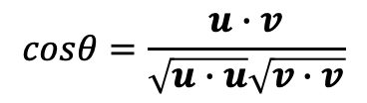






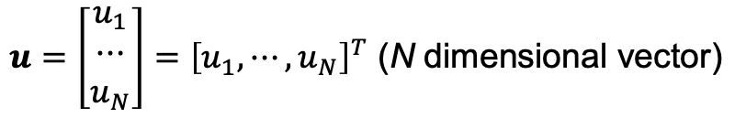
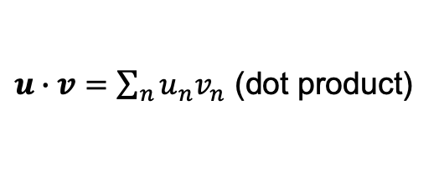
Vectors
{
$$2u$$
$$u$$
$$θ$$
$$w=u−v$$
$u∙v=\sum_{n}{u_{n}v_{n}}$ (dot product)
$$v$$
$$cosθ=\frac{u∙v}{\sqrt{u∙u}\sqrt{v∙v}}$$
$u=\left[\begin{matrix}u_{1} \\ ⋯ \\ u_{N}\end{matrix}\right]={\left[u_{1},⋯,u_{N}\right]}^{T}$ (N dimensional vector)
$u∙v=0≡θ=90°$ (orthogonal)
Can add and dot product vectors if they have the same dimension.
Can scalar multiply vectors. (No change in dimension.)
Notes:
Multi by a constant, positive or negative
Vectors are a convenient abstraction for multidimensional data.

Slide 5

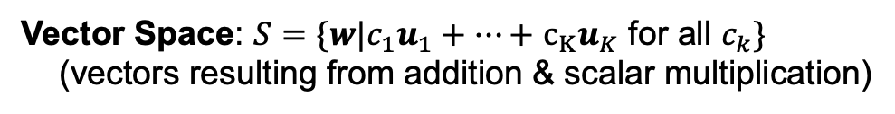
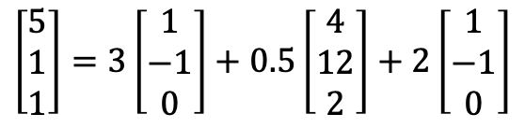
Vector Spaces
Linear Combination: $w={c_{1}u}_{1}+⋯+$ $c_{K}u_{K}$
$$\left[\begin{matrix}5 \\ 1 \\ 1\end{matrix}\right]=3\left[\begin{matrix}1 \\ −1 \\ 0\end{matrix}\right]+0.5\left[\begin{matrix}4 \\ 12 \\ 2\end{matrix}\right]+2\left[\begin{matrix}1 \\ −1 \\ 0\end{matrix}\right]$$
Vector Space: $S=\{w|{c_{1}u}_{1}+⋯+$ $c_{K}u_{K}$ for all $c_{k}\}$
(vectors resulting from addition & scalar multiplication)
Linearly independent vectors: ${c_{1}u}_{1}+⋯+$ $c_{K}u_{K}≠0$ for all $c_{k}$, $c≠0$
$$\dim\left(S\right)=\min_{|\left\{u_{1},⋯\text{,}u_{K}\right\}|}{\{S={c_{1}u}_{1}+⋯+ c_{K}u_{K} \text{for} \text{all} c_{k}\}}$$
Basis: If $u_{1},⋯\text{,}u_{K}$ generate $S$ and $\dim\left(S\right)=K$, then $u_{1},⋯\text{,}u_{K}$ is a basis for $S$.
Notes:
Why must a basis be linearly independent?
Is there only one basis?

Slide 6
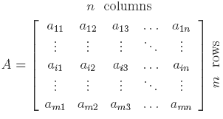

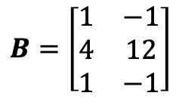


Matrices
Represent a set of vectors
..as columns
..as rows
Transpose
$$B=\left[\begin{matrix}1 & −1 \\ 4 & 12 \\ 1 & −1\end{matrix}\right]$$
$$B=A^{T}$$
$$\left[\begin{matrix}1 \\ −1\end{matrix}\right],\left[\begin{matrix}4 \\ 12\end{matrix}\right],\left[\begin{matrix}1 \\ −1\end{matrix}\right]$$
$$A=\left[\begin{matrix}1 & 4 & 1 \\ −1 & 12 & −1\end{matrix}\right]$$
Notes:
Row space.
Column space.
Null space.
Rank of a matrix.
Transpose.
Matrix multiplication
Coordinate representation

Slide 7
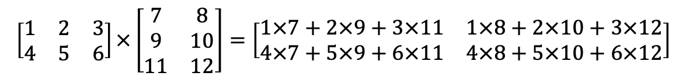
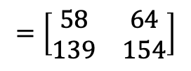

Matrix Multiplication: Mechanics
$$\left[\begin{matrix}1 & 2 & 3 \\ 4 & 5 & 6\end{matrix}\right]×\left[\begin{matrix}7 & 8 \\ 9 & 10 \\ 11 & 12\end{matrix}\right]=\left[\begin{matrix}1×7+2×9+3×11 & 1×8+2×10+3×12 \\ 4×7+5×9+6×11 & 4×8+5×10+6×12\end{matrix}\right]$$
$$=\left[\begin{matrix}1×7 & 1×8 \\ 4×7 & 4×8\end{matrix}\right]+\left[\begin{matrix}2×9 & 2×10 \\ 5×9 & 5×10\end{matrix}\right]+\left[\begin{matrix}3×11 & 3×12 \\ 6×11 & 6×12\end{matrix}\right]$$
$$=\left[\begin{matrix}58 & 64 \\ 139 & 154\end{matrix}\right]$$
Notes:
Note that decomposition is all rank one matrices

Slide 8
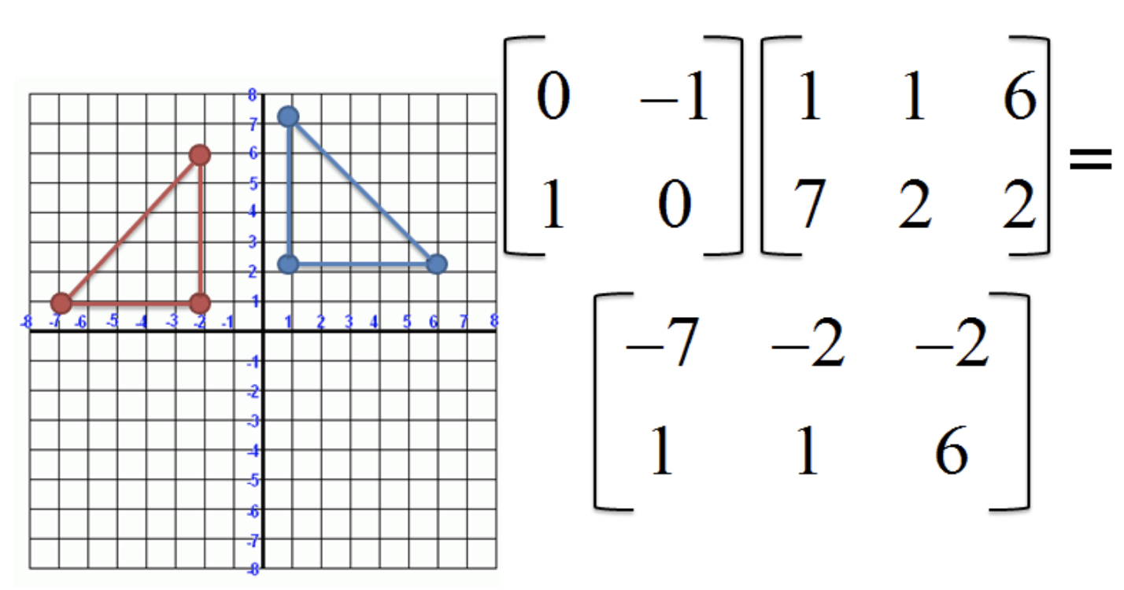
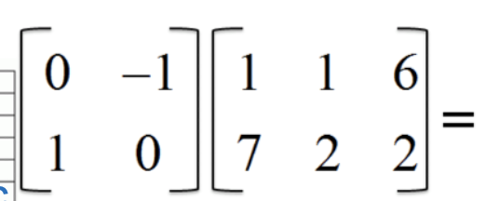
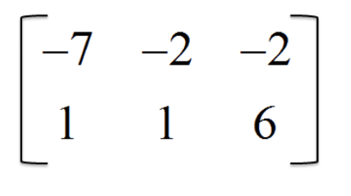
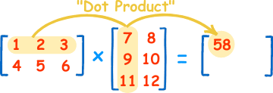


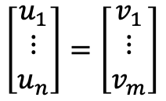








Matrix Multiplication: Interpretations
Rotates a vector.
c
a
a
b
c
b
Compute angles between vectors.
Convert a vector in $R^{n}$ (# col) to $R^{m}$ (# row).
$$w_{1}$$
$$w_{2}$$
$$u_{1}^{T}$$
$$u_{1}^{T}∙w_{1}$$
$$u_{1}^{T}∙w_{2}$$
$$\left[\begin{matrix}u_{1} \\ ⋮ \\ u_{n}\end{matrix}\right]=\left[\begin{matrix}v_{1} \\ ⋮ \\ v_{m}\end{matrix}\right]$$
$$u_{1}^{T}$$
$$u_{2}^{T}∙w_{1}$$
$$u_{2}^{T}∙w_{2}$$
Notes:
Row space.
Column space.
Null space.
Rank of a matrix.
Transpose.
Matrix multiplication
Coordinate representation

Slide 9
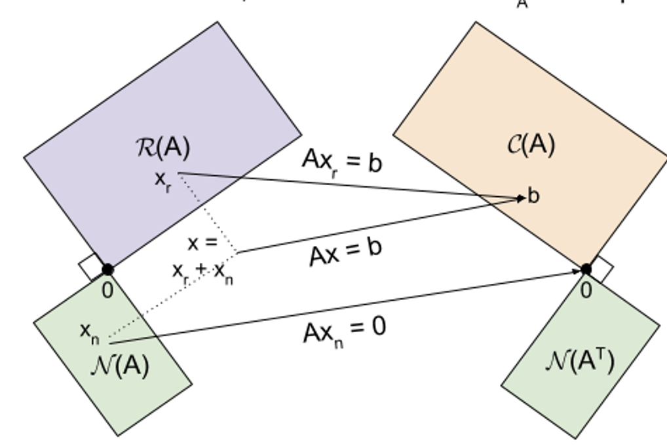







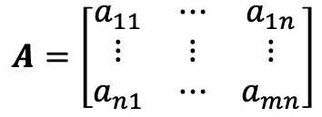


Fundamental Subspaces of a Matrix
Dimension of space row vectors: n
{
$$A=\left[\begin{matrix}a_{11} & ⋯ & a_{1n} \\ ⋮ & ⋮ & ⋮ \\ a_{n1} & ⋯ & a_{mn}\end{matrix}\right]$$
{
Dimension of space of column vectors: m
Column subspace (image of row vectors): C(A): $Au∈R^{m}, u∈R^{n}$
Dim n (row space)
Row subspace (image of column vectors): R(A): $A^{T}v, v∈R^{m}$
Null subspace: N(A): $Au, u∈R^{n}$
Left null subspace: N(A^{T}): $A^{T}v, v∈R^{m}$
$$u$$
$$Au$$
$$v$$
$$A^{T}v$$
Fundamental Theorem
$$\dim\left(C\left(A\right)\right)=\dim\left(R(A)\right)$$
$$\dim\left(C\left(A\right)\right)+\dim\left(N\left(A\right)\right)=n$$
$$\dim\left(R\left(A\right)\right)+\dim\left(N\left(A^{T}\right)\right)=m$$
Dim m (column space)
Notes:
Column vectors live in column space, which has dimension m.
Row vectors live in row space, which has dimension n.

Slide 10





Matrix Inverse
$A, n×n,$ is invertible iff there exists $B, n×n,$ such that $AB=BA=I.$
A matrix that is not invertible is singular. An invertible matrix is non-singular.
Invertibility implies that the null space has dimension 0.
Dim n (row space)
Inverse of 2X2 matrix
$$u$$
$$Au$$
$$v$$
$$A^{T}v$$
Dim m (column space)

Slide 11
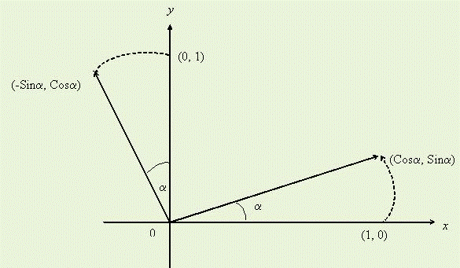



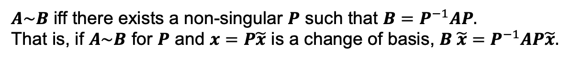

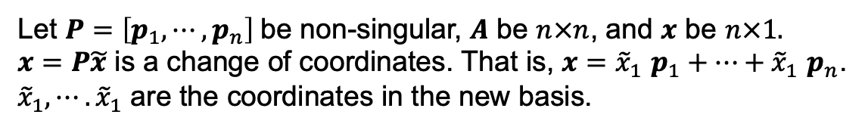


Changing Coordinate (Basis) Systems
Example: Rotation
$$e_{1}=\left[\begin{matrix}1 \\ 0\end{matrix}\right],e_{2}=\left[\begin{matrix}0 \\ 1\end{matrix}\right]$$
$$f_{1}=\left[\begin{matrix}Cosα \\ Sinα\end{matrix}\right],f_{2}=\left[\begin{matrix}−Sinα \\ Cosα\end{matrix}\right]$$
$$P=\left[\begin{matrix}Cosα & −Sinα \\ Sinα & Cosα\end{matrix}\right], detP=1$$
$$\left[\begin{matrix}f_{1} & f_{2}\end{matrix}\right]=P\left[\begin{matrix}e_{1} & e_{2}\end{matrix}\right]$$
$$P^{−1}=\left[\begin{matrix}Cosα & Sinα \\ −Sinα & Cosα\end{matrix}\right]$$
Observation
If $P$ is non-singular, then $AP$ has the same column space as $A.$
Change of coordinates to basis $p_{1},⋯,p_{n}$
Let $P=\left[p_{1},⋯,p_{n}\right]$be non-singular, $A$ be $n×n$, and $x$ be $n×1.$
$x=P\tilde{x}$ is a change of coordinates. That is, $x={\tilde{x}}_{1}$ $p_{1}+⋯+{\tilde{x}}_{1} p_{n}$.
${\tilde{x}}_{1},⋯.{\tilde{x}}_{1}$ are the coordinates in the new basis.
Similarity
$A\sim B$ iff there exists a non-singular $P$ such that $B=P^{−1}AP.$
That is, if $A\sim B$ for $P$ and $x=P\tilde{x}$ is a change of basis, $B \tilde{x}=P^{−1}AP\tilde{x}.$

Slide 12
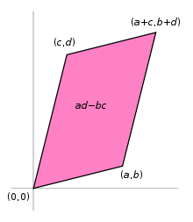
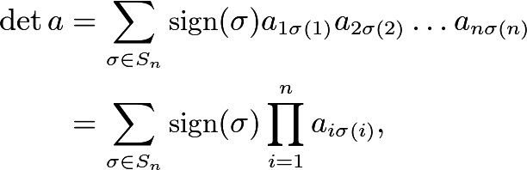

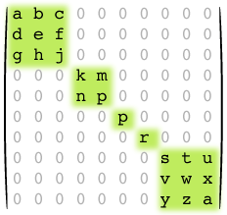


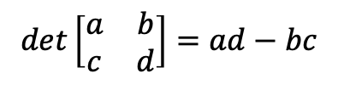

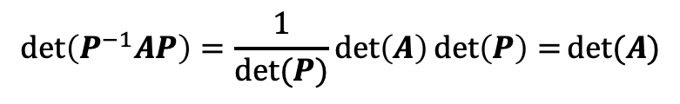





Determinant
Measure of volume
$$det\left[\begin{matrix}a & b \\ c & d\end{matrix}\right]=ad−bc$$
det$A=$
Det of triangular matrix is product of terms in diagonal
($σ$ is a permutation.)
Singular matrices
$detA=0≡A$ is singular.
Computing determinant of block matrix
$$A_{1}$$
$$A_{2}$$
$$det$$
$$=\det\left[A_{1}A_{2}a_{3}A_{4}\right]=\det\left(A_{1}\right)\det\left(A_{2}\right)\det\left(a_{3}\right)det⁡(A_{4})$$
$$a_{3}$$
$$A_{4}$$
$$\det\left(P^{−1}AP\right)=\frac{1}{det⁡(P)}\det\left(A\right)\det\left(P\right)=det⁡(A)$$

Slide 13
Eigenvalues & Eigenvectors
Definition
Characteristic polynomial
Calculating
Eigenvalues don’t change under change in coordinate
Eigenvector change of coordinates

Slide 14
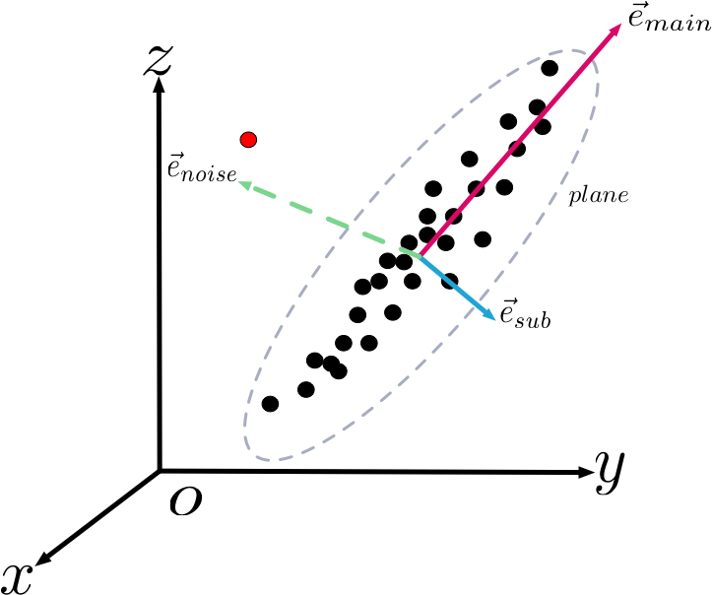

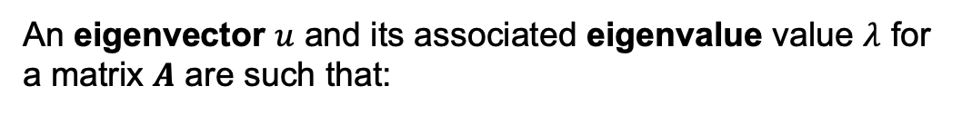
Eigenvalues and Eigenvectors
Eigenvalues and eigenvectors describe how a matrix transforms a vector.
An eigenvector $u$ and its associated eigenvalue value $λ$ for
a matrix $A$ are such that:
$Au=λu$
Eigenvectors are the “natural” basis for a matrix transformation.
Eigenvalues indicate stretching along a dimension.

Slide 15
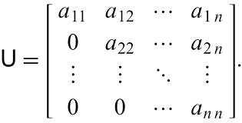



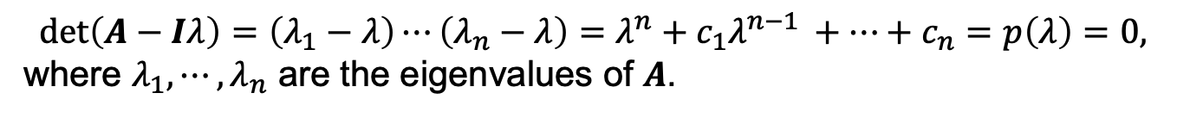

Calculating Eigenvalues and Eigenvectors
$u, λ$ are an eigenvector, eigenvalue pair if
$Au=λu$
Key equation
$u\left(A−Iλ\right)=0≡det\left(A−Iλ\right)=0⁡$
Finding eigenvalues
$$det\left(A−Iλ\right)=\left(λ_{1}−λ\right)⋯\left(λ_{n}−λ\right)=λ^{n}+c_{1}λ^{n−1 }+⋯+c_{n}=p\left(λ\right)=0,$$
where $λ_{1},⋯,λ_{n}$ are the eigenvalues of $A$.
Finding eigenvectors
Solve $\left(A−Iλ_{n}\right)u=0$, for each eigenvalue.
Eigenvectors of triangular matrix
Notes:
Characteristic poly

Slide 16
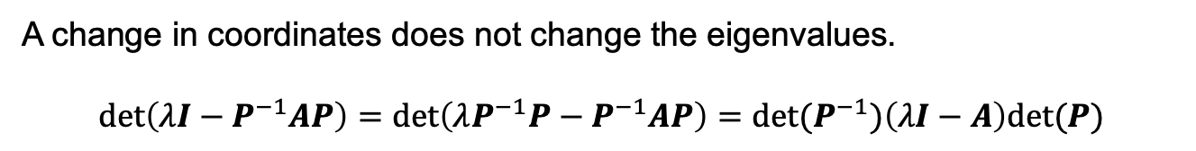
Observations About Eigenvalues, Eigenvectors
Eigenvalues may be repeated (algebraic multiplicity). Usually, there will be more than one eigenvector (geometric multiplicity) if there is more than one eigenvalue.
$A$ is non-singular iff there is no eigenvalue at 0.
A change in coordinates does not change the eigenvalues.
$$\det\left(λI−P^{−1}AP\right)=\det\left(λP^{−1}P−P^{−1}AP\right)=\det{(P^{−1})\left(λI−A\right)det⁡(P)}$$
$$\det\left(P^{−1}\right)\left(λI−A\right)\det\left(P\right)=[1/det{(P)]\left(λI−A\right)det⁡(P})$$
$=\det\left(λI−A\right),$ which yields the eigenvalues of $A$.
Notes:
Will the eigenvectors change?

Slide 17
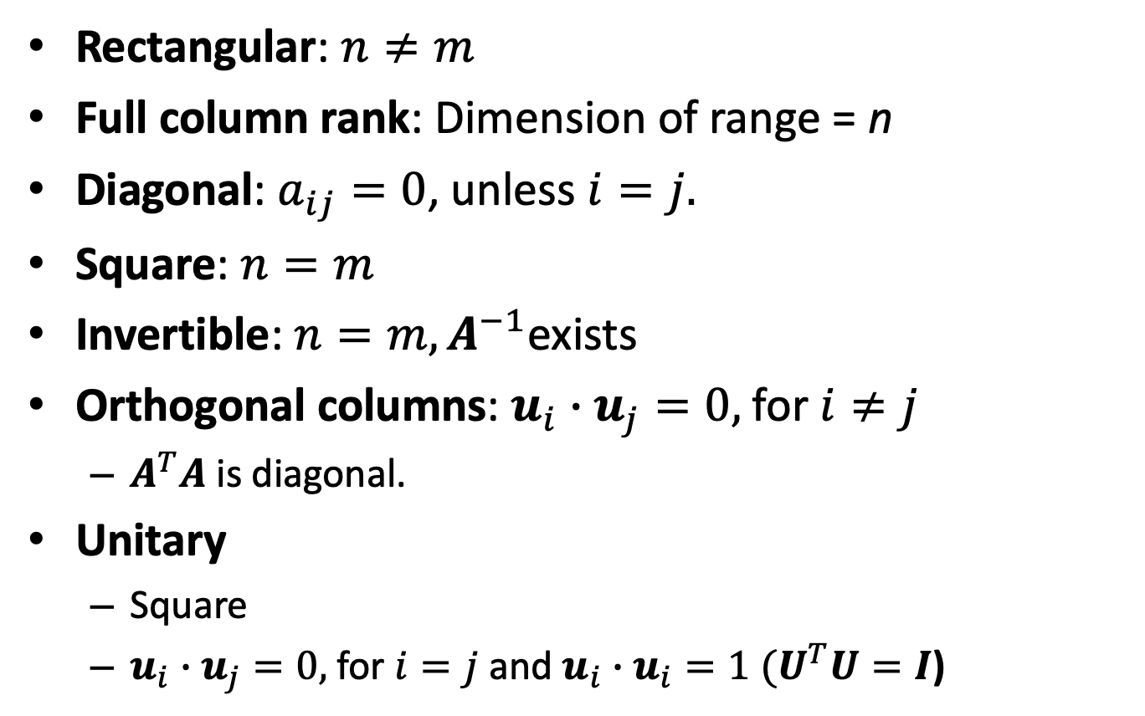

Classifications of $m×n$Matrices
Rectangular: $n≠m$
Full column rank: Dimension of range = n
Diagonal: $a_{ij}=0$, unless $i=j.$
Square: $n=m$
Invertible: $n=m, A^{−1}$exists
Orthogonal columns: $u_{i}∙u_{j}=0,$for $i≠j$
$A^{T}A$ is diagonal.
Unitary
Square
$u_{i}∙u_{j}=0,$for $i=j$ and $u_{i}∙u_{i}=1 (U^{T}U=I$)

Slide 18
BACKUP

Slide 19



Matrix Range Space & Null Space
Translates a vector to a new space, the range of the matrix.
$$Au=\left[\begin{matrix}1 & 1 \\ 2 & 2\end{matrix}\right]\left[\begin{matrix}u_{1} \\ u_{2}\end{matrix}\right]=(u_{1}+u_{2})\left[\begin{matrix}1 \\ 2\end{matrix}\right]$$
The range of $A$ is a 1-d subspace of $R^{2}$.
If you “lose” a dimension, it gets mapped to 0.
The null space of the matrix consists of all vectors that map to 0.
Solve for null space.
$$\left[\begin{matrix}1 & 1 \\ 2 & 2\end{matrix}\right]\left[\begin{matrix}u_{1} \\ u_{2}\end{matrix}\right]=\left[\begin{matrix}0 \\ 0\end{matrix}\right]=0≡u_{1}=u_{2}$$

Slide 20
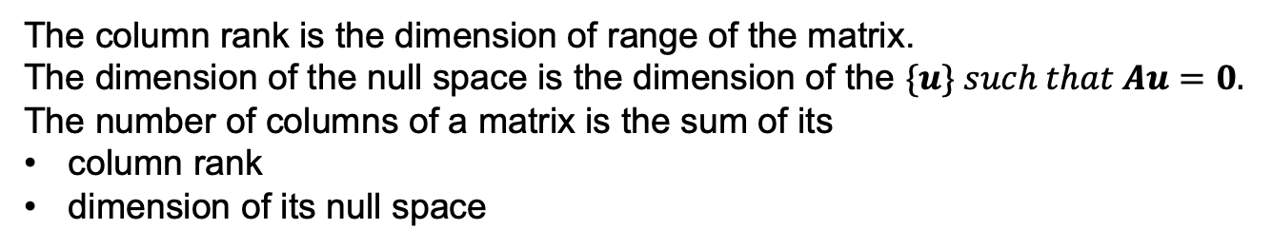

Column Rank & Null Space
Domain: dim = n
Range: dim = m
Range
(Column Space)
$$A$$
Null Space
0
0
The column rank is the dimension of range of the matrix.
The dimension of the null space is the dimension of the $\{u\} such that Au=0.$
The number of columns of a matrix is the sum of its
column rank
dimension of its null space

Slide 21
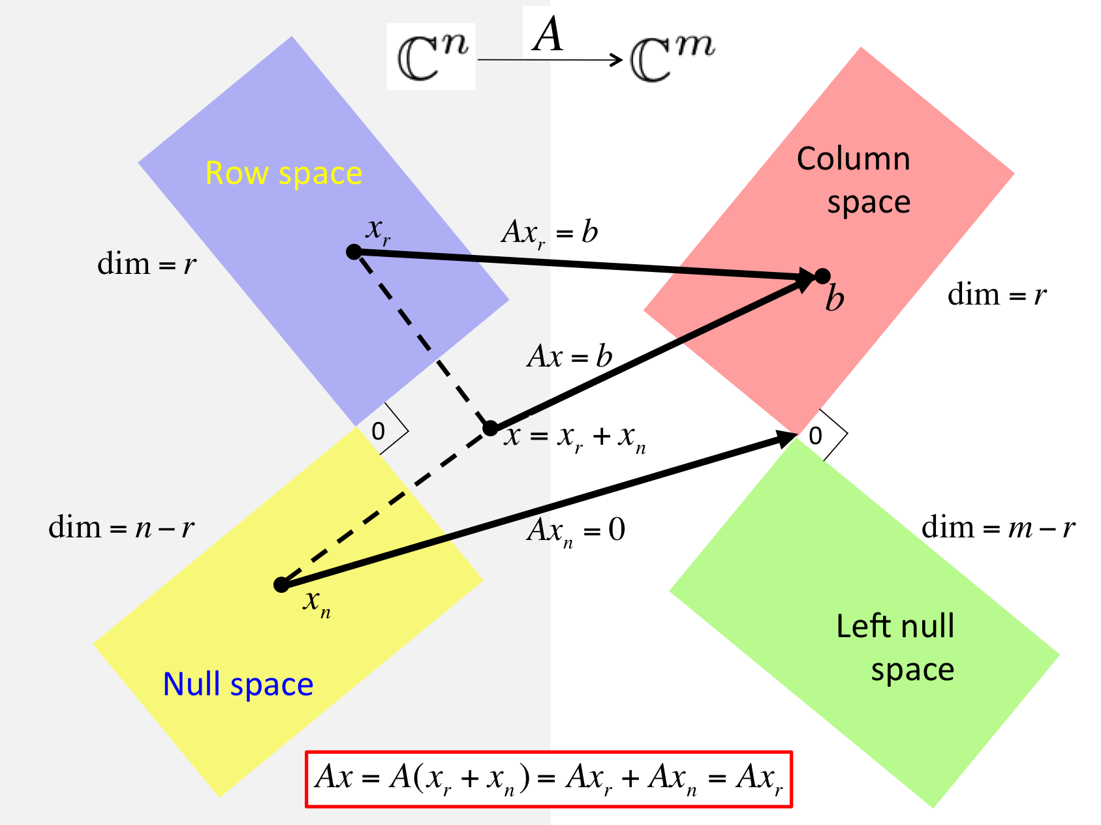

Slide 22
Notes
Fundamental subspaces and orthogonality relationships. Relationship between dim of null space, range, and number of rows. Relationship between singularity and size of null space.
Learning objectives
Visual interpretation of linear algebra
New representations of linear operations
Some key results: SVD, Cayley Hamilton
Definition of linearity
Multi-dimensional modeling with dimensions, angles, lengths.
Transformations of vectors: rotations, stretching, dimension change.
Interpreting linear algebra in terms of transformations
Cross product: angle between two vectors
Summation: decomposed effect of parts
Matrix multiplication: rotation, stretch, dimension change
Basis, characteristic polynomial, eigenvalues, independence, orthogonality, unitary matrices, Jordan form, Cayley Hamilton, SVD, computations, orthogonal decomposition from singular values, A*A is PSD, pseudo inverse.
Submatrices, column stacking
Diagonal representation of a square matrix with distinct non-zero eigenvalues.
Transformations resulting from a unitary and diagonal matrix

Slide 23
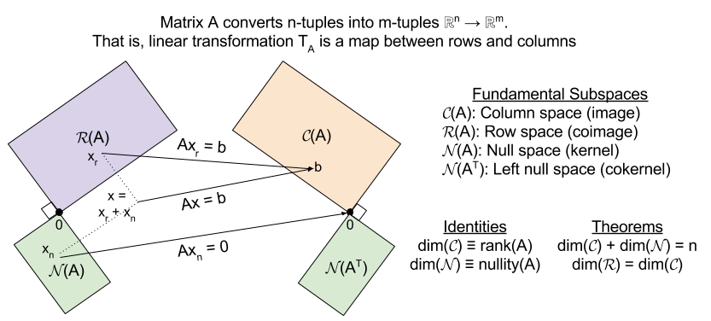
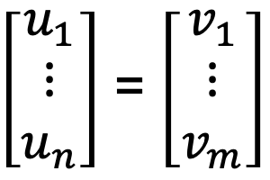
4 Fundamental Spaces
$\left[\begin{matrix}u_{1} \\ ⋮ \\ u_{n}\end{matrix}\right]$ = $\left[\begin{matrix}v_{1} \\ ⋮ \\ v_{m}\end{matrix}\right]$

