Slide 1
BIOE 498 / BIOE 599 Advanced Biological Control Systems Lecture 8: Laplace Transforms
Joseph L. Hellerstein
eScience Institute, Computer Science & Engineering
Allen School of Computer Science
BioEngineering
Notes:
Diverse students. Some with bio-backgrounds; some without. Some with CS background; some with very limited. Two separate courses combined because of a substantial shared curriculum.

Slide 2
Agenda
Why Laplace Transforms?
Basic Laplace Transforms
Properties
Applying Laplace Transforms

Slide 3
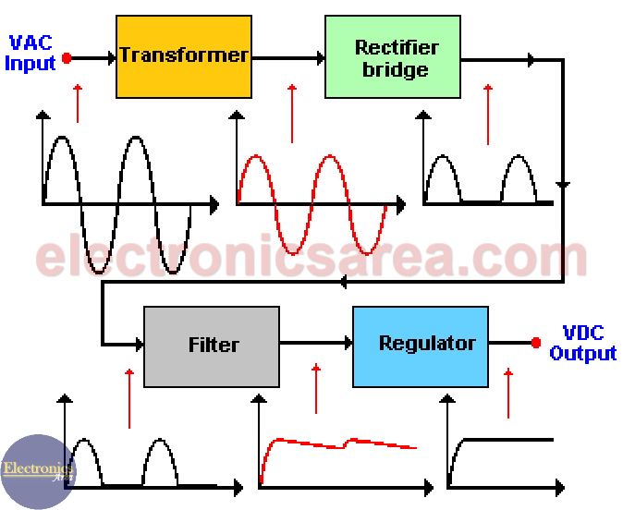
Motivating Example
How does a DC power supply convert AC power?

Slide 4

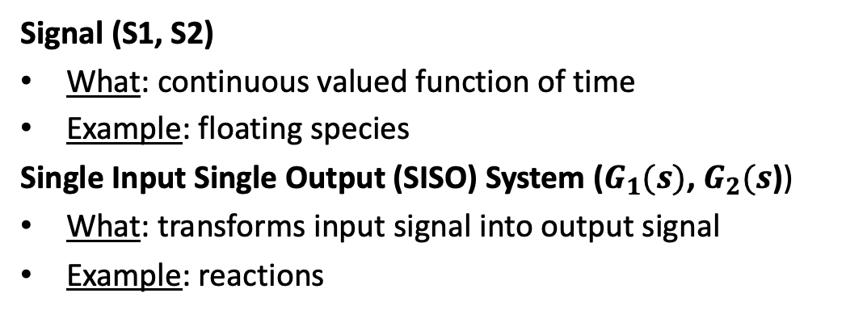


System Abstraction for Reaction Networks
System abstraction of reaction network
Reaction Network
J1: $S1→ S2; k1*$S1
J2: S2 -> S3; k2*S2
S1
S2
S3
$$G_{1}(s)$$
$$G_{2}(s)$$
S1
J1
S2
$$J2$$
S3
Signal (S1, S2)
What: continuous valued function of time
Example: floating species
Single Input Single Output (SISO) System ($G_{1}(s)$, $G_{2}(s$))
What: transforms input signal into output signal
Example: reactions

Slide 5
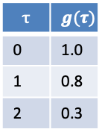



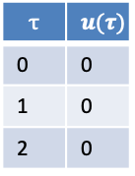
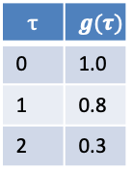




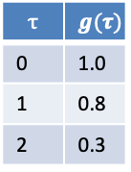










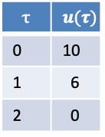
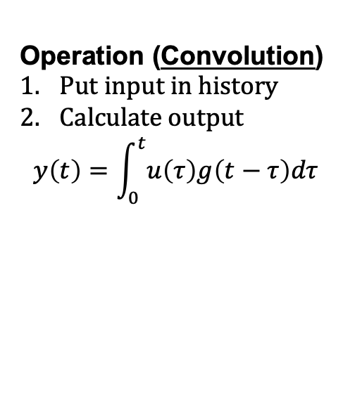
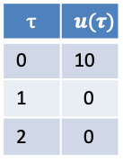
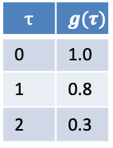
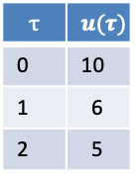

Operation of Linear Time Invariant (LTI) System
Input History
Function
Operation (Convolution)
Put input in history
Calculate output
$$y\left(t\right)=\int_{0}^{t}{u\left(τ\right)g\left(t−τ\right)dτ}$$
$$u$$
$$τ$$ | $$u(τ)$$
0 | 0
1 | 0
2 | 0
$$τ$$ | $$g(τ)$$
0 | 1.0
1 | 0.8
2 | 0.3
$$y$$
$$t=2$$
$$t=0$$
Input History
Function
Input History
Function
$$10.0$$
$$y$$
$$5$$
$$y$$
$$u$$
$$τ$$ | $$u(τ)$$
0 | 10
1 | 0
2 | 0
$$τ$$ | $$g(τ)$$
0 | 1.0
1 | 0.8
2 | 0.3
$$τ$$ | $$u(τ)$$
0 | 10
1 | 6
2 | 5
$$τ$$ | $$g(τ)$$
0 | 1.0
1 | 0.8
2 | 0.3
$$u$$
$$y\left(t\right)=u\left(0\right)g\left(t−0\right)=10∗1=10$$
$$y\left(t\right)=u\left(0\right)g\left(t−0\right)+u\left(1\right)g\left(t−1\right)$$
+ $u\left(2\right)g\left(t−2\right)=12.8$
$$t=1$$
Input History
Function
$$6$$
$$y$$
$$u$$
$$τ$$ | $$u(τ)$$
0 | 10
1 | 6
2 | 0
$$τ$$ | $$g(τ)$$
0 | 1.0
1 | 0.8
2 | 0.3
$$y\left(t\right)=u\left(0\right)g\left(t−0\right)+u\left(1\right)g\left(t−1\right)$$
$=1.0∗6+0.8∗10=14$

Slide 6


We Describe Signals and Systems Using Laplace Transforms
S1
S2
S3
$$G_{1}(s)$$
$$G_{2}(s)$$
The LT for a system is called a Transfer Function.
Appeal
Describe the dynamics of a system by identifying its poles
Calculate the step response of a system (if it converges)
Can combine LTs of systems to infer the dynamics of the combined systems
Important tool for control design (e.g., choosing the poles of the controlled system)

Slide 7
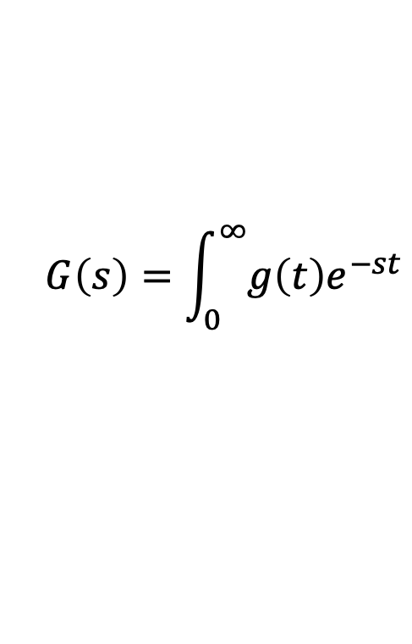
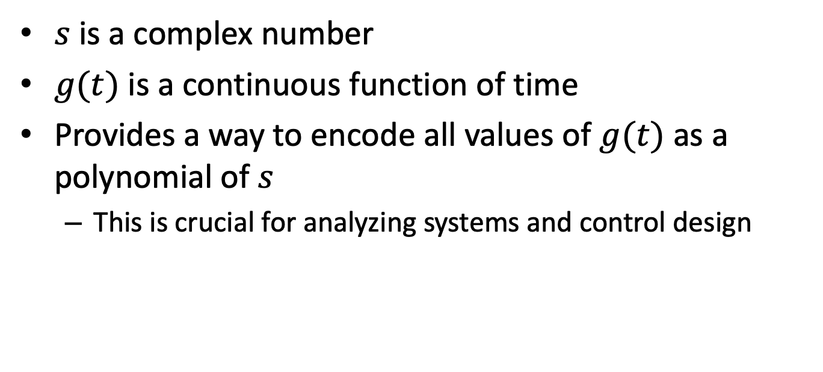
LT Definition
$$G\left(s\right)=\int_{0}^{∞}{g\left(t\right)e^{−st}}$$
$s$ is a complex number
$g(t)$ is a continuous function of time
Provides a way to encode all values of $g(t)$ as a polynomial of $s$
This is crucial for analyzing systems and control design

Slide 8
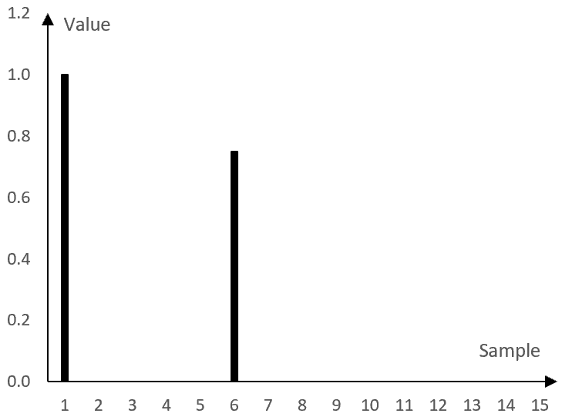






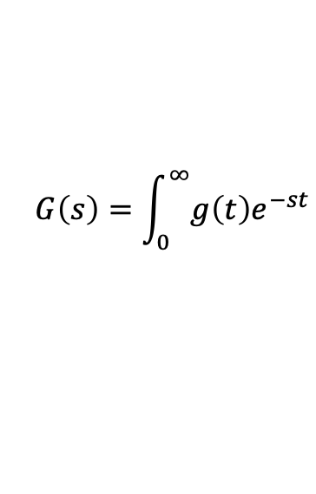


A First Laplace Transform
$$G\left(s\right)=\int_{0}^{∞}{g\left(t\right)e^{−st}}$$
Impulse signal at time $τ$: $δ_{τ}\left(t\right)=1, τ=t;0, τ≠t$
Laplace Transform
$${L[δ}_{τ}\left(t\right){]=e}^{−sτ}$$
$${L[δ}_{0}\left(t\right)]=$$
$$1$$
$$δ_{1}$$
$${L[δ}_{1}]=e^{−s}$$
$${L[δ}_{1}]=e^{−st}+\left(0.8\right)e^{−6s}$$
$${(0.8)δ}_{6}$$
$${L[δ}_{6}]={(0.8)e}^{−6s}$$
Signals and systems can be described using combinations of more Laplace Transforms.
Notes:
Show how can encode a discrete signal with a sum of e^-st terms. Show time shifts and scale by constant.

Slide 9
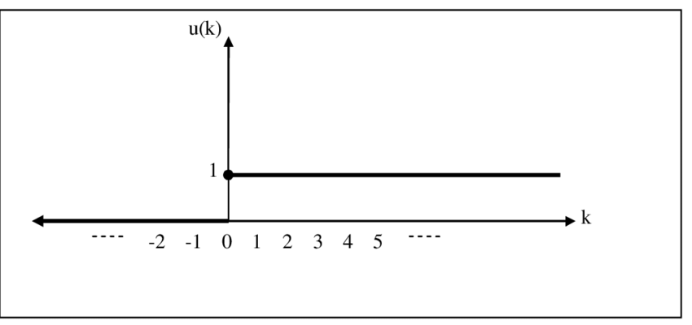
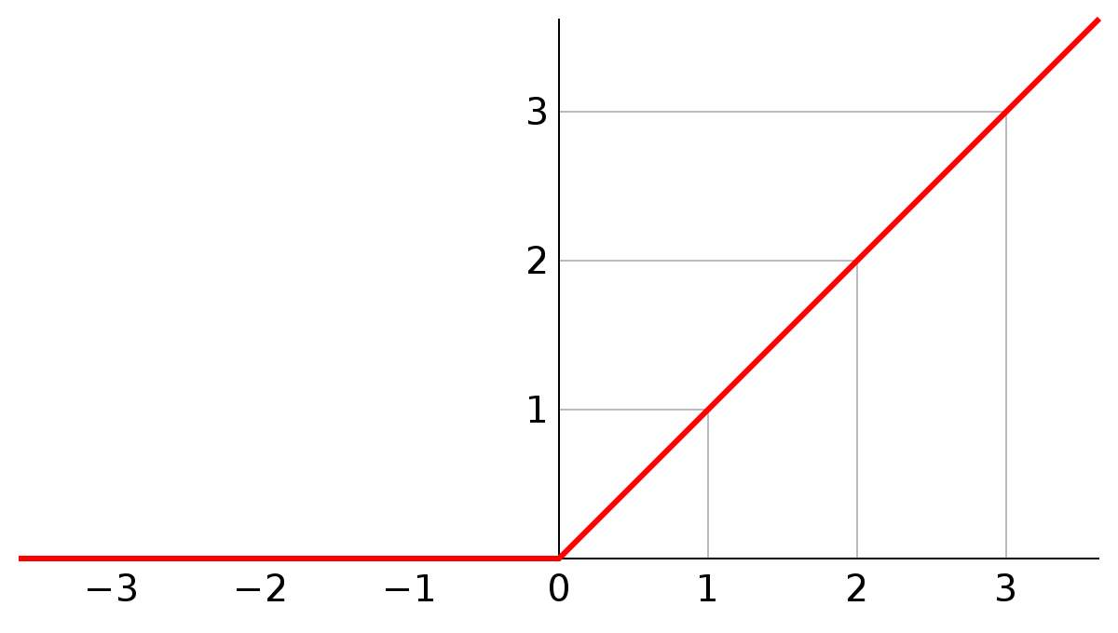

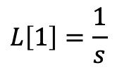


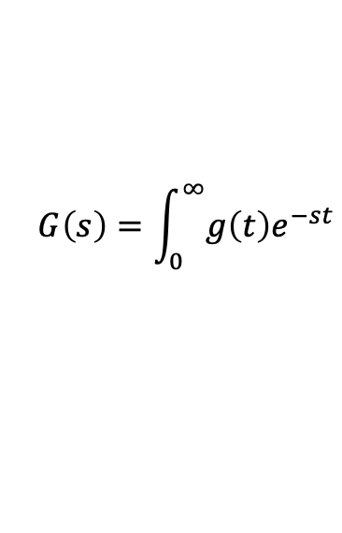

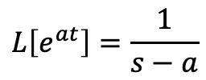



More Laplace Transforms
$$G\left(s\right)=\int_{0}^{∞}{g\left(t\right)e^{−st}}$$
Unit step at time 0: g$\left(t\right)=1, t≥0;0, t<0.$
Ramp: g$\left(t\right)=t, t≥0;0, t<0.$
$$g\left(t\right)$$
$$g\left(t\right)$$
Laplace Transform
$$L\left[1\right]=\frac{1}{s}$$
Laplace Transform
$$L\left[t\right]=\frac{1}{s^{2}}$$
Laplace Transform of transcendentals:
$$L\left[e^{at}\right]=\frac{1}{s−a}$$
$$L\left[cos⁡(ωt)\right]=\frac{s}{s^{2}+ω^{2}}$$
$$L\left[sin⁡(αt)\right]=\frac{ω}{s^{2}+ω^{2}}$$

Slide 10






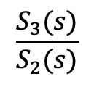
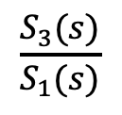
Transfer Function
S1
S2
S3
$$G_{1}(s)$$
$$G_{2}(s)$$
$$G\left(s\right)$$
A transfer function is the ratio of the Laplace transform of the output to the Laplace transform of the input.
$$G_{1}\left(s\right)=\frac{S_{2}(s)}{S_{1}(s)}$$
$$\frac{S_{3}(s)}{S_{2}(s)}$$
$$\frac{S_{3}(s)}{S_{1}(s)}$$
$$G_{2}\left(s\right)=$$
$$G\left(s\right)=$$

Slide 11
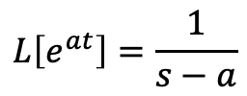
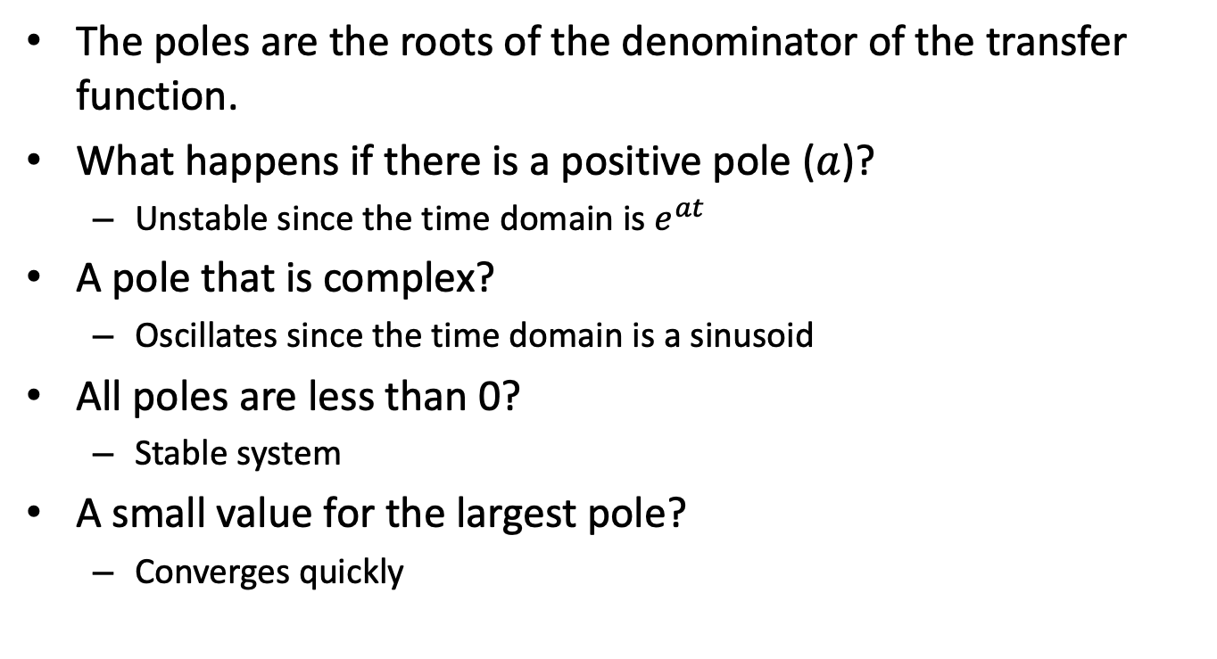


What Poles Say About a System
$$L\left[e^{at}\right]=\frac{1}{s−a}$$
$$L\left[cos⁡(ωt)\right]=\frac{s}{s^{2}+ω^{2}}$$
$$L\left[sin⁡(αt)\right]=\frac{ω}{s^{2}+ω^{2}}$$
The poles are the roots of the denominator of the transfer function.
What happens if there is a positive pole ($a$)?
Unstable since the time domain is $e^{at}$
A pole that is complex?
Oscillates since the time domain is a sinusoid
All poles are less than 0?
Stable system
A small value for the largest pole?
Converges quickly

Slide 12
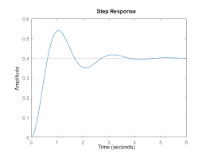
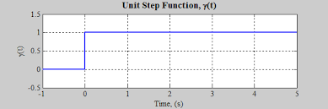

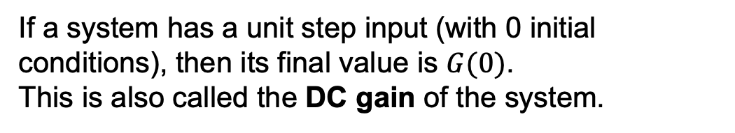


Step Response of a System
Transfer Function: The Laplace transform of a system
$$y(∞)$$
$$G(s)$$
$$G(0)=y(∞)$$
If a system has a unit step input (with 0 initial conditions), then its final value is $G(0)$.
This is also called the DC gain of the system.

Slide 13
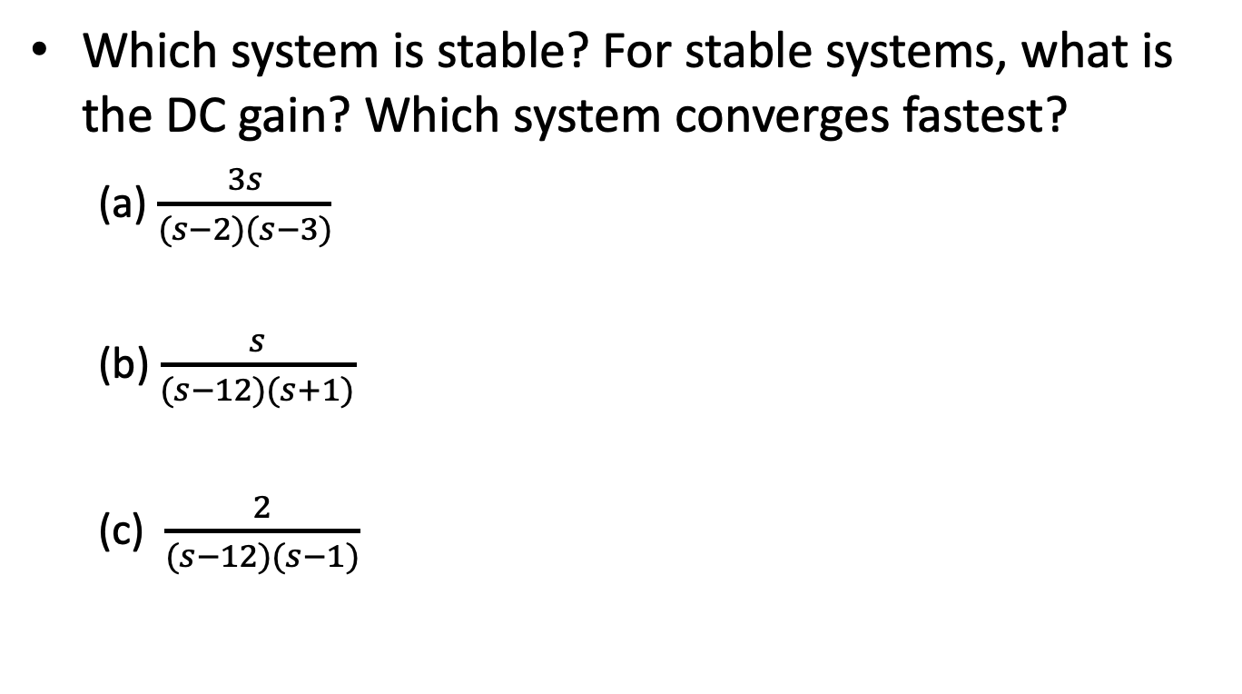
Exercise
Which system is stable? For stable systems, what is the DC gain? Which system converges fastest?
(a) $\frac{3s}{(s−2)(s−3)}$
(b) $\frac{s}{(s−12)(s+1)}$
(c) $\frac{2}{(s−12)(s−1)}$

Slide 14
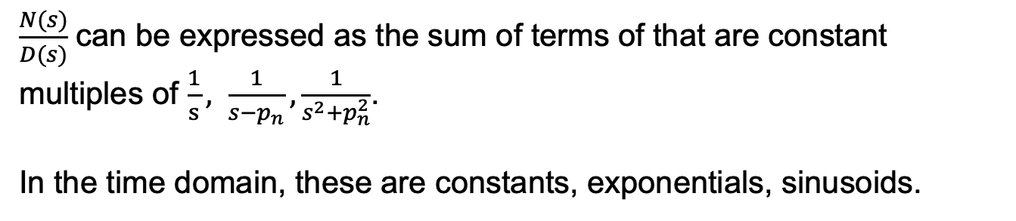

Inverse of a Laplace Function
$$G\left(s\right)=\int_{0}^{∞}{g\left(t\right)e^{−st}}$$
General form for a T.F.: $G\left(s\right)=\frac{N(s)}{D(s)}=\frac{s^{M}+b_{1}s^{M−1 }+⋯+b_{M}}{s^{N}+a_{1}s^{N−1 }+⋯+a_{N}}=\frac{\left(s−z_{1}\right)⋯(s−z_{M})}{\left(s−p_{1}\right)⋯(s−p_{N})}$
$z_{m}$ are the zeroes, $p_{n}$ are the poles.
$\frac{N(s)}{D(s)}$ can be expressed as the sum of terms of that are constant multiples of $\frac{1}{s}, \frac{1}{s−p_{n}}, \frac{1}{s^{2}+p_{n}^{2}}$.
In the time domain, these are constants, exponentials, sinusoids.

Slide 15

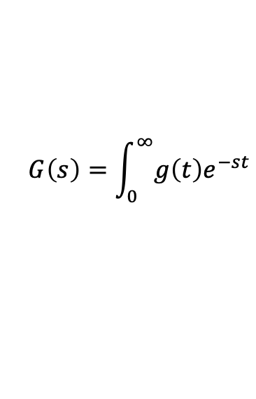
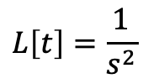

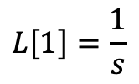
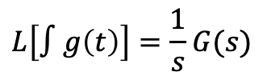



Properties of Laplace Transforms
$$G\left(s\right)=\int_{0}^{∞}{g\left(t\right)e^{−st}}$$
Constant multiplication
Derivative
Integral
$$L[\dot{g}\left(t\right)]=sG(s)$$
$$L\left[∫g\left(t\right)\right]=\frac{1}{s}G(s)$$
$$L[ag\left(t\right)]=aG(s)$$
Summation
$$L\left[g\left(t\right)+h\left(t\right)\right]=G\left(s\right)+H(s)$$
$L\left[⋅\right]$ is a linear operator.
Explain the relationship between these functions.
${L[δ}_{0}]=$1
$$L\left[1\right]=\frac{1}{s}$$
$$L\left[t\right]=\frac{1}{s^{2}}$$
Notes:
How do the last 3 LT relate to each other?

Slide 16



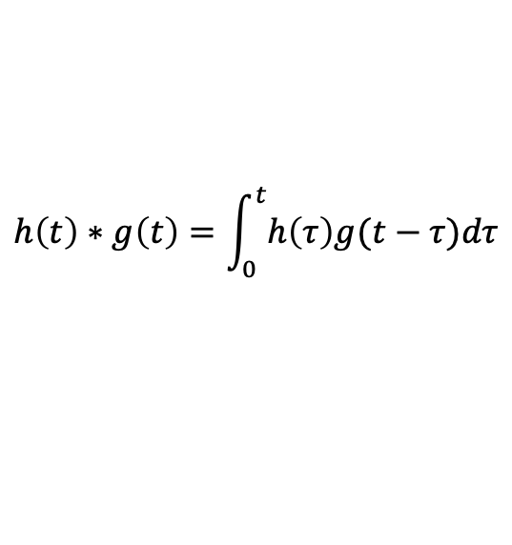


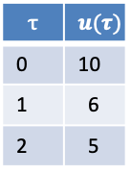

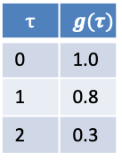

Convolution of Laplace Transforms
Input History
Function
Definition
$$y$$
$$u$$
$$τ$$ | $$u(τ)$$
0 | 10
1 | 6
2 | 5
$$τ$$ | $$g(τ)$$
0 | 1.0
1 | 0.8
2 | 0.3
$$h\left(t\right)∗g\left(t\right)=\int_{0}^{t}{h\left(τ\right)g(t−τ})dτ$$
$$L[h\left(t\right)∗g\left(t\right)]=H\left(s\right)G(s)$$
Systems in series result in a convolution.
S1
S2
$$G_{2}(s)$$
S3
$$G_{1}(s)$$
$$S_{2}\left(s\right)=S_{1}\left(s\right)G_{1}(s)$$
$$S_{3}\left(s\right)=S_{2}\left(s\right)G_{2}\left(s\right)=S_{1}\left(s\right)G_{1}\left(s\right)G_{2}(s)$$

Slide 17

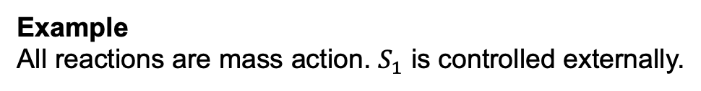

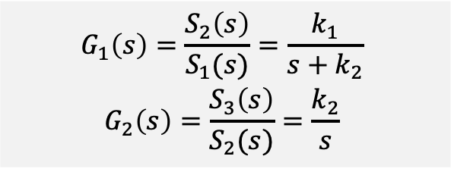
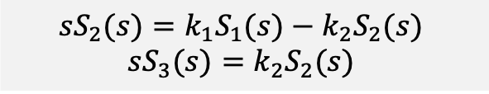
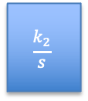


Transfer Functions for Reaction Networks
Steps
Write state equations in terms of the inputs
Calculate the ratios for each system. Signals other than the input to and output from the system are set to 0.
Reaction Network
J1: $S1→ S2; k1*$S1
J2: S2 -> S3; k2*S2
S1
S2
$$G_{2}(s)$$
S3
$$G_{1}(s)$$
Example
All reactions are mass action. $S_{1}$ is controlled externally.
$${{\dot{S}}_{2}=k_{1}S_{1}−k_{2}S_{2}}_{ }$$
$${{\dot{S}}_{3}=k_{2}S_{2}}_{ }$$
$$G_{1}\left(s\right)={\frac{S_{2}\left(s\right)}{S_{1}(s)}=\frac{k_{1}}{s+k_{2}}}_{ }$$
$${G_{2}\left(s\right)=\frac{S_{3}\left(s\right)}{S_{2}(s)}=\frac{k_{2}}{s}}_{ }$$
$${{sS}_{2}(s)=k_{1}S_{1}(s)−k_{2}S_{2}(s)}_{ }$$
$${sS_{3}(s)=k_{2}S_{2}(s)}_{ }$$
S1
S2
$$\frac{k_{2}}{s}$$
S3
$$\frac{k_{1}}{s+k_{2}}$$
Notes:
Possibilities for the input signal

Slide 18
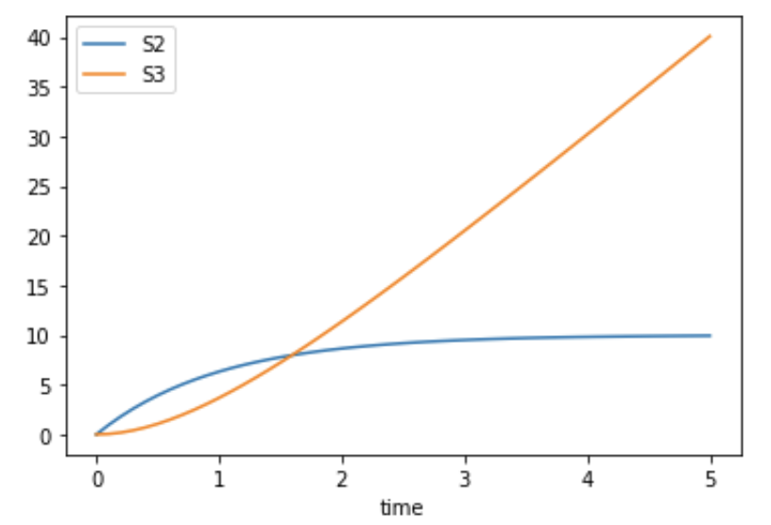

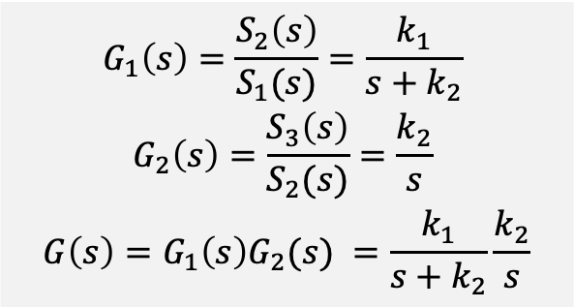
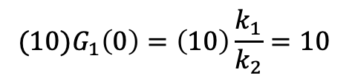
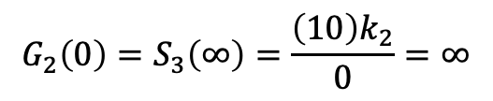

Analysis Using LTs
S1
S2
$$G_{2}(s)$$
S3
$$G_{1}\left(s\right)={\frac{S_{2}\left(s\right)}{S_{1}(s)}=\frac{k_{1}}{s+k_{2}}}_{ }$$
$${G_{2}\left(s\right)=\frac{S_{3}\left(s\right)}{S_{2}(s)}=\frac{k_{2}}{s}}_{ }$$
$$G\left(s\right)=G_{1}\left(s\right)G_{2}(s) =\frac{k_{1}}{s+k_{2}}\frac{k_{2}}{s}$$
$$G_{1}(s)$$
What are the poles of the system?
$$−k_{2}, 0$$
What is the response of $G_{1}\left(s\right)$ to a step of size 10?
$${(10)G}_{1}\left(0\right)={\left(10\right)\frac{k_{1}}{k_{2}}=10}_{ }$$
$$k_{1}=1=k_{2}$$
What is the response of $G_{2}\left(s\right)$ to a step of size 10?
$$G_{2}\left(0\right)=S_{3}\left(∞\right)=\frac{{\left(10\right)k}_{2}}{0}=∞$$
Notes:
Possibilities for the input signal

Slide 19
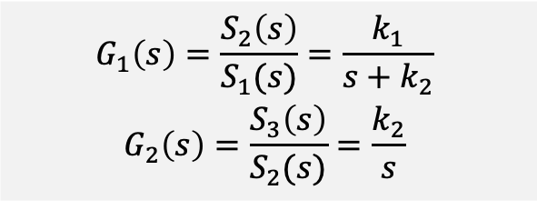
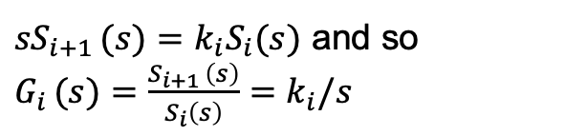
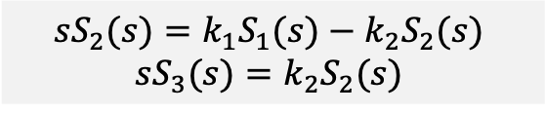
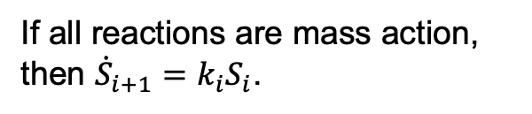




Analysis of System 2
If all reactions are mass action, then ${\dot{S}}_{i+1}=k_{i}S_{i}$.
S1
S2
S3
${sS}_{i+1 }(s)=k_{i}S_{i}(s)$ and so $G_{i }(s)={\frac{S_{i+1 }\left(s\right)}{S_{i}\left(s\right)}=k}_{i}/s$
$$G_{1}(s)$$
$$G_{2}(s)$$
$$G_{1}\left(s\right)={\frac{S_{2}\left(s\right)}{S_{1}(s)}=\frac{k_{1}}{s+k_{2}}}_{ }$$
$${G_{2}\left(s\right)=\frac{S_{3}\left(s\right)}{S_{2}(s)}=\frac{k_{2}}{s}}_{ }$$
$${\dot{S}}_{1}={−k}_{1}S_{1}$$
$${{\dot{S}}_{2}=k_{1}S_{1}−k_{2}S_{2}}_{ }$$
$${{\dot{S}}_{3}=k_{2}S_{2}}_{ }$$
$${{sS}_{2}(s)=k_{1}S_{1}(s)−k_{2}S_{2}(s)}_{ }$$
$${sS_{3}(s)=k_{2}S_{2}(s)}_{ }$$
$S_{1}\left(s\right)=\frac{1}{s+k_{1}}$, since exponential decay.

Slide 20




Analysis of System 2
$$S_{1}\left(s\right)=\frac{1}{s+k_{1}}$$
$$G_{1}\left(s\right)={\frac{S_{2}\left(s\right)}{S_{1}(s)}=\frac{k_{1}}{s+k_{2}}}_{ }$$
$${G_{2}\left(s\right)=\frac{S_{3}\left(s\right)}{S_{2}(s)}=\frac{k_{2}}{s}}_{ }$$
S1
S2
$$G_{2}(s)$$
S3
$$G_{1}(s)$$

Slide 21
BACKUP

Slide 22





Properties of Laplace Transforms
$$G\left(s\right)=\int_{0}^{∞}{g\left(t\right)e^{−st}}$$
Constant multiplication
$$L[ag\left(t\right)]=aG(s)$$
Derivative
Integral
$$δ_{1}$$
$${(0.8)δ}_{6}$$
$$L[\dot{g}\left(t\right)]=sG(s)$$
$$L\left[∫g\left(t\right)\right]=\frac{1}{s}G(s)$$
${L[δ}_{0}]=$1
$$L\left[1\right]=\frac{1}{s}$$
$$L\left[t\right]=\frac{1}{s^{2}}$$
Summation
$$L\left[g\left(t\right)+h\left(t\right)\right]=G\left(s\right)+H(s)$$
LTs are linear operators.
Notes:
How do the last 3 LT relate to each other?

Slide 23













LaPlace Transform Essentials
Definition
$$L\left[f\left(t\right)\right]=\int_{0}^{∞}{e^{−st}f(t)}=F(s)$$
(0 initial conditions)
Properties`
Calculating LaPlace Transforms
$$L\left[∫f(t)\right]=\frac{1}{s}F(s)$$
$$L\left[1\right]=\frac{1}{s}$$
$$L\left[e^{at}\right]=\frac{1}{s+a}$$
$$L\left[\frac{df}{dt}\right]=sF(s)$$
$$L\left[\int{1}\right]=\frac{1}{s}\frac{1}{s}=\frac{1}{s^{2}}$$
$$L\left[∫af\left(t\right)\right]=aF\left(s\right)$$
$$L\left[t\right]=$$
$$L\left[∫f\left(t\right)g(t)\right]=F\left(s\right)G(s)$$
$$L\left[∫f\left(t\right)+g(t)\right]=F\left(s\right)+G(s)$$
$$\frac{4}{s}[\frac{1}{s+a}+\frac{1}{s+b} ]$$
$$L\left[{4∫(e}^{at}+e^{bt} )\right]=$$
$F\left(s\right)=\frac{s^{m}+a_{m−1 }s^{m−1}+⋯a_{0}}{s^{n}+b_{n−1 }s^{n−1}+⋯b_{0}}=\frac{N(s)}{D(s)}$
Roots of D(s) are the poles of F(s)
Roots of N(s) are the zeroes of F(s)

