Slide 1
BIOE 498 / BIOE 599 Advanced Biological Control Systems Analyzing Signals and Systems
Joseph L. Hellerstein
eScience Institute, Computer Science & Engineering
Allen School of Computer Science
BioEngineering
Notes:
Diverse students. Some with bio-backgrounds; some without. Some with CS background; some with very limited. Two separate courses combined because of a substantial shared curriculum.

Slide 2
Agenda
These slides describe common analyses done on signals and transfer functions.
Signals
Final value
Analyzing systems using transfer functions
Poles
Response to initial conditions
Impulse response
Step response

Slide 3




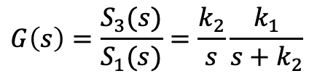

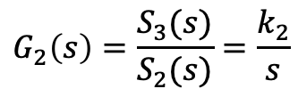

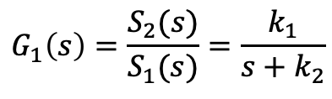
Running Example
Reaction Network
J1: S1 -> S2; k1*S1
J2: S2 -> S3; k2*S2
k1=2; k2=0.5
S1=10; S2=0; S3=0
S1
S2
S3
$$G_{1}(s)$$
$$G_{2}(s)$$
$$G\left(s\right)$$
System equations
Transfer Functions
$${\dot{S}}_{1}=−k_{1}S_{1}$$
$$G_{1}\left(s\right)=\frac{S_{2}(s)}{S_{1}(s)}=\frac{k_{1}}{s+k_{2}}$$
$${\dot{S}}_{2}=k_{1}S_{1}−k_{2}S_{2}$$
$${\dot{S}}_{3}=k_{2}S_{2}$$
$$G_{2}\left(s\right)=\frac{S_{3}(s)}{S_{2}(s)}=\frac{k_{2}}{s}$$
$$G\left(s\right)=\frac{S_{3}(s)}{S_{1}(s)}=\frac{k_{2}}{s}\frac{k_{1}}{s+k_{2}}$$

Slide 4
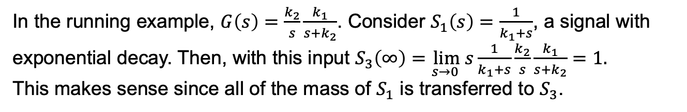
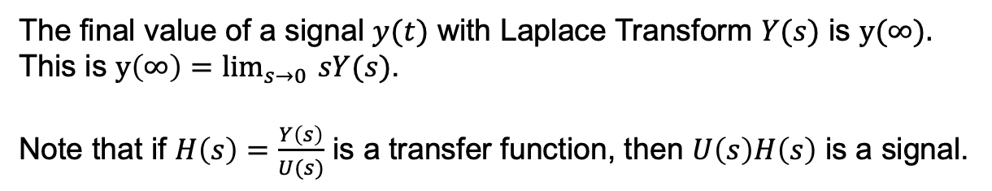
Final Value of a Signal
The final value of a signal $y(t)$ with Laplace Transform $Y(s)$ is $y(∞).$
This is $y\left(∞\right)=\lim_{s→0 }{sY(s)}$.
Note that if $H\left(s\right)=\frac{Y\left(s\right)}{U(s)}$ is a transfer function, then $U\left(s\right)H\left(s\right)$ is a signal.
In the running example, $G\left(s\right)=\frac{k_{2}}{s}\frac{k_{1}}{s+k_{2}}$. Consider $S_{1}\left(s\right)=\frac{1}{k_{1}+s}$, a signal with exponential decay. Then, with this input $S_{3}\left(∞\right)=\lim_{s→0 }{s}\frac{1}{k_{1}+s}\frac{k_{2}}{s}\frac{k_{1}}{s+k_{2}}=1.$
This makes sense since all of the mass of $S_{1}$ is transferred to $S_{3}$.

Slide 5
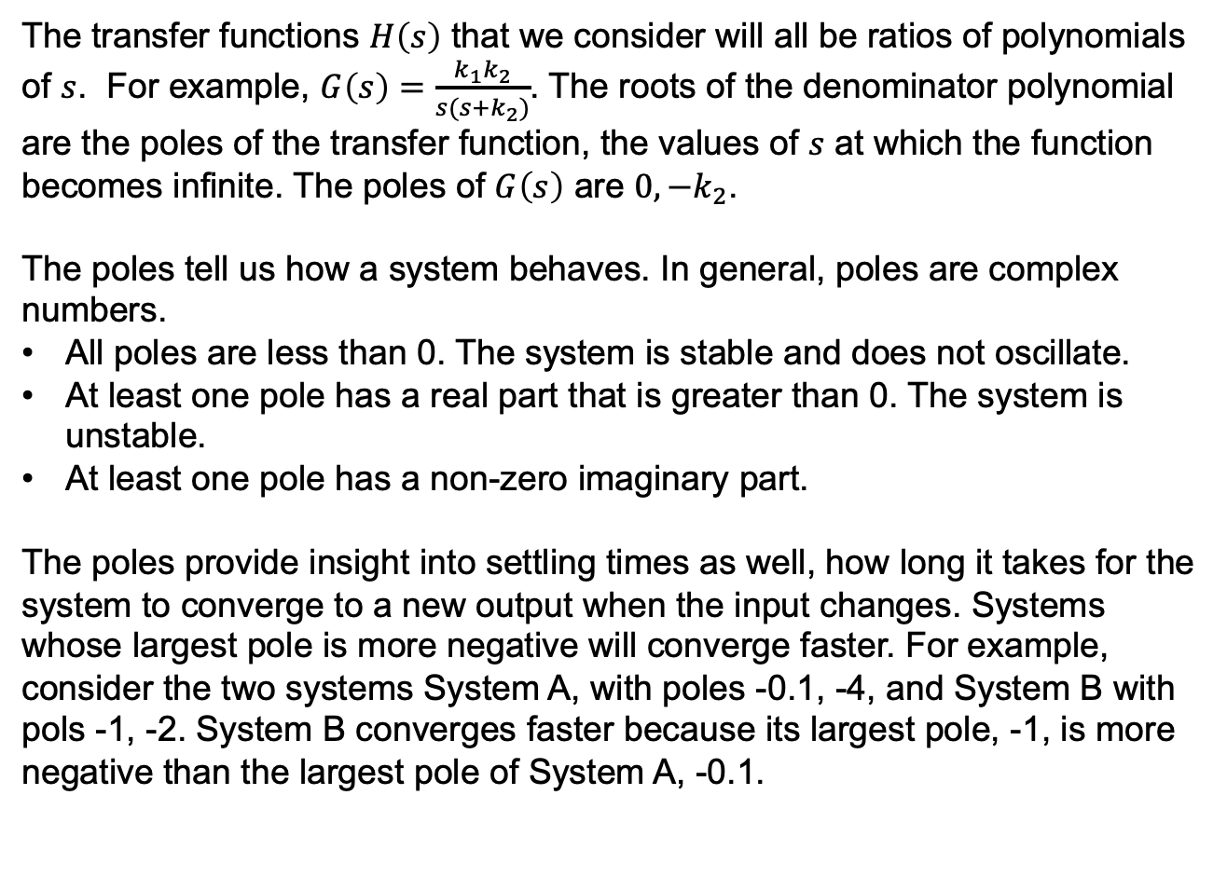
Poles of a Transfer Function
The transfer functions $H\left(s\right)$ that we consider will all be ratios of polynomials of $s$. For example, $G\left(s\right)=\frac{k_{1}k_{2}}{s(s+k_{2})}$. The roots of the denominator polynomial are the poles of the transfer function, the values of $s$ at which the function becomes infinite. The poles of $G\left(s\right)$ are $0, −k_{2}$.
The poles tell us how a system behaves. In general, poles are complex numbers.
All poles are less than 0. The system is stable and does not oscillate.
At least one pole has a real part that is greater than 0. The system is unstable.
At least one pole has a non-zero imaginary part.
The poles provide insight into settling times as well, how long it takes for the system to converge to a new output when the input changes. Systems whose largest pole is more negative will converge faster. For example, consider the two systems System A, with poles -0.1, -4, and System B with pols -1, -2. System B converges faster because its largest pole, -1, is more negative than the largest pole of System A, -0.1.

Slide 6
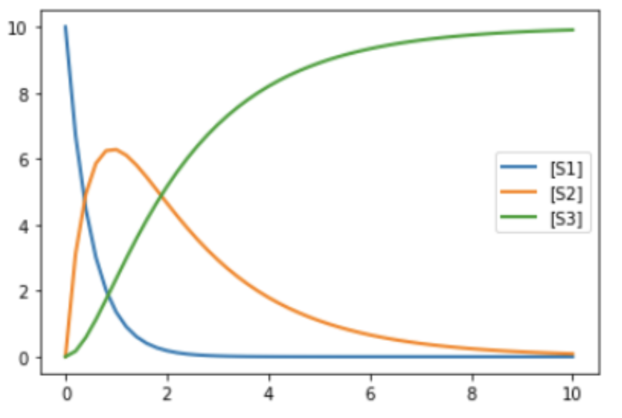
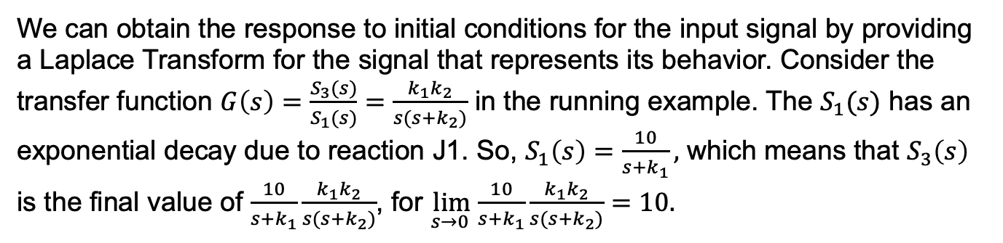
Response to Initial Conditions
The response to initial conditions is what happens when we run the system with just initial concentrations of floating species, as displayed below for the running example.
We can obtain the response to initial conditions for the input signal by providing a Laplace Transform for the signal that represents its behavior. Consider the transfer function $G\left(s\right)=\frac{S_{3}(s)}{S_{1}(s)}=\frac{k_{1}k_{2}}{s(s+k_{2})}$ in the running example. The $S_{1}(s)$ has an exponential decay due to reaction J1. So, $S_{1}\left(s\right)=\frac{10}{s+k_{1}},$ which means that $S_{3}\left(s\right)$ is the final value of $\frac{10}{s+k_{1}}\frac{k_{1}k_{2}}{s(s+k_{2})}$, for $\lim_{s→0 }\frac{10}{s+k_{1}}\frac{k_{1}k_{2}}{s(s+k_{2})}=10.$

Slide 7
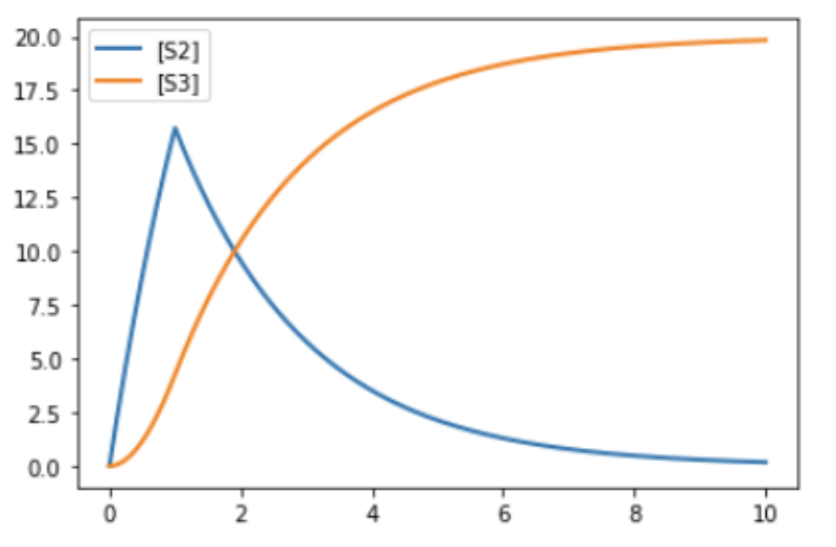
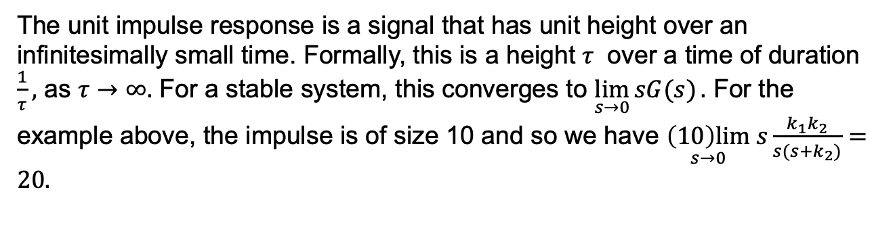
Impulse Response
J1: $S1 -> S2; k1*$S1 J2: S2 -> S3; k2*S2 k1=2; k2=0.5
S1=10; S2=0; S3=0
at (time > 1): $S1 = 0
The unit impulse response is a signal that has unit height over an infinitesimally small time. Formally, this is a height $τ$ over a time of duration $\frac{1}{τ},$ as $τ→∞.$ For a stable system, this converges to $\lim_{s→0}{sG(s)}.$ For the example above, the impulse is of size 10 and so we have $\underset{s→0}{\left(10\right)lim} s\frac{k_{1}k_{2}}{s(s+k_{2})}=20.$
If the impulse response is 0, then the system is robust to small changes.

Slide 8
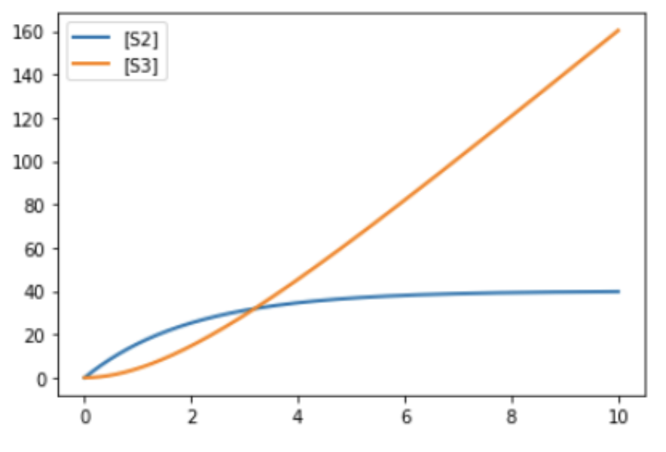
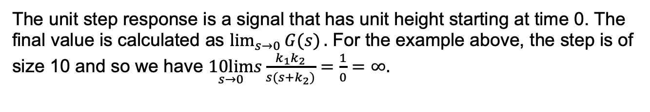
Step Response
J1: $S1 -> S2; k1*$S1 J2: S2 -> S3; k2*S2 k1=2; k2=0.5
$S1=10; S2=0; S3=0
The unit step response is a signal that has unit height starting at time 0. The final value is calculated as $\lim_{s→0}{G(s)}.$ For the example above, the step is of size 10 and so we have $\underset{s→0}{10lim}s\frac{k_{1}k_{2}}{s(s+k_{2})}=\frac{1}{0}=∞.$
The step response provides insight into controllability, how the input affects the output. Consider the following three possibilities for the step response:
0: The input has no control over the output
<0: Our algorithm for controlling the output must decrease the input if the output is too large.
>0: Our algorithm for controlling the output must increase the input if the output is too large.

