Slide 1
BIOE 498 / BIOE 599 Advanced Biological Control Systems Lecture 5: Geometric Linear Algebra
Joseph L. Hellerstein
eScience Institute, Computer Science & Engineering
Allen School of Computer Science
BioEngineering
Notes:
Diverse students. Some with bio-backgrounds; some without. Some with CS background; some with very limited. Two separate courses combined because of a substantial shared curriculum.

Slide 2
Objective
Review of key concepts from linear algebra with a geometric twist to promote intuition
Introduce python capabilities for computational linear algebra

Slide 3





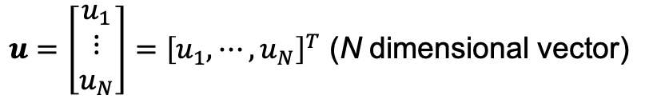
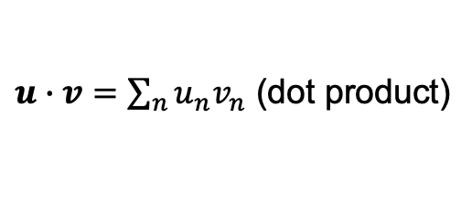

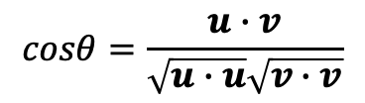
Vectors
{
$$2u$$
$$u$$
$u=\left[\begin{matrix}u_{1} \\ ⋮ \\ u_{N}\end{matrix}\right]={\left[u_{1},⋯,u_{N}\right]}^{T}$ (N dimensional vector)
$$θ$$
$$w=u−v$$
$$v$$
$u∙v=\sum_{n}{u_{n}v_{n}}$ (dot product)
$$cosθ=\frac{u∙v}{\sqrt{u∙u}\sqrt{v∙v}}$$
$u∙v=0≡θ=90°$ (orthogonal)
Can add and dot product vectors if they have the same dimension.
Can scalar multiply vectors. (No change in dimension.)
Notes:
Multi by a constant, positive or negative
Vectors are a convenient abstraction for multidimensional data.

Slide 4


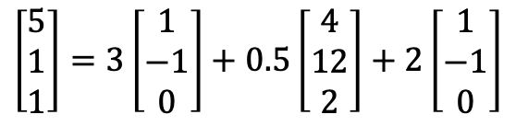
Vector Spaces
Linear Combination: $w={c_{1}u}_{1}+⋯+$ $c_{K}u_{K}$
$$\left[\begin{matrix}5 \\ 1 \\ 1\end{matrix}\right]=3\left[\begin{matrix}1 \\ −1 \\ 0\end{matrix}\right]+0.5\left[\begin{matrix}4 \\ 12 \\ 2\end{matrix}\right]+2\left[\begin{matrix}1 \\ −1 \\ 0\end{matrix}\right]$$
Vector Space: $S=\{w|{c_{1}u}_{1}+⋯+$ $c_{K}u_{K}$ for all $c_{k}\}$
(vectors resulting from addition & scalar multiplication)
Linearly independent vectors: ${c_{1}u}_{1}+⋯+$ $c_{K}u_{K}≠0$ for all $c_{k}$, $c≠0$
$$\dim\left(S\right)=\min_{|\left\{u_{1},⋯\text{,}u_{K}\right\}|}{\{S={c_{1}u}_{1}+⋯+ c_{K}u_{K} \text{for} \text{all} c_{k}\}}$$
Basis: If $u_{1},⋯\text{,}u_{K}$ generate $S$ and $\dim\left(S\right)=K$, then $u_{1},⋯\text{,}u_{K}$ is a basis for $S$.
Notes:
Why must a basis be linearly independent?
Is there only one basis?

Slide 5
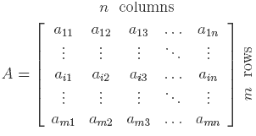

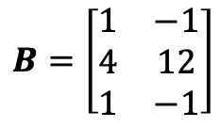


Matrices
Represent a set of vectors
..as columns
..as rows
Transpose
$$B=\left[\begin{matrix}1 & −1 \\ 4 & 12 \\ 1 & −1\end{matrix}\right]$$
$$B=A^{T}$$
$$\left[\begin{matrix}1 \\ −1\end{matrix}\right],\left[\begin{matrix}4 \\ 12\end{matrix}\right],\left[\begin{matrix}1 \\ −1\end{matrix}\right]$$
$$A=\left[\begin{matrix}1 & 4 & 1 \\ −1 & 12 & −1\end{matrix}\right]$$
Notes:
Row space.
Column space.
Null space.
Rank of a matrix.
Transpose.
Matrix multiplication
Coordinate representation

Slide 6
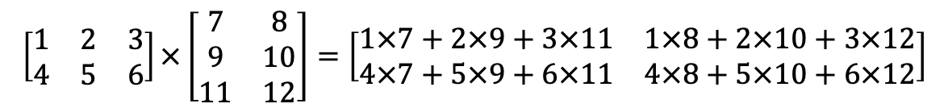
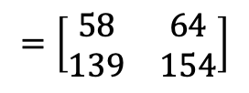

Matrix Multiplication: Mechanics
$$\left[\begin{matrix}1 & 2 & 3 \\ 4 & 5 & 6\end{matrix}\right]×\left[\begin{matrix}7 & 8 \\ 9 & 10 \\ 11 & 12\end{matrix}\right]=\left[\begin{matrix}1×7+2×9+3×11 & 1×8+2×10+3×12 \\ 4×7+5×9+6×11 & 4×8+5×10+6×12\end{matrix}\right]$$
$$=\left[\begin{matrix}1×7 & 1×8 \\ 4×7 & 4×8\end{matrix}\right]+\left[\begin{matrix}2×9 & 2×10 \\ 5×9 & 5×10\end{matrix}\right]+\left[\begin{matrix}3×11 & 3×12 \\ 6×11 & 6×12\end{matrix}\right]$$
$$=\left[\begin{matrix}58 & 64 \\ 139 & 154\end{matrix}\right]$$
Notes:
Note that decomposition is all rank one matrices

Slide 7

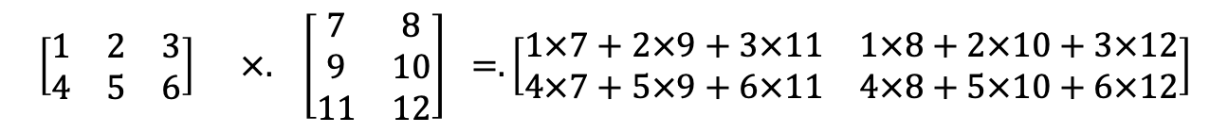
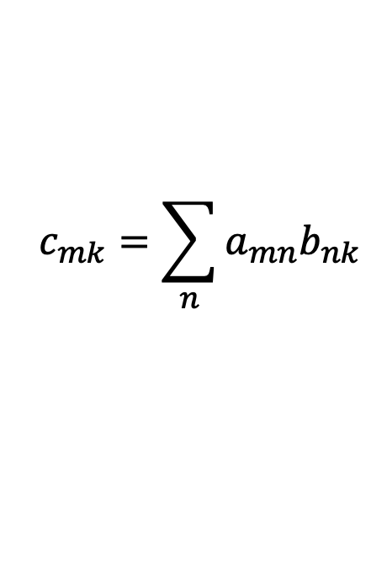



Matrix Multiplication Definition
$$c_{mk}=\sum_{n}{a_{mn}b_{nk}}$$
N
K
K
M
$$×$$
=
M
N
$$A$$
$$B$$
$$C$$
$$\left[\begin{matrix}1 & 2 & 3 \\ 4 & 5 & 6\end{matrix}\right] ×. \left[\begin{matrix}7 & 8 \\ 9 & 10 \\ 11 & 12\end{matrix}\right] =.\left[\begin{matrix}1×7+2×9+3×11 & 1×8+2×10+3×12 \\ 4×7+5×9+6×11 & 4×8+5×10+6×12\end{matrix}\right]$$
Matrices can be multiplied only if they are compatible.

Slide 8
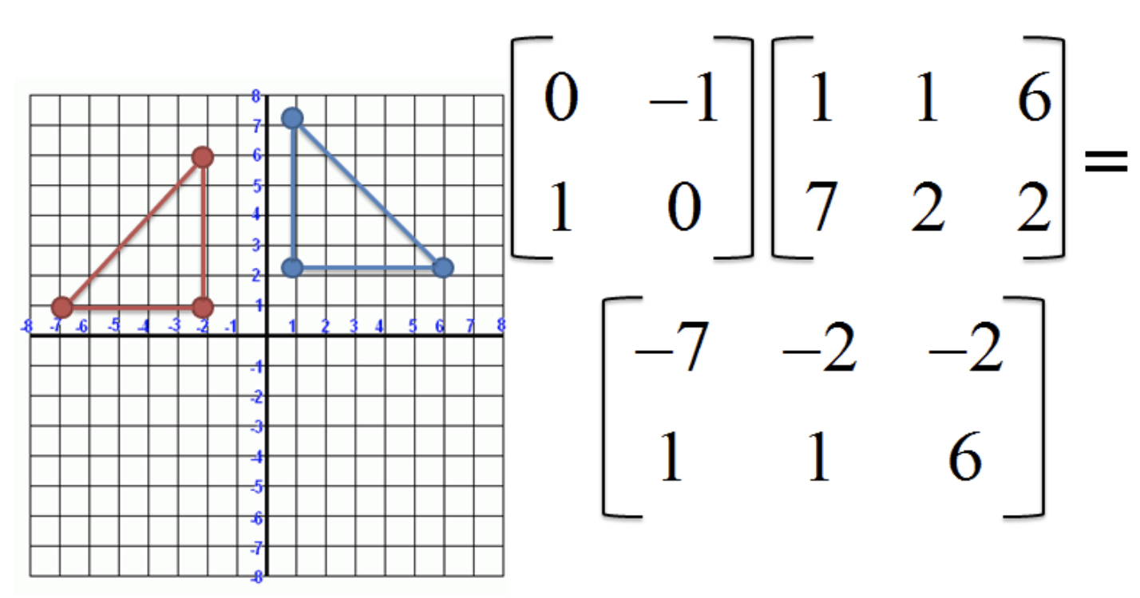
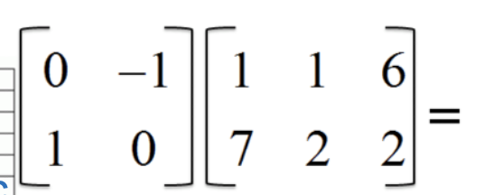
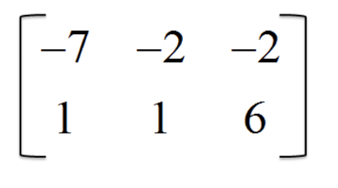
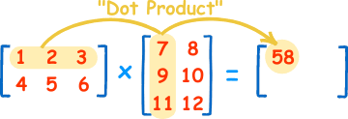


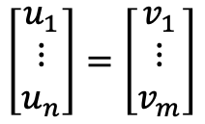








Matrix Multiplication: Interpretations
Rotates vectors.
c
a
a
b
c
b
Compute angles between vectors.
Convert a vector in $R^{n}$ (# col) to $R^{m}$ (# row).
$$w_{1}$$
$$w_{2}$$
$$u_{1}^{T}$$
$$u_{1}^{T}∙w_{1}$$
$$u_{1}^{T}∙w_{2}$$
$$\left[\begin{matrix}u_{1} \\ ⋮ \\ u_{n}\end{matrix}\right]=\left[\begin{matrix}v_{1} \\ ⋮ \\ v_{m}\end{matrix}\right]$$
$$u_{1}^{T}$$
$$u_{2}^{T}∙w_{1}$$
$$u_{2}^{T}∙w_{2}$$

Slide 9
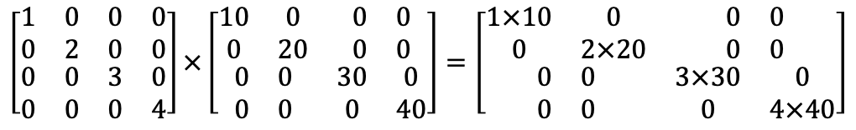


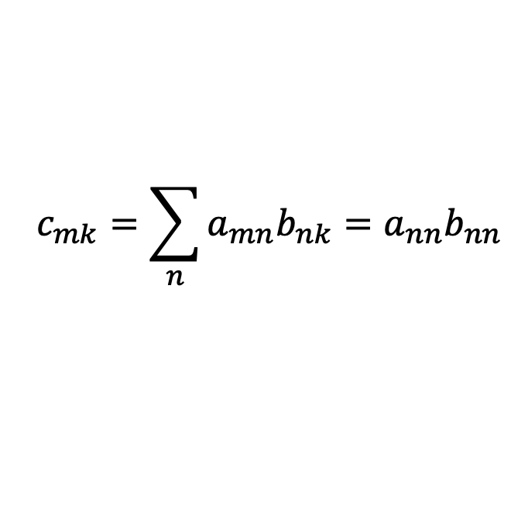



Multiplying Diagonal Matrices
A matrix $A$ is diagonal iff $a_{ij}=0$ if $i≠j.$
N
K
K
0
0
M
$$×$$
N
=
M
0
0
0
0
$$A$$
$$B$$
$$C$$
$$c_{mk}=\sum_{n}{a_{mn}b_{nk}=a_{nn}b_{nn}}$$
The product of two diagonal matrices is diagonal.
$$\left[\begin{matrix}\begin{matrix}1 & 0 \\ 0 & 2\end{matrix} & \begin{matrix}0 & 0 \\ 0 & 0\end{matrix} \\ \begin{matrix}0 & 0 \\ 0 & 0\end{matrix} & \begin{matrix}3 & 0 \\ 0 & 4\end{matrix}\end{matrix}\right]×\left[\begin{matrix}\begin{matrix}10 & 0 \\ 0 & 20\end{matrix} & \begin{matrix}0 & 0 \\ 0 & 0\end{matrix} \\ \begin{matrix}0 & 0 \\ 0 & 0\end{matrix} & \begin{matrix}30 & 0 \\ 0 & 40\end{matrix}\end{matrix}\right]=\left[\begin{matrix}\begin{matrix}1×10 & 0 \\ 0 & 2×20\end{matrix} & \begin{matrix}0 & 0 \\ 0 & 0\end{matrix} \\ \begin{matrix}0 & 0 \\ 0 & 0\end{matrix} & \begin{matrix}3×30 & 0 \\ 0 & 4×40\end{matrix}\end{matrix}\right]$$

Slide 10
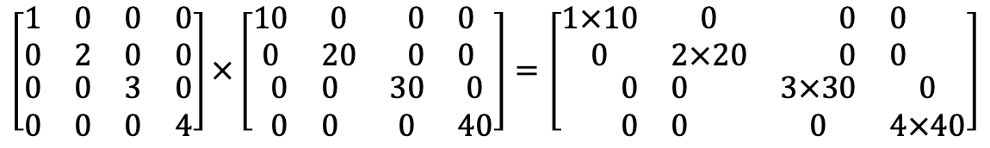
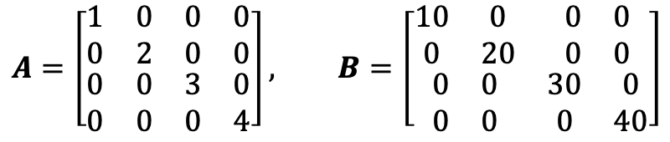
$$A=\left[\begin{matrix}\begin{matrix}1 & 0 \\ 0 & 2\end{matrix} & \begin{matrix}0 & 0 \\ 0 & 0\end{matrix} \\ \begin{matrix}0 & 0 \\ 0 & 0\end{matrix} & \begin{matrix}3 & 0 \\ 0 & 4\end{matrix}\end{matrix}\right], B=\left[\begin{matrix}\begin{matrix}10 & 0 \\ 0 & 20\end{matrix} & \begin{matrix}0 & 0 \\ 0 & 0\end{matrix} \\ \begin{matrix}0 & 0 \\ 0 & 0\end{matrix} & \begin{matrix}30 & 0 \\ 0 & 40\end{matrix}\end{matrix}\right]$$
$$\left[\begin{matrix}\begin{matrix}1 & 0 \\ 0 & 2\end{matrix} & \begin{matrix}0 & 0 \\ 0 & 0\end{matrix} \\ \begin{matrix}0 & 0 \\ 0 & 0\end{matrix} & \begin{matrix}3 & 0 \\ 0 & 4\end{matrix}\end{matrix}\right]×\left[\begin{matrix}\begin{matrix}10 & 0 \\ 0 & 20\end{matrix} & \begin{matrix}0 & 0 \\ 0 & 0\end{matrix} \\ \begin{matrix}0 & 0 \\ 0 & 0\end{matrix} & \begin{matrix}30 & 0 \\ 0 & 40\end{matrix}\end{matrix}\right]=\left[\begin{matrix}\begin{matrix}1×10 & 0 \\ 0 & 2×20\end{matrix} & \begin{matrix}0 & 0 \\ 0 & 0\end{matrix} \\ \begin{matrix}0 & 0 \\ 0 & 0\end{matrix} & \begin{matrix}3×30 & 0 \\ 0 & 4×40\end{matrix}\end{matrix}\right]$$
Just multiply corresponding elements in the diagonals.

Slide 11

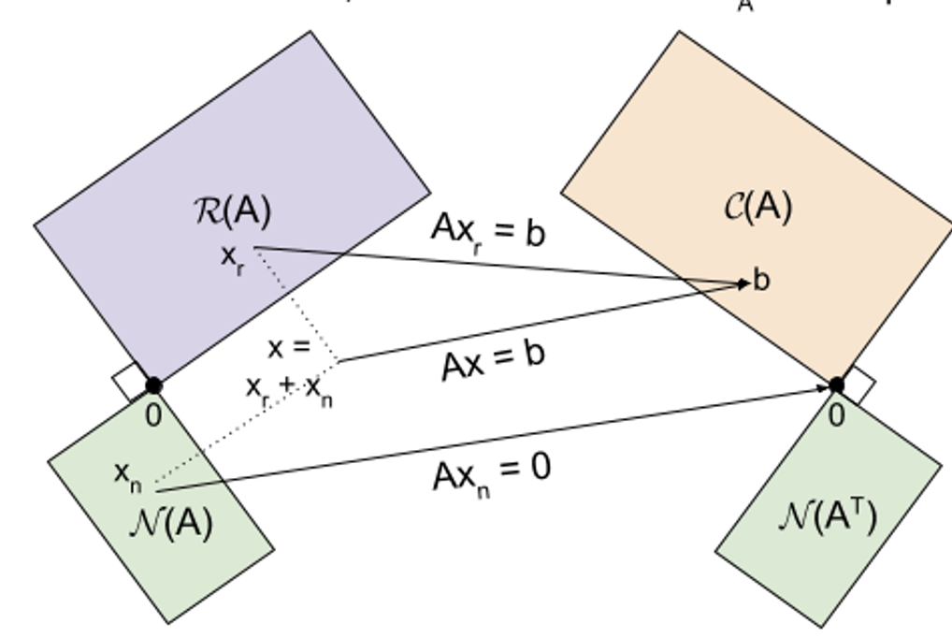







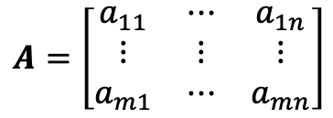


Fundamental Subspaces of a Matrix
Vector in
m
(columns)
$$A=\left[\begin{matrix}a_{11} & ⋯ & a_{1n} \\ ⋮ & ⋮ & ⋮ \\ a_{m1} & ⋯ & a_{mn}\end{matrix}\right]$$
Vector in
n
(rows)
Column subspace (image of row vectors): C(A): $Au∈R^{m}, u∈R^{n}$
n
Row subspace (image of column vectors): R(A): $A^{T}v, v∈R^{m}$
(rows)
m
Null subspace: N(A): $Au, u∈R^{n}$
(columns)
Left null subspace: N(A^{T}): $A^{T}v, v∈R^{m}$
$$u$$
$$Au$$
$$v$$
$$A^{T}v$$
Fundamental Theorem of L.A.
$$\dim\left(C\left(A\right)\right)=\dim\left(R(A)\right)$$
$$\dim\left(C\left(A\right)\right)+\dim\left(N\left(A\right)\right)=n$$
$$\dim\left(R\left(A\right)\right)+\dim\left(N\left(A^{T}\right)\right)=m$$
Notes:
Column vectors live in column space, which has dimension m.
Row vectors live in row space, which has dimension n.

Slide 12





Matrix Inverse
$A, n×n,$ is invertible iff there exists $B, n×n,$ such that $AB=BA=I.$
A matrix that is not invertible is singular. An invertible matrix is non-singular.
Invertibility implies that the null space has dimension 0.
Inverse of 2X2 matrix
$$u$$
$$Au$$
$$v$$
$$A^{T}v$$

Slide 13
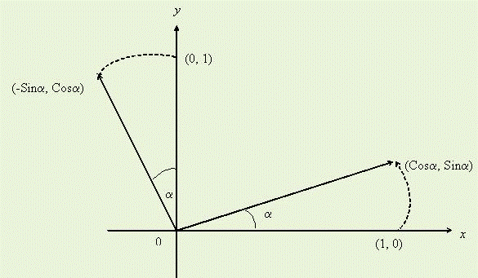



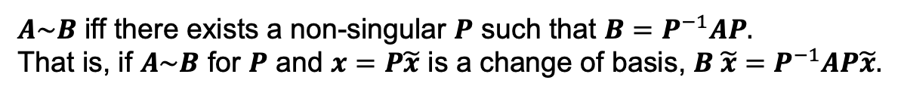

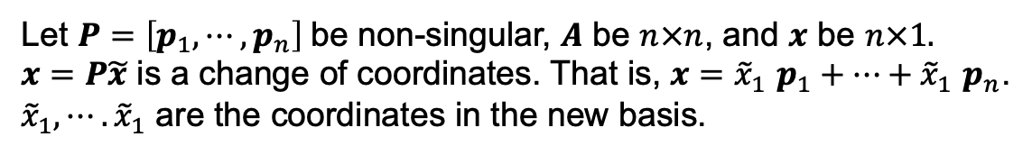


Changing Basis (New Coordinates)
Example: Rotation
$$e_{1}=\left[\begin{matrix}1 \\ 0\end{matrix}\right],e_{2}=\left[\begin{matrix}0 \\ 1\end{matrix}\right]$$
$$f_{1}=\left[\begin{matrix}Cosα \\ Sinα\end{matrix}\right],f_{2}=\left[\begin{matrix}−Sinα \\ Cosα\end{matrix}\right]$$
$$P=\left[\begin{matrix}Cosα & −Sinα \\ Sinα & Cosα\end{matrix}\right], detP=1$$
$$\left[\begin{matrix}f_{1} & f_{2}\end{matrix}\right]=P\left[\begin{matrix}e_{1} & e_{2}\end{matrix}\right]$$
$$P^{−1}=\left[\begin{matrix}Cosα & Sinα \\ −Sinα & Cosα\end{matrix}\right]$$
Observation
If $P$ is non-singular, then $AP$ has the same column space as $A.$
Change of coordinates to basis $p_{1},⋯,p_{n}$
Let $P=\left[p_{1},⋯,p_{n}\right]$be non-singular, $A$ be $n×n$, and $x$ be $n×1.$
$x=P\tilde{x}$ is a change of coordinates. That is, $x={\tilde{x}}_{1}$ $p_{1}+⋯+{\tilde{x}}_{1} p_{n}$.
${\tilde{x}}_{1},⋯.{\tilde{x}}_{1}$ are the coordinates in the new basis.
Similarity
$A\sim B$ iff there exists a non-singular $P$ such that $B=P^{−1}AP.$
That is, if $A\sim B$ for $P$ and $x=P\tilde{x}$ is a change of basis, $B \tilde{x}=P^{−1}AP\tilde{x}.$

Slide 14
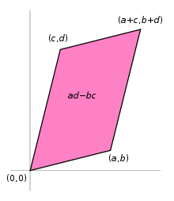
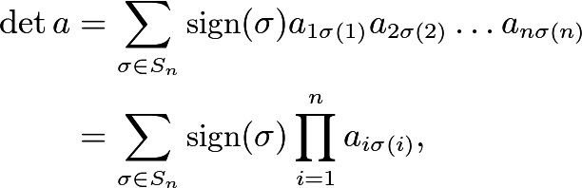

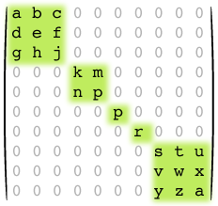


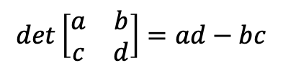

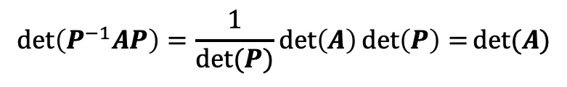





Determinant
Measure of volume
$$det\left[\begin{matrix}a & b \\ c & d\end{matrix}\right]=ad−bc$$
det$A=$
Det of triangular matrix is product of terms in diagonal
($σ$ is a permutation.)
Singular matrices
$detA=0≡A$ is singular.
Computing determinant of block matrix
$$A_{1}$$
$$A_{2}$$
$$det$$
$$=\det\left[A_{1}A_{2}a_{3}A_{4}\right]=\det\left(A_{1}\right)\det\left(A_{2}\right)\det\left(a_{3}\right)det⁡(A_{4})$$
$$a_{3}$$
$$A_{4}$$
$$\det\left(P^{−1}AP\right)=\frac{1}{det⁡(P)}\det\left(A\right)\det\left(P\right)=det⁡(A)$$

Slide 15
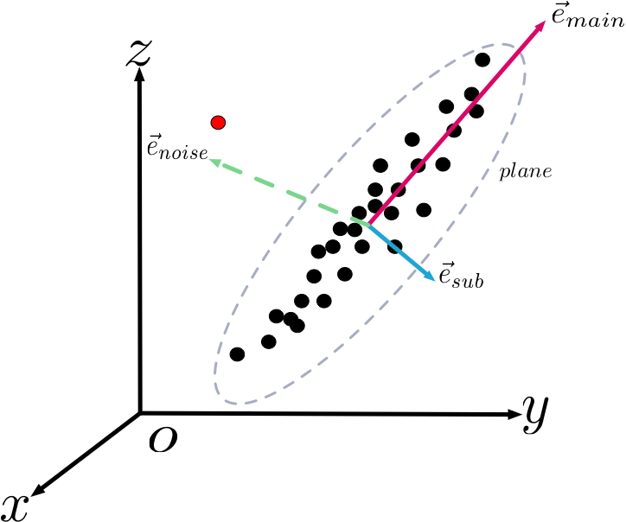

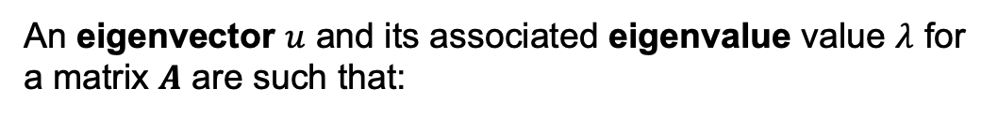
Eigenvalues and Eigenvectors
Eigenvalues and eigenvectors describe how a matrix transforms a vector.
An eigenvector $u$ and its associated eigenvalue value $λ$ for
a matrix $A$ are such that:
$Au=λu$
Eigenvectors are the “natural” basis for a matrix transformation.
Eigenvalues indicate stretching along a dimension.

Slide 16
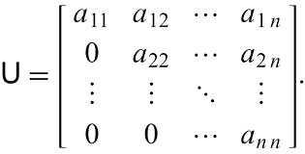



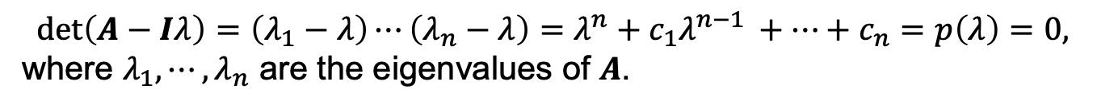


Calculating Eigenvalues and Eigenvectors
$u, λ$ are an eigenvector, eigenvalue pair if
$Au=λu$
Key equation
$$u\left(A−Iλ\right)=0$$
Can find eigenvalues using $det\left(A−Iλ\right)=0.$
Finding eigenvalues
$$det\left(A−Iλ\right)=\left(λ_{1}−λ\right)⋯\left(λ_{n}−λ\right)=λ^{n}+c_{1}λ^{n−1 }+⋯+c_{n}=p\left(λ\right)=0,$$
where $λ_{1},⋯,λ_{n}$ are the eigenvalues of $A$.
Finding eigenvectors
Solve $\left(A−Iλ_{n}\right)u=0$, for each eigenvalue.
Eigenvalues of a triangular matrix is the diagonal.
Notes:
Characteristic poly

Slide 17
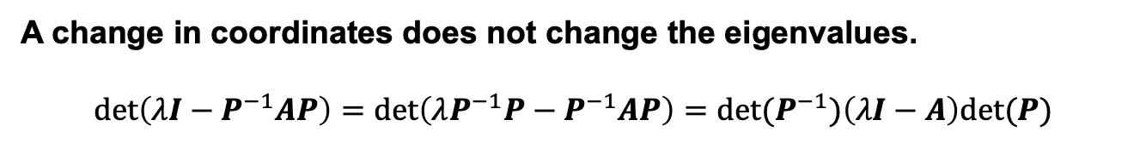
Observations About Eigenvalues, Eigenvectors
Eigenvalues may be repeated (algebraic multiplicity). Usually, there will be more than one eigenvector (geometric multiplicity) if there is more than one eigenvalue.
$A$ is non-singular iff there is no eigenvalue at 0.
A change in coordinates does not change the eigenvalues.
$$\det\left(λI−P^{−1}AP\right)=\det\left(λP^{−1}P−P^{−1}AP\right)=\det{(P^{−1})\left(λI−A\right)det⁡(P)}$$
$$\det\left(P^{−1}\right)\left(λI−A\right)\det\left(P\right)=[1/det{(P)]\left(λI−A\right)det⁡(P})$$
$=\det\left(λI−A\right),$ which yields the eigenvalues of $A$.
Notes:
Will the eigenvectors change?

Slide 18

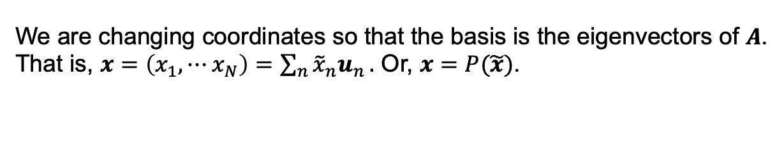
Eigenvectors Are a Natural Coordinate System for the Range (Column Space) of a Matrix
Consider the linear system $y=Ax$, for a non-singular (square) matrix.
Let $U=[u_{1},⋯,u_{N}]$, be the matrix of the eigenvectors of $A.$
We are changing coordinates so that the basis is the eigenvectors of $A$.
That is, $x=\left(x_{1},⋯x_{N}\right)=\sum_{n}{{\tilde{x}}_{n}u_{n}}.$ Or, $x=P(\tilde{x})$.
In this new system,$\tilde{y}=D\tilde{x}.$
$D$ is “diagonal” with eigenvalues along its diagonal.
True diagonal if eigenvectors are distinct
Otherwise, block diagonal (Jordan Normal Form)

Slide 19
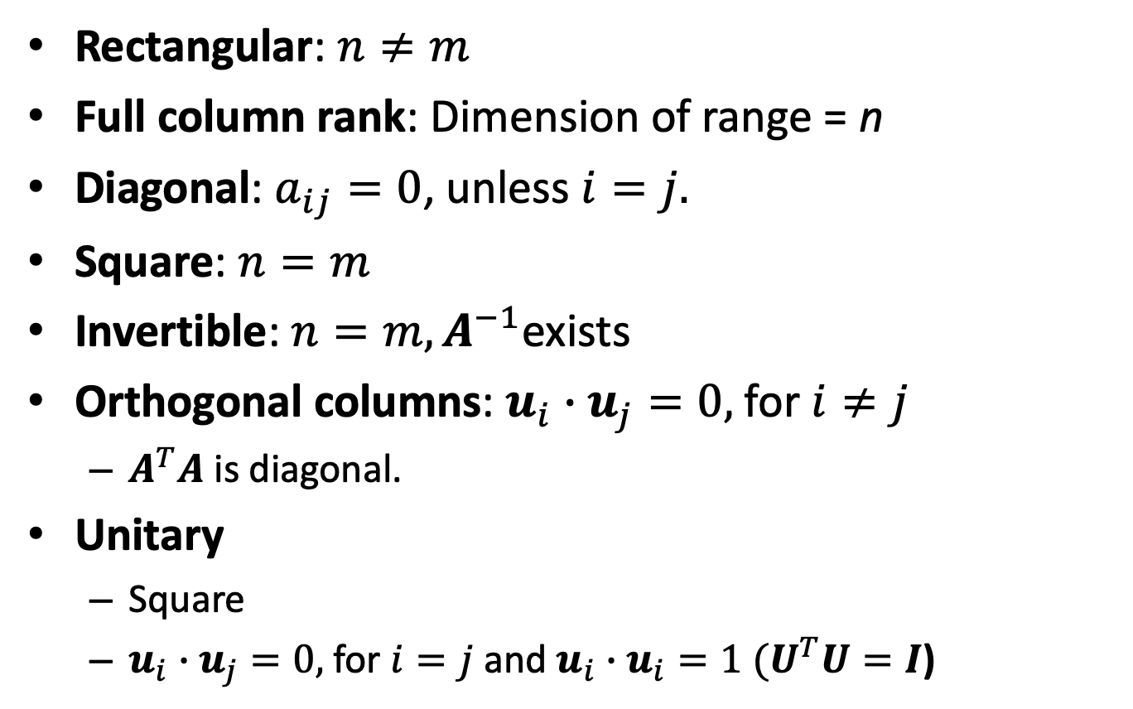

Classifications of $m×n$Matrices
Rectangular: $n≠m$
Full column rank: Dimension of range = n
Diagonal: $a_{ij}=0$, unless $i=j.$
Square: $n=m$
Invertible: $n=m, A^{−1}$exists
Orthogonal columns: $u_{i}∙u_{j}=0,$for $i≠j$
$A^{T}A$ is diagonal.
Unitary
Square
$u_{i}∙u_{j}=0,$for $i=j$ and $u_{i}∙u_{i}=1 (U^{T}U=I$)

