Slide 1
BIOE 498 / BIOE 599 Advanced Biological Control Systems Linear Time Invariant Systems
Joseph L. Hellerstein
eScience Institute, Computer Science & Engineering
Allen School of Computer Science
BioEngineering
Notes:
Diverse students. Some with bio-backgrounds; some without. Some with CS background; some with very limited. Two separate courses combined because of a substantial shared curriculum.

Slide 2
Agenda
Linear time invariant (LTI) systems
Laplace transforms
Definition, calculation, poles
Solving high order approximations
Poles determine stability and oscillations.
Definition of transfer function.
Calculating DC gain.

Slide 3
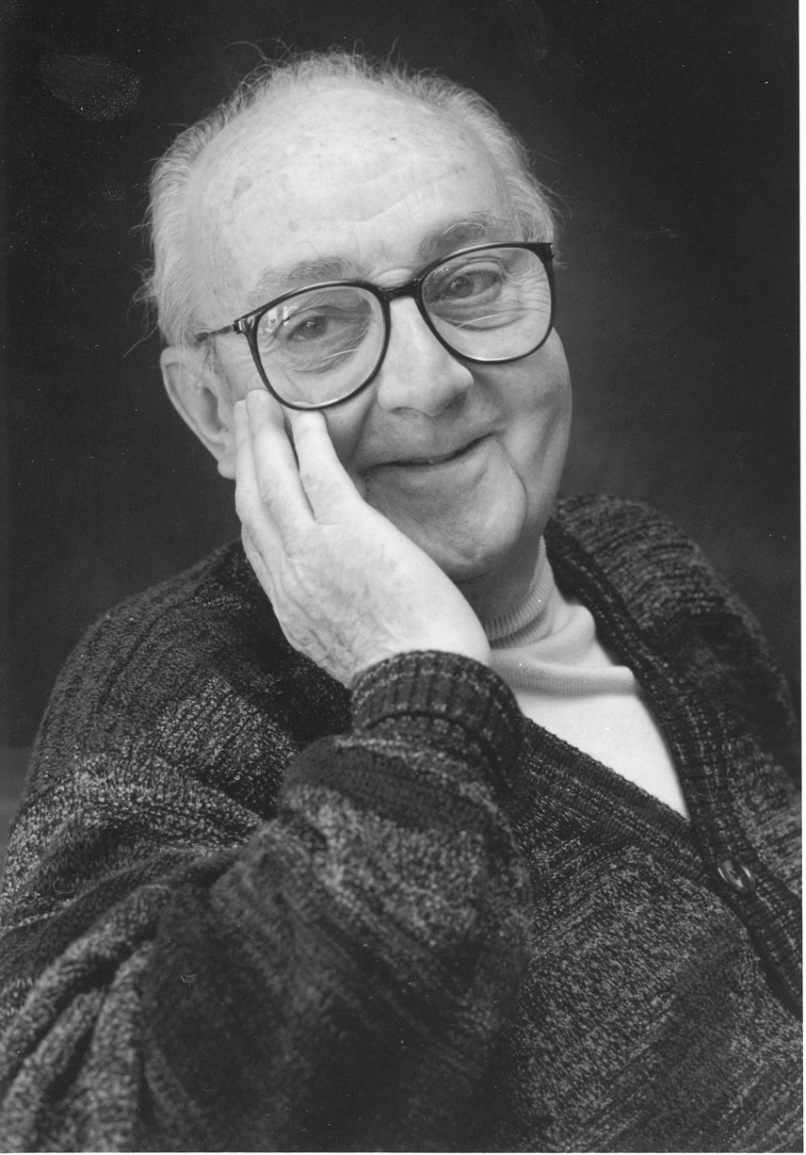
G.P.E. Box (Famous Statistician)
All models are wrong.
But some models are useful.

Slide 4

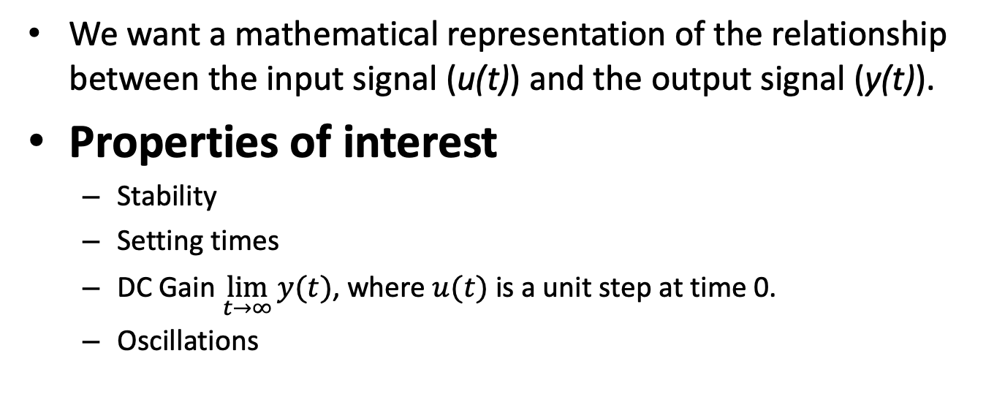

Modeling Signals & Systems
$$u(t)$$
System
$$y(t)$$
We want a mathematical representation of the relationship between the input signal (u(t)) and the output signal (y(t)).
Properties of interest
Stability
Setting times
DC Gain $\lim_{t→∞}{y(t)}$, where $u(t)$ is a unit step at time 0.
Oscillations

Slide 5
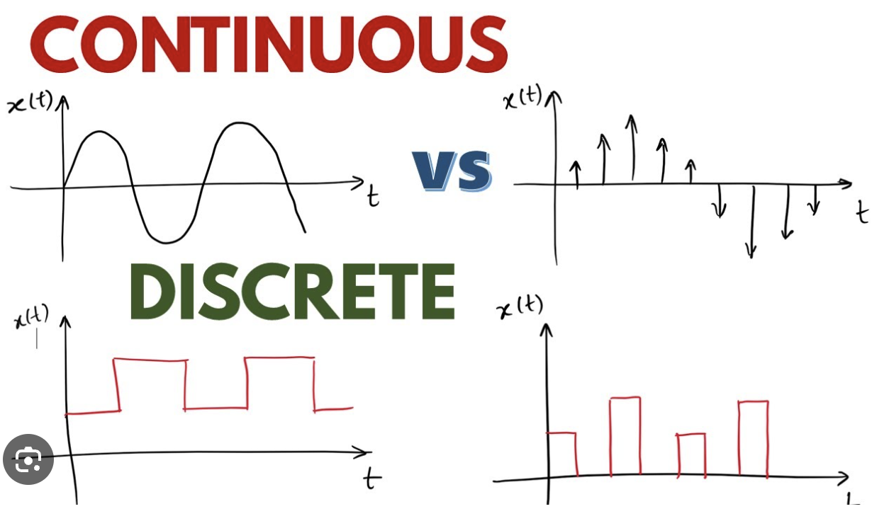
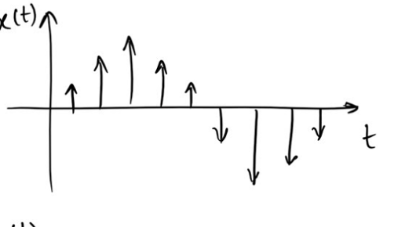





Discrete vs. Continuous Time
$$y(t)$$
$$t$$
$$y(k)$$
$$y(k)$$
$$k$$

Slide 6




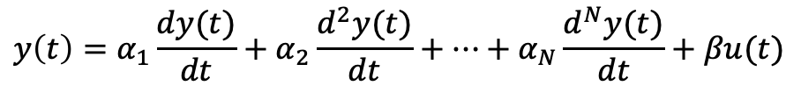

Motivation
$$y(t)$$
$$t$$
Most control properties are dynamic: stability, oscillations, settling times.
We need a way to easily assess these properties and to manipulate signals and systems (which are dynamical objects).
We will mostly work with continuous time, but we start with discrete time because it’s more intuitive.
$$y(k)$$
$$y(k)$$
$$k$$
Linear discrete time model, AR(N)
$$y\left(k\right)=a_{1}y\left(k−1\right)+a_{2}y\left(k−2\right)+…+a_{N}y\left(k−N\right)+bu(k)$$
Linear continuous time model
$$y\left(t\right)=α_{1}\frac{dy(t)}{dt}+α_{2}\frac{d^{2}y(t)}{dt}+…+α_{N}\frac{d^{N}y(t)}{dt}+βu(t)$$

Slide 7



Encoding Signals in Discrete Time
30
X
$$y(k)$$
20
X
X
10
X
X
X
0
0
1
2
3
4
5
$$k$$
$$y\left(k\right)=5, 10.1, 20.03, 15, 30, 11.11$$
Let $z$ be a complex number. We can encode discrete times as a polynomial, where the exponent indicates the time index. This is called a z-transform.
$$Y\left(z\right)5z^{0}+10.1z^{−1}+20{.03z}^{−2}+15 z^{−3}+30 z^{−4}+11.11z^{−5}$$

Slide 8

Shifting in time
30
X
$$y(k)$$
20
X
X
10
X
X
X
0
0
1
2
3
4
5
$$k$$
$$y\left(k\right)=0, 5, 10.1, 20.03, 15, 30, 11.11$$
Let $Y^{⋆}(z)$ the z-transform of $Y^{⋆}(z)$ that is shifted by one time unit.
$$Y^{⋆}\left(z\right)=\left(5z^{−1}+10.1z^{−2}+20{.03z}^{−3}+15 z^{−4}+30 z^{−5}+11.11z^{−6}\right)=z^{−1}Y(z)$$

Slide 9




Adding Signals
$$y_{1}\left(k\right)=5, 10, 0,15$$
$$Y_{1}\left(z\right)=5z^{0}+10z^{−1}+15z^{−3}$$
$$y_{2}\left(k\right)=1, 2, 3, 0$$
$$Y_{2}\left(z\right)=z^{0}+2z^{−1}+{3z}^{−2}$$
$$Y_{1}\left(z\right)+Y_{2}\left(z\right)={6z}^{0}+12z^{−1}+{3z}^{−2}+15z^{−3}$$
The z-transform of the sum of two time series is the sum of the z-transforms.

Slide 10





Multiplication by a Constant
$$y_{1}\left(k\right)=5, 10, 0, 15$$
$$Y_{1}\left(z\right)=5z^{0}+10z^{−1}+15z^{−3}$$
$$y_{2}\left(k\right)=15, 30, 0, 45$$
$$Y_{2}\left(z\right)=15z^{0}+30z^{−1}+45z^{−3}$$
$Y_{2}\left(z\right)=3Y_{1}(z)$
The z-transform of the product of a constant times a time series is the constant times the z-transform of the time series.

Slide 11




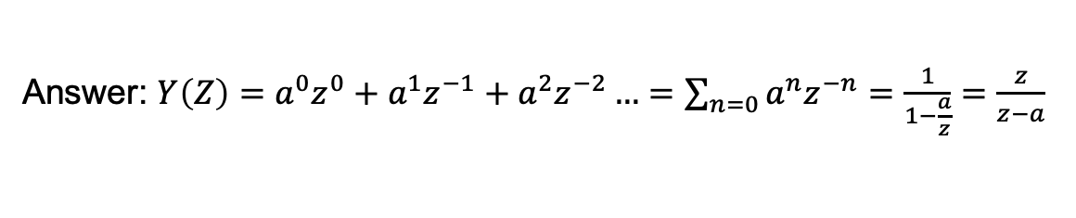
Exercise: Find the z-Transform
A. Find the z-transform of
$$y\left(k\right)=1, a, a^{2}, …$$
$$∞$$
Answer: $Y\left(Z\right)=a^{0}z^{0}+a^{1}z^{−1}+a^{2}z^{−2}…=\sum_{n=0}{a^{n}z^{−n}}=\frac{1}{1−\frac{a}{z}}=\frac{z}{z−a}$
B. For which values of a is this signal bounded (stable)?
Answer: $a<1$
C. Does the signal converge faster when $a→0$ or when $a→1$?
Answer: $a→0$

Slide 12

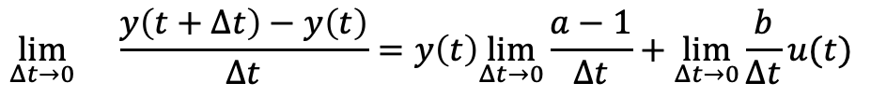

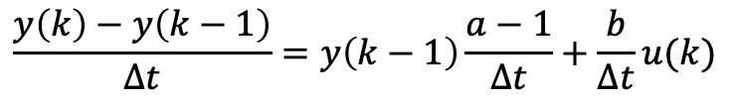
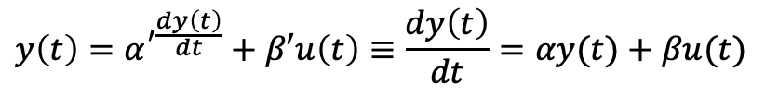

From Discrete to Continuous Time
$$y\left(t\right)=α^{′\frac{dy\left(t\right)}{dt}}+β′u\left(t\right)≡\frac{dy\left(t\right)}{dt}=αy(t)+βu(t)$$
$$y\left(k\right)=ay\left(k−1\right)+u(k)$$
$$y\left(k\right)−y\left(k−1\right)=ay\left(k−1\right)−y(k−1)+bu(k)$$
$$y\left(k\right)−y\left(k−1\right)=y\left(k−1\right)[a−1]+bu(k)$$
$$\frac{y\left(k\right)−y\left(k−1\right)}{Δt}=y\left(k−1\right)\frac{a−1}{Δt}+\frac{b}{Δt}u(k)$$
$$\lim_{Δt→0}{}\frac{y\left(t+Δt\right)−y\left(t\right)}{Δt}=y\left(t\right)\lim_{Δt→0}\frac{a−1}{Δt}+\lim_{Δt→0}\frac{b}{Δt}u(t)$$
$$\frac{dy\left(t\right)}{dt}=αy(t)+βu(t)$$
$$α=\lim_{Δt→0}\frac{a−1}{Δt}, β=\lim_{Δt→0}\frac{b}{Δt}$$
When is $y(t)$ bounded? How does this relate to when $y\left(k\right)$ is bounded?

Slide 13
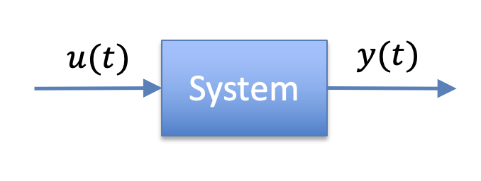
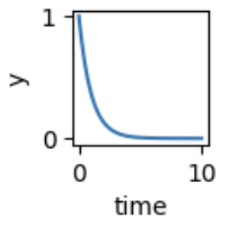
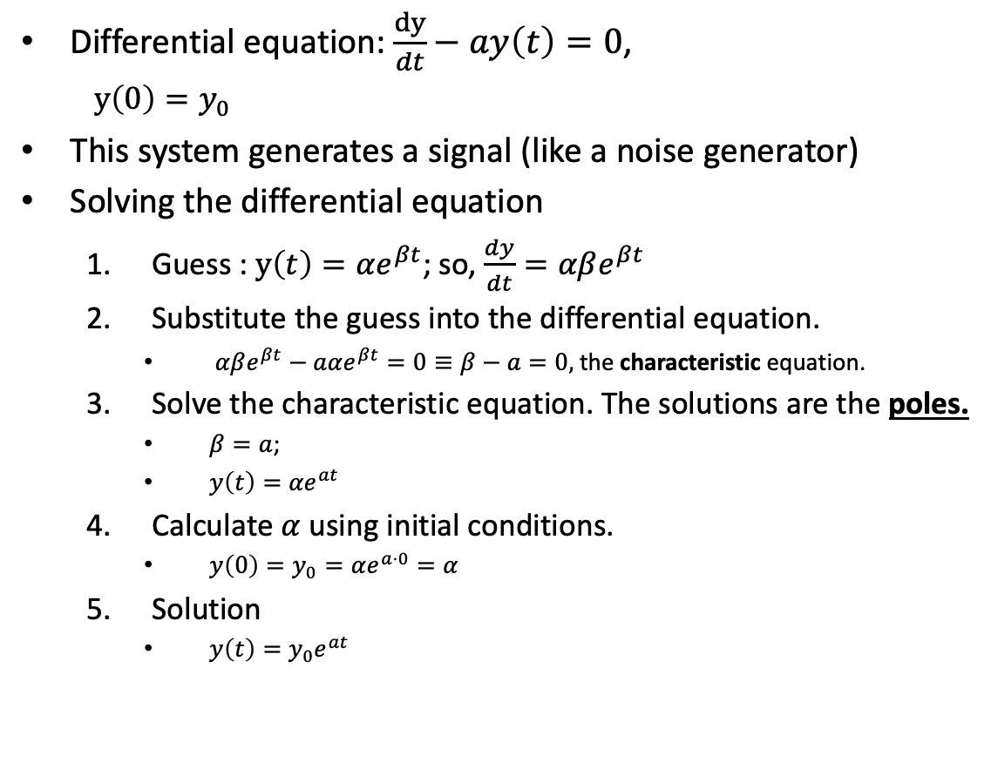
First Order Linear Time Invariant (LTI) System
X
Differential equation: $\frac{dy}{dt}−ay\left(t\right)=0$,
$y\left(0\right)=y_{0}$
This system generates a signal (like a noise generator)
Solving the differential equation
Guess : $y\left(t\right)=αe^{βt}$; so, $\frac{dy}{dt}=αβe^{βt}$
Substitute the guess into the differential equation.
$αβe^{βt}−aαe^{βt}=0≡β−a=0,$ the characteristic equation.
Solve the characteristic equation. The solutions are the poles.
$β=a$;
$y\left(t\right)={αe}^{at}$
Calculate $α$ using initial conditions.
$y\left(0\right)=y_{0}=αe^{a⋅0}=α$
Solution
$y\left(t\right)=y_{0}e^{at}$

Slide 14
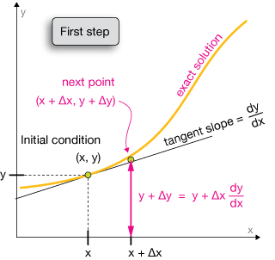


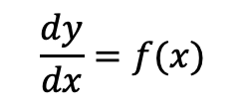


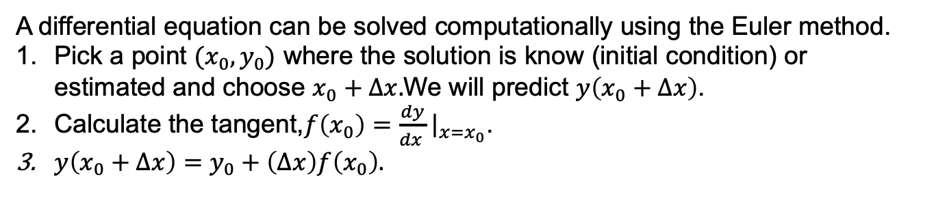






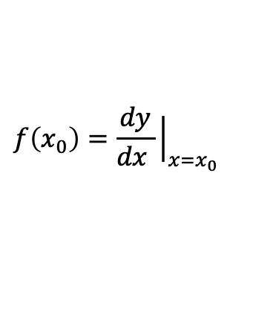

Computational Solutions to Differential Equations
$$\frac{dy}{dx}=f(x)$$
$$\frac{dy}{dx}$$
$$\frac{dy}{dx}$$
$$f\left(x_{0}\right)=\frac{dy}{dx }{\left.​\right|}_{x=x_{0}}$$
$$\frac{dy}{dx}$$
$$y_{0}+\left(Δx\right)f\left(x_{0}\right)$$
$$\frac{dy}{dx}$$
$$y_{0}$$
$$\frac{dy}{dx}$$
$$\frac{dy}{dx}$$
$$\frac{dy}{dx}$$
$$x_{0}$$
$$x_{0}+Δx$$
A differential equation can be solved computationally using the Euler method.
Pick a point $(x_{0},y_{0})$ where the solution is know (initial condition) or estimated and choose $x_{0}+Δx.$We will predict $y\left(x_{0}+Δx\right)$.
Calculate the tangent,$f\left(x_{0}\right)=\frac{dy}{dx }{\left.​\right|}_{x=x_{0}}$.
$y\left(x_{0}+Δx\right)=y_{0}+\left(Δx\right)f\left(x_{0}\right).$

Slide 15
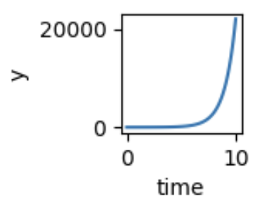
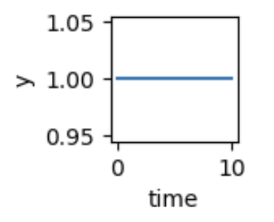


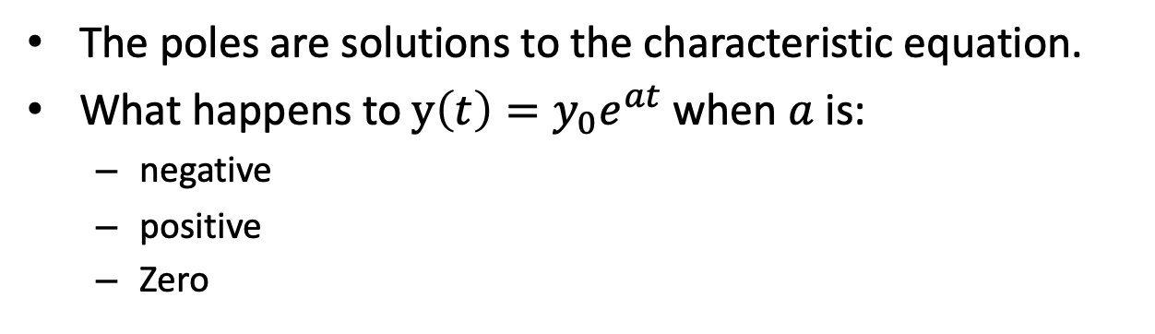

Poles
X
The poles are solutions to the characteristic equation.
What happens to $y\left(t\right)=y_{0}e^{at}$ when $a$ is:
negative
positive
Zero
$$a>0$$
$$a=0$$
$$a<0$$

Slide 16
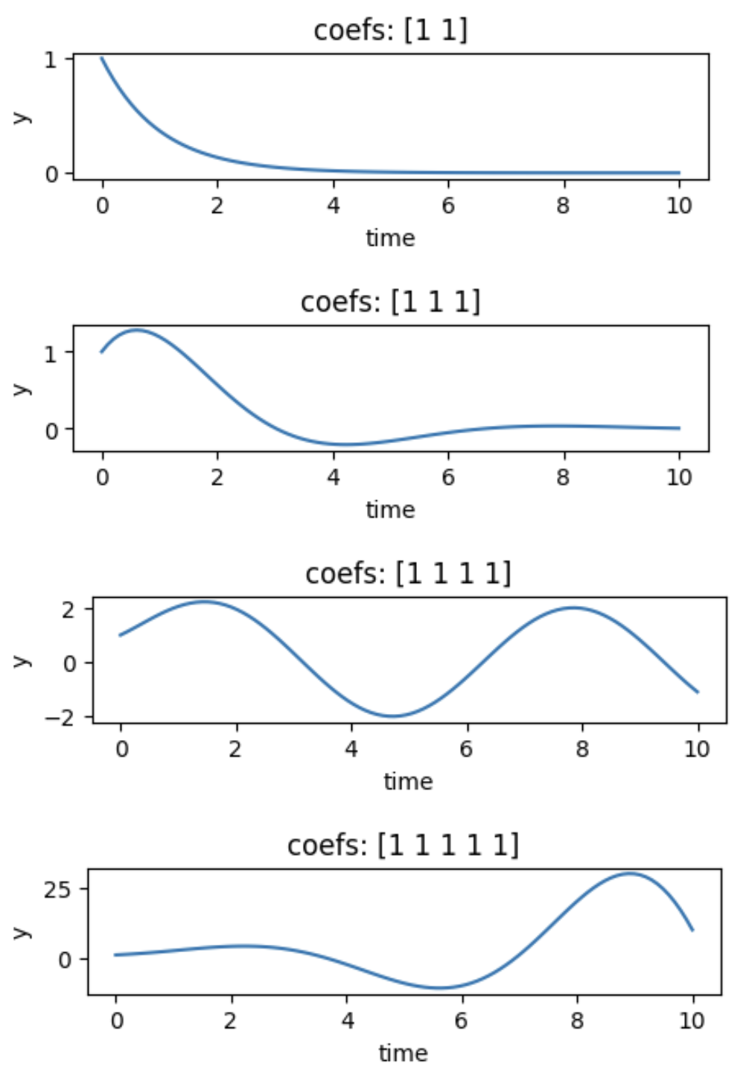
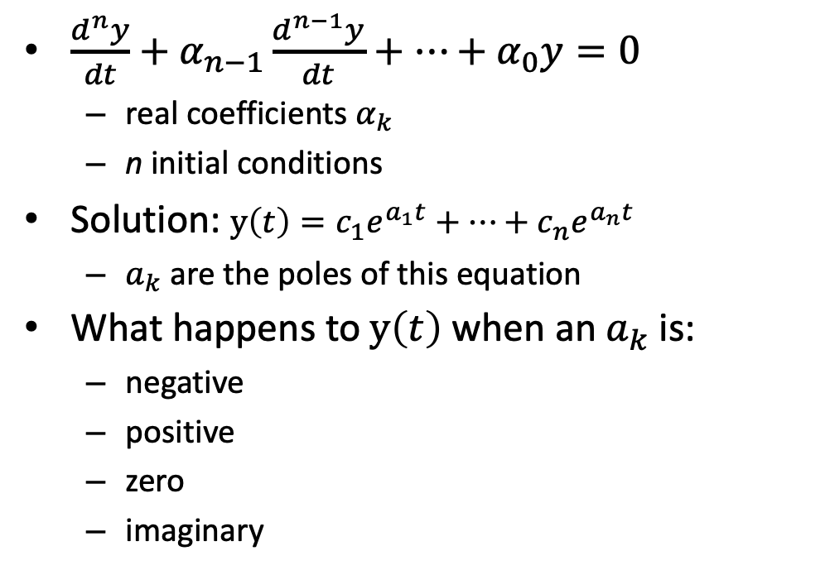

High Order Differential Equations
X
$\frac{d^{n}y}{dt}+α_{n−1}\frac{d^{n−1}y}{dt}+⋯+α_{0}y=0$
real coefficients $α_{k}$
n initial conditions
Solution: $y\left(t\right)=c_{1}e^{a_{1}t}+⋯+c_{n}e^{a_{n}t}$
$a_{k}$ are the poles of this equation
What happens to $y\left(t\right)$ when an${ a}_{k}$ is:
negative
positive
zero
imaginary
1st order
2nd order
3rd order
4th order
$$α_{k}=1$$

Slide 17
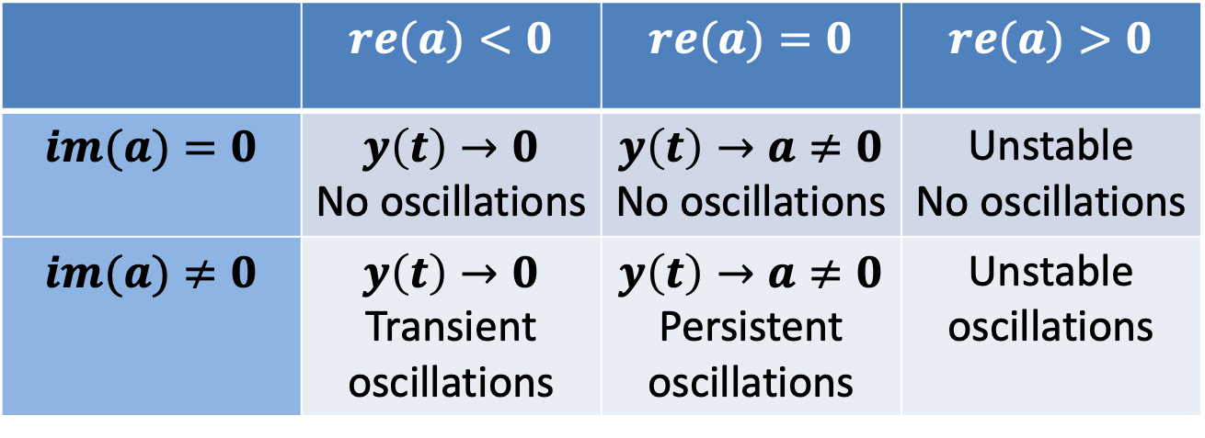
Poles Tell Us About Stability and Oscillations
Consider the (possibly complex) pole $a=(re\left(a\right), im\left(a\right))$
 | $$re(a)<0$$ | $$re(a)=0$$ | $$re(a)>0$$
$$im(a)=0$$ | $$y\left(t\right)→0$$ No oscillations | $$y\left(t\right)→a≠0$$ No oscillations | Unstable No oscillations
$$im(a)≠0$$ | $$y\left(t\right)→0$$ Transient oscillations | $$y\left(t\right)→a≠0$$ Persistent oscillations | Unstable oscillations

Slide 18
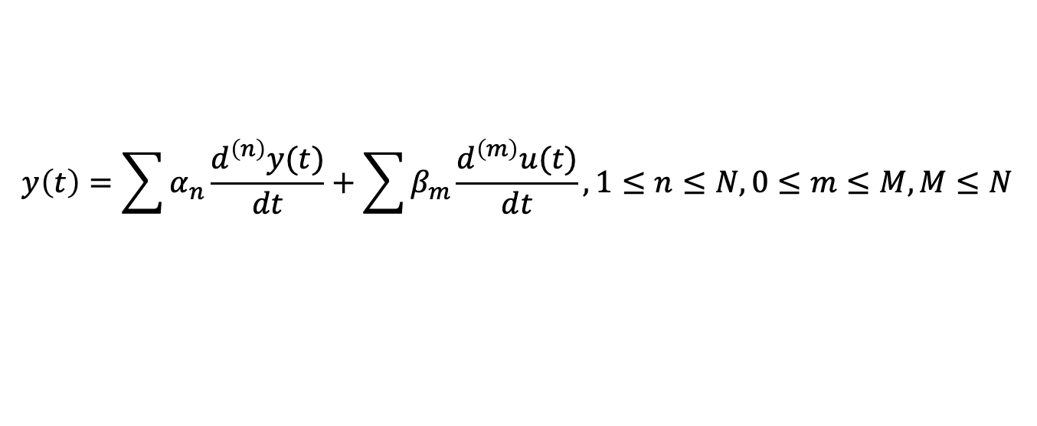
High Order Systems With Inputs
$$y\left(t\right)=\sum{α_{n}\frac{d^{\left(n\right)}y(t)}{dt}}+\sum{β_{m}\frac{d^{\left(m\right)}u(t)}{dt}}, 1≤n≤N, 0≤m≤M, M≤N$$
This is getting complicated!
We need a simpler approach than solving in the time domain.

Slide 19
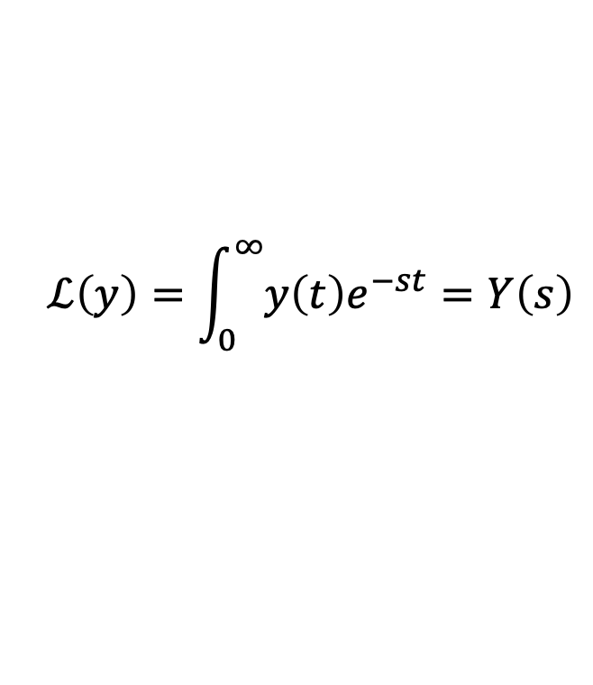
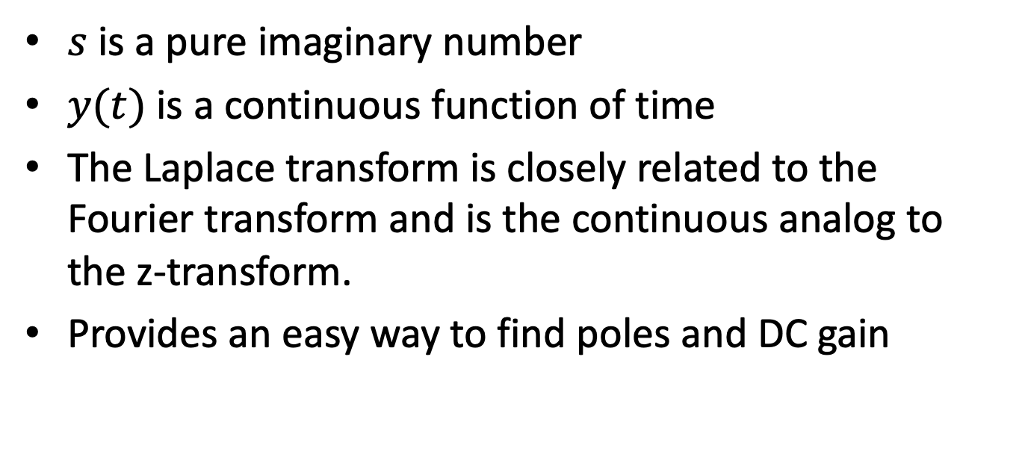
Laplace Transform
$$ℒ\left(y\right)=\int_{0}^{∞}{y\left(t\right)e^{−st}}=Y\left(s\right)$$
$s$ is a pure imaginary number
$y(t)$ is a continuous function of time
The Laplace transform is closely related to the Fourier transform and is the continuous analog to the z-transform.
Provides an easy way to find poles and DC gain

Slide 20
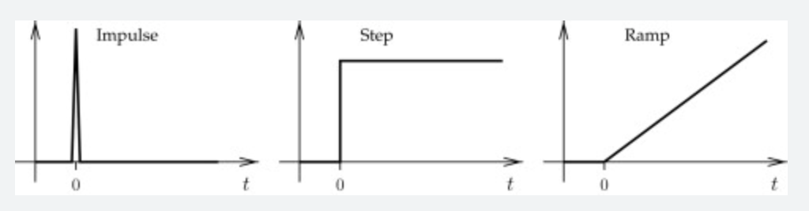



Basic Signals
$${u\left(t\right)=δ}_{0}(t)$$
$${y\left(t\right)= 1}_{0}(t)$$
$$y\left(t\right)=t$$

Slide 21
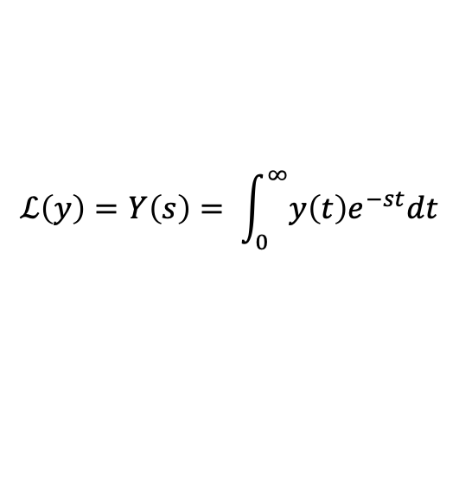
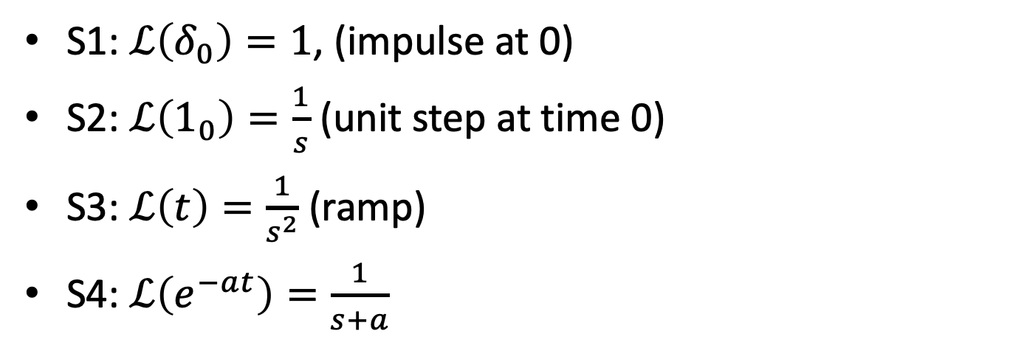
Laplace Transforms of Basic Signals
$$ℒ\left(y\right)=Y\left(s\right)= \int_{0}^{∞}{y\left(t\right)e^{−st}dt}$$
S1: $ℒ\left(δ_{0}\right)=1$, (impulse at 0)
S2: $ℒ\left(1_{0}\right)=\frac{1}{s}$ (unit step at time 0)
S3: $ℒ\left(t\right)=\frac{1}{s^{2}}$ (ramp)
S4: $ℒ\left(e^{−at}\right)=\frac{1}{s+a}$

Slide 22
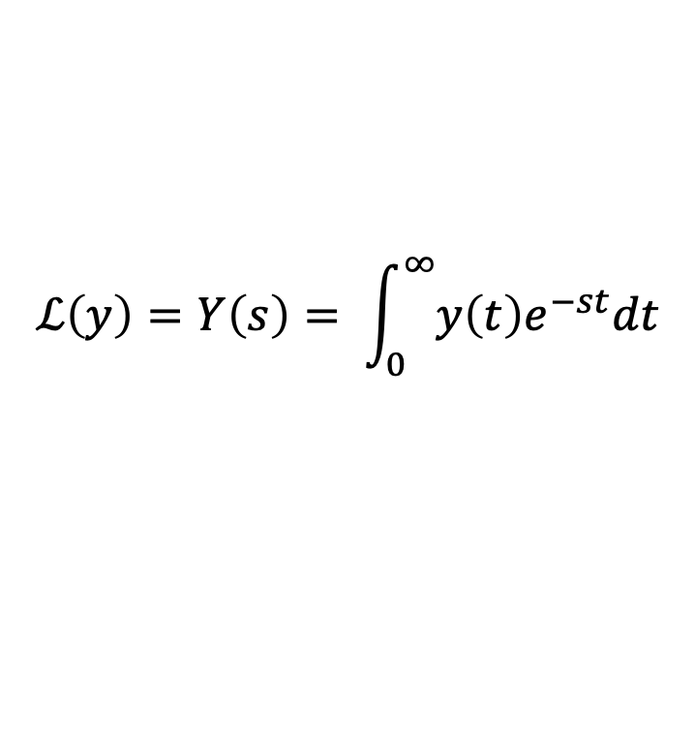
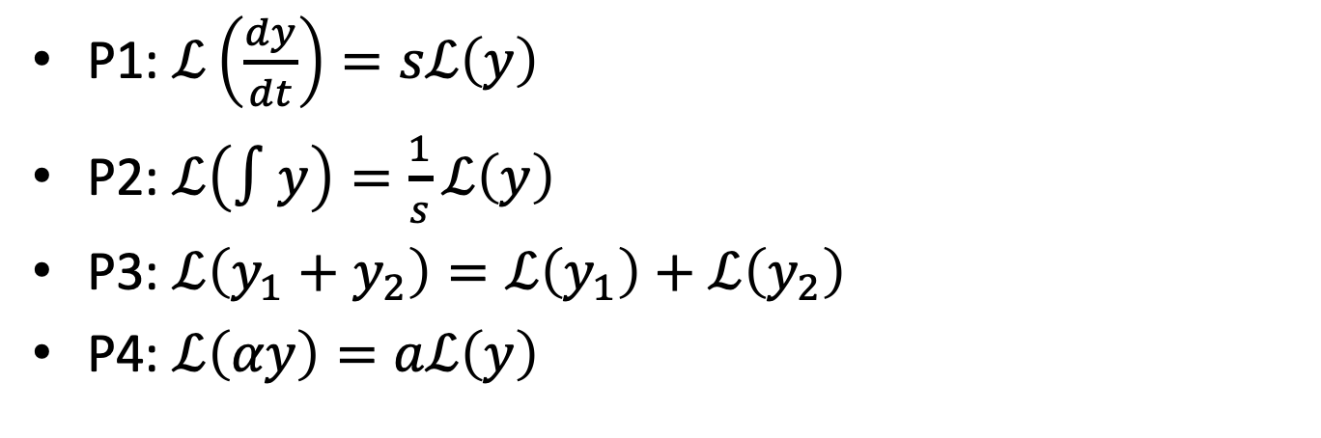
Laplace Transforms Properties
$$ℒ\left(y\right)=Y\left(s\right)= \int_{0}^{∞}{y\left(t\right)e^{−st}dt}$$
P1: $ℒ\left(\frac{dy}{dt}\right)=sℒ\left(y\right)$
P2: $ℒ\left(∫y\right)=\frac{1}{s}ℒ\left(y\right)$
P3: $ℒ\left(y_{1}+y_{2}\right)=ℒ\left(y_{1}\right)+ℒ\left(y_{2}\right)$
P4: $ℒ\left(αy\right)=aℒ\left(y\right)$

Slide 23


Find These Laplace Transforms
$y\left(t\right)=5+3t^{2}+ 100δ$
$\frac{5}{s}+\frac{3}{s^{3}}+100$
$y\left(t\right)={6e}^{−4t }+∫8e^{0.2 t}$
$\frac{6}{s+4}+\frac{8}{s(s−0.2)}$
S1: $ℒ\left(δ_{0}\right)=1$
S2: $ℒ\left(1_{0}\right)=\frac{1}{s}$
S3: $ℒ\left(t\right)=\frac{1}{s^{2}}$
S4: $ℒ\left(e^{−at}\right)=\frac{1}{s+a}$
P1: $ℒ\left(\frac{dy}{dt}\right)=sℒ\left(y\right)$
P2: $ℒ\left(∫y\right)=\frac{1}{s}ℒ\left(y\right)$
P3: $ℒ\left(y_{1}+y_{2}\right)=ℒ\left(y_{1}\right)+ℒ\left(y_{2}\right)$
P4: $ℒ\left(αy\right)=aℒ\left(y\right)$

Slide 24
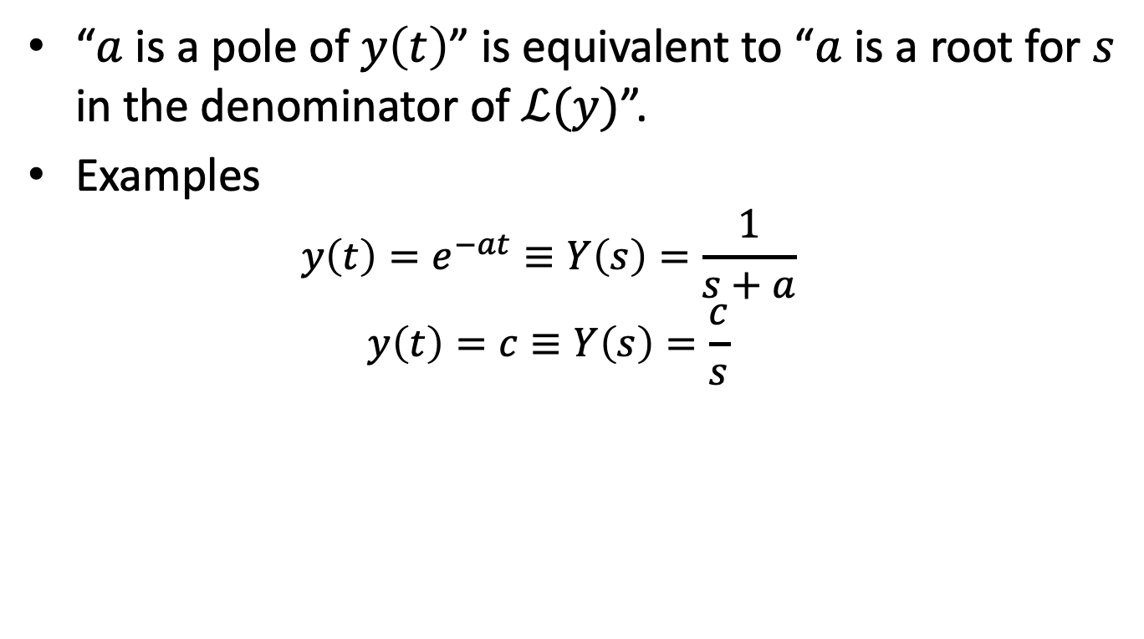
Poles & Laplace Transforms
“$a$ is a pole of $y\left(t\right)$” is equivalent to “$a$ is a root for $s$ in the denominator of $ℒ(y)$”.
Examples
$$y\left(t\right)=e^{−at}≡Y\left(s\right)=\frac{1}{s+a}$$
$$y\left(t\right)=c≡Y\left(s\right)=\frac{c}{s}$$

Slide 25


What are the poles? Are the systems stable?
$\frac{5}{s}+100$
poles at 0. Step + impulse.
$\frac{6}{s+4}+\frac{8}{s(s−0.2)}$
poles at -4, 0, 0.2. unstable.
S1: $ℒ\left(δ_{0}\right)=1$
S2: $ℒ\left(1_{0}\right)=\frac{1}{s}$
S3: $ℒ\left(t\right)=\frac{1}{s^{2}}$
S4: $ℒ\left(e^{at}\right)=\frac{1}{s+a}$
P1: $ℒ\left(\frac{dy}{dt}\right)=sℒ\left(y\right)$
P2: $ℒ\left(∫y\right)=\frac{1}{s}ℒ\left(y\right)$
P3: $ℒ\left(y_{1}+y_{2}\right)=ℒ\left(y_{1}\right)+ℒ\left(y_{2}\right)$
P4: $ℒ\left(αy\right)=aℒ\left(y\right)$

Slide 26






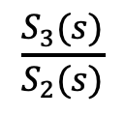
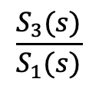
Transfer Function
S1
S2
S3
$$G_{1}(s)$$
$$G_{2}(s)$$
$$G\left(s\right)$$
A transfer function is the ratio of the Laplace transform of the output to the Laplace transform of the input.
$$G_{1}\left(s\right)=\frac{S_{2}(s)}{S_{1}(s)}$$
$$\frac{S_{3}(s)}{S_{2}(s)}$$
$$\frac{S_{3}(s)}{S_{1}(s)}$$
$$G_{2}\left(s\right)=$$
$$G\left(s\right)=$$
A transfer function is a Laplace transform and so has all of its properties.

Slide 27
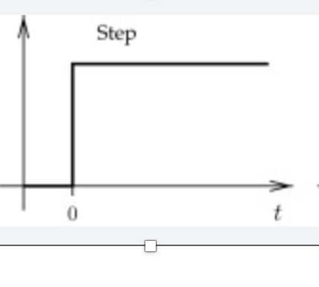

Final Value Theorem (for Signals)
If $Y\left(s\right)=ℒ\left(y\right)$ and $y\left(t\right)$ converges, then $y\left(∞\right)=\lim_{s→0}{sY(s)}.$
Examples
$Y\left(s\right)=\frac{4}{s}$. $y\left(∞\right)=s\lim_{s→0}{\frac{4}{s}}=4$
$Y\left(s\right)=\frac{1}{s+1}$. $y\left(∞\right)=s\lim_{s→0}{\frac{1}{s+1}}=0$
4

Slide 28
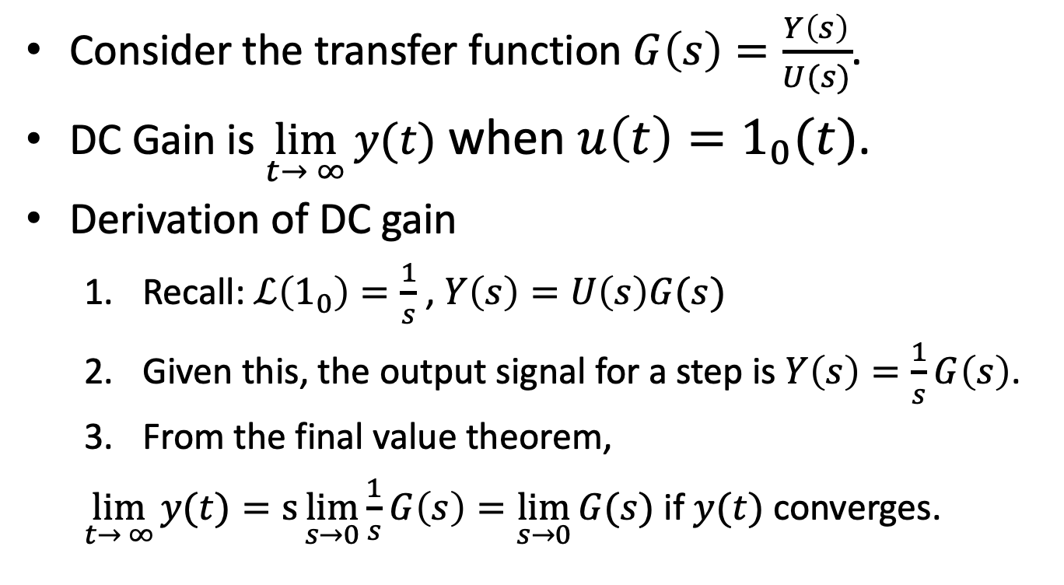
DC Gain For Transfer Functions
Consider the transfer function $G\left(s\right)=\frac{Y\left(s\right)}{U(s)}$.
DC Gain is $\lim_{t→ ∞}{y(t)}$ when $u\left(t\right)=1_{0}(t)$.
Derivation of DC gain
Recall: $ℒ\left(1_{0}\right)=\frac{1}{s}$ , $Y\left(s\right)=U\left(s\right)G(s)$
Given this, the output signal for a step is $Y\left(s\right)=\frac{1}{s}G\left(s\right)$.
From the final value theorem,
$\lim_{t→ ∞}{y(t)}=s\lim_{s→0}{\frac{1}{s}G\left(s\right)=\lim_{s→0}{G(s)}}$ if $y(t)$ converges.

Slide 29
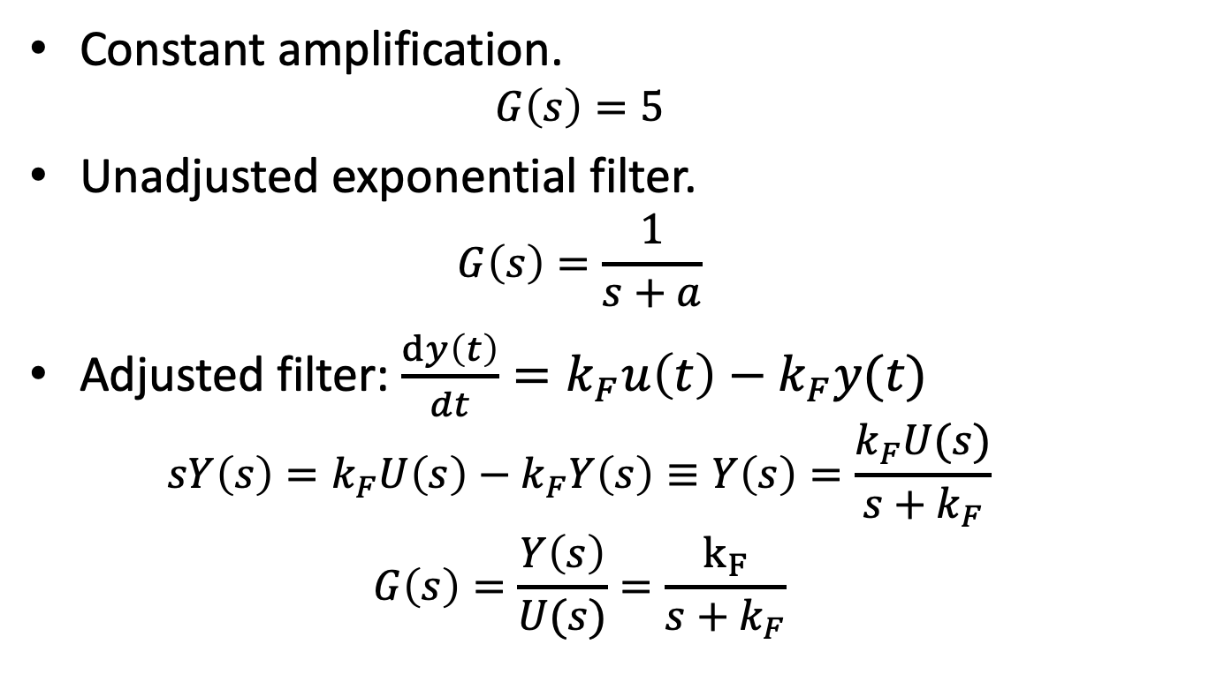

Examples of Calculating DC Gain
DC Gain: ${\lim_{s→0}{G(s)}}$
Constant amplification.
$$G\left(s\right)=5$$
Unadjusted exponential filter.
$$G\left(s\right)=\frac{1}{s+a}$$
Adjusted filter: $\frac{dy\left(t\right)}{dt}=k_{F}u\left(t\right)−k_{F}y(t)$
$$sY\left(s\right)=k_{F}U\left(s\right)−k_{F}Y\left(s\right)≡Y\left(s\right)=\frac{k_{F}U(s)}{s+k_{F}}$$
$$G\left(s\right)=\frac{Y\left(s\right)}{U(s)}=\frac{k_{F}}{s+k_{F}}$$
Notes:
DC gain for constant amplification: 5
DC gain for exponential: 1/a
DC gain for filter: 1

Slide 30
What You Need to Know
Definition of Laplace Transform.
Calculating Laplace Transforms.
LT of signals (S1-S4)
Properties of LTs (P1-P5)
How stability, oscillation are determined by poles.
Definition of Transfer Function.
Calculating DC gain from transfer functions.

