Slide 1
BIOE 498 / BIOE 599 Advanced Biological Control Systems Lecture 8: Laplace Transforms
Joseph L. Hellerstein
eScience Institute, Computer Science & Engineering
Allen School of Computer Science
BioEngineering
Notes:
Diverse students. Some with bio-backgrounds; some without. Some with CS background; some with very limited. Two separate courses combined because of a substantial shared curriculum.

Slide 2
Agenda
Why Laplace Transforms?
Basic Laplace Transforms
Properties
Applying Laplace Transforms

Slide 3
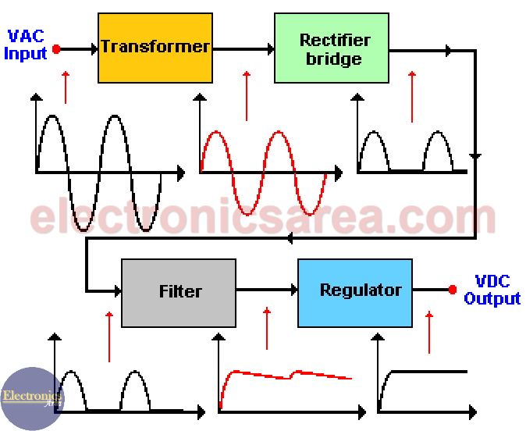
Motivating Example
How does a DC power supply convert AC power?

Slide 4

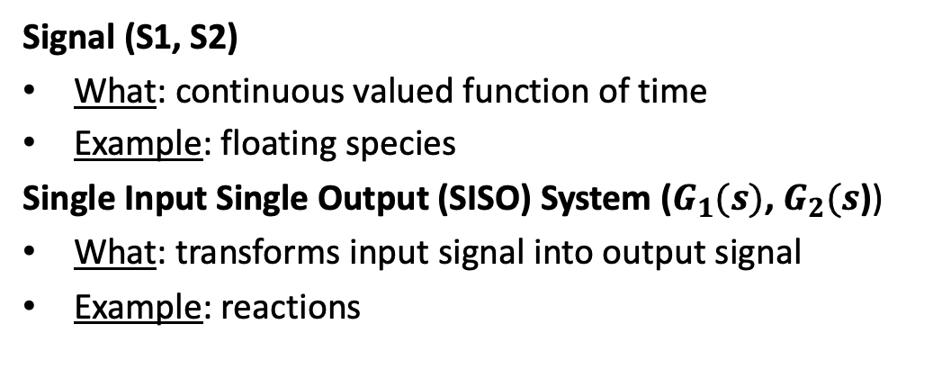


System Abstraction for Reaction Networks
System abstraction of reaction network
Reaction Network
J1: S1→ S2; k1*S1
J2: S2 -> S3; k2*S2
S1
S2
S3
$$G_{1}(s)$$
$$G_{2}(s)$$
S1
J1
S2
$$J2$$
S3
Signal (S1, S2)
What: continuous valued function of time
Example: floating species
Single Input Single Output (SISO) System ($G_{1}(s)$, $G_{2}(s$))
What: transforms input signal into output signal
Example: reactions

Slide 5
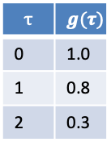



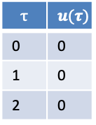
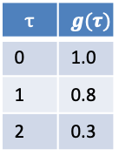




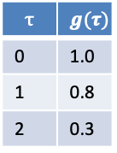










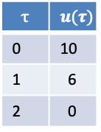
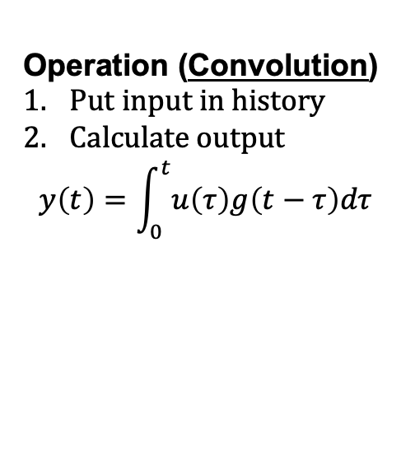
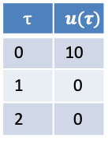
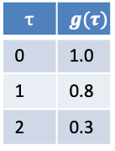
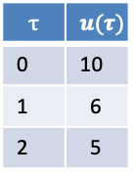

Operation of Linear Time Invariant (LTI) System
Input History
Function
Operation (Convolution)
Put input in history
Calculate output
$$y\left(t\right)=\int_{0}^{t}{u\left(τ\right)g\left(t−τ\right)dτ}$$
$$u$$
$$τ$$ | $$u(τ)$$
0 | 0
1 | 0
2 | 0
$$τ$$ | $$g(τ)$$
0 | 1.0
1 | 0.8
2 | 0.3
$$y$$
$$t=2$$
$$t=0$$
Input History
Function
Input History
Function
$$10.0$$
$$y$$
$$5$$
$$y$$
$$u$$
$$τ$$ | $$u(τ)$$
0 | 10
1 | 0
2 | 0
$$τ$$ | $$g(τ)$$
0 | 1.0
1 | 0.8
2 | 0.3
$$τ$$ | $$u(τ)$$
0 | 10
1 | 6
2 | 5
$$τ$$ | $$g(τ)$$
0 | 1.0
1 | 0.8
2 | 0.3
$$u$$
$$y\left(t\right)=u\left(0\right)g\left(t−0\right)=10∗1=10$$
$$y\left(t\right)=u\left(0\right)g\left(t−0\right)+u\left(1\right)g\left(t−1\right)$$
+ $u\left(2\right)g\left(t−2\right)=12.8$
$$t=1$$
Input History
Function
$$6$$
$$y$$
$$u$$
$$τ$$ | $$u(τ)$$
0 | 10
1 | 6
2 | 0
$$τ$$ | $$g(τ)$$
0 | 1.0
1 | 0.8
2 | 0.3
$$y\left(t\right)=u\left(0\right)g\left(t−0\right)+u\left(1\right)g\left(t−1\right)$$
$=1.0∗6+0.8∗10=14$

Slide 6


Why Laplace Transforms (LT)
S1
S2
S3
$$G_{1}(s)$$
$$G_{2}(s)$$
Laplace transforms provide a mathematical description of signals and systems.
The LT for a system is called a Transfer Function.
Appeal of LT
Describe the dynamics of a system by identifying its poles
Calculate the step response of a system (if it converges)
Can combine LTs of systems to infer the dynamics of the combined systems
Important tool for control design (e.g., choosing the poles of the controlled system)

Slide 7
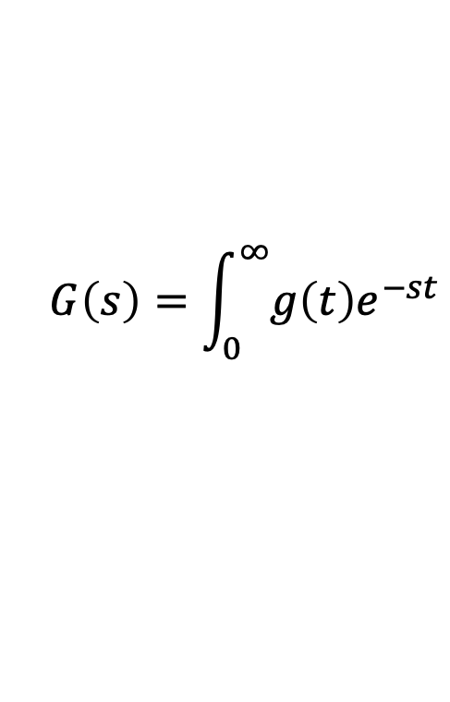
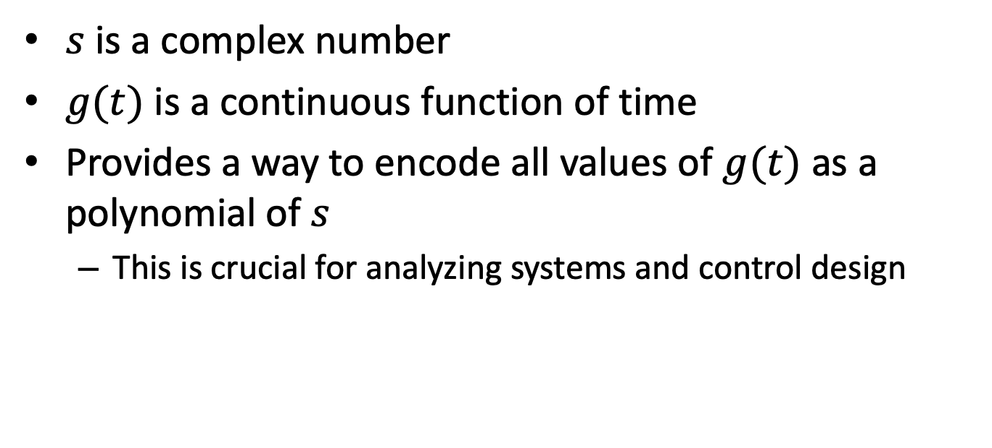
LT Definition
$$G\left(s\right)=\int_{0}^{∞}{g\left(t\right)e^{−st}}$$
$s$ is a complex number
$g(t)$ is a continuous function of time
Provides a way to encode all values of $g(t)$ as a polynomial of $s$
This is crucial for analyzing systems and control design

Slide 8
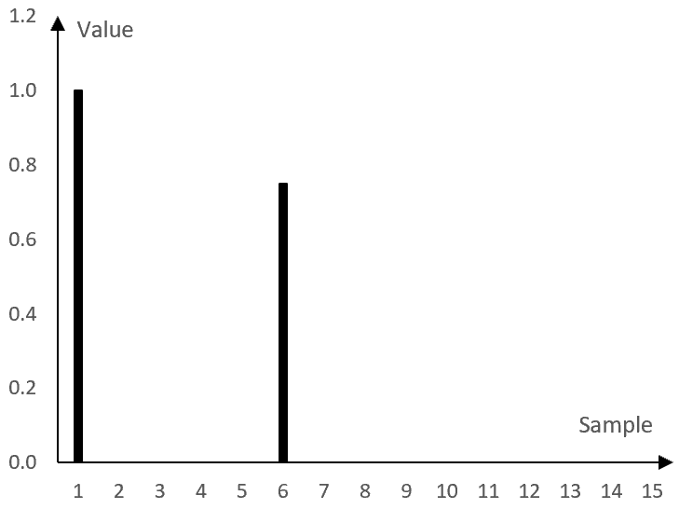






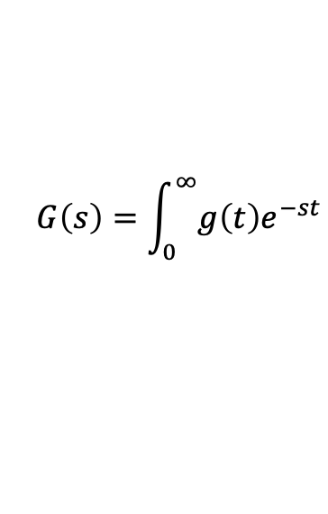


A First Laplace Transform
$$G\left(s\right)=\int_{0}^{∞}{g\left(t\right)e^{−st}}$$
Impulse signal at time $τ$: $δ_{τ}\left(t\right)=1, τ=t;0, τ≠t$
Laplace Transform
$${L[δ}_{τ}\left(t\right){]=e}^{−sτ}$$
$${L[δ}_{0}\left(t\right)]=$$
$$1$$
$$δ_{1}$$
$${L[δ}_{1}]=e^{−s}$$
$${L[δ}_{1}]=e^{−st}+\left(0.8\right)e^{−6s}$$
$${(0.8)δ}_{6}$$
$${L[δ}_{6}]={(0.8)e}^{−6s}$$
Signals and systems can be described using combinations of more Laplace Transforms.
Notes:
Show how can encode a discrete signal with a sum of e^-st terms. Show time shifts and scale by constant.

Slide 9
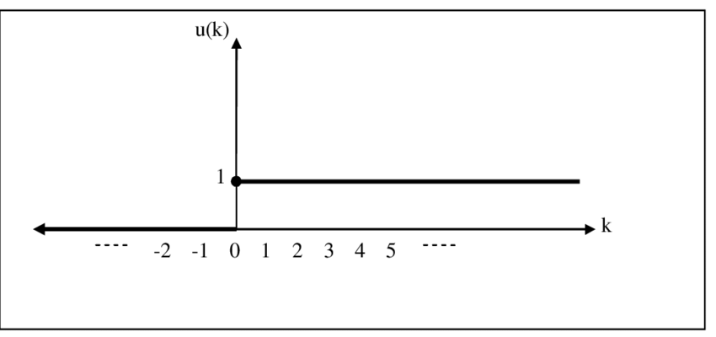
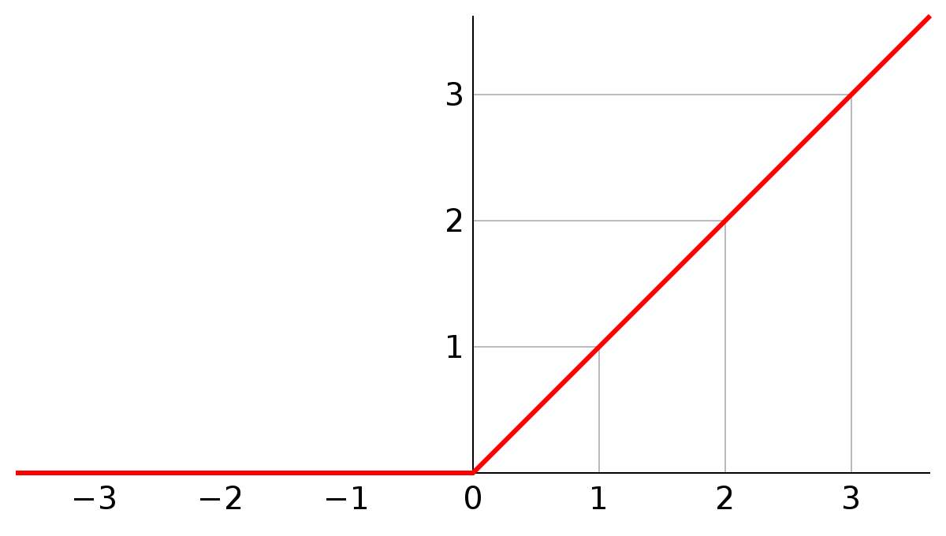

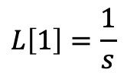


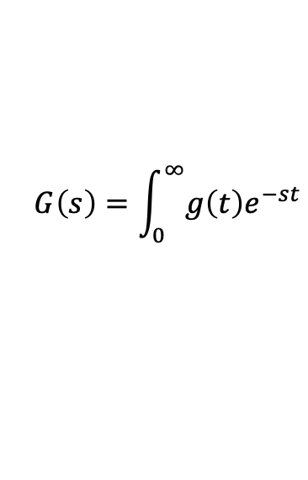

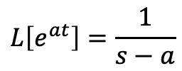



More Laplace Transforms
$$G\left(s\right)=\int_{0}^{∞}{g\left(t\right)e^{−st}}$$
Unit step at time 0: g$\left(t\right)=1, t≥0;0, t<0.$
Ramp: g$\left(t\right)=t, t≥0;0, t<0.$
$$g\left(t\right)$$
$$g\left(t\right)$$
Laplace Transform
$$L\left[1\right]=\frac{1}{s}$$
Laplace Transform
$$L\left[t\right]=\frac{1}{s^{2}}$$
Laplace Transform of transcendentals:
$$L\left[e^{at}\right]=\frac{1}{s−a}$$
$$L\left[cos⁡(ωt)\right]=\frac{s}{s^{2}+ω^{2}}$$
$$L\left[sin⁡(αt)\right]=\frac{ω}{s^{2}+ω^{2}}$$

Slide 10
What Poles Say About a System

Slide 11
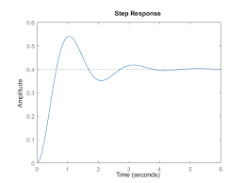
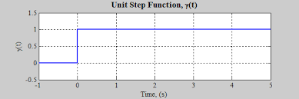

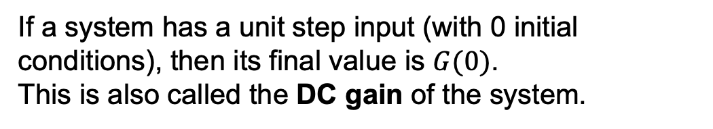


Step Response of a System
Transfer Function: The Laplace transform of a system
$$y(∞)$$
$$G(s)$$
$$G(0)=y(∞)$$
If a system has a unit step input (with 0 initial conditions), then its final value is $G(0)$.
This is also called the DC gain of the system.

Slide 12

System Analysis Using LTs
Dynamics from poles of $G(s)$
Step response from $G(0)$

Slide 13


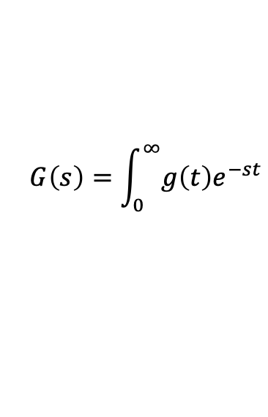
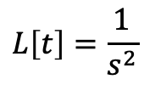

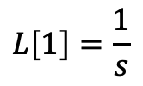
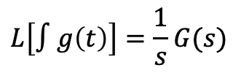



Transformed Systems and Their LTs
$$G\left(s\right)=\int_{0}^{∞}{g\left(t\right)e^{−st}}$$
Constant multiplication
$$L[ag\left(t\right)]=aG(s)$$
Derivative
Integral
$${(0.8)δ}_{6}$$
$$L[\dot{g}\left(t\right)]=sG(s)$$
$$L\left[∫g\left(t\right)\right]=\frac{1}{s}G(s)$$
${L[δ}_{0}]=$1
$$L\left[1\right]=\frac{1}{s}$$
$$L\left[t\right]=\frac{1}{s^{2}}$$
$$δ_{1}$$
Summation
$$L\left[g\left(t\right)+h\left(t\right)\right]=G\left(s\right)+H(s)$$
LTs are linear operators.
Notes:
How do the last 3 LT relate to each other?

Slide 14

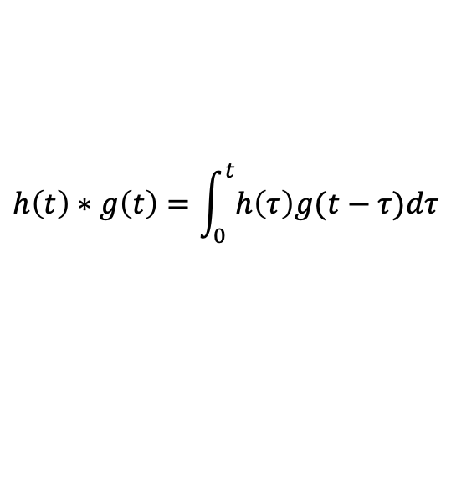
Convolution of Transfer Functions
Convolution
$$h\left(t\right)∗g\left(t\right)=\int_{0}^{t}{h\left(τ\right)g(t−τ})dτ$$
$$L[h\left(t\right)∗g\left(t\right)]=H\left(s\right)G(s)$$

Slide 15
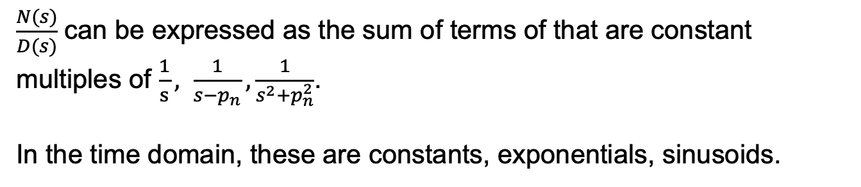

Inverse of a Laplace Function
$$G\left(s\right)=\int_{0}^{∞}{g\left(t\right)e^{−st}}$$
General form for a T.F.: $G\left(s\right)=\frac{N(s)}{D(s)}=\frac{s^{M}+b_{1}s^{M−1 }+⋯+b_{M}}{s^{N}+a_{1}s^{N−1 }+⋯+a_{N}}=\frac{\left(s−z_{1}\right)⋯(s−z_{M})}{\left(s−p_{1}\right)⋯(s−p_{N})}$
$z_{m}$ are the zeroes, $p_{n}$ are the poles.
$\frac{N(s)}{D(s)}$ can be expressed as the sum of terms of that are constant multiples of $\frac{1}{s}, \frac{1}{s−p_{n}}, \frac{1}{s^{2}+p_{n}^{2}}$.
In the time domain, these are constants, exponentials, sinusoids.
Poles indicate stability, oscillations

Slide 16

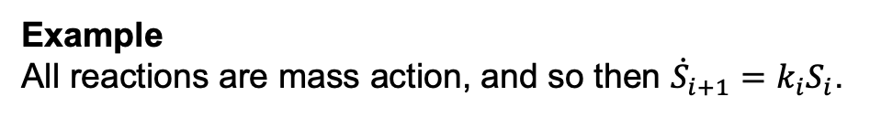

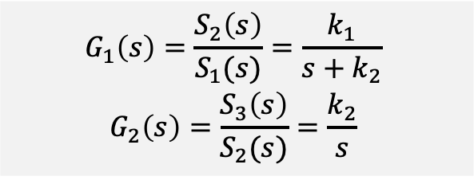
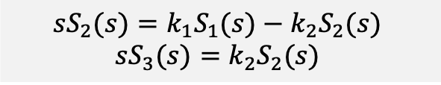
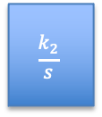


Analysis of a Reaction Network: Calculate LTs
Finding Transfer Functions
Write state equations in terms of the inputs
Calculate the ratios for each system. Signals other than the input to and output from the system are set to 0.
Example
All reactions are mass action, and so then ${\dot{S}}_{i+1}=k_{i}S_{i}$.
S1
S2
$$G_{2}(s)$$
S3
$$G_{1}(s)$$
$${{\dot{S}}_{2}=k_{1}S_{1}−k_{2}S_{2}}_{ }$$
$${{\dot{S}}_{3}=k_{2}S_{2}}_{ }$$
$$G_{1}\left(s\right)={\frac{S_{2}\left(s\right)}{S_{1}(s)}=\frac{k_{1}}{s+k_{2}}}_{ }$$
$${G_{2}\left(s\right)=\frac{S_{3}\left(s\right)}{S_{2}(s)}=\frac{k_{2}}{s}}_{ }$$
$${{sS}_{2}(s)=k_{1}S_{1}(s)−k_{2}S_{2}(s)}_{ }$$
$${sS_{3}(s)=k_{2}S_{2}(s)}_{ }$$
S1
S2
$$\frac{k_{2}}{s}$$
S3
$$\frac{k_{1}}{s+k_{2}}$$
Notes:
Possibilities for the input signal

Slide 17
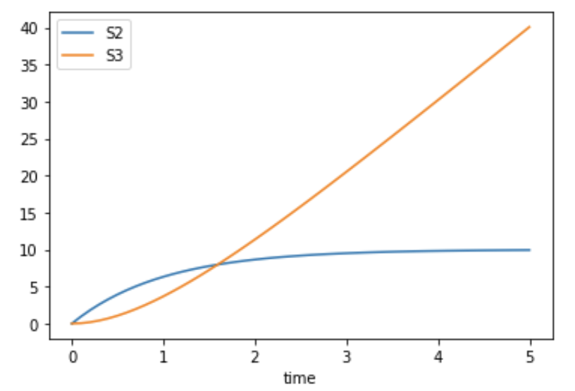

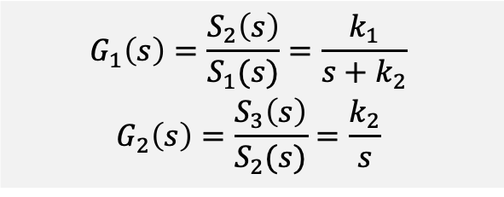
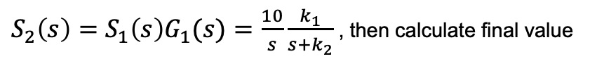
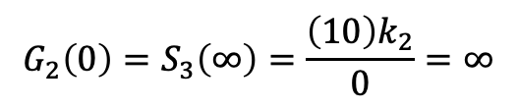



Analysis of Reaction Network: Poles and Step Response
$$G_{1}\left(s\right)={\frac{S_{2}\left(s\right)}{S_{1}(s)}=\frac{k_{1}}{s+k_{2}}}_{ }$$
$${G_{2}\left(s\right)=\frac{S_{3}\left(s\right)}{S_{2}(s)}=\frac{k_{2}}{s}}_{ }$$
S1
S2
$$G_{2}(s)$$
S3
$$G_{1}(s)$$
What is the response of $G_{1}\left(s\right)$ to a step of size 10?
$S_{2}\left(s\right)={{S_{1}\left(s\right)G}_{1}(s)=\frac{10}{s}\frac{k_{1}}{s+k_{2}}}_{ }$, then calculate final value
$$k_{1}=1=k_{2}$$
$$G_{1}\left(0\right)=S_{2}\left(∞\right)={(10)k}_{1}/k_{2}$$
What is the response of $G_{2}\left(s\right)$ to a step of size 10?
$$G_{2}\left(0\right)=S_{3}\left(∞\right)=\frac{{\left(10\right)k}_{2}}{0}=∞$$
Notes:
Possibilities for the input signal

Slide 18
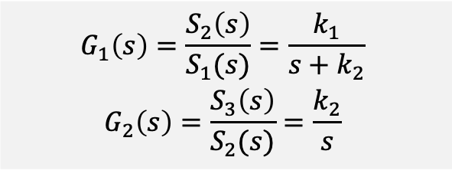
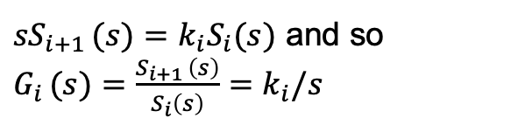
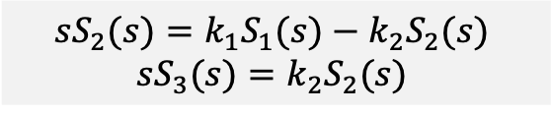
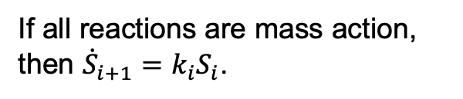
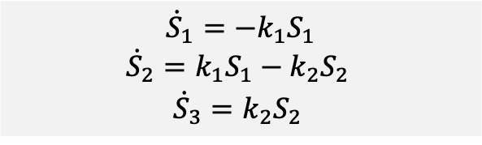



System 2: S1 is part of the system
If all reactions are mass action, then ${\dot{S}}_{i+1}=k_{i}S_{i}$.
S1
S2
S3
${sS}_{i+1 }(s)=k_{i}S_{i}(s)$ and so $G_{i }(s)={\frac{S_{i+1 }\left(s\right)}{S_{i}\left(s\right)}=k}_{i}/s$
$$G_{1}(s)$$
$$G_{2}(s)$$
$$G_{1}\left(s\right)={\frac{S_{2}\left(s\right)}{S_{1}(s)}=\frac{k_{1}}{s+k_{2}}}_{ }$$
$${G_{2}\left(s\right)=\frac{S_{3}\left(s\right)}{S_{2}(s)}=\frac{k_{2}}{s}}_{ }$$
$${\dot{S}}_{1}={−k}_{1}S_{1}$$
$${{\dot{S}}_{2}=k_{1}S_{1}−k_{2}S_{2}}_{ }$$
$${{\dot{S}}_{3}=k_{2}S_{2}}_{ }$$
$${{sS}_{2}(s)=k_{1}S_{1}(s)−k_{2}S_{2}(s)}_{ }$$
$${sS_{3}(s)=k_{2}S_{2}(s)}_{ }$$
$S_{1}\left(s\right)=\frac{1}{s+k_{1}}$, since exponential decay.

Slide 19
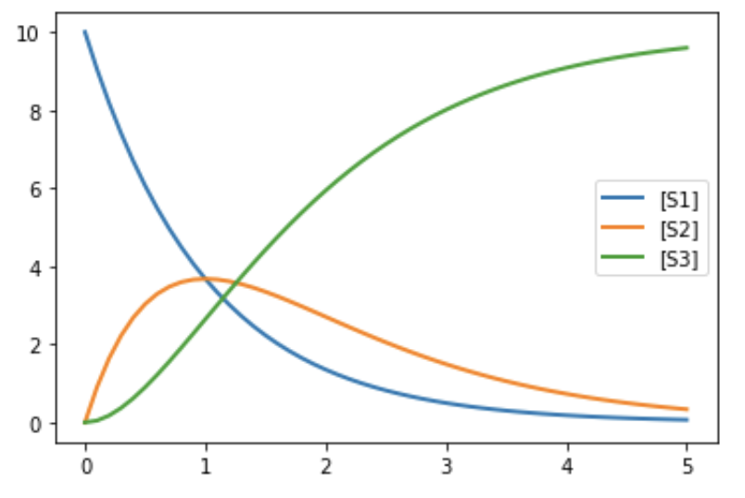


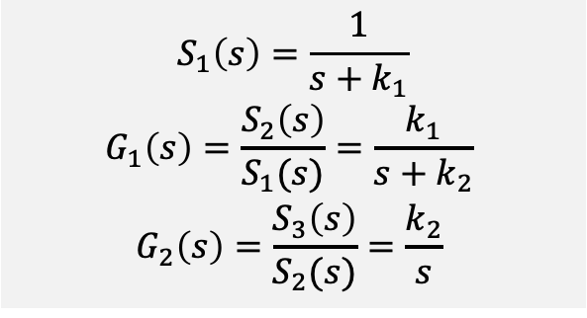
Analysis of System 2
$$S_{1}\left(s\right)=\frac{1}{s+k_{1}}$$
$$G_{1}\left(s\right)={\frac{S_{2}\left(s\right)}{S_{1}(s)}=\frac{k_{1}}{s+k_{2}}}_{ }$$
$${G_{2}\left(s\right)=\frac{S_{3}\left(s\right)}{S_{2}(s)}=\frac{k_{2}}{s}}_{ }$$
S1
S2
$$G_{2}(s)$$
S3
$$G_{1}(s)$$

Slide 20
BACKUP

Slide 21


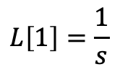
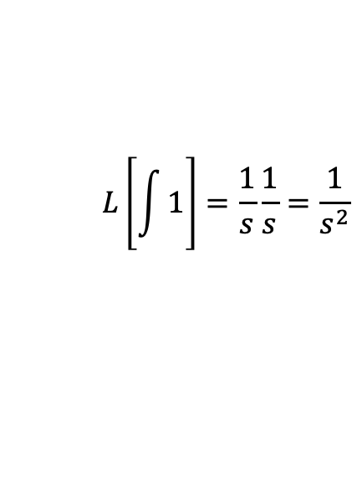
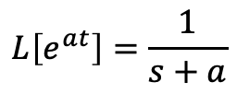
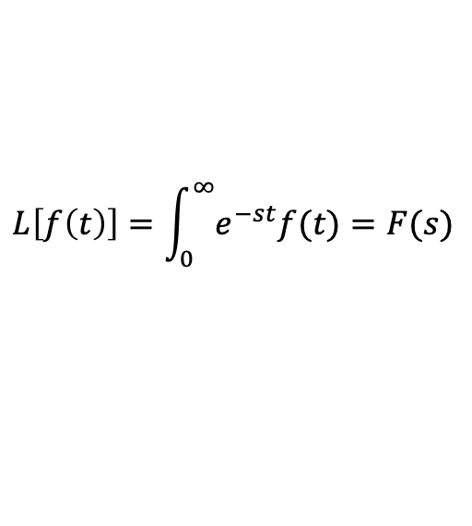







LaPlace Transform Essentials
Definition
$$L\left[f\left(t\right)\right]=\int_{0}^{∞}{e^{−st}f(t)}=F(s)$$
(0 initial conditions)
Properties`
Calculating LaPlace Transforms
$$L\left[∫f(t)\right]=\frac{1}{s}F(s)$$
$$L\left[1\right]=\frac{1}{s}$$
$$L\left[e^{at}\right]=\frac{1}{s+a}$$
$$L\left[\frac{df}{dt}\right]=sF(s)$$
$$L\left[\int{1}\right]=\frac{1}{s}\frac{1}{s}=\frac{1}{s^{2}}$$
$$L\left[∫af\left(t\right)\right]=aF\left(s\right)$$
$$L\left[t\right]=$$
$$L\left[∫f\left(t\right)g(t)\right]=F\left(s\right)G(s)$$
$$L\left[∫f\left(t\right)+g(t)\right]=F\left(s\right)+G(s)$$
$$\frac{4}{s}[\frac{1}{s+a}+\frac{1}{s+b} ]$$
$$L\left[{4∫(e}^{at}+e^{bt} )\right]=$$
$F\left(s\right)=\frac{s^{m}+a_{m−1 }s^{m−1}+⋯a_{0}}{s^{n}+b_{n−1 }s^{n−1}+⋯b_{0}}=\frac{N(s)}{D(s)}$
Roots of D(s) are the poles of F(s)
Roots of N(s) are the zeroes of F(s)

